Slide 1


DEVELOPMENT OF INTEGRATED WEARABLE DEVICE FOR REMOTE MONITORING OF PREGNANT WOMEN
IN GHANA
Group Members
Project Supervisor Dr. Godfrey Mills Co-Supervisor
Prof. Elsie Effah Kaufmann
Owoh Einsteina Ofunne - 10943874 Anane George Nyarko – 10947340 Adika Nathaniel - 10957036
DATE: 13th
December,2024
UNIVERSITY OF GHANA

Slide 2

COLLABORATORS
Nathaniel Sakyi Adibuer , IT Consortium
Dr. Richard Dei Asamoa, Korle-Bu Teaching Hospital
UNIVERSITY OF GHANA

Slide 3
PRESENTATION OUTLINE
PROJECT BACKGROUND
PROBLEM STATEMENT
OBJECTIVES
RELEVANCE OF WORK
EXISTING SOLUTIONS
PROPOSED SOLUTION
SYSTEM REQUIREMENTS
RESOURCE REQUIREMENTS
PROJECT TIMELINES
CONCLUSION
REFERENCES
UNIVERSITY OF GHANA

Slide 4

IMAGES OF PREGNANT WOMEN
UNIVERSITY OF GHANA

Slide 5
BACKGROUND
Monitoring of pregnant women is an important issue in maternal care due to
possibility of complications
Pregnant women are required to regularly visit a clinic for antenatal care.
Pregnant women are monitored for critical parameters like; body temperature, blood pressure, protein in the urine, heart rate, blood glucose levels and oxygen saturation which help in assessing the health of both mother and baby.
UNIVERSITY OF GHANA

Slide 6
BACKGROUND
Body Temperature: Detects fever or infections that could harm both mother
and fetus.
Blood Pressure and Protein in Urine: Monitors for hypertension disorders like preeclampsia to prevent complications.
Oxygen Saturation: Tracks oxygen levels to prevent anemia and maternal
respiratory issues.
Heart Rate: Assesses cardiovascular health to ensure the heart is coping with
pregnancy demands.
Blood Glucose Level: Identifies gestational diabetes to manage risks for mother and baby.
UNIVERSITY OF GHANA

Slide 7
BACKGROUND
Potential dangers of not monitoring can lead to critical challenges such as; preeclampsia, anemia, low birth weight and developmental delays and ultimately lead to death.
Leveraging on technology that can support remote monitoring to acquire all the key parameters and provide rapid decision could help save mother and baby in real time.
UNIVERSITY OF GHANA

Slide 8
PROBLEM STATEMENT
According to World Health Organization(WHO), over 40% of pregnancies in developing countries face significant health risks, making pregnancy complications a major public health concern. ^{[2]}
Reports ^{[2]} reveal that, in Ghana, 12% of female deaths (ages 15-49) in the previous 5 years stem from pregnancy complications, with 62% due to late or poor medical intervention.
Barriers of distance, transportation cost and time constraints hinder pregnant women
from undergoing regular antenatal care, hence increasing maternal risks.
UNIVERSITY OF GHANA

Slide 9
PROBLEM STATEMENT
Infrequent visitation to antennal care lead to late detection of pregnancy complications such as preeclampsia and anemia lowers chances of survival of pregnant women.
UNIVERSITY OF GHANA

Slide 10
RELEVANCE OF WORK
Early detection of pregnancy complications hence reducing maternal mortality
Equip pregnant women with tools to monitor and manage their health
Continuous data collection and visualization empower doctors to make informed,
data-driven decisions rather than relying solely on periodic observations
Ease of pressure on antenatal clinics due to reduced visitations
UNIVERSITY OF GHANA

Slide 11
OBJECTIVES
To develop an integrated system consisting of a wearable device and a mobile application to continuously monitor, detect and trigger alerts in event of abnormality.
To train a machine learning model for risk prediction of pregnancy complications
like preeclampsia and anemia long before standard detection window.
To develop a user-friendly interface system to acquire and visualize information for
processing by the system.
UNIVERSITY OF GHANA

Slide 12
EXISTING SOLUTIONS
(1) A Comprehensive Framework for Wearable Module for Prenatal Health Monitoring
and Risk Detection(2024)
[1]
GOAL: A system to continuously monitor vitals of pregnant women throughout pregnancy and send SMS to healthcare providers in event of any anomaly.
TECHNIQUE: Threshold values are set in the ESP-32 microcontroller and comparison is done with values captured by the wearable device. Body temperature, blood glucose, blood pressure, oxygen saturation, heart rate, fetal movement and falls of pregnant woman were monitored.

Slide 13
EXISTING SOLUTIONS
RESEARCH GAP: No mechanism for predictive analysis of patient's vitals to forewarn a
risk of complication or possible illness of mother

Slide 14
EXISTING SOLUTIONS
(2)Explainable Early Prediction of Gestational Diabetes Biomarkers by Combining Medical Background and Wearable Devices: A Pilot Study With a Cohort Group in South Africa(2024) ^{[5]}
GOAL: A wrist-worn device that forecasts biomarkers 13 to 16 weeks prior to the Gestational Diabetes Mellitus(GDM) screening test done 24-28 weeks in pregnancy.
TECHNIQUE: Glucose monitoring devices, a wristband for activity detection, and medical background data were fed into a ML model to predict possible occurrence of GDM.
UNIVERSITY OF GHANA
RESEARCH GAP: Limited scope to GDM.

Slide 15
EXISTING SOLUTIONS
(3)Health Monitoring Of Expecting Mothers Using Multiple Sensor Approach: "Preg
Care" (2020) ^{[6]}
GOAL: A hand/wrist-worn system comprising provides complete health monitoring during the pregnancy period.
TECHNIQUE: Body temperature, glucose rate detection, heart rate, sudden fall detection and anemia status(using python-based image processing) are monitored throughout gestational period. Alert systems are implemented.
RESEARCH GAP: No data security measures are implemented.
UNIVERSITY OF GHANA

Slide 16
PROPOSED METHODOLOGY
Data of vitals measured are captured by the wrist-worn wearable device and additional data such as protein in urine are manually inputted into a mobile app and sent to the cloud.
Data Preprocessing and feature selection occurs in the cloud. These are fed into a machine learning model trained to predict pregnancy complications weeks ahead of standard detection window and alert a pregnant woman and doctor if anomaly is detected in vitals.
Mobile app provides a dashboard each for the pregnant woman and the doctor to
visualize vitals and receive alerts in event of anomaly.
Nathaniel Adibuer
2024-12-14 09:01:50
--------------------------------------------
If you do not want run computations on the edge using the low-powered wearable you can consider an option of introducing a low-powered mini hub to offload computations.
Nathaniel Adibuer
2024-12-14 08:51:29
--------------------------------------------
How about situations where there is poor network connectivity? It might compromise your requirement for data to be streamed and sent to the cloud in realtime. You can consider TInyML, running model on the edge, model quantization, pruning.etc for prediction of complications? Here are some materials for reference: https://www.datacamp.com/blog/what-is-tinyml-tiny-machine-learning https://www.edgeaifoundation.org
Nathaniel Adibuer
2024-12-14 08:59:25
--------------------------------------------
How about sms to cover for emergency situations in case of poor network connectivity?

Slide 17
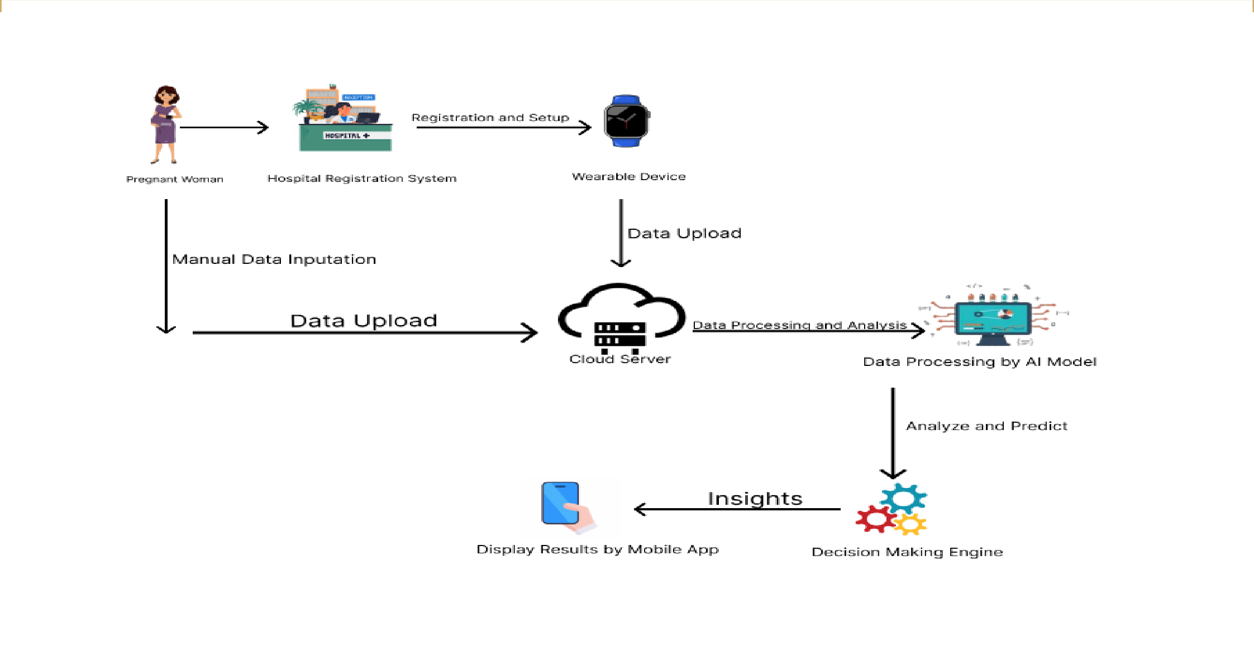
SYSTEM ARCHITECTURE

Slide 18
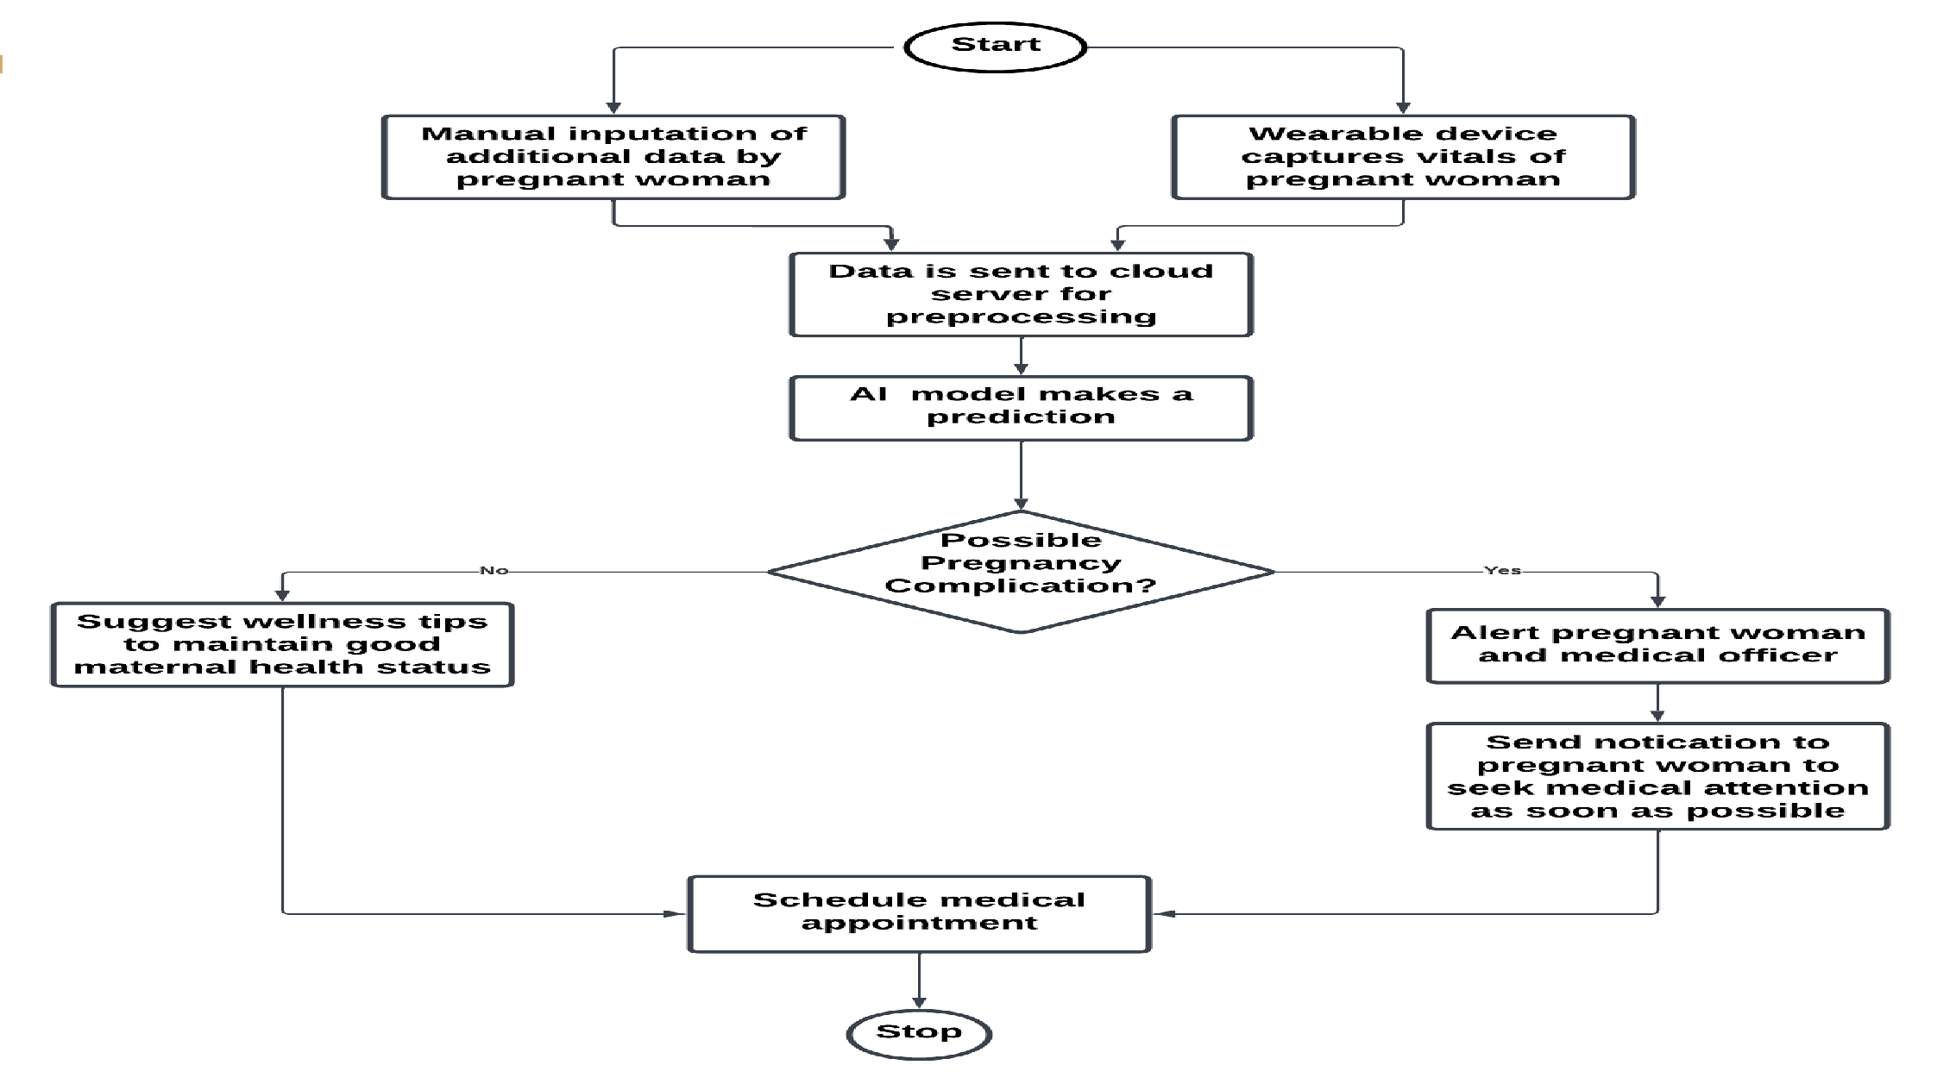
OPERATIONAL FLOW DIAGRAM

Slide 19
HARDWARE FUNCTIONAL REQUIREMENTS
The wearable must continuously collect and transmit vitals data to cloud every 30 seconds.
The device should store essential data temporarily.
The wearable must be designed to operate on low power, with a focus on battery
optimization.
All health data transmitted from the device to the mobile application or cloud platform must be encrypted.
Nathaniel Adibuer
2024-12-14 09:05:11
--------------------------------------------
If the number of seconds can be reduced that will be great.
Nathaniel Adibuer
2024-12-14 09:06:20
--------------------------------------------
Battery circuit optimization? Or optimizating computations/algorithms on the device you’re using? Unless you are building a new battery to optimize it.

Slide 20
SOFTWARE FUNCTIONAL REQUIREMENTS
The app should present data visually to make it easy for users to track changes in their health over time.
In case of anomalies in data, the AI should automatically trigger an alert to both pregnant woman and medical officer.
The app should provide functionality for users to back up their health data and
retrieve it if needed.
The app should allow for Patient-Doctor appointment booking

Slide 21
HARDWARE NON-FUNCTIONAL REQUIREMENTS
The wearable device should be lightweight and comfortable to wear for long period.
The wearable should require minimal maintenance, with replaceable parts such as
batteries that are easily accessible and affordable to users.
The wearable must be durable hence water and shock resistance.
Cross-platform compatibility hence easy communication

Slide 22
SOFTWARE NON-FUNCTIONAL REQUIREMENTS
User-friendly and intuitive mobile interface
Low latency between wearable device, cloud and mobile application
Cross-platform support on the mobile app
Scalability to accommodate a growing user base

Slide 23
RESOURCE REQUIREMENTS
DS18B20 temperature sensor  Flutter
MAX30100 sensor
Withings BPM Connect
GlucoWise
ESP32 microcontroller
AWS(Amazon Web Services) IoT Core
Python
TensorFlow
Nathaniel Adibuer
2024-12-14 09:14:03
--------------------------------------------
Explore more of the biometric sensors
Nathaniel Adibuer
2024-12-14 09:12:06
--------------------------------------------
You can explore Xiao developer boards since they are light-weight, low-powered, have resources for TinyML applications. etc

Slide 24
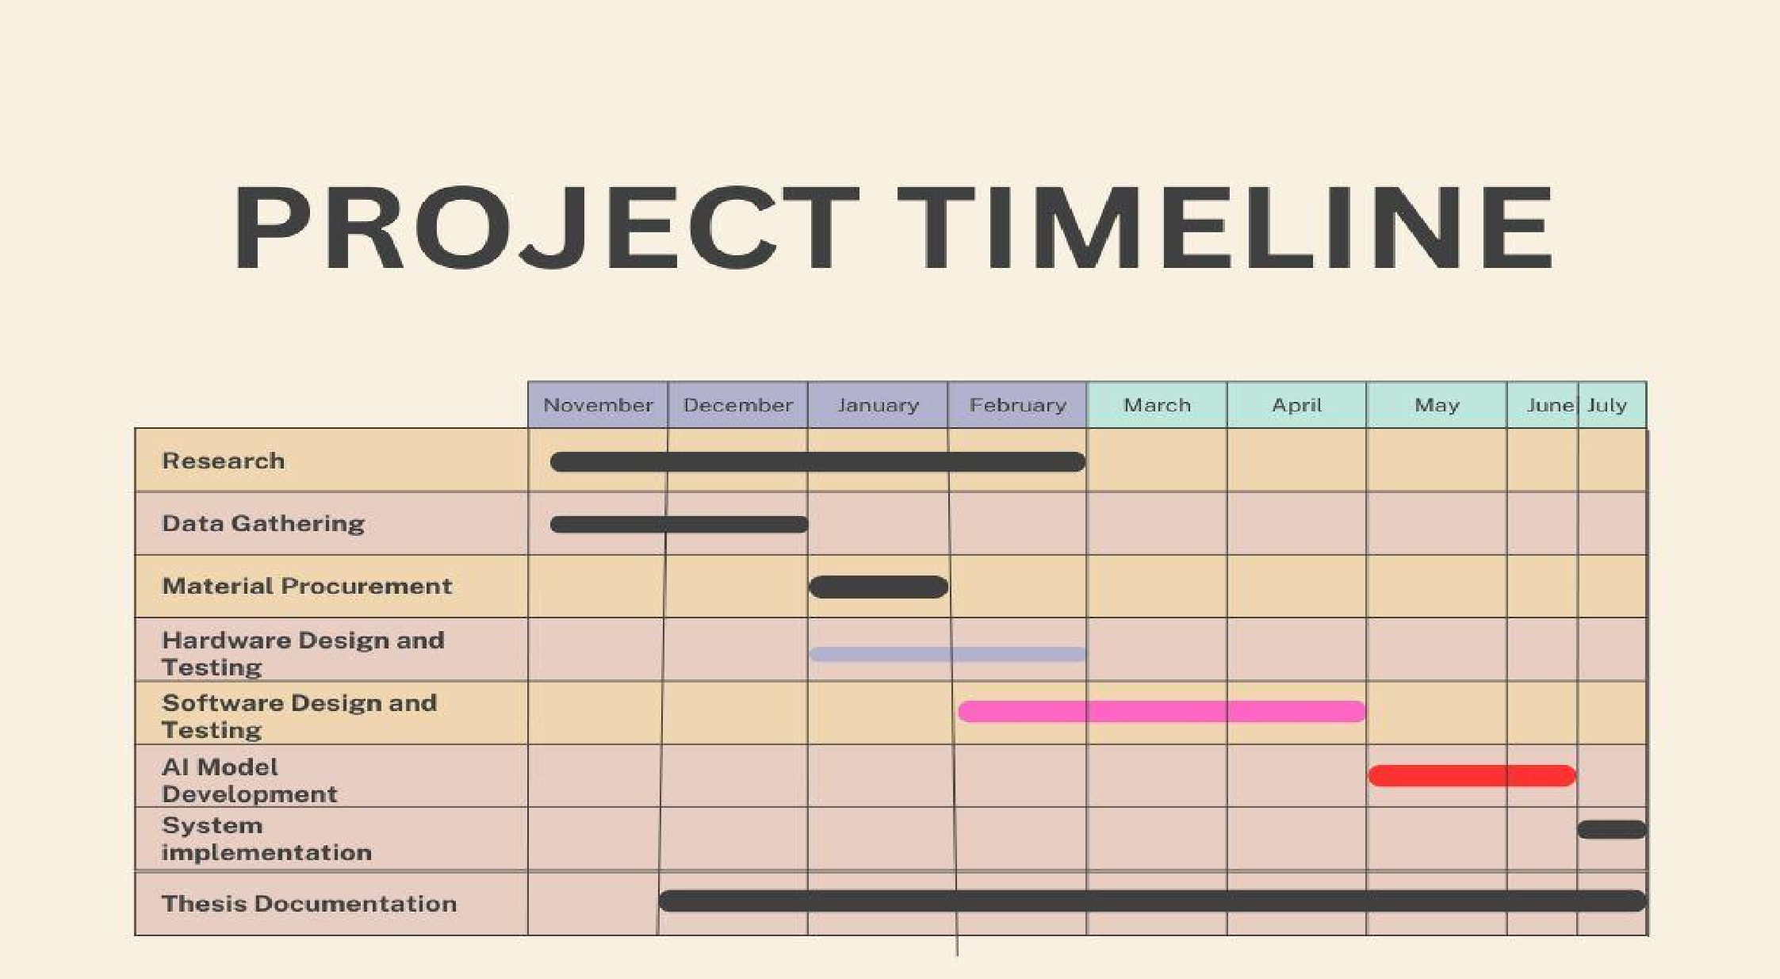
PROJECT TIMELINES

Slide 25
CONCLUSION
The wearable device provides a practical solution for monitoring pregnant women in Ghana, using advanced sensors and AI to track vital signs and detect complications like preeclampsia, anemia and gestational diabetes early
The mobile app enhances care for pregnant women by offering real-time data, alerts about health risks, and appointment scheduling, ensuring better communication with healthcare providers.
This project addresses critical gaps in maternal healthcare and contributes to global
efforts to reduce maternal and child mortality rates.

Slide 26
REFERENCES
T. Tabassum, S. Podder, and S. T. S. Rafid, "A Comprehensive Framework for Wearable Module for Prenatal Health Monitoring and Risk Detection," IEEE Int. Conf. Women Innov., Technol. Entrepreneurship (ICWITE), pp. 283-288, 2024.
Y. K. Wiafe, A. Asamoah, P. Akweongo, and A. Kumah, "Factors Affecting Pregnancy Complications in Ghana," Global J. Quality Safety Healthcare, vol. 7, no. 4, pp. 156-161, 2024.
B. D. B. Lopez, J. A. A. Aguirre, D. A. R. Coronado, and P. A. Gonzalez, "Wearable technology model to control and monitor hypertension during pregnancy," Proc. IEEE,
Lima, Peru, 2017.
UNIVERSITY OF GHANA

Slide 27
REFERENCES
[4] F. Sarhaddi, I. Azimi, S. Labbaf, H. Niela-Vilén, N. Dutt, A. Axelin, P. Liljeberg, and A
M. Rahmani, "Long-Term IoT-Based Maternal Monitoring: System Design and
Evaluation," Sensors, vol. 21, no. 7, p. 2281,2021.
[5]A. F. Hernández-Castañeda, R. Pardo-Gómez, M. Sierra-Sosa, and A. García-Ramos, "Explainable Early Prediction of Gestational Diabetes Biomarkers by Combining Medica Background and Wearable Devices: A Pilot Study With a Cohort Group," Sensors, vol. 22 no. 15, p. 5793, 2022
[6] A. Kumar, D. Sharma, and V. Gupta, "Health Monitoring of Expecting Mothers using
Multiple Sensor Approach: 'Preg Care'," in Proceedings of the 2nd International
Conference on Advanced Information and Communication Technology
77-82
(ICAICT), 2020, pp.
UNIVERSITY OF GHANA

Slide 28
MISCELLANEOUS
QUESTIONS/FEEDBACK

