Slide 1


DEVELOPMENT OF INTEGRATED WEARABLE DEVICE FOR REMOTE MONITORING OF PREGNANT WOMEN IN GHANA
Project Supervisor
Dr. Godfrey Mills
Co-Supervisor
Prof. Elsie Effah Kaufmann
Group Members
Owoh Einsteina Ofunne - 10943874
Anane George Nyarko – 10947340
Adika Nathaniel - 10957036
DATE: 25th April,2025
UNIVERSITY OF GHANA

Slide 2

COLLABORATORS
Nathaniel Sakyi Adibuer, IT Consortium
Dr. Frank Amegah, Korle-Bu Teaching Hospital

Slide 3
TASK DELEGATION
Owoh Einsteina Ofunne - AI Model Development
George Anane Nyarko - Mobile App Development
Adika Nathaniel - Wearable Device Development

Slide 4
AI MODEL PROGRESS
KEY OBJECTIVES
Train separate models for detecting preeclampsia, anemia, and gestational diabetes.
Use real-world medical datasets to analyze health indicators.
Implement a structured machine learning pipeline from preprocessing to evaluation.
Compare different models to find the best-performing approach for each condition.

Slide 5
DATASET OVERVIEW
PREECLAMPSIA
Dataset Name: train_dataset.xlsx
Source: Preeclampsia in Pregnant Women Dataset by Muhammad Asif
Number of Samples: 163
Number of Input Features: 14
Output States: Low, mid or High
Description: No description of dataset provided

Slide 6
FEATURES
PREECLAMPSIA
Gravida
Parity
Gestational Age
Age
BMI
Diabetes
History of Hypertension
Systolic Bp
Diastolic Bp
HB
Fetal weight
Protein in urine
Amniotic fluid level
Risk Level

Slide 7
DATASET OVERVIEW
GESTATIONAL DIABETES
Dataset Name: Gestational Diabetes 2.csv & Gestational Diabetes 3.csv
Source: Gestational diabetes by Rasool Jader
Number of Samples: 2026
Number of Input Features: 6
Output States: 0 or 1
Description: The dataset was obtained from the Kurdistan region laboratories, which collected information from pregnant women with and without diabetes.

Slide 8
FEATURES
GESTATIONAL DIABETES
Age
Pregnancy
Weight
Height
BMI
Heredity
Prediction

Slide 9
DATASET OVERVIEW
ANEMIA
Dataset Name: Book2.xlsx
Source: Maternal Health and High-Risk Pregnancy Dataset by Ankur Ray Chayan
Number of Samples: 999
Number of Input Features: 17
Output States: yes or no
Description: This dataset includes maternal health indicators. It classifies pregnancies as high-risk or non-high-risk.

Slide 10
FEATURES
ANEMIA
Name
Age
Gravida
Pregnancy
Gestational age
Weight
Height
Blood Pressure
Anemia
Jaundice
Fetal Position
Fetal movements
Fetal heartbeats
Urine test- Sugar
VDRL
HRsAg
High Risk Pregnancy

Slide 11
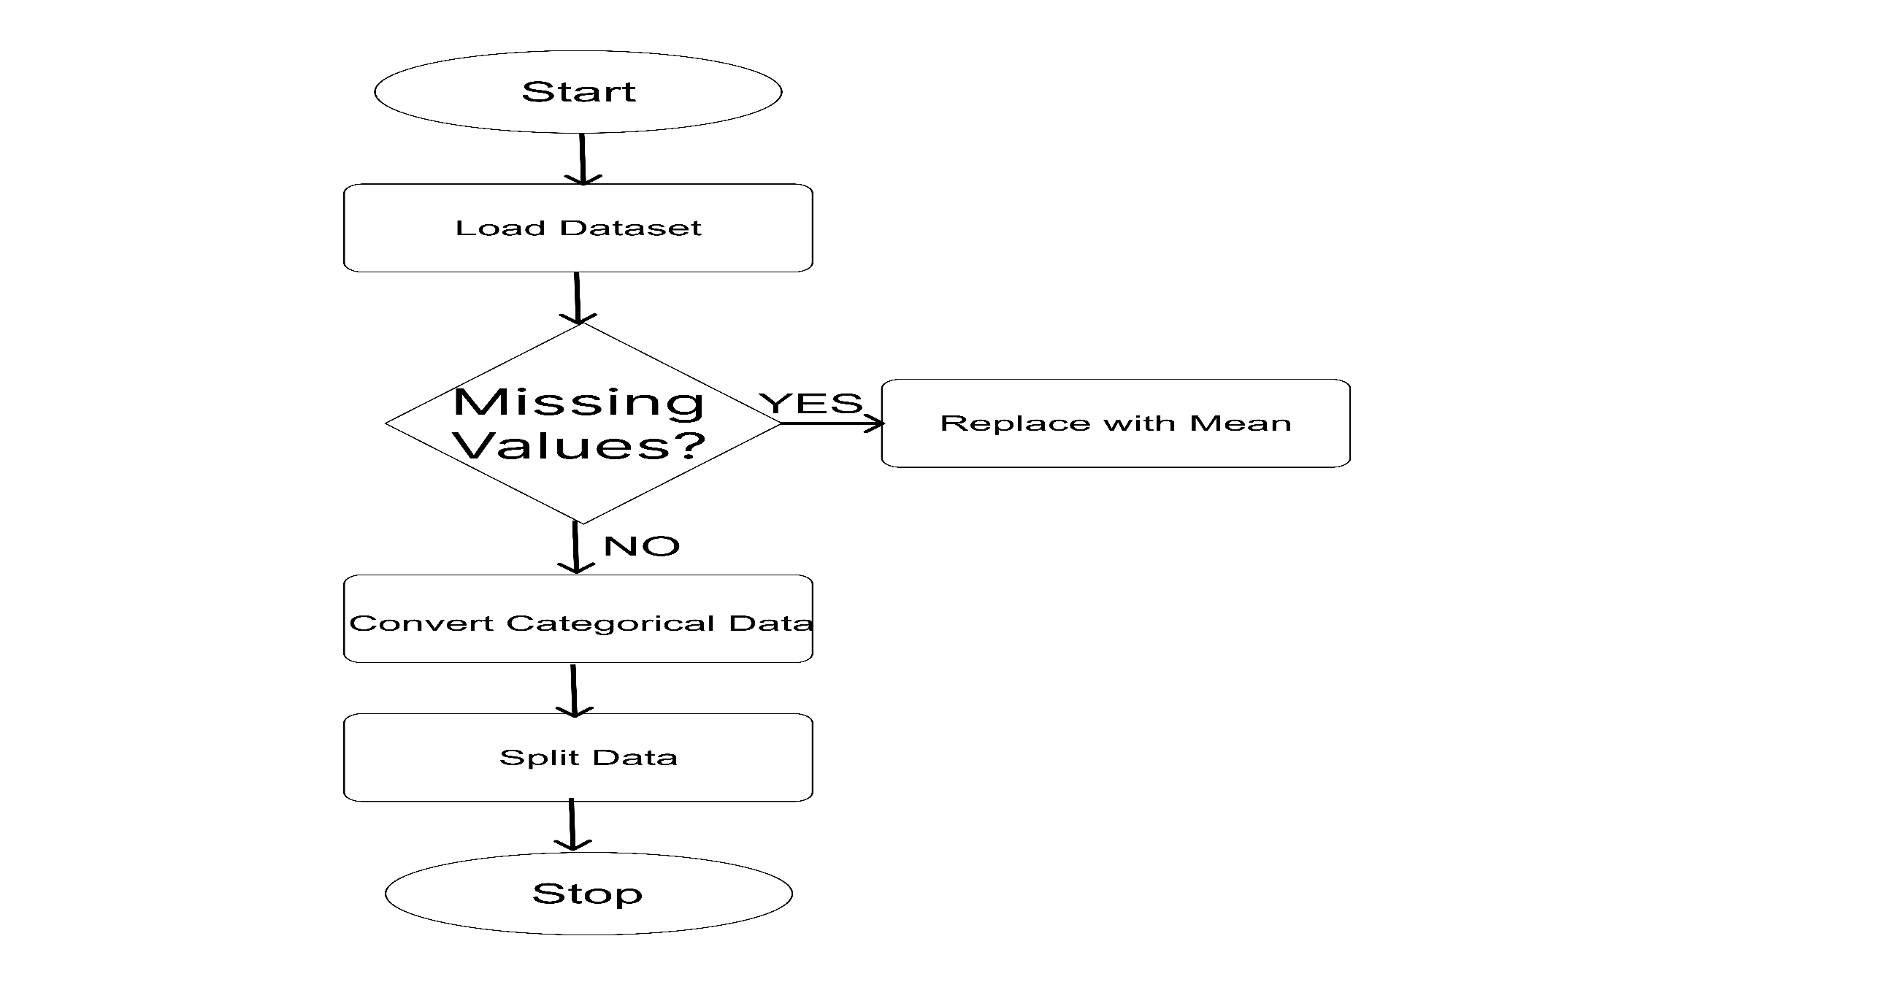
DATA PREPROCESSING

Slide 12
MODEL SELECTION
PREECLAMPSIA
We chose the best performing model which was Logistic Regression. Although Decision Tree and Random Forest performed slightly better overall, they tend to overfit, whereas Logistic Regression generalizes well to unseen data.
Performance Metrics | Logistic Regression | K-Nearest Neighbour | Support Vector Machine | Decision Tree Classifier | Random Forest Classifier | Gradient Boosting Classifier | MLP Classifier
Accuracy | 0.925926 | 0.814815 | 0.907407 | 0.981481 | 0.962963 | 0.962963 | 0.944444
Precision | 0.935494 | 0.875281 | 0.910847 | 0.982510 | 0.967593 | 0.967901 | 0.950397
F1 Score | 0.925308 | 0.818896 | 0.905208 | 0.981259 | 0.963430 | 0.963128 | 0.944377
Recall | 0.925926 | 0.814815 | 0.907407 | 0.981481 | 0.962963 | 0.962963 | 0.944444
Training Accuracy | 0.9225 | 0.7984 | 0.9302 | 0.9922 | 0.9922 | 0.9922 | 0.9922
Test Accuracy | 0.9091 | 0.5152 | 0.8788 | 0.8788 | 0.8182 | 0.7879 | 0.8485

Slide 13
TIME TAKEN (S)
PREECLAMPSIA
Performance Metrics | Logistic Regression | K-Nearest Neighbour | Support Vector Machine | Decision Tree Classifier | Random Forest Classifier | Gradient Boosting Classifier | MLP Classifier
Training Time | 0.0120 | 0.0005 | 0.0031 | 0.0010 | 0.2952 | 0.4847 | 0.3411
Prediction Time | 0.0010 | 0.0039 | 0.0000 | 0.0001 | 0.0050 | 0.0010 | 0.0010

Slide 14
MODEL SELECTION
GESTATIONAL DIABETES
Although K-Nearest Algorithm performed slightly better overall, they tend to overfit. It is also known as “Lazy Algorithm” because it memorizes the training data. We chose Random Forest because it generalizes better to new data, and provides insights into feature importance.
Performance Metrics | Logistic Regression | K-Nearest Neighbour | Support Vector Machine | Decision Tree Classifier | Random Forest Classifier | Gradient Boosting Classifier | Neural Network
Accuracy | 0.864198 | 0.977778 | 0.883951 | 0.869136 | 0.977777 | 0.869136 | 0.869136
Precision | 0.856495 | 0.977652 | 0.878886 | 0.867501 | 0.977595 | 0.863144 | 0.863144
F1 Score | 0.856225 | 0.977635 | 0.878521 | 0.854014 | 0.967984 | 0.864471 | 0.864471
Recall | 0.864198 | 0.977778 | 0.883951 | 0.869136 | 0.959160 | 0.869136 | 0.869136
Training Accuracy | 0.8641 | 0.9018 | 0.8808 | 0.9963 | 0.9963 | 0.9240 | 0.8326
Test Accuracy | 0.8765 | 0.8340 | 0.8840 | 0.9802 | 0.9802 | 0.9333 | 0.8395

Slide 15
TIME TAKEN (S)
GESTATIONAL DIABETES
Performance Metrics | Logistic Regression | K-Nearest Neighbour | Support Vector Machine | Decision Tree Classifier | Random Forest Classifier | Gradient Boosting Classifier | Neural Network
Training Time | 0.0100 | 0.0050 | 0.0758 | 0.0060 | 0.4767 | 0.2922 | 3.4149
Prediction Time | 0.0010 | 0.0329 | 0.0309 | 0.0001 | 0.0100 | 0.0010 | 0.0010

Slide 16
MODEL SELECTION
ANEMIA
Here we chose Logistic Regression because it was the best performing model and it also generalizes well to unseen data.
Performance Metrics | Logistic Regression | K-Nearest Neighbour | Support Vector Machine | Decision Tree Classifier | Random Forest Classifier | Gradient Boosting Classifier | Neural Network
Accuracy | 0.9733 | 0.9400 | 0.9400 | 0.8600 | 0.9350 | 0.9100 | 0.9400
Precision | 0.9600 | 0.9400 | 0.9400 | 0.9494 | 0.9397 | 0.9474 | 0.9400
F1 Score | 0.9600 | 0.9691 | 0.9691 | 0.9235 | 0.9664 | 0.9525 | 0.9691
Recall | 0.9600 | 1.0000 | 1.0000 | 0.8989 | 0.9947 | 0.9574 | 1.0000
Training Accuracy | 0.9687 | 0.8645 | 0.8645 | 1.0000 | 1.0000 | 0.9799 | 1.0000
Test Accuracy | 0.9352 | 0.8950 | 0.9000 | 0.8900 | 0.9650 | 0.9450 | 0.9050

Slide 17
TIME TAKEN (S)
ANEMIA
Performance Metrics | Logistic Regression | K-Nearest Neighbour | Support Vector Machine | Decision Tree Classifier | Random Forest Classifier | Gradient Boosting Classifier | Neural Network
Training Time | 0.1795 | 0.0110 | 0.1466 | 0.0110 | 0.3521 | 0.5217 | 2.6669
Prediction Time | 0.0070 | 0.0339 | 0.0499 | 0.0060 | 0.0140 | 0.0039 | 0.0040

Slide 18
BRIEF DESCRIPTION OF MODELS
LOGISTIC REGRESSION
Logistic regression is a statistical model used for binary classification tasks, where the output is a categorical variable with two possible outcomes. The model uses a sigmoid function to map predicted values to probabilities.
Random Forest Classifier
A Random Forest classifier is an ensemble learning method used for classification tasks, which combines the predictions of multiple decision trees to improve accuracy and prevent overfitting.

Slide 19
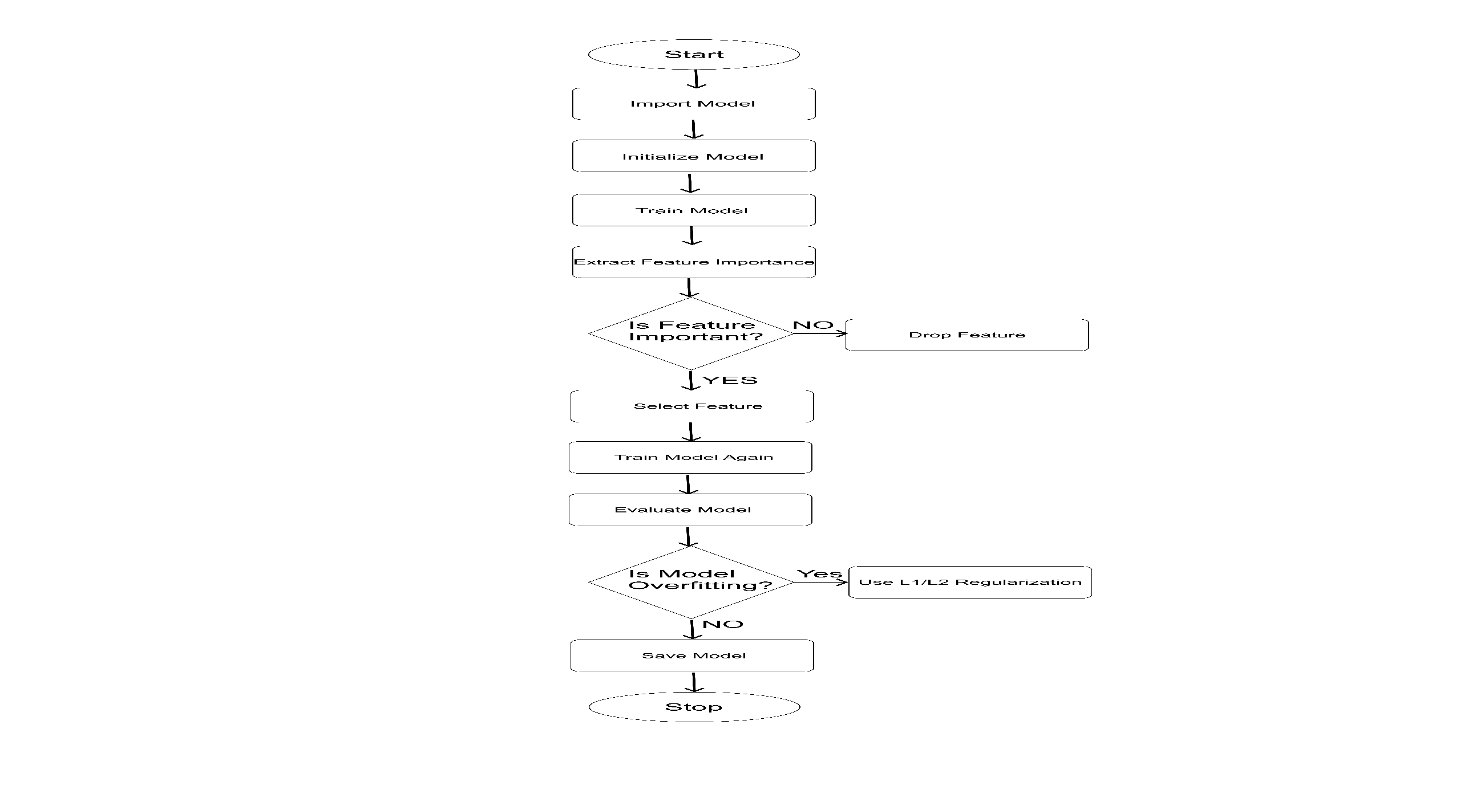
MACHINE LEARNING WORKFLOW

Slide 20
RESULTS
PREECLAMPSIA
Training Accuracy: 0.92
Test Accuracy: 0.90
Precision: 0.94
Recall: 0.93
F1 Score: 0.93
K FOLD CROSS VALIDATION SCORES
Cross validation Scores across each fold: [0.8077 0.6923 0.7308 0.6923 0.8000]
Mean Cross Validation Score: 0.7446
Standard Deviation of Cross Validation Scores: 0.0504
Training Accuracy: 0.9225
Test Accuracy: 0.9091

Slide 21
RESULTS
GESTATIONAL DIABETES
Training Accuracy: 0.99
Test Accuracy: 0.97
Precision: 0.98
Recall: 0.96
F1 Score: 0.97
K FOLD CROSS VALIDATION SCORES
Cross validation Scores across each fold: [0.9225 0.9469 0.9187 0.9257 0.9116]
Mean Cross Validation Score: 0.9251
Standard Deviation of Cross Validation Scores: 0.0119
Training Accuracy: 0.9939
Test Accuracy: 0.9570

Slide 22
RESULTS
ANEMIA
Training Accuracy: 0.97
Test Accuracy: 0.96
Precision: 0.96
Recall: 0.96
F1 Score: 0.96
K FOLD CROSS VALIDATION SCORES
Cross validation Scores across each fold: [0.9300 0.9450 0.9200 0.8944 0,9447]
Mean Cross Validation Score: 0.9268
Standard Deviation of Cross Validation Scores: 0.0187
Training Accuracy: 0.9704
Test Accuracy: 0.9268

Slide 23
LIMITATIONS
Public Datasets have limited number of records

Slide 24
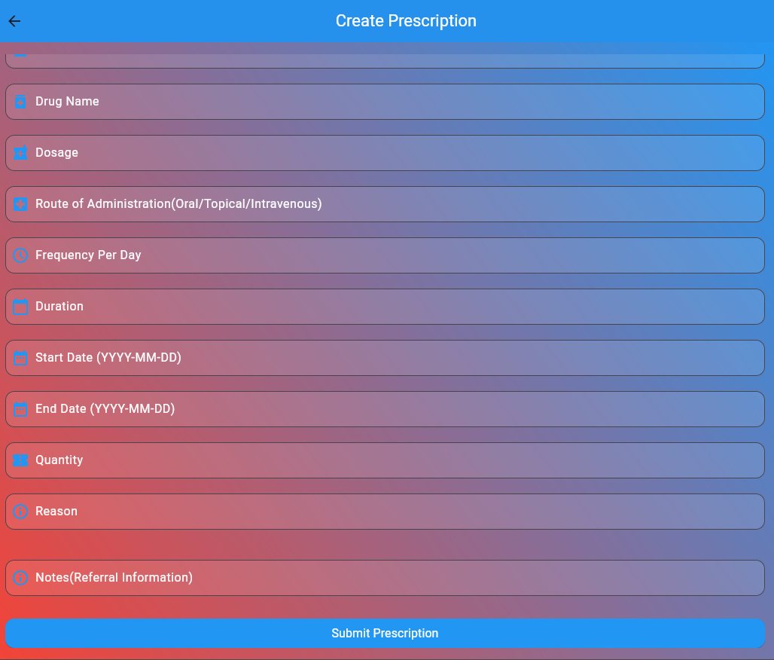
CREATE PRESCRIPTION PAGE

Slide 25
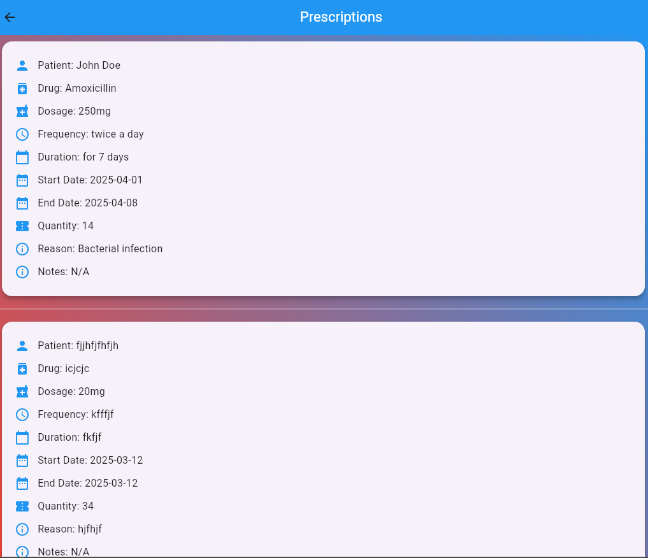
VIEW PRESCRIPTIONS PAGE

Slide 26
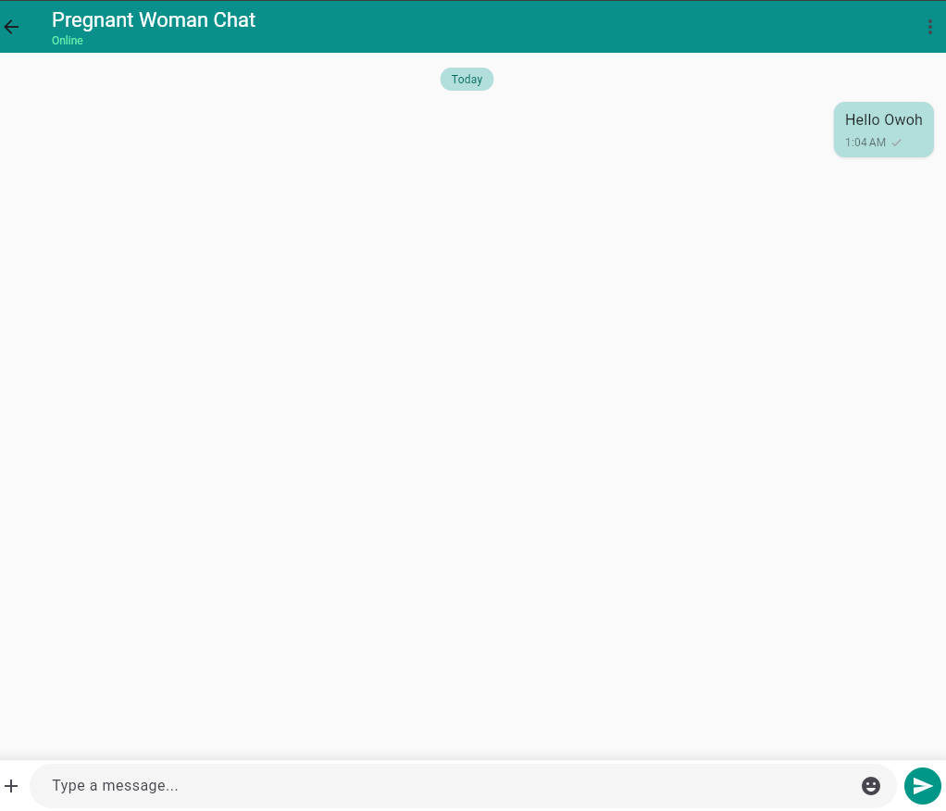
REAL-TIME CHAT PAGE

Slide 27

REAL-TIME CHAT PAGE

Slide 28
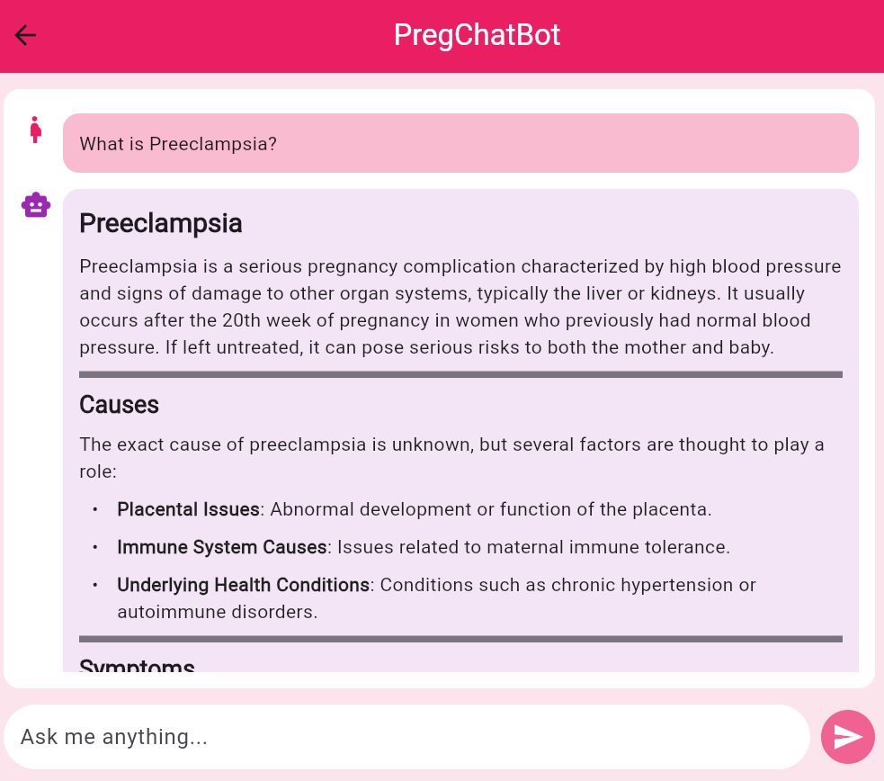
CHATBOT PAGE

Slide 29
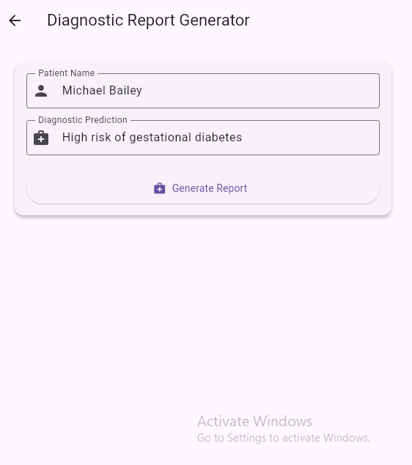
DIAGNOSTIC REPORT PAGE

Slide 30
DIAGNOSTIC REPORT PAGE

Slide 31
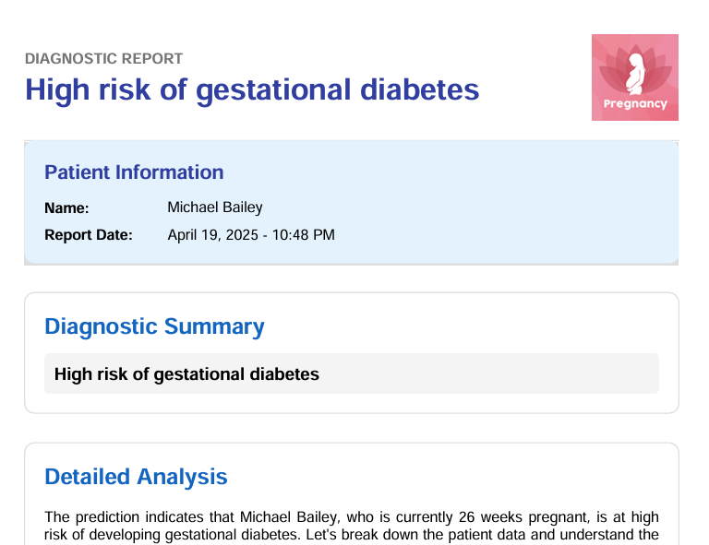
IMAGES OF GENERATED REPORT

Slide 32
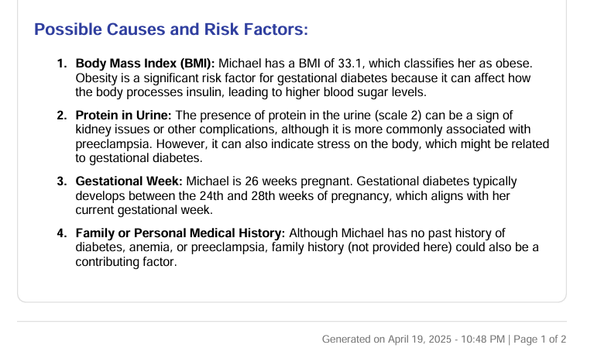
IMAGES OF GENERATED REPORT

Slide 33
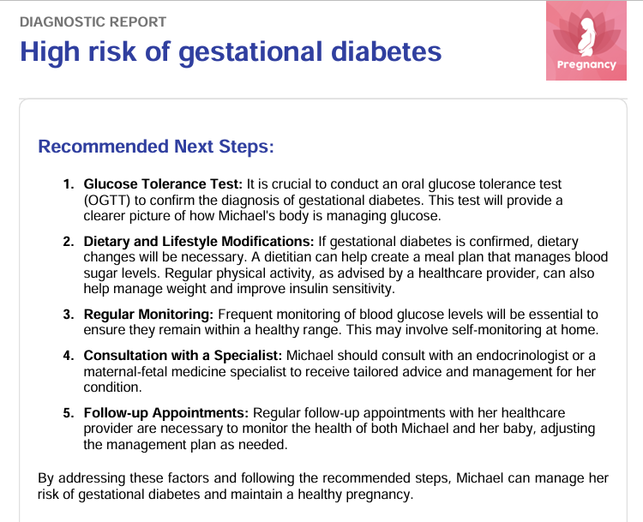
IMAGES OF GENERATED REPORT

Slide 34
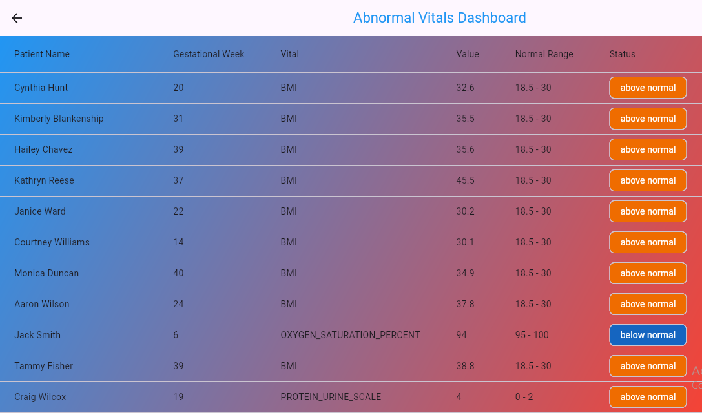
ANOMALY VITALS DASHBOARD

Slide 35
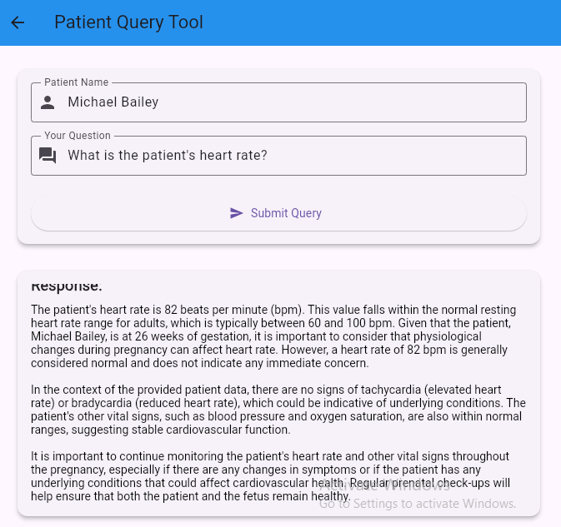
PATIENT DATA QUERY PAGE

Slide 36
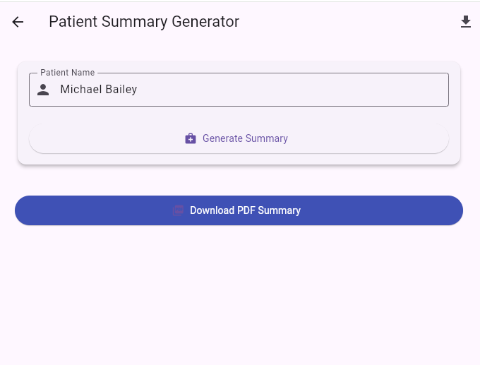
PATIENT SUMMARY PAGE

Slide 37
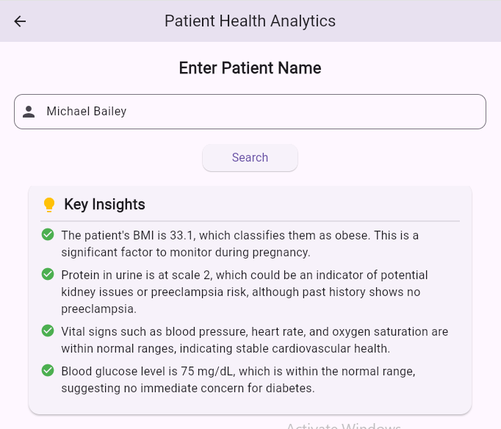
PATIENT ANALYTICS PAGE

Slide 38
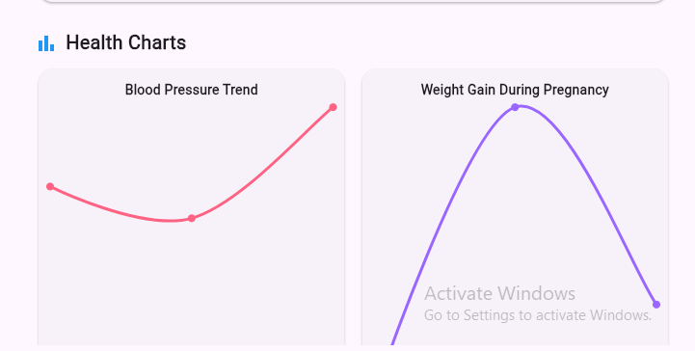
PATIENT ANALYTICS PAGE

Slide 39
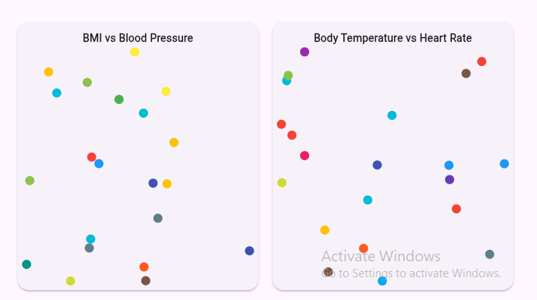
PATIENT ANALYTICS PAGE

Slide 40
REPORT ON THE XIAOMI SMART BAND 8
Mode of Communication is Bluetooth
Sensors include:
3-axis accelerometer and 3-axis gyroscope - Motion Tracking and Activity Recognition
PPG Sensor - Heart Rate and Blood Oxygen Saturation
Circuit Is Not Publicly Accessible

Slide 41
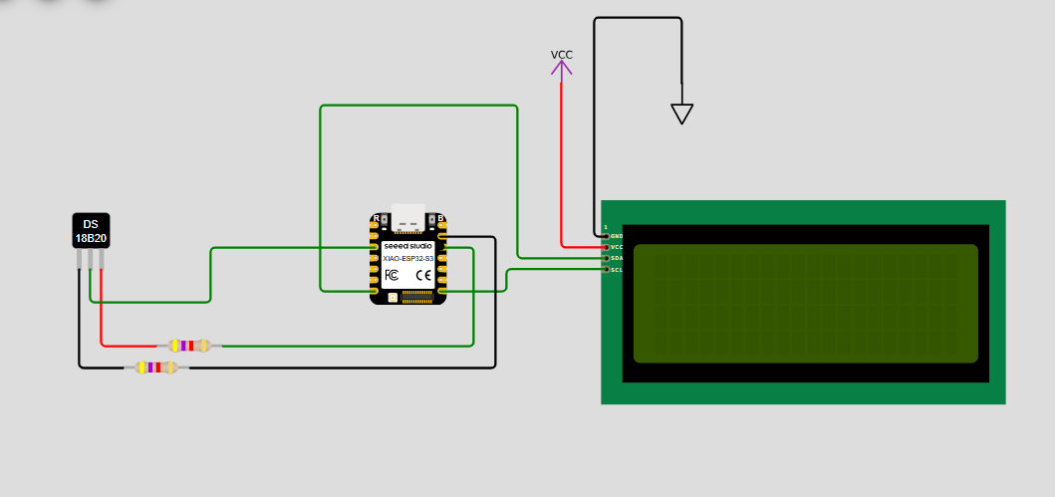
PROGRESS ON SIMULATION

Slide 42
MISCELLANEOUS
QUESTIONS/FEEDBACK

