Slide 1


DEVELOPMENT OF INTEGRATED WEARABLE DEVICE FOR REMOTE MONITORING OF PREGNANT WOMEN IN GHANA
Project Supervisor
Dr. Godfrey Mills
Co-Supervisor
Prof. Elsie Effah Kaufmann
Group Members
Owoh Einsteina Ofunne - 10943874
Anane George Nyarko – 10947340
Adika Nathaniel - 10957036
DATE: 17th July 2025
UNIVERSITY OF GHANA

Slide 2

COLLABORATORS
Nathaniel Sakyi Adibuer, IT Consortium
Dr. Frank Amegah, Korle-Bu Teaching Hospital
Dr. Kobby Sakyi Appiah , Britannia Medical Centre

Slide 3
MACHINE LEARNING MODEL PROGRESS

Slide 4
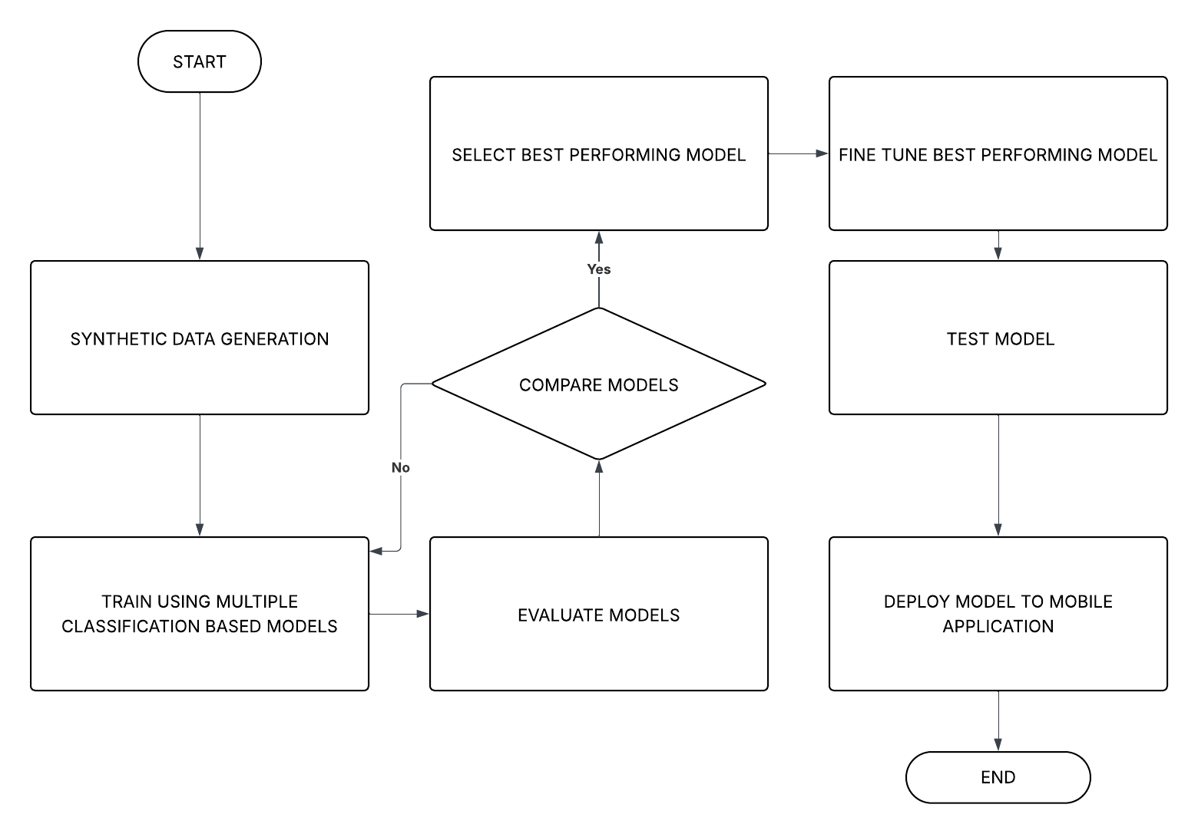
MACHINE LEARNING WORKFLOW

Slide 5
PREECLAMPSIA DATASET OVERVIEW
Dataset Name: preeclampsia_dataset.csv
Source: Synthetic Data Generation
Number of Samples: 10,000
Input Features: Systolic blood pressure, Diastolic blood pressure , MAP, Protein in urine
Output States: No_Preeclampsia, Mild, Moderate and Severe
Description: Dataset of 10,000 records generated to predict preeclampsia risk based on MAP and urine protein levels, with added noise to simulate real-world variability.

Slide 6
PREECLAMPSIA FEATURES
 | PROTEIN IN URIA | BLOOD PRESSURE
LOW | NIL | 70-106
MILD | 1+ | 107-113
MODERATE | 2+ OR > | 114-129
HIGH | 2+ OR > | 130 OR >

Slide 7
PREECLAMPSIA STATUS
 | PROTEIN IN URIA | BLOOD PRESSURE
NO PREECLAMPSIA | <2+
MILD | 2+ OR > | 114-124
MODERATE | 2+ OR > | 125-129
HIGH | 2+ OR > | 130 OR >

Slide 8
PREECLAMPSIA MODEL SELECTION
Metrics | Logistic Regression | K-Nearest Neighbour | Support Vector Machine | Decision Tree Classifier | Random Forest Classifier | Gradient Boosting Classifier | MLP Classifier
Precision | 0.9746 | 0.9569 | 0.9634 | 0.9305 | 0.9584 | 0.9545 | 0.9664
F1 Score | 0.9745 | 0.9567 | 0.9633 | 0.9305 | 0.9582 | 0.9548 | 0.9664
Recall | 0.9745 | 0.9568 | 0.9634 | 0.9305 | 0.9535 | 0.9549 | 0.9666
Training Accuracy | 0.9700 | 0.9700 | 0.9690 | 1.0000 | 1.0000 | 0.9600 | 0.9703
Test Accuracy | 0.9710 | 0.9650 | 0.9745 | 0.9680 | 0.9680 | 0.9645 | 0.9675
Validation Accuracy | 0.9724 | 0.9590 | 0.9635 | 0.9301 | 0.9585 | 0.9550 | 0.9665

Slide 9
TIME TAKEN (S)
Performance Metrics | Logistic Regression | K-Nearest Neighbour | Support Vector Machine | Decision Tree Classifier | Random Forest Classifier | Gradient Boosting Classifier | MLP Classifier
Training Time | 5.1027 | 0.0180 | 0.3880 | 0.0598 | 1.4372 | 7.0223 | 12.8828
Prediction Time | 0.0005 | 0.0004 | 0.4300 | 0.0010 | 0.0249 | 0.0300 | 0.0050

Slide 10
ANEMIA DATASET OVERVIEW
Dataset Name: anemia_dataset.csv
Source: Synthetic Data Generation
Number of Samples: 10,000
Input Features: Features will be listed in the next slide
Output States: High risk or Low Risk
Description: Dataset of 10,000 records generated to predict preeclampsia risk based on MAP and urine protein levels, with added noise to simulate real-world variability.

Slide 11
ANEMIA FEATURES
Excessive vomiting (e.g., frequent vomiting during pregnancy or illness leading to nutrient loss)
Diarrhea (e.g., persistent or repeated diarrhea that can cause dehydration and poor nutrient absorption
Heavy menstrual flow (e.g., menstruation lasting more than 7 days or requiring frequent pad/tampon changes)
Chronic disease (e.g., sickle cell disease, kidney disease, HIV, tuberculosis, or malaria)
Family history (e.g., close relatives with anemia or iron deficiency)
BMI (Body Mass Index <18.5 is considered underweight and a risk factor)
Age (e.g., <20 years or >35 years — age groups with higher anemia risk in pregnancy)
Education level (Low education — no formal schooling or only primary school)
Short interpregnancy interval (e.g., <18 months between pregnancies)

Slide 12
ANEMIA FEATURES
Multiple pregnancy (e.g., twins or triplets — higher iron demand)
Poverty (e.g., limited access to iron-rich foods or supplements due to low income)
Lack of access to healthcare (e.g., distance from hospital, inability to attend antenatal care)
Infections (e.g., recent parasitic infections like hookworm, or malaria)

Slide 13
ANEMIA MODEL SELECTION
Metrics | Logistic Regression | K-Nearest Neighbour | Support Vector Machine | Decision Tree Classifier | Random Forest Classifier | Gradient Boosting Classifier | MLP Classifier
Precision | 0.9572 | 0.6667 | 0.6934 | 0.3333 | 1.0000 | 1.0000 | 0.6923
F1 Score | 0.9474 | 0.2000 | 0.3333 | 0.3000 | 0.4078 | 0.7000 | 0.9000
Recall | 0.9000 | 0.3075 | 0.3334 | 0.3158 | 0.5714 | 0.8235 | 0.7826
Training Accuracy | 0.9458 | 0.8333 | 0.9690 | 1.0000 | 1.0000 | 1.0000 | 0.8958
Test Accuracy | 0.9833 | 0.8333 | 0.9225 | 0.9167 | 0.9000 | 0.9500 | 0.9167
Validation Accuracy | 0.9367 | 0.8500 | 0.8335 | 0.9133 | 0.8667 | 0.8833 | 0.9133

Slide 14
TIME TAKEN (S)
Performance Metrics | Logistic Regression | K-Nearest Neighbour | Support Vector Machine | Decision Tree Classifier | Random Forest Classifier | Gradient Boosting Classifier | MLP Classifier
Training Time | 0.9367 | 0.0040 | 0.3389 | 0.0044 | 0.8667 | 0.3357 | 5.2377
Prediction Time | 0.0789 | 0.0109 | 0.2245 | 0.0016 | 0.2494 | 0.0028 | 0.2080

Slide 15
WEB APP PROGRESS

Slide 16


Slide 17
NEW FEATURES ON THE MOBILE APP
1.New User Role Added To Mobile App
2.Payment Portal Integrated Using Paystack Payment Gateway

Slide 18
HARDWARE PROGRESS

Slide 19
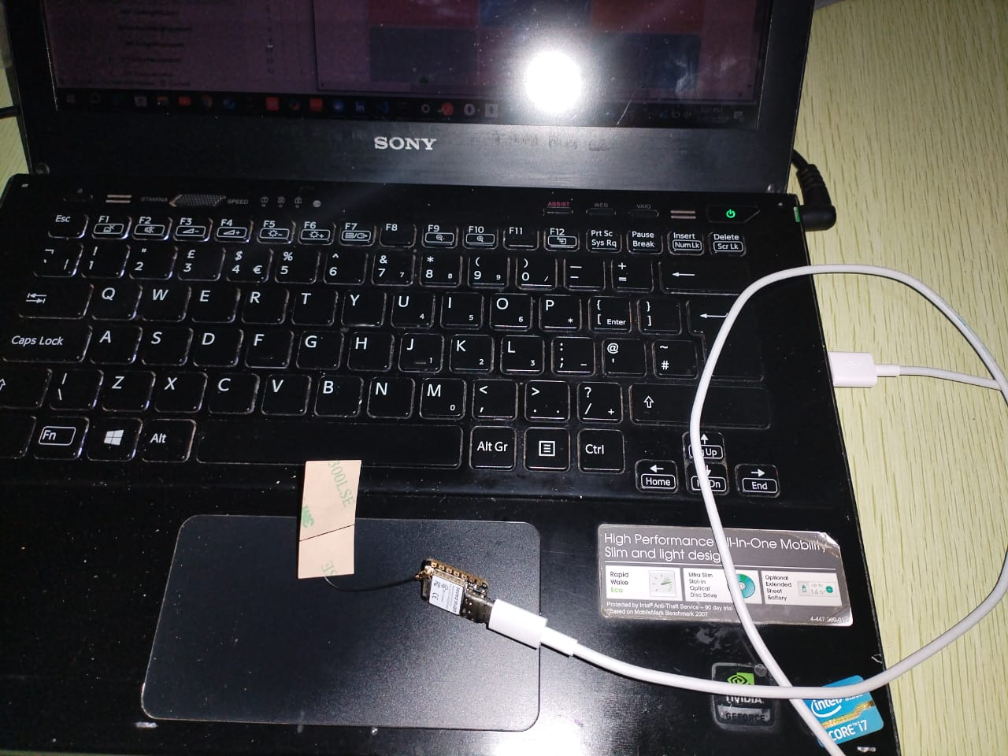

Slide 20
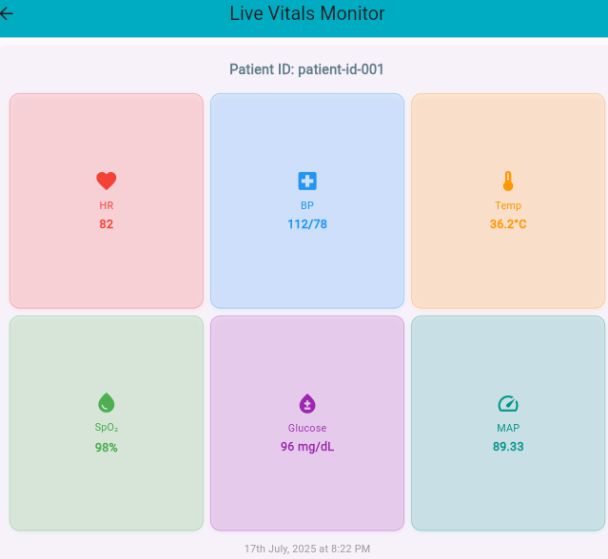

Slide 21
NEXT STEPS
Acquistion Of Sensors from Actual Sensor Data Transmission
Connection Of Backend To Web App Designed In React

Slide 22
QUESTIONS/FEEDBACK

