Slide 1


REMOTE MONITORING OF PREGNANT WOMEN IN GHANA USING A WEARABLE DEVICE AND A MOBILE APP
Project Supervisor
Prof. Godfrey Mills
Co-Supervisor
Prof. Elsie Effah Kaufmann
Group Members
Owoh Einsteina Ofunne - 10943874
Anane George Nyarko – 10947340
Adika Nathaniel - 10957036
DATE: 24th July 2025
UNIVERSITY OF GHANA

Slide 2

COLLABORATORS
Nathaniel Sakyi Adibuer, IT Consortium
Dr. Frank Amegah, Korle-Bu Teaching Hospital
Dr. Sakyi Appiah, Britannica Medical Centre

Slide 3
HARDWARE PROGRESS

Slide 4
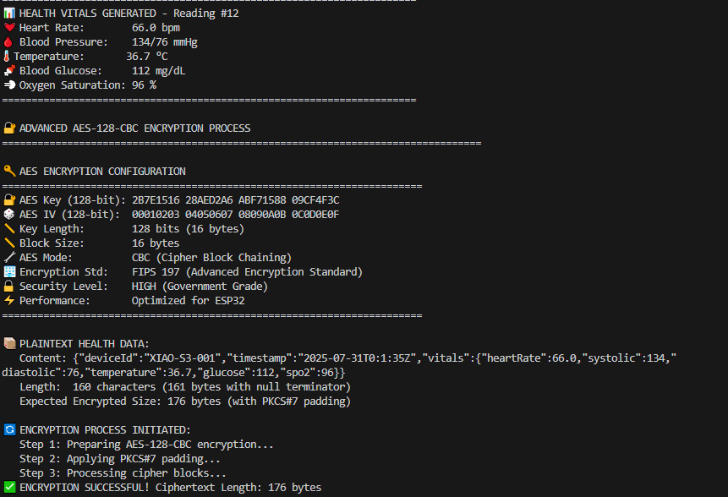
HEALTH DATA ENCRYPTION/DECRYPTION

Slide 5
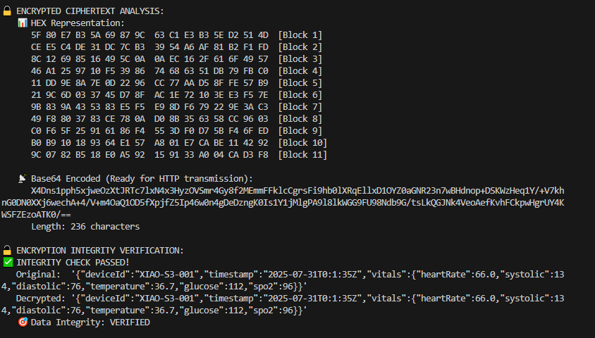
HEALTH DATA ENCRYPTION/DECRYPTION

Slide 6
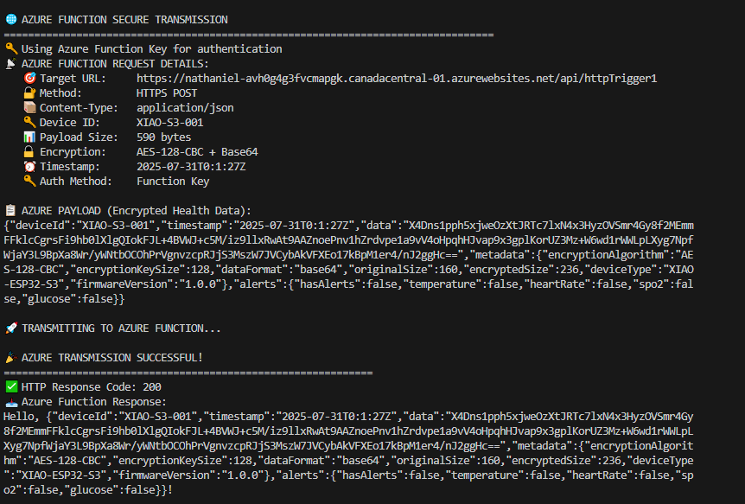
CLOUD PLATFORM DATA RECEPTION

Slide 7
MACHINE LEARNING MODEL PROGRESS

Slide 8
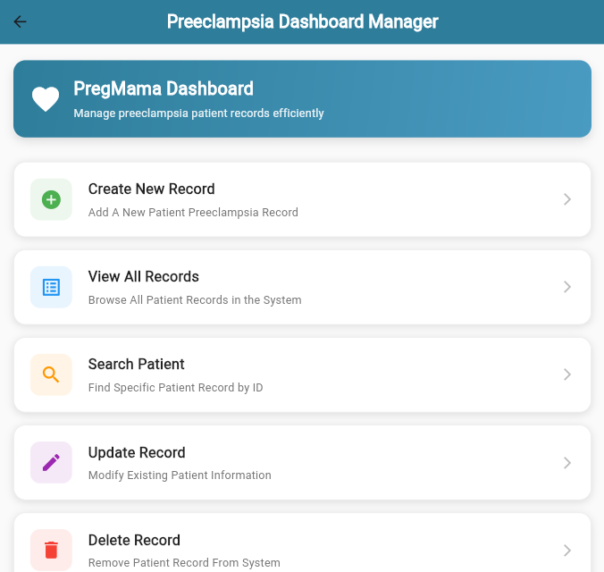
PREECLAMPSIA MODEL CONNECTION TO BACKEND

Slide 9
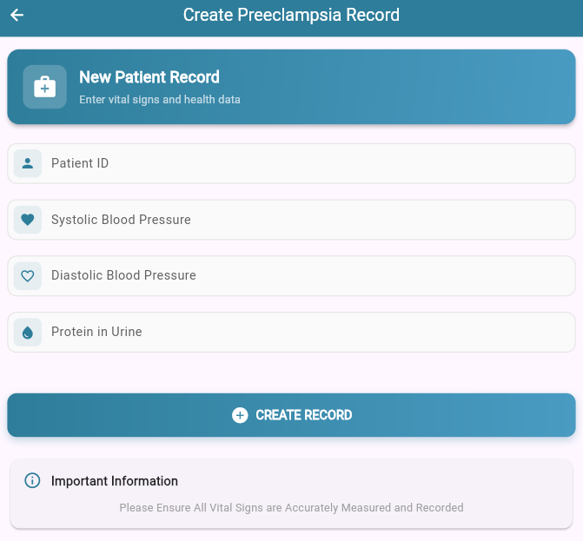
CREATING A PREECLAMPSIA RECORD FOR TESTING

Slide 10
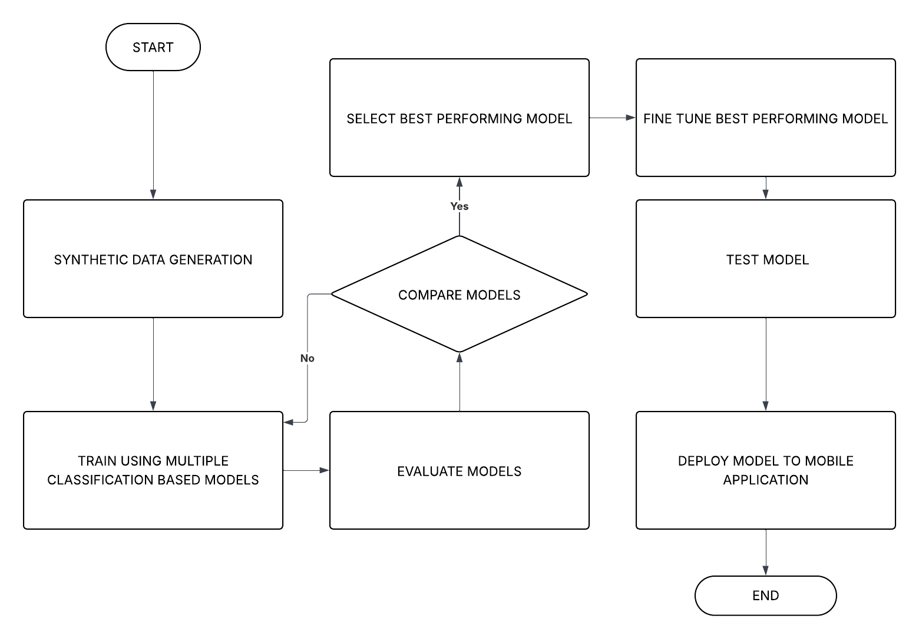
MACHINE LEARNING WORKFLOW

Slide 11
PREECLAMPSIA DATASET OVERVIEW
Dataset Name: preeclampsia_dataset.csv
Source: Synthetic Data Generation
Number of Samples: 10,000
Input Features: Systolic blood pressure, Diastolic blood pressure , MAP, Protein in urine
Output States: No_Preeclampsia, Mild, Moderate and Severe
Description: Dataset of 10,000 records generated to predict preeclampsia risk based on MAP and urine protein levels, with added noise to simulate real-world variability.

Slide 12
PREECLAMPSIA FEATURES
 | PROTEIN IN URIA | MAP
LOW | NIL | 70-106
MILD | 1+ | 107-113
MODERATE | 2+ OR > | 114-129
HIGH | 2+ OR > | 130 OR >

Slide 13
PREECLAMPSIA STATUS
 | PROTEIN IN URIA | MAP
NO PREECLAMPSIA | <2+
MILD | 2+ OR > | 114-124
MODERATE | 2+ OR > | 125-129
SEVERE | 2+ OR > | 130 OR >

Slide 14
PREECLAMPSIA MODEL SELECTION
Metrics | Logistic Regression | K-Nearest Neighbour | Support Vector Machine | Decision Tree Classifier | Random Forest Classifier | Gradient Boosting Classifier | MLP Classifier
Precision | 0.9746 | 0.9569 | 0.9634 | 0.9305 | 0.9584 | 0.9545 | 0.9664
F1 Score | 0.9745 | 0.9567 | 0.9633 | 0.9305 | 0.9582 | 0.9548 | 0.9664
Recall | 0.9745 | 0.9568 | 0.9634 | 0.9305 | 0.9535 | 0.9549 | 0.9666
Training Accuracy | 0.9700 | 0.9700 | 0.9690 | 1.0000 | 1.0000 | 0.9600 | 0.9703
Test Accuracy | 0.9710 | 0.9650 | 0.9745 | 0.9680 | 0.9680 | 0.9645 | 0.9675
Validation Accuracy | 0.9724 | 0.9590 | 0.9635 | 0.9301 | 0.9585 | 0.9550 | 0.9665

Slide 15
TIME TAKEN (S)
Performance Metrics | Logistic Regression | K-Nearest Neighbour | Support Vector Machine | Decision Tree Classifier | Random Forest Classifier | Gradient Boosting Classifier | MLP Classifier
Training Time(s) | 5.1027 | 0.0180 | 0.3880 | 0.0598 | 1.4372 | 7.0223 | 12.8828
Prediction Time(s) | 0.0005 | 0.0004 | 0.4300 | 0.0010 | 0.0249 | 0.0300 | 0.0050

Slide 16
ANEMIA DATASET OVERVIEW
Dataset Name: anemia_dataset.csv
Source: Synthetic Data Generation
Number of Samples: 10,000
Input Features: Features will be listed in the next slide
Output States: High risk or Low Risk
Description: Dataset of 10,000 records generated to predict preeclampsia risk based on MAP and urine protein levels, with added noise to simulate real-world variability.

Slide 17
ANEMIA FEATURES
Excessive vomiting
Diarrhea
Heavy menstrual flow
Chronic disease
Family history
BMI
Age

Slide 18
ANEMIA FEATURES
Education level
Short interpregnancy interval
Multiple Pregnancy
Poverty
Lack Of Access To Healthcare
Infections

Slide 19
ANEMIA MODEL SELECTION
Metrics | Logistic Regression | K-Nearest Neighbour | Support Vector Machine | Decision Tree Classifier | Random Forest Classifier | Gradient Boosting Classifier | MLP Classifier
Precision | 0.9572 | 0.6667 | 0.6934 | 0.3333 | 1.0000 | 1.0000 | 0.6923
F1 Score | 0.9474 | 0.2000 | 0.3333 | 0.3000 | 0.4078 | 0.7000 | 0.9000
Recall | 0.9000 | 0.3075 | 0.3334 | 0.3158 | 0.5714 | 0.8235 | 0.7826
Training Accuracy | 0.9458 | 0.8333 | 0.9690 | 1.0000 | 1.0000 | 1.0000 | 0.8958
Test Accuracy | 0.9833 | 0.8333 | 0.9225 | 0.9167 | 0.9000 | 0.9500 | 0.9167
Validation Accuracy | 0.9367 | 0.8500 | 0.8335 | 0.9133 | 0.8667 | 0.8833 | 0.9133

Slide 20
TIME TAKEN (S)
Performance Metrics | Logistic Regression | K-Nearest Neighbour | Support Vector Machine | Decision Tree Classifier | Random Forest Classifier | Gradient Boosting Classifier | MLP Classifier
Training Time(s) | 0.9367 | 0.0040 | 0.3389 | 0.0044 | 0.8667 | 0.3357 | 5.2377
Prediction Time(s) | 0.0789 | 0.0109 | 0.2245 | 0.0016 | 0.2494 | 0.0028 | 0.2080

Slide 21
WEB APP PROGRESS

Slide 22
Completion Of Connection Of Backend To Web App Frontend

Slide 23
NEXT STEPS
Implementation Of Wrist Wearable Device With Sensors
Broadening Scope Of Project To General Health Information From Vitals

Slide 24
FEEDBACK

