Slide 1

SCHOOL OF ENGINEERING SCIENCES
COLLEGE OF BASIC AND APPLIED SCIENCES
DEPARTMENT OF COMPUTER ENGINEERING
FIRST SEMESTER 2024/2025 ACADEMIC YEAR
COURSE CODE & TITLE: CPEN 403 – EMBEDDED SYSTEMS
COURSE INSTRUCTOR: DR. GODFREY MILLS
TEACHING ASSISTANT: KELVIN BOATENG

Slide 2
A SECURITY
DETECTION SYSTEM USING LDR
Adika Nathaniel - 10957036

Slide 3
CONTENTS
01
05
09
Introduction & Project definition
System Operational Flow Diagram
Implementation, Testing & Evaluation
02
06
10
Design Objectives
System Specs, Req. & constraints
Conclusion & Future work
03
07
11
System Functions, Inputs & Outputs
Hardware Schematic Diagram
References
04
08
Architectural Diagram & Components
Software Logic Flow Diagram

Slide 4
Introduction And Project Definition
Project Overview
  This project involves designing an intruder detection system using an LDR to detect motion based on light intensity changes. A 555 timer simulates natural frequency variations of the LDR, while an Arduino processes signals and controls outputs. The system minimizes false alarms by filtering noise and features an LCD for status updates, LEDs for visual alerts, and a buzzer for sound alerts. Simulation is done in Proteus, considering real-world feasibility and its frequency limitations.
Why Embedded Systems?
  Compact, real-time, power-efficient.
  Utilizes Timers, PWM, ADC, and Interrupts for optimal performance.

Slide 5
Design Objectives
Primary Objective:
  Accurately detect changes in ambient light intensity using an LDR and trigger alarms reliably.
Secondary Objectives:
  Implement real-time processing with ADC and filtering.
  Use hysteresis logic to avoid false alarms.
  Store detection data in EEPROM for retrieval.
  Optimize power with low-power sleep mode.
  Provide a user-friendly interface with an LCD and button interaction.

Slide 6
System Functions, Inputs and Outputs
System Functions
  Sensing: LDR continuously measures light intensity.
  Filtering: Biquad filter reduces noise and unwanted frequency components.
  Detection: Hysteresis logic determines threshold crossing.
  Alarm Activation: Buzzer sounds & LED blinks on detection.
  Status Display: LCD provides real-time system status.
  Data Logging: EEPROM stores event count & detection time.
  User Interaction: Button press retrieves stored data.

Slide 7
System Functions, Inputs and Outputs
Inputs & Outputs
Inputs:
  LDR Sensor Signal: Analog voltage based on light levels.
  Push-Button Input: User requests stored detection count/time.
Outputs:
  Buzzer (PWM modulated): Generates alarm sound.
  LEDs: Red LED blinks in alarm mode, green LED stays on in normal mode.
  LCD: Displays “Status: Normal” or “ALARM: DETECTED.”

Slide 8
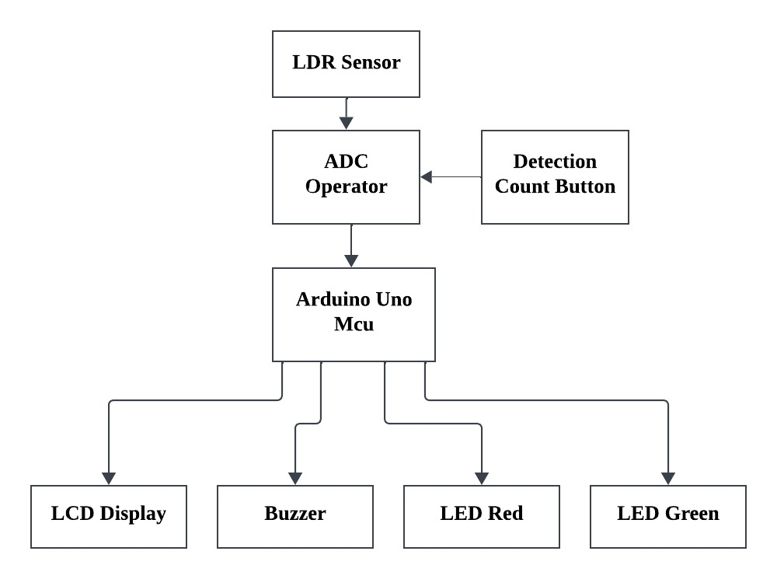
Architectural Diagram

Slide 9
Key Components
Microcontroller (Arduino/STM32F4)
LDR Sensor Circuit
Comparator (Op-Amp LM358)
LCD Display (16×2 or OLED)
Buzzer & LEDs

Slide 10
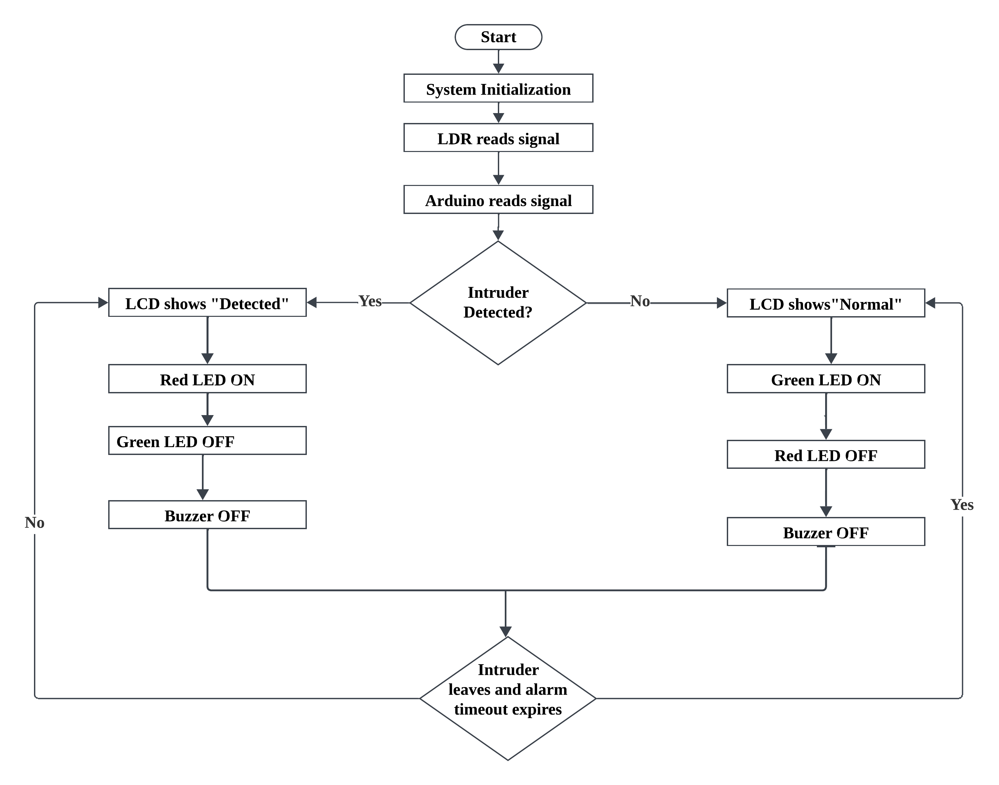
System Operational Flow diagram

Slide 11
System specifications, Requirements & Constraints
System Specifications
  Power Supply: 5V regulated, stable operation for all components.
  ADC Sampling Rate: 100 Hz for accurate detection.
  Buzzer Frequency: 400–600 Hz, modulated for alarm effect.
  EEPROM Storage: Detection count & timestamp persistence

Slide 12
System specifications, Requirements & Constraints
Functional & Performance Requirements
  Detect light changes accurately and trigger an alarm for 5 seconds.
  Filter out noise frequencies (e.g., 6Hz) to prevent false alarms.
  Watchdog Timer ensures system resets if the loop hangs.
  EEPROM storage must persist detection history even after power loss.

Slide 13
System specifications, Requirements & Constraints
1. Hardware Constraints
  Arduino Uno Pin Availability
  Limited EEPROM Storage (1kB)
2. Software Constraints
  ADC Resolution
  Timer1 Usage for Sampling
  PWM Limitations
  .

Slide 14
System specifications, Requirements & Constraints
3. Simulation Constraints (Proteus & Real-World Differences)
  Frequency Limitations in Proteus
  EEPROM Persistence in Proteus
4. Power & Timing Constraints
  Sleep Mode Timing:
  Watchdog Timer (2s Timeout)
  Alarm Duration
  .

Slide 15
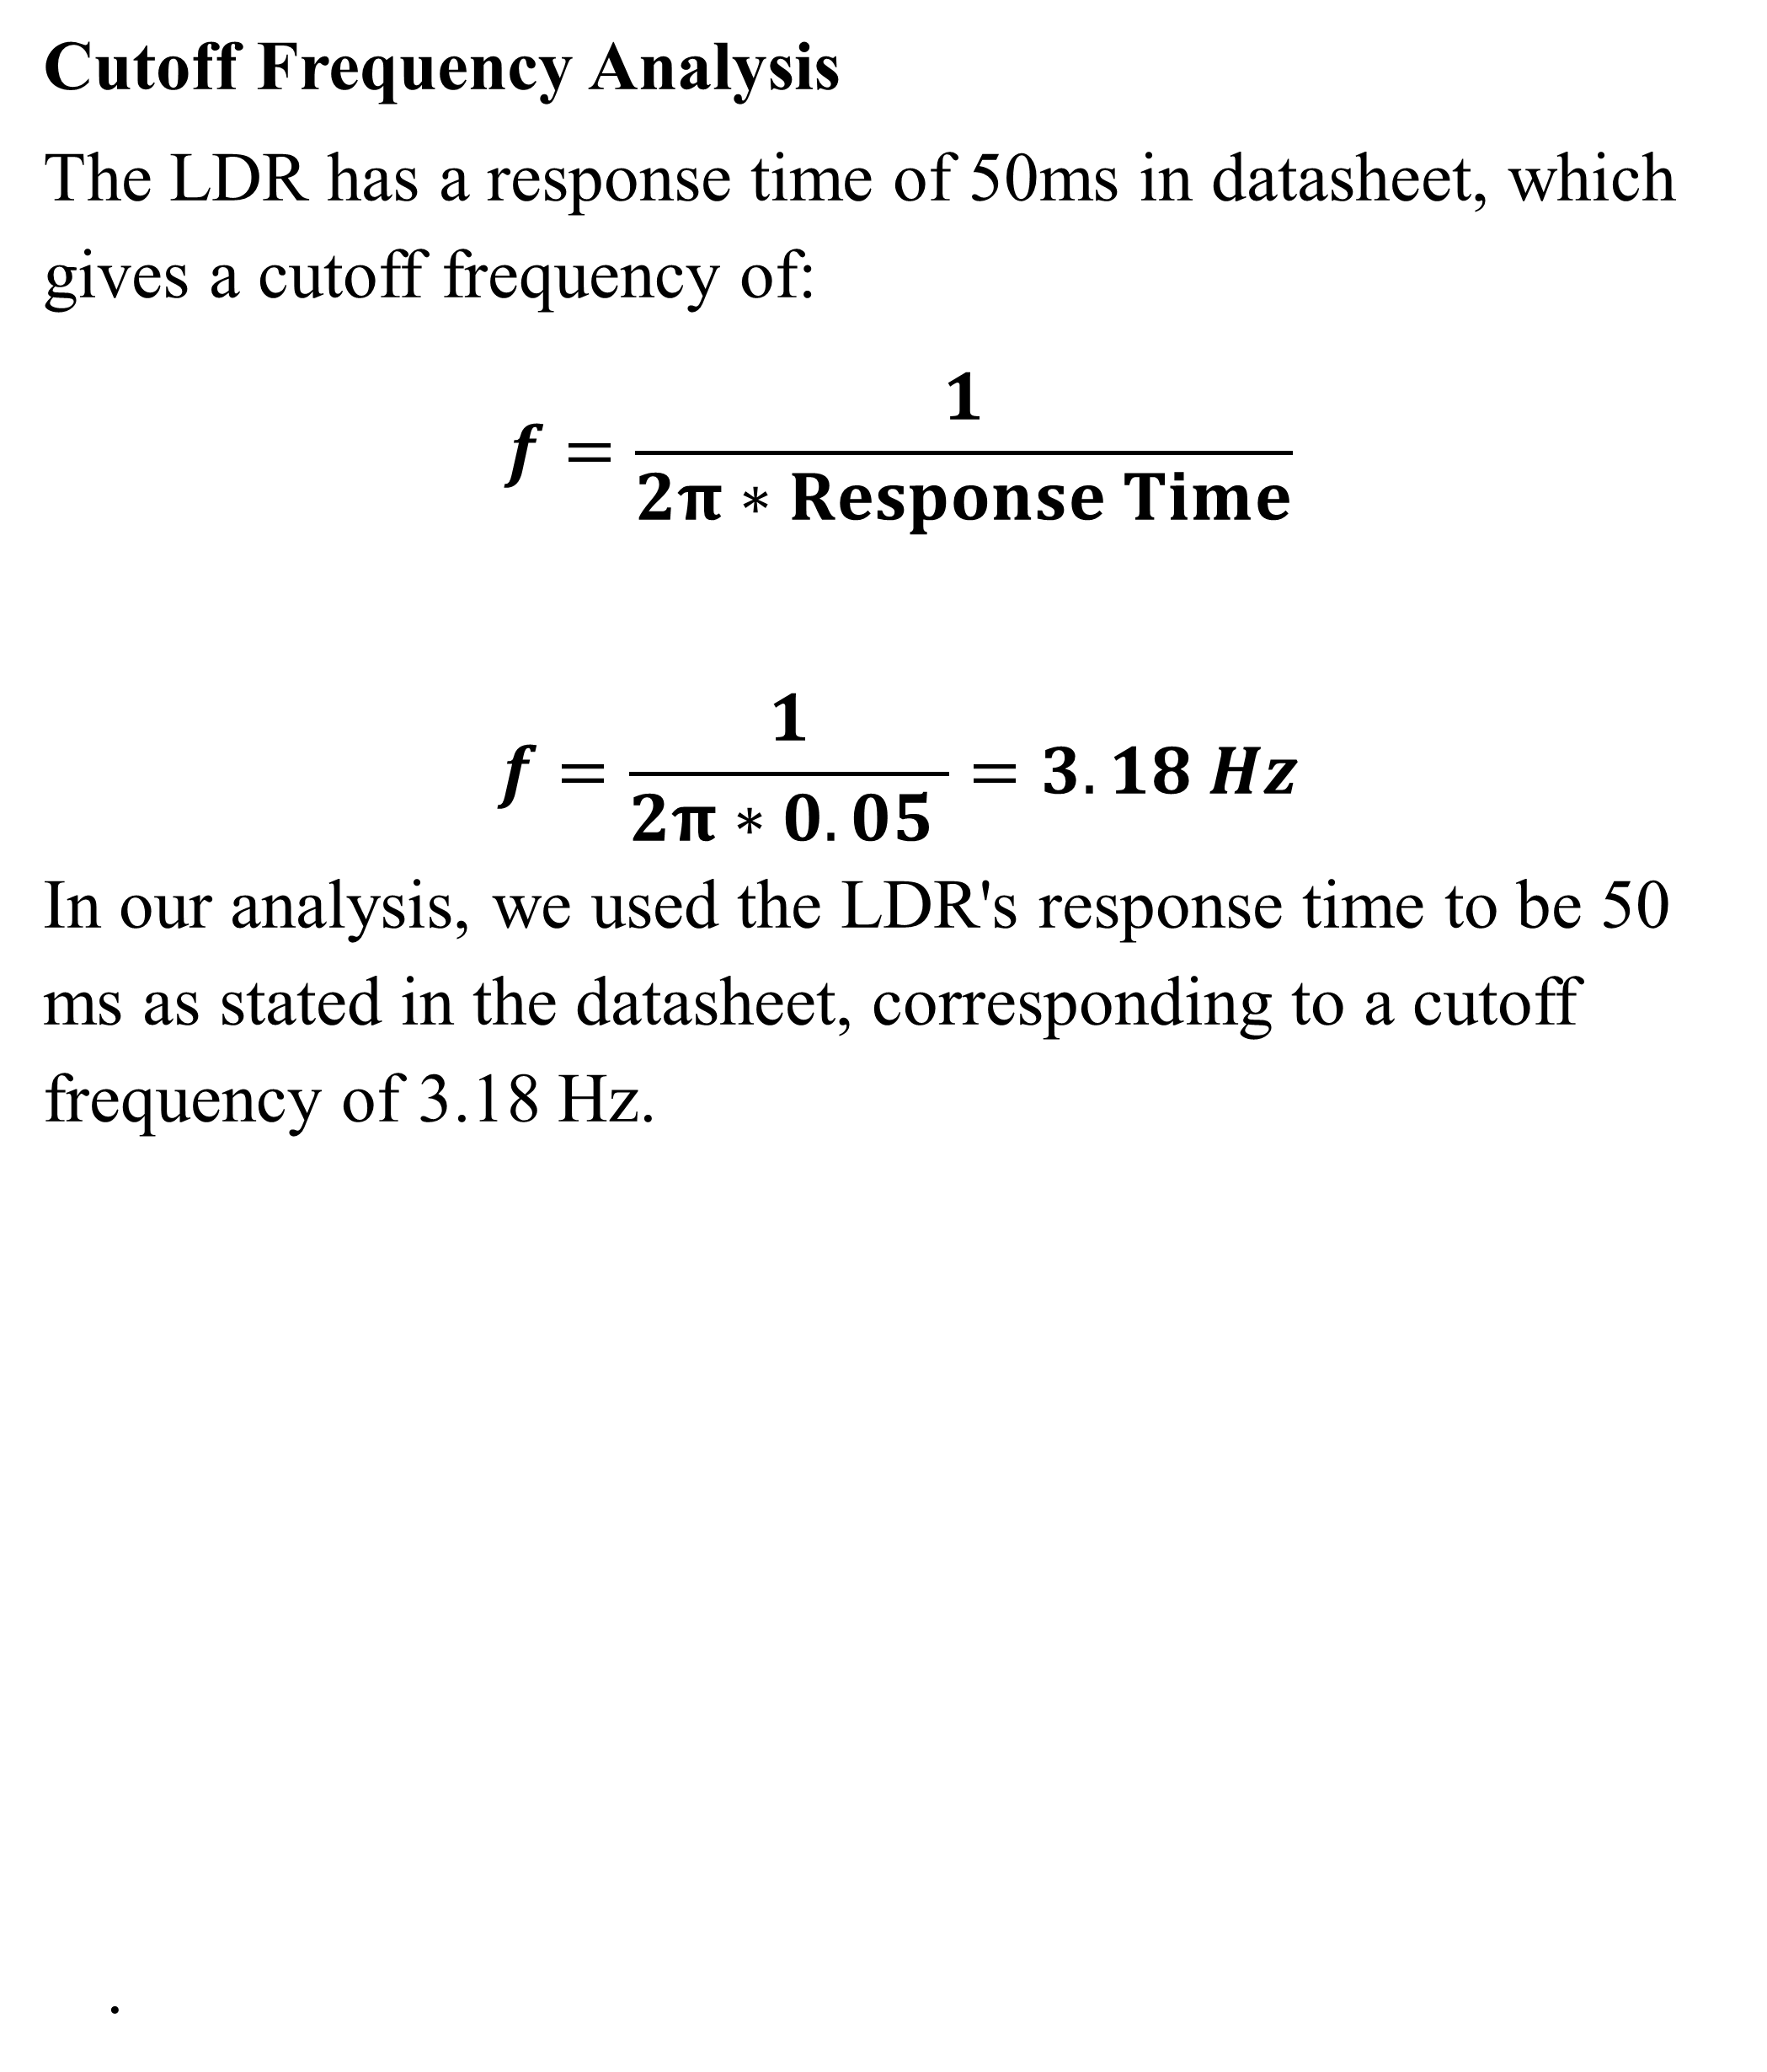
System specifications, Requirements & Constraints
Cutoff Frequency Analysis
The LDR has a response time of 50ms in datasheet, which gives a cutoff frequency of:
$$f=\frac{1}{2π∗Response Time}$$
$$f=\frac{1}{2π∗0.05 }=3.18 Hz$$
In our analysis, we used the LDR's response time to be 50 ms as stated in the datasheet, corresponding to a cutoff frequency of 3.18 Hz.
  .

Slide 16
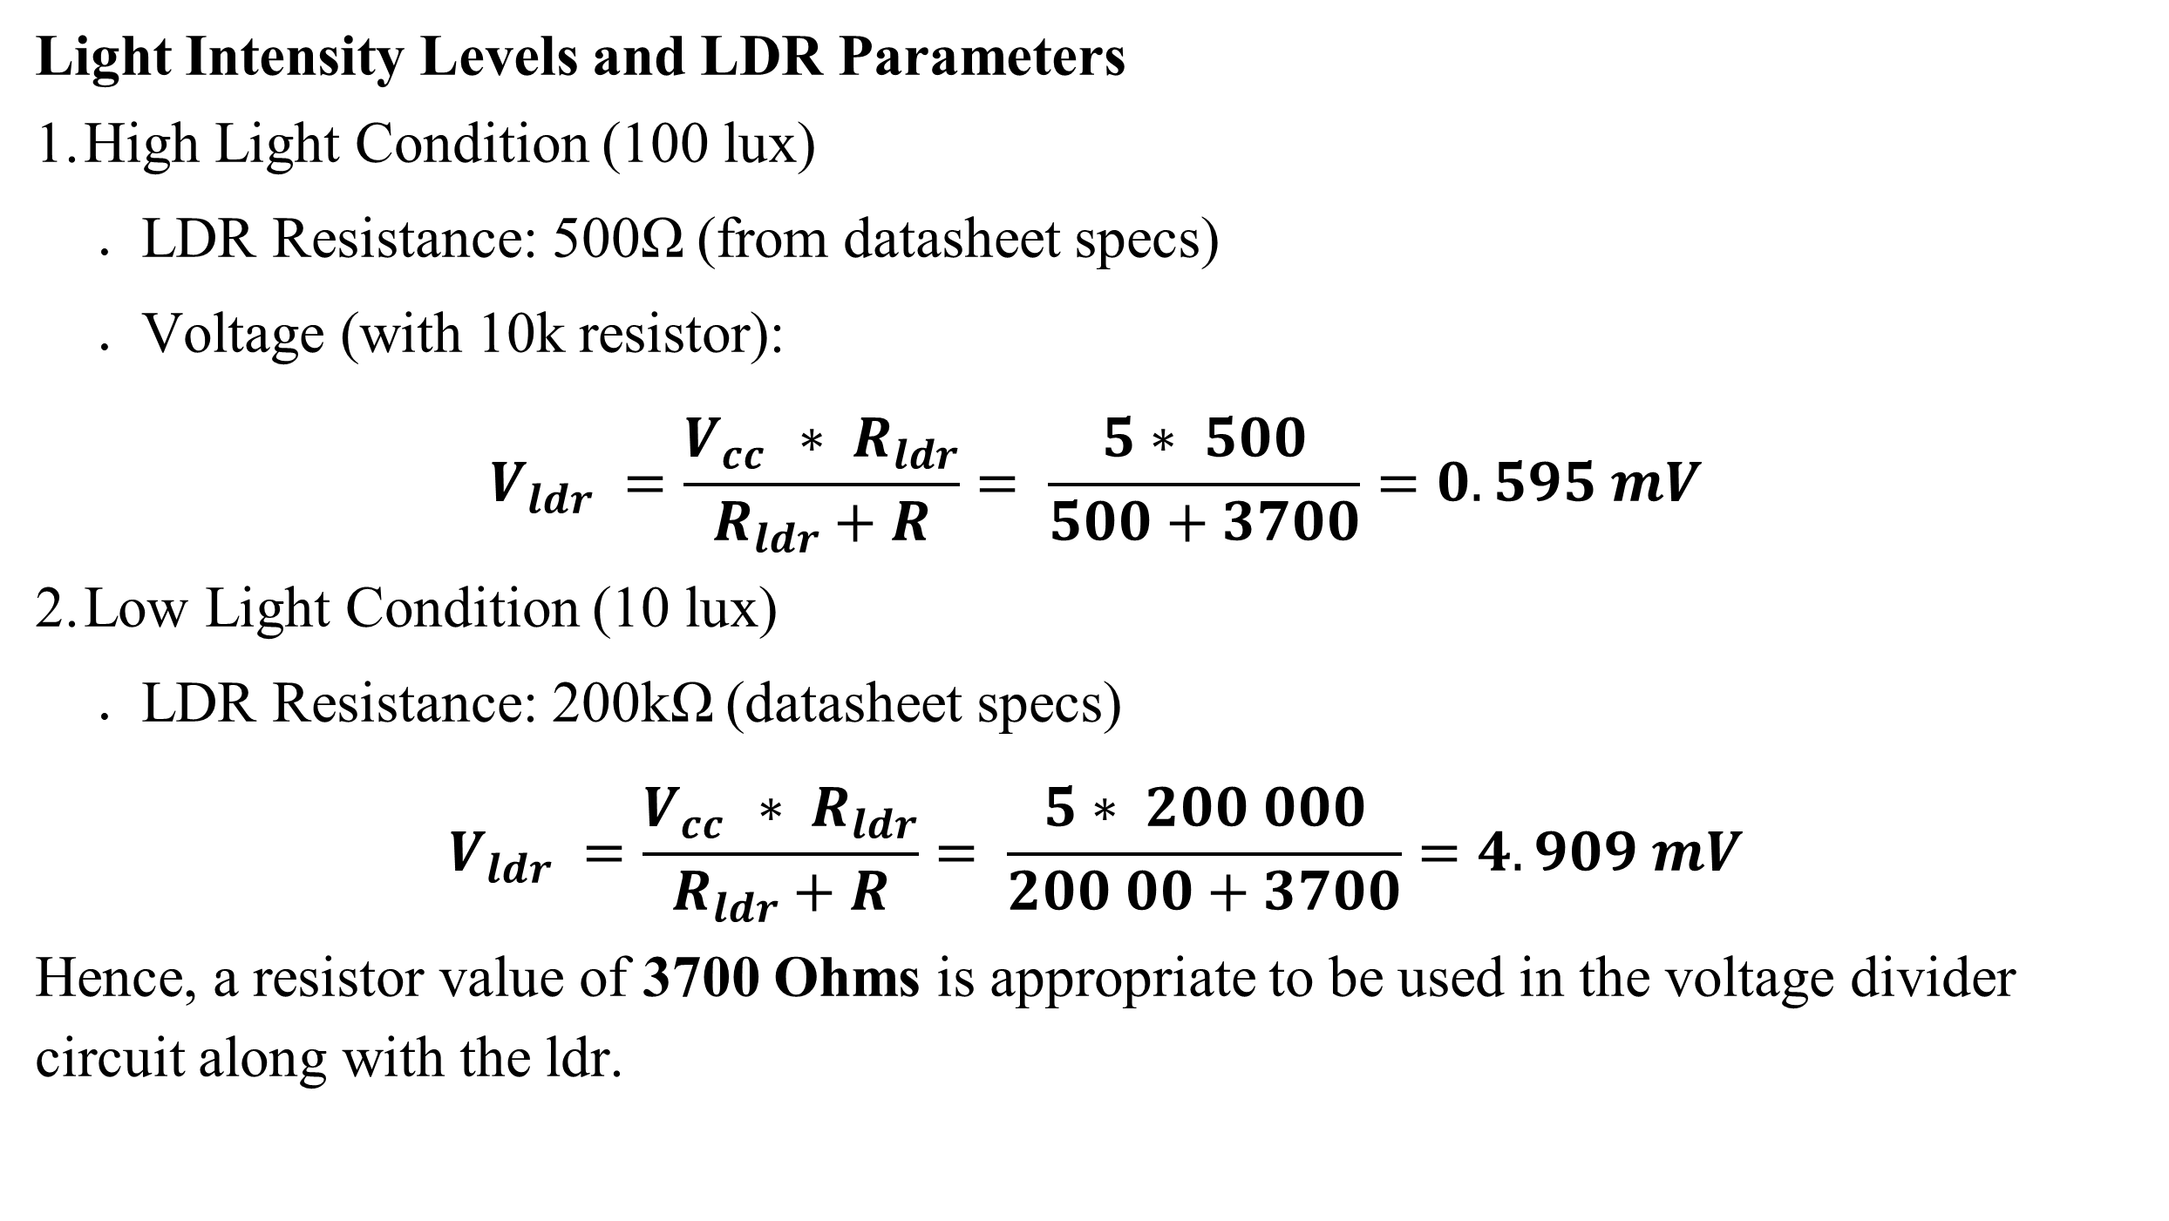
Hardware Schematic Diagram & Modelling
Light Intensity Levels and LDR Parameters
High Light Condition (100 lux)
  LDR Resistance: 500Ω (from datasheet specs)
  Voltage (with 10k resistor):
$$V_{ldr} =\frac{V_{cc }∗ R_{ldr}}{R_{ldr}+R}= \frac{5∗ 500}{500+3700}=0.595 mV$$
Low Light Condition (10 lux)
  LDR Resistance: 200kΩ (datasheet specs)
$$V_{ldr} =\frac{V_{cc }∗ R_{ldr}}{R_{ldr}+R}= \frac{5∗ 200 000}{200 00+3700}=4.909 mV$$
Hence, a resistor value of 3700 Ohms is appropriate to be used in the voltage divider circuit along with the ldr.

Slide 17
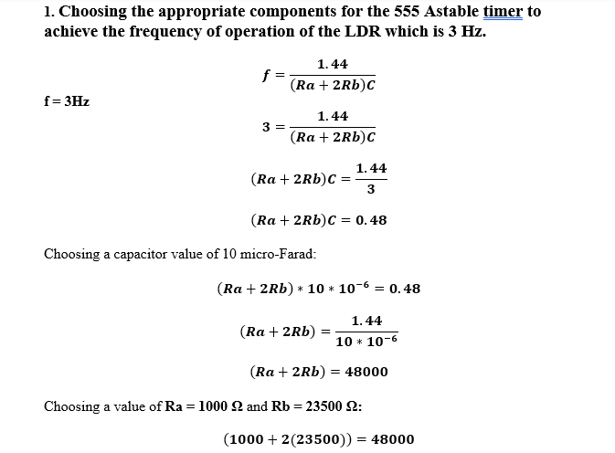
Hardware Schematic Diagram & Modelling

Slide 18
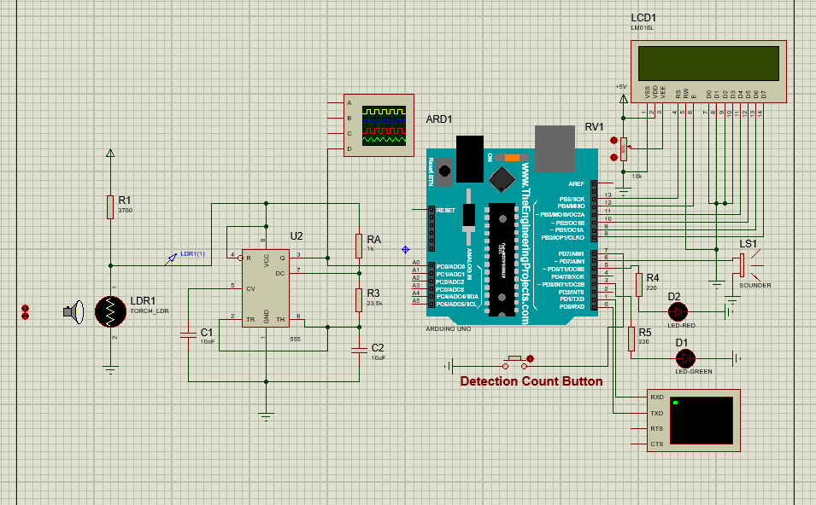
Hardware Schematic Diagram & Modelling

Slide 19
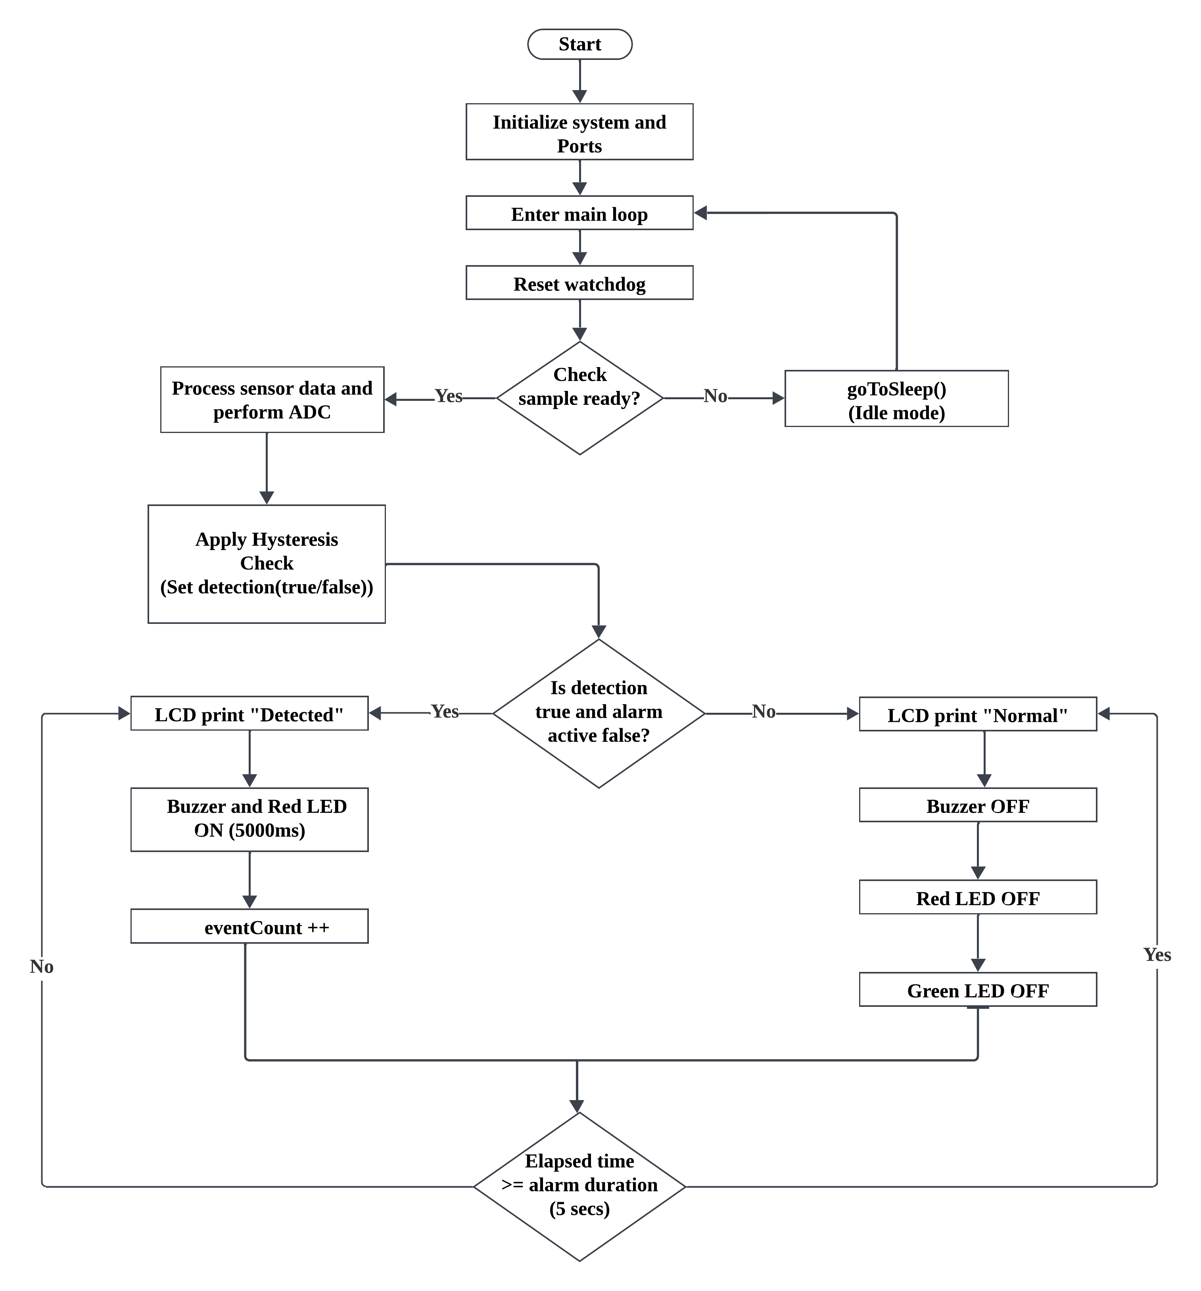
Software Logic Flow & Code Development

Slide 20
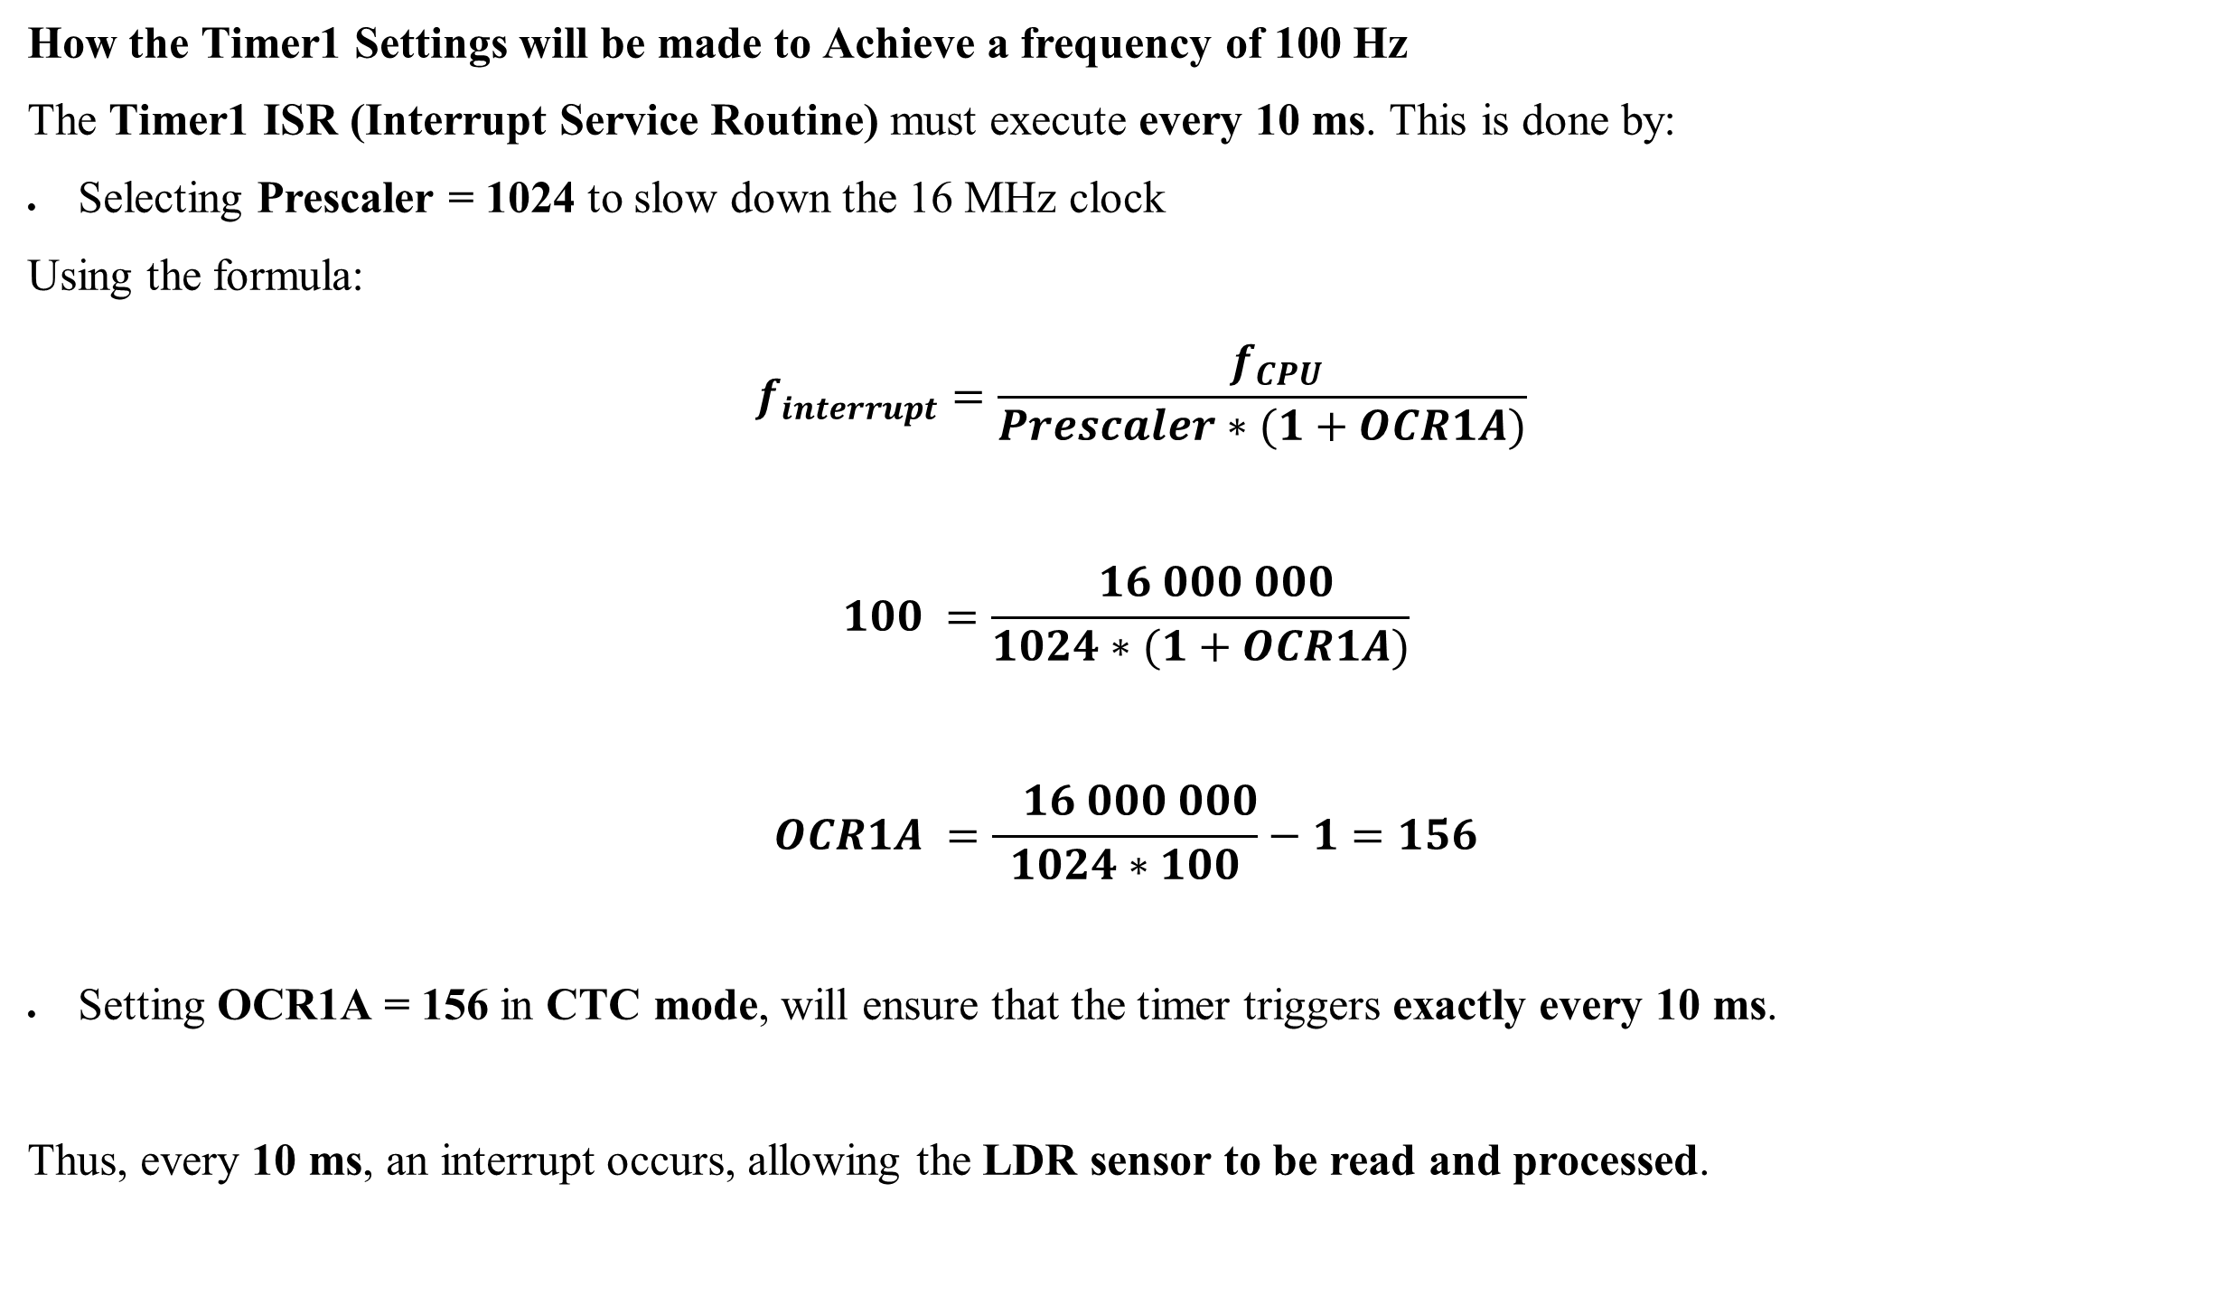
Software Logic Flow & Code Development
How the Timer1 Settings will be made to Achieve a frequency of 100 Hz
The Timer1 ISR (Interrupt Service Routine) must execute every 10 ms. This is done by:
Selecting Prescaler = 1024 to slow down the 16 MHz clock
Using the formula:
$$f_{interrupt}=\frac{ f_{CPU}}{Prescaler∗(1+OCR1A)}$$
$$100 =\frac{ 16 000 000}{1024∗(1+OCR1A)}$$
$$OCR1A =\frac{ 16 000 000}{1024∗100}−1=156$$
Setting OCR1A = 156 in CTC mode, will ensure that the timer triggers exactly every 10 ms.
Thus, every 10 ms, an interrupt occurs, allowing the LDR sensor to be read and processed.

Slide 21
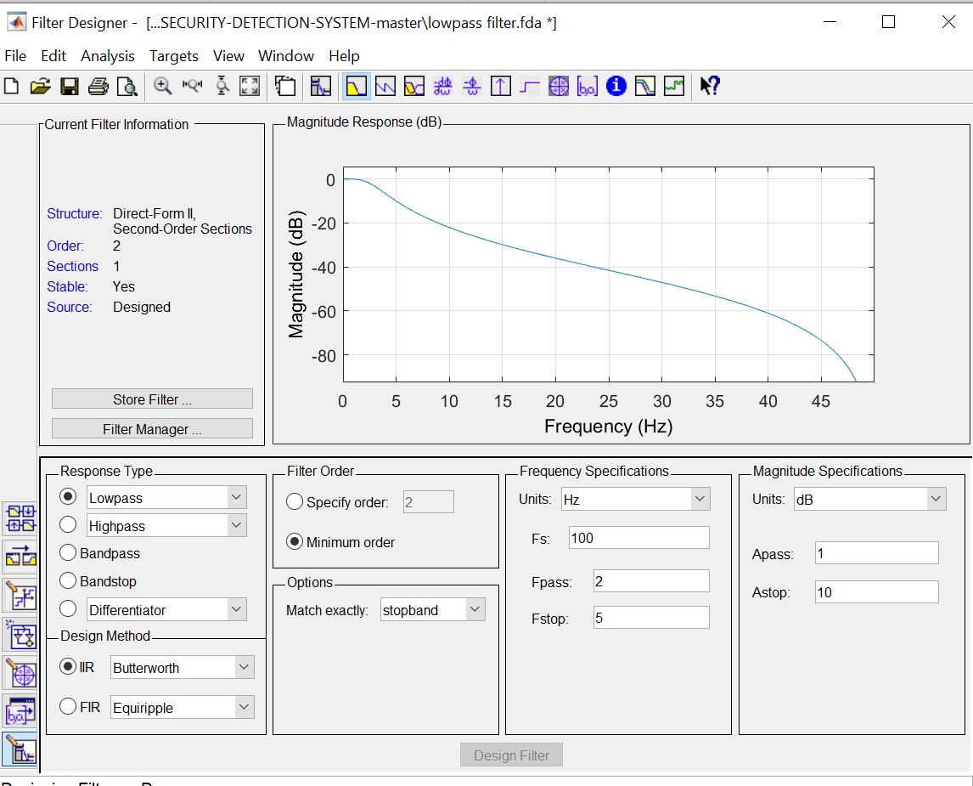
Digital Filter Design
The figure above shows the magnitude response of the filter.

Slide 22
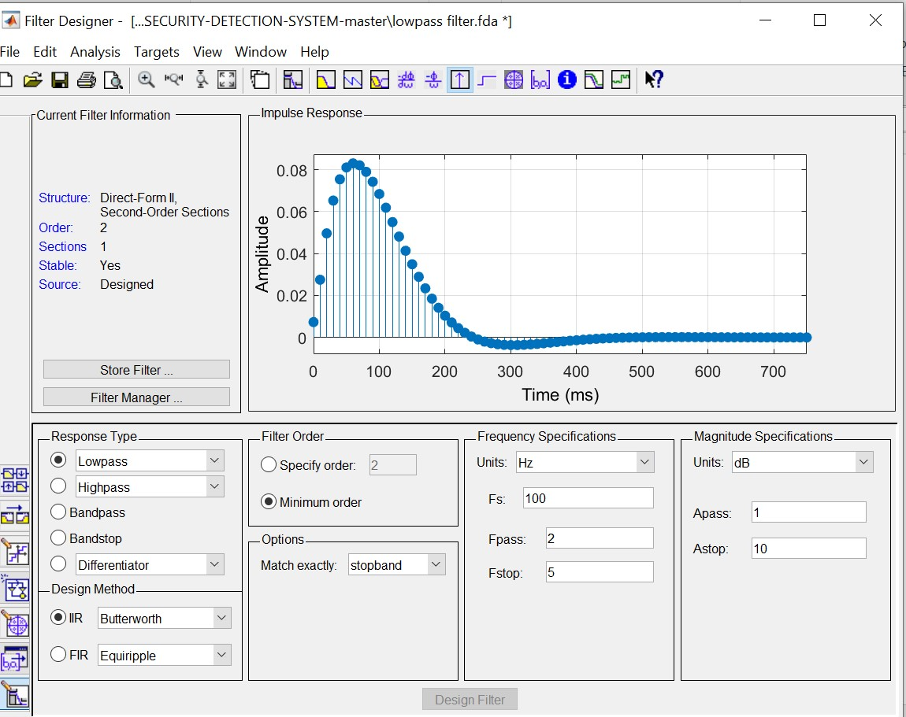
The figure above shows the impulse response of the filter.

Slide 23
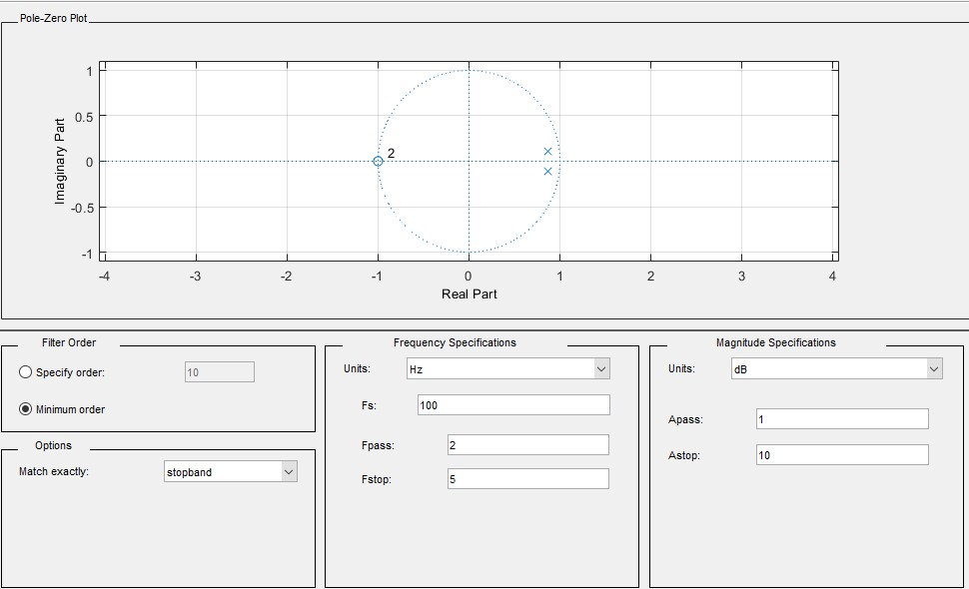
The figure above shows the zero pole map of the filter indicating that the system is stable

Slide 24
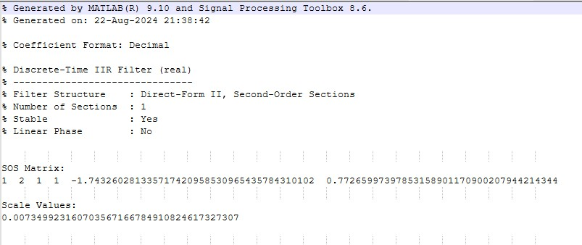
The figure above shows the filter coefficients for the digital filter design

Slide 25
Software Logic Flow & Code Development
Key Code Sections
  Timer1 Setup: 100Hz interrupt for sensor sampling.
  Filtering: Biquad filter for noise reduction.
  EEPROM Handling: Saves detection data.
  Alarm Mode: Buzzer & LED PWM control.
  Low-Power Mode: MCU sleeps between readings.

Slide 26
Testing and Performance Evaluation
Test Scenarios:
  Low Light: Normal mode (Green LED ON).
  Sudden Bright Light: Alarm triggers (Buzzer + Red LED Blinking).
  Button Press: Displays detection count & timestamp on LCD.
Key Observations:
  Accurate light detection with minimal false alarms.
  Noise filtering works as expected.
  Power optimization reduces energy consumption.

Slide 27
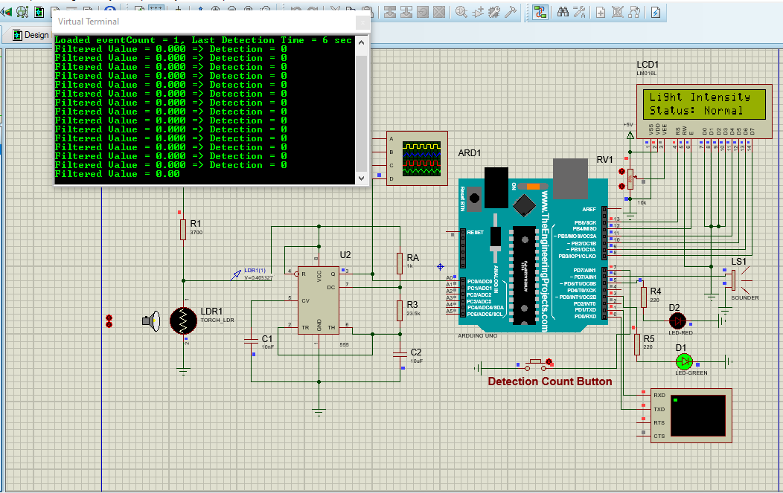
Normal light intensity meaning no intruder has invaded the area.

Slide 28
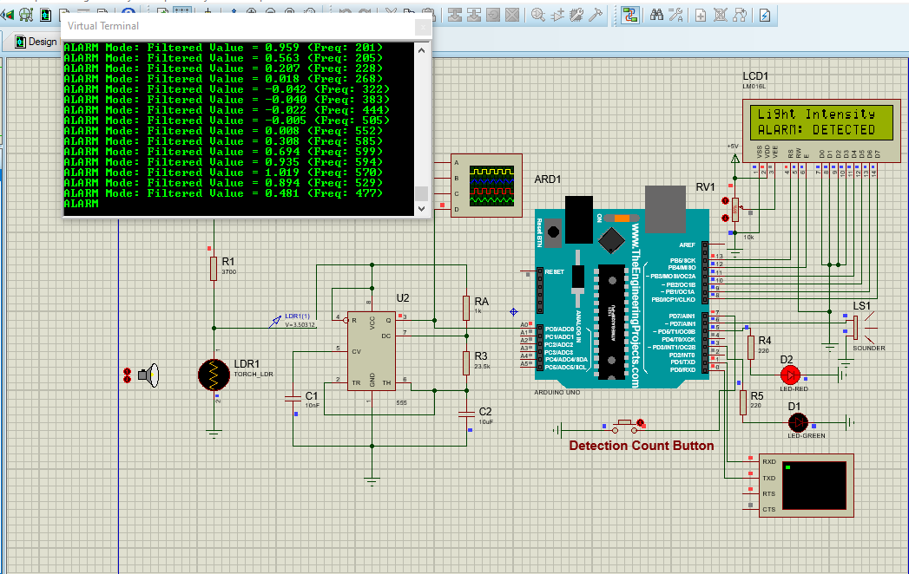
When darkness falls on it or light intensity is low meaning there is an intruder.

Slide 29
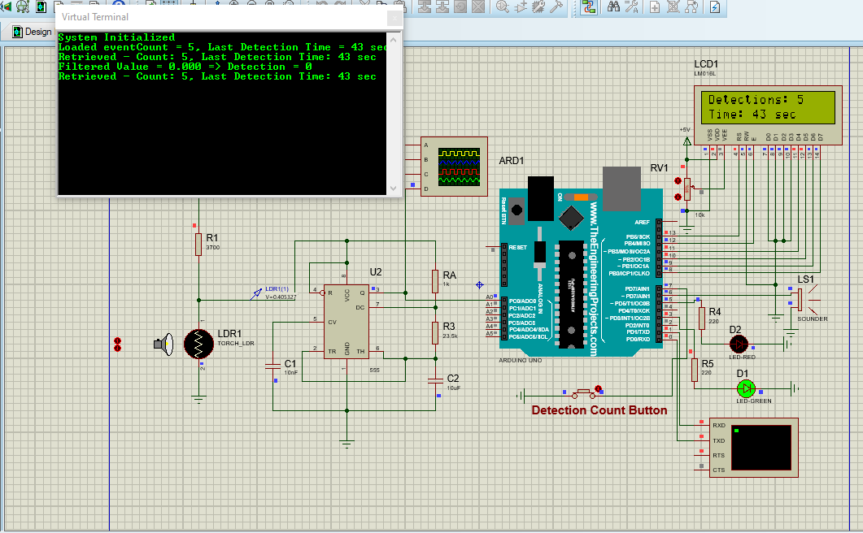
When the button is pressed it indicates the number of detections on the LCD and the time the detection took place since the Arduino has been working or active.

Slide 30
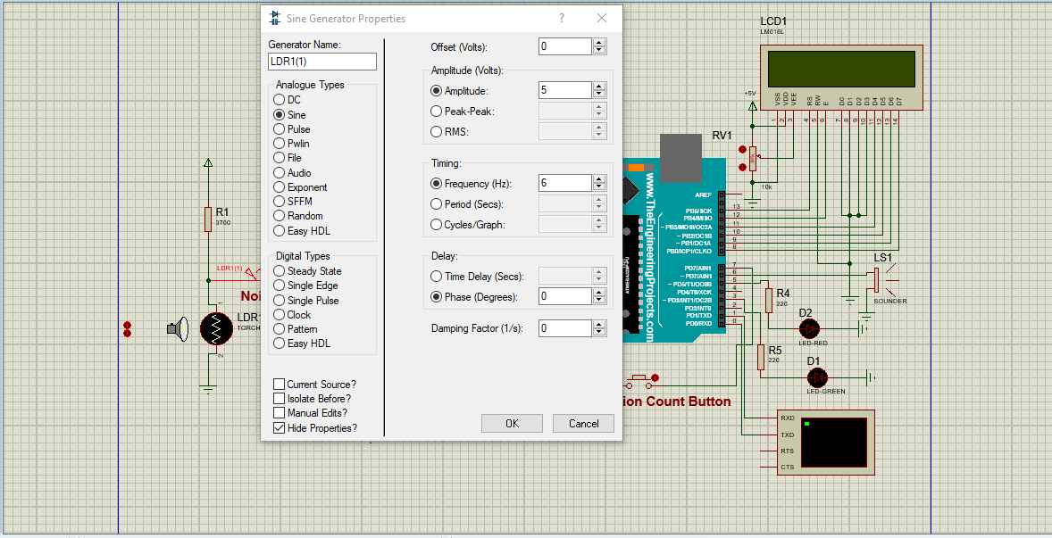
Frequency of 6Hz beyond the 3Hz cutoff frequency is added to the system to simulate noise.

Slide 31
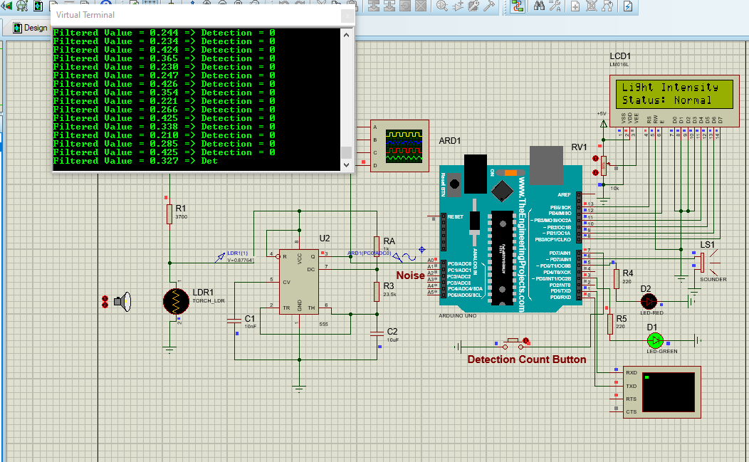
In Proteus, the 6 Hz noise is completely filtered, making the LDR appear unresponsive even when an intruder is present.

Slide 32
Conclusion and Future work
Successfully implemented an embedded security detection system.
Real-time processing using ADC, timers, and PWM.
Hysteresis logic prevents false alarms.
Power-efficient with sleep mode & watchdog timer.
Future Enhancements
  Wireless Connectivity: Wi-Fi/Bluetooth for remote monitoring.
  Machine Learning: Adaptive threshold detection.
  Mobile App: Real-time alerts via IoT integration.

Slide 33
REFERENCES
1. Putri, M., & Aryza, S. (2018). Design of security tools using sensor light dependent resistor (LDR) through mobile phone. International Journal for Innovative Research in Multidisciplinary Field, 4(10), 1681.
2. Dixit, J., Katiyar, D., & Goel, G. (2021). Automatic street light controller system using LDR and PIR sensor. International Journal of Creative Research Thoughts, 9(4), 9492.
3. Misra, D. S. (2021). Research on automatic light control system using LDR. International Journal of Creative Research Thoughts, 9(4), 1323.
4. Hossain, A. (2021). Automatic light detector using LDR in Proteus. The Engineering Projects.
5. Utsource Parts. (2020). Laser based security system with Arduino. Maker Pro.
6. Electronics Tutorials. (n.d.). Light sensor including photocell and LDR sensor.

Slide 34

Thank you

