Slide 1


DEVELOPMENT OF INTEGRATED WEARABLE DEVICE FOR REMOTE MONITORING OF PREGNANT WOMEN IN GHANA
Project Supervisor
Dr. Godfrey Mills
Co-Supervisor
Prof. Elsie Effah Kaufmann
Group Members
Owoh Einsteina Ofunne - 10943874
Anane George Nyarko – 10947340
Adika Nathaniel - 10957036
DATE: 13th December,2024
UNIVERSITY OF GHANA

Slide 2

COLLABORATORS
Nathaniel ^{[1]}
Richard Dei Asamoa ^{[2]}
^{[1]}IT Consortium
^{[2]} Korle-Bu Teaching Hospital

Slide 3
PRESENTATION OUTLINE
PROJECT BACKGROUND
PROBLEM STATEMENT
RELEVANCE OF WORK
EXISTING SOLUTIONS
OBJECTIVES
METHODOLOGY
SYSTEM REQUIREMENTS
RESOURCE REQUIREMENTS
ESTIMATED COST
PROJECT TIMELINES
CONCLUSION
REFERENCES

Slide 4
PROJECT BACKGROUND
Monitoring of pregnant women is an important issue in maternal care due to possibility of complications
Pregnant women are required to regularly visit a clinic for antenatal care.
Pregnant women are monitored for critical parameters like; body temperature, blood pressure, heart rate, blood glucose levels and oxygen saturation which help in assessing the health of both mother and baby.

Slide 5
PROJECT BACKGROUND
Neglecting monitoring can lead to cases such as; preeclampsia, anemia, low birth weight and developmental delays and ultimately lead to death.

Slide 6
PROJECT BACKGROUND
Body Temperature: Detects fever or infections that could harm both mother and fetus.
Blood Pressure: Monitors for hypertension disorders like preeclampsia to prevent complications.
Oxygen Saturation: Tracks oxygen levels to prevent anemia and maternal respiratory issues.
Heart Rate: Assesses cardiovascular health to ensure the heart is coping with pregnancy demands.
Blood Glucose Level: Identifies gestational diabetes to manage risks for mother and baby.

Slide 7
PROJECT BACKGROUND

Slide 8
PROBLEM STATEMENT
Reports ^{[2]} reveal that, in Ghana, 12% of female deaths (ages 15-49) in the previous 5 years stem from pregnancy complications, with 62% due to late or poor medical intervention.
Barriers of distance, transportation cost and time constraints hinder pregnant women from undergoing regular antenatal care, hence increasing maternal risks.
Late detection of pregnancy complications such as preeclampsia and anemia lowers chances of survival of pregnant women.

Slide 9
RELEVANCE OF WORK
Reduction of maternal mortality
Empowerment of pregnant women through technology
Enhanced healthcare accessibility

Slide 10
OBJECTIVES
To develop an integrated system consisting of a wearable device and a mobile application to continuously monitor, detect and trigger alerts in event of abnormality.
To train a machine learning model for risk prediction of pregnancy complications like preeclampsia and anemia long before standard detection window.
To develop a user-friendly interface to receive additional data from a pregnant woman.

Slide 11
EXISTING SOLUTIONS
1. A Comprehensive Framework for Wearable Module for Prenatal Health Monitoring and Risk Detection(2024) ^{[1]}
GOAL: A system to continuously monitor vitals of pregnant women throughout pregnancy and send SMS to healthcare providers in event of any anomaly.
TECHNIQUE: Body temperature, blood glucose, blood pressure, oxygen saturation, heart rate, fetal movement and falls of pregnant woman were monitored.
RESEARCH GAP: No mechanism for predictive analysis of patient's vitals to forewarn a risk of complication or possible illness of mother and no security measures for data protection

Slide 12
EXISTING SOLUTIONS
2. Wearable Technology Model to Control and Monitor Hypertension during Pregnancy(2018) ^{[3]}
GOAL: A wrist-worn wearable device monitors vitals of pregnant women and sends alert in event of high blood pressure to reduce prevalence of preeclampsia in Lima, Peru.
TECHNIQUE: Blood pressure , heart rate and patient steps are monitored, and weight, age and gestational age are manually inputted into the app by pregnant woman.
GAP: Few vitals were monitored hence risk-prediction was done for only one complication in pregnancy.

Slide 13
EXISTING SOLUTIONS
3.Explainable Early Prediction of Gestational Diabetes Biomarkers by Combining Medical Background and Wearable Devices: A Pilot Study With a Cohort Group in South Africa(2024) ^{[5]}
GOAL: A wrist-worn device that forecasts biomarkers 13 to 16 weeks prior to the Gestational Diabetes Mellitus(GDM) screening test done 24-28 weeks in pregnancy.
TECHNIQUE: Glucose monitoring devices, a wristband for activity detection, and medical background data were fed into a ML model to predict possible occurrence of GDM.
RESEARCH GAP: Limited scope to GDM.

Slide 14
EXISTING SOLUTIONS
4.Health Monitoring Of Expecting Mothers Using Multiple Sensor Approach: "Preg Care" (2020) ^{[6]}
GOAL: A hand/wrist-worn system comprising provides complete health monitoring during the pregnancy period.
TECHNIQUE: Body temperature, glucose rate detection, heart rate, sudden fall detection and anemia status(using python-based image processing) are monitored throughout gestational period. Alert systems are implemented.
RESEARCH GAP: No data security measures are implemented.

Slide 15
SYTEM ARCHITECTURE

Slide 16
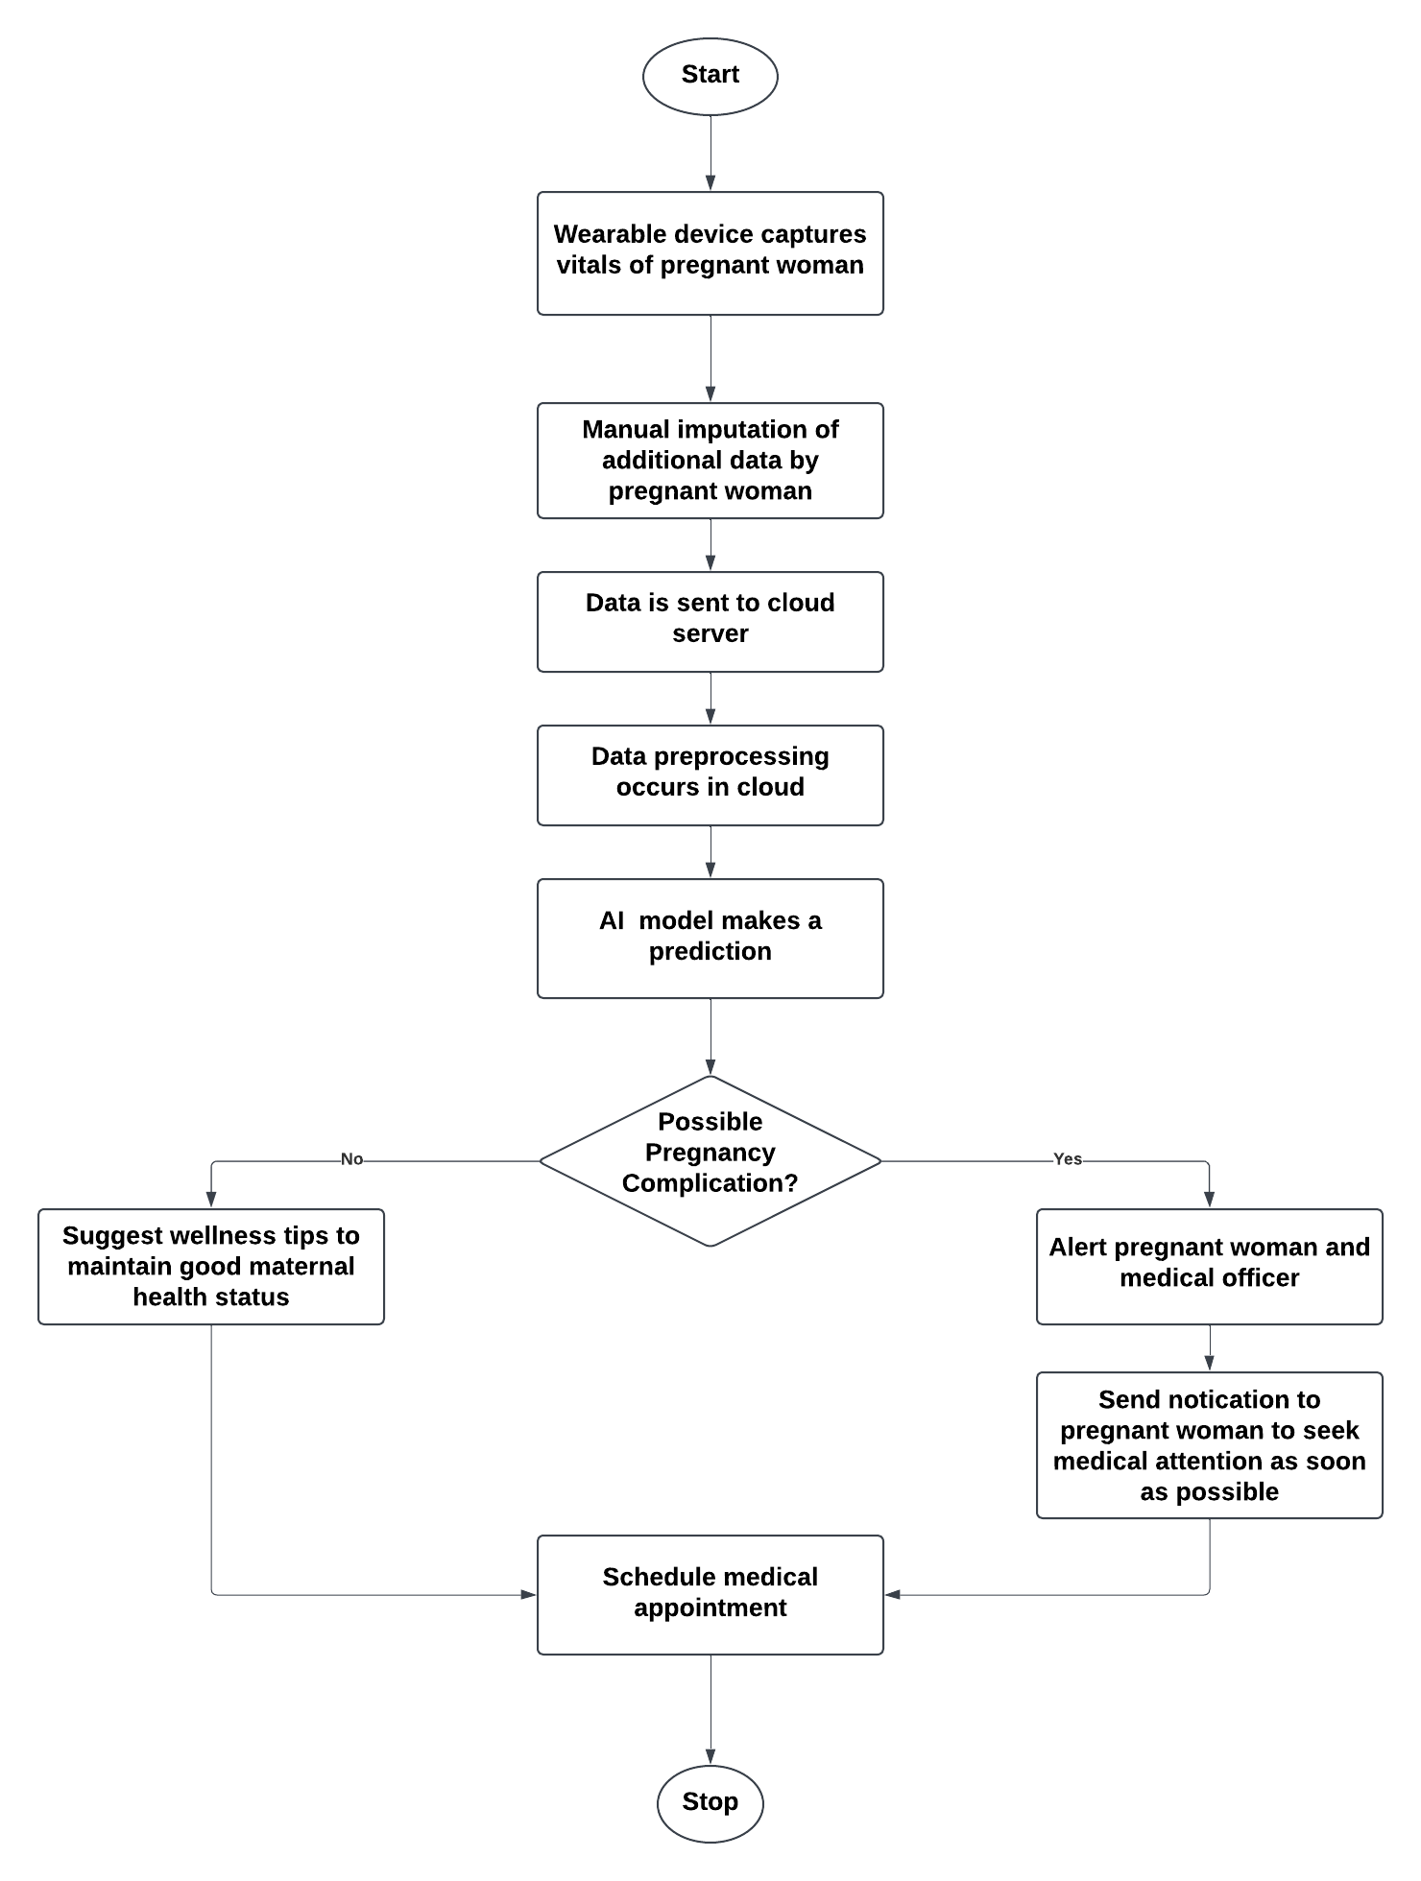
OPERATIONAL FLOW DIAGRAM

Slide 17
PROPOSED METHODOLOGY
Data of vitals measured are captured by the wrist-worn wearable device and additional data such as protein in urine are manually imputed into a mobile app and sent to the cloud.
Data Preprocessing and feature selection occurs in the cloud. These are fed into a machine learning model trained to predict pregnancy complications and alert a pregnant woman and doctor if anomaly is detected in vitals.
Mobile app provides a dashboard each for the pregnant woman and the doctor to visualize vitals and receive alerts in event of anomaly.

Slide 18
RESOURCE REQUIREMENTS
DS18B20 temperature sensor
MAX30100 sensor
Withings BPM Connect
GlucoWise
ESP32 microcontroller
AWS(Amazon Web Services) IoT Core

Slide 19
FUNCTIONAL REQUIREMENTS
Continuous tracking and recording of physiological biomarkers such as heart rate, blood pressure, blood glucose level, heart rate and oxygen saturation.
Real-Time Data Transmission to a mobile application
Display of monitored data, trend analysis and alerts for abnormal readings.
Prediction of possible pregnancy complications such as preeclampsia, anemia and GDM weeks ahead of standard detection window.
Patient-Doctor appointment Booking

Slide 20
NON-FUNCTIONAL REQUIREMENTS
Data Security and healthcare regulations compliance
User-friendly and intuitive mobile interface
Low latency between wearable device, cloud and mobile application
Cross-platform support on the mobile app
Scalability to accommodate a growing user base

Slide 21
CONCLUSION

Slide 22
REFERENCES
[1] T. Tabassum, S. Podder, and S. T. S. Rafid, "A Comprehensive Framework for Wearable Module for Prenatal Health Monitoring and Risk Detection," IEEE Int. Conf. Women Innov., Technol. Entrepreneurship (ICWITE), pp. 283-288, 2024.
[2] Y. K. Wiafe, A. Asamoah, P. Akweongo, and A. Kumah, "Factors Affecting Pregnancy Complications in Ghana," Global J. Quality Safety Healthcare, vol. 7, no. 4, pp. 156-161, 2024.
[3] B. D. B. Lopez, J. A. A. Aguirre, D. A. R. Coronado, and P. A. Gonzalez, "Wearable technology model to control and monitor hypertension during pregnancy," Proc. IEEE, Lima, Peru, 2017.

Slide 23
REFERENCES
[4] F. Sarhaddi, I. Azimi, S. Labbaf, H. Niela-Vilén, N. Dutt, A. Axelin, P. Liljeberg, and A. M. Rahmani, "Long-Term IoT-Based Maternal Monitoring: System Design and Evaluation," Sensors, vol. 21, no. 7, p. 2281,2021.
[5]A. F. Hernández-Castañeda, R. Pardo-Gómez, M. Sierra-Sosa, and A. García-Ramos, "Explainable Early Prediction of Gestational Diabetes Biomarkers by Combining Medical Background and Wearable Devices: A Pilot Study With a Cohort Group," Sensors, vol. 22, no. 15, p. 5793, 2022
[6] A. Kumar, D. Sharma, and V. Gupta, "Health Monitoring of Expecting Mothers using Multiple Sensor Approach: 'Preg Care'," in Proceedings of the 2nd International Conference on Advanced Information and Communication Technology (ICAICT), 2020, pp. 77-82

Slide 24
MISCELLANEOUS
QUESTIONS/FEEDBACK

