Slide 1


DEVELOPMENT OF INTEGRATED WEARABLE DEVICE FOR REMOTE MONITORING OF PREGNANT WOMEN IN GHANA
Project Supervisor
Dr. Godfrey Mills
Co-Supervisor
Prof. Elsie Effah Kaufmann
Group Members
Owoh Einsteina Ofunne - 10943874
Anane George Nyarko – 10947340
Adika Nathaniel - 10957036
DATE: 13th December,2024
UNIVERSITY OF GHANA

Slide 2

COLLABORATORS
Nathaniel ^{[1]}
Richard Dei Asamoa ^{[2]}
^{[1]}IT Consortium
^{[2]} Korle-Bu Teaching Hospital

Slide 3
PRESENTATION OUTLINE
PROJECT BACKGROUND
PROBLEM STATEMENT
RELEVANCE OF WORK
EXISTING SOLUTIONS
OBJECTIVES
METHODOLOGY
SYSTEM REQUIREMENTS
RESOURCE REQUIREMENTS
ESTIMATED COST
PROJECT TIMELINES
CONCLUSION
REFERENCES

Slide 4
PROJECT BACKGROUND
Pregnant women are monitored to detect and prevent maternal or fetal complications.
Monitoring of pregnant women is a critical thing that needs to be carefully handled, otherwise it will lead to loss of mother or baby.
They are typically monitored for vital signs like; body temperature, blood pressure, heart rate, blood glucose levels and oxygen saturation which help in assessing the health of both mother and baby.

Slide 5
PROJECT BACKGROUND
Body Temperature: Detects fever or infections that could harm both mother and fetus.
Blood Pressure: Monitors for hypertension disorders like preeclampsia to prevent complications.
Oxygen Saturation: Tracks oxygen levels to prevent anemia and maternal respiratory issues.
Heart Rate: Assesses cardiovascular health to ensure the heart is coping with pregnancy demands.
Blood Glucose Level: Identifies gestational diabetes to manage risks for mother and baby.

Slide 6
PROJECT BACKGROUND
Body Temperature: Detects fever or infections that could harm both mother and fetus.
Blood Pressure: Monitors for hypertension disorders like preeclampsia to prevent complications.
Oxygen Saturation: Tracks oxygen levels to prevent anemia and maternal respiratory issues.
Heart Rate: Assesses cardiovascular health to ensure the heart is coping with pregnancy demands.
Blood Glucose Level: Identifies gestational diabetes to manage risks for mother and baby.

Slide 7
PROJECT BACKGROUND

Slide 8
INTRODUCTION
Neglecting monitoring can lead to cases such as; preeclampsia, anemia, low birth weight and developmental delays and ultimately lead to death.
Traditionally, pregnant women are monitored through regular antenatal visits with modern methods now incorporating remote technologies like wearable devices for convenience and enhanced data accuracy.

Slide 9
PROBLEM STATEMENT
Reports ^{[2]} reveal that, in Ghana, 12% of female deaths (ages 15-49) in the previous 5 years stem from pregnancy complications, with 62% due to late or poor medical intervention.
Barriers of distance, transportation cost and time constraints hinder pregnant women from undergoing regular antenatal care, hence increasing maternal risks.
Late detection of pregnancy complications such as preeclampsia and anemia lowers chances of survival of pregnant women.

Slide 10
RELEVANCE OF WORK

Slide 11
OBJECTIVES
To develop an integrated system consisting of a wearable device and a mobile application to continuously monitor, detect and trigger alerts in event of abnormality.
To train a machine learning model for risk prediction of pregnancy complications like preeclampsia and anemia long before standard detection window.

Slide 12
EXISTING WORKS
TITLE : A Comprehensive Framework for Wearable Module for Prenatal Health Monitoring and Risk Detection(2024) ^{[1]}
GOAL : A system to continuously monitor health of pregnant women throughout pregnancy and send SMS to healthcare providers in event of any anomaly in vitals measured or a fall.

Slide 13
EXISTING WORKS
METHODOLOGY :
The system monitors temperature (DS18B20 sensor on the underarm), heart rate, and oxygen saturation (MAX30100 sensor on the fingers), blood glucose (NIR 940nm LED and photodetector on the fingers), and blood pressure (wrist-mounted device with EEPROM3). Fall detection (MPU6050) and fetal kick monitoring (ADXL335) are achieved using waist-mounted sensors.
The ESP-32s microcontroller collects data from all sensors and transmits it to the cloud via Wi-Fi every 30 seconds for continuous monitoring.

Slide 14
EXISTING WORKS
A database-backed mobile and web app is used to store, display, and analyze historical data, enabling doctors to monitor patient trends effectively.

Slide 15
EXISTING WORKS
RESULTS :
System tested by 4 volunteers:
Commercially available devices (thermometer, pulse oximeter, blood pressure machine, blood glucose monitor) were used as reference standards.
Fall Detection was detected based on abrupt changes in acceleration values.
Fetal Movement was monitored via noticeable shifts in sensor readings.

Slide 16
EXISTING WORKS
Accuracy of Measured Vitals:
Temperature: MSE of 0.0035.
Oxygen Saturation & Heart Rate: MSE of 1.1 and 2.45, respectively.
Blood Pressure: MAPE of 4.54% (systolic) and 5.43% (diastolic).
Blood Glucose Level: MAPE of 4.77%

Slide 17
EXISTING WORKS
STRENGTHS: The values obtained from the wearable device compared to commercial devices goes to show the high level of accuracy of the system.
GAP : No mechanism for predictive analysis of patient's vitals to forewarn a risk of complication or possible illness of mother.

Slide 18
EXISTING WORKS
TITLE : Wearable Technology Model to Control and Monitor Hypertension during Pregnancy(2024) ^{[3]}
GOAL: A system to control and monitor Preeclampsia where a wearable captures blood pressure, heart rate and patient steps and an alert is sent to both health care providers and patient in event of high blood pressure.

Slide 19
EXISTING WORKS
METHODOLOGY :
The "V07" wearable, compatible with Android and iOS, connects to a smartphone via Bluetooth to transfer data (blood pressure, heart rate, and patient steps) to a mobile app. Data is cleared from the wearable's memory once transferred. If the phone is disconnected, data is stored temporarily on the wearable until the connection is restored.
Data is uploaded to the SAP HANA cloud platform every 30 minutes, enabling both the doctor and the expectant mother to access health information through the mobile app.

Slide 20
EXISTING WORKS
The app provides real-time health monitoring, medicine reminders, and treatment updates. Alerts with location details (via Google Maps) are sent to health organizations and patients during incidents of high blood pressure

Slide 21
EXISTING WORKS
RESULTS :
The system, validated at EsSalud in Lima, monitored 20 pregnant women (3–9 months gestation) during October–December 2017. It identified 70% with abnormal health parameters, highlighting critical alerts for high blood pressure and heart rate, particularly around the 30th week of pregnancy.
The system increased controlled cases by 11% and reduced maternal mortality by 7%, enabling timely treatment and care for high-risk patients.

Slide 22
EXISTING WORKS
STRENGTHS: There is analysis of data collected to help deploy new strategies to monitor and treat patients effectively.
GAP : Data Security measures are not implemented.

Slide 23
EXISTING WORKS
TITLE :Health Monitoring Of Expecting Mothers Using Multiple Sensor Approach: "Preg Care" (2020) ^{[6]}
GOAL : A system comprising numerous sensors to provide complete health monitoring during the pregnancy period.

Slide 24
EXISTING WORKS
METHODOLOGY :
Device monitors heart rate, body temperature, blood glucose, oxygen saturation, anemia status, and detects sudden falls using sensors like MAX30100, MLX90614, NIR LED-Photodetector, and ADXL345.
Data is processed by an Arduino microcontroller and transmitted via WIFI, GSM, and Wemos D1 Mini to a ThingSpeak cloud server
Health data is accessible through SMS and the mobile app "Preg-Care", enabling real-time decision-making by doctors and relatives.

Slide 25
EXISTING WORKS
Python-based image processing algorithm analyzes eye pallor images to detect anemia.
Dataset: 109 images (81 for training, 28 for testing).
Models tested: Decision Tree, Random Forest, SVM, Logistic Regression, Naïve Bayes, and KNN using Orange data mining software.
Heltec ESP32 OLED and GSM modules upload vital stats to the cloud, ensuring remote monitoring and emergency notifications.

Slide 26
EXISTING WORKS
RESULTS :
Decision Tree achieved the highest accuracy (0.821) with an AUC of 0.824.
Logistic Regression delivered the highest AUC (0.872), despite lower accuracy (0.714).
Random Forest and SVM showed competitive AUC values (0.853 and 0.840) but fell short in accuracy compared to the Decision Tree.
Naïve Bayes and KNN exhibited the lowest overall performance in both metrics
Decision Tree was chosen for the classification.

Slide 27
EXISTING WORKS
STRENGTHS:
Application of image processing and machine learning to predict anemic status of patient.
Highly applicable to rural-settings

Slide 28
EXISTING WORKS
GAPS :
Manual Imputation of Blood Pressure value into the app.
ThingSpeak Server provides less data security.
Accuracy of components was not checked for as no gold standard measurement were done.
No predictive mechanism to forewarn of potential health issues of pregnant woman.

Slide 29
EXISTING WORKS
TITLE :Explainable Early Prediction of Gestational Diabetes Biomarkers by Combining Medical Background and Wearable Devices: A Pilot Study With a Cohort Group in South Africa(2024) ^{[5]}
GOAL : A system that forecasts biomarkers such as LDL, HDL, triglycerides, cholesterol, HbA1c(biomarker values)13 to 16 weeks prior to the Gestational Diabetes Mellitus(GDM) screening test.

Slide 30
EXISTING WORKS
METHODOLOGY :
Pregnant women (12–14 weeks) with high GDM risk factors were recruited from Chris Hani Baragwanath Teaching Hospital. Data included continuous glucose monitoring (Freestyle Libre 2), physical activity (Empatica E4), medical history, BMI, and biomarkers. Controlled activity recordings and surveys were conducted using validated tools.
Continuous glucose readings (15-minute intervals) and activity data (64 Hz sampling) were collected over 14–28 days. Feature extraction and aggregation were applied, focusing on daily activities. Coupled-Matrix and Tensor Factorisation-Alternating Least Squares were used for data fusion

Slide 31
EXISTING WORKS
Decision Tree and Random Forest regression models were trained on baseline data (weeks 12–14) to estimate biomarker values at weeks 25–28, aiding in early GDM risk prediction

Slide 32
EXISTING WORKS
RESULTS :
Prediction Performance for HbA1c and OGTT Biomarkers:
Decision Tree (DT) for HbA1c: 0.34 (±0.06) MSE, 0.44 (±0.04) MAE.
Random Forest (RF) for HbA1c: 0.36 (±0.09) MSE, 0.43 (±0.04) MAE
CMTF-ALS for OGTT: 0.36 (±0.22) MSE, 0.43 (±0.12) MAE
Biomarker Analysis Results:
LDL: 0.29 MSE, 0.43 MAE
HDL: 0.32 MSE, 0.41 MAE.

Slide 33
EXISTING WORKS
HDL: 0.32 MSE, 0.41 MAE.
Triglycerides: 0.34 MSE, 0.43 MAE
Cholesterol: 0.33 MSE, 0.44 MAE
Glucose and HbA1c Predictions:
1-hour Post-Load Glucose: 0.95 MSE, 0.70 MAE
2-hour Post-Load Glucose: 1.08 MSE, 0.72 MAE.
Fasting Glucose: 2.44 (±4.28) MSE, 0.91 (±0.86) MAE.
HbA1c: 0.42 MSE, 0.45 MAE.

Slide 34
EXISTING WORKS
STRENGTHS: This is the first GDM study attempting to forecast biomarker values associated with the presence of GDM 13 to 16 weeks prior to the GDM screening test.
GAP : No mechanism for analytics of captured data

Slide 35
PROPOSED SOLUTION
METHODOLOGY :
Physiological biomarkers are continuously monitored using a wearable device placed on the wrist of the pregnant woman.
The vitals to be measured include:
Blood Glucose Level
Blood Pressure
Body Temperature
Heart Rate

Slide 36
PROPOSED SOLUTION
Oxygen Saturation
The captured data is sent to a cloud server every 3 minutes.
The wearable device is administered from a hospital at onset of pregnancy such that the pregnant woman can be monitored even at home.
If anomaly is detected in recorded biomarkers, an AI model predicts possible pregnancy complications such as preeclampsia, anemia in pregnancy and gestational diabetes.
This prediction is done weeks ahead of the standard detection window.

Slide 37
PROPOSED METHODOLOGY
Data of vitals measured are captured by the wrist-worn wearable device and additional data such as protein in urine are manually imputed into a mobile app and sent to the cloud.
Data Preprocessing and feature selection occurs in the cloud. These are fed into a machine learning model trained to predict pregnancy complications and alert a pregnant woman and doctor if anomaly is detected in vitals.
Mobile app provides a dashboard each for the pregnant woman and the doctor to visualize vitals and receive alerts in event of anomaly.

Slide 38
PROPOSED SOLUTION
Data details are sent to the medical officer and the pregnant woman immediately.
A notification is sent to smartphone of pregnant woman to seek medical attention as soon as possible to initiate treatment.
Either the doctor or pregnant woman can schedule a medical appointment.
If no anomalies in vitals are identified, wellness tips are sent to the pregnant woman to maintain her good health status.
The mobile app performs data analytics to identify trends and draw insights from captured physiological data.
The data analyzed are displayed to the pregnant woman and the medical officer.

Slide 39
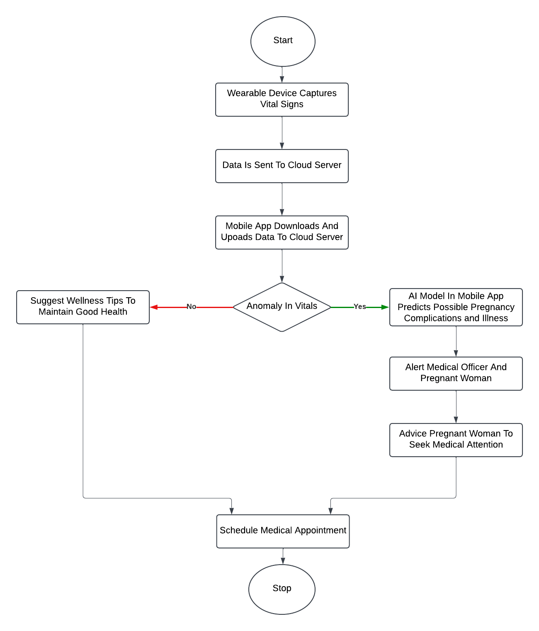
PROPOSED SOLUTION
FLOW DIAGRAM OF SYSTEM:

Slide 40
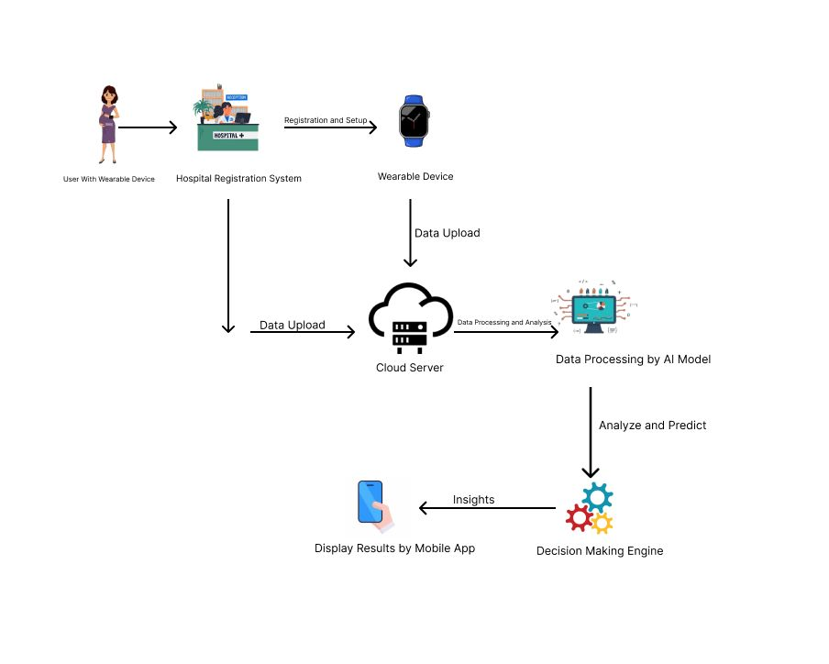
PROPOSED SOLUTION

Slide 41
FUNCTIONAL REQUIREMENTS
Continuous tracking and recording of physiological biomarkers such as heart rate, blood pressure, blood glucose level, heart rate and oxygen saturation.
Real-Time Data Transmission to a mobile application
Display of monitored data, trend analysis and alerts for abnormal readings.
Prediction of possible pregnancy complications such as preeclampsia, anemia and GDM weeks ahead of standard detection window.
Patient-Doctor appointment Booking

Slide 42
NON-FUNCTIONAL REQUIREMENTS
Data Security and healthcare regulations compliance
User-friendly and intuitive mobile interface
Low latency between wearable device, cloud and mobile application
Cross-platform support on the mobile app
Scalability to accommodate a growing user base

Slide 43
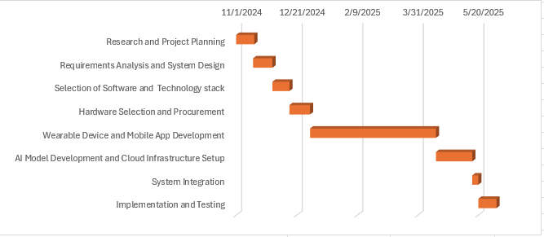
PROJECT TIMELINE

Slide 44
CONCLUSION

Slide 45
REFERENCES
[1] T. Tabassum, S. Podder, and S. T. S. Rafid, "A Comprehensive Framework for Wearable Module for Prenatal Health Monitoring and Risk Detection," IEEE Int. Conf. Women Innov., Technol. Entrepreneurship (ICWITE), pp. 283-288, 2024.
[2] Y. K. Wiafe, A. Asamoah, P. Akweongo, and A. Kumah, "Factors Affecting Pregnancy Complications in Ghana," Global J. Quality Safety Healthcare, vol. 7, no. 4, pp. 156-161, 2024.
[3] B. D. B. Lopez, J. A. A. Aguirre, D. A. R. Coronado, and P. A. Gonzalez, "Wearable technology model to control and monitor hypertension during pregnancy," Proc. IEEE, Lima, Peru, 2017.

Slide 46
REFERENCES
[4] F. Sarhaddi, I. Azimi, S. Labbaf, H. Niela-Vilén, N. Dutt, A. Axelin, P. Liljeberg, and A. M. Rahmani, "Long-Term IoT-Based Maternal Monitoring: System Design and Evaluation," Sensors, vol. 21, no. 7, p. 2281,2021.
[5]A. F. Hernández-Castañeda, R. Pardo-Gómez, M. Sierra-Sosa, and A. García-Ramos, "Explainable Early Prediction of Gestational Diabetes Biomarkers by Combining Medical Background and Wearable Devices: A Pilot Study With a Cohort Group," Sensors, vol. 22, no. 15, p. 5793, 2022
[6] A. Kumar, D. Sharma, and V. Gupta, "Health Monitoring of Expecting Mothers using Multiple Sensor Approach: 'Preg Care'," in Proceedings of the 2nd International Conference on Advanced Information and Communication Technology (ICAICT), 2020, pp. 77-82

Slide 47
MISCELLANEOUS
QUESTIONS/FEEDBACK

