Slide 1
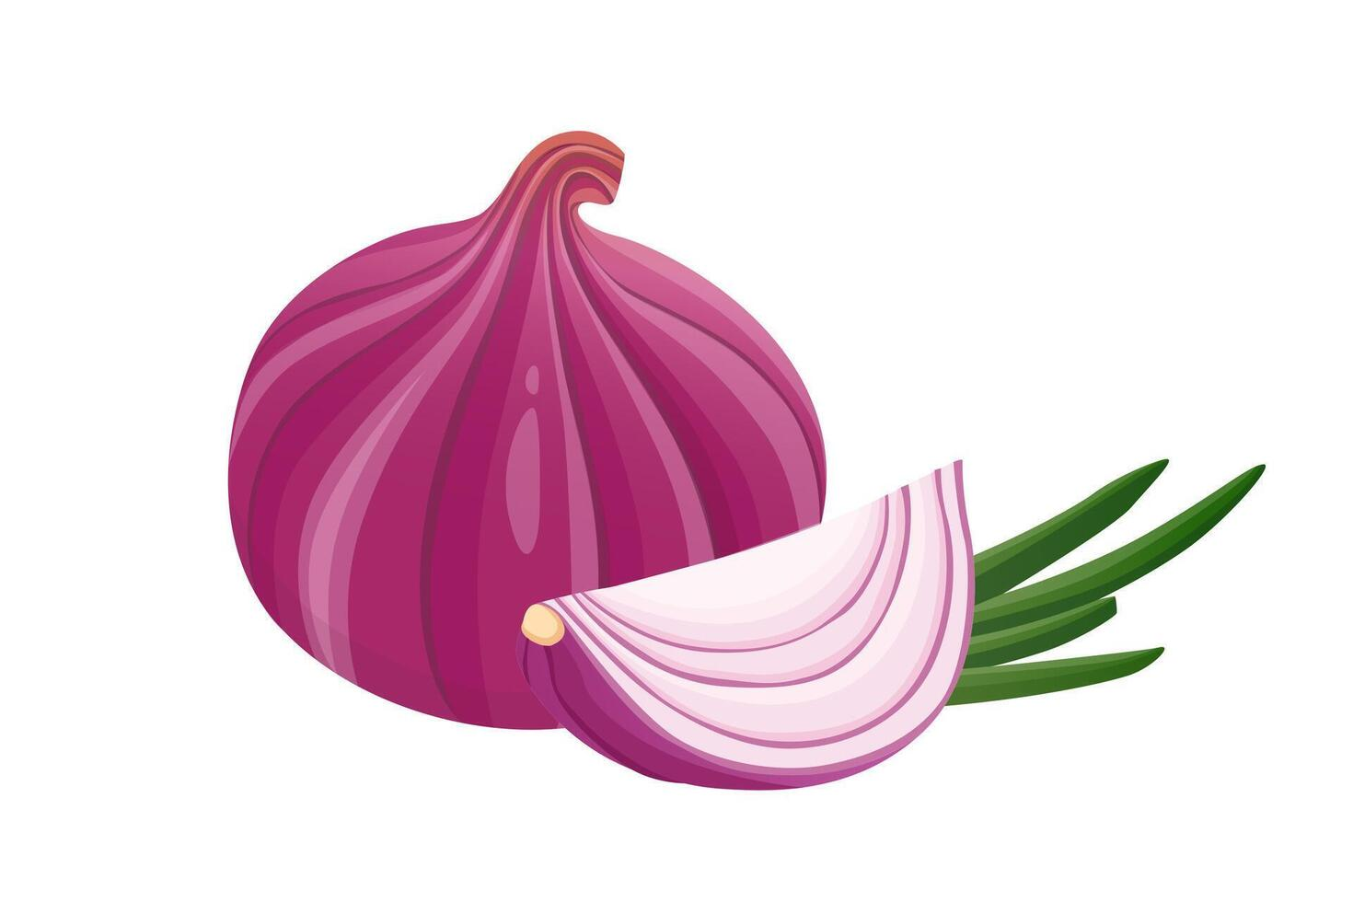
OnionGuard
AI-Powered Onion Disease Detection for Farmers
Management Presentation
Nkabom Honours Team | University of Ghana | 2026
Currently in Closed Testing on Google Play Store

Slide 2
The Problem
Why OnionGuard is needed
Key Challenges
50%
No ML models exist for the TOM2024 onion disease dataset
Limited access to agricultural extension officers in rural areas
Language barriers prevent farmers from accessing disease info
No affordable diagnostic tools for smallholder farmers
No centralized system for tracking regional disease outbreaks
Crop losses in West Africa due to pests & diseases
ZERO
Pre-existing ML models for onion disease classification
Source: Appiah et al., 2025 (Data in Brief, Elsevier)

Slide 3
Our Solution
OnionGuard mobile application
Disease Detection
Freshness Check
Treatment Guides
Analytics
On-device AI classifies 6 onion conditions from camera photos. Works offline.
Gemini Vision AI evaluates onion freshness with storage recommendations.
Detailed treatment in 5 languages with voice playback for low-literacy farmers.
Personal & regional disease tracking dashboards for farmers and officers.
Security: JWT Auth + Bcrypt + Biometric Login + HTTPS (TLS 1.2/1.3) + Let's Encrypt SSL

Slide 4
Machine Learning Model
MobileNetV3-Large trained on TOM2024 dataset
Model Architecture
TOM2024 Dataset (Onion Subset)
Base: MobileNetV3-Large (ImageNet pretrained)
Input: 224 x 224 x 3 RGB images
Output: 6 disease classes with confidence scores
Training: 3-stage progressive fine-tuning
Quantization: Float16 for mobile deployment
Size: 5.72 MB (TFLite)
Class | Type | Images
Caterpillar | Pest | 879
Fusarium | Disease | 738
Healthy | Healthy | 679
Alternaria | Disease | 515
Virosis | Disease | 203
Bulb Blight | Disease | 30
3-Stage Progressive Fine-Tuning
Phase 1: Classifier head only (20 epochs, lr=1e-3)
Phase 2: Unfreeze 30% backbone (25 epochs, lr=1e-4)
Phase 3: Full fine-tuning (15 epochs, lr=1e-5)

Slide 5
Model Performance
Evaluation on held-out test set (304 images)
Classification Report
93.75%
Class | Precision | Recall | F1-Score | Accuracy
Alternaria | 0.766 | 0.878 | 0.818 | 87.80%
Bulb Blight | 1.000 | 1.000 | 1.000 | 100.00%
Caterpillar | 1.000 | 0.987 | 0.994 | 98.73%
Fusarium | 0.958 | 0.840 | 0.895 | 83.95%
Healthy | 0.945 | 1.000 | 0.972 | 100.00%
Virosis | 0.970 | 1.000 | 0.985 | 100.00%
Macro Avg | 0.940 | 0.951 | 0.944
Overall Test Accuracy
TFLite: 93.75% | Size: 5.72 MB
Key Insights
Caterpillar, Healthy, Virosis & Bulb Blight achieve 98-100% accuracy
Fusarium (83.95%) shows lowest accuracy due to visual similarity with Alternaria
Class weights handle imbalance effectively (879 Caterpillar vs 30 Bulb Blight)
TFLite quantization maintains full accuracy with 5.72 MB model size

Slide 6
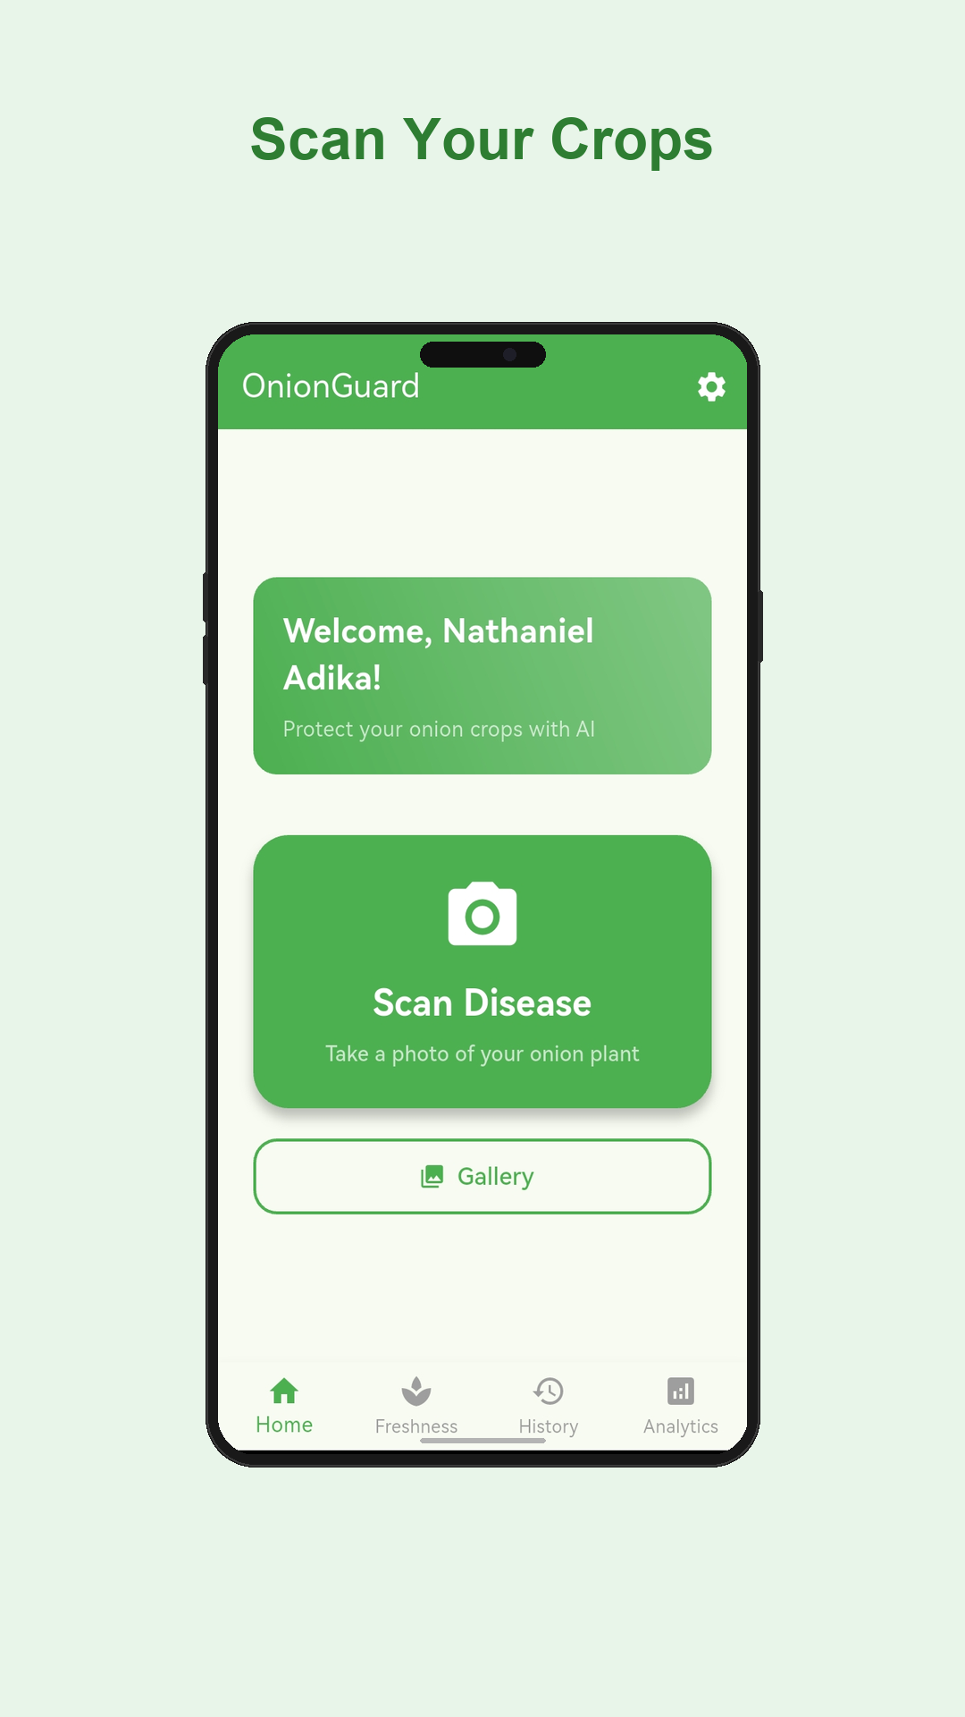
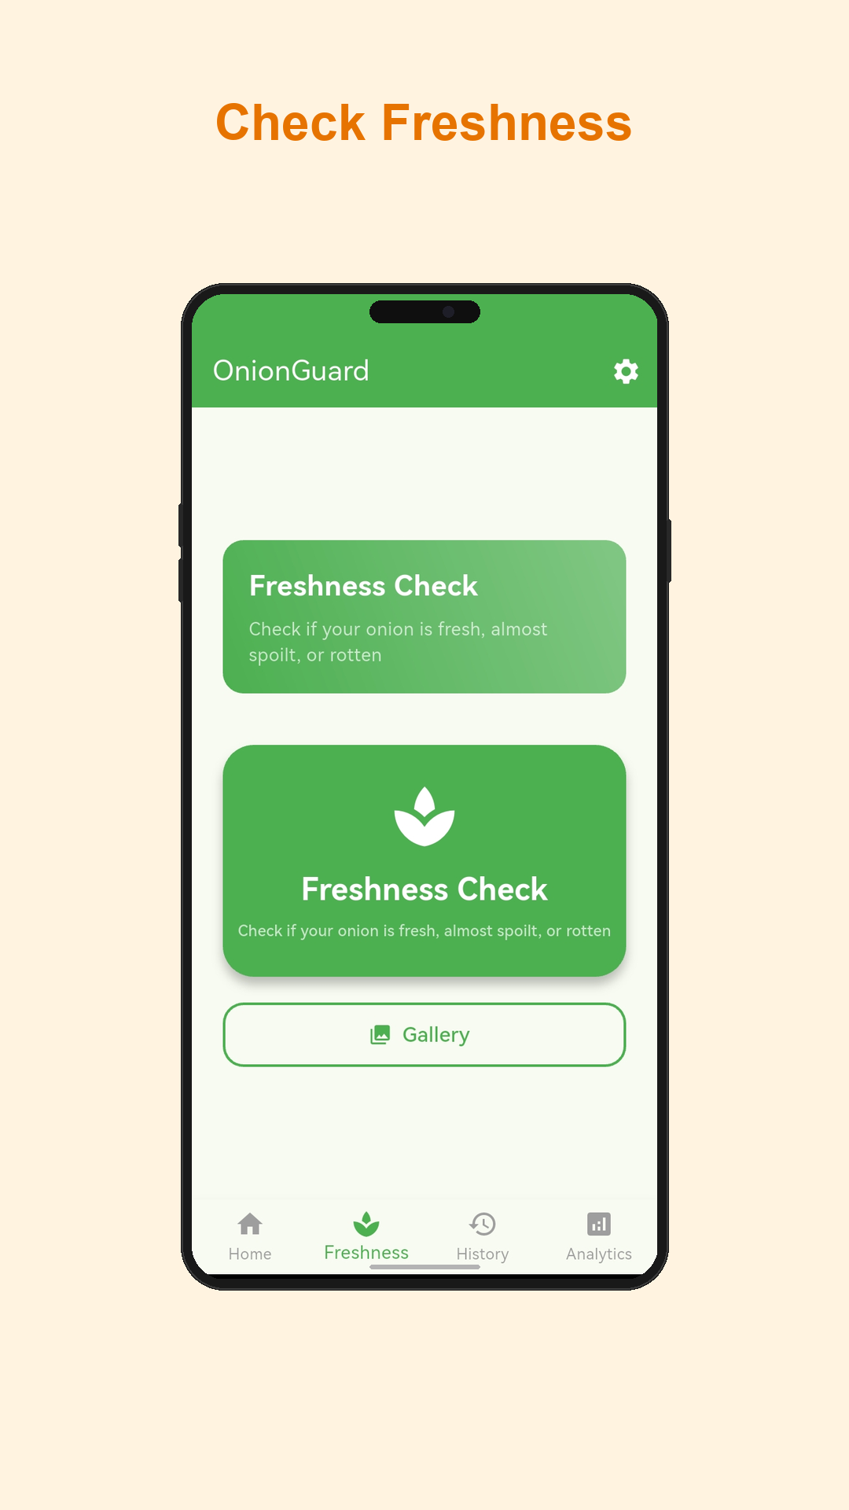
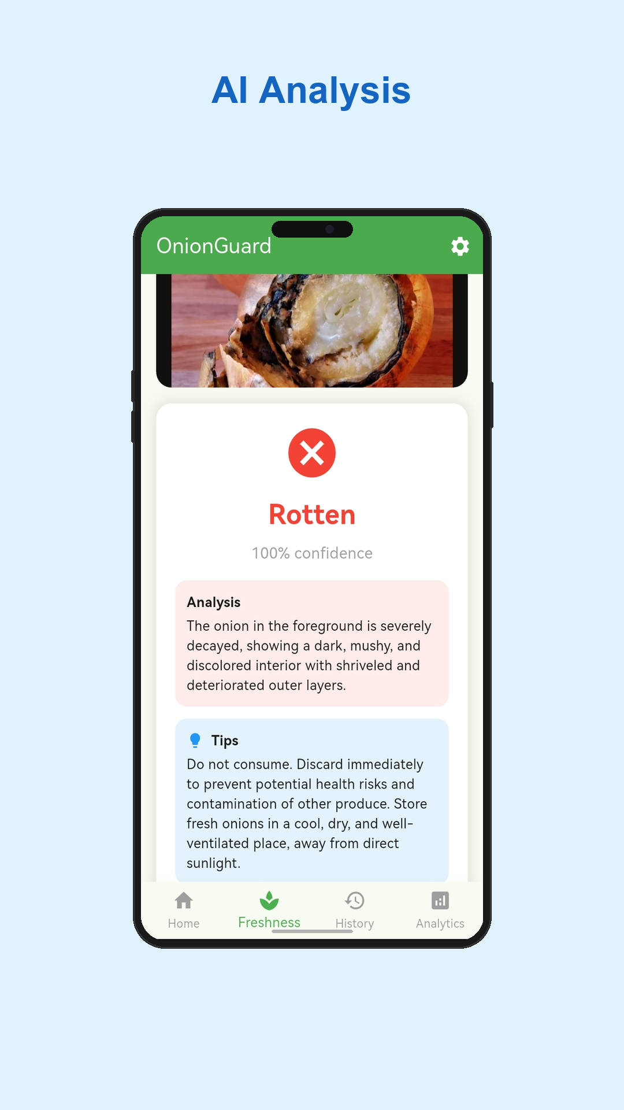
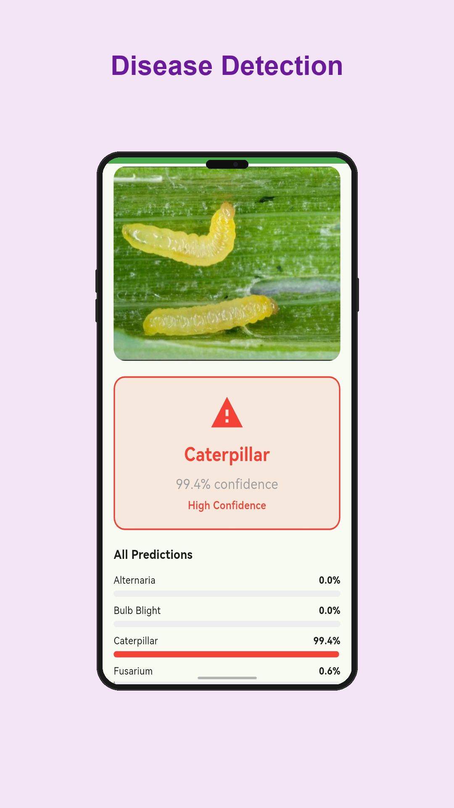
Mobile Application
Home | Freshness | AI Analysis | Disease Detection
Home Screen
Freshness Check
AI Analysis
Disease Detection

Slide 7
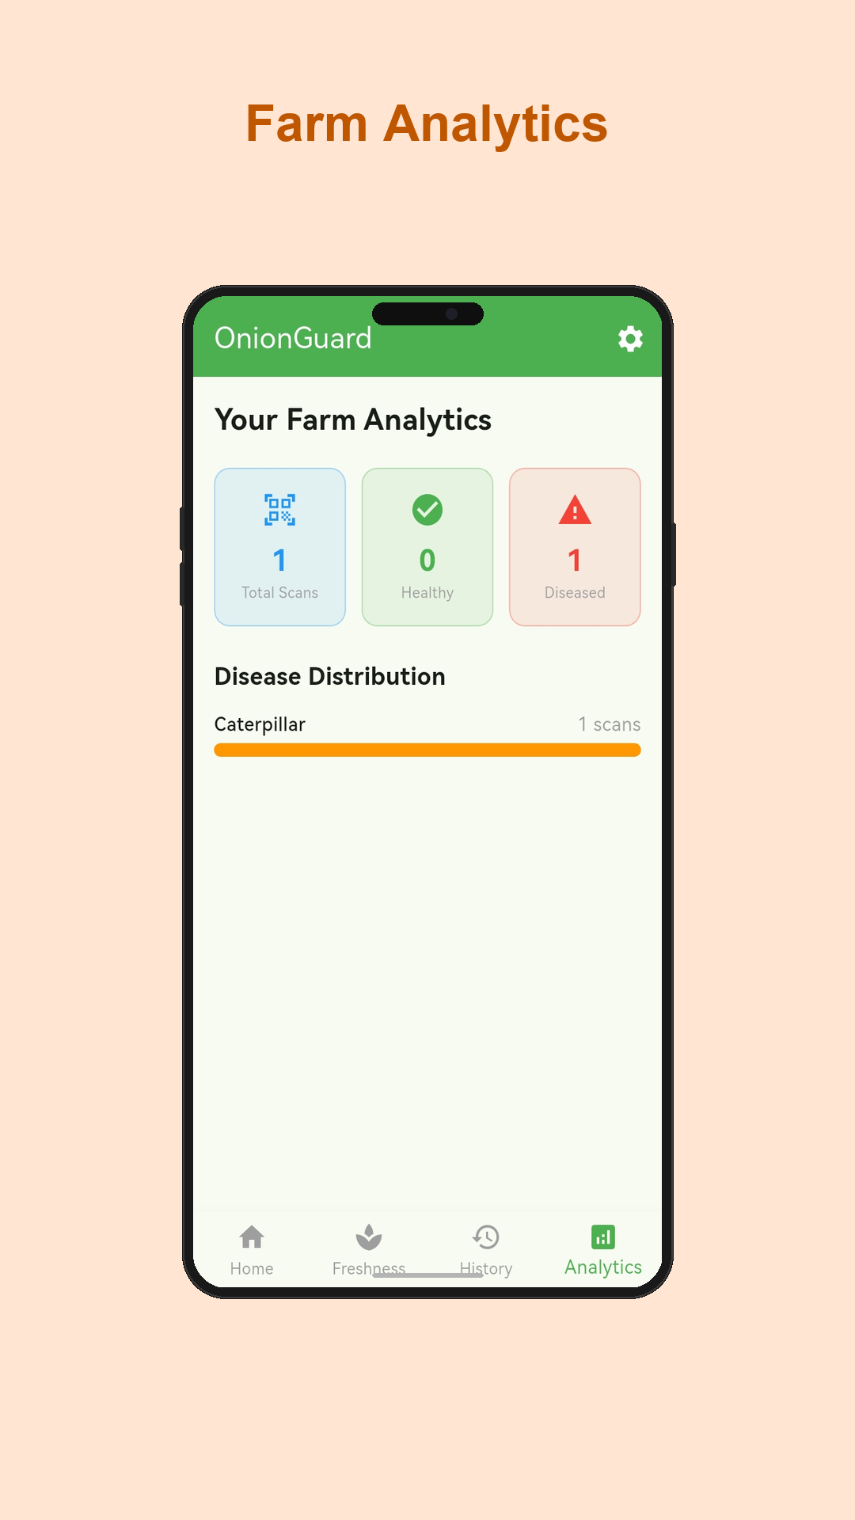
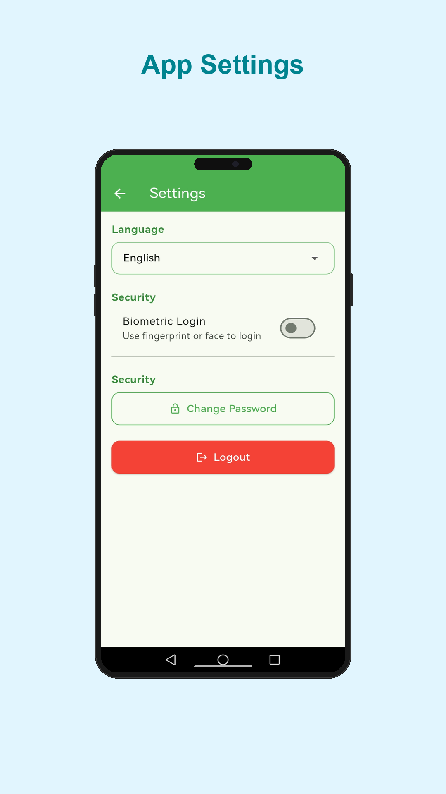
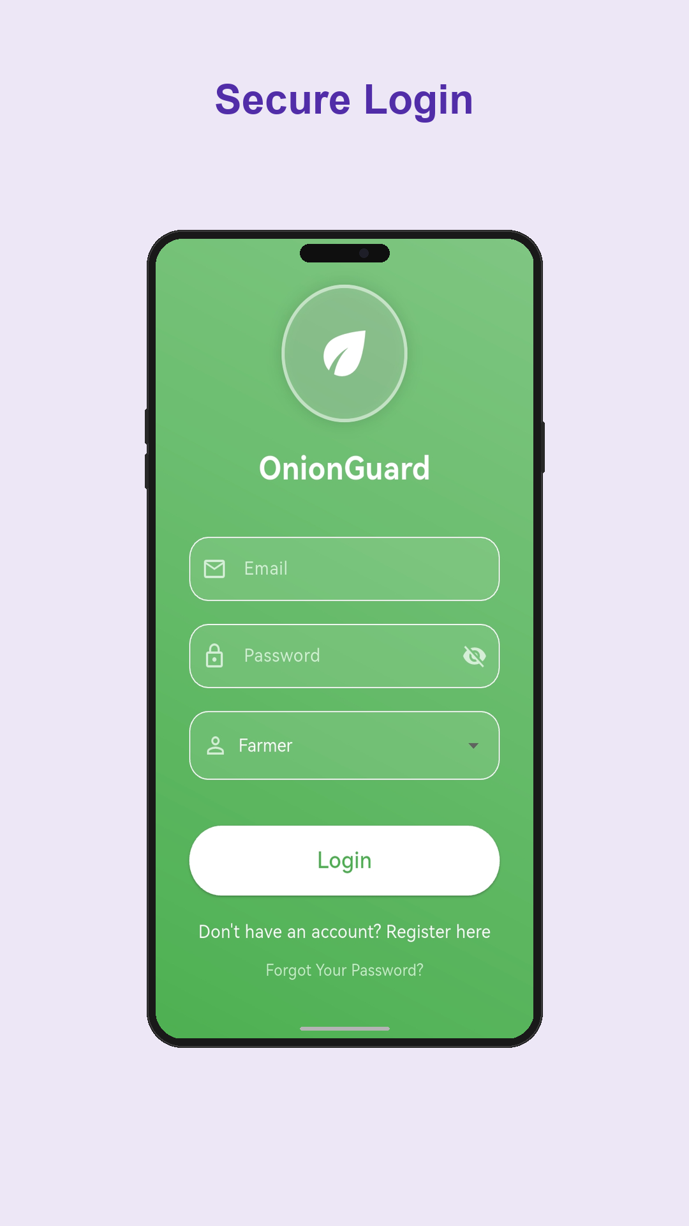
Mobile Application
Analytics | Settings | Login
Farm Analytics
Settings
Secure Login

Slide 8
System Architecture
Microservices deployed on AWS EC2
Flutter App
Nginx + SSL
API Gateway :8000
Auth :8001
Diagnosis :8002
Treatment :8003
Analytics :8004
MongoDB Atlas (Cloud Database)

Slide 9
Deployment & Security
AWS EC2 + Docker + HTTPS
Infrastructure
HTTPS & Security
AWS EC2 instance hosting all services
Docker + Docker Compose orchestration
7 containers: Nginx, Certbot, Gateway, Auth, Diagnosis, Treatment, Analytics
Backend ports internal only (not exposed)
Nginx handles ports 80 & 443
Auto-restart policies for reliability
DuckDNS: onion-guard.duckdns.org domain
Let's Encrypt SSL (auto-renewed every 12h)
TLS 1.2/1.3 with strong cipher suites
HTTP auto-redirects to HTTPS
JWT + Bcrypt authentication
Biometric login (fingerprint/face)
Cleartext traffic blocked in Android manifest

Slide 10
User Roles
Three distinct roles with tailored dashboards
Farmer
Extension Officer
Admin
The primary user
Monitors communities
Platform management
Scan crops for diseases (camera/gallery)
Check onion freshness with AI
View personal scan history
Track farm analytics & trends
Same scanning capabilities
View ALL farmer scans platform-wide
Regional disease statistics
Identify outbreak patterns
User management (activate/deactivate)
Filter users by type
Platform-wide analytics
System health monitoring

Slide 11
Multi-Language & Voice Support
Accessible to low-literacy farmers
5 Supported Languages
Voice & Accessibility
Language | Region
English | Default
Twi | Ashanti Region
Dagbani | Northern Ghana
Ewe | Volta Region
Hausa | West Africa
240+ translated UI strings across all languages
Google TTS voice playback for treatment guides
Audio treatment instructions in all 5 languages
Language preference persists per user
Designed for farmers with limited literacy
OpenRouter LLM for dynamic content translation

Slide 12
Technology Stack
Full-stack modern architecture
Frontend
Flutter / Dart
Charts
fl_chart
Backend
FastAPI / Python 3.11
Auth
JWT + Bcrypt
Database
MongoDB Atlas
Biometrics
local_auth
ML Model
TensorFlow Lite
Containers
Docker + Compose
Vision AI
Google Gemini 2.5 Flash
Proxy
Nginx
Voice
Google TTS (gTTS)
SSL
Let's Encrypt + Certbot
State Mgmt
Provider
DNS
DuckDNS

Slide 13
Features Discussed
Future development and improvements
Fingerprint Auth
Simplify Admin UI
Biometric login using fingerprint and face recognition
Remove/restructure admin role from the main app flow
LLM Disease Analysis
Enhanced Analytics
AI-generated contextual advice when a disease is detected
Richer charts, trends over time, comparative & actionable data
Farmers to Customers
Voice for All Text
Marketplace connecting farmers directly to buyers
Read all app content in local languages for accessibility
Freshness to Customer
Needed
Share freshness results as proof of quality for buyers
API keys for additional services Apple Developer account for iOS deployment

Slide 14
Google Play Store Status
Currently in closed testing
Closed Testing
App bundle uploaded and under review
Minimum 12 testers required to opt-in
14-day closed testing period before production access
Production release pending successful testing phase

Slide 15
Thank You
Nkabom Honours Team
University of Ghana | 2026
OnionGuard | AI-Powered Onion Disease Detection https://onion-guard.duckdns.org

