Slide 1
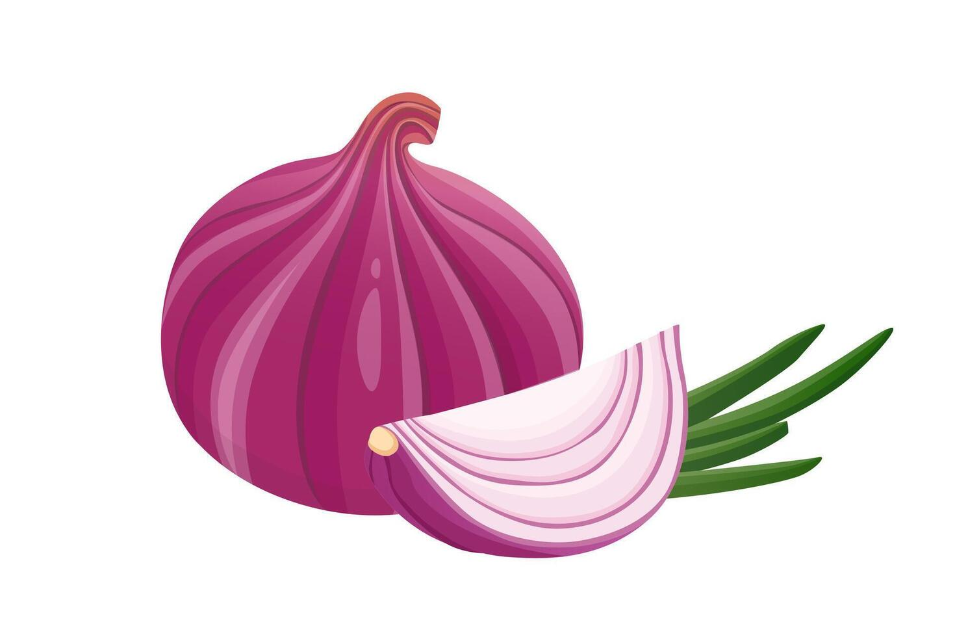
OnionGuard
AI-Powered Onion Disease Detection for Farmers
Nkabom Honours Team | University of Ghana | 2026
Currently Live on Google Play Store

Slide 2
The Problem
Why OnionGuard is needed
Key Challenges
50%
No ML models exist for the TOM2024 onion disease dataset
Limited access to agricultural extension officers in rural areas
Language barriers prevent farmers from accessing disease information
No affordable diagnostic tools for smallholder farmers
No centralized system for tracking regional disease outbreaks
Crop losses in West Africa due to pests & diseases
ZERO
Pre-existing ML models for onion disease classification
Source: Appiah et al., 2025 (Data in Brief, Elsevier)

Slide 3
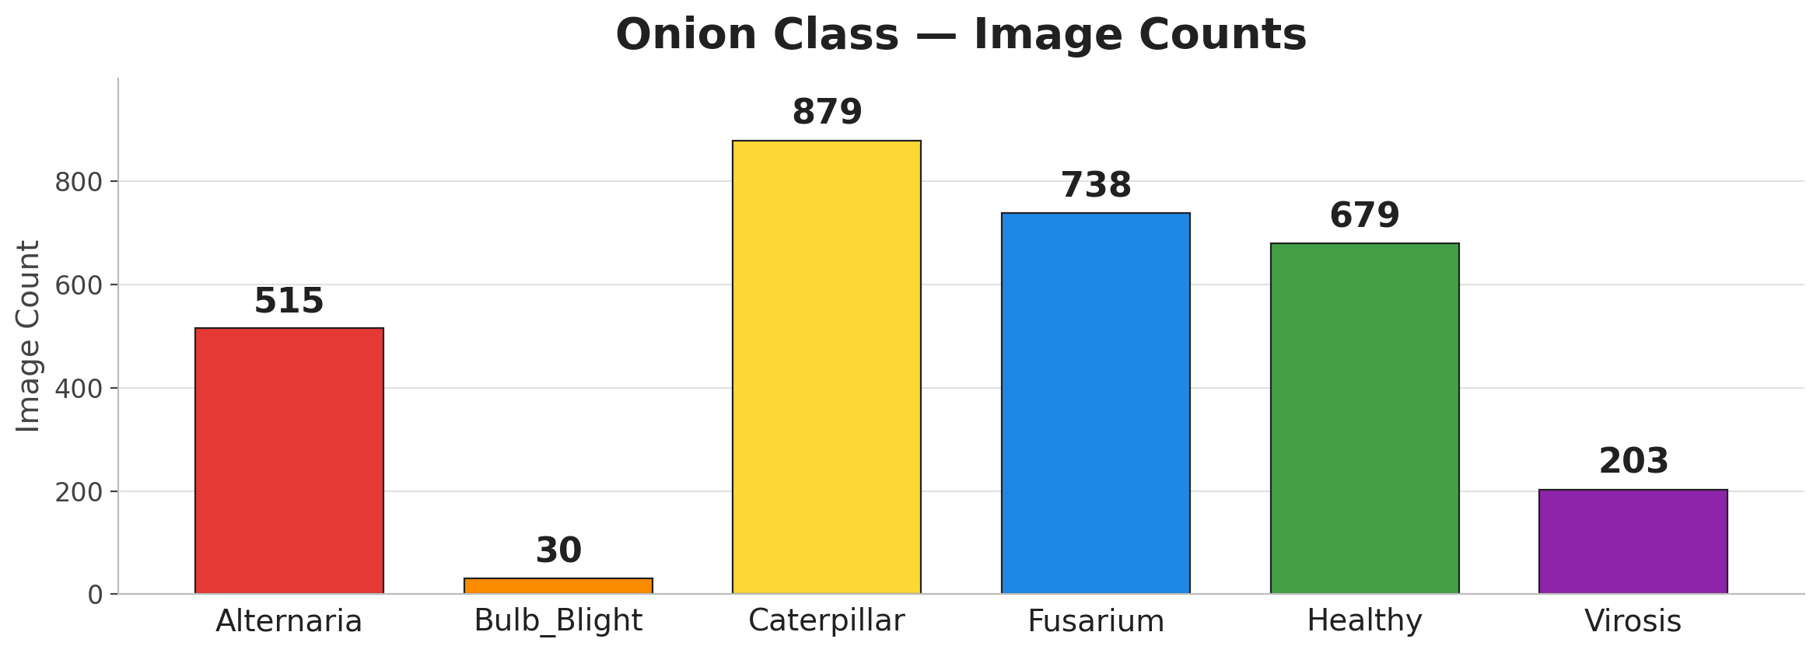
Dataset — TOM2024
Maize, Tomato & Onion Multi-class Data
About TOM2024
Onion Subset — what we used
Published in Data in Brief (Elsevier), 2025
Field-collected from farms in Burkina Faso
Covers healthy crops, pests and diseases
Addresses the West-African ML data gap
First public benchmark for onion classes
6 classes: 1 healthy + 4 diseases + 1 pest
3,044 onion images across all classes
Resized from variable sizes to 224x224
Imbalanced: Caterpillar 879 vs Bulb_Blight 30
Class weights + 3-stage fine-tuning

Slide 4
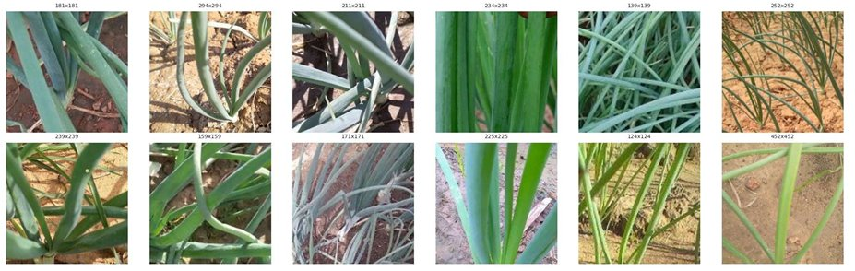
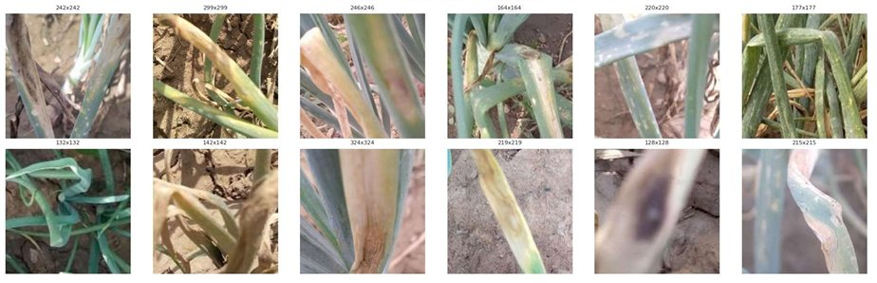
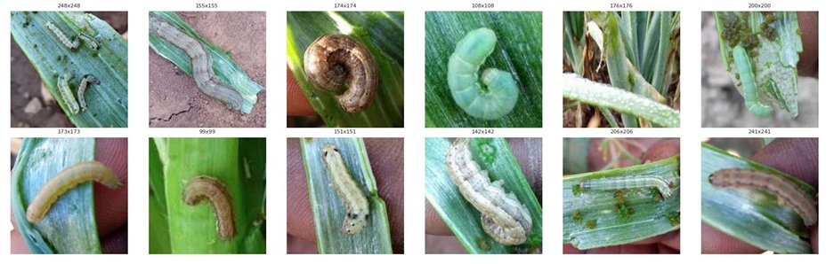
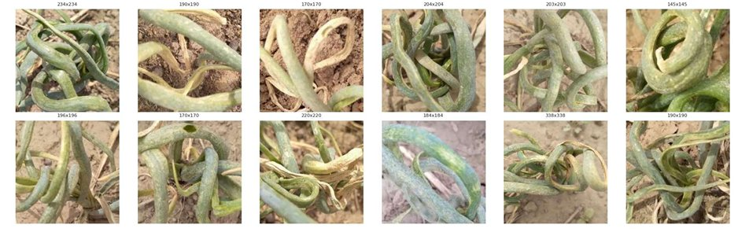
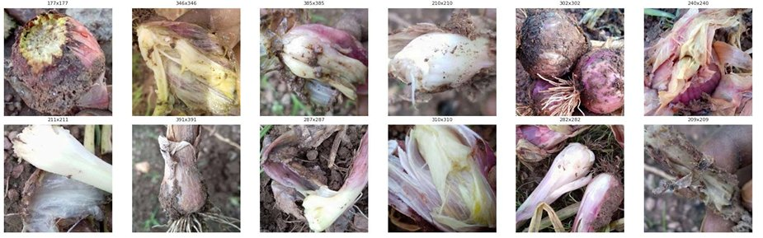
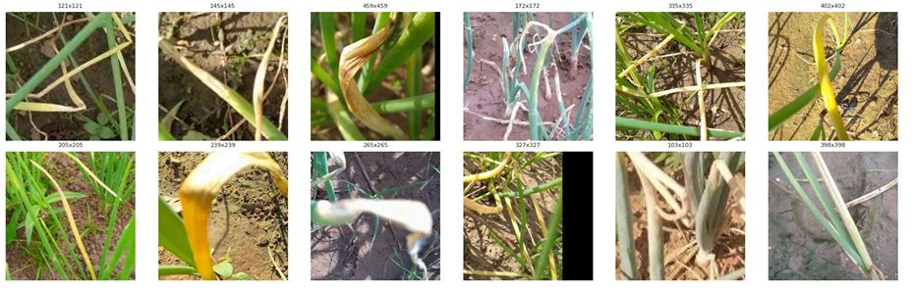
Onion Classes
Six classes the model learns to distinguish
Healthy
Alternaria
Caterpillar
Virosis
Bulb Blight
Fusarium

Slide 5
Our Solution
OnionGuard mobile application
Disease Detection
Freshness Check
Treatment Guides
Analytics
On-device AI classifies 6 onion conditions from camera photos.
Gemini Vision AI evaluates onion freshness
Detailed treatment in 5 languages with voice playback for low-literacy farmers.
Personal & regional disease tracking dashboards for farmers and officers.
Security: JWT Auth + Bcrypt + Biometric Login + HTTPS (TLS 1.2/1.3) + Let's Encrypt SSL

Slide 6
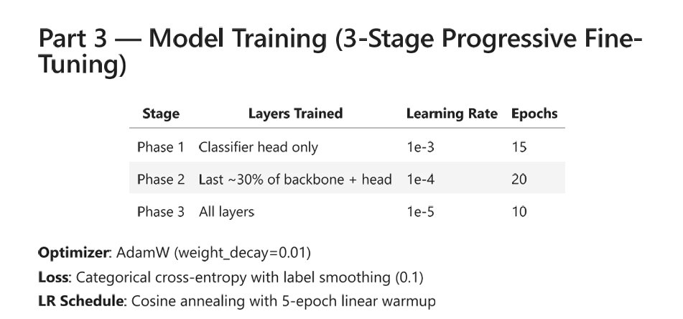
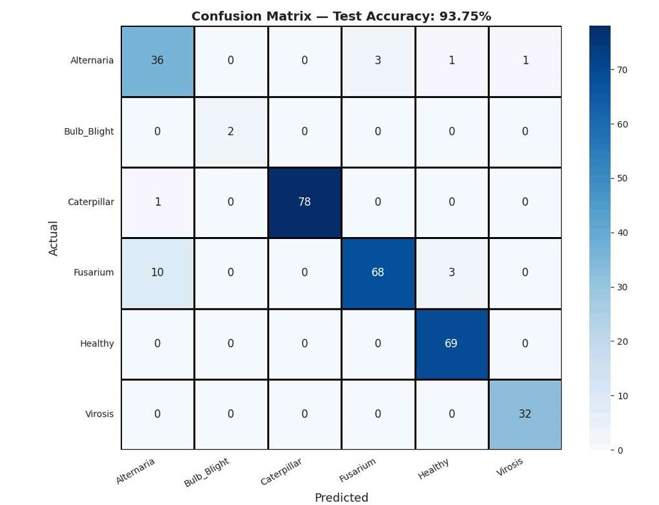
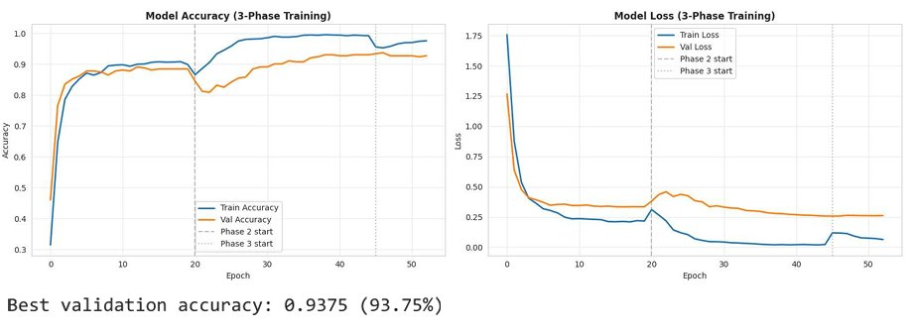
Machine Learning Model
MobileNetV3-Large trained on TOM2024 dataset
Base: MobileNetV3-Large (ImageNet pretrained)
Quantization: Float16 for mobile deployment
Size: 5.72 MB (TFLite)

Slide 7
Model Performance
Evaluation on held-out test set (304 images)
Classification Report
93.75%
Class | Precision | Recall | F1-Score | Accuracy
Alternaria | 0.766 | 0.878 | 0.818 | 87.80%
Bulb Blight | 1.000 | 1.000 | 1.000 | 100.00%
Caterpillar | 1.000 | 0.987 | 0.994 | 98.73%
Fusarium | 0.958 | 0.840 | 0.895 | 83.95%
Healthy | 0.945 | 1.000 | 0.972 | 100.00%
Virosis | 0.970 | 1.000 | 0.985 | 100.00%
Macro Avg | 0.940 | 0.951 | 0.944
Overall Test Accuracy
TFLite: 93.75% | Size: 5.72 MB
Key Insights
Caterpillar, Healthy, Virosis & Bulb Blight achieve 98-100% accuracy
Fusarium (83.95%) shows lowest accuracy due to visual similarity with Alternaria
Class weights handle imbalance effectively (879 Caterpillar vs 30 Bulb Blight)
TFLite quantization maintains full accuracy with 5.72 MB model size

Slide 8
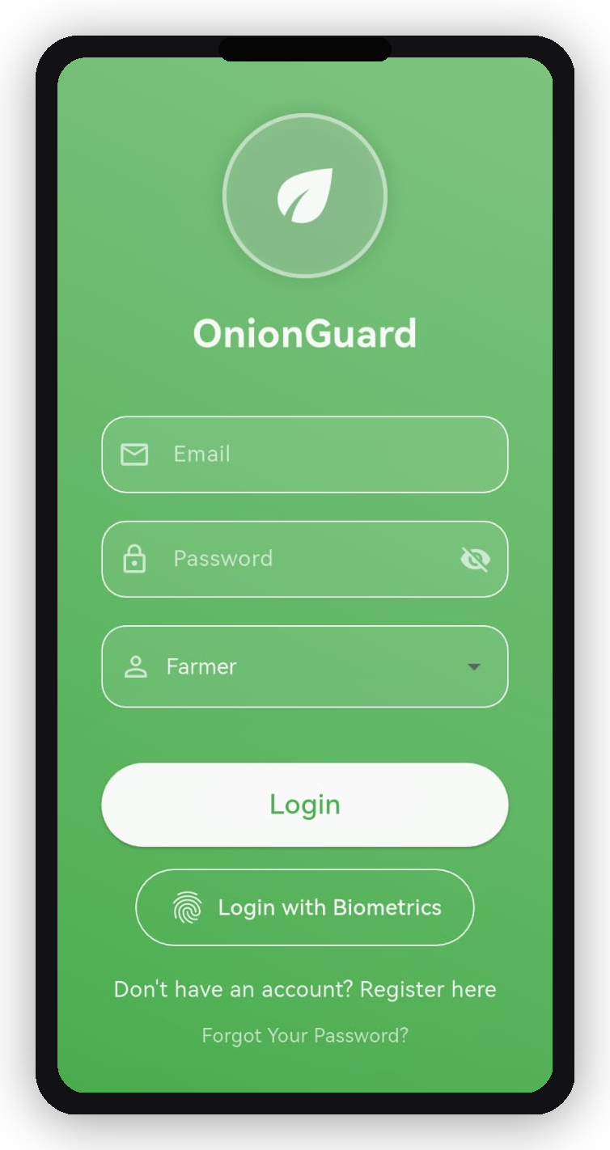
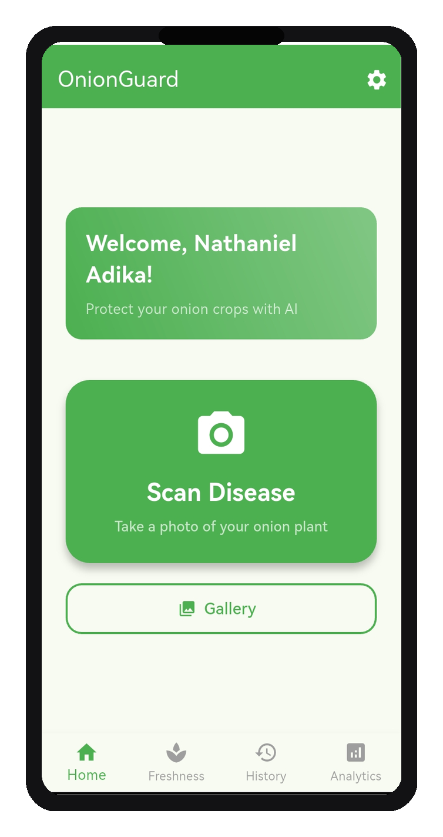
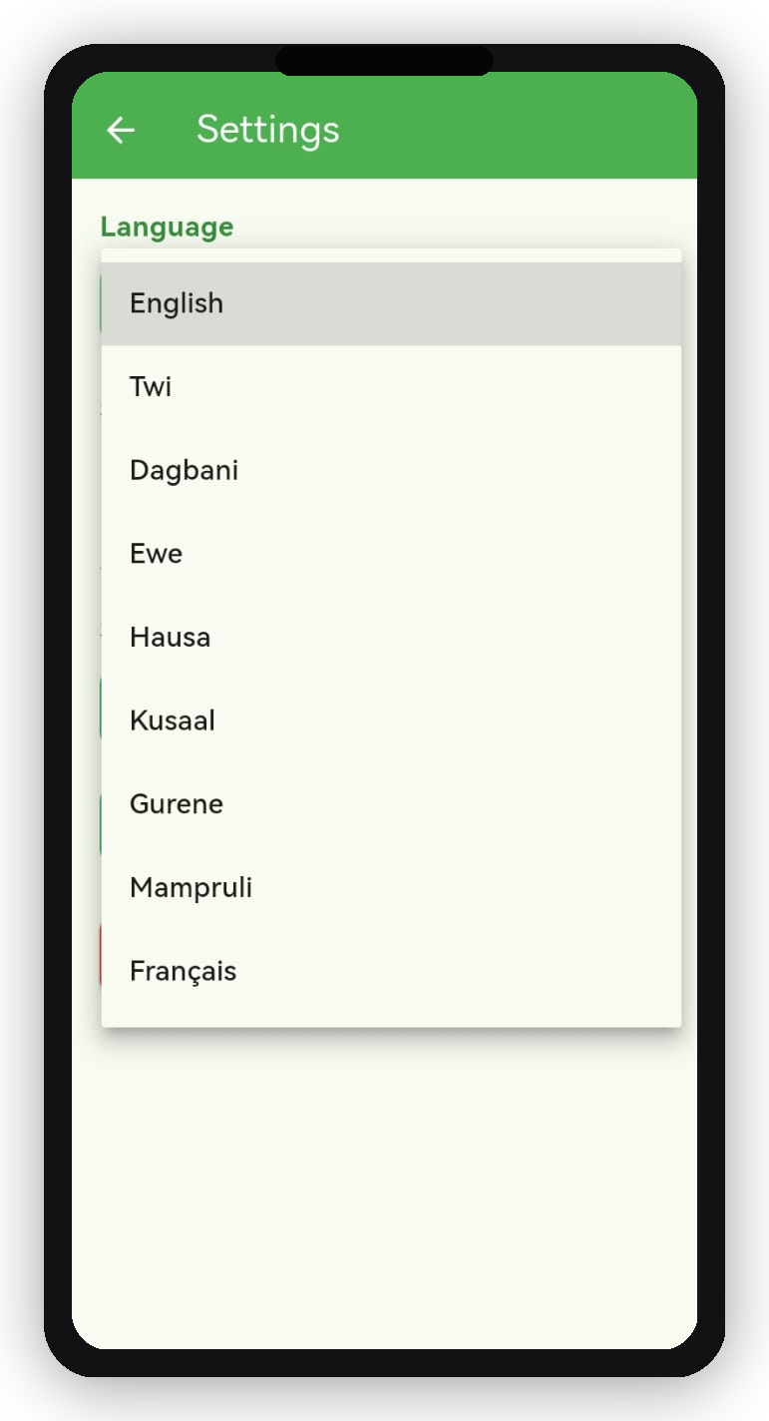
Mobile Application (1/3)
Fingerprint Login | Home Screen | 9 Languages
Fingerprint Login
Home Screen
9 Languages

Slide 9
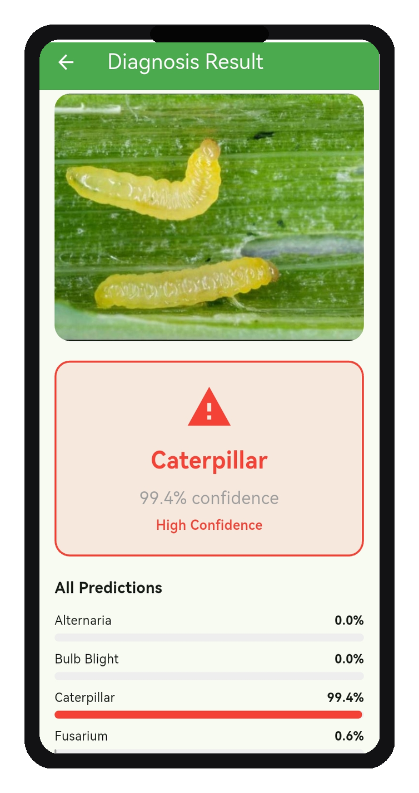
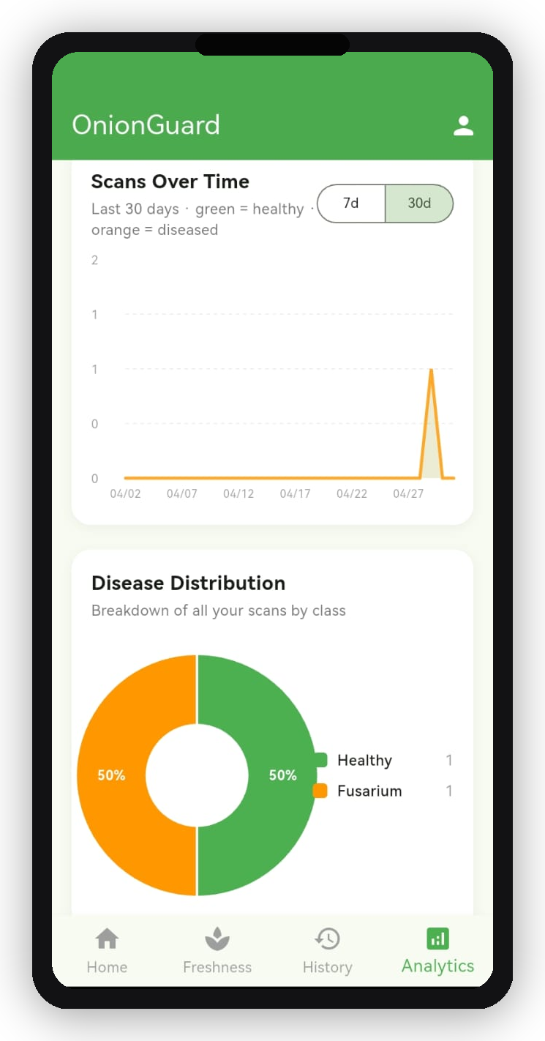
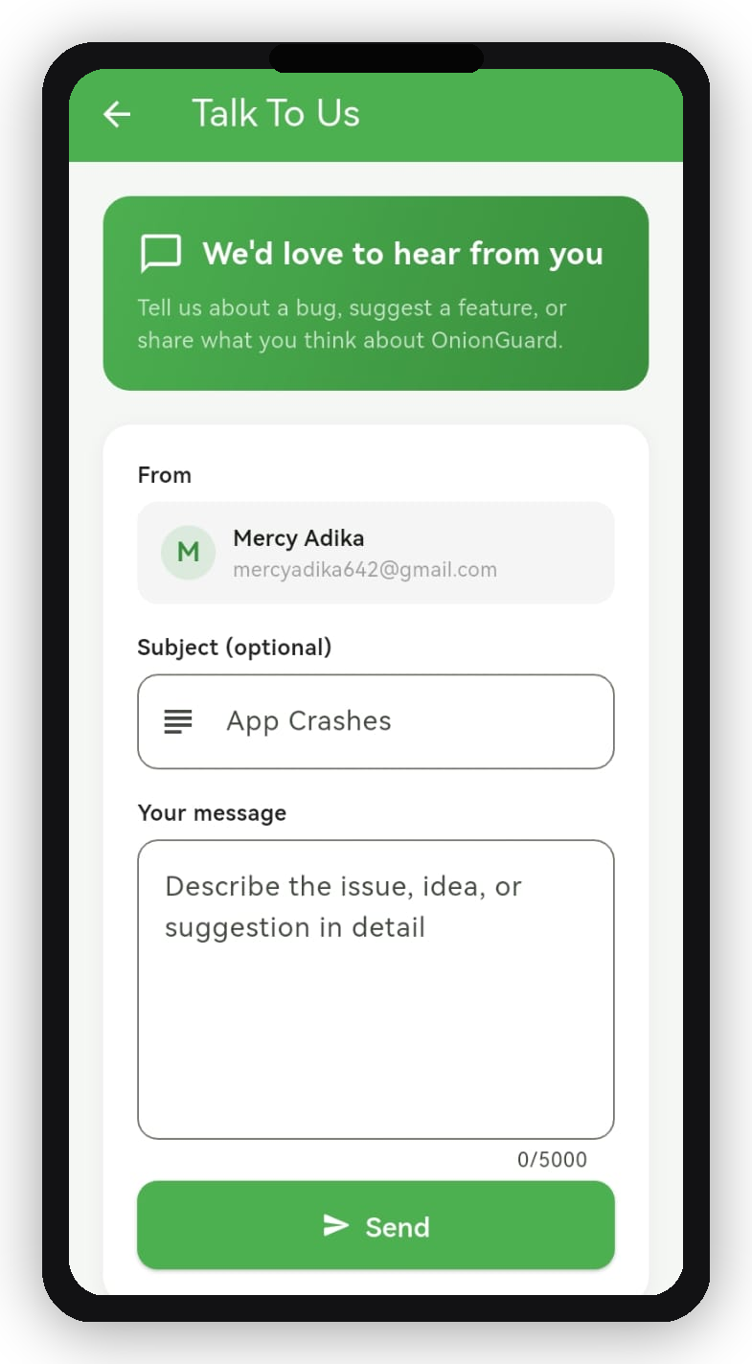
Mobile Application (2/3)
Disease Detection | Farm Analytics | Talk To Us
Disease Detection
Farm Analytics
Talk To Us

Slide 10
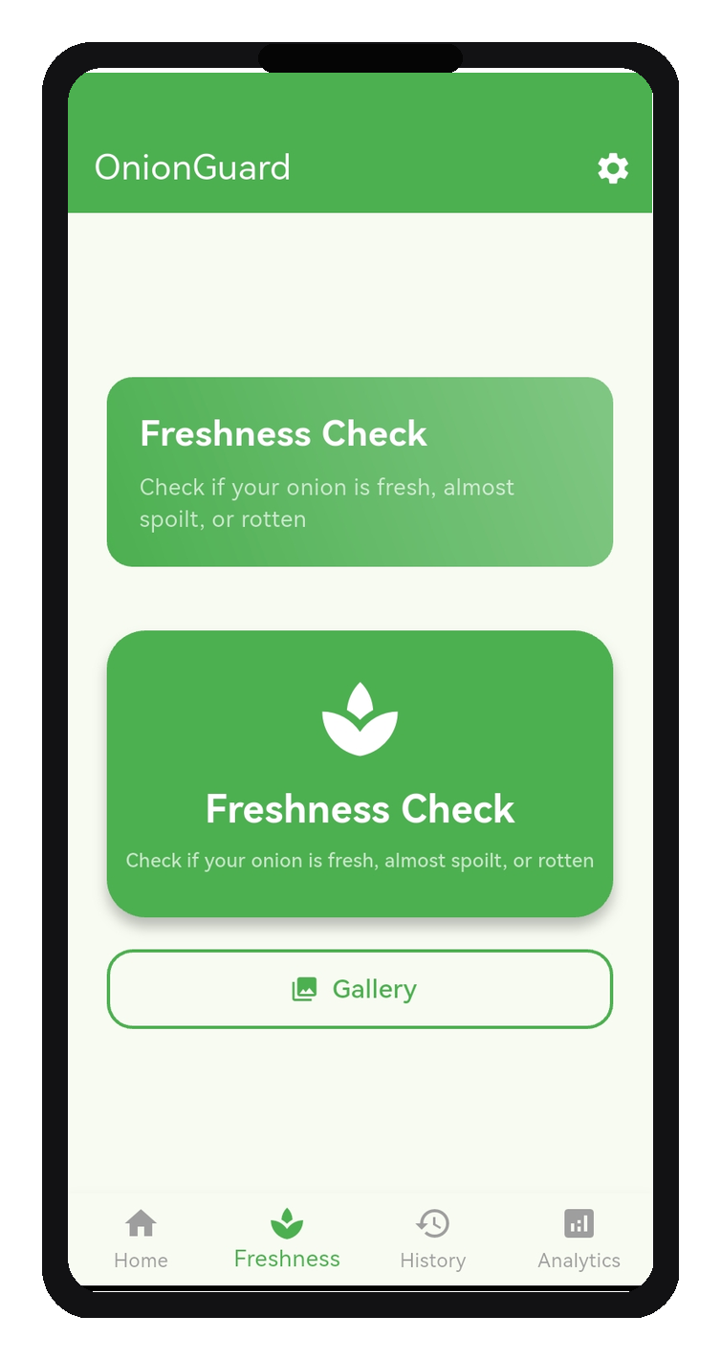
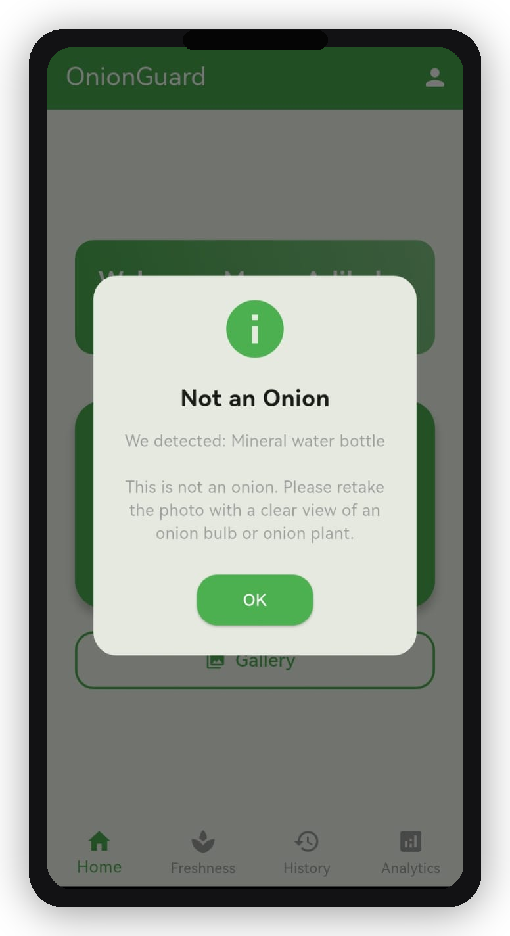
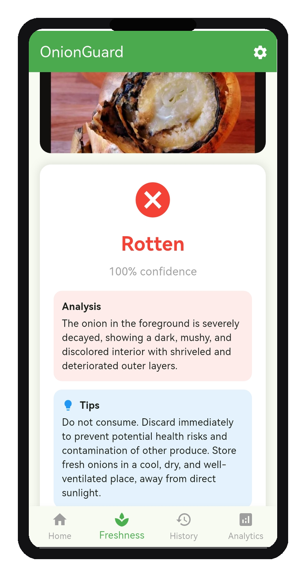
Mobile Application (3/3)
Freshness Check | Smart Pre-Check | AI Analysis
Freshness Check
Smart Pre-Check
AI Analysis

Slide 11
System Architecture
Microservices deployed on AWS EC2
Flutter App
Nginx + SSL
API Gateway :8000
Auth :8001
Diagnosis :8002
Treatment :8003
Analytics :8004
MongoDB Atlas (Cloud Database)

Slide 12
Use Case Diagram
Role-based access control
Legend
Scan Disease
Voice Playback
Farmer
Extension Officer
Check Freshness
Scan History
Admin
Farmer
View Treatment
Personal Analytics
Scan Disease
View All Scans
Check Freshness
Regional Trends
Extension Officer
Scan Disease
Manage Users
Check Freshness
Platform Analytics
Admin

Slide 13
Technology Stack
Full-stack modern architecture
Frontend
Flutter / Dart
Charts
fl_chart
Backend
FastAPI / Python 3.11
Auth
JWT + Bcrypt
Database
MongoDB Atlas
Biometrics
local_auth
ML Model
TensorFlow Lite
Containers
Docker + Compose
Vision AI
Google Gemini 2.5 Flash
Proxy
Nginx
Voice
Google TTS (gTTS)
SSL
Let's Encrypt + Certbot
State Mgmt
Provider
DNS
DuckDNS

Slide 14
Relevance of This Work
Why OnionGuard matters beyond the classroom
First ML Benchmark for Onion Disease
Food Security Impact in West Africa
Zero ML models existed for onion disease on TOM2024 before this project
First production benchmark across 6 onion disease classes
Directly closes gap identified by Appiah et al. (2025, Elsevier)
Up to 50% crop losses due to undetected pests and diseases
Expert-level disease diagnosis in any farmer’s hands via smartphone
Early intervention that protects yields and farm incomes at scale
Removes Language & Literacy Barriers
Human-in-the-Loop Feedback Pipeline
240+ translated UI strings across 9 local languages
Google TTS voice playback for all treatment guides
Reaches farmers excluded by English-only AgriTech tools
Farmers flag wrong AI predictions directly in the app
Admins export ML-ready correction ZIPs for model retraining
Self-improving data flywheel grounded in real field conditions

Slide 15
Conclusion
OnionGuard: from research benchmark to live agricultural tool
Technical Achievement
Human Impact
93.75% test accuracy on held-out images
5.72 MB TFLite model runs fully on-device
First ever ML benchmark for onion disease on TOM2024
Smallholder farmers lose up to 50% of onion crops to disease
Expert-grade diagnosis now accessible via any smartphone
Culturally accessible: 9 languages with voice-guided treatment
Full-Stack Solution
Path Forward
On-device AI + Gemini Vision freshness assessment
Human-in-the-loop correction pipeline for continuous improvement
Microservices on AWS EC2, designed to scale across West Africa
Live on Google Play Store — beyond the academic prototype
Field testing on onion farms across Ghana and West Africa
Extend to other crops — Maize & Tomato (TOM2024) and other crops with prevalent diseases

Slide 16
References
Sources cited in this presentation
Dataset
Appiah, M. K., et al. (2025). TOM2024: A multi-class image dataset for maize, tomato and onion disease and pest classification. Data in Brief, Elsevier. https://doi.org/10.1016/j.dib.2025.111413
ML Model
Howard, A., et al. (2019). Searching for MobileNetV3. IEEE/CVF International Conference on Computer Vision (ICCV). arXiv:1905.02244
Project & Application
Nkabom Honours Team. (2026). OnionGuard: AI-Powered Onion Disease Detection [Mobile Application]. University of Ghana. Available on Google Play Store. https://onion-guard.duckdns.org
Vision AI
Google. (2025). Gemini 2.5 Flash: Multimodal AI Model. Google DeepMind. https://deepmind.google/technologies/gemini/flash/

Slide 17
Thank You
Nkabom Honours Team
University of Ghana | 2026
OnionGuard | AI-Powered Onion Disease Detection https://onion-guard.duckdns.org

