Slide 1
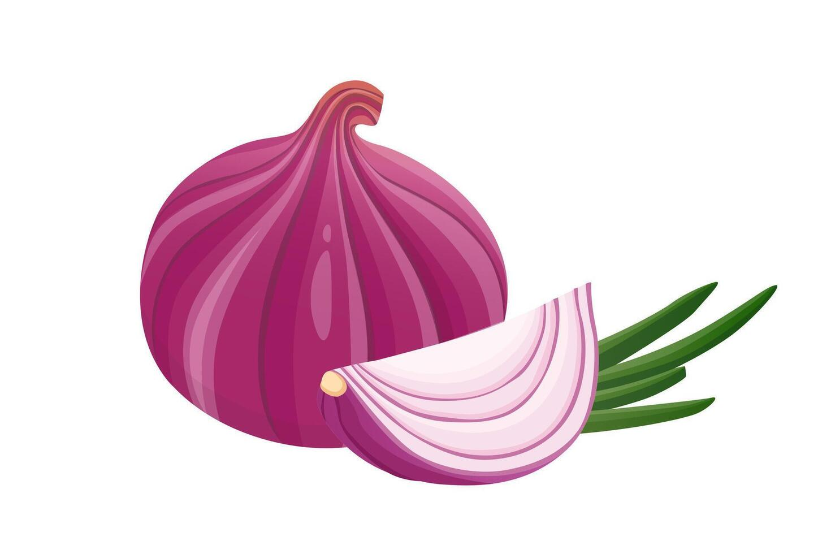
OnionGuard
Update Release Report
Version 1.2.0
Released: April 29, 2026
NOW LIVE ON GOOGLE PLAY STORE
Nkabom Honours Team · University of Ghana

Slide 2
What's New in This Release
Four updates shipping in version 1.2.0
Headline: farmers can now correct the AI when it gets things wrong
A human-in-the-loop correction system — every correction makes the next model smarter.
1. Scan Correction & Review System
2. Smarter Scan Pre-Check
• "Review this" button on every scan result
• Dropdown for correct class + optional comment
• Admin queue with one-click ZIP export (CSV + images)
• Model now rejects non-onion images before classifying
• Removes confidently-wrong predictions on hands, tomatoes, etc.
• Higher trust in every disease result
3. Fingerprint Login Fixed
4. Analytics & Language Support
• Was completely broken — tap did nothing
• Now: fingerprint match opens the app instantly
• No password retyping, even after logout
• Smoother spline-curve time-series chart
• +2 new languages: Kusaal, Gurene (Frafra)
• Total supported languages: 9

Slide 3
Headline: Scan Correction & Review
Closing the loop between users and the AI model
Why this matters
Until now, when the AI got a diagnosis wrong, that mistake was invisible. Now every wrong prediction can be flagged with the correct answer — turning errors into training data and creating a feedback loop that compounds with usage.
How it works (user flow)
1
User scans an onion
2
Sees the AI prediction
3
Taps "Review this" if wrong
4
Picks correct class + comment
5
Saved to admin queue
Roles & access
• Farmers & Extension Officers — see only their own corrections (Settings → My Reviews)
• Admins — see the full queue across all users, plus one-click ZIP export
• Export bundle is ML-ready: reviews.csv (metadata) + images/<id>.jpg (training samples)
• CSV columns: id, image path, user, role, original prediction, corrected label, comment, timestamps

Slide 4
Improved AI Scan Reliability
Catching obvious non-onion images before classification
BEFORE
AFTER
• User accidentally scans a hand, tomato, or coin
• Model confidently labels it as "Fusarium 87%"
• Farmer trusts the wrong diagnosis
• False-positive disease counts pollute analytics
• Trust in the app erodes
• Pre-check rejects non-onion images
• User gets clear "Please scan an onion" message
• Disease classifier only runs on real onion images
• Cleaner analytics, more reliable disease counts
• Stronger user trust in every result

Slide 5
Fixed: Fingerprint Login
From completely broken to instant entry
What was broken
Tapping "Login with Biometrics" did nothing — no prompt appeared, no error shown. A complete user-facing failure that affected every user with biometrics enabled.
What we fixed
• Three Android-side configuration bugs traced & corrected
• Errors no longer swallowed silently — users see clear messages on failure
• Removed the requirement to retype the password before each biometric login
Net result for users
Open the app → tap fingerprint → in. Even after logout. A daily friction point removed for every active user.

Slide 6
Analytics & Language Support
Smoother charts and broader linguistic reach
ANALYTICS
LANGUAGES (7 → 9)
• Time-series chart upgraded to spline curves — smoother, more readable
• Regional analytics fully localized into all supported languages
• Disease-trend visualisations now consistent across the app
Existing (7):
English · Twi · Dagbani · Ewe · Hausa · Mampruli · French
New this release (2):
Kusaal · Gurene (Frafra)
Both are northern Ghanaian languages in the Mabia/Gur family. Currently use Dagbani as a fallback while native translations are being collected — speakers from these regions can already pick their language in the app today.

Slide 7
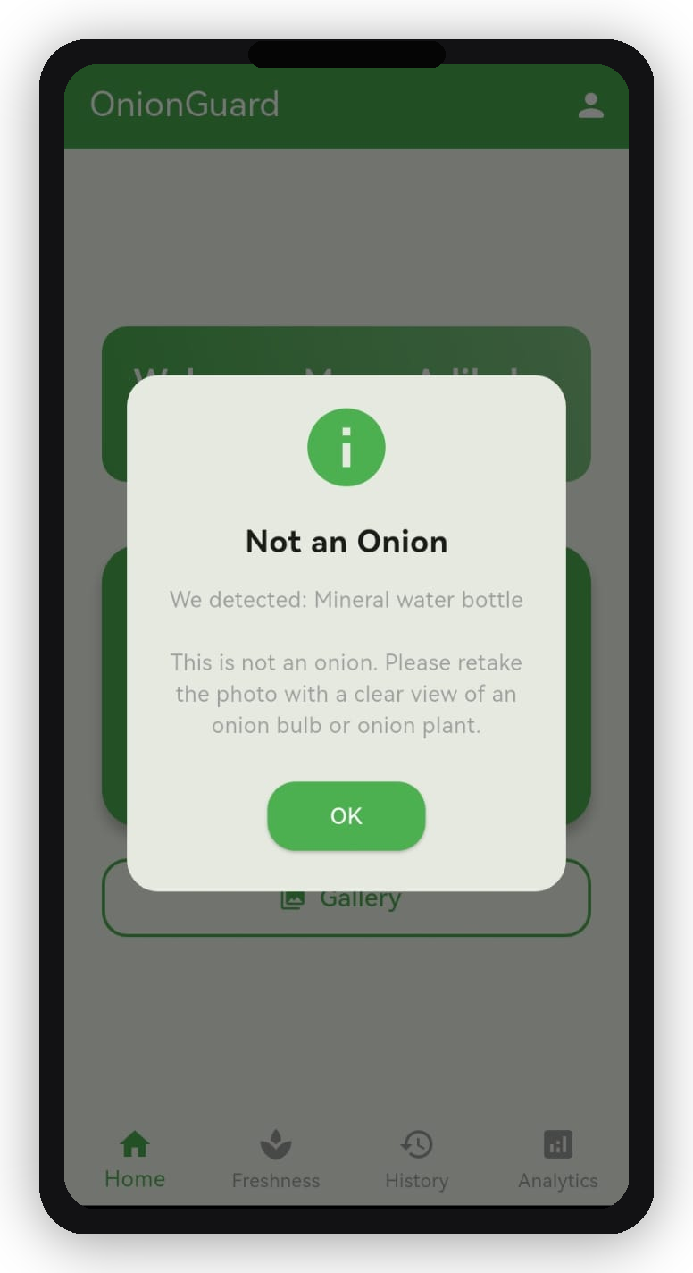
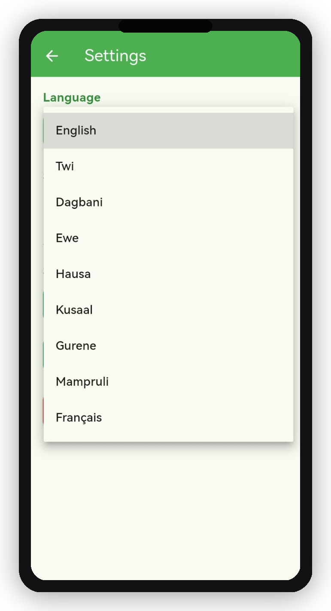
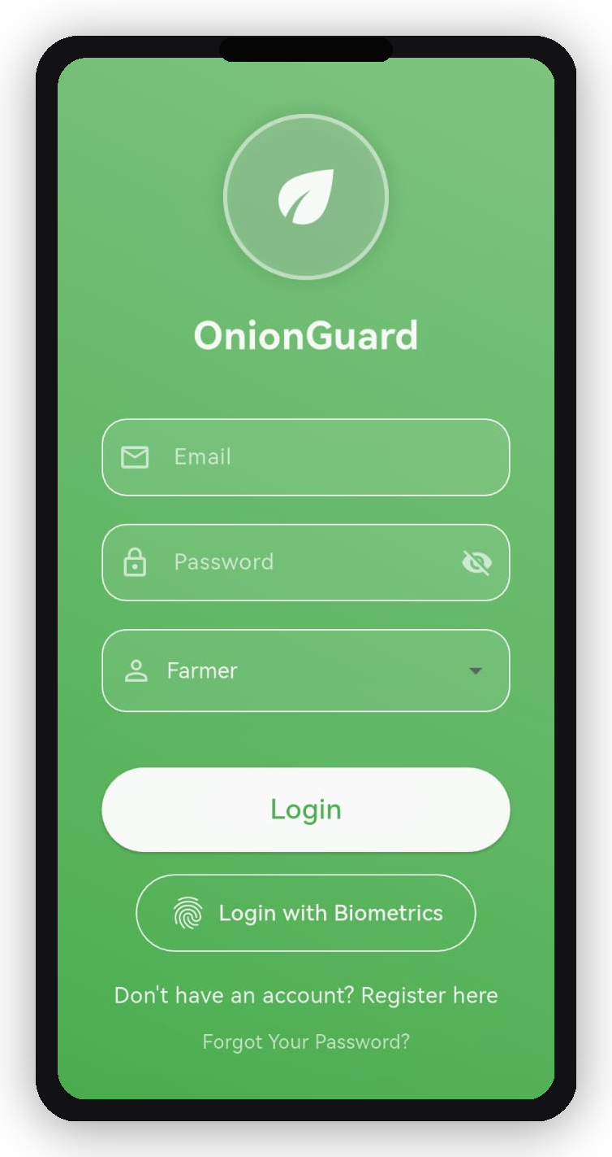
App Updates in Action (1/2)
Smart Pre-Check | Fingerprint Login | Languages
Smart Pre-Check
Fingerprint Login
9 Languages

Slide 8
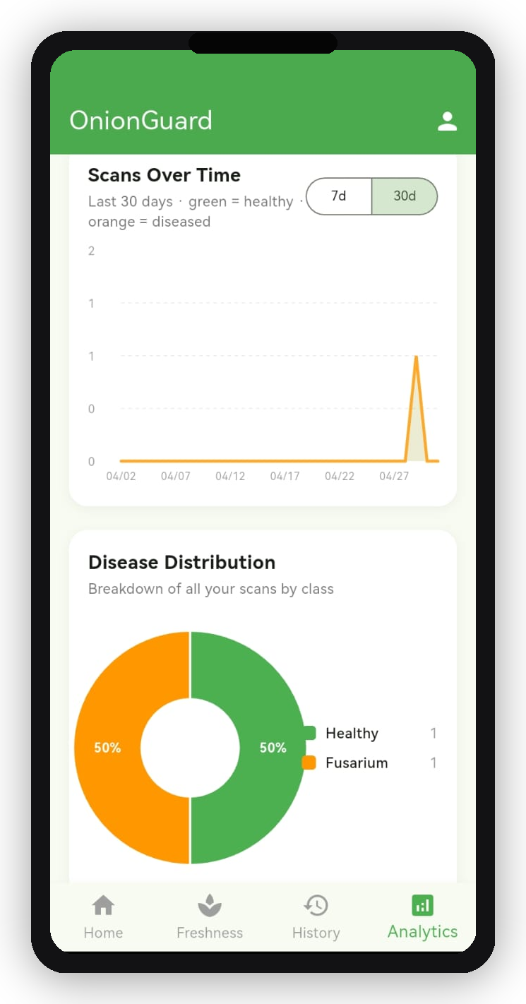
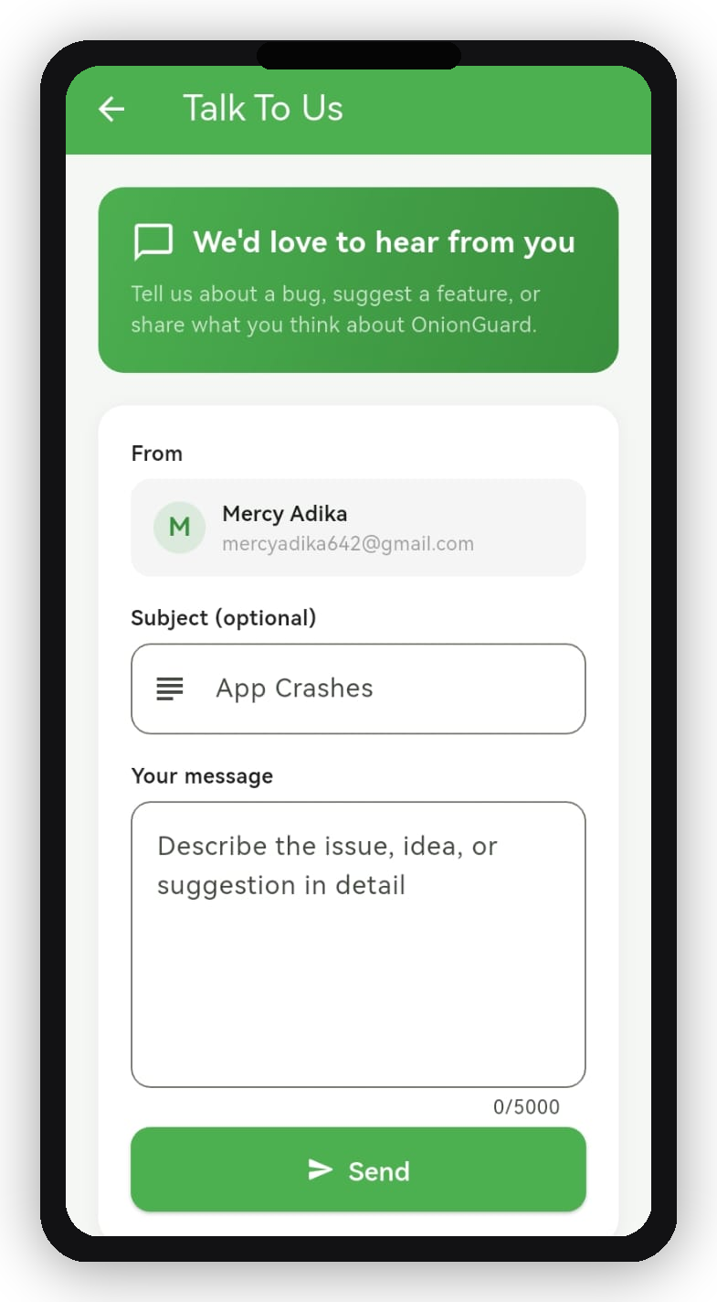
App Updates in Action (2/2)
Smoother Analytics | Direct Feedback Channel
Smoother Analytics (Spline Chart)
Talk to Us — Direct Feedback

Slide 9
Release Status
Where each component stands right now
Now Live on Google Play Store
Backend
Live in production
AWS EC2 · SSL valid through 4 Jul 2026
Mobile (Android)
Live on Play Store
1.2.0 (build 9) · 65.4 MB · signed
Play Store rollout
Auto-update in progress
Existing users receive update over 24–48h
Install base
9 users · 177 countries
Per Play Console dashboard

Slide 10
What This Means for Users
Translating shipped features into user value
Smarter AI over time
Every correction submitted by farmers and extension officers becomes training data for the next model. This release lays the foundation for a data flywheel — the model improves with use.
Faster daily entry
Fingerprint login removes a daily friction point. Users no longer retype their password each time they open the app.
Higher trust in results
The non-onion pre-check eliminates a class of confidently-wrong diagnoses that previously eroded user confidence.
Wider linguistic reach
Northern Ghanaian Kusaal and Gurene/Frafra speakers are now first-class users of the app — visible in the picker, with native translations on the way.

Slide 11
Risks & Watch Items
What to keep an eye on going forward
Small install base
9 users today — corrections will trickle in until the user base grows. Pair this release with growth and outreach activity to maximise feedback volume.
Native translations pending
Kusaal and Gurene currently fall back to Dagbani text. The fallback is functional but not native — translator engagement is the next step.
Android 15 edge-to-edge deprecation
A non-blocking warning from Play Console. Has to be addressed before Aug 2026 when Google starts enforcing it for new uploads.

Slide 12
OnionGuard is Live
Nkabom Honours Team · University of Ghana

