Slide 1

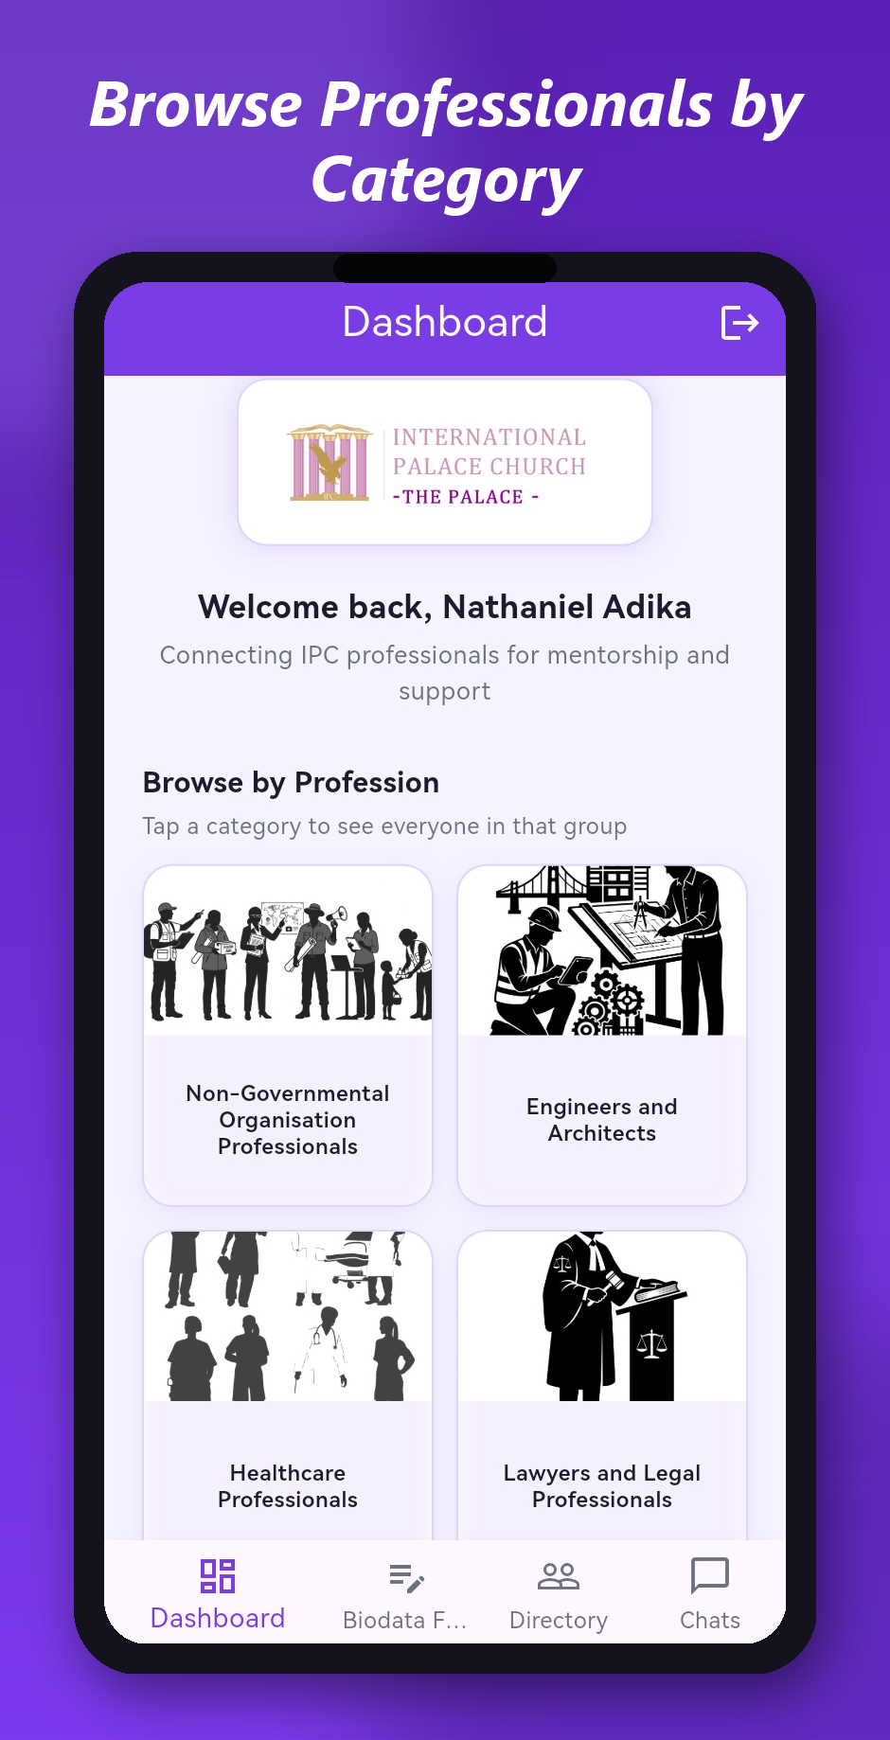

Palace Professional Network
Connecting IPC Professionals for Mentorship, Networking & Growth
PROJECT SUMMARY
International Palace Church • Mobile & Web Platform • September 2026

Slide 2
What This Project Is
A professional networking & mentorship platform for IPC members
Palace Professional Network (PPN) brings every working professional in the congregation into a single, searchable directory organized by profession.
Members can find each other, connect for mentorship, and grow their careers within a community of people who already share their values.
Before PPN, connections happened informally, through word of mouth and Sunday conversations. PPN turns that same idea into a mobile app.
115
church members already imported
12
profession categories
1
searchable directory for everyone
Palace Professional Network
2

Slide 3



Who It's For
Built for every part of the IPC professional community
Members
Mentors & Mentees
Church Leadership
Professionals across every trade and field, from healthcare to ICT, law to skilled trades, who want to be discoverable and connect with others in their profession.
Experienced professionals offering guidance, and younger or newer professionals looking for it.
A living record of the professional skill base within the congregation, useful for outreach, referrals, and support.
Palace Professional Network
3

Slide 4



The Problem It Solves
Professional connections lived only in people's memories
No central directory
Member professions and contact details lived nowhere but in individual memories.
Hard to find the right person
No way to search “who in the church is a lawyer” or “who works in tech.”
No way to connect by profession
No group space for, say, all healthcare professionals to talk to each other.

Slide 5






What Has Been Built
Live in production and working end to end: mobile app → backend → database
Secure Login & Accounts
Professional Biodata Profile
Professional Directory
Phone number + PIN; all 115 members can log in
Pre-filled, editable, 12 profession categories
Search by name or profession, browse by category
Real-Time Chat
Settings
Live Today
One-to-one messages and profession group chats
Change your PIN any time, no admin needed
Real dataset of 115 church members imported
Palace Professional Network
5

Slide 6
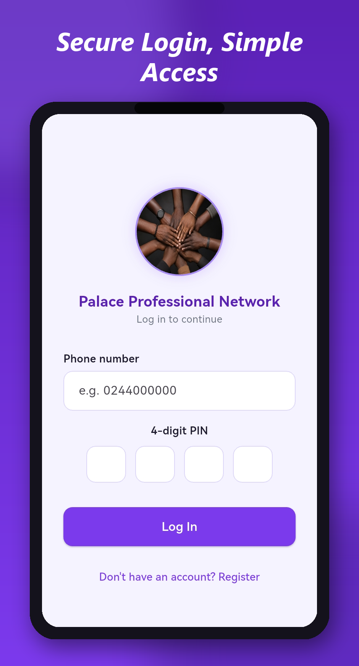
FEATURE 1
Secure Login & Accounts
Simple, familiar sign-in with nothing extra to remember
Phone number + PIN login: no email or password to remember.
Every member has an account: all 115 imported members can log in immediately with a default PIN.
Change PIN anytime: a dedicated Settings tab lets members update their PIN without contacting an administrator.
Palace Professional Network
6

Slide 7
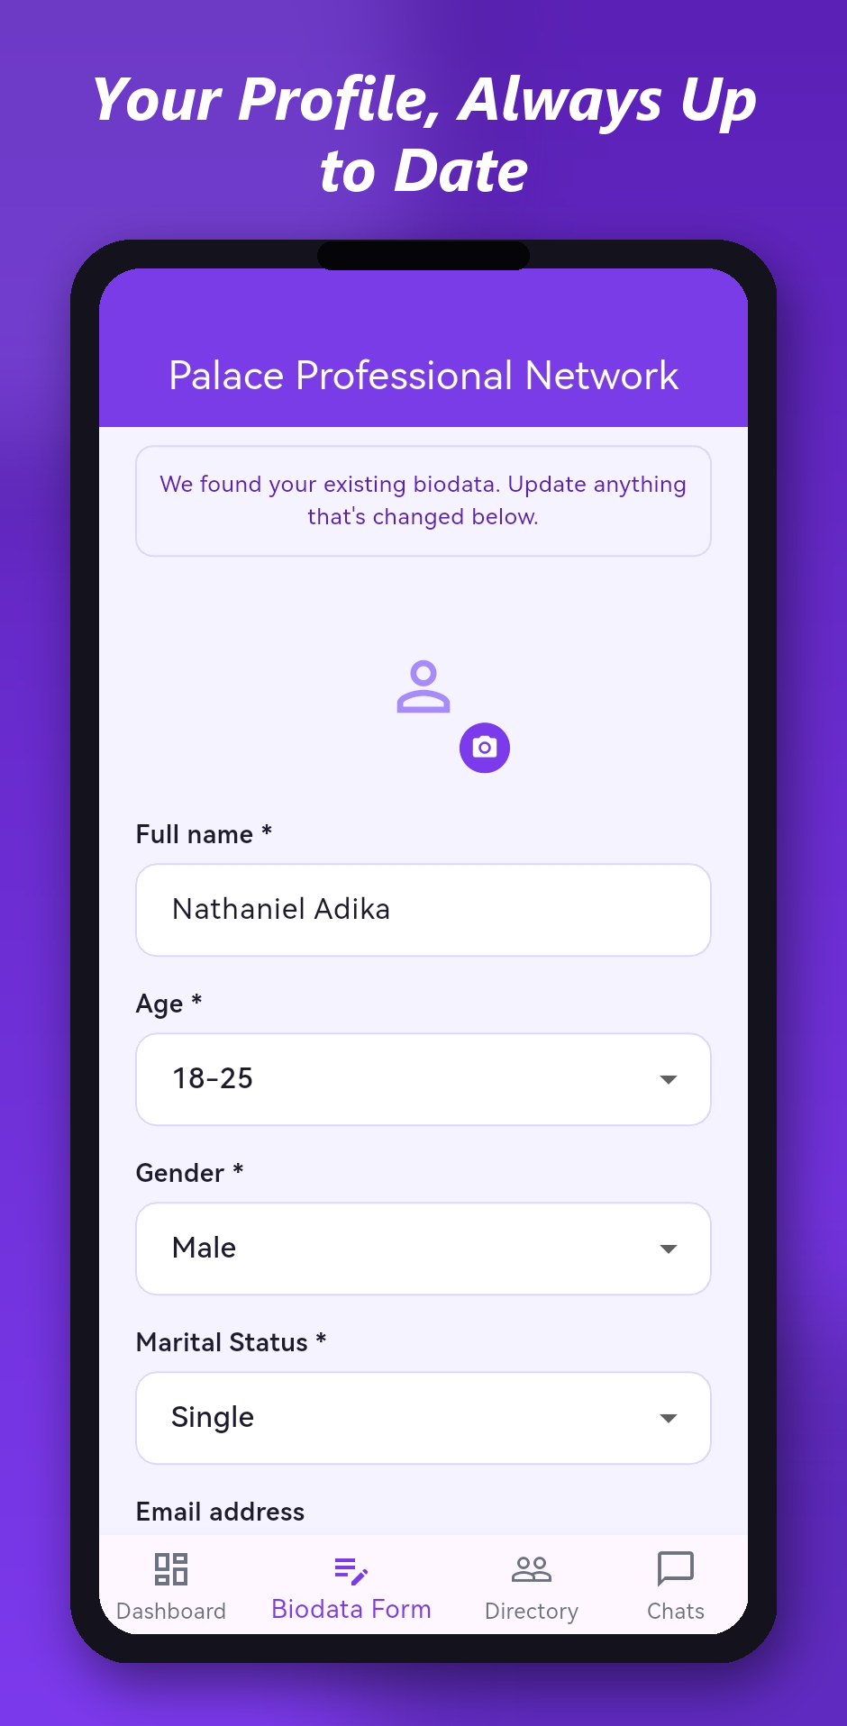
FEATURE 2
Professional Biodata Profile
Your profile, always up to date
One profile per member: name, age range, gender, marital status, profession, workplace, email and profile photo.
Pre-filled & editable: returning users see their details already filled in and can update them, e.g. after changing jobs.
12 profession categories: including sub-categories for artisans and vendors.
Palace Professional Network
7

Slide 8
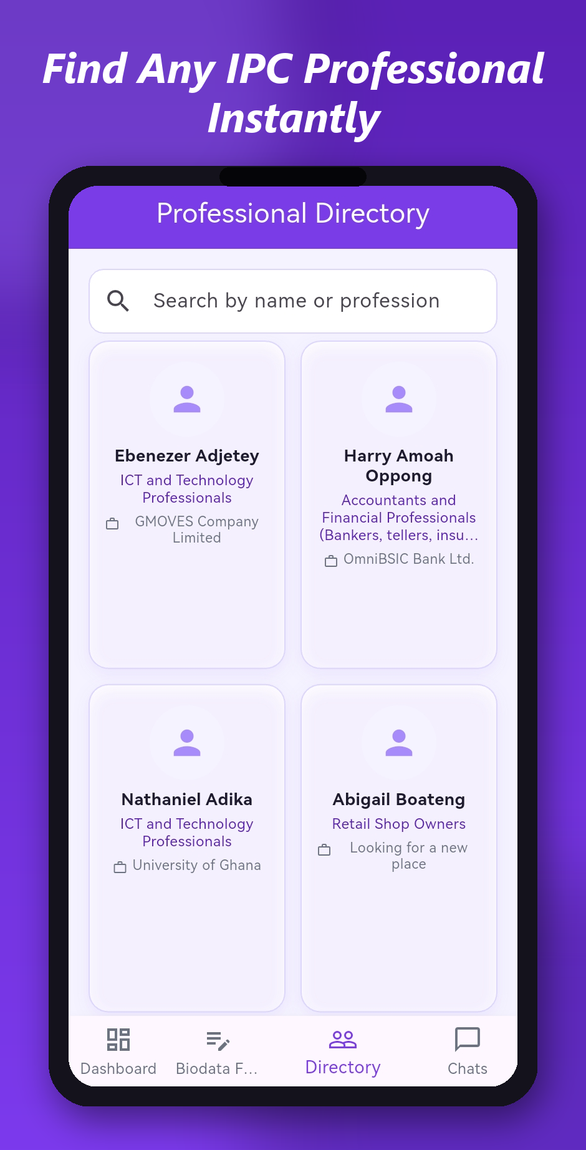
FEATURE 3
Professional Directory
Find any IPC professional instantly
Searchable: find any member by name or profession.
Browse by category: a visual grid on the Dashboard groups the directory by profession; tap to see everyone in it.
Full profile view: see a member's workplace and details, and message them directly.
Palace Professional Network
8

Slide 9
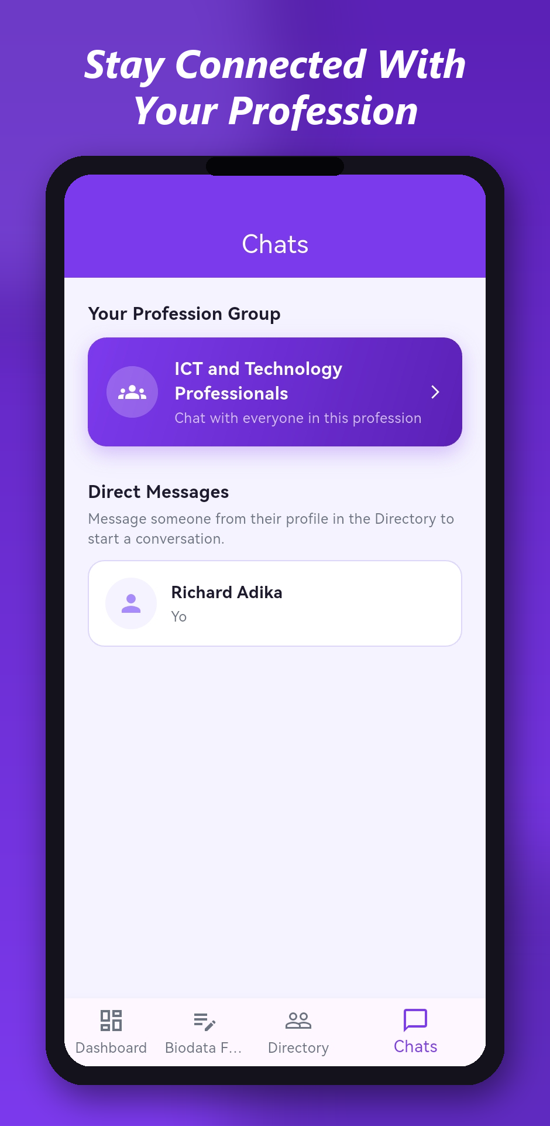
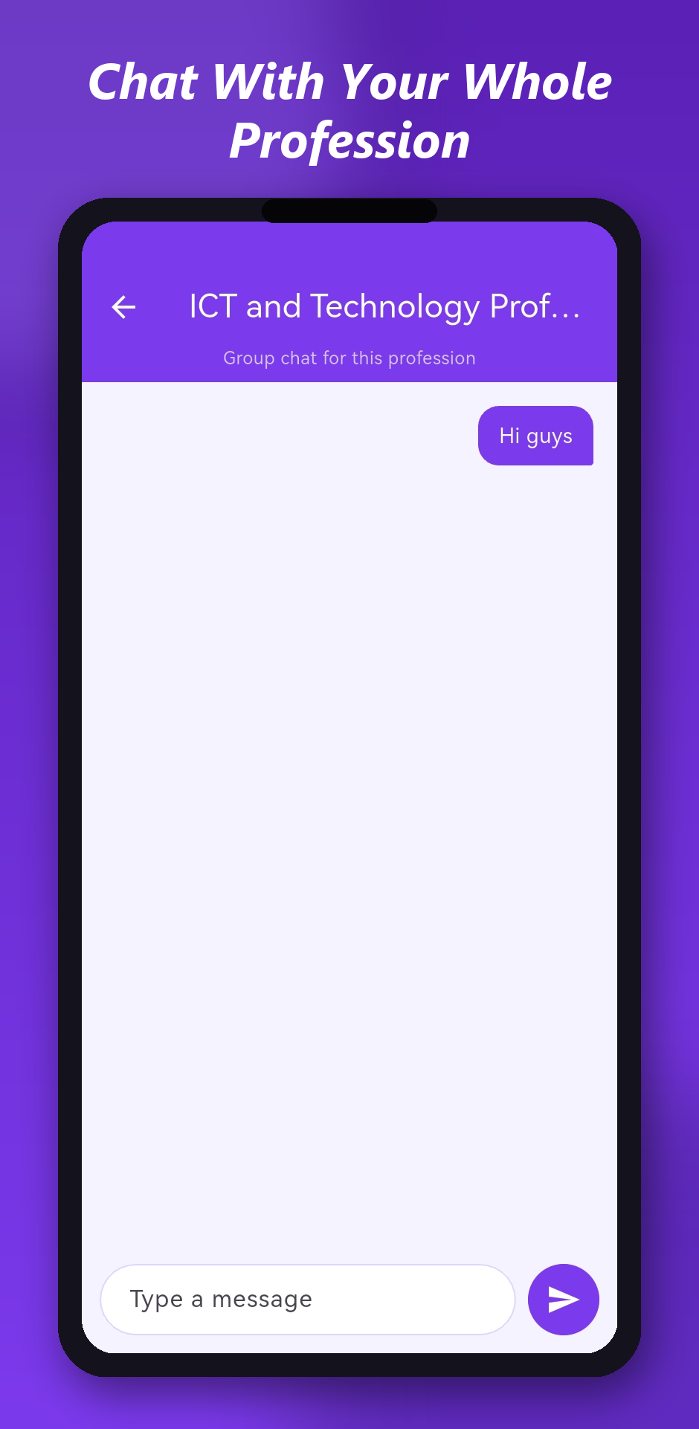
FEATURE 4
Real-Time Chat
Stay connected with your whole profession
One-to-one messaging: message any member directly from their directory profile.
Profession group chats: every category has its own live group chat, open to everyone in it.
Built on WebSockets: messages arrive instantly, with full history saved so nothing is lost.
Palace Professional Network
9

Slide 10
The App at a Glance
Screens from the live production app on Android
Login
Dashboard
Directory
Chats
Group Chat
Profile

Slide 11






How It's Built
A modern, scalable system where each part can grow independently
MOBILE APP
Flutter
Primary way members use PPN, on Android (iOS-ready)
WEB APP
React
Browser-based version of the platform
BACKEND
NestJS microservices
Public gateway + biodata/data service
REAL-TIME CHAT
WebSockets (Socket.IO)
Instant delivery for direct and group chats
DATABASE
MongoDB Atlas
Cloud-hosted profiles, accounts, chat history
HOSTING
Fly.io
Runs the backend in production, worldwide
Palace Professional Network
11

Slide 12



Security & Privacy
Members' data is protected at every step
Encrypted in transit
PINs are hashed
Private by default
All traffic between the app and the server uses HTTPS/WSS.
Login PINs are never stored in plain text, only as one-way bcrypt hashes.
Profiles and messages are only visible to logged-in members, never public on the internet.
Palace Professional Network
12

Slide 13

Current Status
Where the project stands today
Live in production
115
The backend is deployed and running on Fly.io.
115 real members imported
The full current church professional membership is in the system.
real members already imported into the live system
Google Play submission in progress
Closed testing complete, signed release ready for the Play Store.
Legal & policy documents in place
LIVE IN PRODUCTION
Privacy Policy and data-deletion process published for app store approval.
Palace Professional Network
13

Slide 14



What's Next
The road from closed testing to a thriving network
STEP 1
STEP 2
STEP 3
Public Launch
Member Onboarding
Ongoing Improvements
Move from closed testing to a full production release on the Google Play Store.
Help the existing 115 members log in for the first time and set their own PIN.
Refine the directory, chat and profile experience based on real member feedback.
Palace Professional Network
14

Slide 15
Thank You
Palace Professional Network: connecting IPC professionals for mentorship, networking & growth
Any Questions?

