Slide 1
Farmeasy crop prediction
AVADHOOT DESAI (07)
ADITYA KAWALE (25)

Slide 2
contents
Introduction
Project Aim and Objective
System study
UML diagrams
Module Description
Limitations & Enhancement

Slide 3
Introduction
What is FarmEasy?
The designed system will recommend the most suitable crop for particular land based on various environmental factors such as weather and soil content.
Why FarmEasy?
This makes the farmers to take right decision in selecting the crop for
cultivation such that they can make more profit without damaging the soil.

Slide 4
Project Aim and Objective
The Aim of this project is to create a farmer friendly GUI that will be easy for them to navigate.
Help farmers make right decisions in selecting the harvest and maximizing both the production and profit.
Implementing the machine learning technology to reduce risks attached with ever growing farming sector.

Slide 5
System study
Existing system
Most of the farmers rely on the history of farming in their state or their own prior experience while selecting which crop to harvest.
Sometimes they will choose the harvest based on the market value of the crop without considering the environmental factors.
This type of decision making can have an effect on the overall harvest quality,
damage the land and even cause financial loss to the farmers.

Slide 6
System study
Proposed System
The proposed system recommends the best suitable crop for particular land by
considering parameters as annual rainfall, temperature, humidity and soil pH.
This makes the farmers to take right decision in selecting the crop for
cultivation such that they can make more profit without damaging the soil.

Slide 7
System study
requirements
programming languages
Software requirements
Windows 10
Hardware requirement
HDD : 256Gb
Chrome Browser
VS code IDE
RAM : 4GB
CPU : Intel 3 or later
FRONT END
HTML
BACK END
Python
Bootstrap CSS
JAVASCRIPT
Flask
ML libraries

Slide 8
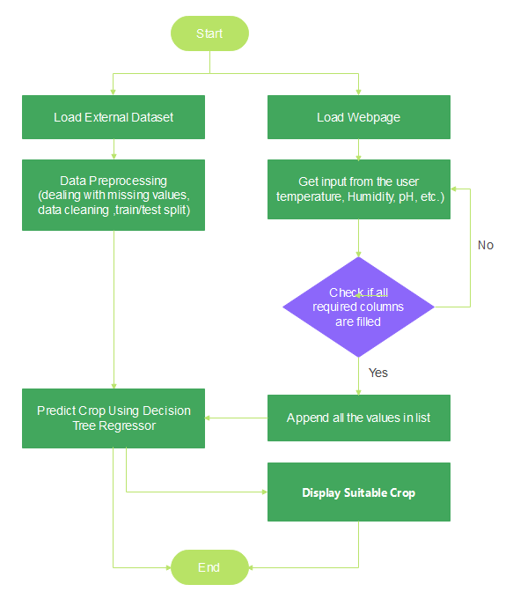
Uml diagrams
Activity diagram:

Slide 9
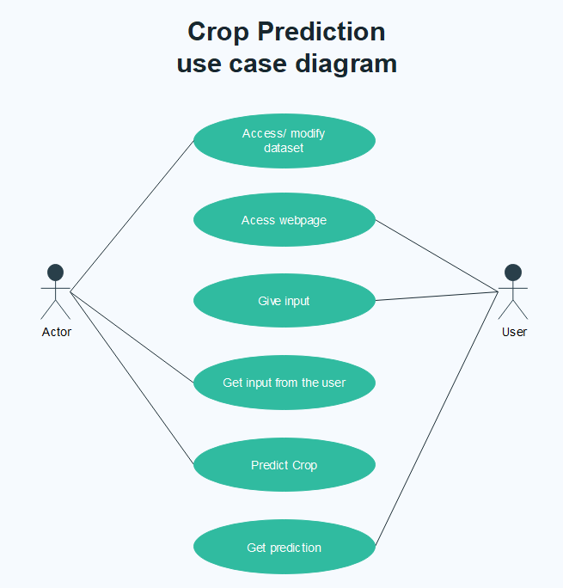
Uml diagrams
Use case diagram:

Slide 10
Module Description
1) Start.html
This if the first page when the user opens the website. Contains prediction page and page for the list of various crops that can be predicted.
2) Crop,html
User can enter the input values and based on those values the prediction can be made and displayed back to the user.

Slide 11
Module Description
3) App.py
Acts as a controller between ML model and GUI.
The actual task of getting the input values from the user side and forwarding those values to the prediction module through pickle file is done here.
4) Crop.py
The actual prediction based on the user input values is done here through ML model.
The trained model is then saved in to pickle file for flask implementation.

Slide 12
Limitations
Application does not have any login features.
Prediction is done on the basis of previous data. Real life results may vary.
No real-time inputs coming from IoT simulator.

Slide 13
Enhancement
Security features such as login can be implemented.
Real-time inputs using various sensors for accurate prediction.

Slide 14
Thank you!

