Slide 1
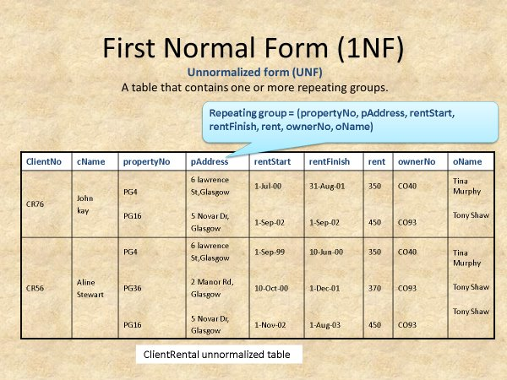

Slide 2
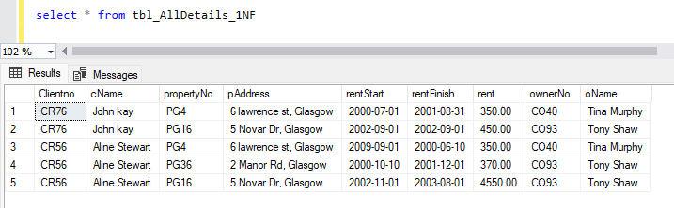
-----------------First Normal Form (1NF)---------------
--Every cell should contains only one attribute
--it increases data integrity
--Data redundancy will be reduced

Slide 3
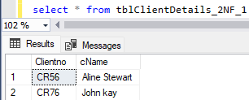
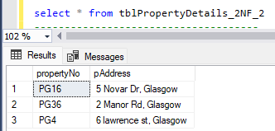
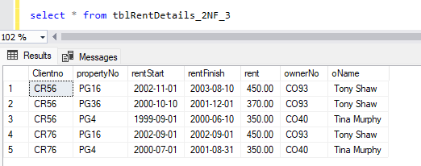
---------------------- Second Normal Form (2NF) ---------------------------
-- Table should be in 1NF
-- No Partial Dependency
-- =>Identify and remove partial dependencies
-- =>2NF requires that every non-key attribute (column) is fully dependent on the primary key.

Slide 4
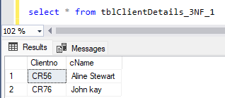
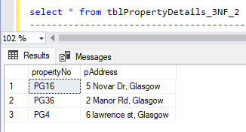
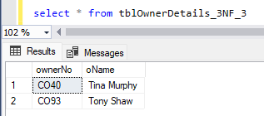
------------------- Third Normal Form (3NF) --------------------------
-- Tables should be in 2NF
-- Eliminate Transitive Dependencies

Slide 5
