Slide 1
Exploratory data analysis of bank customer churn dataset
By: Aditya Kumar Singh

Slide 2
Problem statement
Understand why customers leave the bank.
Identify churn patterns using EDA.
Support future prediction models.
Generate business insights.

Slide 3
Dataset overview
10,000 customer records.
Target: Exited.
Features include demographics, banking activity and satisfaction metrics.
Rich dataset for churn analysis.

Slide 4
Data cleaning
Checked dataset information.
Verified missing values.
Generated descriptive statistics.
No missing values found.

Slide 5
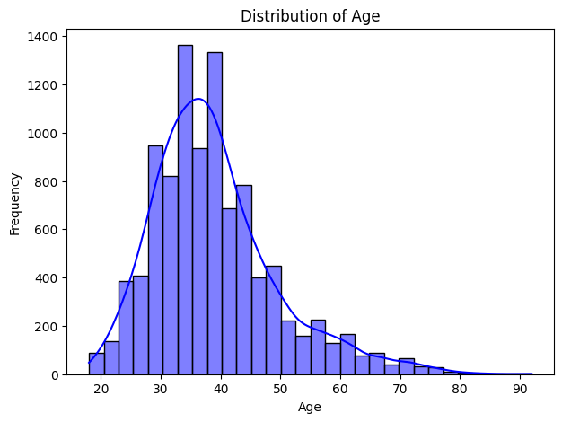
Age distribution of customers

Slide 6
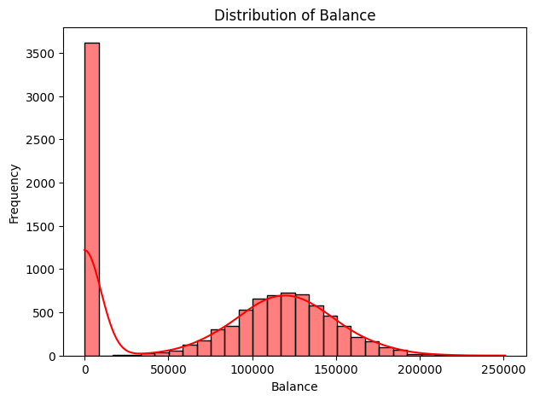
Balance distribution

Slide 7
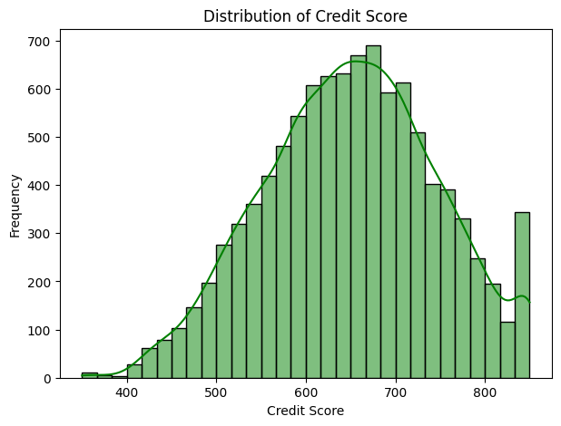
Credit score distribution

Slide 8
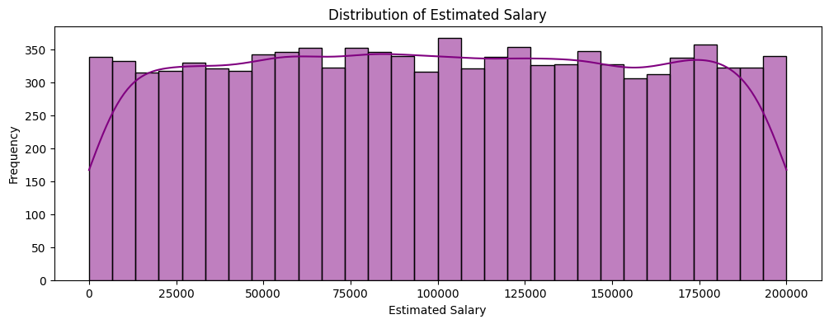
Estimated salary distribution

Slide 9
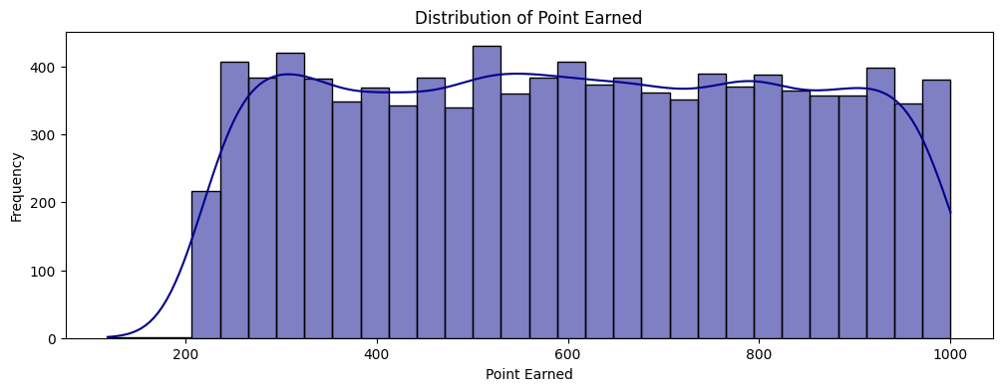
Points earned distribution

Slide 10
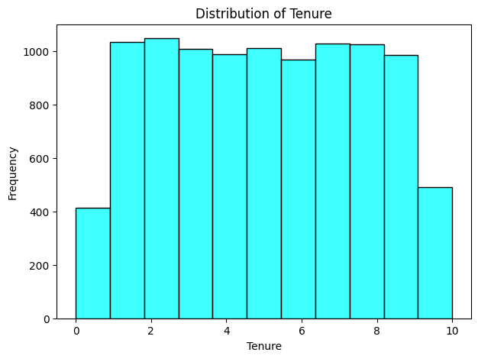
Tenure distribution

Slide 11
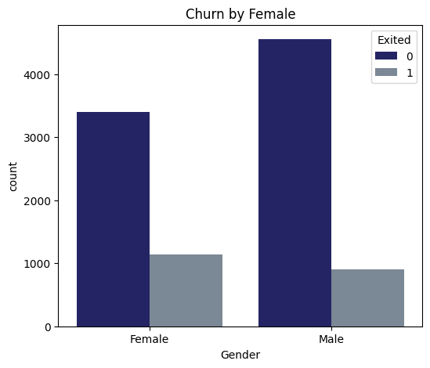
Compare churn status by gender

Slide 12
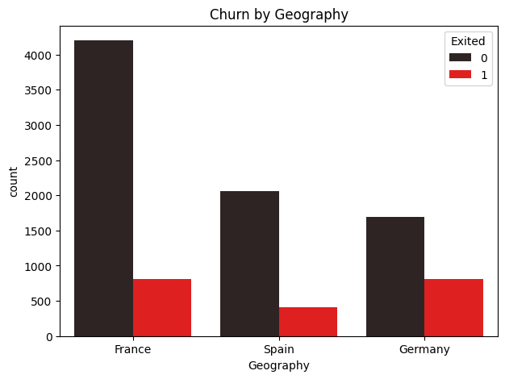
Compare churn status by geography

Slide 13
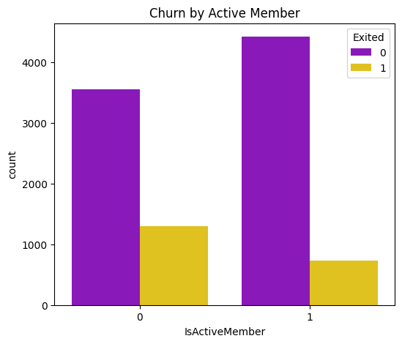
Compare churn status by active membership

Slide 14
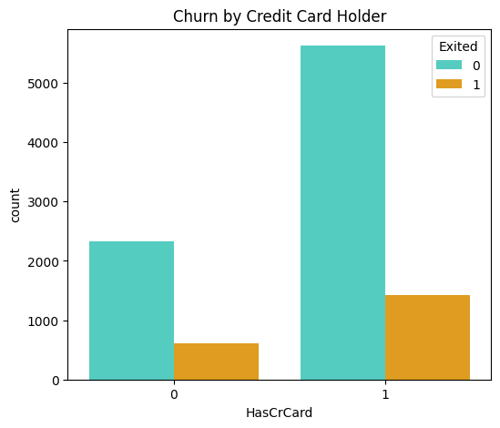
Compare churn status by credit card ownership

Slide 15
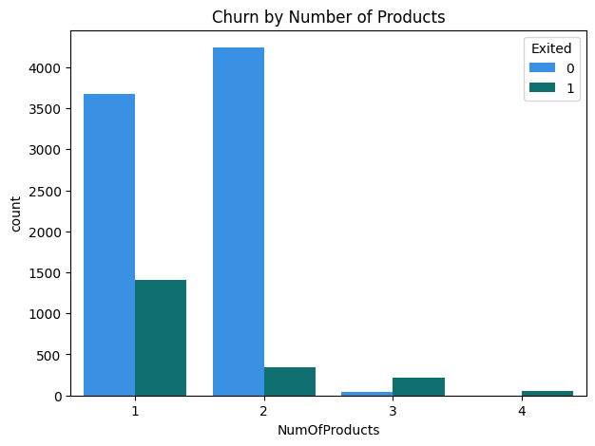
Compare churn status by number of products

Slide 16
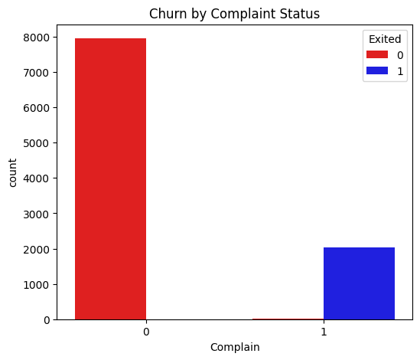
Compare churn status by complaints

Slide 17
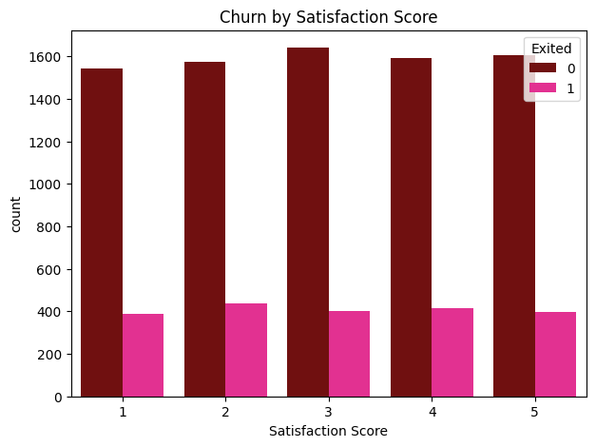
Compare churn status by satisfaction score

Slide 18
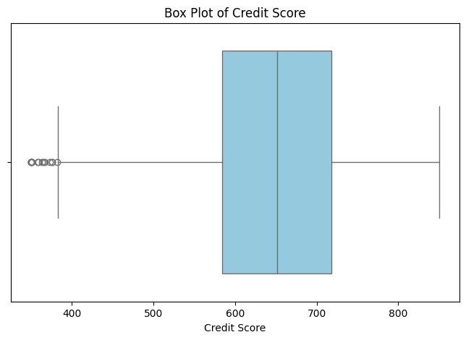
Box plot to identify outliers in customer credit scores

Slide 19
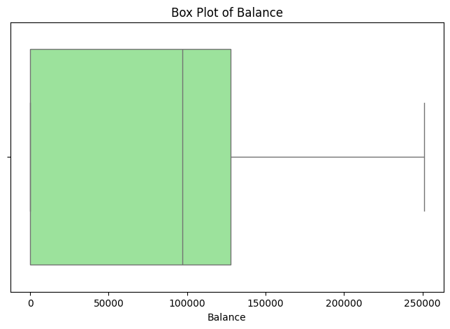
Box plot to identify outliers in customer account balances

Slide 20
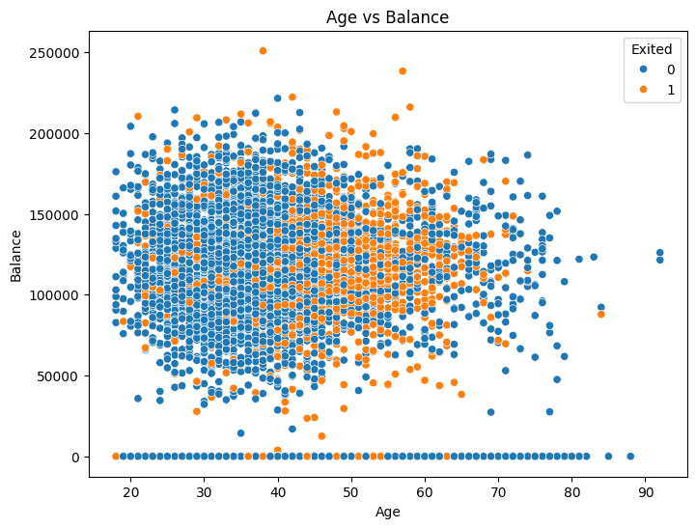
Scatter plot to visualize the relationship between age,balance,and churn status

Slide 21
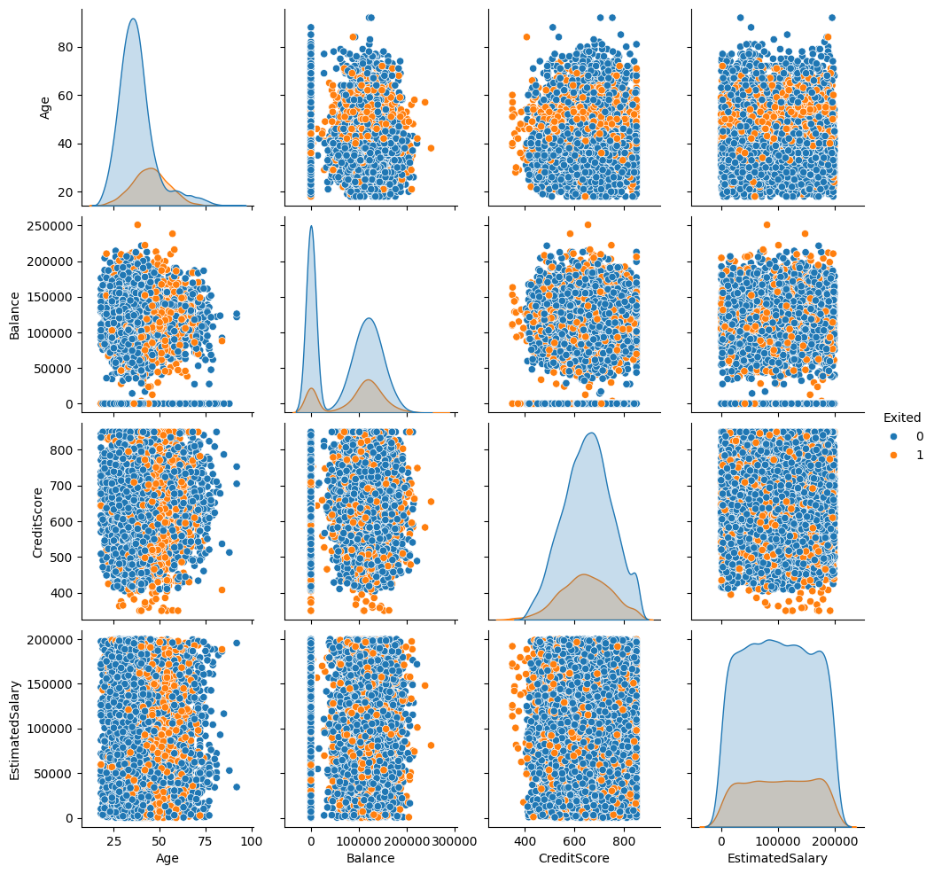
Pair plot to examine relationship among key features

Slide 22
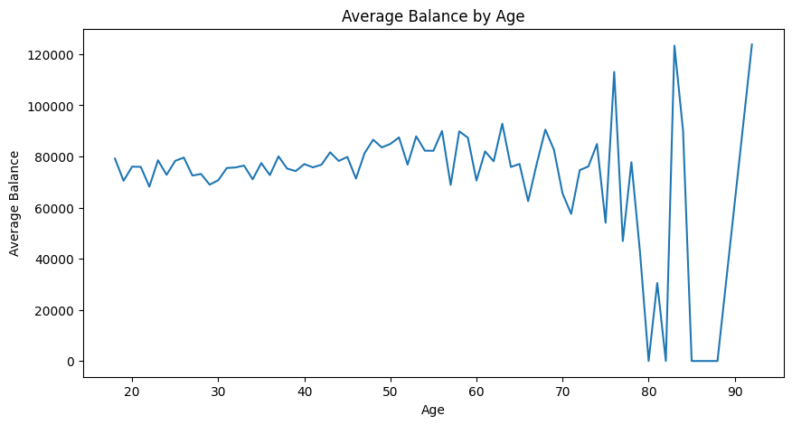
Plot the average account balance for each age group

Slide 23
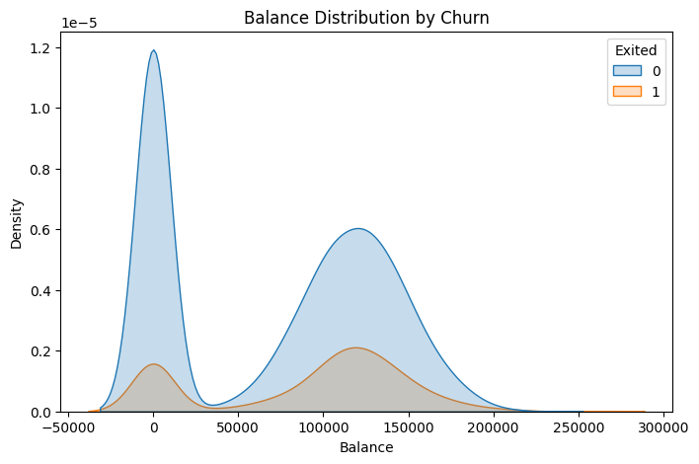
Density distribution of account balance based on churn status

Slide 24
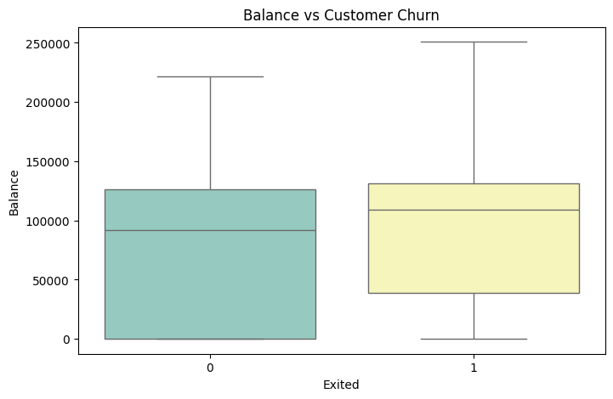
Comparing balance distribution between retained and churned customer using box plot

Slide 25
Key Insights
Customer behaviour varies across demographic groups.
Active members generally show better retention.
Complaints and satisfaction influence churn.
EDA supports business decisions.

Slide 26
Tools and technologies
Python
Pandas
NumPy
Matplotlib
Seaborn
Jupyter Notebook

Slide 27
Business Impact
Customer retention
Marketing optimization
Revenue improvement
Data-driven decision making

Slide 28
Future Scope
Logistic Regression
Random Forest
XGBoost
Dashboard
Real-time prediction

