Slide 1
Classic Models SQL Queries

Slide 2
1. Retrieve customer orders with product details
select c.customername,c.phone,o.customernumber,p.productname,p.productline,p.productdescription,p.quantityinstock,o.orderdate from products p
inner join orderdetails od on p.productcode = od.productcode
inner join orders o on o.ordernumber = od.ordernumber
inner join customers c on c.customernumber = o.customernumber
order by p.quantityinstock ;

Slide 3
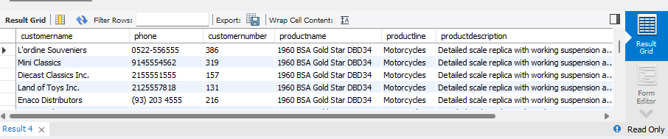
OUTPUT:
As you can see in the output, the table contains customer details and the products they purchased, along with product information. This allows the reader to analyze product sales data by category.
With the help of the customer's phone number, the reader can instantly contact them to provide necessary updates on product status. The Order Date column helps in identifying the oldest and newest customers.
Additionally, the Quantity in Stock column indicates the availability of products. If the quantity is low, it suggests higher demand, whereas a higher quantity may indicate lower demand.
Overall, this query helps businesses optimize inventory management and enhance customer engagement.

Slide 4
2. Find customers who have placed more than 5 orders (Subquery + HAVING)
select c.customername,c.customernumber,count(o.ordernumber) as total_orders from customers c
inner join orders o on c.customernumber = o.customernumber
group by c.customername,c.customernumber
having count(o.ordernumber) > 5;

Slide 5
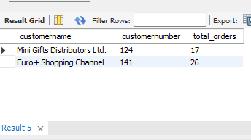
OUTPUT:
This query helps the reader analyze the customer's name along with their ID, where the total orders purchased by that customer are significant. These customers are a valuable asset to the company and should be placed on a top-tier customer list. This ensures they receive goodies after every five orders as a gesture of appreciation, encouraging loyalty.
By recognizing and rewarding these customers, the company can strengthen customer trust and retention, even during situations like stock shortages.

Slide 6
3. Get total revenue by product line (JOIN + GROUP BY)
Select
p.productline,sum(od.quantityordered * od.priceeach) as total_revenue f
rom productlines pl inner join products p on pl.productline = p.productline
inner join orderdetails od on od.productcode = p.productcode group by p.productline
order by total_revenue desc;

Slide 7
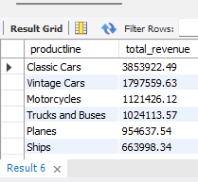
OUTPUT:
The following query helps the company analyze details of the product line that generated the total revenue amount for the company. On top, being the highest, indicates that "Classic Cars" is the best-selling product in the company and acts as the primary source of revenue. If the Classic Cars quantity is low when the demand is high, the company will automatically generate less revenue from the Classic Cars department.
With the help of this query, you can identify the least revenue-generating product line to make decisions like "How to improve this product line's revenue" and list down the factors explaining why "Classic Cars" perform better than "Trains." This allows the company to decide whether to keep listing the low revenue generator or remove it. This query provides valuable insights for data-driven product line decisions

Slide 8
4.Creates a view showing total quantity sold and revenue per product.
create view view_revenue as
(select p.productname,sum(od.quantityordered ) as total_quantity,sum(od.quantityordered * od.priceeach) as total_revenue from productlines pl inner join products p on pl.productline = p.productline inner join orderdetails od on od.productcode = p.productcode group by p.productname) ;
select * from view_revenue order by total_revenue desc;

Slide 9
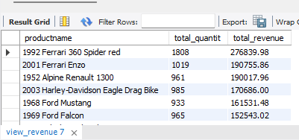
OUTPUT:
This data is derived from the view table, which indicates that this information is passed to other departments. This data is used to analyze the products that are sold more and the revenue they generated for the company. With this info, the company can improve the standards of total revenue generated by the product.
For example, let's say the "1969 Ford Falcon" has been sold less compared to last year, and the inventory is filled with those cars. In order to sell this car and clear inventory, the company will provide huge discounts and strategies to sell the car ASAP. This way, the newly generated revenue from that car increases, resulting in the increasing standards of that particular product

Slide 10
5. Create a temporary table for high-value customers (Temporary Table)
create temporary table temp_high_value_customer as
(select c.customername,sum(p.amount) as total_amount from customers cinner join payments p on c.customernumber = p.customernumber group by c.customername);
select * from temp_high_value_customer order by total_amount desc;

Slide 11
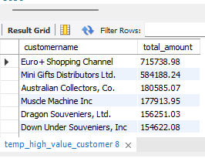
OUTPUT:
This temporary table is used to analyze the data without changing the original data. With the help of this information, the company can identify which of their customers are a loyal asset to them and can rely on them in cases of stock clearance. Also, one can know which customers are least valuable to them to prioritize order availability based on the customer's value to the company.
This data can also help the company think of ways to improve the least valued customers to become the most valued customers, maybe by providing trust-building factors and better quality of orders with transparency in the market value. Calculating customer value in terms of the amount paid rather than the quantity ordered is a more sensible approach because the quantity ordered can also be canceled later, but once the amount is deducted, it can't be returned again

Slide 12
6. Retrieve the top 5 customers by order value (JOIN + ORDER BY + LIMIT)
select c.customername,sum(od.quantityordered * od.priceeach) as total_orders_revenue
from customers c inner join orders o on c.customernumber = o.customernumber
inner join orderdetails od on od.ordernumber = o.ordernumber group by c.customername o
rder by total_orders_revenue desc
limit 5 ;

Slide 13
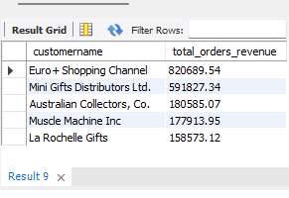
OUTPUT:
This query retrieves the top 5 customers based on order value, helping the company identify its most valuable clients.
By analyzing this data, the company can recognize high-revenue customers and ensure their payments are received as expected. Additionally, these top customers are likely regular buyers, making them valuable for long-term business relationships.
Businesses can use this insight for customer retention strategies, such as offering exclusive deals, festive rewards, or personalized services to strengthen trust. Over time, such customers may develop strong loyalty, sometimes even prioritizing the company's products over market alternatives

Slide 14
7 . Find employees who have not made any sales (LEFT JOIN + WHERE NULL)
select concat(e.firstname," ",e.lastname) as employee_name,e.employeenumber,o.ordernumber
from employees e left join customers c on e.employeenumber = c.salesRepEmployeeNumber
left join orders o on o.customernumber = c.customernumber where c.customernumber is null ;

Slide 15
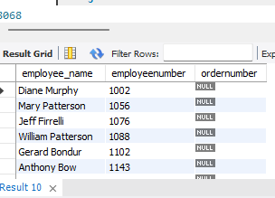
OUTPUT:
This query retrieves details of employees who have not made any sales. The data can be used to assess employee performance, identifying those who may need training or support to improve their sales skills. Additionally, if an employee consistently shows no improvement, the company can take necessary actions, such as issuing warnings or considering termination. Beyond individual performance, this data also helps the company analyze broader sales trends—for example, identifying market gaps or issues that prevent sales from occurring. By investigating these patterns, the company can refine its sales strategies, enhance customer engagement, and ultimately improve its overall service quality.

