Slide 1

Enhancing Hotel Reviews: Leveraging Robotic Process Automation and Generative AI for Sentiment Analysis
Md. Shafee Md. Adil

Slide 2
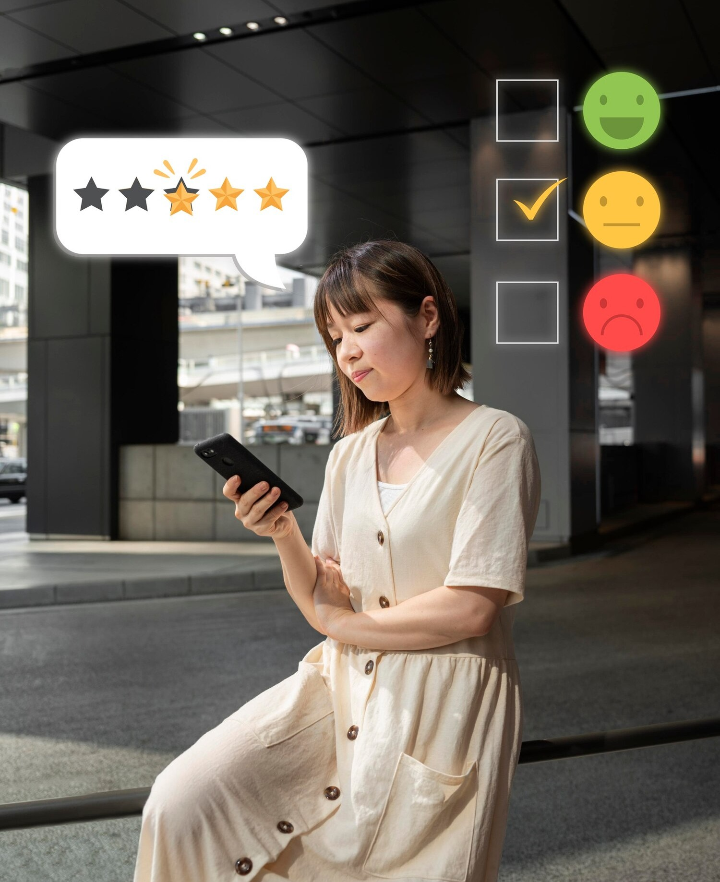





Introduction to Sentiment Analysis
In today's digital age,
a crucial role in shaping customer perceptions. By utilizing
and
, we can enhance the analysis of these reviews, providing deeper insights into customer
play
and .

Slide 3


Understanding Robotic Process Automation
streamlines repetitive tasks, enabling businesses to efﬁciently collect and process large volumes of data. In the context of hotel reviews, RPA can
automate the extraction of
from multiple sources, saving time and
resources.

Slide 4
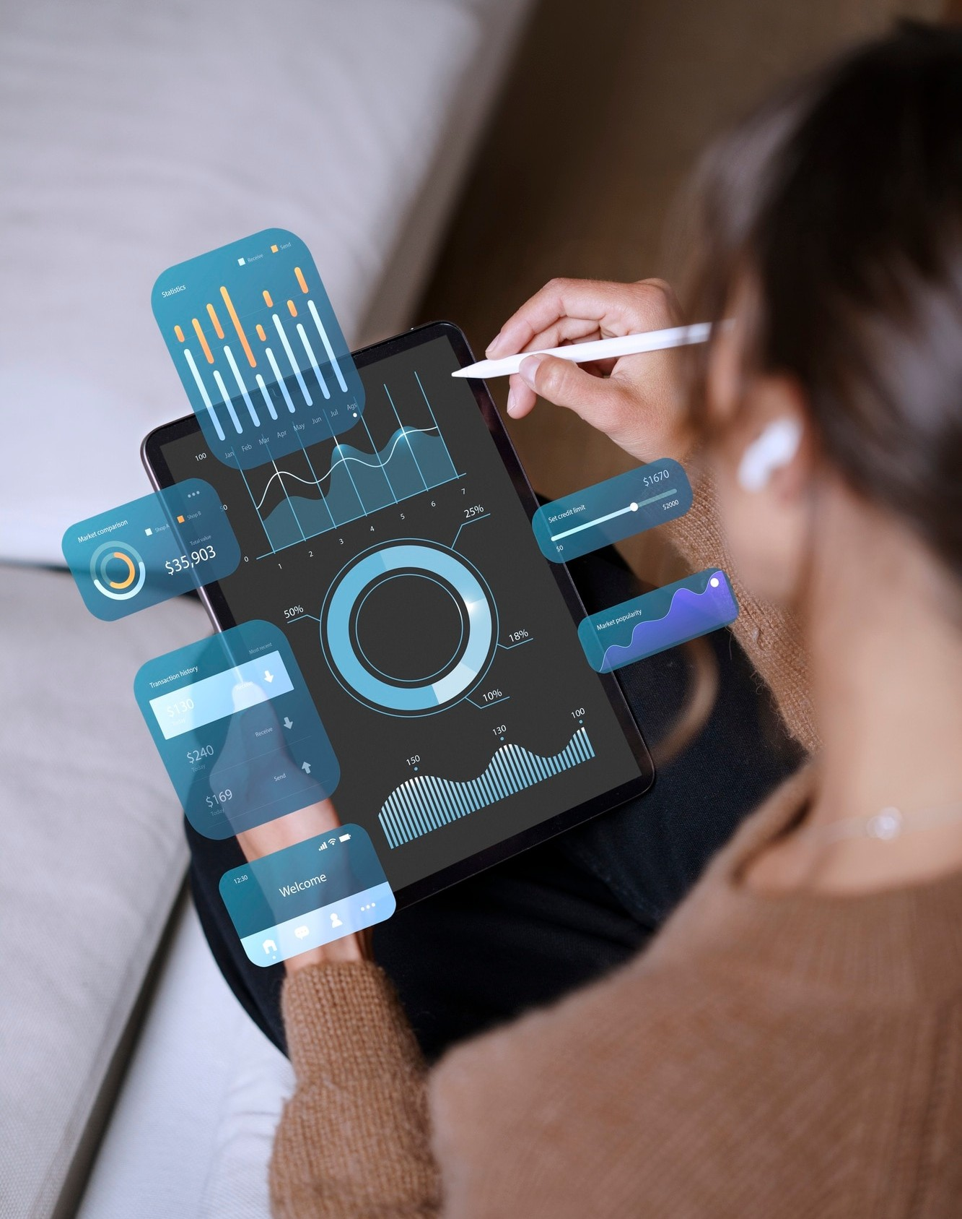




Role of Generative AI
can analyze and interpret textual data from hotel reviews, generating meaningful
insights. It can identify , , and
, transforming raw data into actionable information that enhances decision-
making.

Slide 5




Beneﬁts of Sentiment
Analysis
Implementing
allows hotels to understand guest experiences better. By identifying
and sentiments, hotels can improve their services, target marketing efforts, and ultimately boost .

Slide 6




Challenges in Implementation
While leveraging RPA and Generative AI offers numerous advantages, there are challenges such as ,
, and the need for continuous of AI models to ensure reliable sentiment interpretation.

Slide 7



Case Studies and Success Stories
Several hotels have successfully implemented RPA and Generative AI for sentiment analysis, leading to improved and increased . These case studies highlight the transformative impact of technology in the hospitality industry.

Slide 8
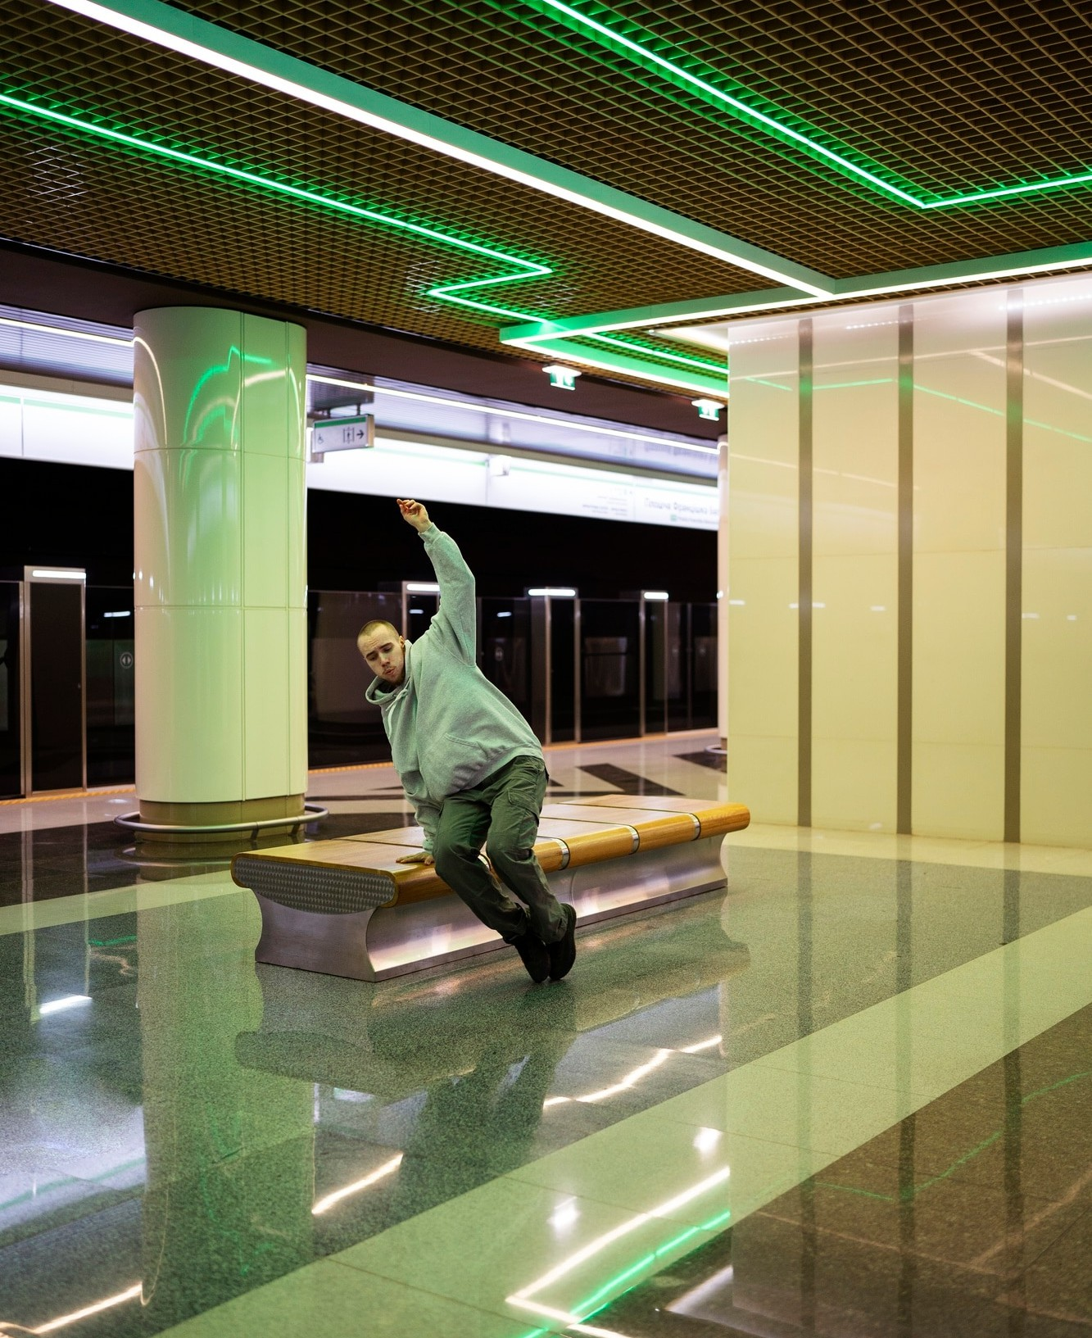


Future Trends in Hotel Reviews
The future of hotel reviews is promising with advancements in and
. As these technologies
evolve, we can expect even more sophisticated sentiment analysis tools that will provide deeper insights into customer and preferences.

Slide 9


Conclusion and Key Takeaways
In conclusion, leveraging and for sentiment analysis can signiﬁcantly enhance the understanding of hotel reviews. By embracing these technologies, hotels can improve
, optimize services, and stay competitive in the evolving hospitality landscape.

Slide 10
Thanks!

