Slide 1
IMAGE BASED CAPTCHA
Submitted to – Isha Ma’am

Slide 2

Intro
Captcha is used for human verification.
Image captcha is more secure than text based captcha.
Challenge image consists in a combination of pictures representing different categories

Slide 3
Requirements
Requirements of this project is to display some images
Based on the images user has to select that image which specify the question
After clicking the image button, Answers should be verify with the user response

Slide 4
Design and GUI
We use python to write the code and tkinter to implement Graphical User Interface.
Tkinter – is a python library user for GUI
from tkinter import *

Slide 5
Coding
Python – To write the code
SQLITE3 – To handle the database for the project
import sqlite3
We make use of classes in our coding part so that we have to write less code.
Also we uses the inheritance of the classes for reusing the code again and easy access to the require data.

Slide 6
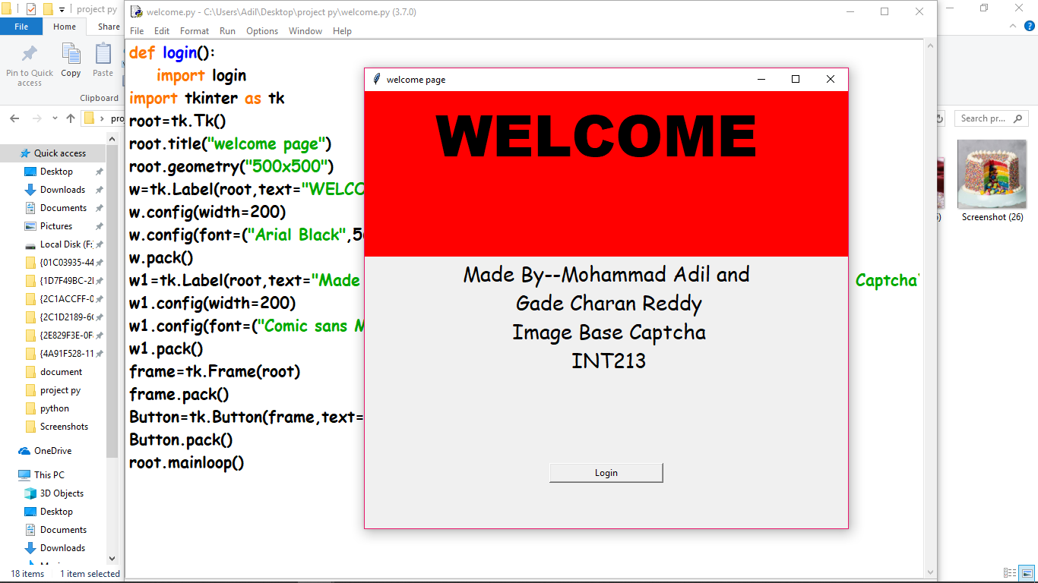
First Welcome Page[GUI]

Slide 7
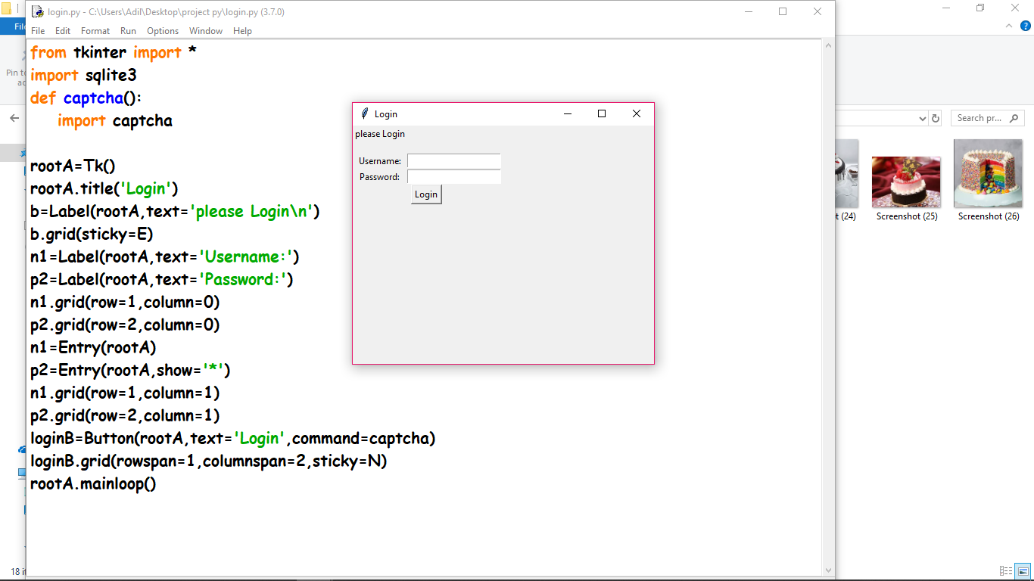
Login Page using [GUI]

Slide 8
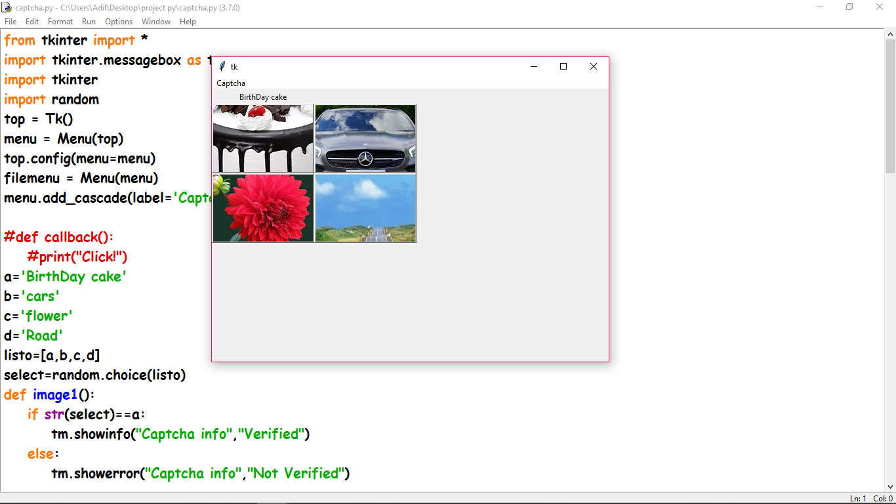
Verify image captcha using GUI and random function

Slide 9
FILES
Database.db
GUI
Random Function
messagebox

Slide 10
Features
RESET
User can reset what ever he/she selected
Click captcha
The given captcha name click the given captcha then verify
If we click the given captcha then it is verified.

Slide 11

After a successful response, this page will open.
Thanks<3

