Slide 1



FYP-I Mid Evaluation Presentation

Slide 2

Outline

Slide 3
Introduction

Slide 4
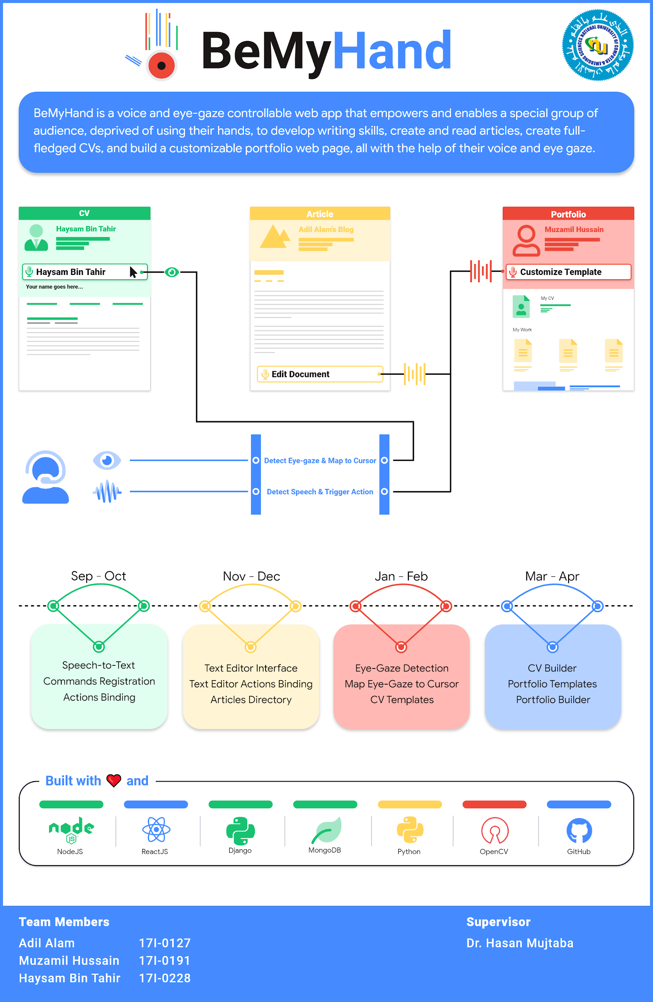
FYP POSTER

Slide 5
Design

Slide 6
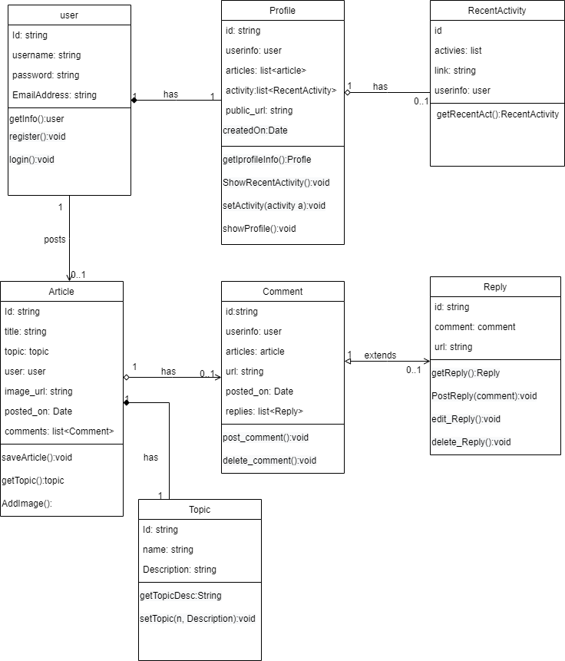
Design - Class Diagram

Slide 7
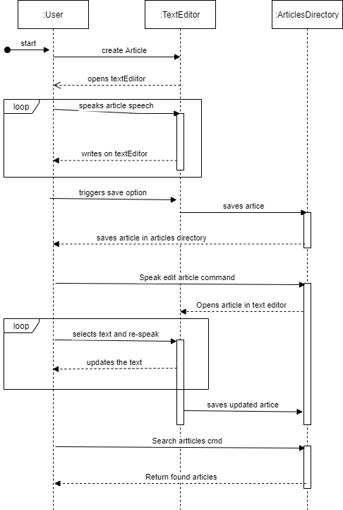
Sequence Diagram

Slide 8
Implementation

Slide 9
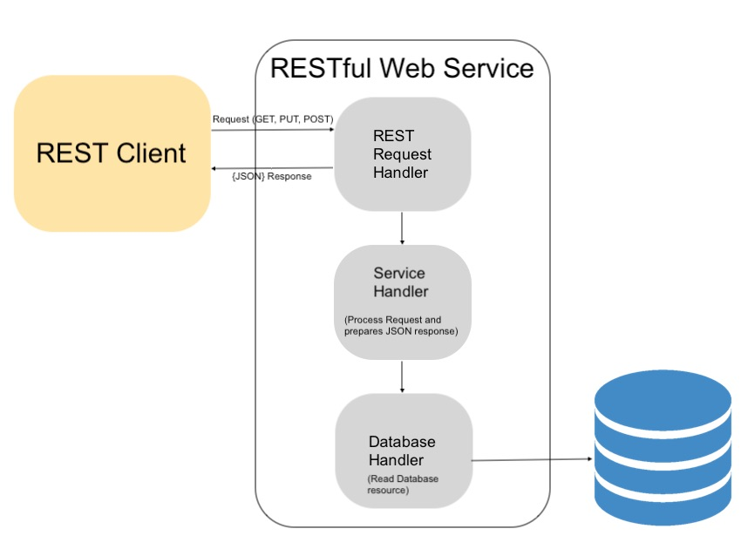
Implementation - Backend
Followed REST Architecture and have implemented our backend that acts like a web service for our client.

Slide 10
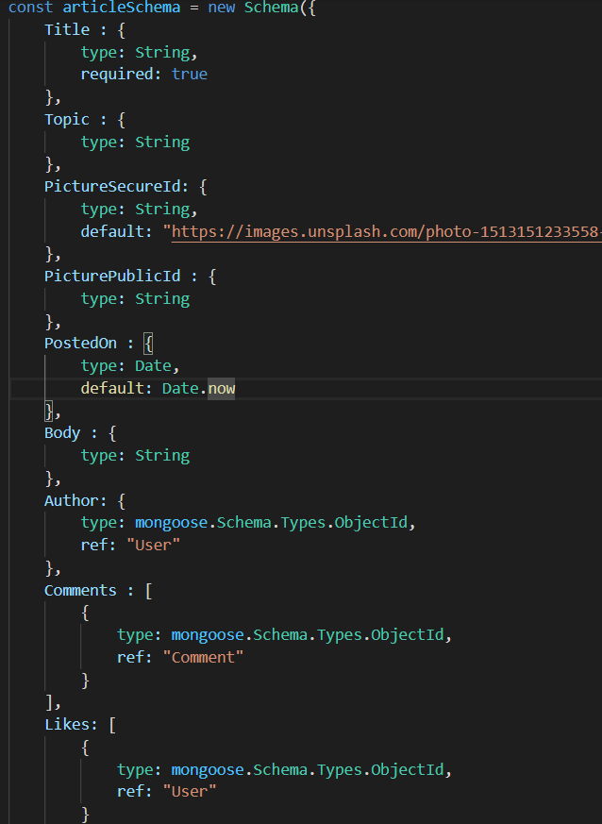
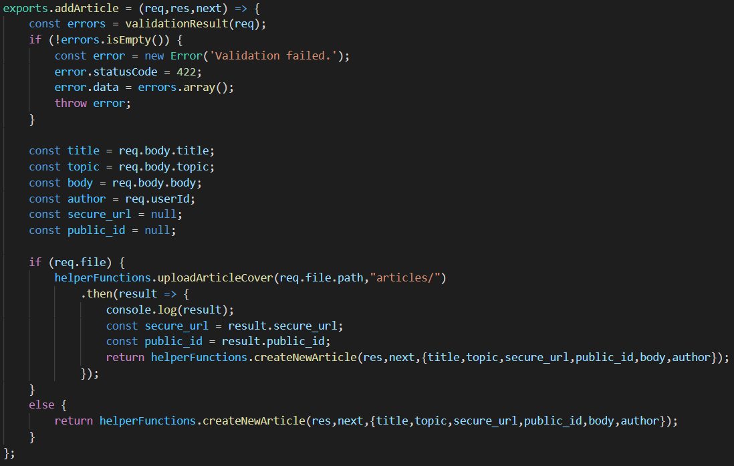
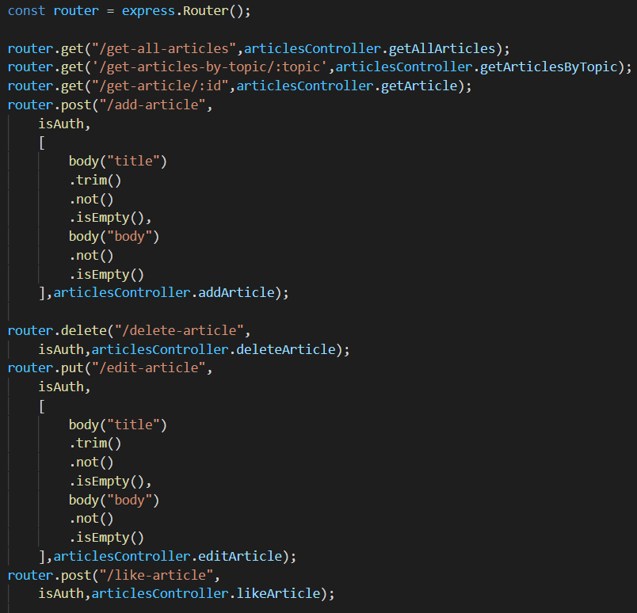
Implementation - Backend (contd …)
Model
Controller
Route

Slide 11
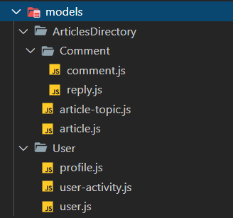
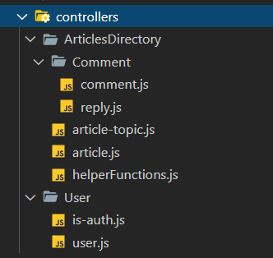
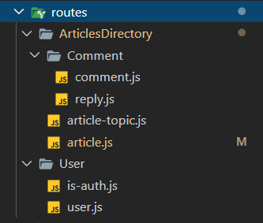
Implementation - Backend Structure
Modular Structure

Slide 12

Major Part - Handle User Interactions

Slide 13

Implementation - React WebSpeech Hook
What did we get?
Hey there, I am some raw text string without any purpose

Slide 14

Implementation - Translate actions
const setEditorContentProgramatically = (text) => {
let shouldProvoke = true;
commands.forEach(cmd => {
if (text === cmd.command) {
shouldProvoke = false;
}
})
if (text.includes('set title'))
shouldProvoke = false;
if (showTopics)
shouldProvoke = false;
if (shouldProvoke) {
setEditorState(currEditorState => {
return insertText(text.length > 0 ? text + ' ' : text, currEditorState);
})
}
};
Translated to
const insertText = (text, editorState) => {
const currContent = editorState.getCurrentContent();
const currSelection = editorState.getSelection();
const newContent = Modifier.replaceText(currContent, currSelection, text, editorState.getCurrentInlineStyle());
const newEditorState = EditorState.push(editorState, newContent, 'insert-characters');
return EditorState.forceSelection(newEditorState, newContent.getSelectionAfter());
}
Typing Text into Editor

Slide 15
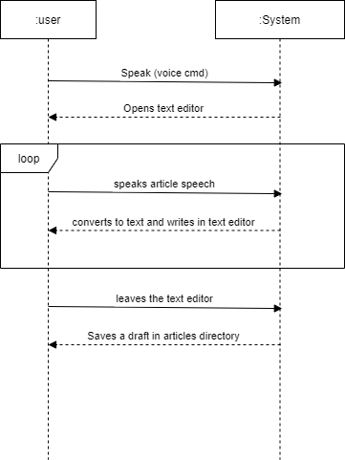
SSD Text Editor

Slide 16
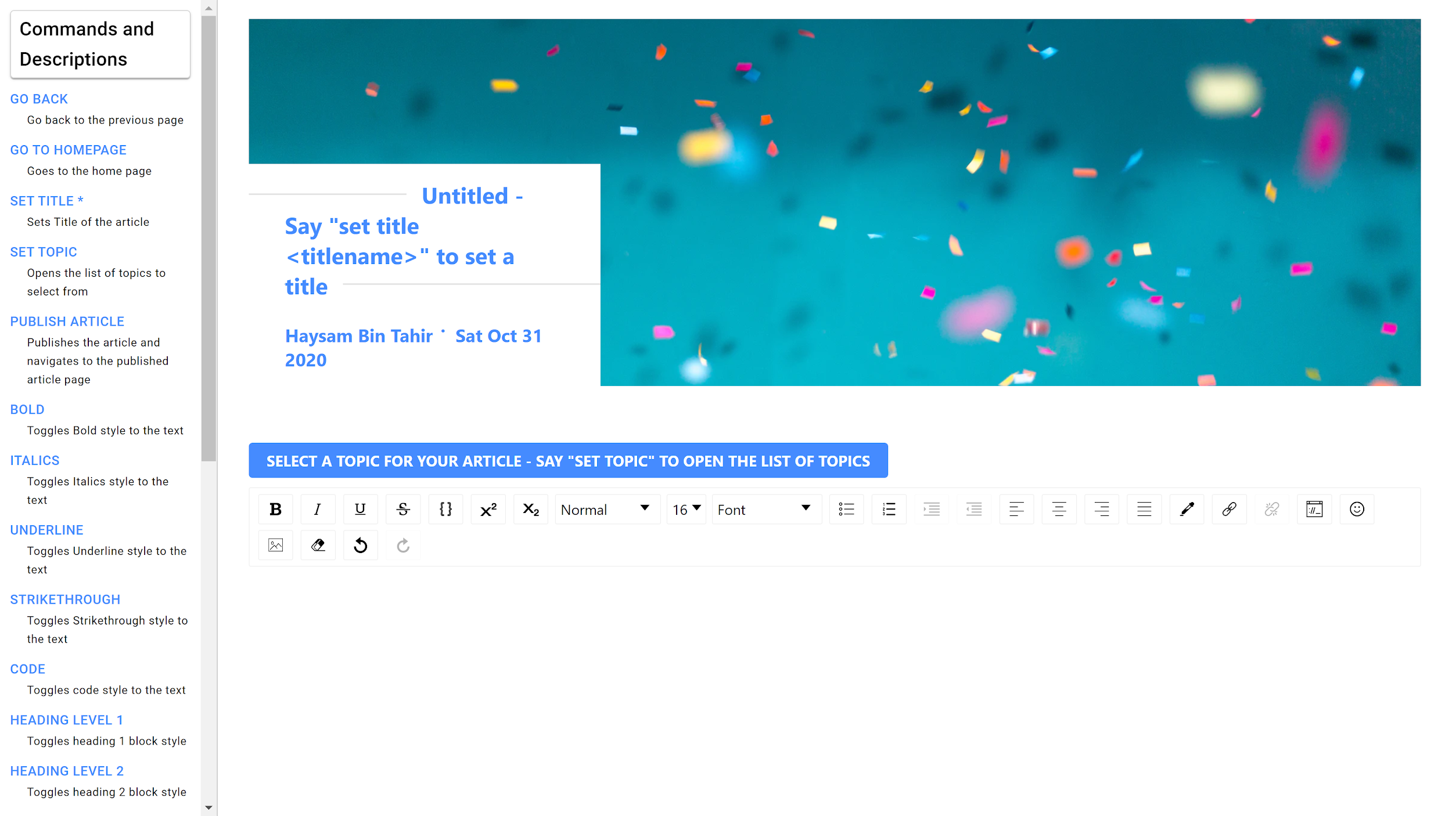
Implementation - Text Editor

Slide 17
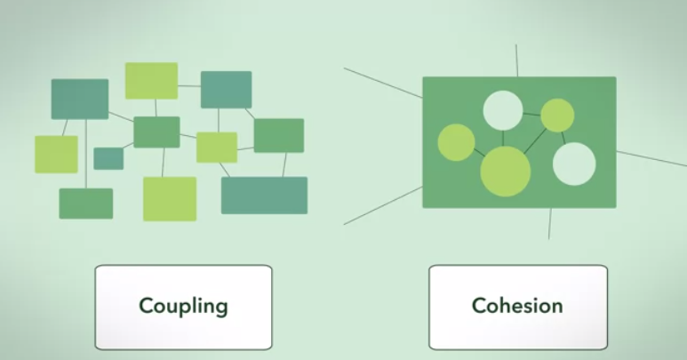
Technical Challenge - Low Coupling, High Cohesion

Slide 18
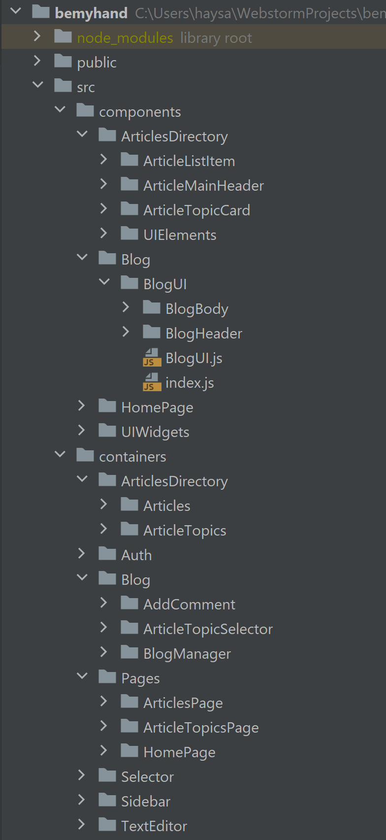
Implementation - Component Architecture

Slide 19
Implementation - Code Splitting
Before
After

Slide 20

Implementation - Validate and Secure Routes
Validation of routes and payload sent to the server
Errors are thrown and handled through promises and custom validators
Secure routes through JWT (JSON Web Tokens) standard and transmit data between client and server securely

Slide 21
Implementation - JWT Authentication
module.exports = (req, res, next) => {
const authHeader = req.get('Authorization');
if (!authHeader) {
const error = new Error('Not authenticated.');
error.statusCode = 401;
throw error;
}
const token = authHeader.split(' ')[1];
let decodedToken;
try {
decodedToken = jwt.verify(token, 'Thisisasecret-password-tercesasisihT');
} catch (err) {
const error = new Error('Not authenticated.');
error.statusCode = 401;
throw err;
}
if (!decodedToken) {
const error = new Error('Not authenticated.');
error.statusCode = 401;
throw error;
}
req.userId = decodedToken.userId;
next();
};
A JSON Web Token consists of following three things
Header
Payload
Signature
Client has to set authorization header while sending request to the server
Bearer + token

Slide 22
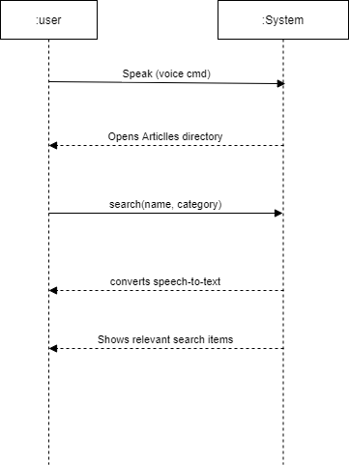
Implementation - SSD Articles Directory

Slide 23

Implementation - Articles Directory

Slide 24
Implementation - HCI Usability
Categorize Articles
Provide predefined topics
Create ease of access

Slide 25

Implementation - HCI Usability

Slide 26
Future Prospects

Slide 27
Future Prospects - Features
Search
Maintain Article Version History
Suggest Topic Automatically to the User Writing Article Using ML
Suggest Images Automatically Within the Text Editor after Classification of the Current Text in the Text Editor
Article Drafts
Published and unpublished Articles
Adding more styles and functionalities to the text editor
Popular and trending articles filter

Slide 28
Future Prospects - Technical Challenge
Maintain Article Version History
Prevent overload on DB
Use appropriate Data Structure

Slide 29
Future Prospects - Technical Challenge
Implement Search in Articles Directory
Search with Name
Search with substring
Search with category
Filter Articles

Slide 30

Demonstration Video

Slide 31
Thank You

