Slide 1
Battery Management System
By students Adil Arystanbek and Ganeshram Manisekaran Sujatha
2025.10.28

Slide 2
Project basics
A project to design a manufacturing ready Battery Management System:
Capable of monitoring individual cell voltages of a 4 cell battery pack.
Capable of monitoring the temperature of the battery pack.
Capable of monitoring battery current.
Control its charge and discharge.

Slide 3
Project specifications
All components have to be SMD.
Temperature monitoring (via two sensors).
Individual battery cell voltages measurement.
MOSFET driven switch (both charging and discharging).
Current measurement, including over current protection (10A).
Plugin design to connect a NUCLEO-L15RE board to the BMS circuit.
STM32 controller with over/under voltage per cell (2.5V min, 3.65V max. per cell),
over/under temperature (charge: 0C to 40C and discharge: -20C to 40C).

Slide 4
Tools used
Version Control - GitHub.
Circuit Simulation - LTspice.
CAD - KiCAD.

Slide 5
Components
Instrumentation Amplifier: 595-INA826AIDR
Thermistor: 504-NRBE104J3435B2J
MOSFET: 781-SI4116DY-E3
Multiplexer: 595-TMUX1204DQAR
Zener diode: 78-MMSZ4683-HE3_A-08
Connector: 737-RS2BE-20-G-SMT, 437-8018700240002101, 649-1012938090202ALF
Resistors: 708-RNCE0805BTE10K0, 667-ERJ-UP6D1600V, 603-PU2512FKNP50R01L

Slide 6
Power Efficiency
Battery = 9 Amps, 12.8 V, 111.6 W.
Instrumentation Amp = 200 uA ~ 2.56 mW.
NMOS = 8.6 mOhm ~ 0.6966 W.
MUX = 10 nA ~ 128 nW.
MCU(at highest possible mode of operation) = 84 uA ~ 277.2 uW
Power Efficiency / Parasitic Efficiency: 99.37%

Slide 7
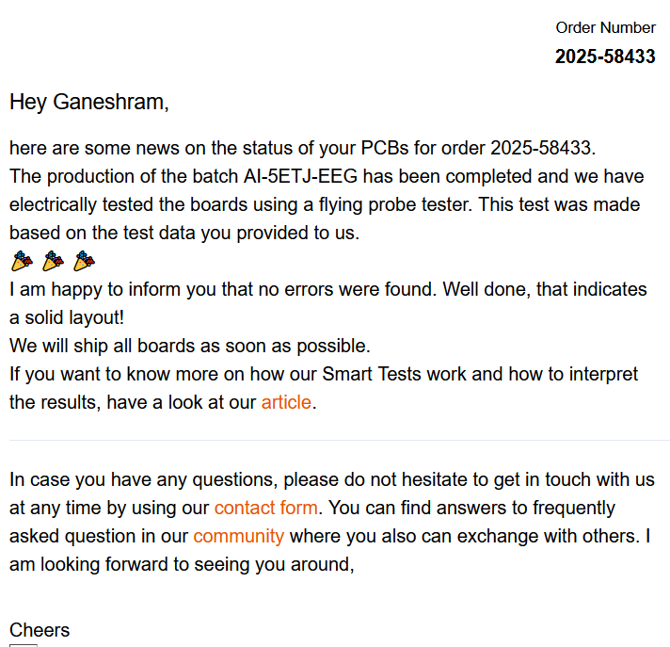
Manufacturer choice
AISLER.
EU based, German.
Fast delivery.
Accepts KiCAD files.

Slide 8
Extra design considerations
Arduino plugin done through Morpho pins.
No 90 degree angles present for the tracks.
1 mm and 0.5 mm track sizes used.
No ICs were used.
2 layer PCB.

Slide 9
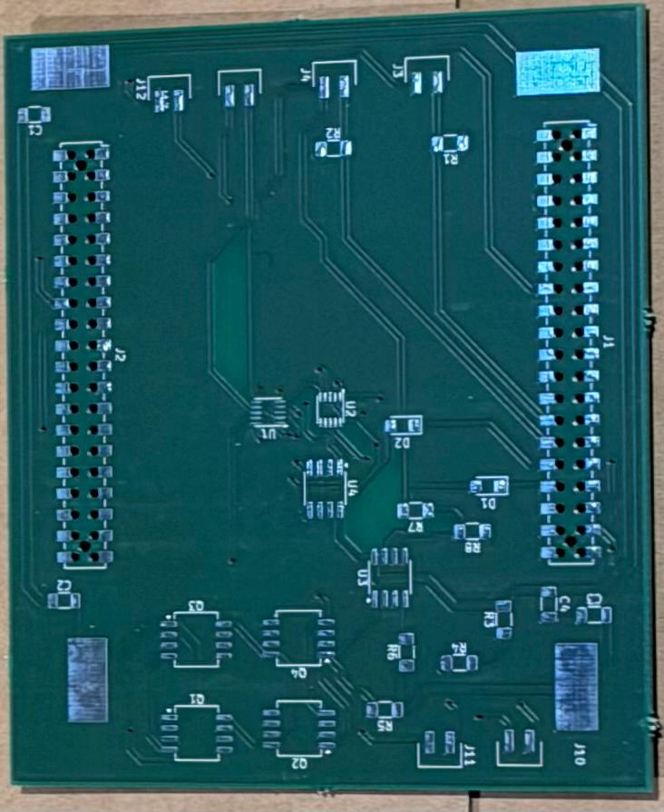
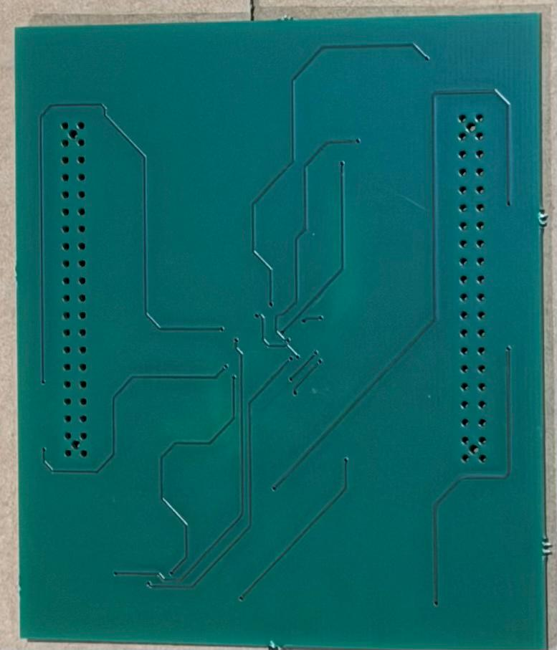
Delivered product

Slide 10
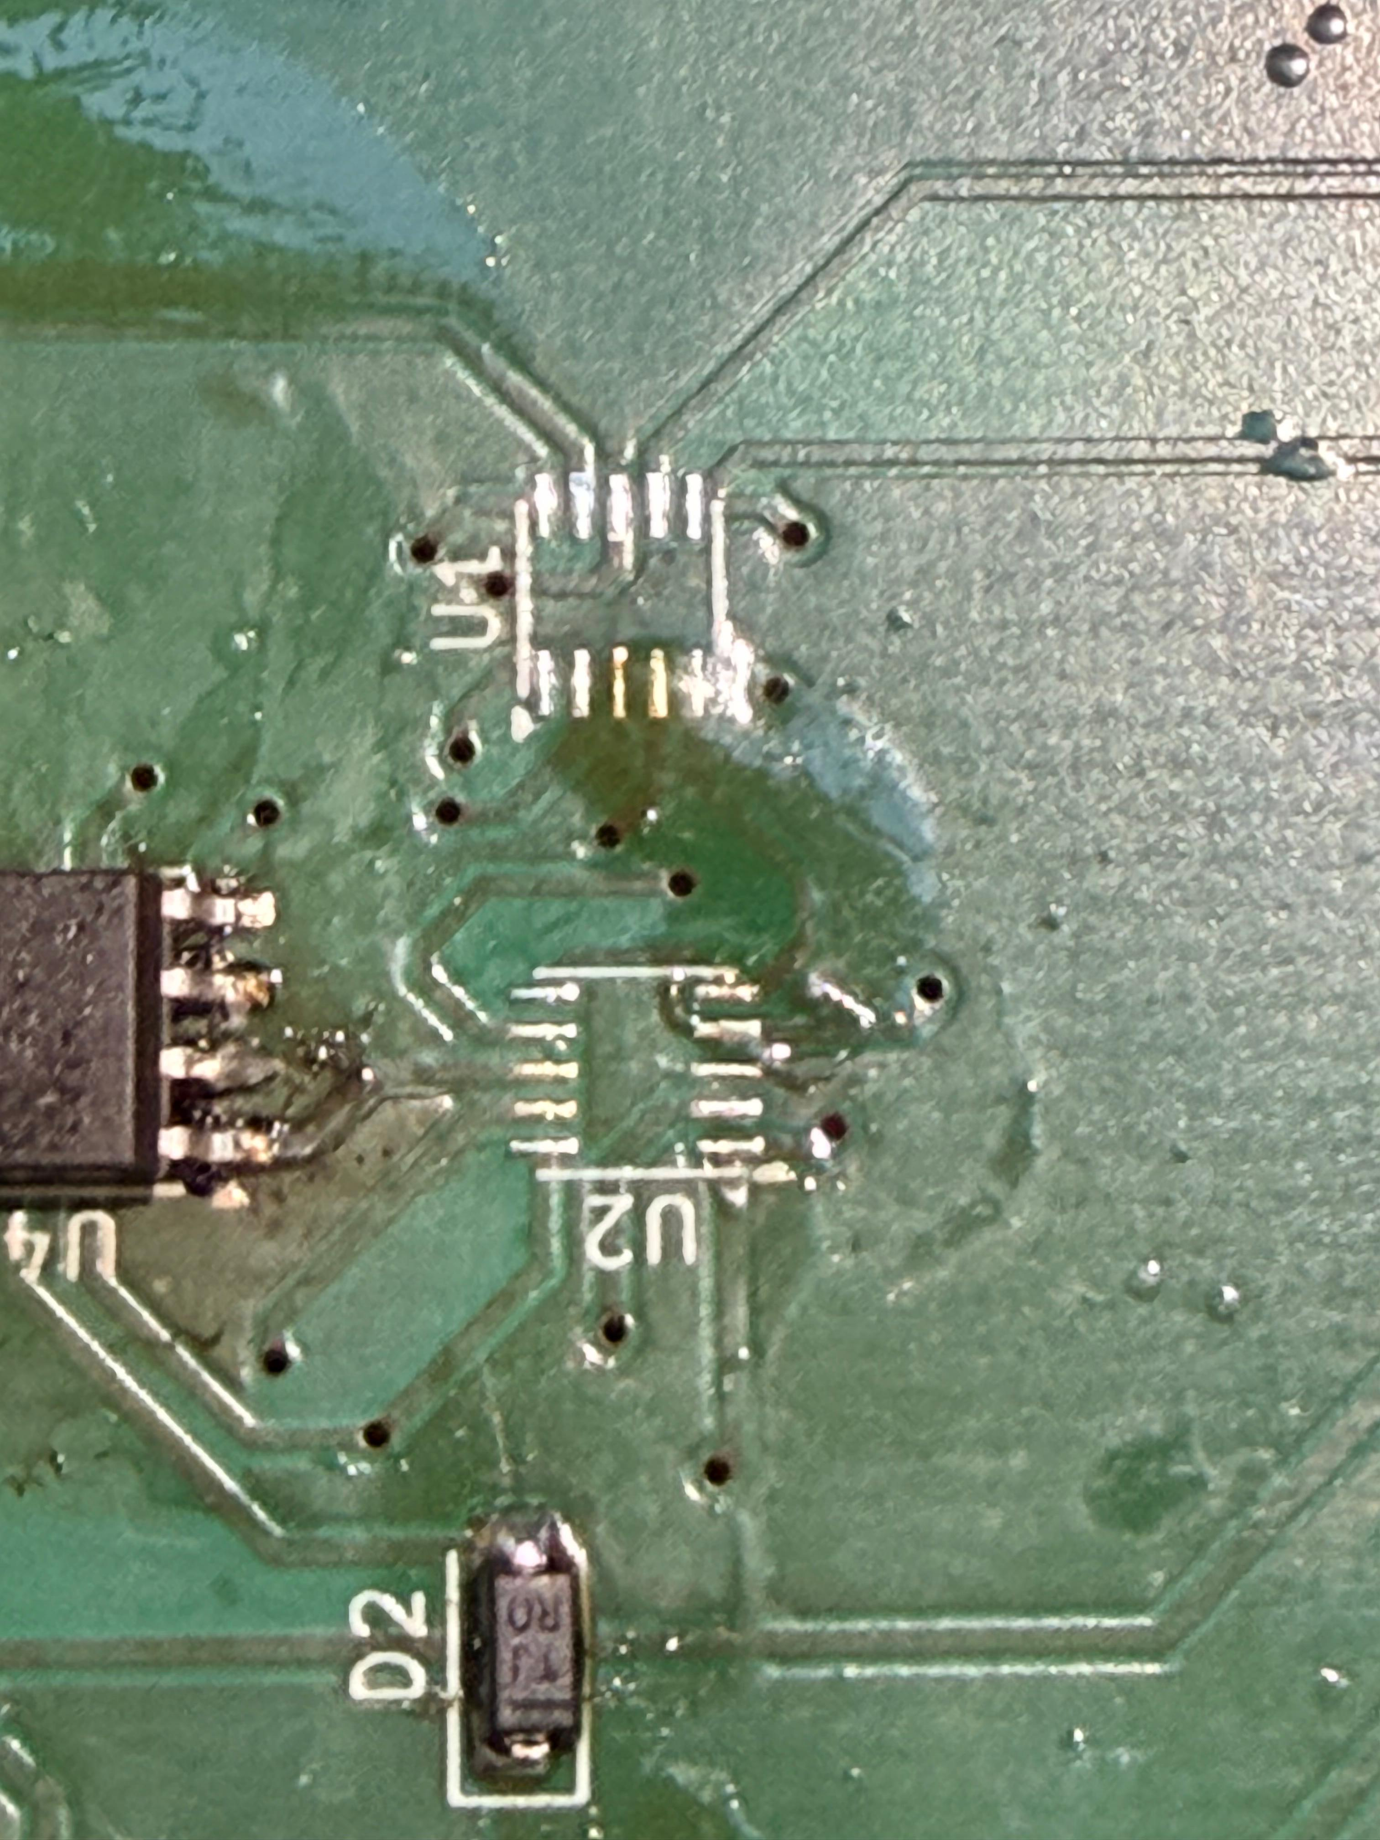
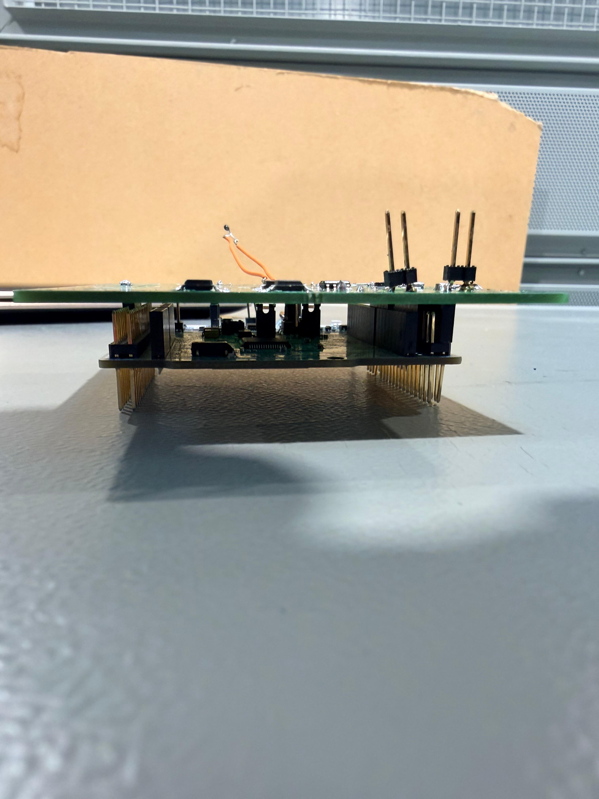
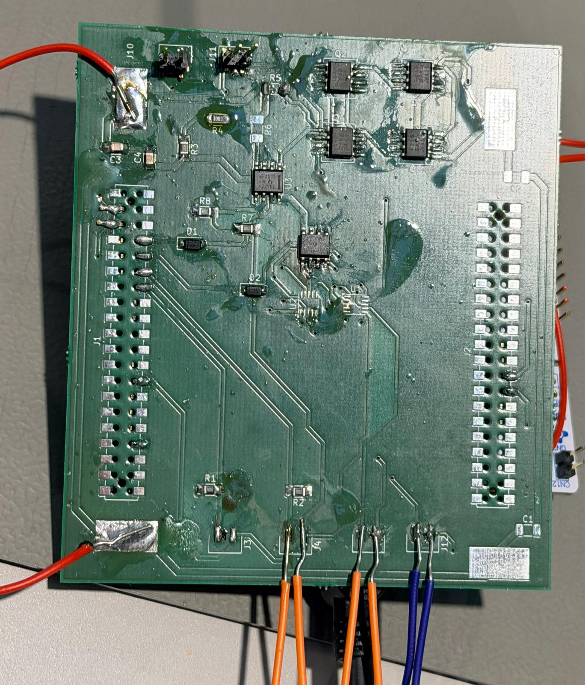
Soldering

Slide 11
Testing - Mistakes
Temperature measurement:
Design failure.
Current measurement:
Incorrect footprint.
Voltage measurement:
Bad choice of a component.

Slide 12
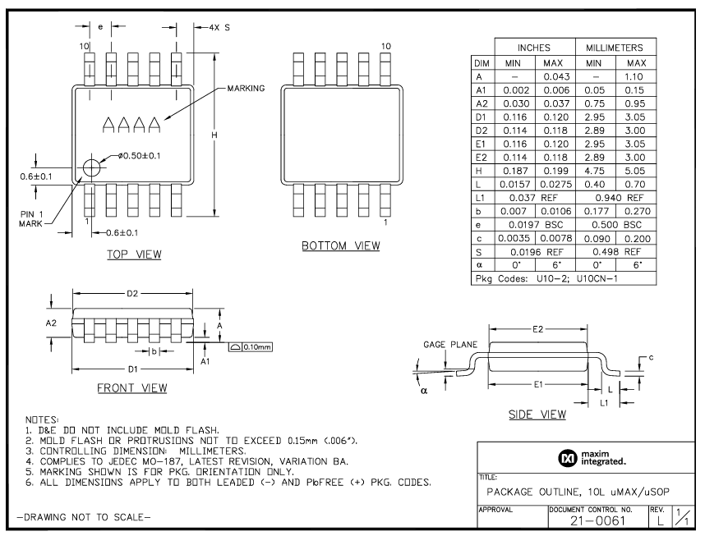
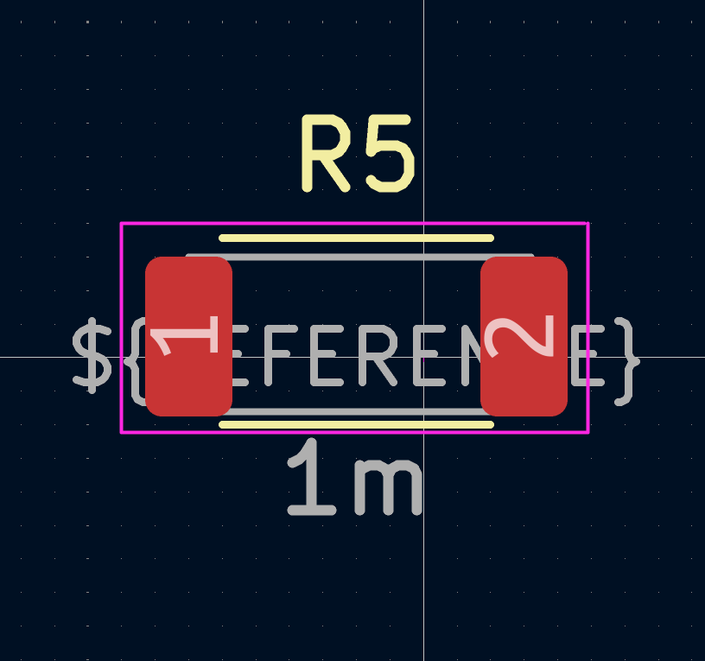
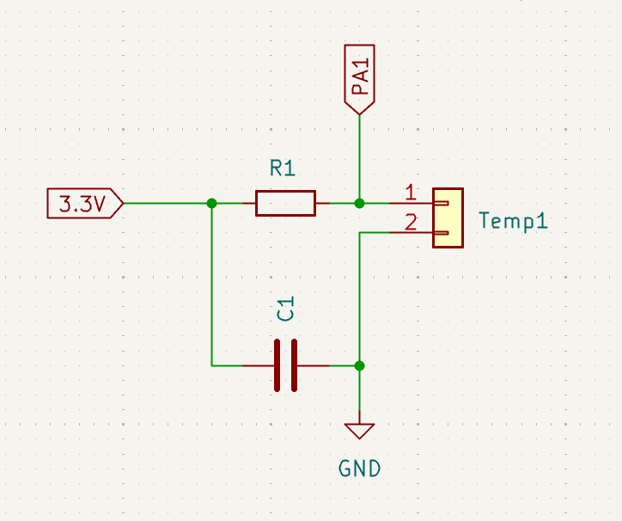
Testing - Fixes

Slide 13
Questions & Answers section

