Slide 1
Team
Shojib Talukder - 011201110 (Test in Burp Suit)
Samman Tasnim - 011201107 (Test in JMeter)
Md. Masum Khondhoker Efaz - 011201108 (Test in Cypress)
Fuad Hasan - 011201110 (Test in Selenium)

Slide 2
Burp Suite
Burp Suite is a leading web application security testing tool used by cybersecurity professionals to identify and fix vulnerabilities in web applications. It provides a comprehensive set of features, including proxy, scanner, intruder, and more, to help ensure the security of web-based systems.

Slide 3
Proxy
Burp Proxy operates as a web proxy server between the browser and target applications. It enables intercept, inspect, and modify traffic that passes in both directions

Slide 4
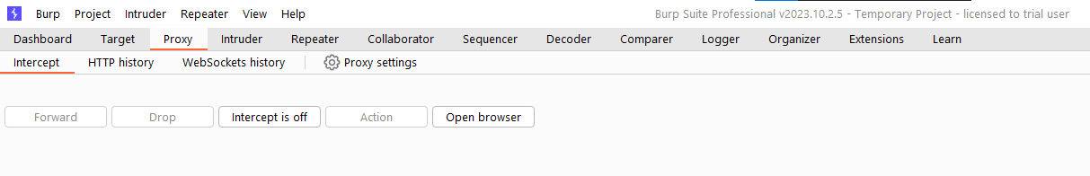
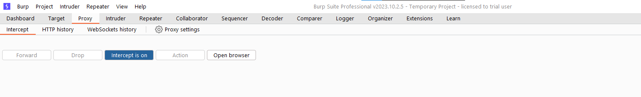
Experiment Design
Proxy Setup:

Slide 5
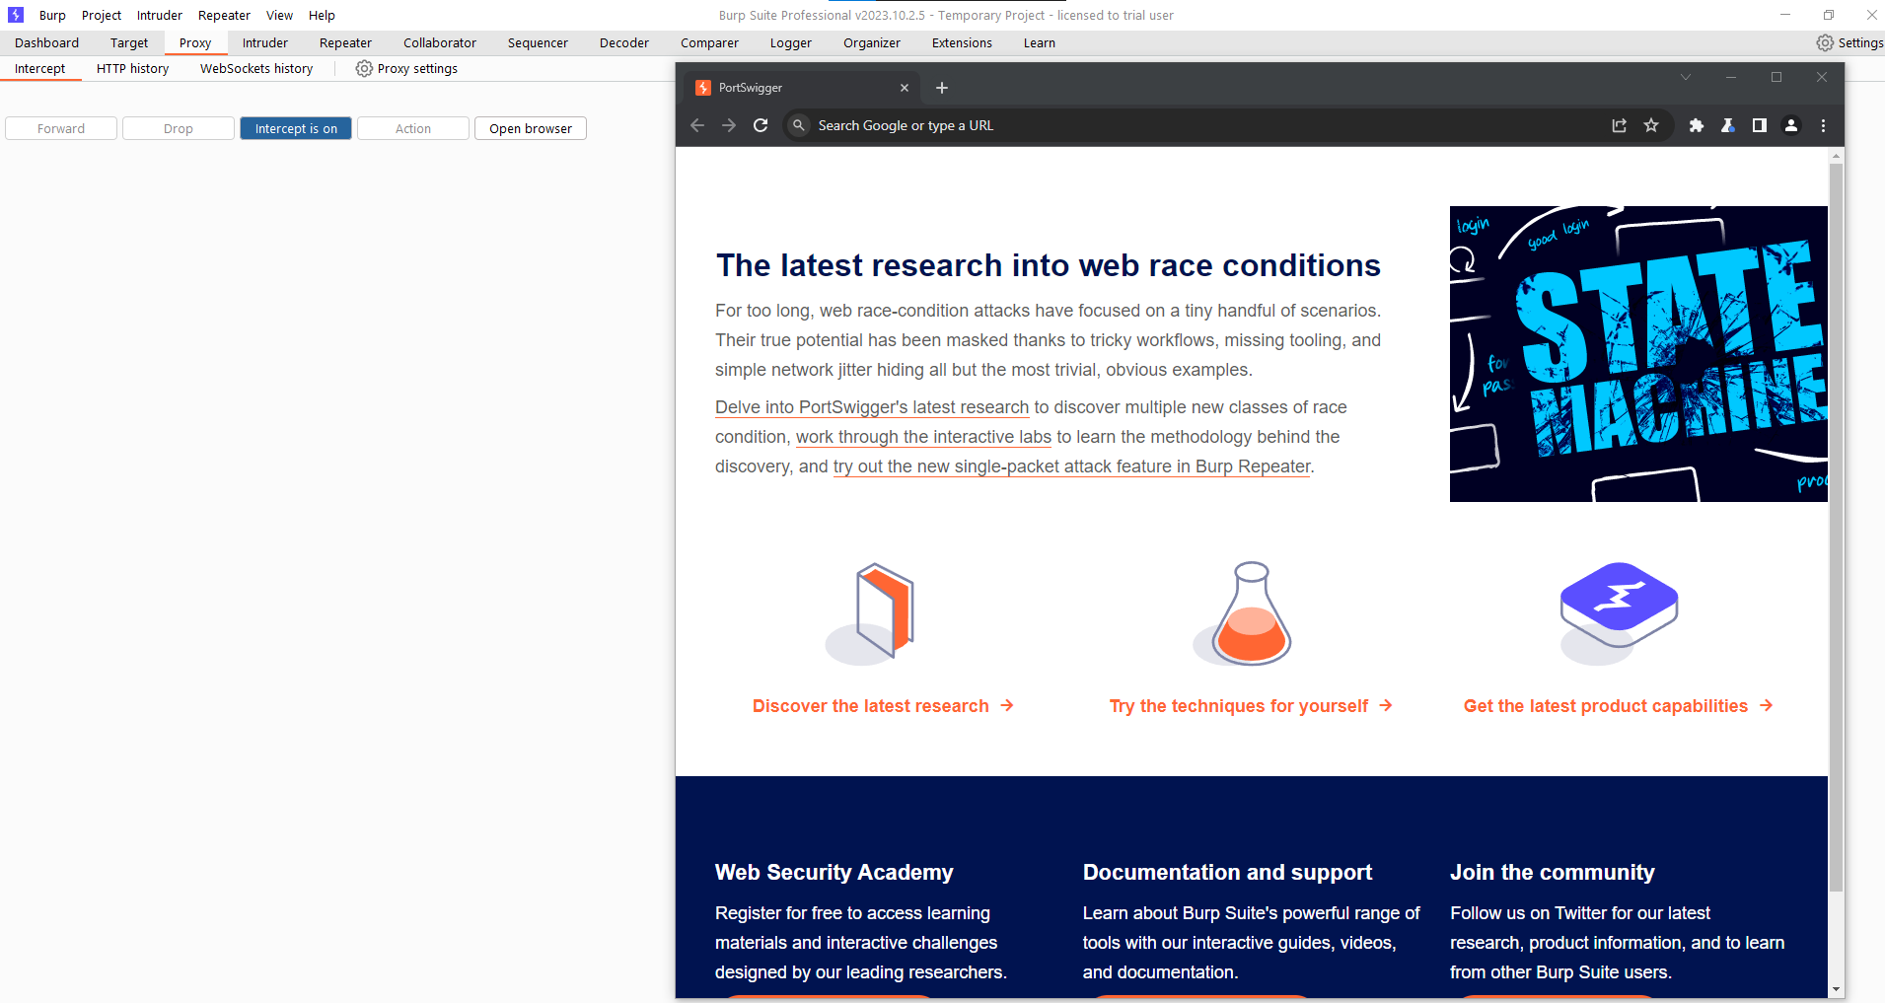
Proxy Setup:

Slide 6
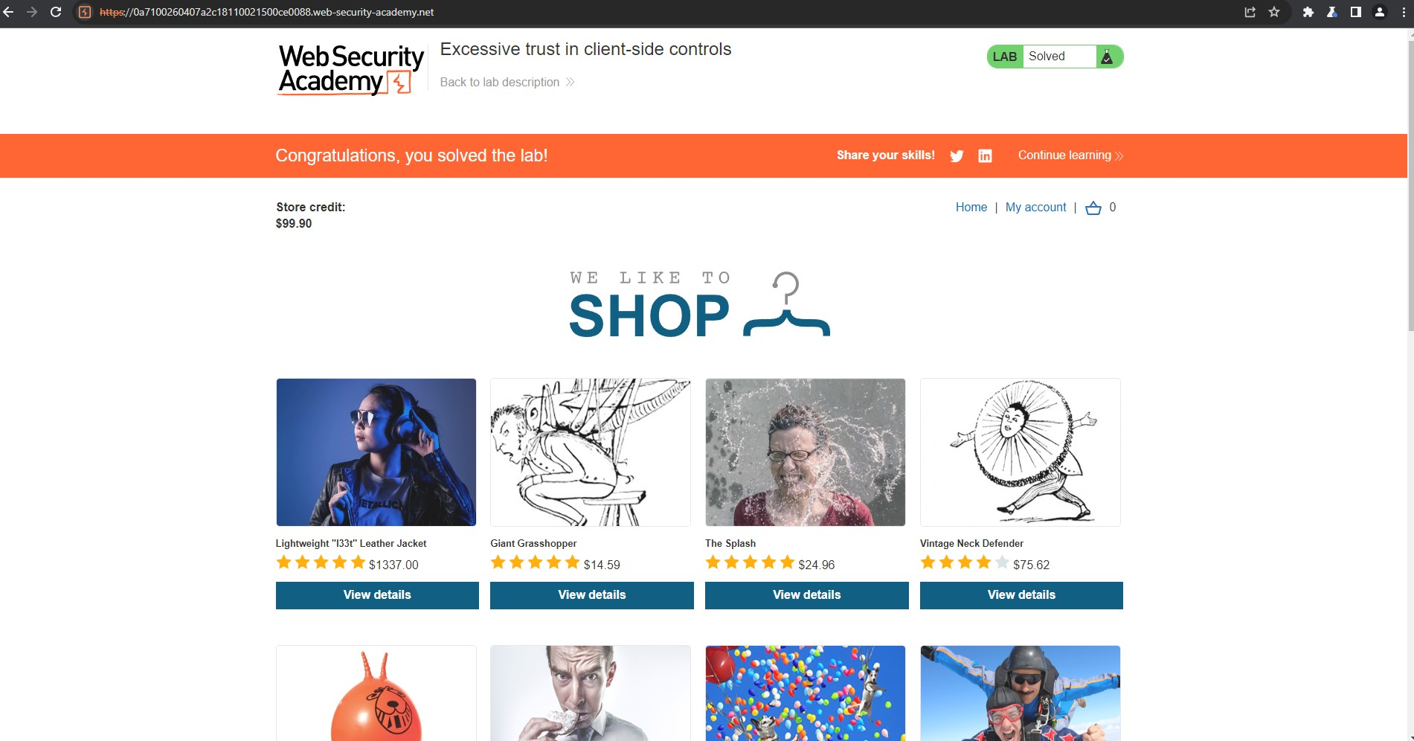
Test Selection
Modifying the HTTP Request.
Website For Testing

Slide 7
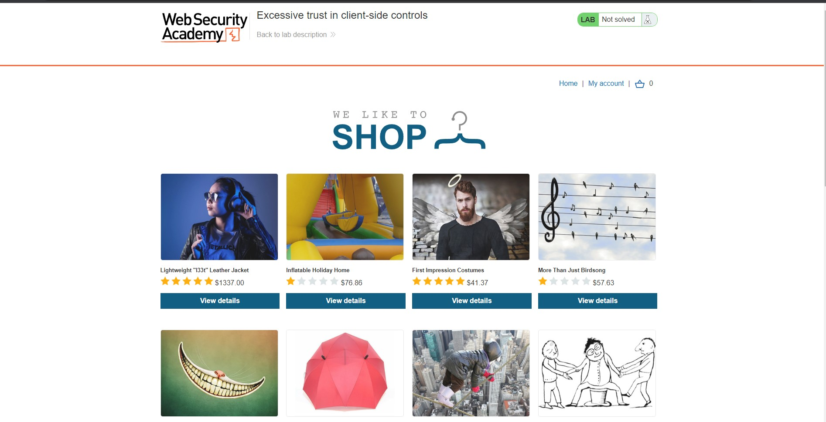
Test step of Modifying the Request
Step 1: Access the vulnerable website in Burp's browser

Slide 8
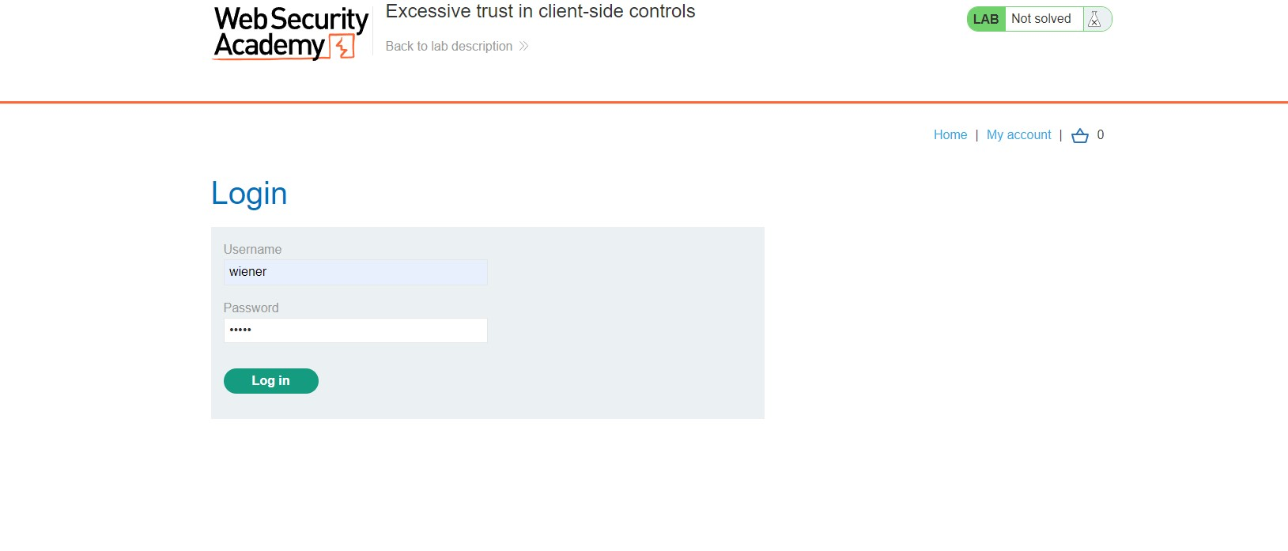
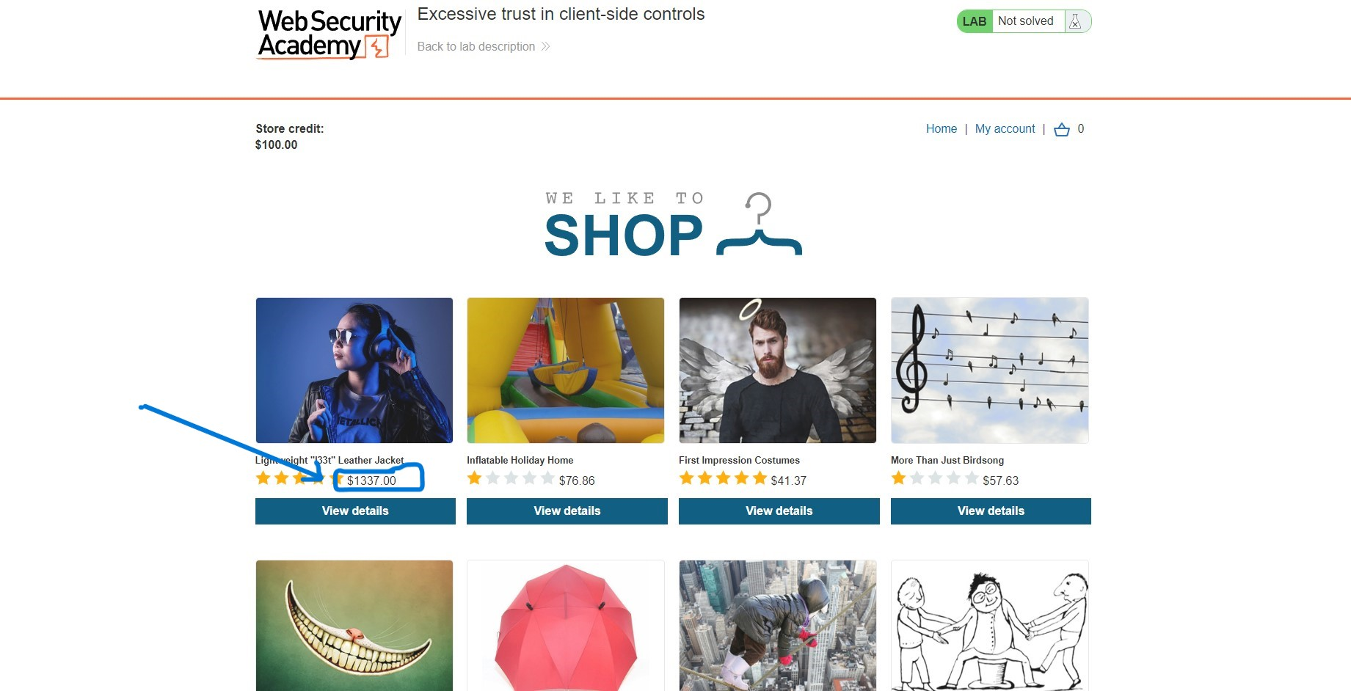
Step 2: Log in to shopping account
Username: wiener
Password: peter
Notice that I have just $100 of store credit.
Step 3: Select Something to Buy
Notice that Leather jacket Price is $1337

Slide 9
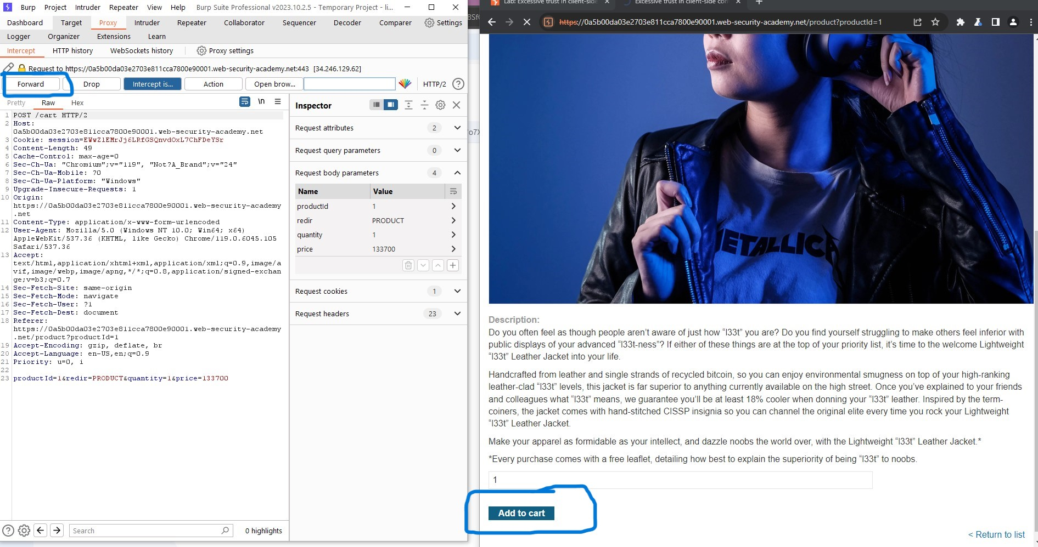
Step 4:Select Add to cart

Slide 10
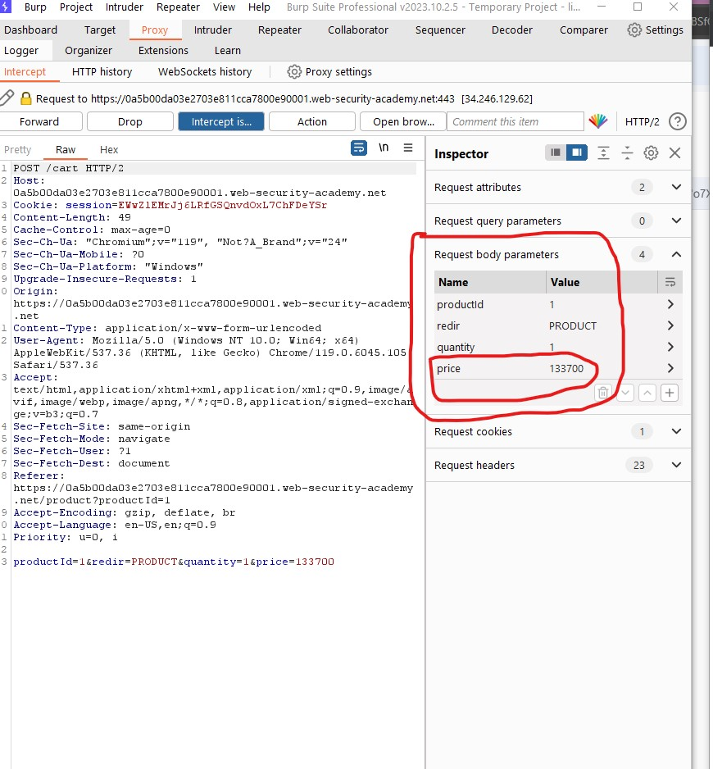
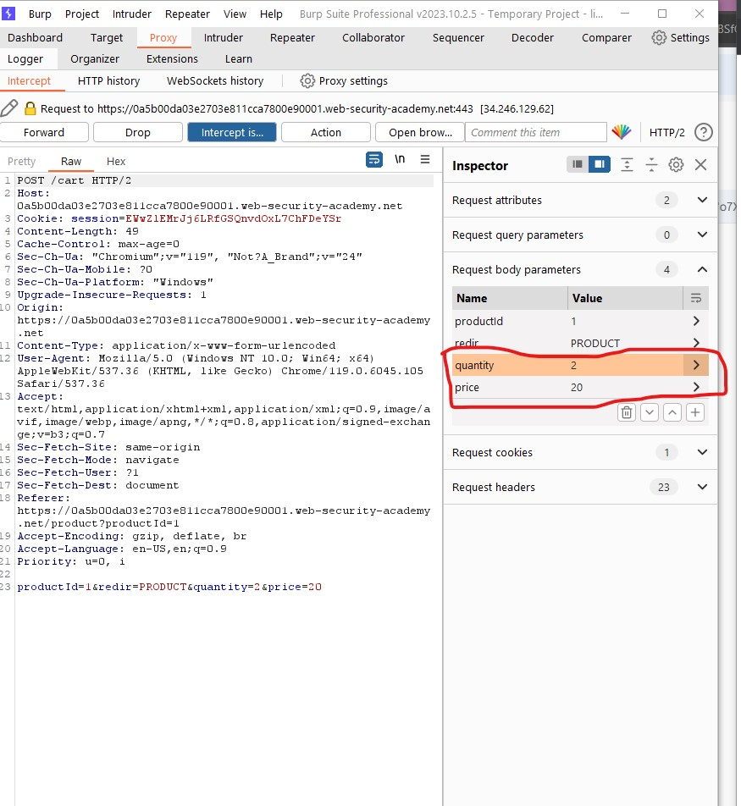
Step 5: Modify the request

Slide 11
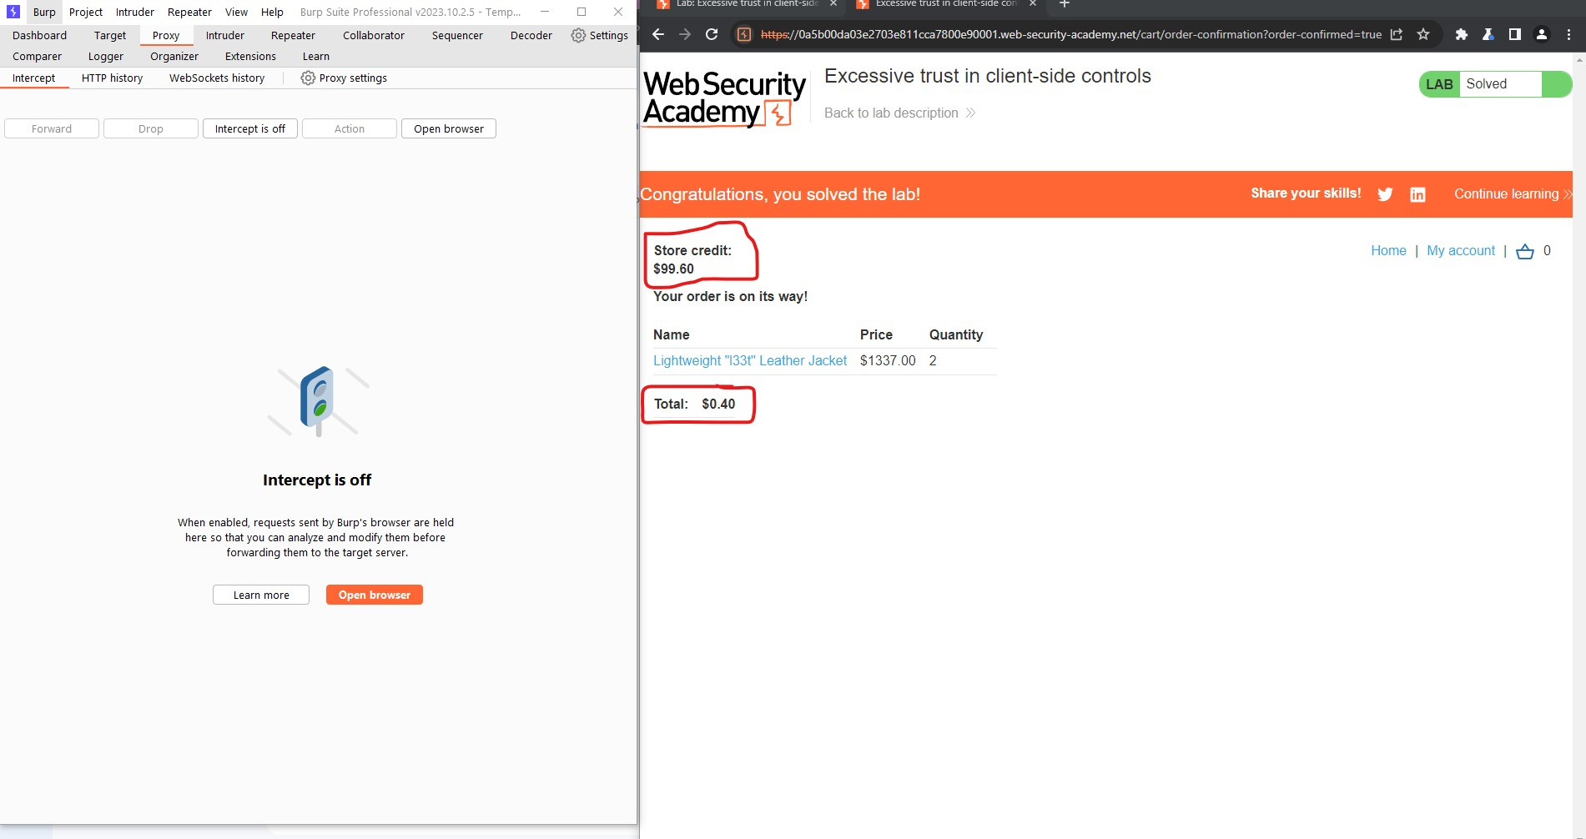
Step 6: Exploit the vulnerability

Slide 12
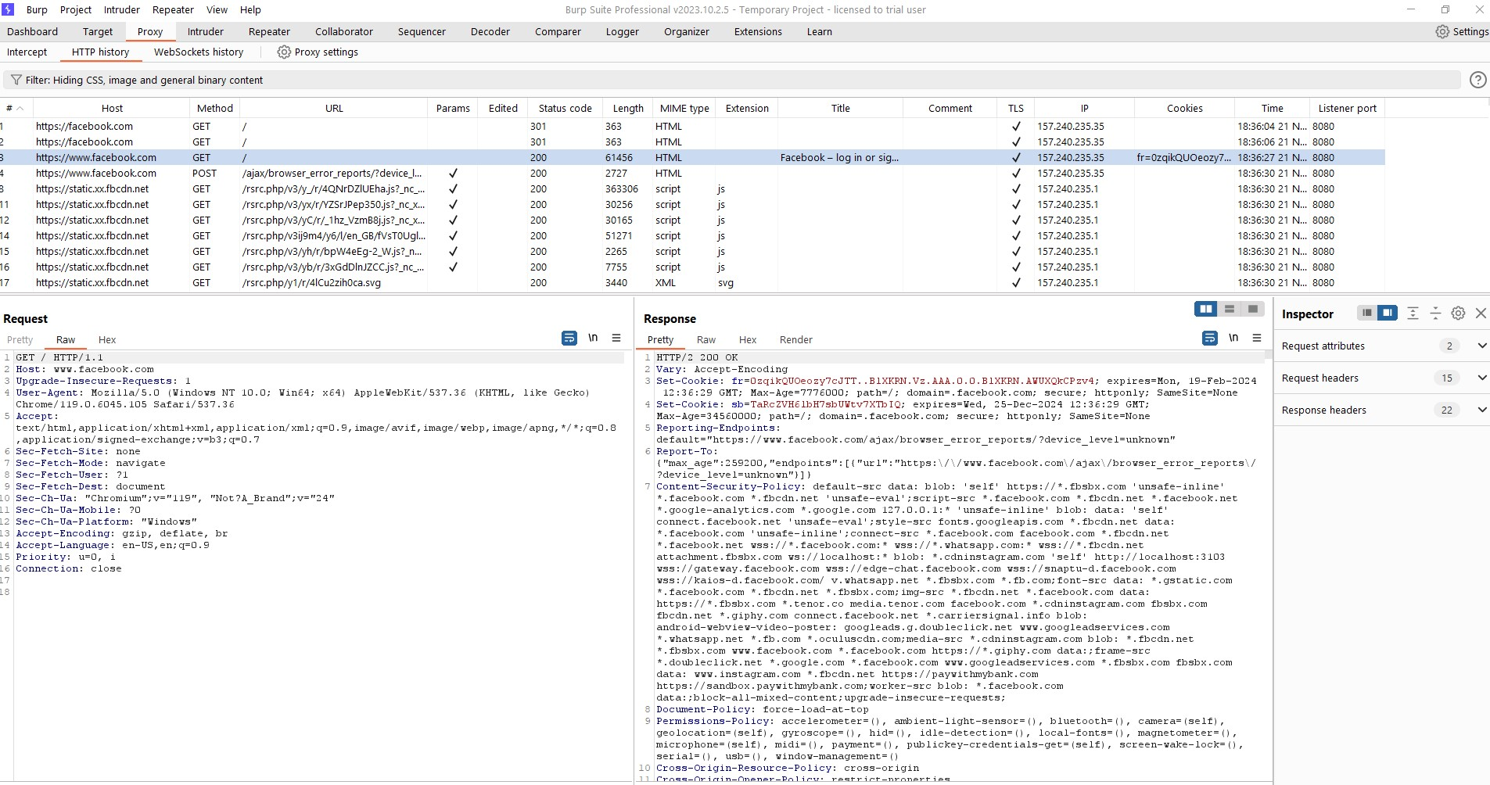
Observation/Result:
Burp Suite acts as a proxy between a web browser and the target website, allowing users to intercept and view HTTP requests and responses. Here I can analyze the data exchanged between the client and server.
I can also modify the data. I can modify the product price and quantity in HTTP Request then send it to the server and the server proceeds to the next step without any error.

Slide 13
Introduction to JMeter
Apache JMeter: An Open-Source Performance Testing Tool
Purpose: Assessing the Performance and Functionality of Software
Key Features:
Load Testing
Stress Testing
Performance Testing
Functional Testing

Slide 14
Load Test

Slide 15

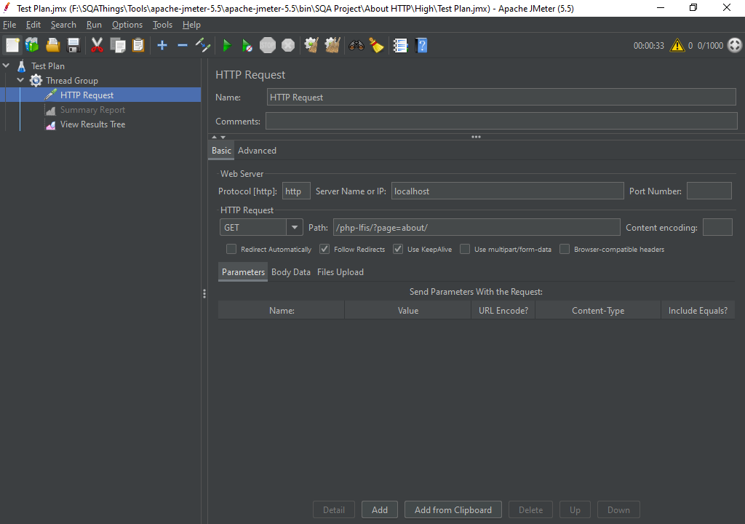

Slide 16
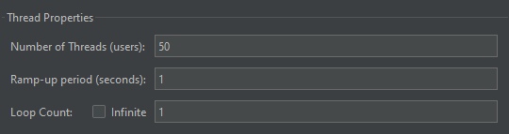


Slide 17
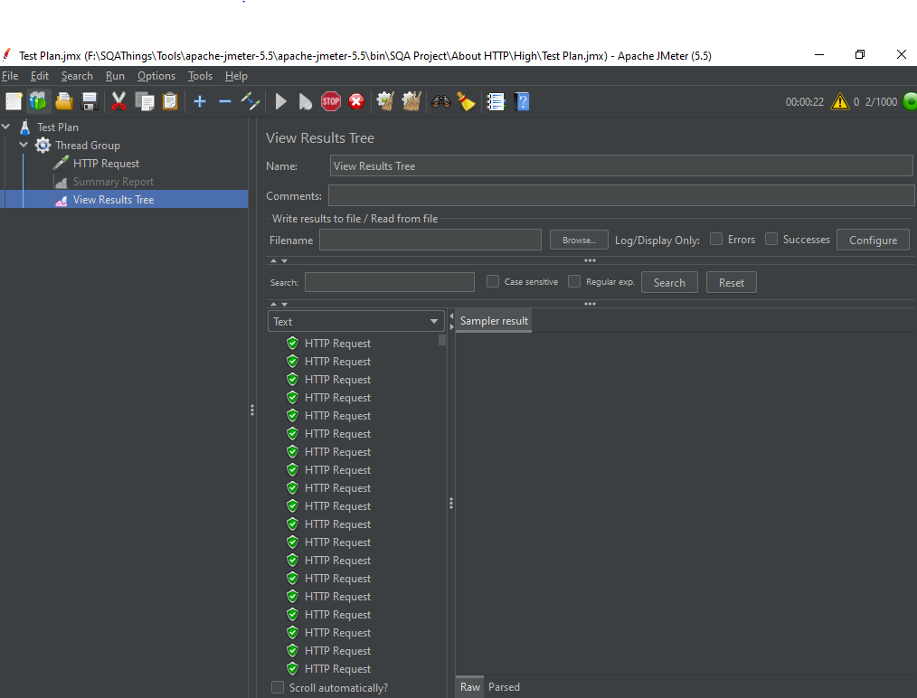
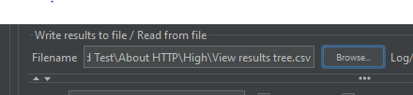

Slide 18
DATABASE Testing

Slide 19
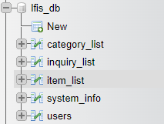
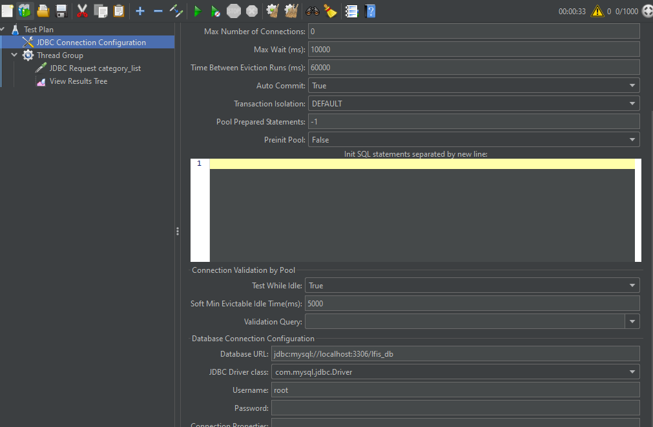
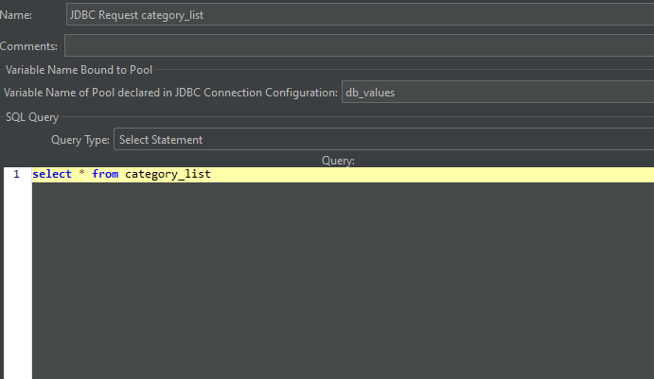
Select Items

Slide 20
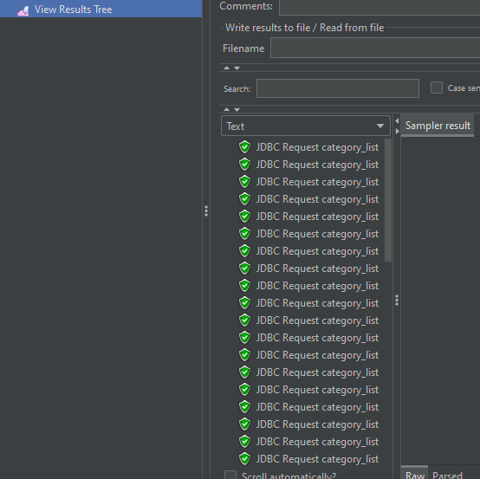

Slide 21
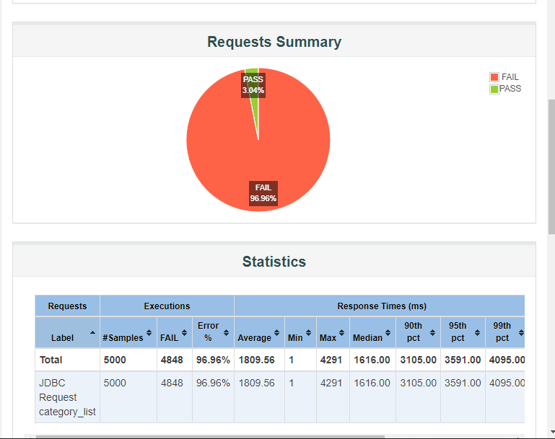
Report

Slide 22
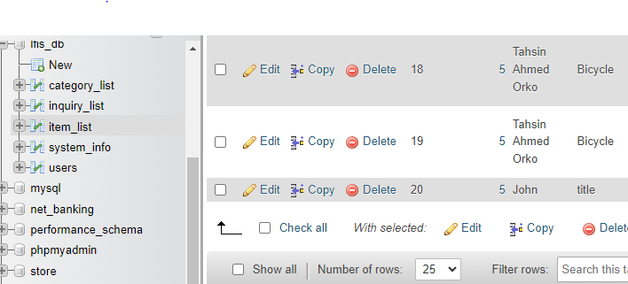
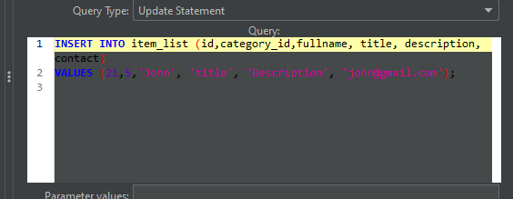
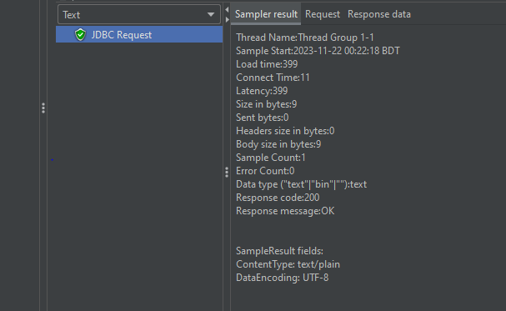
Insert Items

Slide 23
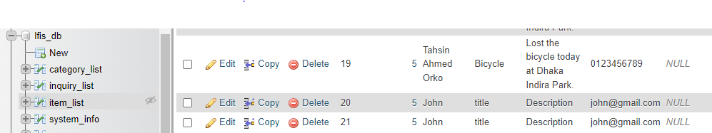

Slide 24

Cypress
Cypress is a powerful and easy-to-use testing framework for end-to-end testing.
The goal of end-to-end testing is to ensure that the entire application, including all its components, works as expected from start to finish.
The Cypress Test Runner provides a user-friendly interface for test execution and debugging.
It use javascript or Type script.

Slide 25
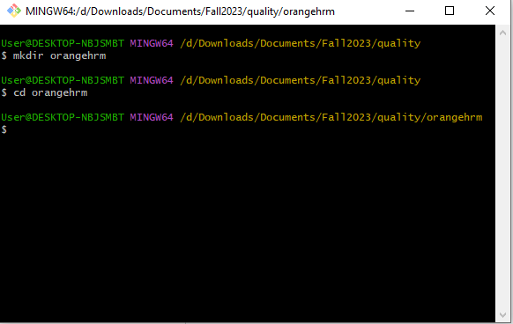
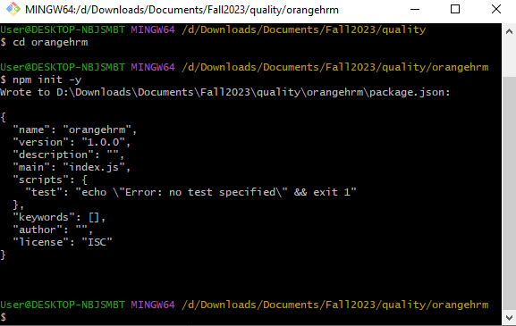
Cypress
Node.js Installation
Cypress is built on top of Node.js, so installing Nodejs is enough. We can also get the npm(Node Package Manager) also. Which is needed for running the project.
Cypress Installation
Open a terminal and navigate to the project directory.
mkdir orangehrm
cd orangehrm
To initialize a new package.json file we need to run the following command.
npm init

Slide 26
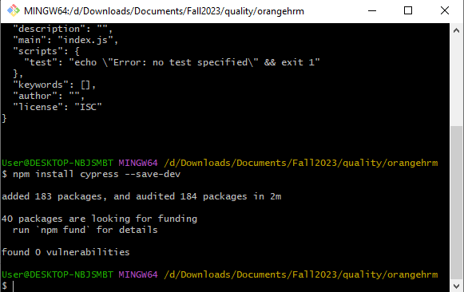
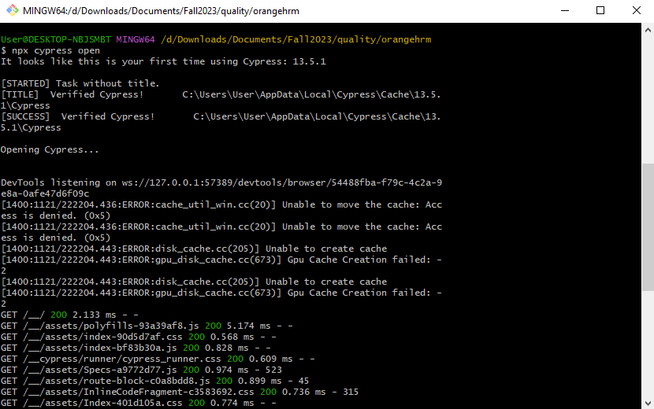
Cypress
Install Cypress using the command
npm install cypress --save-dev
Open Cypress
After installation, I can open Cypress project with the command
npx cypress open

Slide 27
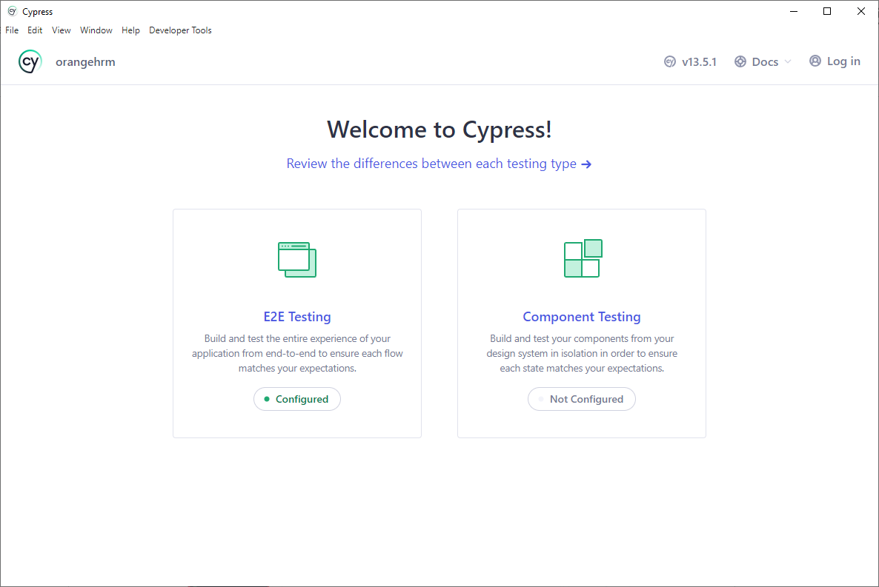
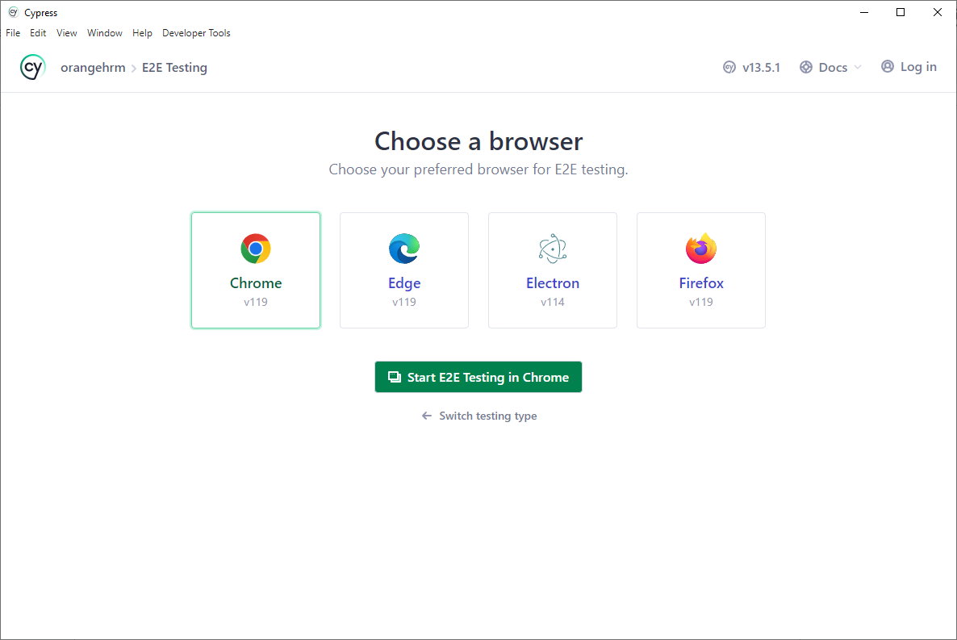
Cypress
Cypress will set up its directory structure and open the Cypress Test Runner.
After selecting the E2E Testing browser option is provided for the test runner.

Slide 28
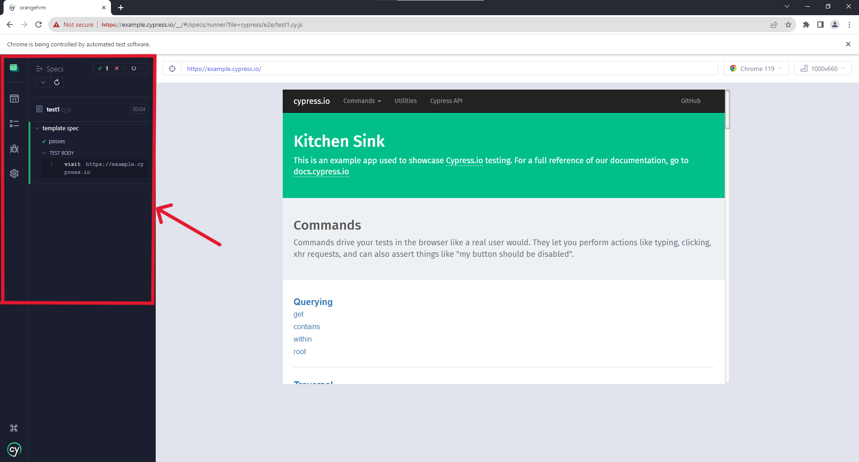
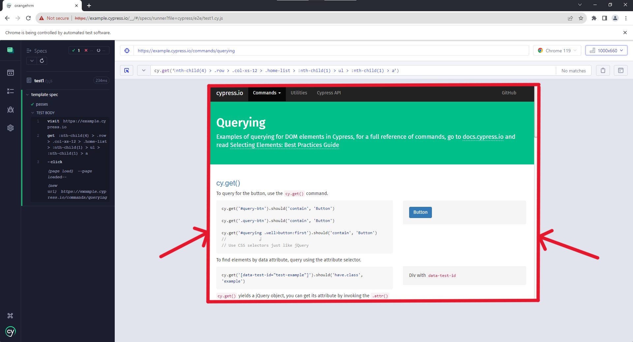
Cypress
Cypress Interface Overview
The Cypress Test Runner interface is divided into several sections:
Test Explorer
After creating a test case:
Located on the left, it displays a list of your test files and folders.
You can organize your tests and run them individually or collectively.
Test Runner
In the center, this is where your tests are executed.
It provides a live preview of your application as the tests run.

Slide 29
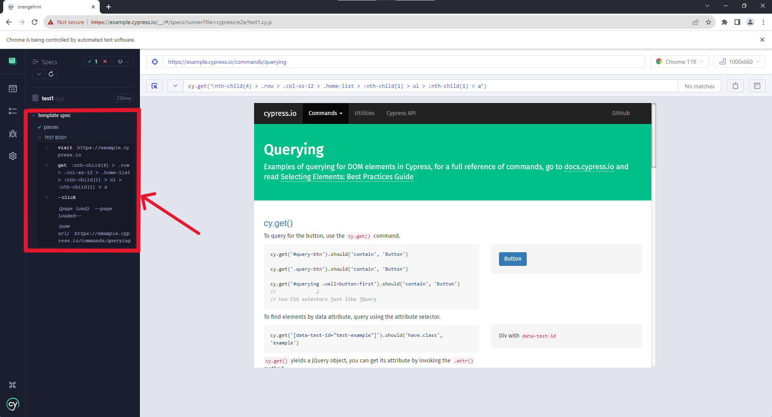
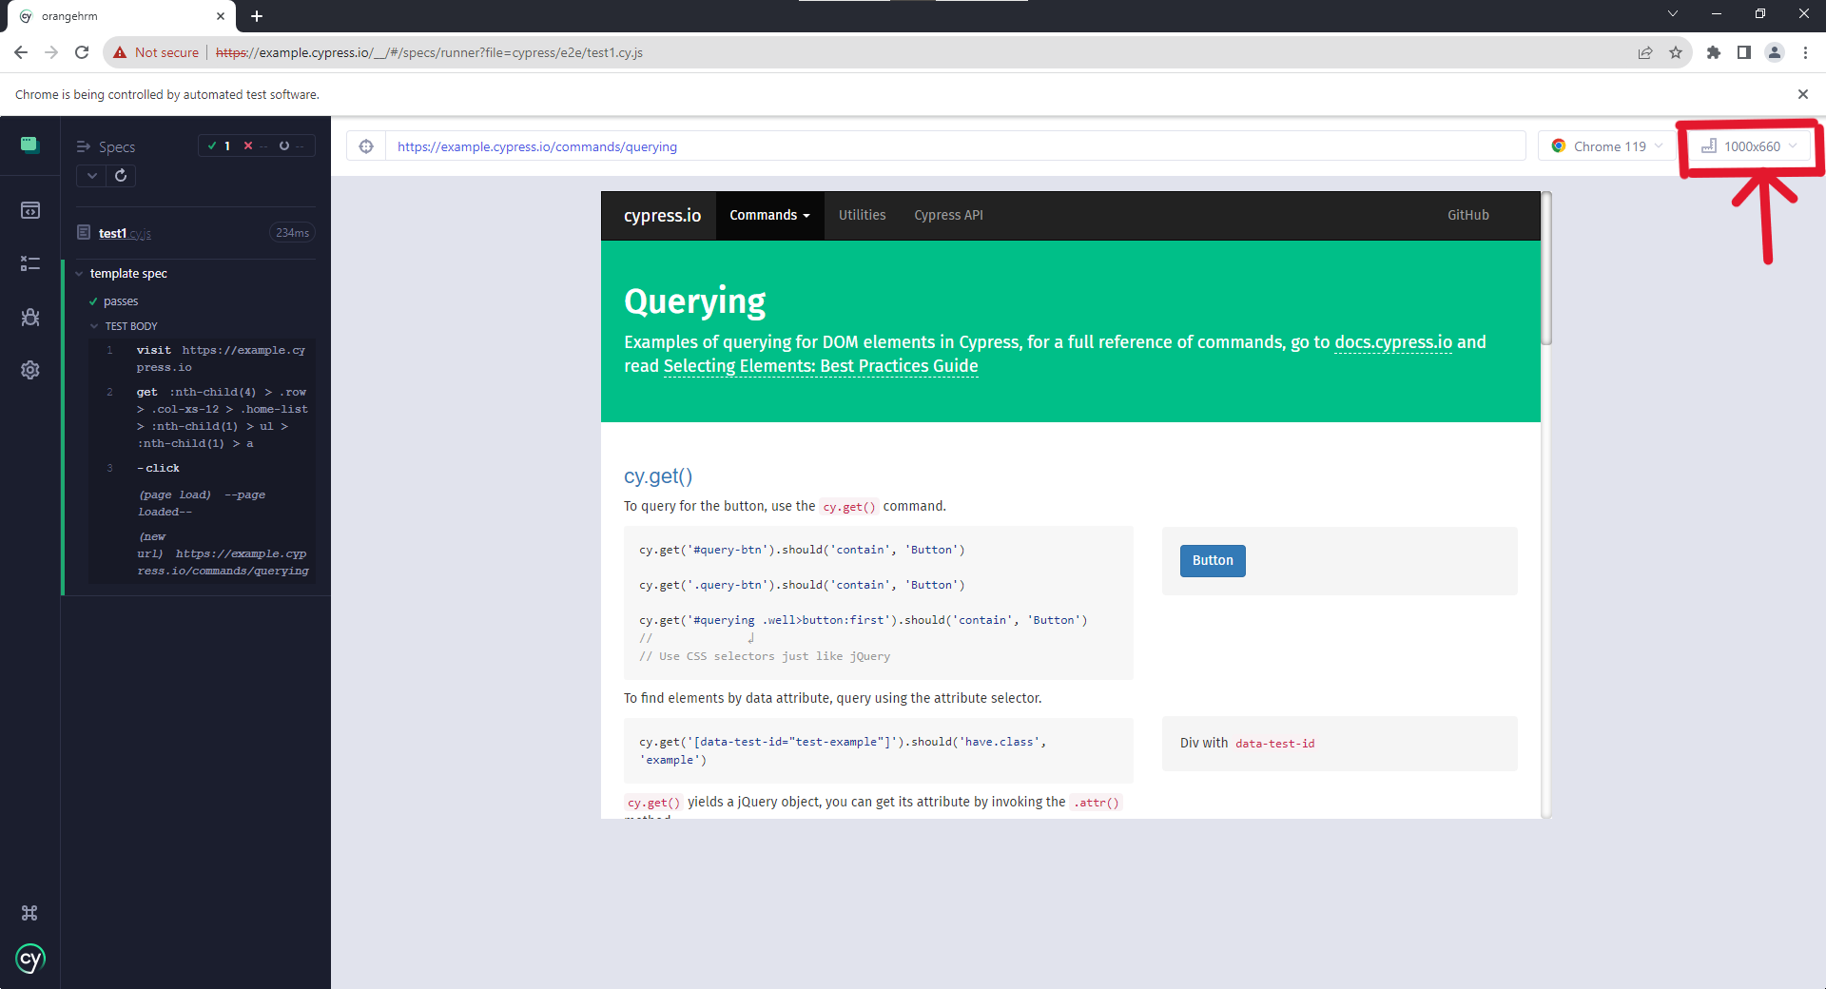
Cypress
Command Log
At the bottom, the command log shows each command Cypress executes.
Logs and commands are displayed in real-time.
You can click on commands to inspect the application's state at that point.
Viewport
On the right, the viewport displays your application in different screen sizes.
Useful for testing responsive designs

Slide 30
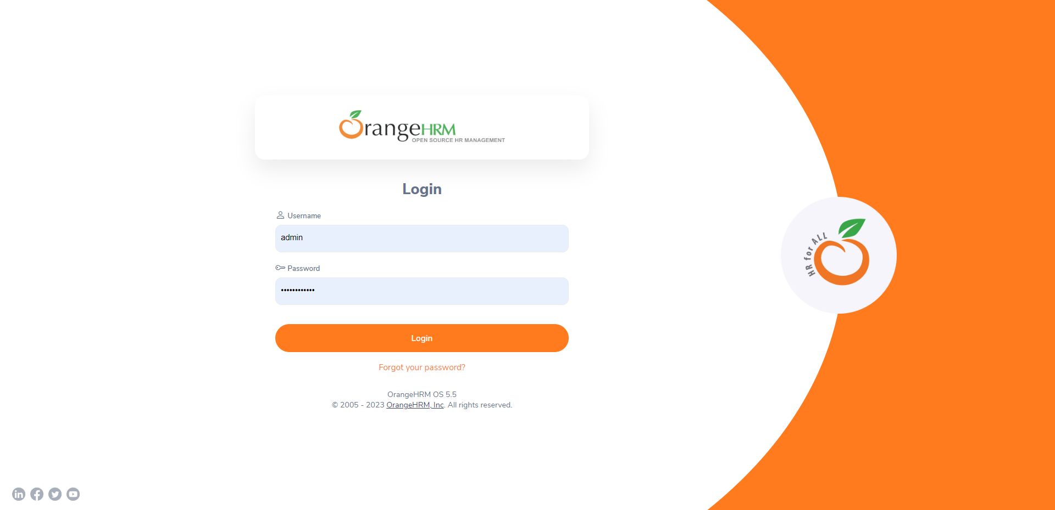
Cypress
OrangeHRM Overview
OrangeHRM: Open-source Human Resource Management System.
Purpose: Designed to simplify HR processes such as recruitment, employee management, leave, time, and attendance tracking.
Features:
Employee Information Management
Leave and Attendance Management
Recruitment and Onboarding
Performance Management
Self-Service Portals
Technology Stack:
Built with PHP and MySQL
Uses modern web technologies for the front end.

Slide 31
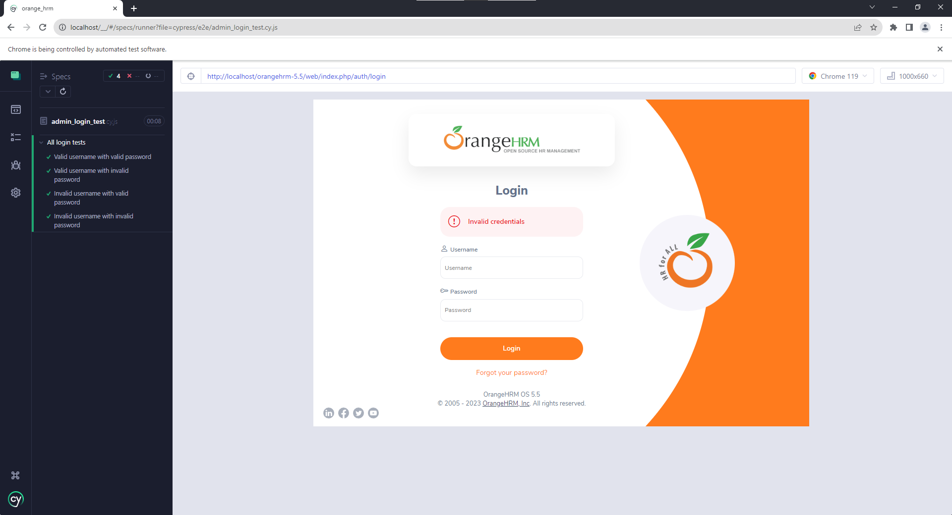
Cypress
Admin login test

Slide 32
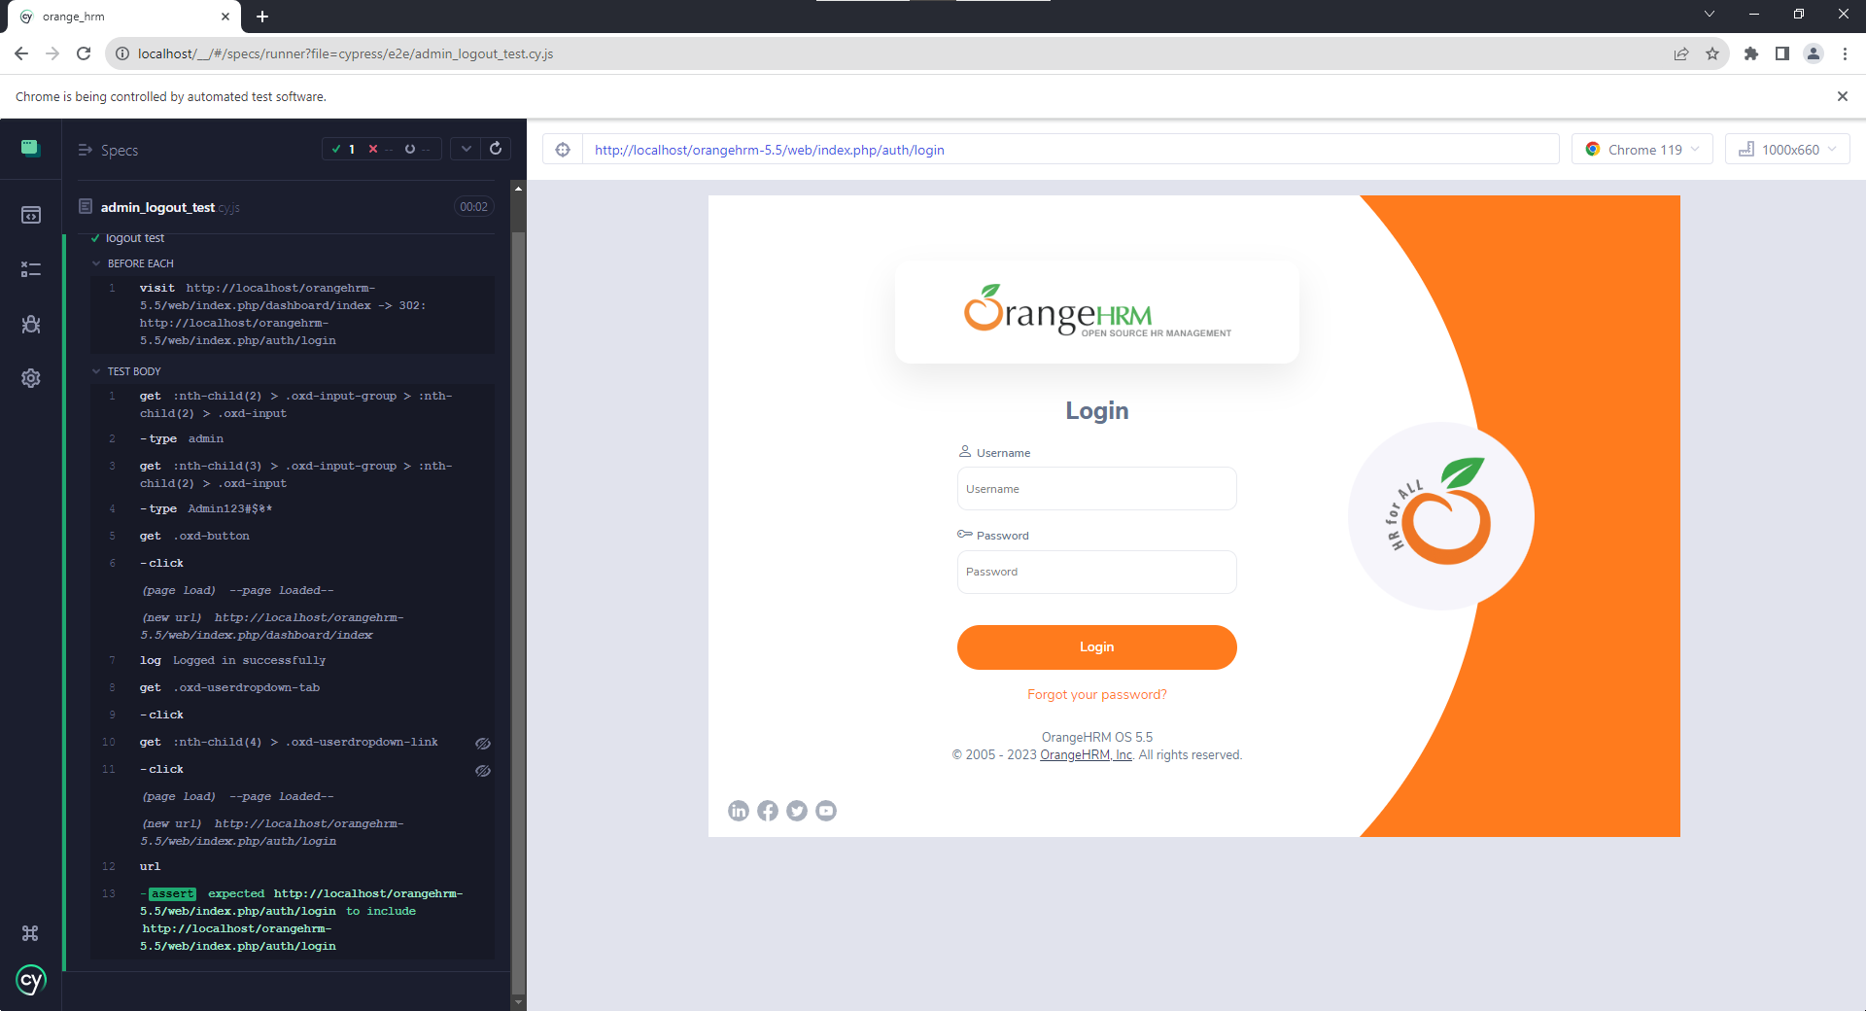
Cypress
Admin logout test

Slide 33
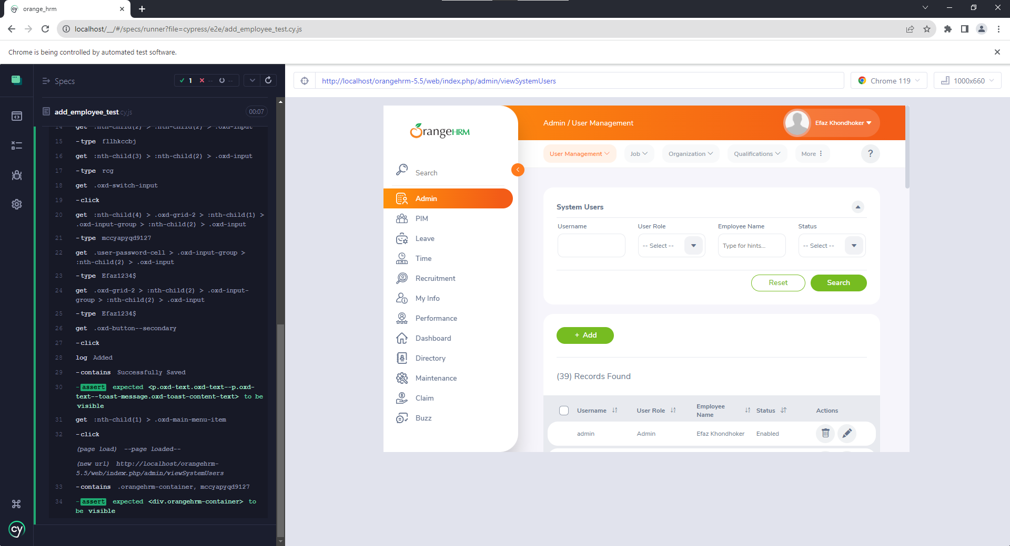
Cypress
Add employee test

Slide 34

Cypress
Add job test

Slide 35

Cypress
Add user test

Slide 36
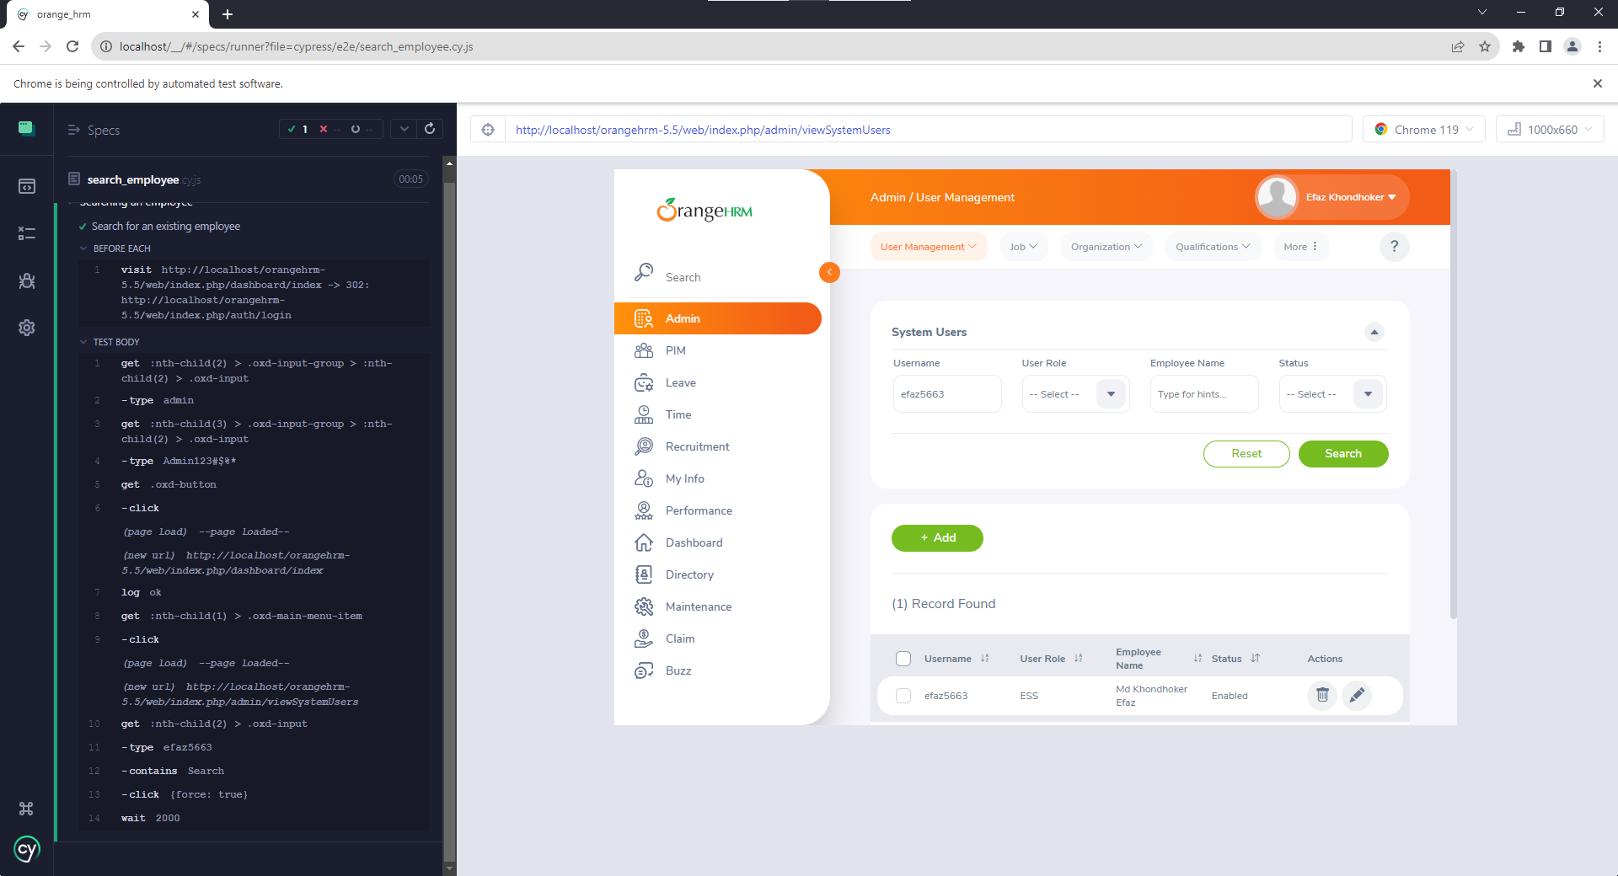
Cypress
Search employee test

Slide 37

Selenium
Selenium is a powerful open-source framework for automating web applications.
It supports multiple programming languages, making it versatile for different projects.

Slide 38
Using Selenium with Python
Python is a popular programming language for Selenium automation.
It provides a user-friendly and readable syntax for writing test scripts.
Python's Selenium library allows seamless interaction with web elements.
Setting Up Selenium with Python
Install Selenium and its dependencies using pip:
pip install selenium
Choose a web driver, such as Chrome or Firefox:
from selenium import webdriver
driver = webdriver.Chrome()

Slide 39

ArtPatio - Our Test Website
ArtPatio is a feature-rich website designed for art enthusiasts.
Features to be tested:
Buy art
Sell art
Digital art gallery
Bid for art
Follow the artist and art gallery
Vote for art

Slide 40
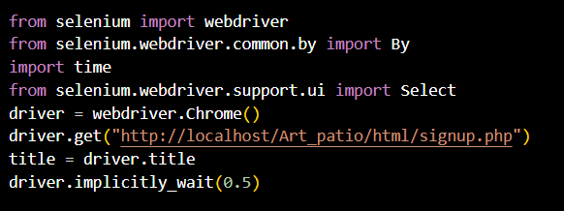
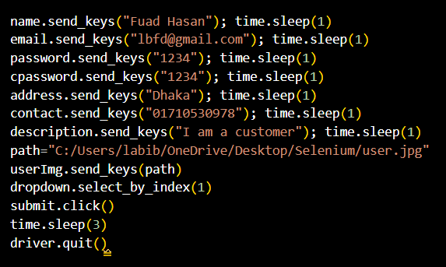
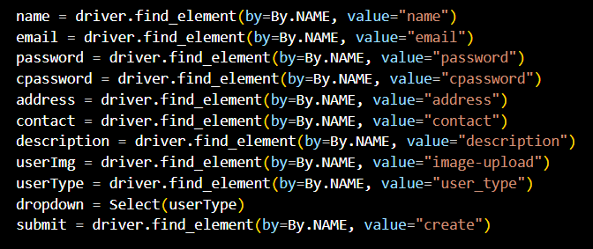
Test Case for Sign Up

Slide 41
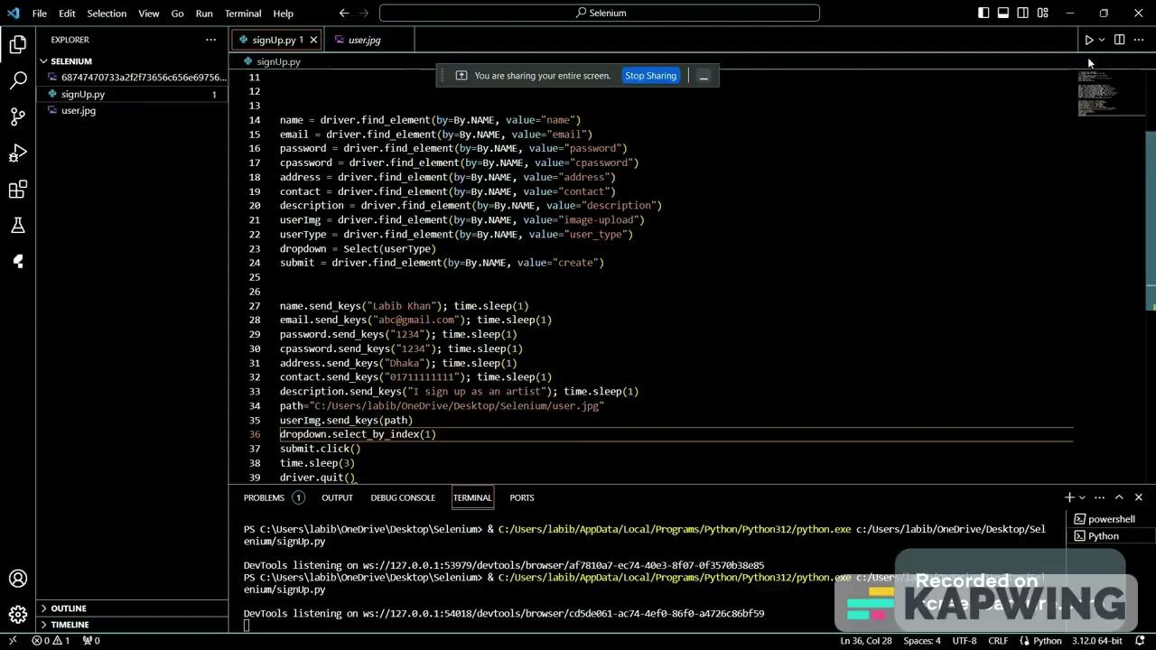
The test Result for Sign Up

Slide 42
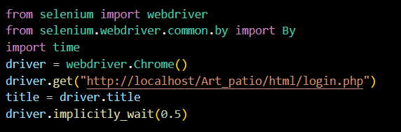
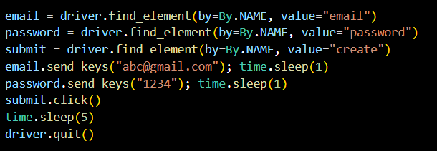
Test Case for Login

Slide 43
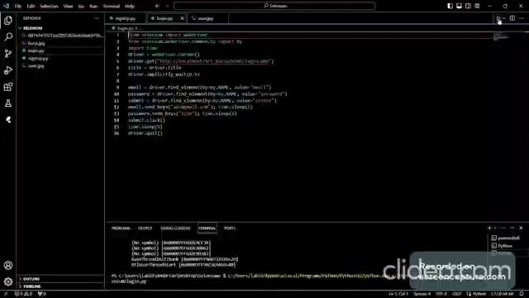
The test Result for Login

Slide 44
Thank You

