Slide 1
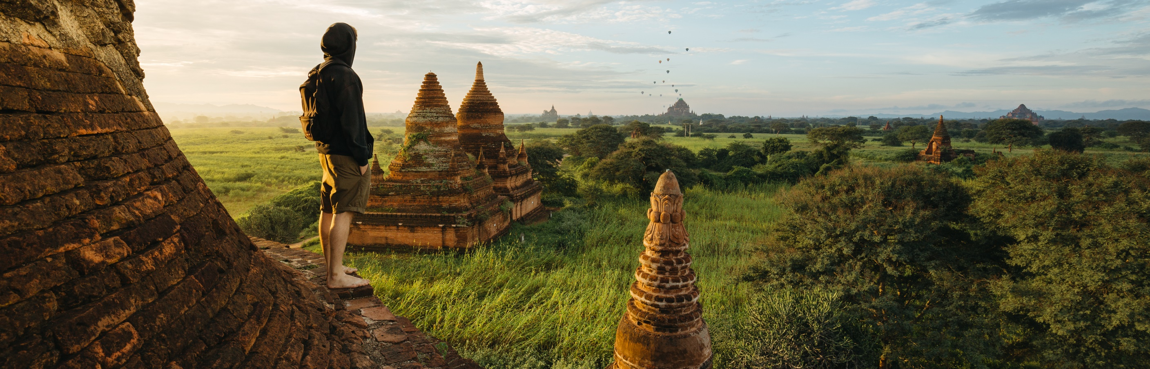
Wanderer
Travel Companion: The better way to enjoy your world travel adventure

Slide 2
Basic Info
Our Team - Group 21
Professor - Tushar Sharma
TA - Manjinder Singh
Our Client Team - Group 6
Indu Munagapati | B00903180
Meghdoot Ojha | B00854209
Adil Otha | B00900955
Janvi Patel | B00896196
Janvi Nayanbhai Patel | B00893747

Slide 3
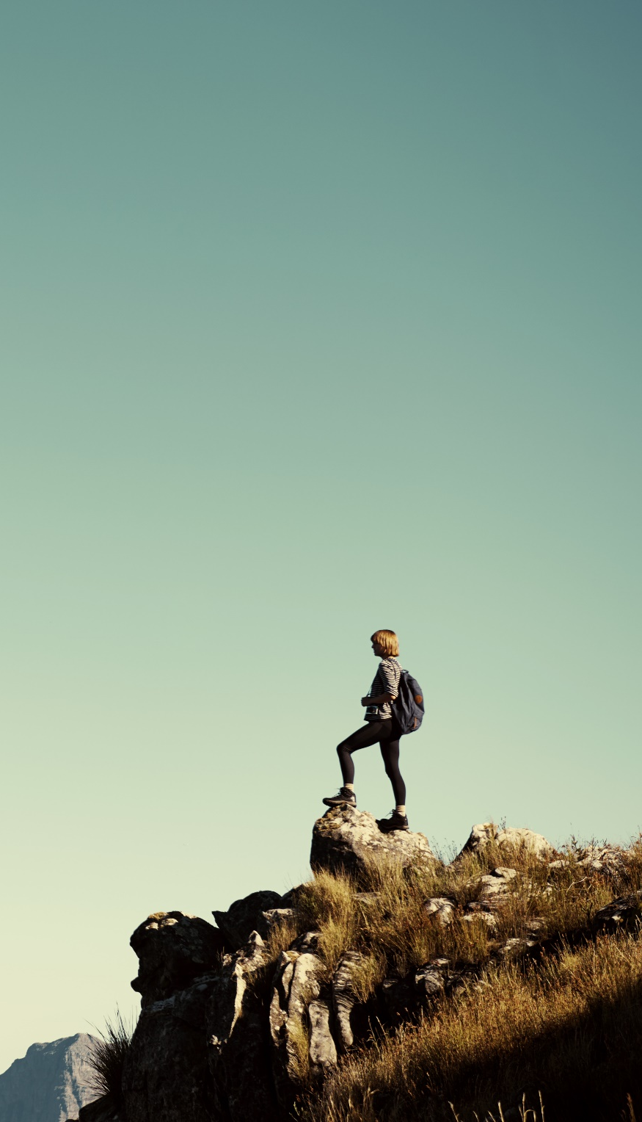
Project Objective
Travel companion app which helps tourists to find famous places of attraction in the nearby locality with real-time map location.
This app is built by a community of tourists and their preferences. The information in this app is crowdsourced by peer travelers who give reviews of places they have visited.
The blend of groups of passionate travelers will make this app a USP(Unique Selling Point) by creating a community.
The idea of this app is to give travellers an opportunity to explore uncharted locations.

Slide 4
Project Dashboard Status
Total Number of Tasks | 65
Name | Task Completed
Adil Otha | 15
Indu Munagapati | 15
Janvi Patel | 15
Meghdoot Ojha | 15
Janvi Nayanbhai Patel | 5

Slide 5
Janvi Patel
Features Worked On
Implemented the login module using OAuth 2. o Single Sign On Feature.
Implemented robust security layer by introducing the concept of Token Based Authentication. This will be helpful to authenticate the users using the tokens.
Implemented the Auth Interceptor and Auth Guard concept to avoid the unauthorized user to access secured pages of an application. If the unauthorized user tries to access other pages of application then they will be redirected to the login page.
Implemented the logout functionality to allow the user to logout from the application.
Implemented the base setup pipeline for CI environment for build, test, and deploy stages for both frontend and backend by specifying the base rules in the yml script that will trigger the pipeline depending upon the changes in the frontend and backend. Also, developed code quality pipeline.
Implemented the profile based management environment deploy process for both frontend and backend.
Implemented the future trip feature where user can create, update, and delete future trips. The future trips can be only in read view for the other users and users won't be able to create future trips for the past date.

Slide 6
Meghdoot Ojha
Features Worked On
Implemented and configured Swagger for REST API authentication and end points testing
Implemented User Profile Module to show all user-related information and to update then if required
Implement Map Module Images feature to add images of the location while creating a pin
Feature to allow users to set and change profile picture with different image formats supported
Module to add Description to the pins, this can be considered like comments about the locations
Setup Pipeline for Production environment by setting up scripts and specifying rules
Configure the application with Global Response and Exception for proper handling of REST APIs
Implement Error Codes as Enum to throw in application whenever required
Logger implementation to store customized necessary logs in the file throughout the application
Configured Profiling for Dev, UAT and Prod

Slide 7
Janvi Nayanbhai Patel
Features Worked On
Implemented the Bucket List feature which enables a particular user to add the place which they want to visit.
It also enables the particular user to delete the location and also see the list of locations added to the bucket.

Slide 8
Adil Dinmahamad Otha
Features Worked On
Implemented Map Module with following functionalities:
Change the Current Location and Radius in the Map using keyboard and mouse controls connected using 2-way-binding.
Filter Pins based on Current Location and Radius to display on the Map.
Creation of Pins on the Map, add/update data to it and real-time updates of Pin Creation on all current User Sessions.
Setting of user permissions on the created Pins. Only the pins created by a specific user can be updated and deleted by them.
Read-only view for all Users with permission to add only ratings and comments through the User Interface.
Categorization of Pins based on colours: Green (user created pins), Red (pins created by other users), Yellow (unsaved pin), Blue (pin in edit mode, can be dragged to update its coordinates)
User Interface for Pin Ratings, Pin Comments, User Profile, Blog Posts/Comments and Bucket List feature.

Slide 9
Indu Munagapati
Features Worked On
Implemented creation, updating, viewing and deletion of Blog posts from Backend.
Feature added to restrict only the owner to edit and delete the Blog post.
Implemented comments section for the Blog posts from Backend.
Feature to add ratings to the already existing pins.
Implemented comments section on the existing pins.
Implement the Images feature to add images while creating or updating the blog.
Added issue specific exceptions in all the above modules implemented.
Created the database schema and imported it into the dev, test and production databases.

Slide 10
Project Status
Final-Term Goals | Achieved | Not-Achieved
1. CI/CD Pipeline for build and test stage. | Yes
2. Authentication and Authorization | Yes
3. Map Integration with real-time updates | Yes
4. Future Trips | Yes
5. Blog | Yes
6. Bucket List | Yes
7. User Profile | Yes

Slide 11
Learning Outcome
We can follow the design pattern techniques for enhancing the code quality of our project.
We can also enhance the bucket list feature by adding the functionality to share with other users.
We can also ameliorate the future trip feature by adding the functionality to generate the request to join the trip with other travelers.
We can enhance the pin creation functionality by creating the cluster.

Slide 12
Extra Functionalities Achieved for Each Feature
1. Map Integration
Implemented the map interface in such a way that it can be controlled using the mouse or the keyboard.
The controls for the map are bound using two-way binding, so any changes made using the mouse will also be reflected on the keyboard input controls and vice-versa.
The state of the pin will be shown using different colours for a better user experience.
2. Future Trip
Achieved all CRUD operations for the future trip module even though we were required to achieve only display the future trips to the users.
Integrated a WYSIWYG editor for the future trip description instead of plain text and also supported the image uploading functionality.
3. Blog
Integrated a WYSIWYG editor for the blog description instead of plain text.

Slide 13
Extra Functionalities Achieved for Each Feature
1. Map Integration
Implemented the map interface in such a way that it can be controlled using the mouse or the keyboard.
The controls for the map are bound using two-way binding, so any changes made using the mouse will also be reflected on the keyboard input controls and vice-versa.
The state of the pin will be shown using different colours for a better user experience.
2. Future Trip
Achieved all CRUD operations for the future trip module even though we were required to achieve only display the future trips to the users.
Integrated a WYSIWYG editor for the future trip description instead of plain text and also supported the image uploading functionality.
3. Blog
Integrated a WYSIWYG editor for the blog description instead of plain text.

Slide 14
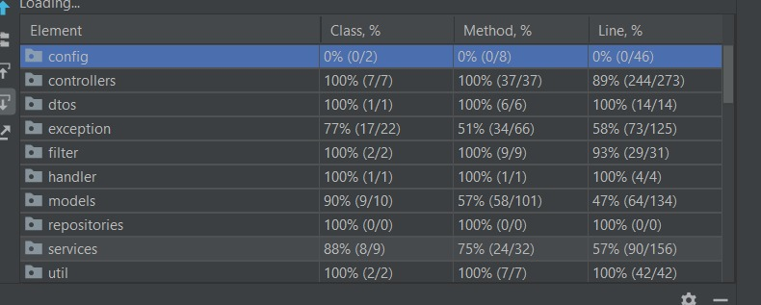
Project Test Coverage

Slide 15
Project wanderer can be accessed on
Production environment:
https://wanderer-live.herokuapp.com/login

Slide 16


