Slide 1

DSBA: Descriptive Statistics
MASTERCLASS ERASMUS Q-INTELLIGENCE

Slide 2
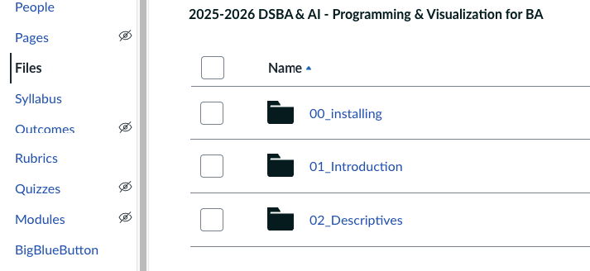

Course progression
Canvas: 02_Descriptives
Iris.csv dataset
Forsale.scv dataset

Slide 3
Math operators
Operator Operation Example
+ Addition x + y
- Subtraction x - y Unary minus. y = -x
* Multiplication x * y
/ Division x / y
** Exponentiation 2 ** 3 = 8
% Modulus 5 % 2 = 1
// Floor division 5 // 2 = 2
Notes:
.

Slide 4
Math functions
Function Operation Example
Abs() Absolute value abs(x)
Round() Round round(x,n)
Math.sqrt() Square root math.sqrt(x)
Math.log() Logarithm math.log(x)
Math.exp() Exponential math.exp(x)
Math.floor() Round down math.floor(x)
Math.ceil() Round up math.ceil(x)
Notes:
Abs() = The absolute value of a number is its distance from zero on the number line, without considering the sign.
math.exp(x) = exponential growth (raise eee to a power).
math.log(x) = reverse the process

Slide 5
Data interpretation - functions
To get an overview of what the data looks like we can use a multitude of functions on a dateframe
Head() -- Shows the first 5 rows of the DataFrame. Useful for a quick glance at the data structure.
Tail() -- Shows the last 5 rows. (You can give a variable for both of these to show more than 5)
Describe() -- Generates summary statistics for numerical columns. (Great for understanding the distribution of numeric data)
Info() -- Provides a summary of the DataFrame: index type, column names, non-null counts, and data types. Useful for checking data completeness and types.
Print() -- Generally usefull to display parts of the dataframe or the whole dataframe.

Slide 6


Data attributes
Shape is a data attribute which is like a stored value of an object. It does not require parentheses (). It gives you information that is already stored inside the object.
-> Read and load the iris.csv
-> Use the shape attribute. result is (rows, columns)
Notes:
Extra: with the following code: rows, cols = df.shape we can use the result programmatically

Slide 7


More data attributes!
Columns.values → Shows the names of all columns in the dataset
Columns: What the data measures
Indices: Which row is which
Index.values → Shows the row numbers or indices for each observation in the dataset
Notes:
Dtype = object means that all the columns names are strings
df.dtypes to get actual dtypes
Index.values can differ:
subset = iris[iris['Sepal.Length'] > 7.0]
subset.index.values

Slide 8
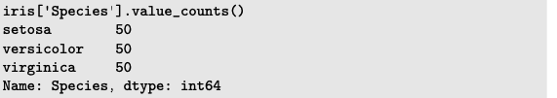
Frequency
value_counts() is used to count the occurrences of each unique value in a column.
Very useful for categorical data to quickly see the distribution of values.
Notes:
iris['Species'].value_counts().plot(kind='bar')

Slide 9
Exercise 1
Open the Descriptives_Exercises.ipynb notebook.
Complete the exercises in 1.1 (Data loading and exploration)
Notes:
pd.set_option('display.float_format', '{:.2f}'.format)

Slide 10
Descriptive statistics
Pandas has lots of functions to gather data from your DataFrame
min(), max()
quantile
mean()
median()
std()
var()
cov()
corr()
describe()
minimum and maximum
cut points in your data average
median
standard deviation
variance
covariance (Make sure your df only has numeric types!)
correlation (Make sure your df only has numeric types!)
quick way to see a lot of these on your dataset
You call these function with: df[“column”].<function>()
Notes:
.describe() is ook een interessante om van alle integers snel informatie op te halen

Slide 11
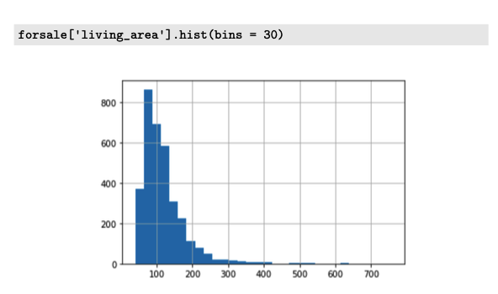
Plots
Use plots to visualize trends or relationships in your data.
For instance we use .hist() to see the distribution of a numeric column
More on this next week!

Slide 12
Exercise 2
Open the Descriptives_Exercises.ipynb notebook.
Complete the exercises in 1.2 (Univariate summary statistics)

Slide 13
Have a nice day!

