Slide 1
DoConnect A Collaborative Question & Answer Platform
Presented by :
Rajulapati naga Venkata Adilakshmi
WIPRO NGA - .Net Full Stack Angular - FY26 – C2
Under the guidence of :
Jyothi S Patil

Slide 2
Table of Contents
1. Abstract
2. Introduction
3. Tech Stack
4. Workflow
5. Conclusion

Slide 3
Abstract
DoConnect is a collaborative Q&A platform for learners and technical communities. Users can register, log in, post questions, share answers, and attach images. An admin module ensures moderation, review, and content management. Built with ASP.NET Core Web API, Angular, and SQL Server (EF Core), it uses JWT authentication and role-based access. With a responsive UI, Swagger docs, and unit testing, DoConnect offers a lightweight, scalable, and reliable solution for knowledge sharing.

Slide 4
Introduction
DoConnect is a collaborative Question & Answer platform built for learners and technical communities to exchange knowledge in a structured way. It allows users to register, log in, and securely access the system through JWT authentication. Users can post questions, provide answers, and attach relevant files such as screenshots, diagrams, or code snippets. An integrated Admin Module ensures content moderation, user management, and approval of contributions, maintaining quality discussions.
The platform is developed using ASP.NET Core Web API, Angular, and SQL Server with EF Core, offering a modern and scalable architecture. With role-based access control, it guarantees secure and reliable usage. The interface is responsive and user-friendly, providing smooth access across devices. Swagger API documentation makes backend testing and integration easier for developers. Additionally, unit testing ensures proper validation and reliability of features. Overall, DoConnect delivers a lightweight, scalable, and effective solution for collaborative knowledge sharing.

Slide 5
Tech Stack – Frontend
Angular (TypeScript)
Angular Router → Navigation
HTTP Client → API Communication
Responsive UI
Testing: Jasmine + Karma

Slide 6
Tech Stack – Backend
ASP.NET Core Web API (C#)
Entity Framework Core
SQL Server Database
Swagger (API Docs)
xUnit Testing

Slide 7
Workflow of Admin
Can be able login
Can Manage Questions
Can Manage Users
Can Manage Answers
Database stores all activity

Slide 8
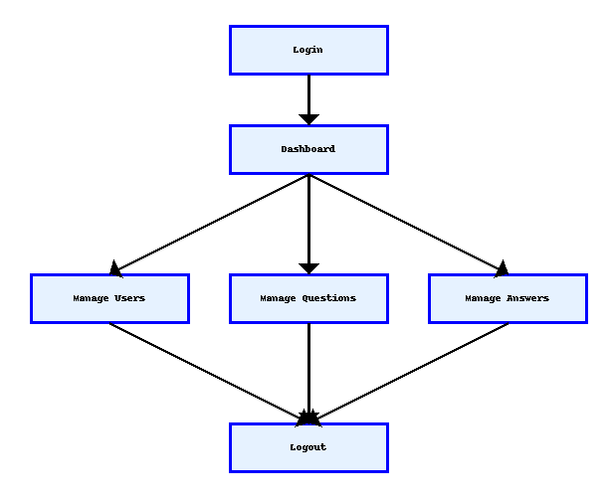
Workflow of Admin

Slide 9
Workflow of User
Can register and/or login
Can do forgot password and reset password
Able to see all the questions with related answers
Able to search for the question
Can ask question/answer the questions
Can see their profile and questions/answers they posted
Database stores all activity

Slide 10
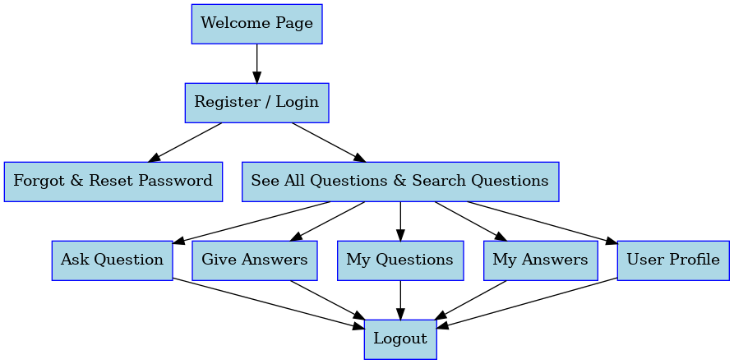
Workflow of User

Slide 11
Conclusion
DoConnect provides a secure and scalable Q&A platform that enables effective knowledge sharing among learners and technical communities. With role-based access, admin moderation, and responsive design, it ensures both reliability and ease of use. The integration of ASP.NET Core, Angular, and SQL Server makes the system robust, while testing and documentation ensure quality and maintainability.

Slide 12


