Slide 1


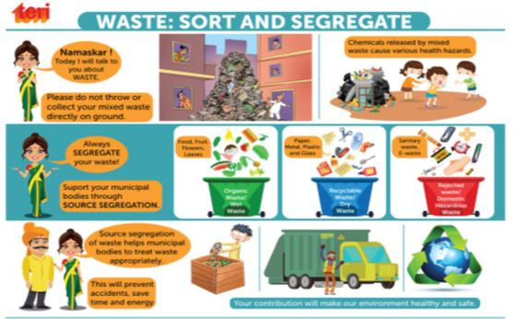
Team Name:
Team Members Name:
Borekar Maya(Team Lead)
Bhomireddy Adilakshmi Chinnaswamy Renugadevi
M Praneta
Ranjitha K N
The Company: FIS India Pvt. Ltd.
The name of Idea:
Hack Elite
Way2Recycle

Slide 2
Problem Statement
The products used by people are thrown away on a regular basis, which contains toxic chemicals. The products end up in landfills or incineration, which pollutes the air and the water hugely. Studies reveal that methane is emitted from landfills and is multiple times potent than carbon dioxide, thereby known as a powerful contributor to our contemporary environmental crisis.
Environmental wastes constituting both organic and inorganic materials that are derived from homes and industries go directly to landfills. Now, proper managing the landfills will result in the production of methane and other greenhouse gases, which has tremendous utilities. These gases contribute to global warming and other environmental hazards, but if managed effectively, they can also serve various useful functions

Slide 3
GitHub Link:
Link to the 3-minute Demo Video:
https://youtu.be/7zxT7NbBaMg
Link to the solution roadmap:
https://github.com/AdilakshmiB/way2recycle-app/blob/main/Solution%20Roadmap.pdf
Link to detailed Solution:
https://github.com/AdilakshmiB/way2recycle-app/blob/main/Way2Recycle.pdf

Slide 4
Thank You

