Slide 1

Analyze of News
What kind of news do Kazakhstanis read?
What are they more interested in?
How many people read the news?
How much time do Kazakhstanis spend on reading the news?
What worries the people of Kazakhstan the most?
Karim Adilet

Slide 2

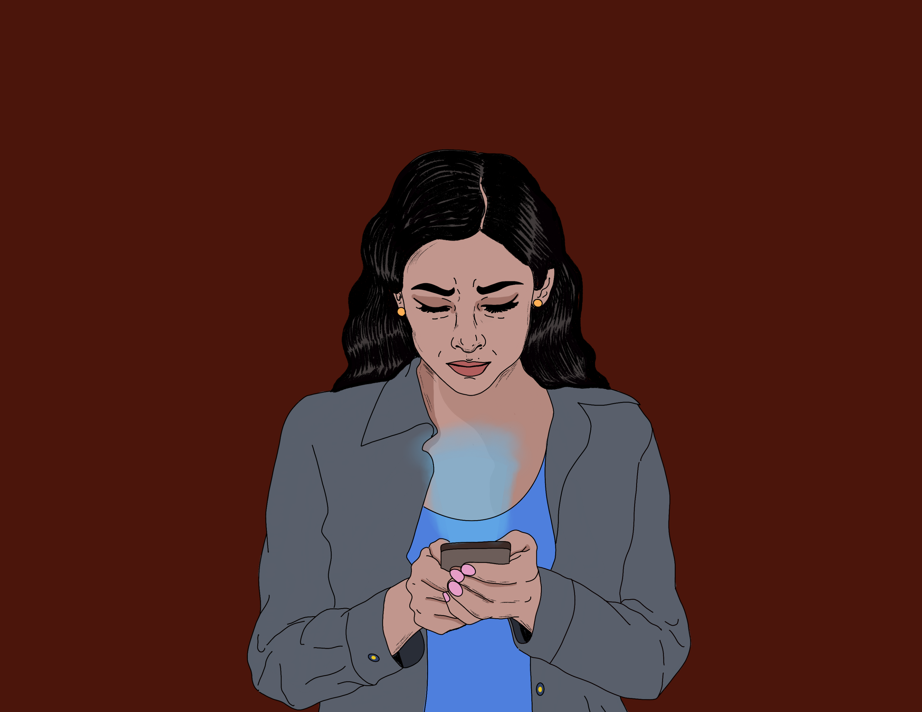

(H) Is there any information manipulation of foreign countries?
(H) Does news affect people's mental well-being?
(H) Are negative news more interesting than positive news and do they get more views?

Slide 3



Dataset sources:
Tengrinews
Informburo
Zakon.kz
Social Networks
International Resources

