Slide 1
SDC HACKATHON 2026
Stock Manager
Inventory counts and owner approvals
for Malaysian small shops
Hackstreet Boys
Hackstreet Boys
01
Notes:
Stock Manager helps Malaysian micro and small shops reconcile shelf counts with inventory records. Clerks submit physical counts. Explicit rules handle small differences, while larger discrepancies require an owner decision. The prototype uses synthetic minimarket data.
Team: Hackstreet Boys. Domain 2: Orbyte Smart SME Challenge. SDG 8: Decent Work and Economic Growth.
Source: team preliminary project proposal and technical declaration. Repository: https://github.com/Adilkrab/Hackstreet-Boys

Slide 2
THE CUSTOMER
The stock count follow-up problem
A clerk counts fewer items
than the spreadsheet shows.
The owner must check the difference, make a decision
and ensure someone updates the stock record.
Target users: Malaysian micro and small business teams
Hackstreet Boys
02
Notes:
The target workflow spans paper records, spreadsheets and WhatsApp follow-up. A discrepancy requires someone to verify the count, decide whether to correct it and update the inventory record. Stock Manager focuses on that reconciliation process. This problem framing follows the challenge brief and remains a hypothesis to validate with shop users.
Source: team preliminary project proposal, problem context. No customer study or measured reduction in workload is claimed.

Slide 3
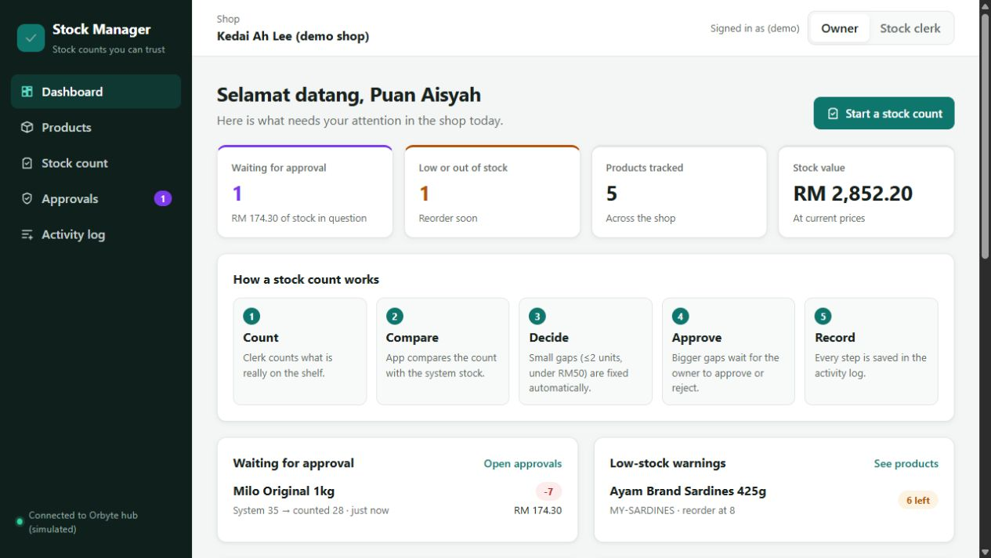
THE PROTOTYPE
Inventory and follow-up in one place
Pending decisions
and low-stock warnings
A shared record for
clerks and the owner
Hackstreet Boys
03
Notes:
The dashboard brings pending approvals, low-stock warnings and stock quantities into one view. The prototype also supports product management, stock movements, spreadsheet imports and an activity log. The screenshot shows synthetic demo data from an isolated local instance of the application.
Orbyte sync is simulated. The application prepares and logs a payload without sending it externally.
Source: team application. Repository: https://github.com/Adilkrab/Hackstreet-Boys

Slide 4
THE WORKFLOW
Rules for inventory corrections
Automatic correction
Owner decision
Difference of at most 2 units
Value below RM50
Nonnegative physical count
Larger discrepancies wait
for approval or rejection.
The activity log records the outcome.
Stock and its history update together
Hackstreet Boys
04
Notes:
A physical count is the full quantity on the shelf. The backend compares that quantity with current system stock and calculates the value of the difference. Automatic correction requires an absolute difference of at most 2 units, a value strictly below RM50 and a nonnegative physical count. Larger valid discrepancies require owner review. Negative counts cannot be approved.
An approval updates inventory, movement history and audit records in one transaction. A rejection leaves stock unchanged. Intervening stock changes prevent approval of a stale count.
Source: backend workflow implementation and automated tests. https://github.com/Adilkrab/Hackstreet-Boys

Slide 5
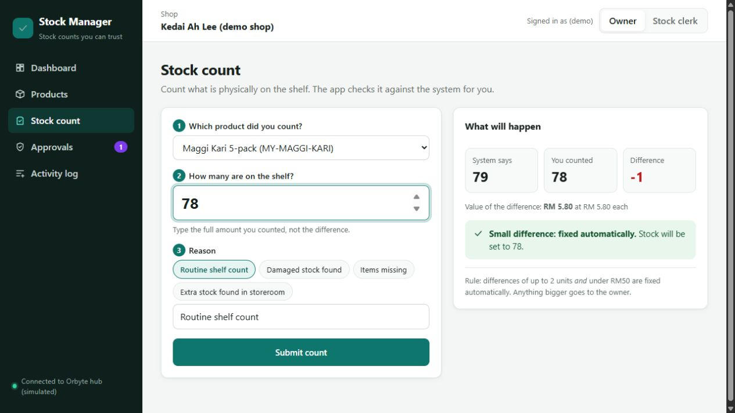
DEMO: CLERK COUNT
A small discrepancy
79 system
78 counted
1 unit
RM5.80 difference
Preview before submission
Hackstreet Boys
05
Notes:
Illustrative synthetic scenario: Maggi Kari 5-pack has 79 units in the system. A clerk counts 78. One unit at RM5.80 produces a discrepancy of RM5.80, which meets the automatic-correction rule. The screenshot shows the decision preview before submission. Submitting the count sets stock to 78 and records the outcome.
These values demonstrate application behavior and do not represent business impact measurements.
Source: team application and synthetic demo inventory. https://github.com/Adilkrab/Hackstreet-Boys

Slide 6
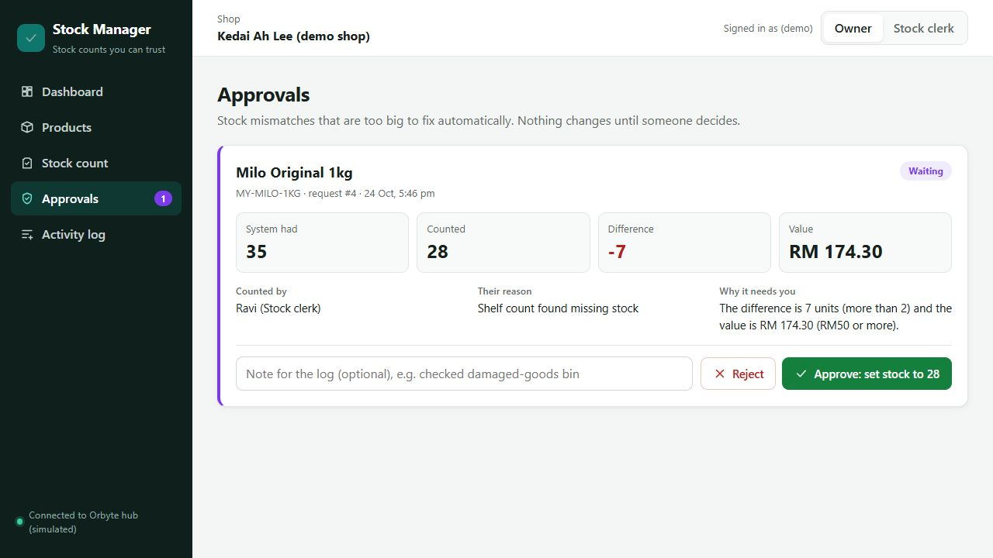
DEMO: OWNER REVIEW
A larger discrepancy
35 system
28 counted
RM174.30
awaits the owner
Stock stays unchanged while waiting
Hackstreet Boys
06
Notes:
Illustrative synthetic scenario: Milo Original 1kg has 35 units in the system and a physical count of 28. The difference is 7 units at RM24.90 each, or RM174.30. The request waits for owner review and stock remains 35 until a decision. Approval sets stock to 28. Rejection keeps it at 35. The log records the decision and review note.
Owner and clerk selection is a demonstration feature. The prototype does not implement production authentication.
Source: team application and synthetic demo inventory. https://github.com/Adilkrab/Hackstreet-Boys

Slide 7
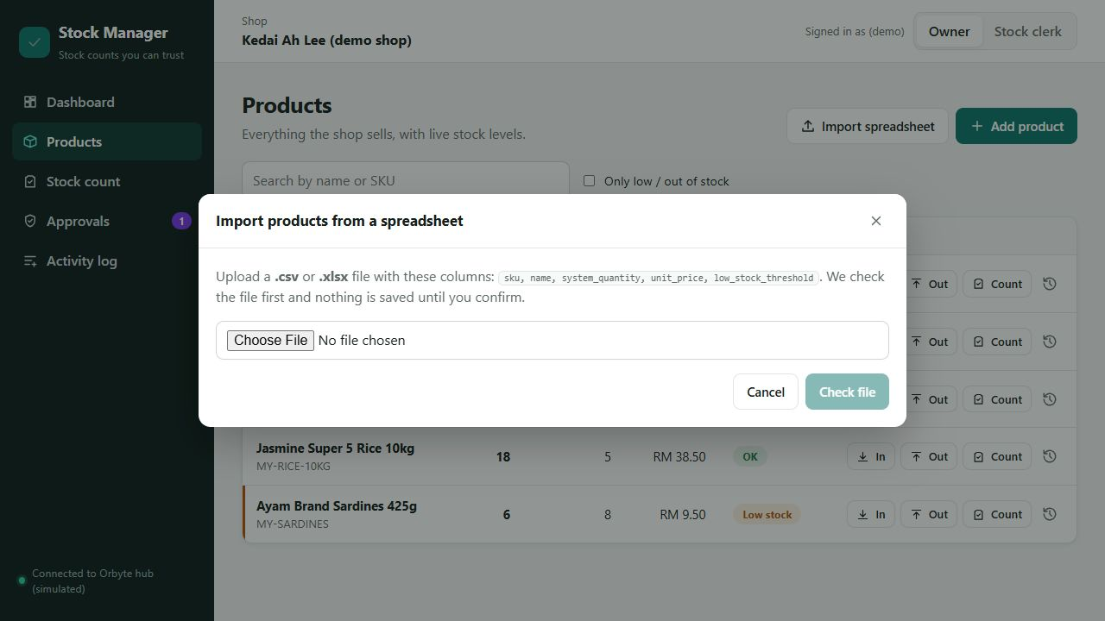
IMPORT AND ONBOARDING
A starting point for existing spreadsheets
CSV and XLSX
Check the file first.
Confirm before saving.
New products only
No silent stock overwrite
Hackstreet Boys
07
Notes:
The app accepts CSV and XLSX product lists with the required fields. It validates the file and previews errors before confirmation. Import creates new products and rejects duplicate or existing SKUs. A failed import does not partially save products. It does not overwrite existing inventory quantities.
The current onboarding format needs validation with shop users and their existing spreadsheets.
Source: import service and interface in the team repository. https://github.com/Adilkrab/Hackstreet-Boys

Slide 8
DELIVERY AND LIMITATIONS
Prototype implementation
React
57 backend tests passed
Interface for clerks and owners
Live prototype on Replit
React interface and FastAPI
FastAPI + SQLite
Stock updates with an audit trail
Rule-based automation. No GPU.
Demo roles and Orbyte sync are simulated.
Hackstreet Boys
08
Notes:
React and Vite provide the interface. FastAPI handles API requests, validation and workflow decisions. SQLAlchemy stores inventory records in SQLite. The most recent local integration check passed 57 backend tests, including workflow boundaries, stale approvals and rollback behavior. That test result does not constitute a production audit.
Replit hosts the accessible prototype. The live interface was checked on 24 October 2026. https://sme-inventory-workflow-backend.replit.app/team-preview/
Runtime automation uses explicit Python rules. No AI model, GPU workload or RunPod service runs in the prototype. Owner/clerk switching and Orbyte sync are simulated.
Source: team repository and technical declaration. https://github.com/Adilkrab/Hackstreet-Boys

Slide 9
IMPACT HYPOTHESIS
Expected value and pilot measures
Less manual follow-up
A traceable stock correction
Pilot measures
SDG 8
Time to resolve a discrepancy
Unresolved requests
Decisions with a recorded reason
Productivity and support
for small businesses
Targets 8.2 and 8.3
Hackstreet Boys
09
Notes:
Expected benefits include less manual follow-up and clearer records of inventory corrections. These are hypotheses for a pilot. No measured productivity gain is claimed. A pilot should track time to resolve discrepancies, unresolved requests and decisions with a recorded reason.
The team's selected track is SDG 8: Decent Work and Economic Growth. Target 8.2 concerns productivity through technological upgrading and innovation. Target 8.3 includes support for micro, small and medium enterprises. These targets provide the basis for the project's proposed contribution.
Sources: team preliminary project proposal. United Nations Goal 8: https://sdgs.un.org/goals/goal8

Slide 10
NEXT STEPS
Stock Manager
Next: shop testing and
owner feedback
github.com/Adilkrab/Hackstreet-Boys
Live demo: sme-inventory-workflow-backend.replit.app/team-preview/
Hackstreet Boys
10
Notes:
The next stage is to test the workflow with shop owners, evaluate the approval thresholds and improve onboarding using their feedback. Production authentication and an actual Orbyte connection remain future work. Planned AI summaries and pattern detection would provide recommendations while owners retain approval authority.
Live prototype: https://sme-inventory-workflow-backend.replit.app/team-preview/
Source code: https://github.com/Adilkrab/Hackstreet-Boys
Source: team preliminary project proposal and technical declaration.

