Slide 1


Stock Manager
35 in the system.
28 on the shelf.
Stock counts you can trust: a count-and-approval
workflow for Malaysian micro-shops.
DOMAIN 2 · SDG 8
Hackstreet Boys · SDC Hackathon 2026
Orbyte Smart SME
Challenge
Xiamen University Malaysia · Monash University Malaysia

Slide 2


The stock-count problem
65%
39.5%
of Malaysia's GDP comes from MSMEs, plus
48.7% of jobs (2024)
Notebooks, spreadsheets, WhatsApp
of retail inventory records
were inaccurate
Counts kept in three places that rarely agree
About 370,000 records across 37 stores
Silent fixes
Stock overwritten with no approval and no log,
so staff get blamed
Sources: DeHoratius & Raman (2008), Management Science 54(4); DOSM (2025), MSMEs Performance 2024

Slide 3

How Stock Manager works
Every count ends in a decision and a record.
1
2
3
4
Count
Compare
Decide
Log
Clerk enters
what is really on
the shelf
System vs
counted, in units
and RM
Every step
saved: who,
what, when
Fixed automatically
≤2 units, under RM50,
never below zero
Owner decides
Anything bigger: approve
or reject, with a note

Slide 4

WHY RULES, NOT AI
An owner must be able to predict
and explain every stock change.
Same input, same result
AI where it adds value
Fixed limits anyone can check: 2 units, RM50,
never below zero.
Domain 2 asks for exactly that. Ours arrives in
Phase 2, as advice only.

Slide 5
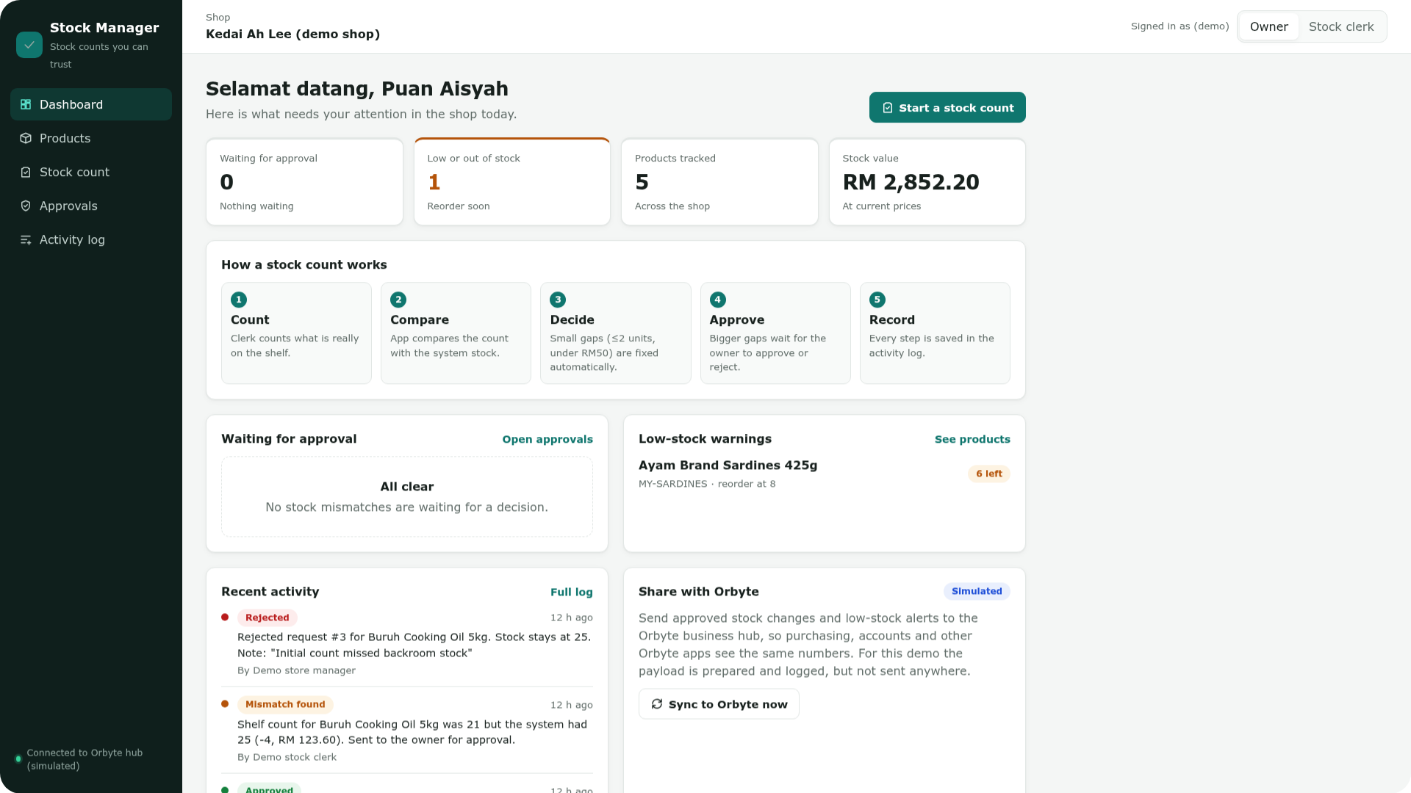

Live prototype
OPEN IT ON ANY PHONE
hackstreetboys-stock
.replit.app/stock_manager/
DEMO SHOP
Kedai Ah Lee
PEOPLE
Owner Puan Aisyah · Clerk Ravi
Synthetic data. Logins and Orbyte sync
are simulated.
Owner dashboard, live build

Slide 6



Built-in accountability
Every number can be traced to a person and a reason.
Activity log
Spreadsheet import
Sync to Orbyte
Who changed what, when
and why. Entries cannot be
edited. Export to CSV.
CSV or XLSX. A preview flags
bad rows first. All rows or
none; nothing overwritten.
Approved changes and
low-stock alerts, packaged for the
Orbyte hub.
Simulated: prepared and logged,
not sent

Slide 7


Architecture
React + Vite
FastAPI
SQLAlchemy
SQLite
Phone-friendly
web UI
Rules and role
checks
Data layer
Products, counts,
log
57
One transaction
A stock change and its audit entry save
together, or not at all
Hosted on Replit
Roles and the Orbyte sync are
simulated in this build
backend tests passing
AI coding tools
Used during development and declared
in our submission

Slide 8



Impact on SDG 8
SDG TARGETS
8.2
100%
Accountability
Higher productivity
through technology
Stock changes with a named approver and
an audit entry. Target.
8.3
20%
Record accuracy
Fewer mismatches (relative) after two
count cycles. Pilot hypothesis.
Growth and formalisation
of micro-enterprises
≥50%
Owner workload
Mismatch reviews closed automatically.
Pilot hypothesis.
Runs in a phone browser.
No new hardware.
No training.

Slide 9
Phase 2 roadmap
PRODUCT
Pilot
Real logins
Live Orbyte link
Shop-set limits
3–5 shop owners
counting real stock
Server-side
roles replace the
demo toggle
Send the prepared
payload for real
Each owner tunes
the auto-fix
thresholds
AI · ADVISORY
AI · ADVISORY
Loss patterns
Weekly summary
The AI recommends.
Flags products that keep
going missing
A short recap in BM
or English
The owner decides.

Slide 10
Stock Manager
Stock counts
you can trust.
LIVE DEMO
hackstreetboys-stock.replit.app/stock_manager/
CODE
github.com/Adilkrab/Hackstreet-Boys
Hackstreet Boys · SDC Hackathon 2026 · Domain 2 · SDG 8

