Slide 1
Flood Risk Prediction &
Early Warning Decision Support System
A data-driven research project for disaster risk management
Aadil Ali Mahar
BS Computer Science, The Islamia University of Bahawalpur (2022–2026)
Master's in Disaster Management — Research Presentation
September 2026

Slide 2
Disaster Problem Background
Pakistan 2010: one of the worst floods in the country's history — ~20 million people affected, ~2,000 lives lost
Pakistan 2022: ~33 million affected and 1,700+ deaths; among the costliest climate disasters on record
Sindh bore the heaviest losses in both events — districts like Dadu, Larkana and Jacobabad were devastated
Floods are Pakistan's most frequent and damaging hazard, yet district-level decisions remain largely qualitative and ad hoc
Relief and rescue arrive late when district officers and communities lack timely, localized risk information
Flood Risk Prediction & Early Warning Decision Support System
2

Slide 3
Research Gap: The Last-Mile Problem
Weather forecasts and flood bulletins exist — but district-actionable risk information is still assembled manually
Machine-learning flood research stops at offline risk maps; it is rarely built into operational, always-on platforms
No integrated open-source platform combines prediction, GIS, automated early warning and citizen reporting in one stack
Decision-makers need answers at district granularity: where will it flood, how bad, and what to do about it
This project closes that last mile: data-driven risk prediction delivered as decision support to authorities and the public
Flood Risk Prediction & Early Warning Decision Support System
3

Slide 4
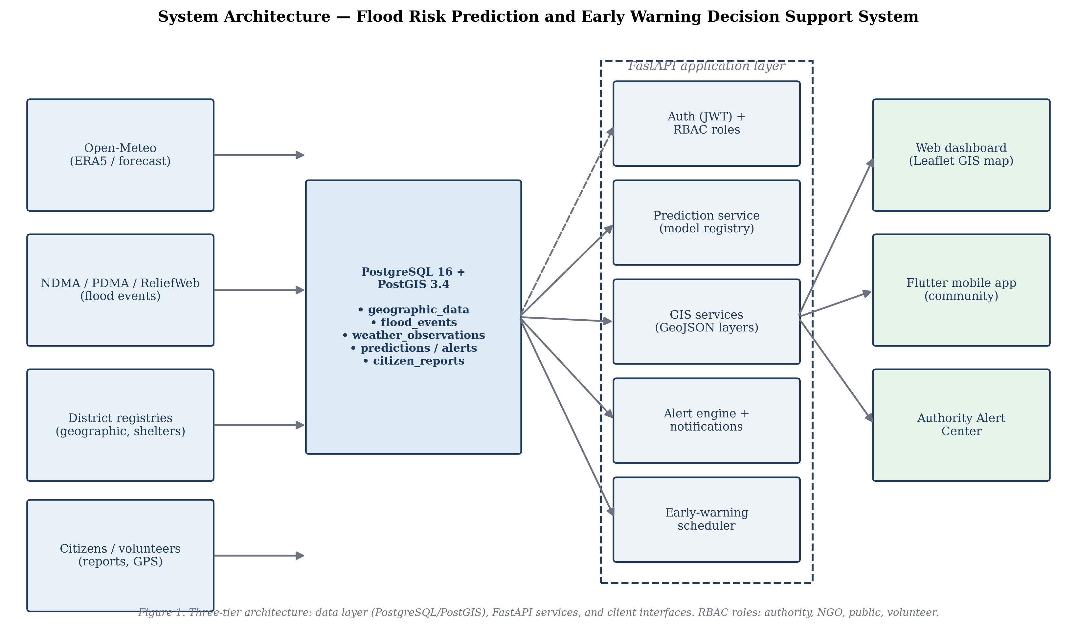
Proposed Framework: Three-Tier System
Data layer — PostgreSQL + PostGIS: 7 core tables, spatial districts, seeded flood events, model registry
Service layer — FastAPI: auth (JWT), dashboard, risk, GIS, alerts, decision-support and mobile APIs
Prediction engine — versioned ML model registry (Random Forest, XGBoost, MLP) with a rule-based fallback
Clients — dashboard prototype with live Leaflet map, Flutter mobile app, and a 30-minute early-warning scheduler
Everything is open-source, containerized with Docker Compose, and documented end to end
Flood Risk Prediction & Early Warning Decision Support System
4

Slide 5
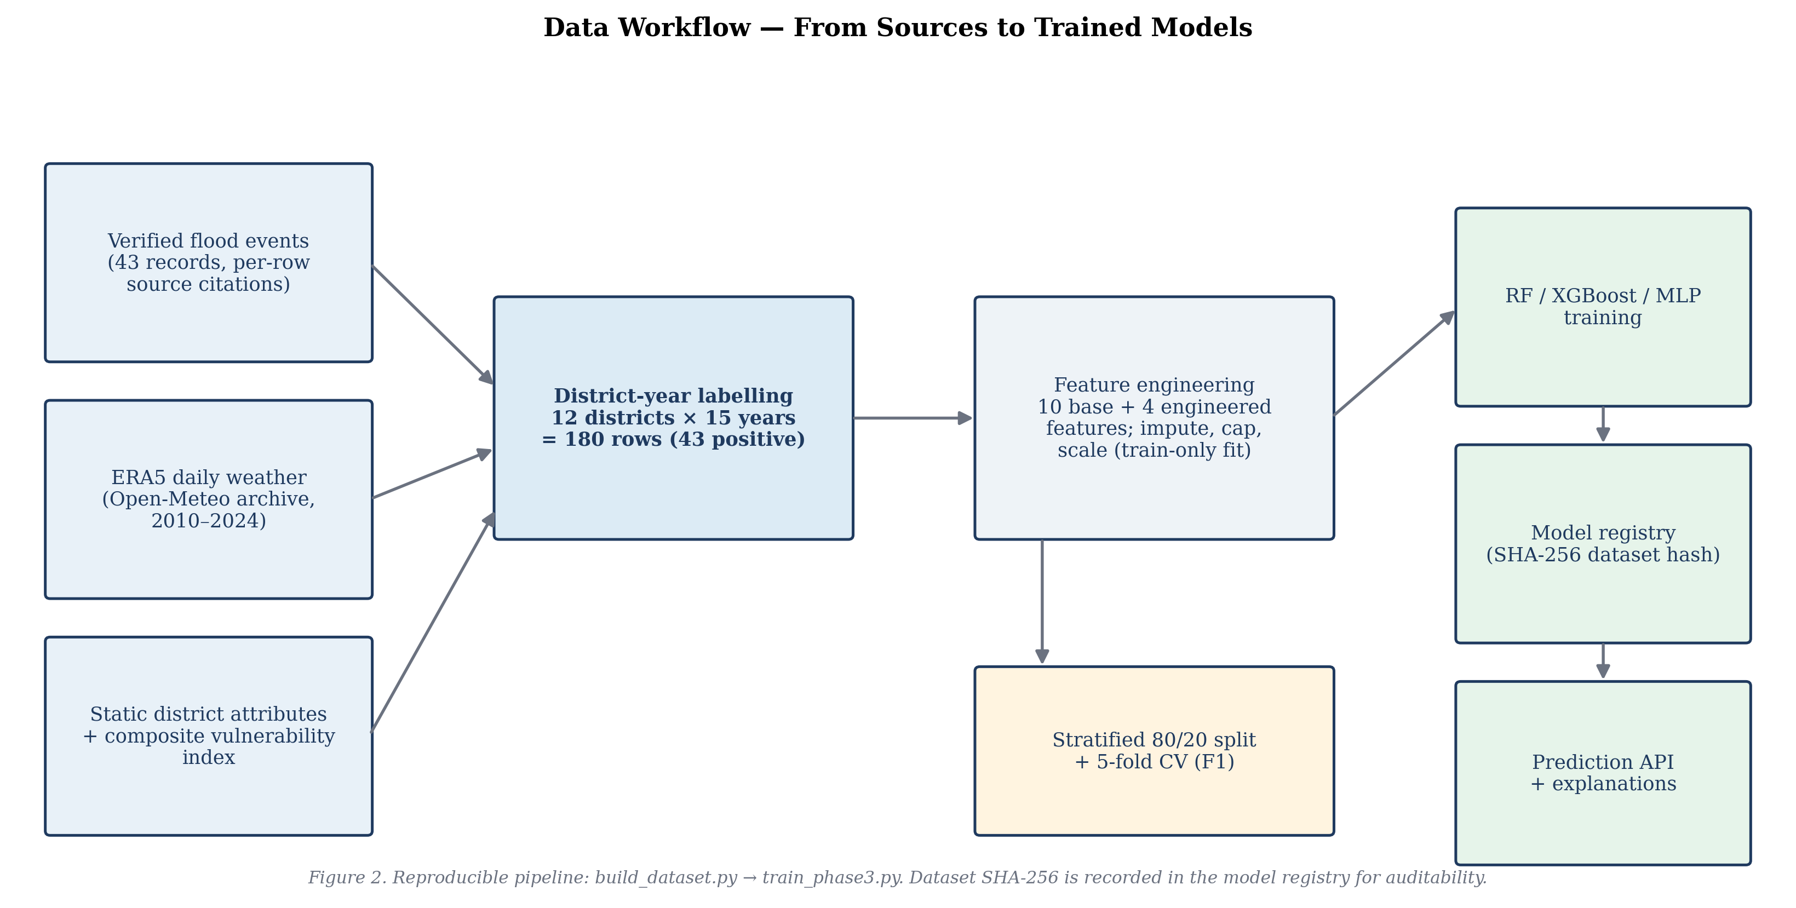
Dataset: Sindh District Floods 2010–2024
180 district-year rows: 12 Sindh districts × 15 years (2010–2024)
43 verified flood years with per-row citations (observatory records, NDMA, ReliefWeb)
Weather features from ERA5 reanalysis via the Open-Meteo API — monsoon-season aggregates
10 base + 4 engineered features: rainfall, flood history, vulnerability indicators, composite index
Documented in a data card; dataset SHA-256 is pinned in the model registry for reproducibility
Flood Risk Prediction & Early Warning Decision Support System
5

Slide 6
Methodology
Stratified 80/20 train/test split preserves the flood-year class ratio in both sets
5-fold cross-validation for honest performance estimates on the 180-row dataset
All preprocessing (scaling, encoding) fitted on training folds only — no leakage into validation
Class imbalance addressed so rare flood years are not drowned out by normal years
Every prediction returns its contributing features plus actionable recommendations
Three model families benchmarked head-to-head: Random Forest, XGBoost and MLP
Flood Risk Prediction & Early Warning Decision Support System
6

Slide 7
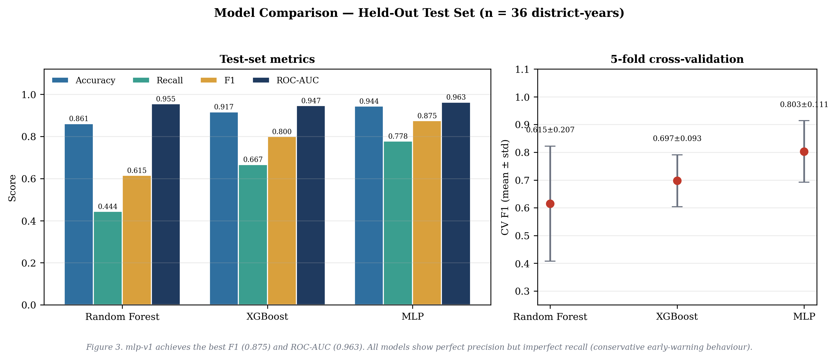
Prediction Model Results
MLP is the best model overall; ROC-AUC exceeds 0.94 for all three models
Perfect precision with imperfect recall → conservative flagging: every raised alert is trustworthy
5-fold CV standard deviations are reported alongside — honest uncertainty, not cherry-picked scores
Limitation: these are district-year classifiers on seasonal aggregates, not event-scale predictors
Model | F1 score | ROC-AUC
Random Forest | 0.6154 | 0.9547
XGBoost | 0.8000 | 0.9465
MLP (best) | 0.8750 | 0.9630
Flood Risk Prediction & Early Warning Decision Support System
7

Slide 8
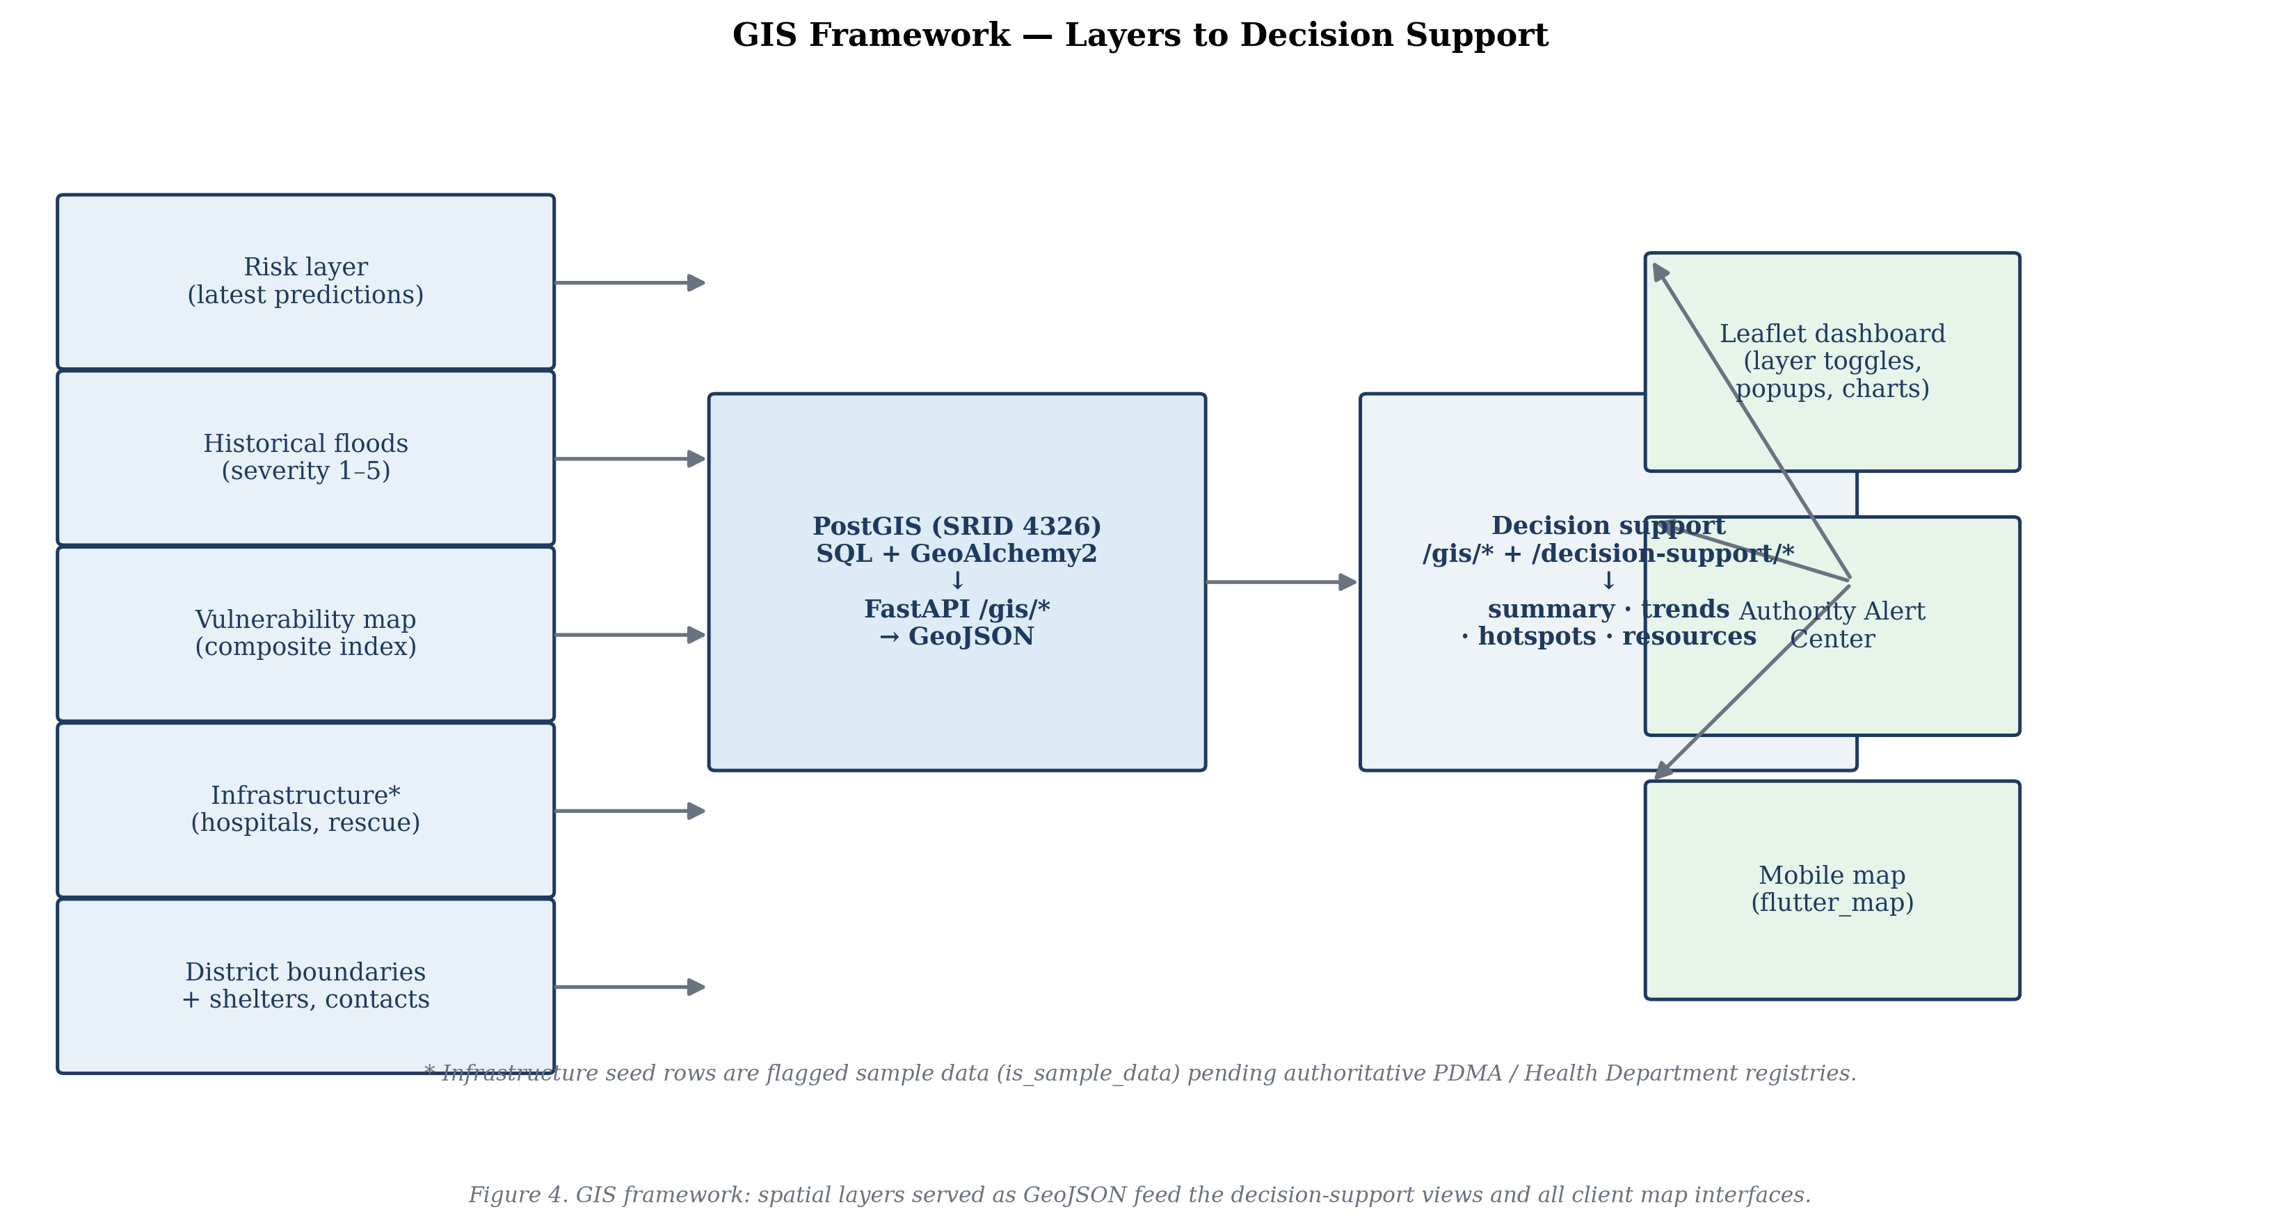
GIS Decision Support
Risk layer: district-level predicted risk rendered as an interactive choropleth map
Historical floods layer: 52 seeded verified flood events for context
Vulnerability map: district vulnerability indicators and composite index
Infrastructure layer (hospitals, shelters, routes) — flagged as sample data pending PDMA/health registries
Decision-support APIs: /decision-support/summary (actions per high-risk district) and /trends (2010–2024 time series)
Dashboard supports district search, layer toggles and rich popups
Flood Risk Prediction & Early Warning Decision Support System
8

Slide 9
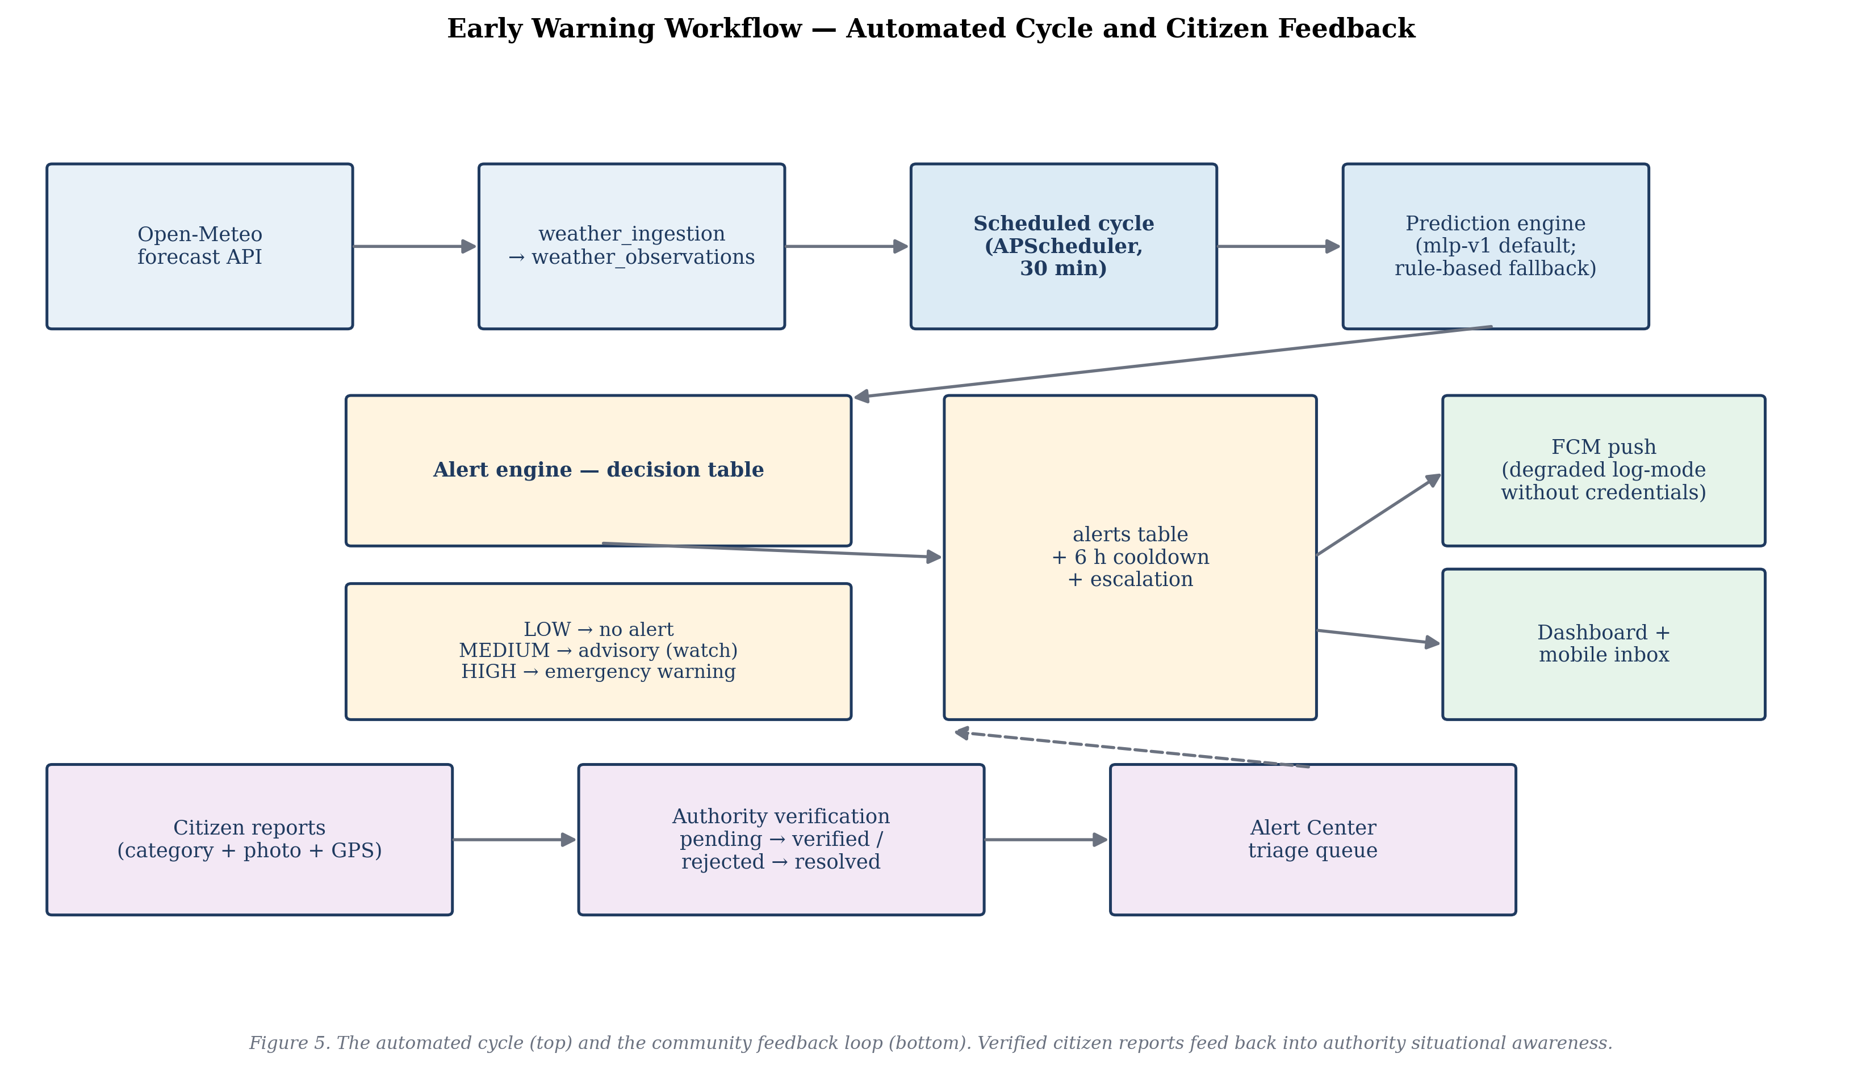
Early Warning System
Ingestion: Open-Meteo forecast API → weather_observations table via CLI + scheduled script
30-minute automated cycle: weather → prediction (mlp-v1) → alert decision → notification
Alert engine tiers: LOW (no action), MEDIUM (advisory), HIGH (emergency warning)
6-hour cooldown deduplication prevents alert fatigue; escalation when risk keeps rising
FCM push notifications with graceful degraded log-mode when no credentials are configured
Citizen reporting loop: pending → verified / rejected / resolved by authority users
Flood Risk Prediction & Early Warning Decision Support System
9

Slide 10
Mobile Application
Flutter 3.47.5 app with feature-first clean architecture — 8 screens: splash, auth, home, risk, map, alerts, emergency, safety
Risk check: any district's current predicted risk on demand
Shelter finder: nearest safe shelters and emergency contacts by district
Offline safety guide: preparedness steps available without connectivity
Categorized citizen reporting: flood water, road blockage, rescue request, medical emergency — with image upload
Volunteer role for trusted reporters; authority-only verification workflow
Code quality: flutter analyze clean, 7/7 widget tests pass, release web build succeeds
Flood Risk Prediction & Early Warning Decision Support System
10

Slide 11
Contributions
Technical — an integrated open-source stack: machine learning + GIS + automated early warning, with a reproducible SHA-256 model registry and 119/119 backend tests passing
Disaster management — aligned with Sendai Framework Priorities 1 (understanding risk) and 4 (enhancing preparedness); DDMA-ready decision views via the summary and trends endpoints
Community — a public mobile app with a shelter finder, verified citizen reporting and an offline safety guide, bringing risk information to the last mile
Flood Risk Prediction & Early Warning Decision Support System
11

Slide 12
Future Improvements
Temporal holdout validation: train on past years, test on future years to prove generalization
Event-scale labels to match the operational granularity decision-makers actually use
Authoritative infrastructure registries from PDMA and health departments to replace sample data
A validated vulnerability index built with domain-expert review
Per-district push notifications with real FCM credentials for the early-warning cycle
Field evaluation with PDMA / DDMA officers in Sindh before operational deployment
Flood Risk Prediction & Early Warning Decision Support System
12

