Slide 1
Wumpus World
Pygame
Default grid size = 10
Act interval = 1s
Debug mode
Manual mode

Slide 2
Entities
Wumpus = 1
  Reward = 1000
Gold = 10
  Reward = 100
Pit = 10
Agent = 5
  2 shots
  Random movement to Neumann neighbors

Slide 3
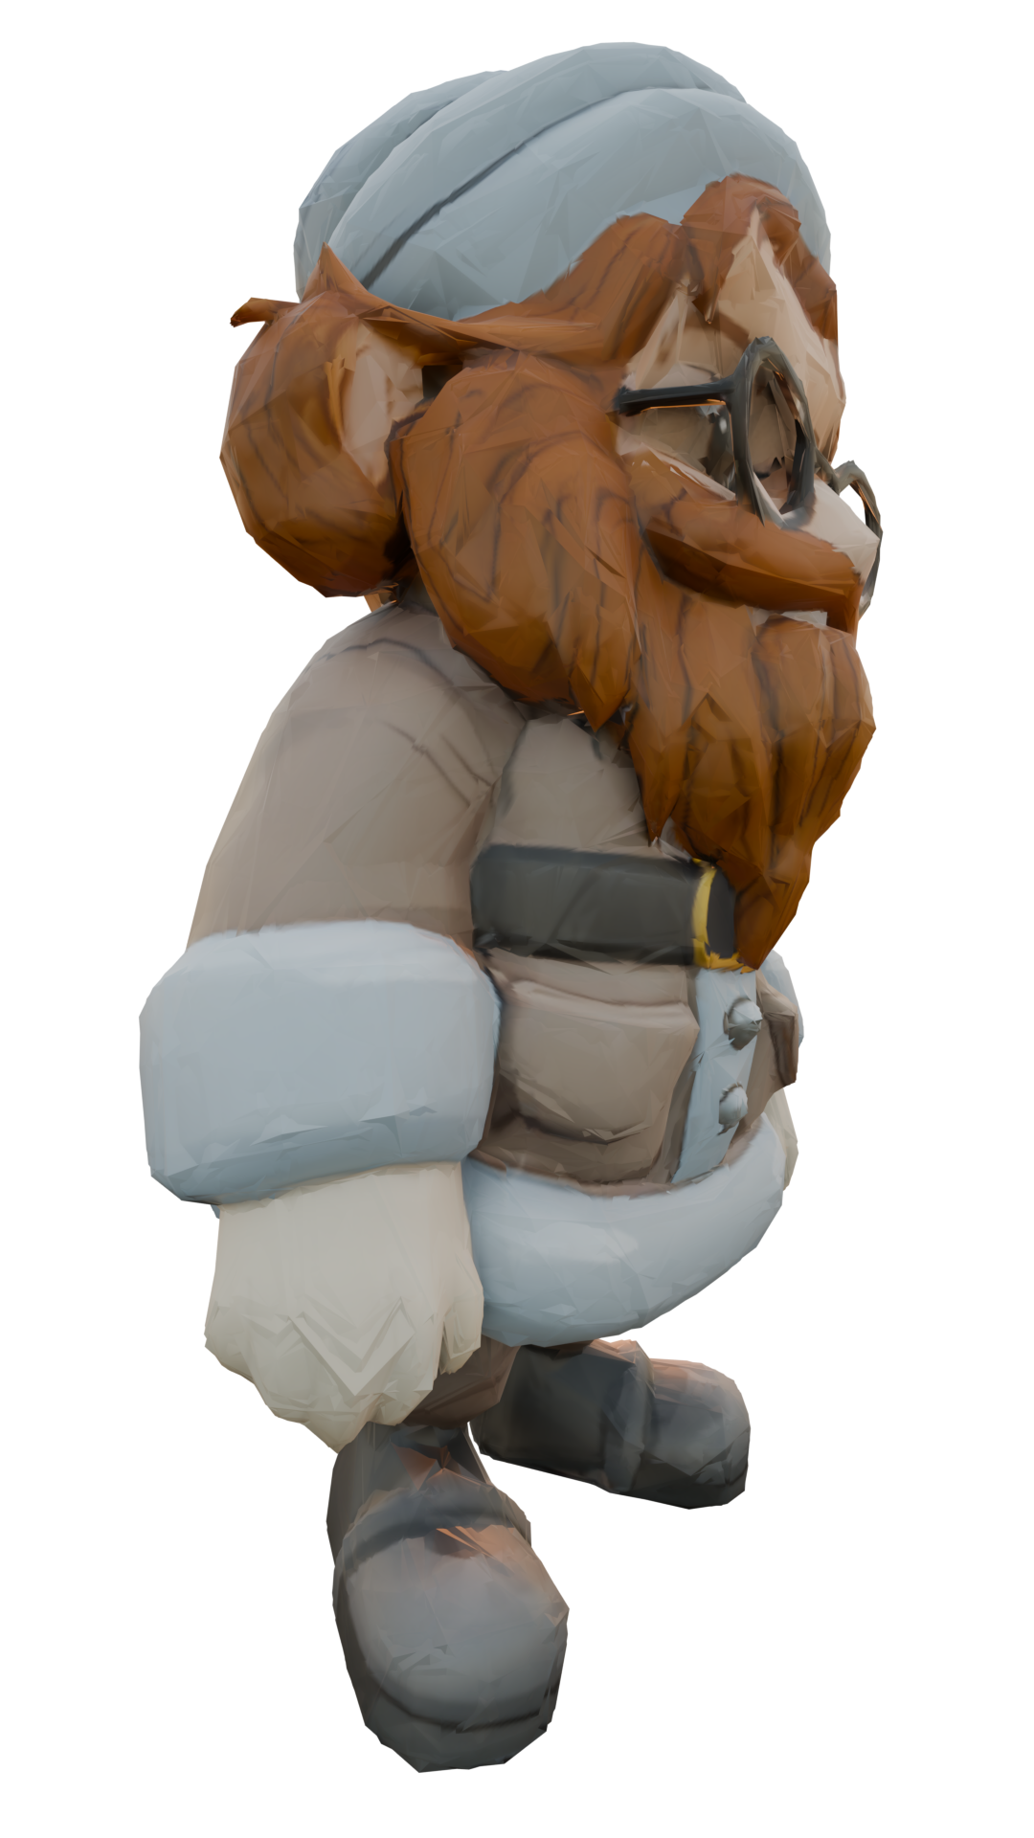
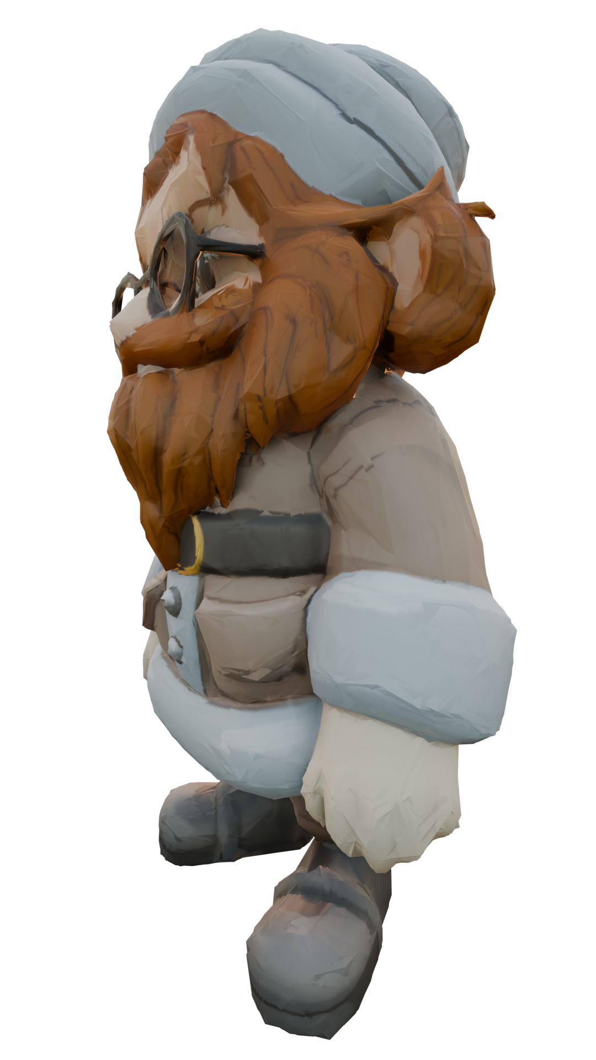
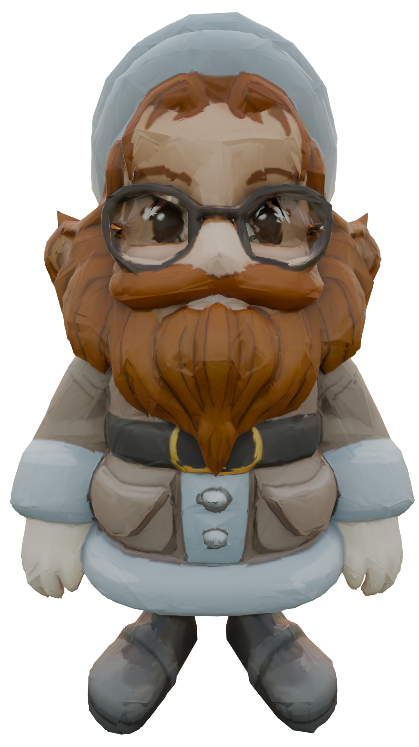
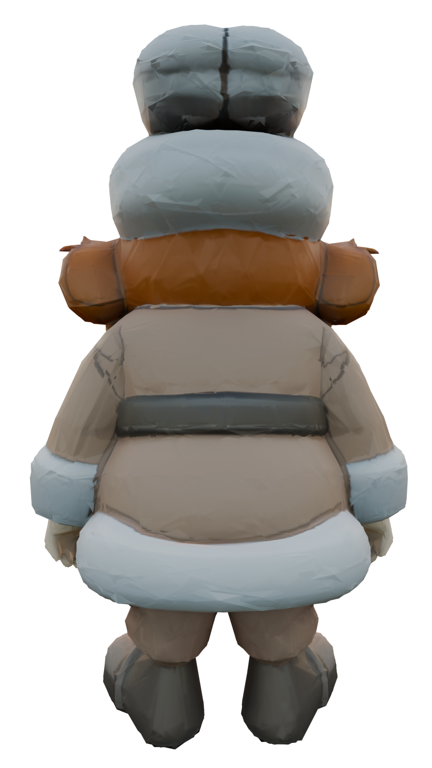

Slide 4
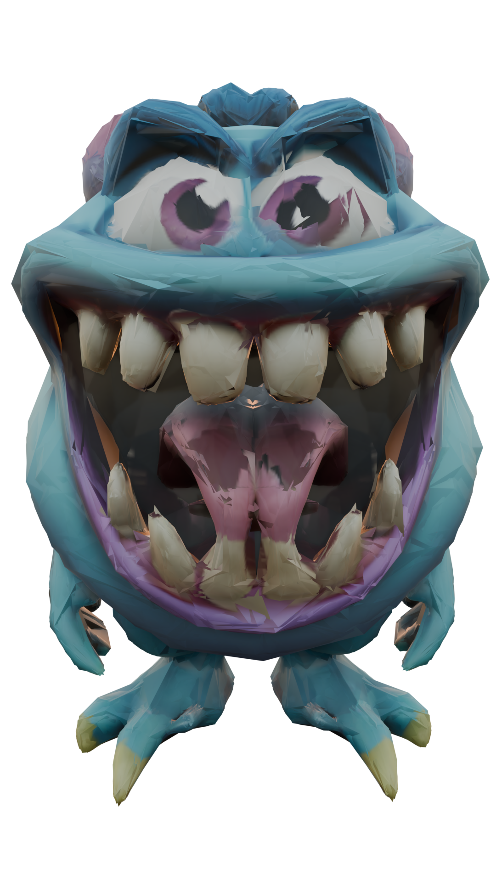
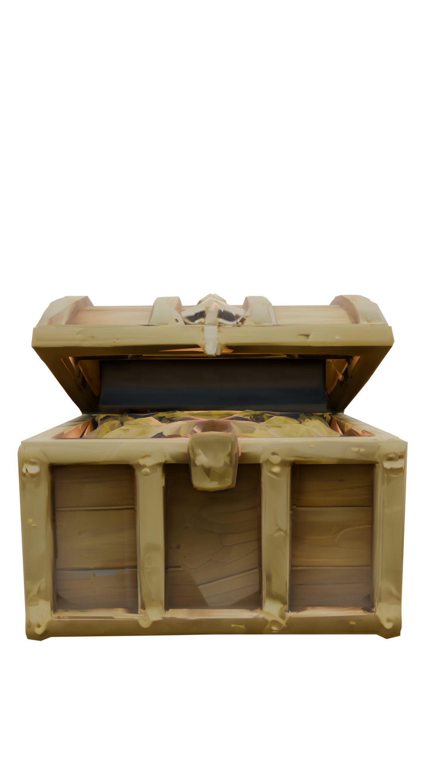
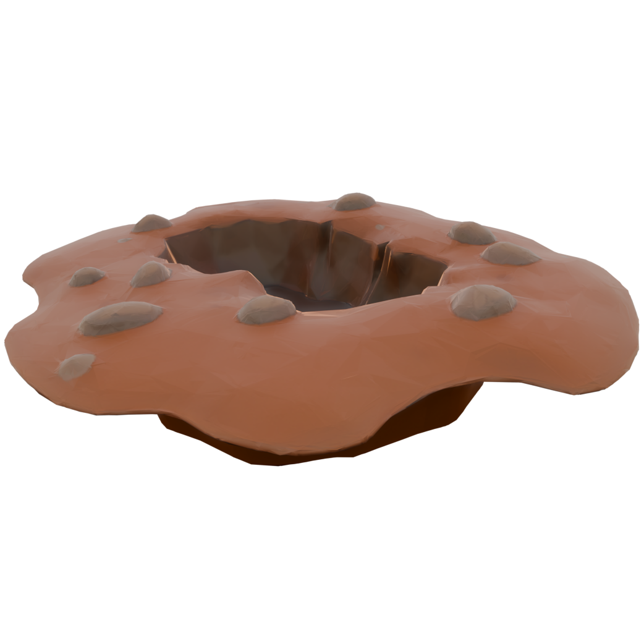

Slide 5
Interactions
Attack
Collect
Communicate

Slide 6
Perceptions
Neumann neighborhood
Breeze
Stench
Shininess

Slide 7
Communication
Whisper
  Between neighbor agents
  To avoid conflicts, free stuck agents
Shout
  Between all agents
  For voting
  Notify that Wumpus got killed
Majority voting between game over and continue

