Slide 1

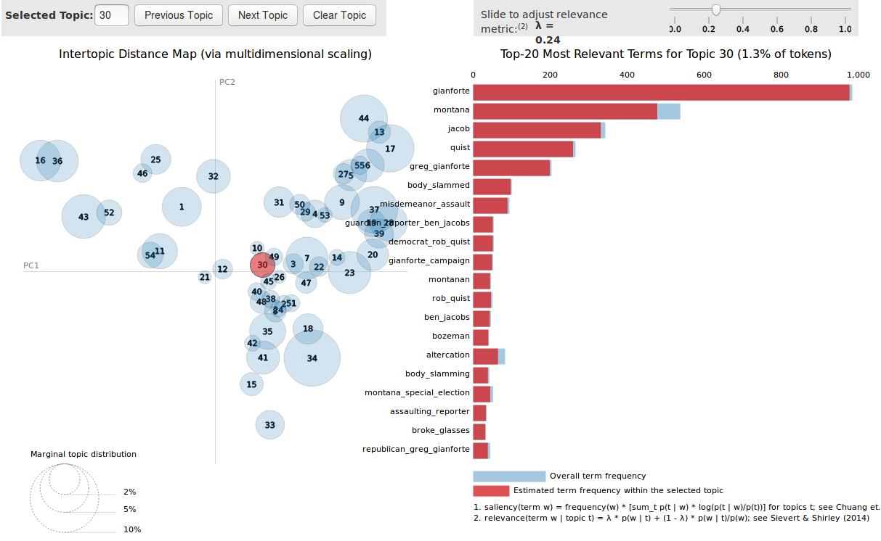
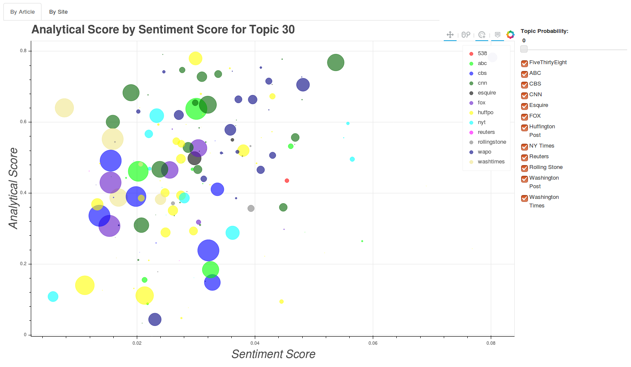
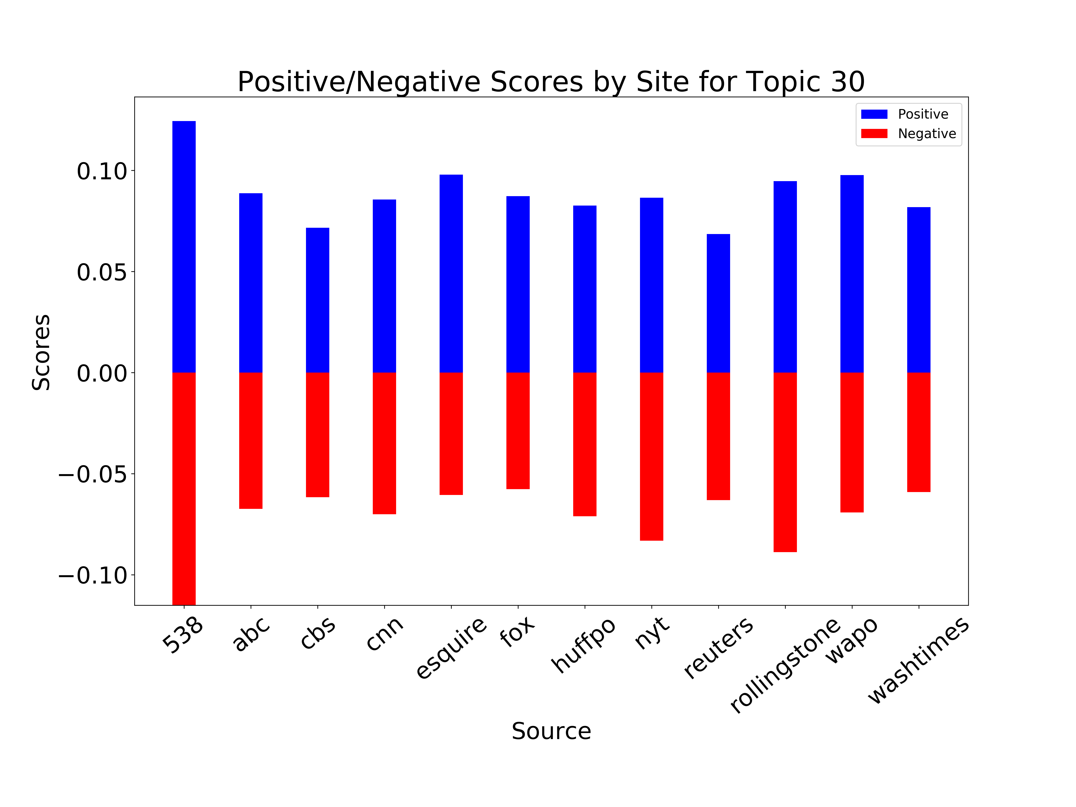
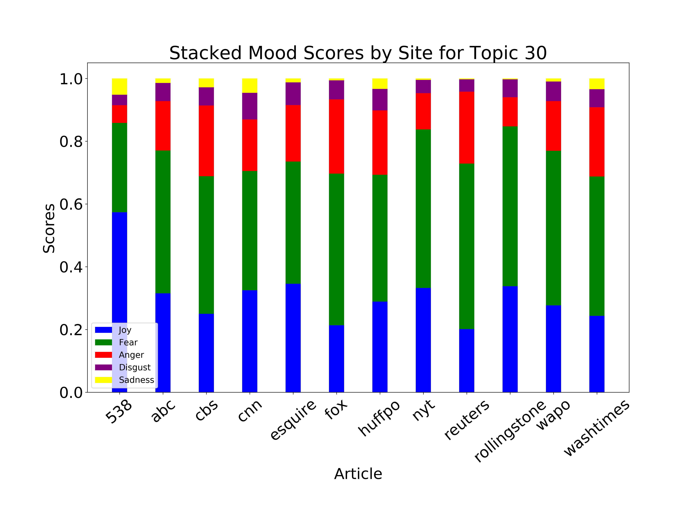
On-line American Political New Analysis
Ian McCann
Galvanize
Background
Conclusion
The aim of this project was to provide users with tools to examine American political news and the websites that post it, in an effort to help neutralize the biases different news organization may posses.
News sources claim they are unbiased, but many Americans do not believe that is so. Opinions in news organizations are not the problem, but presenting those opinions as facts is. This project does not attempt to uncover their bias, but merely allow users to see how they cover and treat different topics. It examines how analytical, objective and opinionated certain news organizations are towards a topic.
This project allows a user to decide for themselves whether they would like to read an analytical piece, opinion piece, neither or both. The hope is that a user can view all sides of an issue and come to a conclusion on their own about how they feel towards it.
Objectives
Once a topic has been selected you go to the topics page where there is an interactive graph as shown below.
Objectives
Latent Dirichlet Allocation (LDA) is used to determine topics discussed in over 7000 political articles from 12 news sources. In LDA, each news article can be considered a mix of multiple topics and LDA assigns a set of topics to it with a probability of pertaining to that topic. Each topic has a set of words related to it, also with probabilities of being related to that topic. It is then assumed in LDA that articles with a high frequency of words that have high probabilities of being in a topic will themselves have a high probability of being in that topic. This assumption is that the topic distribution has a sparse Dirichlet prior or that articles cover a small set of topics and that topics use a small set of words frequently.
On the left side of Figure 1 is an interactive visualization of the topics that were created using LDA. Topic 30 was selected and on the right you can see the top 20 most relevant terms for that topic. This topic will be used as an example of the analysis I performed on all topics.
This graph plots all articles related to this topic by their Analytical score versus their Sentiment score. The Analytical score was determined using IBM Watson’s ToneAnalyzerV3 and the Sentiment score was determined using the state-of-the-art sentiment analysis library SentiWordNet. The size of the circle indicates the probability the article relates to this topic and the slider on the top right allows you to set a probability threshold the article must reach to be shown. Below that are check-boxes for all 12 sources, which allows you to only see those you are interested in. You may also click any circle and it will open the article for you to read.
References

