Slide 1
Teachable Voice Automation
Teach any Android app once by doing it. Replay it by voice with new values.
Samsung PRISM Gen AI Hackathon | Theme 3
SRM University, Kattankulathur, Chennai | Team Ciphera's
Notes:
Open with the one-line pitch: teach once, replay by voice with new parameters, on any app.

Slide 2
The problem
Voice assistants only work where developers built support.
Per-app integration
Long tail unserved
Rigid commands
Bixby capabilities and app actions need each app's developer to build and maintain them. Most apps never do.
Users still tap through the same 6 screens every day in apps that expose no voice API.
Macro tools replay fixed taps. Change "burger" to "pizza" and they break.

Slide 3
The solution
Learn by demonstration, generalise with an LLM, replay against the live UI.
1 Teach
2 Generalise
3 Replay
Say a command the assistant does not know. Do the task once by hand.
Groq turns the demo into a flow: steps, selectors, and {{slots}} for the parts that change.
Say it again with new values. The Replayer matches elements on the live screen and acts.
Example: taught "calculate 5 plus 3" -> replayed "what is 9 plus 4" = 13, "compute 6 plus 1" = 7

Slide 4
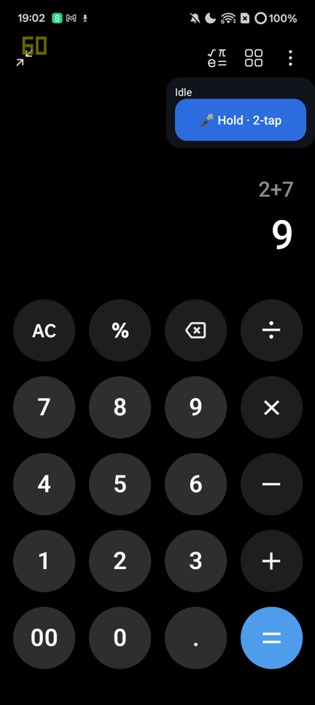
Open any app by name
Built in. No demonstration needed.
How it works
The phone sends the backend its launchable apps (label + package). "Open Calculator" is matched on the exact app name and the app is launched.
Safe by construction
Exact-name match only, so "open Bluetooth settings" still replays your taught flow instead of hitting the Settings app. Unknown names fall back to teach mode.
Notes:
Answers the first thing a user tries: opening an app. Teaching cannot capture this because launcher taps are ignored by the recorder.

Slide 5
Architecture
Android does the acting. The backend does the understanding.
Android (Kotlin)
Backend (Node, Express, Mongo, Docker)
AccessibilityService: read UI tree, tap, type, scroll, back
Flow Recorder: events to selectors, passwords redacted
Flow Replayer: resourceId > text > desc > class, 6 s wait, retry, LLM fallback
Overlay: draggable mic, TEACH MODE indicator, Yes/No
Foreground service: push-to-talk audio, WebSocket, TTS playback
WebSocket: audio to Deepgram Nova 3 STT
Groq JSON mode: intent + slots, generalise, paraphrase match, pick-element fallback
Deepgram Aura TTS over the same socket
Mongo: Flow + RunLog
REST + /dashboard metrics from real RunLogs
docker compose up

Slide 6
Why Accessibility beats app-specific integrations
Per-app integration
Accessibility + demonstration
One integration per app, built by that app's developer
Breaks when the app ships an update they did not plan for
Covers only partners
Works on apps that know nothing about us
The user is the integration: one demo, minutes not months
Same UI tree screen readers already use
Covers the long tail, including Chrome, Settings, Clock, Calculator

Slide 7
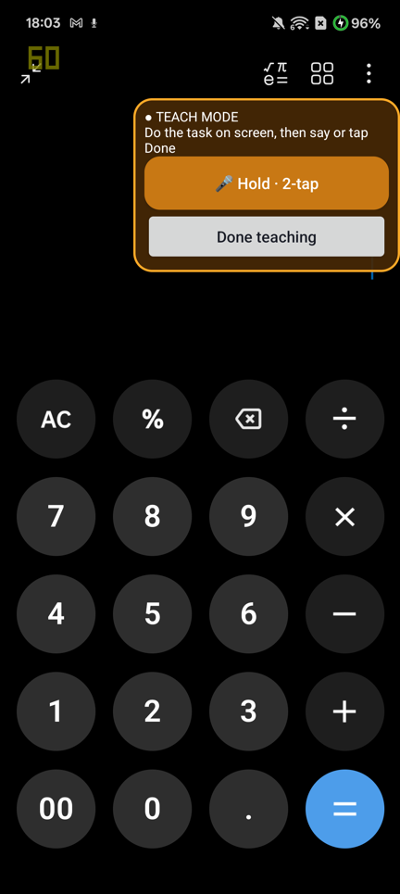
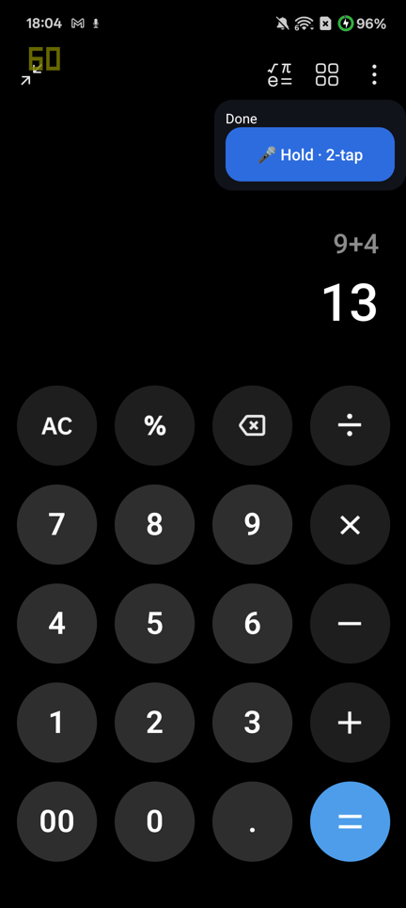
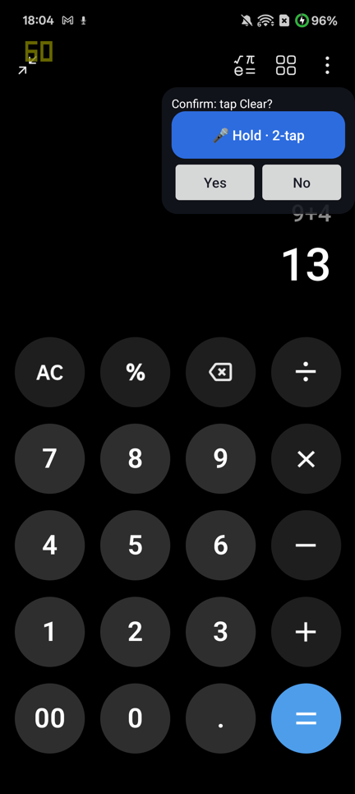
Demo on a real phone
Realme device, real Accessibility events, real STT and TTS.
Teach mode: user demonstrates
New slot, same flow: 9 + 4 = 13
Confirm before sensitive step

Slide 8
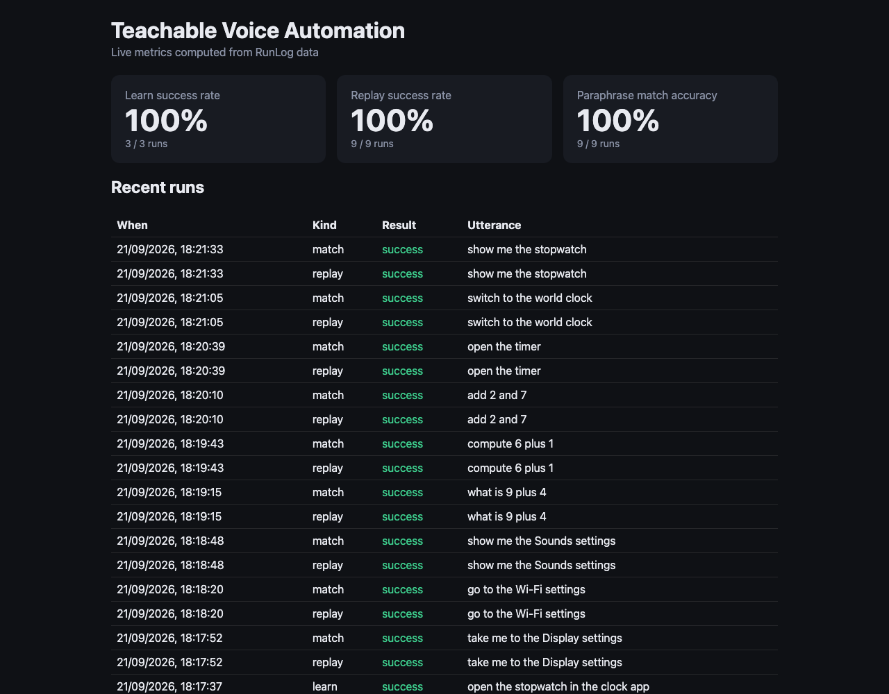
Measured results
Real phone. Flows and RunLogs reset first. Computed by the dashboard from RunLog data.
Learn success
Replay success
Paraphrase match
100%
100%
100%
3 / 3 demonstrations turned into flows
9 / 9 replays with new slot values
9 / 9 live; 13 / 13 offline eval incl. 2 negative controls
3 flows: Settings, Calculator, Clock. Small sample, own device: read these as a working proof, not a benchmark.
Notes:
Be honest: 3 flows, one phone. Two earlier attempts failed while building (slot extraction bug, matcher miss); both fixed and covered by the eval.

Slide 9
Safety by design
Never auto-complete
Privacy and secrets
Steps that look like pay, send, order, delete are flagged.
Replay pauses, speaks "Confirm?", waits for Yes or No.
Unclear answer or no answer = No.
A declined run is logged as declined, not a failure.
Password / PIN / OTP fields are redacted at record time and never stored or sent to the LLM.
Keys only via environment; .env gitignored.
Input validated on every endpoint and WebSocket message.
Non-root Docker image.

Slide 10
Limitations, stated plainly
Chrome address-bar suggestion taps emit no accessibility click event, so those flows are hand-authored, not taught.
Long-press and drag gestures are not captured yet.
Operators are not slots: "plus" is baked into the taught calculator flow; "9 minus 4" needs its own demo.
Matching depends on an LLM (openai/gpt-oss-20b on Groq; the Llama model was not available on our key).
Cleartext LAN/localhost transport for development; production needs TLS.
Accessibility must be enabled by the user in Settings; Android does not allow it programmatically.

Slide 11
Production: an OEM system service
The architecture is what Samsung could ship.
Fallback under Bixby
On-device
System-level trust
Bixby stays first choice where a developer built support. Teach mode covers everything else.
Move STT and the small models on-device. Flows stay private on the phone.
As a privileged service: signed confirmations, per-app policy, shareable flows.

