Slide 1

INSIGHTPRO
AI POWERED PRESENTATION QUALITY CHECKER

Slide 2




MEET THE TEAM
Dhruvish shah
agastya shetty
aditya tripathi

Slide 3
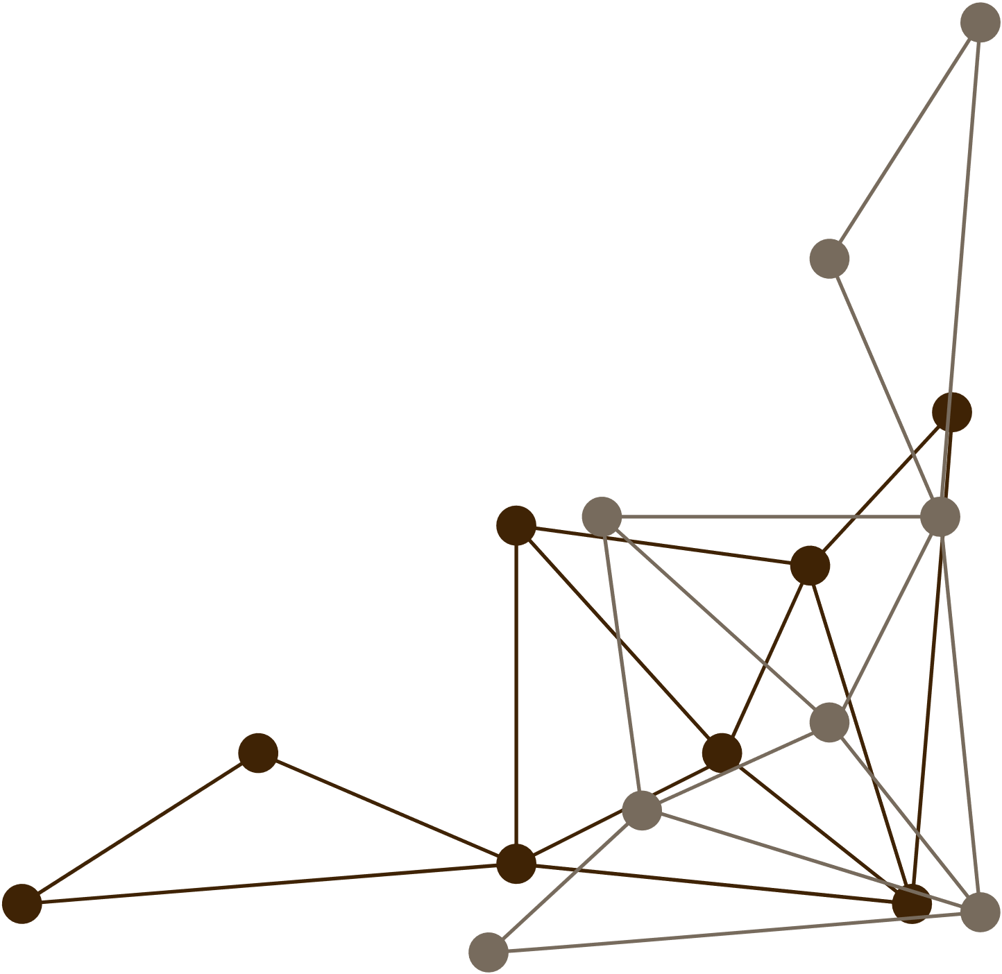


Provides real-world business value
Many organizations rely on presentations to communicate ideas and make key decisions. A tool that evaluates presentation quality ensures these decisions are based on well-structured, clear, and factual information.
Aligns with improving decision-making through better presentation evaluation:
By analyzing the content, visuals, and structure of slides, our tool helps presenters improve their messaging, which can lead to more effective decision-making in corporate settings.
Challenges us with AI-based content and visual assessment
The market changes fast, and startups need to keep up. But without a big team or resources, it's tough to stay on top of the latest trends and adapt their marketing strategies accordingly.
PRESENTATION QUALITY CHECKER

Slide 4
FEATURES ENVISIONED
Comprehensive Content & Visual Evaluation
Automated Fact-Checking & Feedback
Final Scoring & Improvement Suggestions
The system analyzes both text and visuals on each slide.
It evaluates the clarity, relevance, and storytelling quality of the text,
while also assessing the effectiveness of infographics, images
overall slide design to ensure everything aligns with the presentation’s message.
Our tool checks the accuracy of data and statements within the presentation by cross-referencing external sources.
It then generates detailed feedback, pointing out areas for improvement, ensuring content is both accurate and impactful.
After evaluating the presentation based on multiple criteria, the system provides a final quality score.
Additionally, it offers actionable suggestions to enhance the presentation, allowing users to refine their content and design for optimal results.

Slide 5
SCHEME OF SOLUTION
Content Extraction
AI-Based Evaluation
Fact-Checking & Feedback
Final Scoring & Re-Evaluation
Extract text, images, charts, and other elements from each slide.
Analyze structure and hierarchy (titles, bullet points, paragraphs).
Identify key themes and topics of the presentation.
Use Optical Character Recognition (OCR) for images containing text.
Summarize slide content for further processing.
Assess slide design consistency (fonts, colors, layout).
Check for readability and accessibility (contrast, font size).
Analyze slide flow and logical progression of information.
Identify unnecessary or redundant content using natural language processing (NLP).
Evaluate visual balance and alignment of elements.
Cross-reference facts, statistics, and data with reliable online sources.
Identify potential misinformation or outdated data.
Provide real-time feedback on factual accuracy.
Offer suggestions to improve slide content (grammar, style, and relevance).
Highlight slides that require revision or fact correction.
Assign a quality score based on content clarity, design, accuracy, and flow.
Offer specific feedback on areas for improvement.
Allow users to make revisions and resubmit for re-evaluation.
Compare the updated presentation to the original for improvement tracking.
Generate a detailed report summarizing the evaluation metrics and final score.

Slide 6
DOUBTS AND QUERIES
01
IS IT NECESSARY TO DEVELOP A SIMPLE USER INTERFACE (UI), POSSIBLY USING A TOOL LIKE STREAMLIT, TO ENHANCE THE USER EXPERIENCE, OR SHOULD WE FOCUS SOLELY ON THE BACKEND FUNCTIONALITY?
02
SHOULD THE PROJECT BE DEVELOPED AND PRESENTED IN A NOTEBOOK FORMAT (I.E., .IPYNB), WHICH FACILITATES STEP-BY-STEP EXPLANATION, OR WOULD IT BE BETTER TO IMPLEMENT IT IN A STANDALONE PYTHON SCRIPT (.PY) FOR GREATER MODULARITY?
03
WHAT LEVEL OF FACT-CHECKING ACCURACY IS EXPECTED? SHOULD WE FOCUS ON BASIC VALIDATION OF COMMON FACTS, OR ARE WE EXPECTED TO IMPLEMENT MORE COMPREHENSIVE FACT-CHECKING PIPELINES THAT CAN HANDLE DOMAIN-SPECIFIC DATA?
04
WHAT DATASETS OR EXTERNAL RESOURCES CAN WE USE FOR TESTING AND EVALUATING THE SOLUTION? ARE THERE ANY RECOMMENDED DATASETS FOR PRESENTATIONS, OR SHOULD WE CREATE SYNTHETIC DATA TO SIMULATE REAL-WORLD CASES?
05
HOW IN-DEPTH SHOULD THE VISUAL ANALYSIS BE? IS IT SUFFICIENT TO EVALUATE BASIC VISUAL QUALITY (E.G., IMAGE PRESENCE AND LAYOUT), OR SHOULD WE DELVE DEEPER INTO ANALYZING SPECIFIC ELEMENTS LIKE CHARTS AND GRAPHS FOR THEIR CORRECTNESS AND RELEVANCE?

Slide 7
THANK YOU

