Slide 1
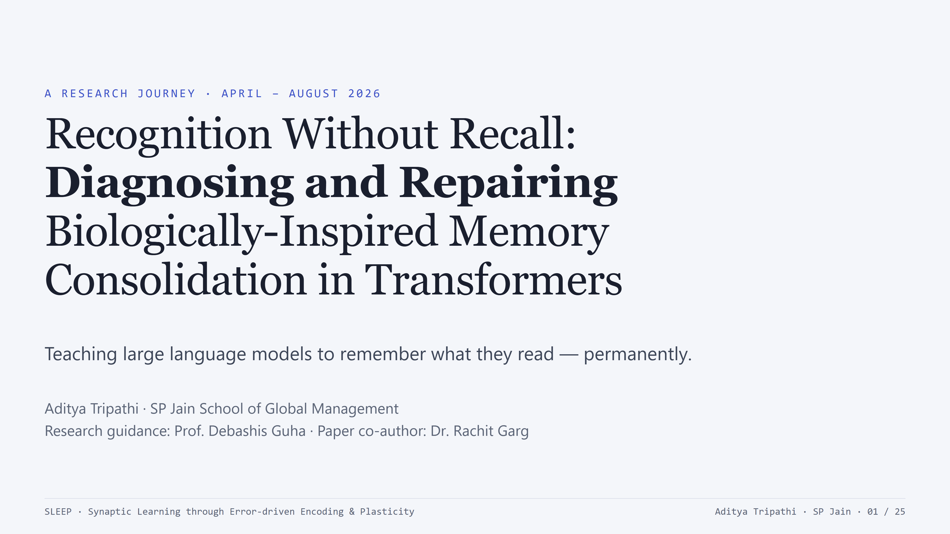
Notes:
Good [morning/afternoon]. This is the story of a research project that set out to give language models a memory, discovered exactly why the obvious approach fails, and then repaired it. The title has two halves for a reason - the first half is a diagnosis, the second half is a fix that works. Everything I'll show you is backed by pre-registered experiments: 4 models, 3 model families, and every headline number replicated across seeds.

Slide 2
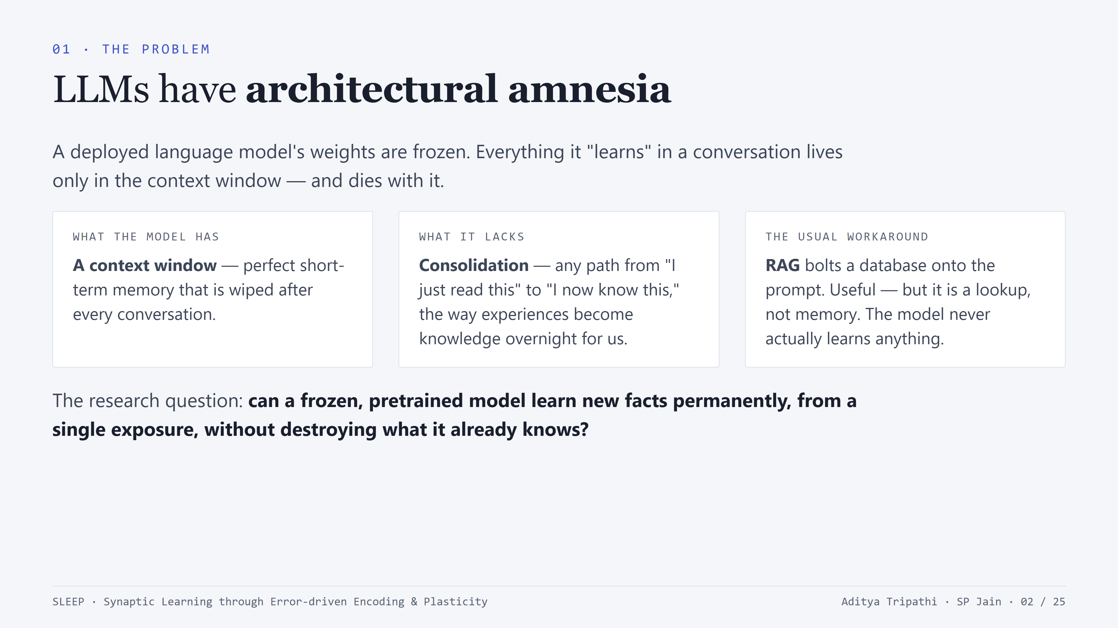
Notes:
Set up the gap: LLMs are frozen at deployment - a form of anterograde amnesia. The context window is short-term memory that gets wiped. RAG is the industry workaround, but it's plumbing - a database lookup on every query - not learning. Our question: single-exposure, permanent, non-destructive learning in a frozen pretrained transformer. Three constraints that make it hard: one exposure only, must survive after context is gone, and must not damage existing capabilities.

Slide 3
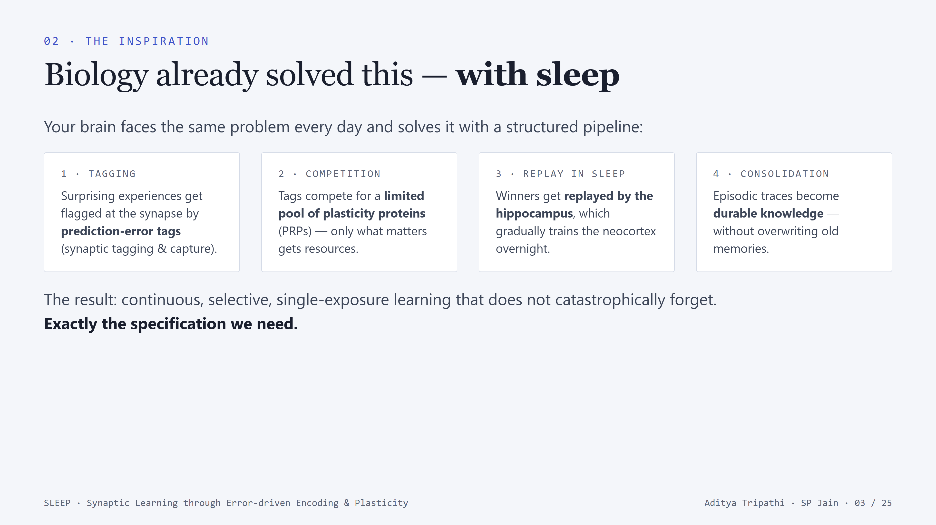
Notes:
The biology: synaptic tagging and capture (Frey & Morris) - weak stimulation creates molecular tags; tags compete for limited plasticity-related proteins; winners get consolidated. Complementary Learning Systems (McClelland): fast hippocampal store + slow neocortical store, bridged by replay during sleep. The output spec of this pipeline is exactly what we want for LLMs: continuous, selective, one-shot learning without catastrophic forgetting. So the hypothesis: implement the pipeline faithfully and the properties should follow.

Slide 4
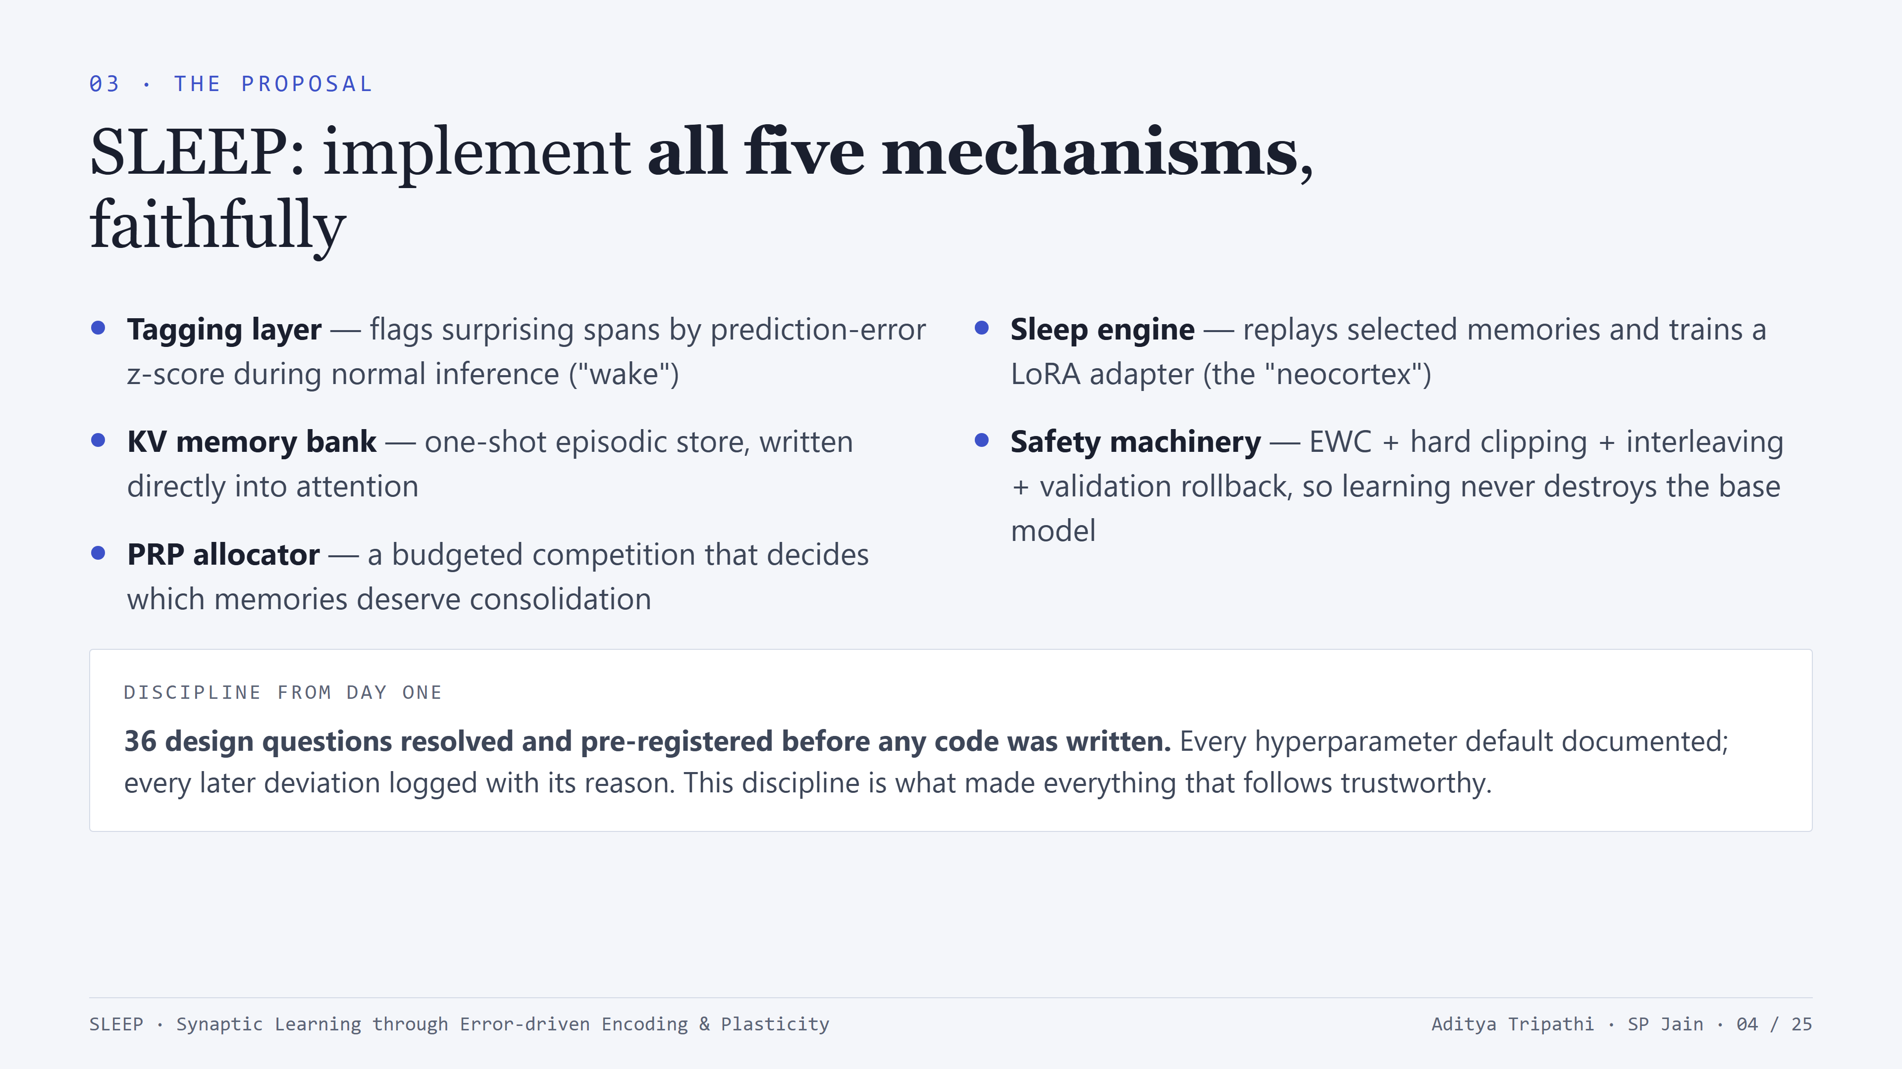
Notes:
SLEEP = Synaptic Learning through Error-driven Encoding and Plasticity. Five components, each mapping to one biological mechanism. Emphasize the pre-registration: 36 design questions resolved in a formalization document before implementation - so when things later failed, we could tell exactly which assumption broke, and when things worked, nobody could accuse us of tuning our way to the answer. About 4,000 lines of Python, 410 tests by the end.

Slide 5
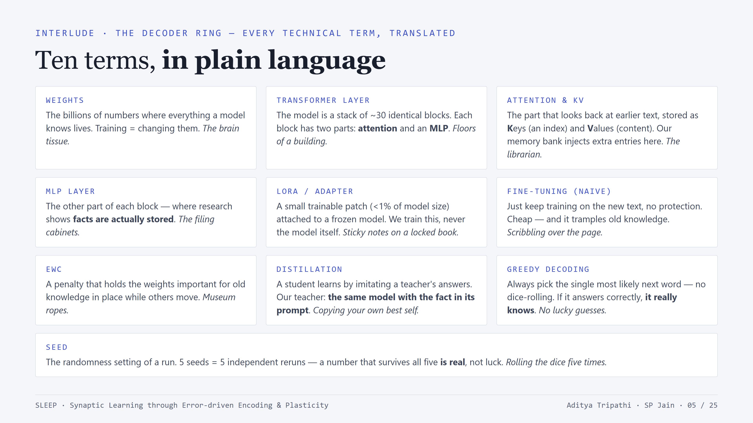
Notes:
A 60-second vocabulary pass so nobody gets lost - pause briefly on the three that carry the whole talk: MLP layers (the filing cabinets where facts live - this is where our fix goes), LoRA (the sticky-note patch we train instead of the model), and seeds (why our numbers are trustworthy). Tell the audience: don't memorize this - the deck will remind you in context, and this slide will be in the handout to refer back to.

Slide 6
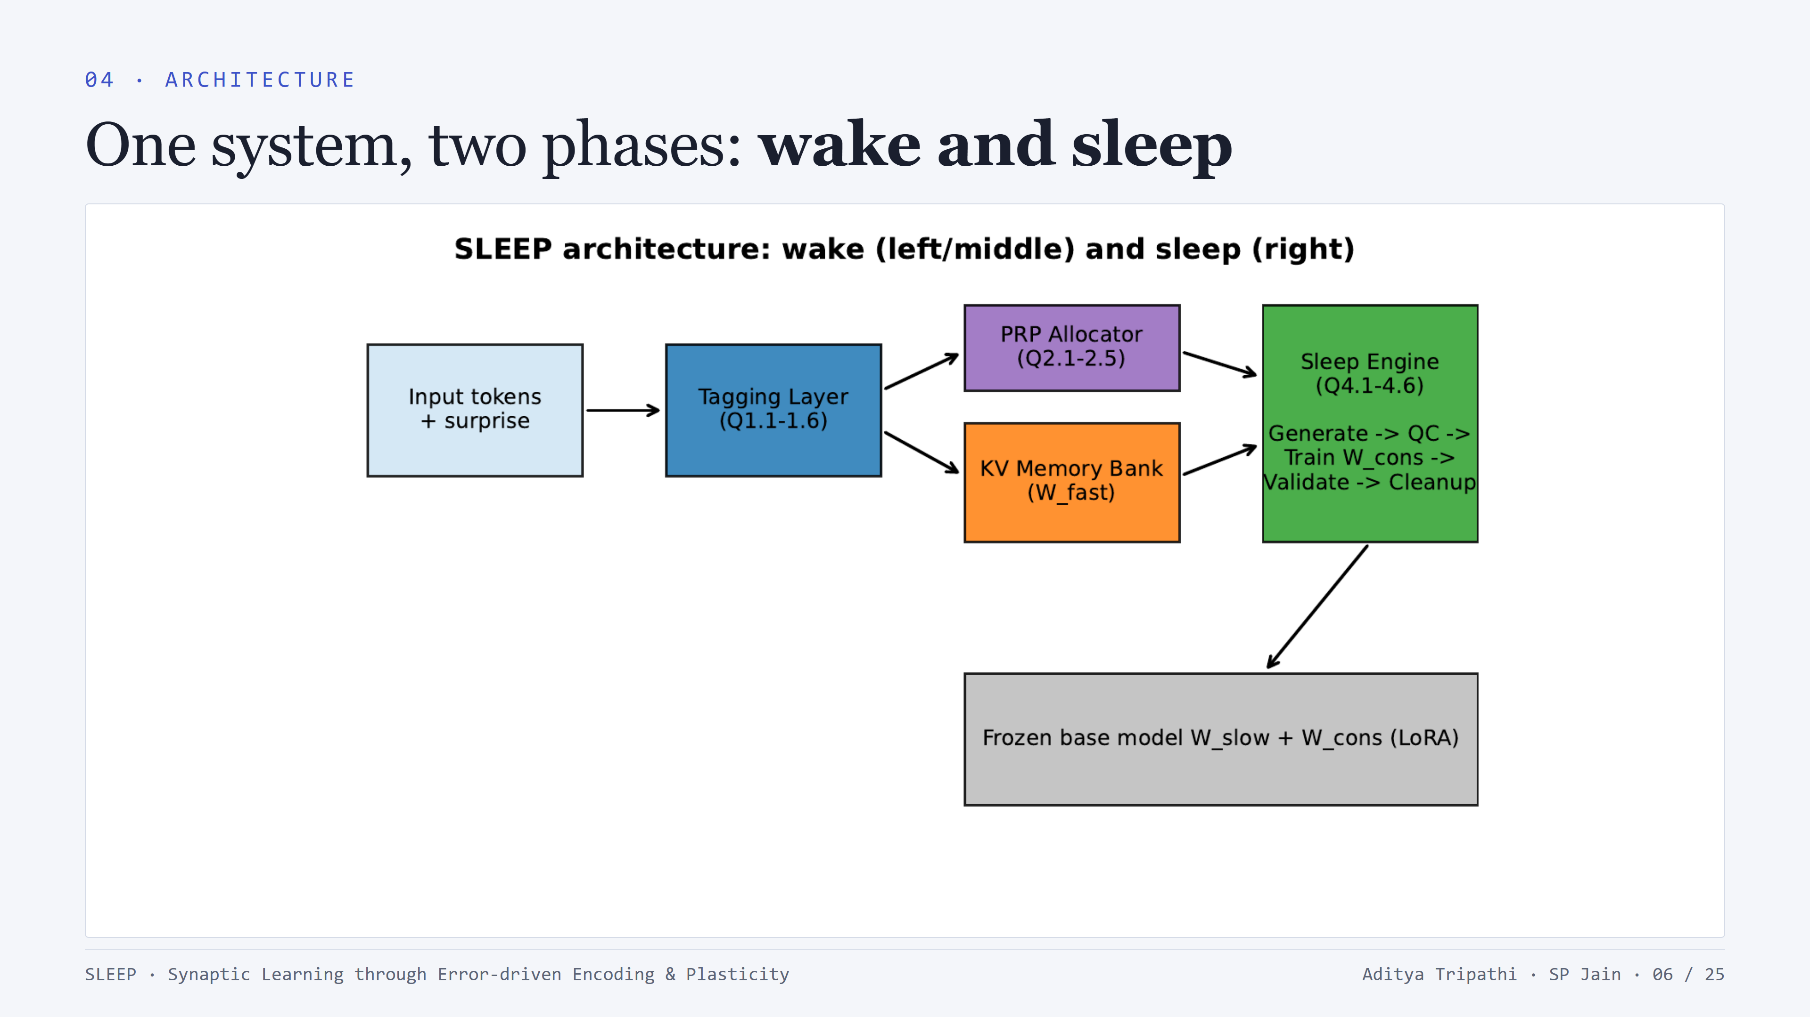
Notes:
Walk the diagram left to right. WAKE: input flows through the model normally; the tagging layer watches per-token surprise; tagged spans allocate against the PRP budget and their full episode is written into the KV memory bank - this is the fast, hippocampus-like store. SLEEP: the engine replays selected memories, trains the consolidation adapter W_cons (LoRA), under four safety mechanisms - EWC penalty, hard per-parameter clipping, old-knowledge interleaving, and validation with rollback. After consolidation the bank is cleared: knowledge should now live in the weights.

Slide 7
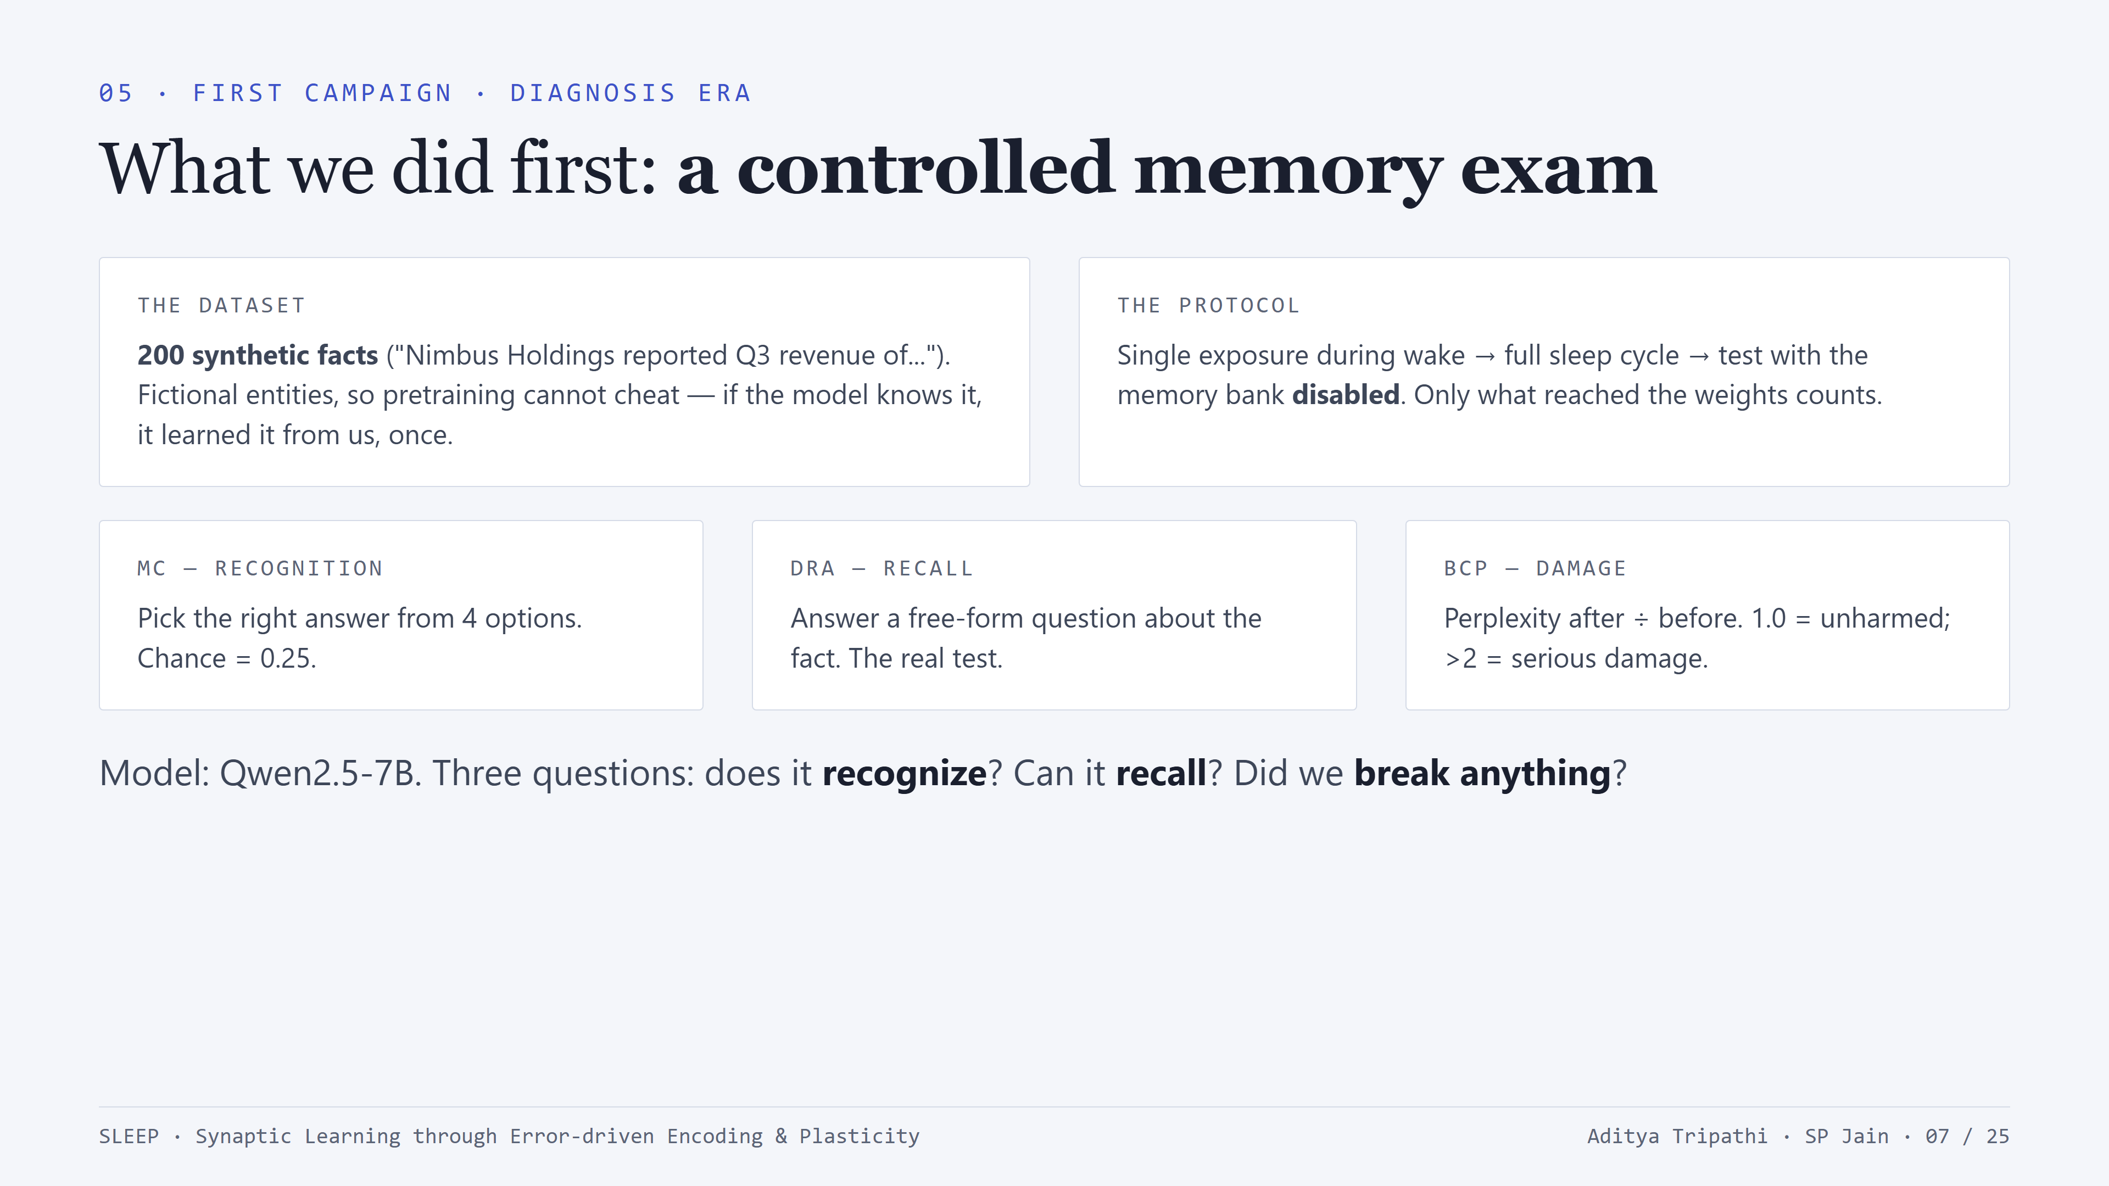
Notes:
Explain the experimental design. Synthetic facts are deliberate - with real facts you can't distinguish 'learned it from us' from 'knew it from pretraining'. The three metrics matter for what comes next: MC is recognition (multiple choice), DRA is free-form recall (generation - the hard one), BCP is damage to general capability. Key protocol detail: at evaluation the KV memory bank is switched OFF - we only credit knowledge that made it into the weights.

Slide 8
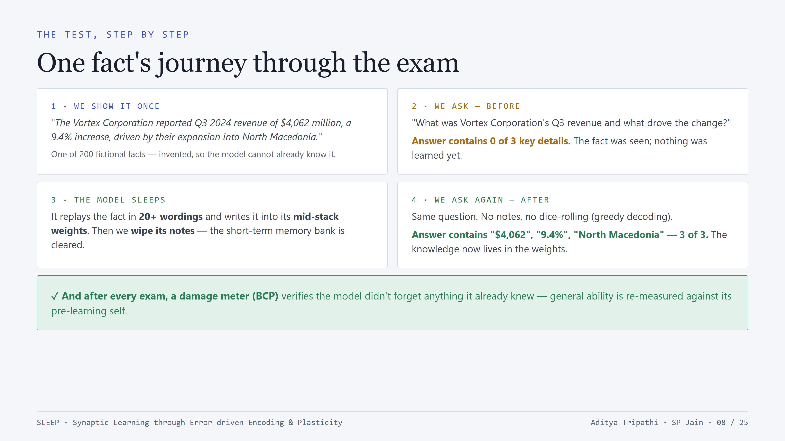
Notes:
This slide makes the method concrete for everyone. Walk it slowly. Step 1: the fact is fictional by design; if the model answers correctly later, the knowledge can only have come from us, from a single exposure. Step 2: before sleep, the score is keyword-based; zero of three key details appear. Step 3: sleep = replay in 20+ wordings + consolidation into mid-stack weights; then the crucial part, we wipe the short-term memory bank; nothing is hiding in a cache. Step 4: same question, greedy decoding so there are no lucky samples; on gate-passing facts all three details appear; on Mistral, 29 of 31 selected facts passed this exact gate. And the BCP meter answers the other half of the question: did learning this break anything else.

Slide 9
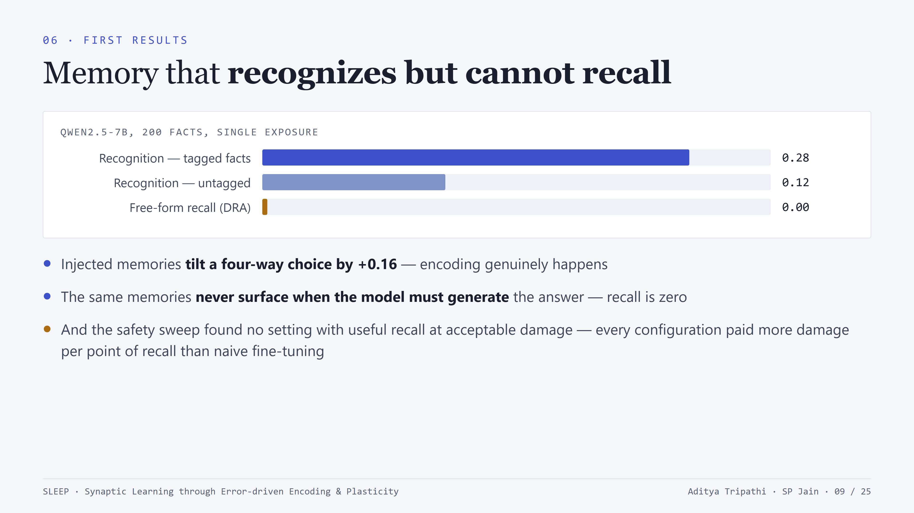
Notes:
The April headline. The recognition signal is real: +0.16 over untagged facts on multiple choice. But cloze accuracy: zero. Free-form recall: zero. The memory can bias a comparison between four options but cannot steer 50 tokens of generation against the pretrained prior. Also: the stability-plasticity sweep looked like a wall - no knee in the Pareto curve. And one more worrying observation: the system's internal validator was certifying consolidations that failed any real test.

Slide 10
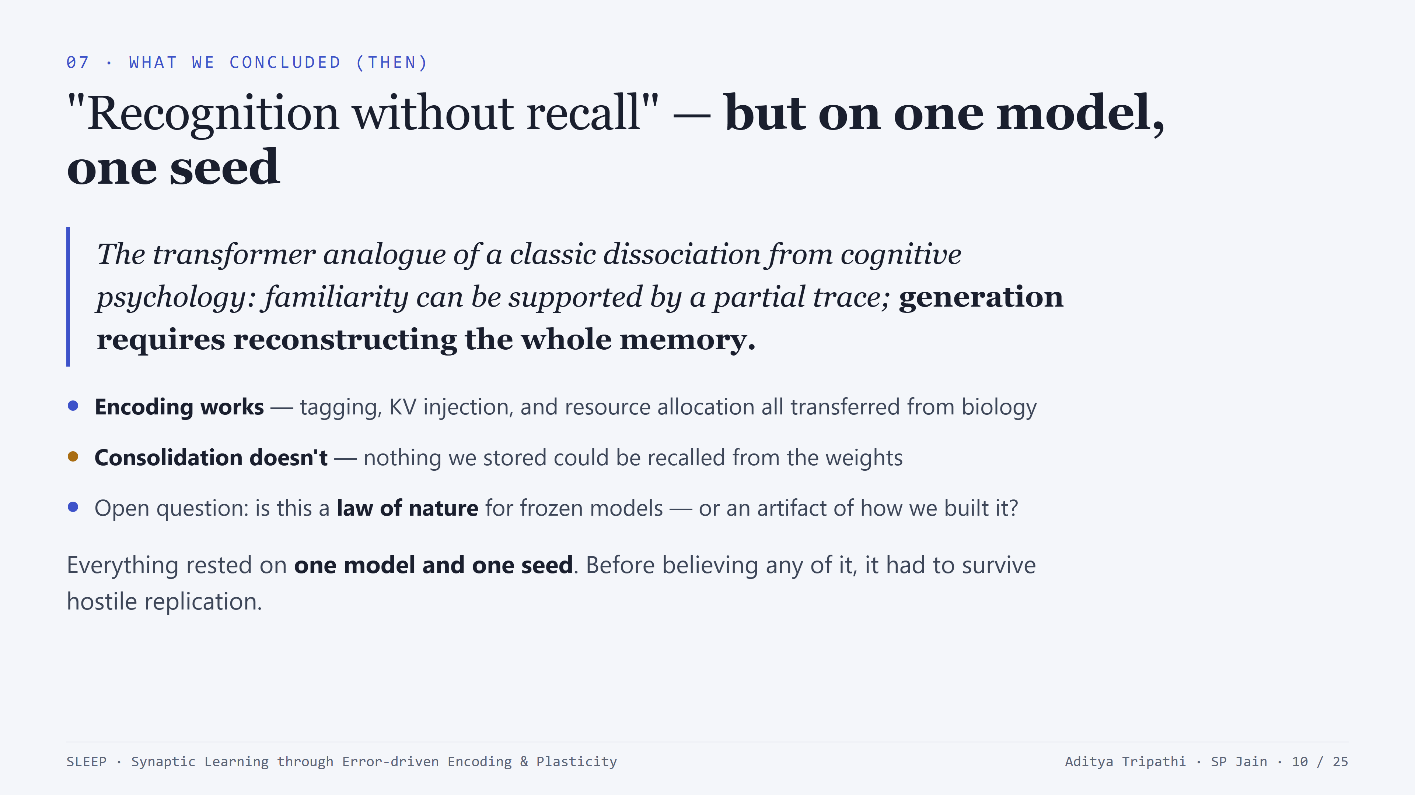
Notes:
Name the finding - recognition without recall, mirroring the recognition/recall dissociation in human memory research (patients with hippocampal damage often retain recognition while losing free recall). Mechanistically: memory KV enters attention as a small perturbation - enough to flip an argmax among 4 options, overwhelmed across autoregressive generation. But be honest about the epistemic status at this point: one model, one seed. The next phase was about stress-testing every claim.

Slide 11
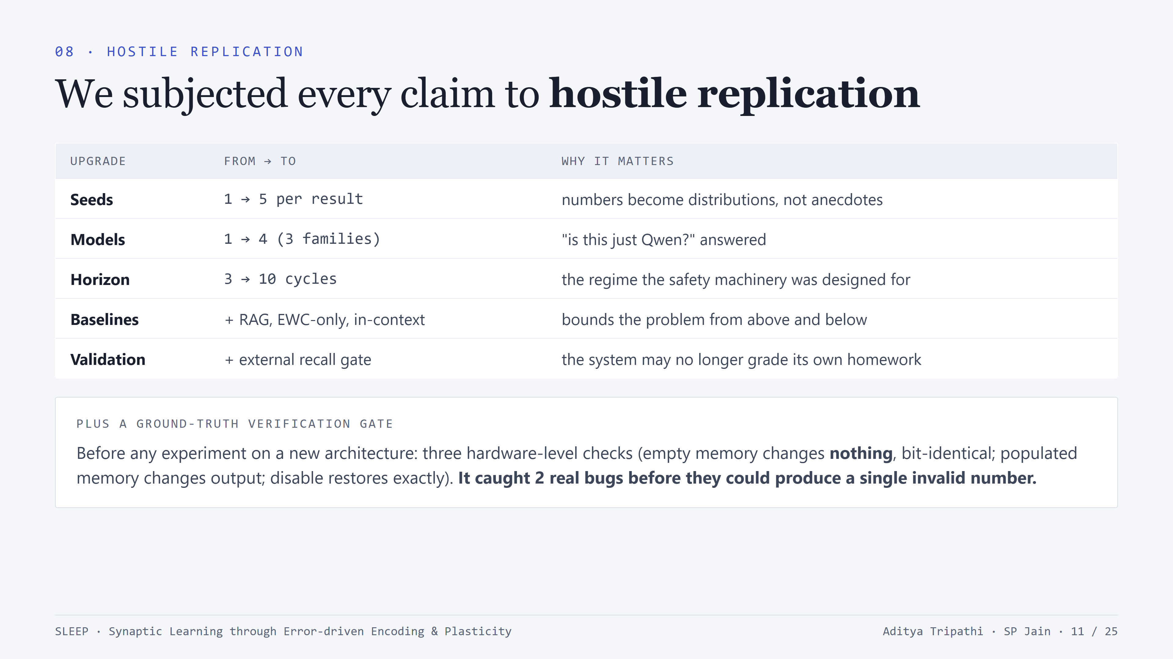
Notes:
This phase came out of the first review round (11 items across the faculty review). Frame it as methodology: every claim was made to survive seeds, models, horizon, and proper baselines. The two-stage validation is worth dwelling on - we added an external gate: a consolidation only counts if the model actually answers a question about the fact under greedy decoding. And the verification gate: three ground-truth checks on real hardware before any run on a new architecture; it caught a config-encoding fault and a Qwen-specific attention assumption - zero invalid numbers ever entered the record.

Slide 12
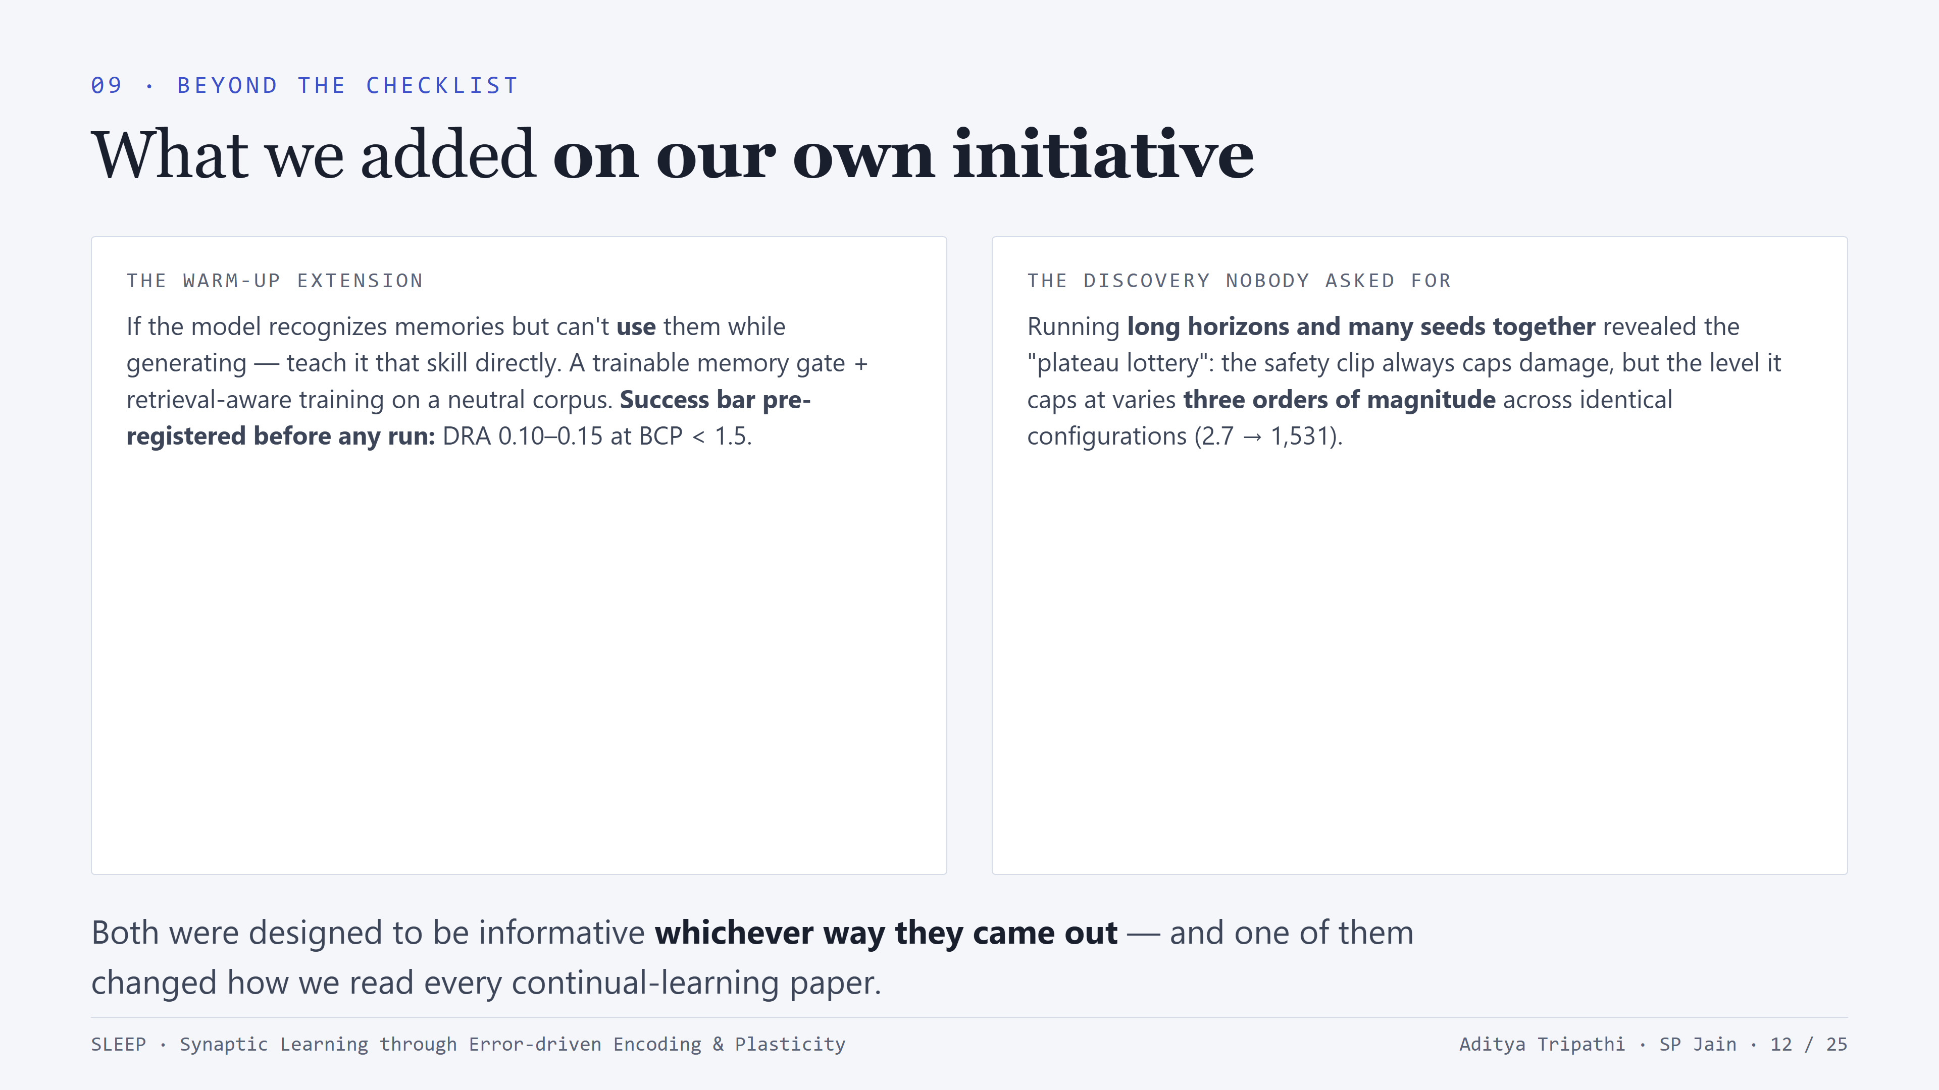
Notes:
Two self-initiated additions. The warm-up: the repair the diagnosis implies - if the gap is a missing skill, teach the skill. We pre-registered the success criterion before running. The plateau lottery: feedback asked for more cycles and more seeds separately; doing both together revealed that the damage ceiling's LEVEL is decided by the optimization path, not the hyperparameters - identical configs landing at 2.7 or 1,531. Implication beyond our project: any continual-learning comparison reported at one horizon with one seed may be reporting the lottery, not the architecture.

Slide 13
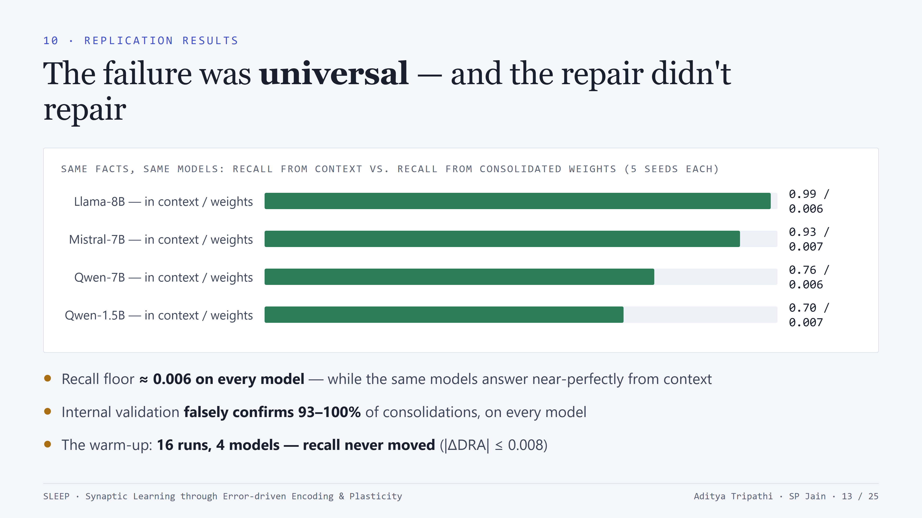
Notes:
The replication verdict. The dissociation is a property of the mechanism, not one model's pretraining: floor of 0.006 everywhere, in-context ceilings 0.70-0.99 - so it's not a comprehension failure. Proxy validation is 93-100% wrong everywhere. And the warm-up is a replicated null: 16 runs, recall never moved - though it did move recognition, which reproduces the dissociation under intervention. At this point we had a rigorous, universal diagnosis - of a failure.

Slide 14
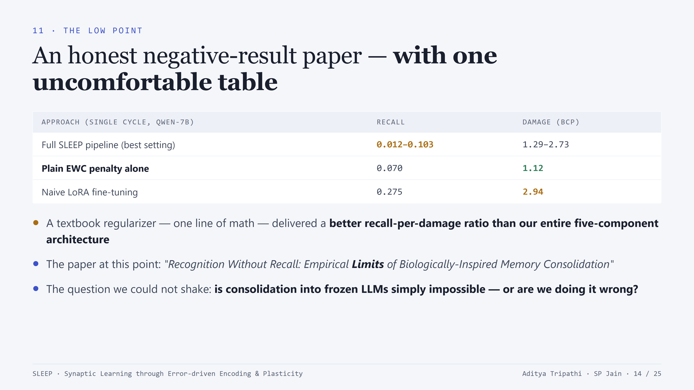
Notes:
The low point, stated plainly. We had found the uncomfortable comparison before a reviewer did: EWC alone beat our whole pipeline on recall-per-damage. The paper title at this stage said 'Empirical Limits'. A defensible, rigorous negative result - but the nagging question: law of nature, or wrong implementation? That tension sets up the turn.

Slide 15
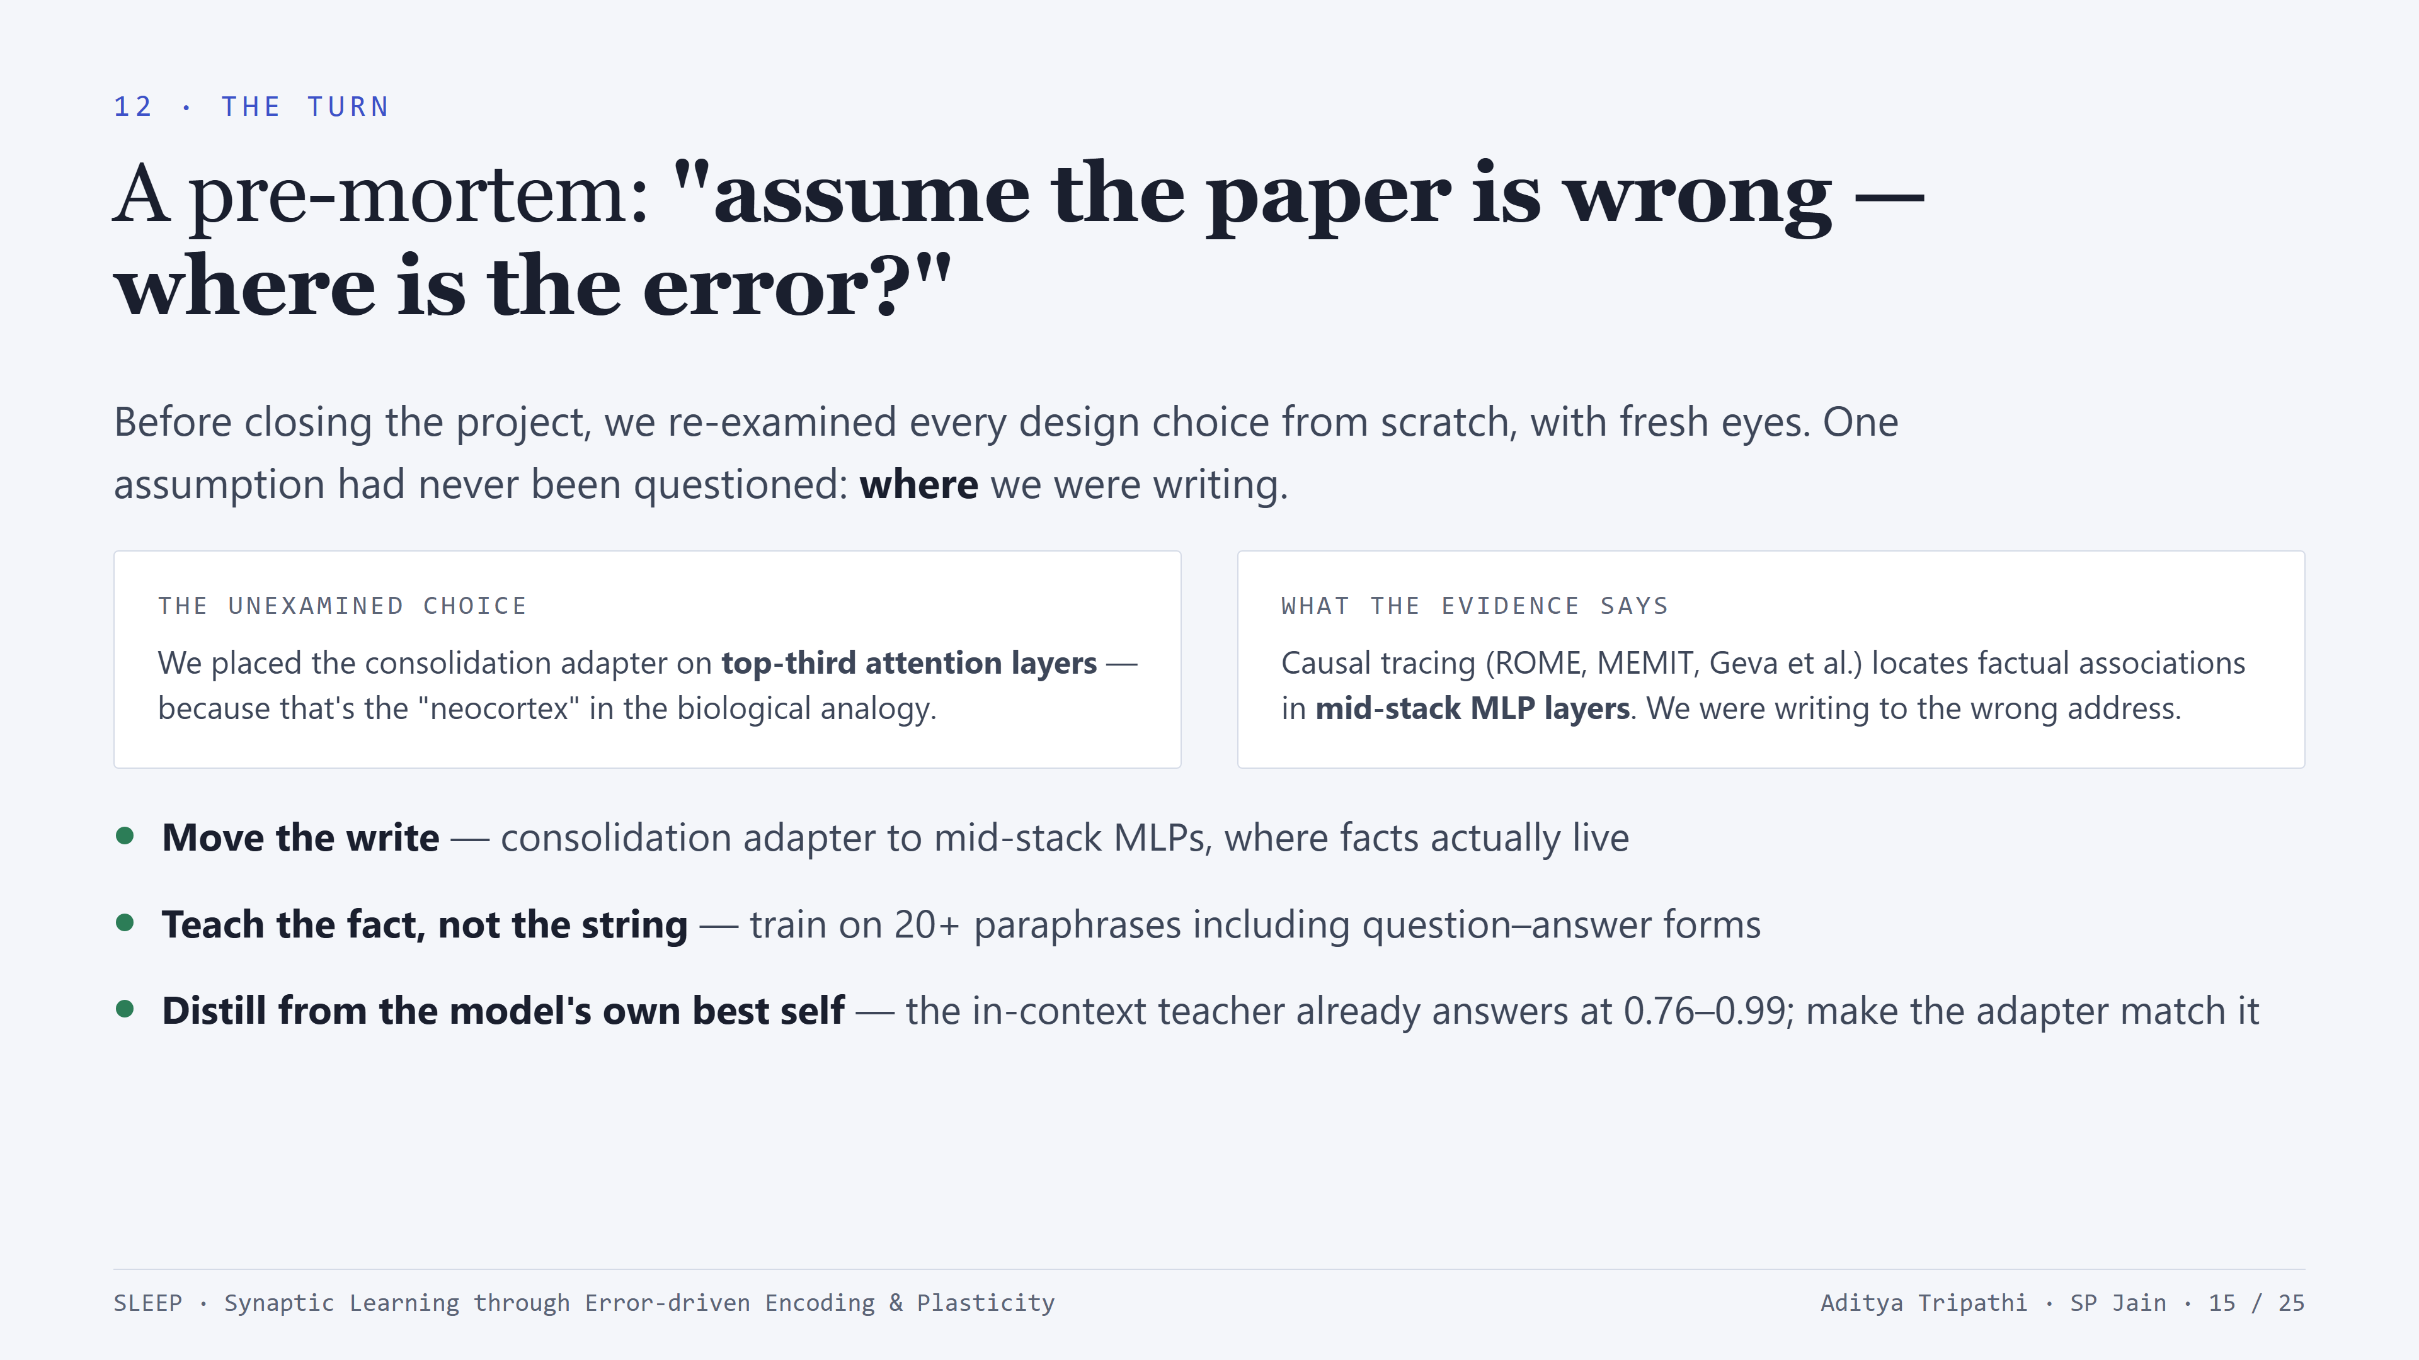
Notes:
The reframe. Present it as a pre-mortem exercise: assume failure was our fault - where's the bug? The one never-questioned choice was the biological analogy for PLACEMENT: top-third attention as 'neocortex'. The knowledge-editing literature says facts live in mid-stack MLPs. Then two more first-principles corrections: single-wording training teaches string reproduction, not knowledge (we saw cloze succeed while recall failed - the signature of memorization); and the model already 'knows' every fact when it can see it - so distill from the in-context teacher. Plus one hygiene fix: greedy decoding for all knowledge claims.

Slide 16
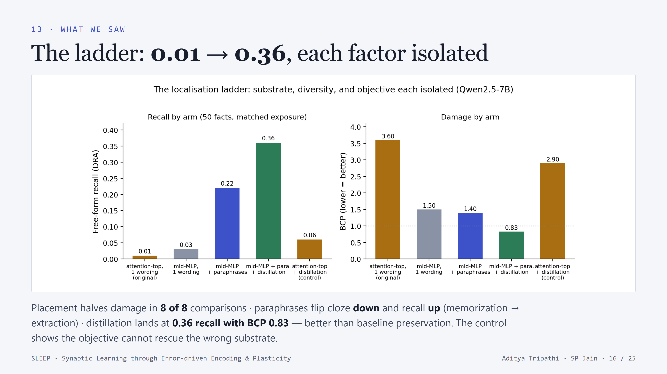
Notes:
The isolation ladder - five arms, two models, two seeds, matched training budget. Read it left to right: original placement 0.01; move to mid-MLP alone and damage halves (8/8 comparisons); add paraphrases and recall jumps to 0.22 while CLOZE falls - that opposite movement is the smoking gun of memorization becoming extraction; add distillation: 0.36 recall at BCP 0.83 - better preservation than baseline. And the control arm - distillation on the OLD placement - recovers almost nothing: the objective can't rescue the wrong substrate. Sixty times the old floor, each factor's contribution isolated.

Slide 17
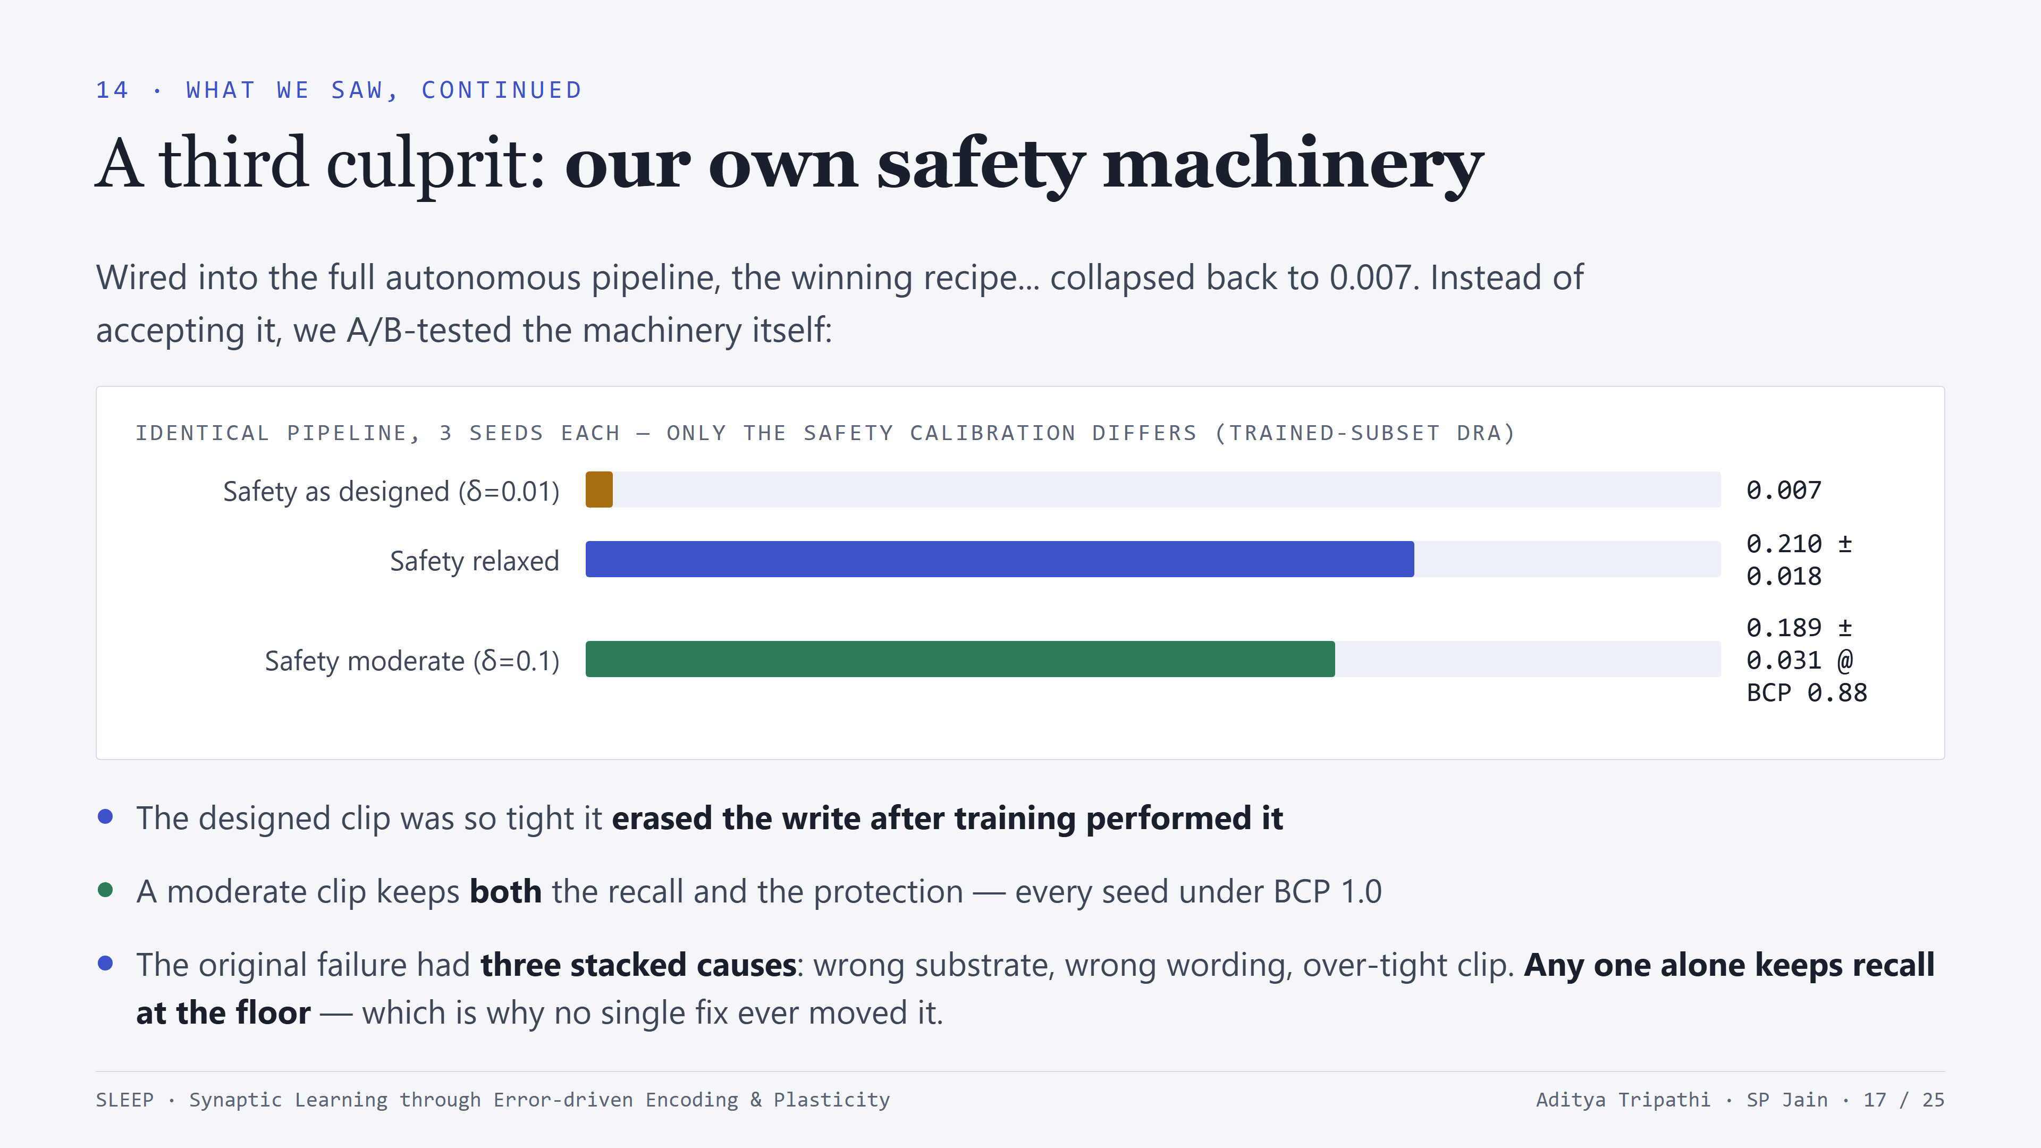
Notes:
The third cause. Integration initially erased everything - back to 0.007. The killer detail: the hard clip (delta_max 0.01) was clipping away the consolidation write AFTER training performed it. Relaxed: 0.210. Moderate (0.1): 0.189 at BCP 0.88 - every seed below 1.0, first externally-verified autonomous consolidations (21-24 of ~50 facts passing the direct recall gate per run). Big picture: three stacked causes - substrate, wording, clip. Each alone suffices to floor recall. That's why the first movement's single-factor interventions all failed - and why the diagnosis took a full pre-mortem to crack.

Slide 18
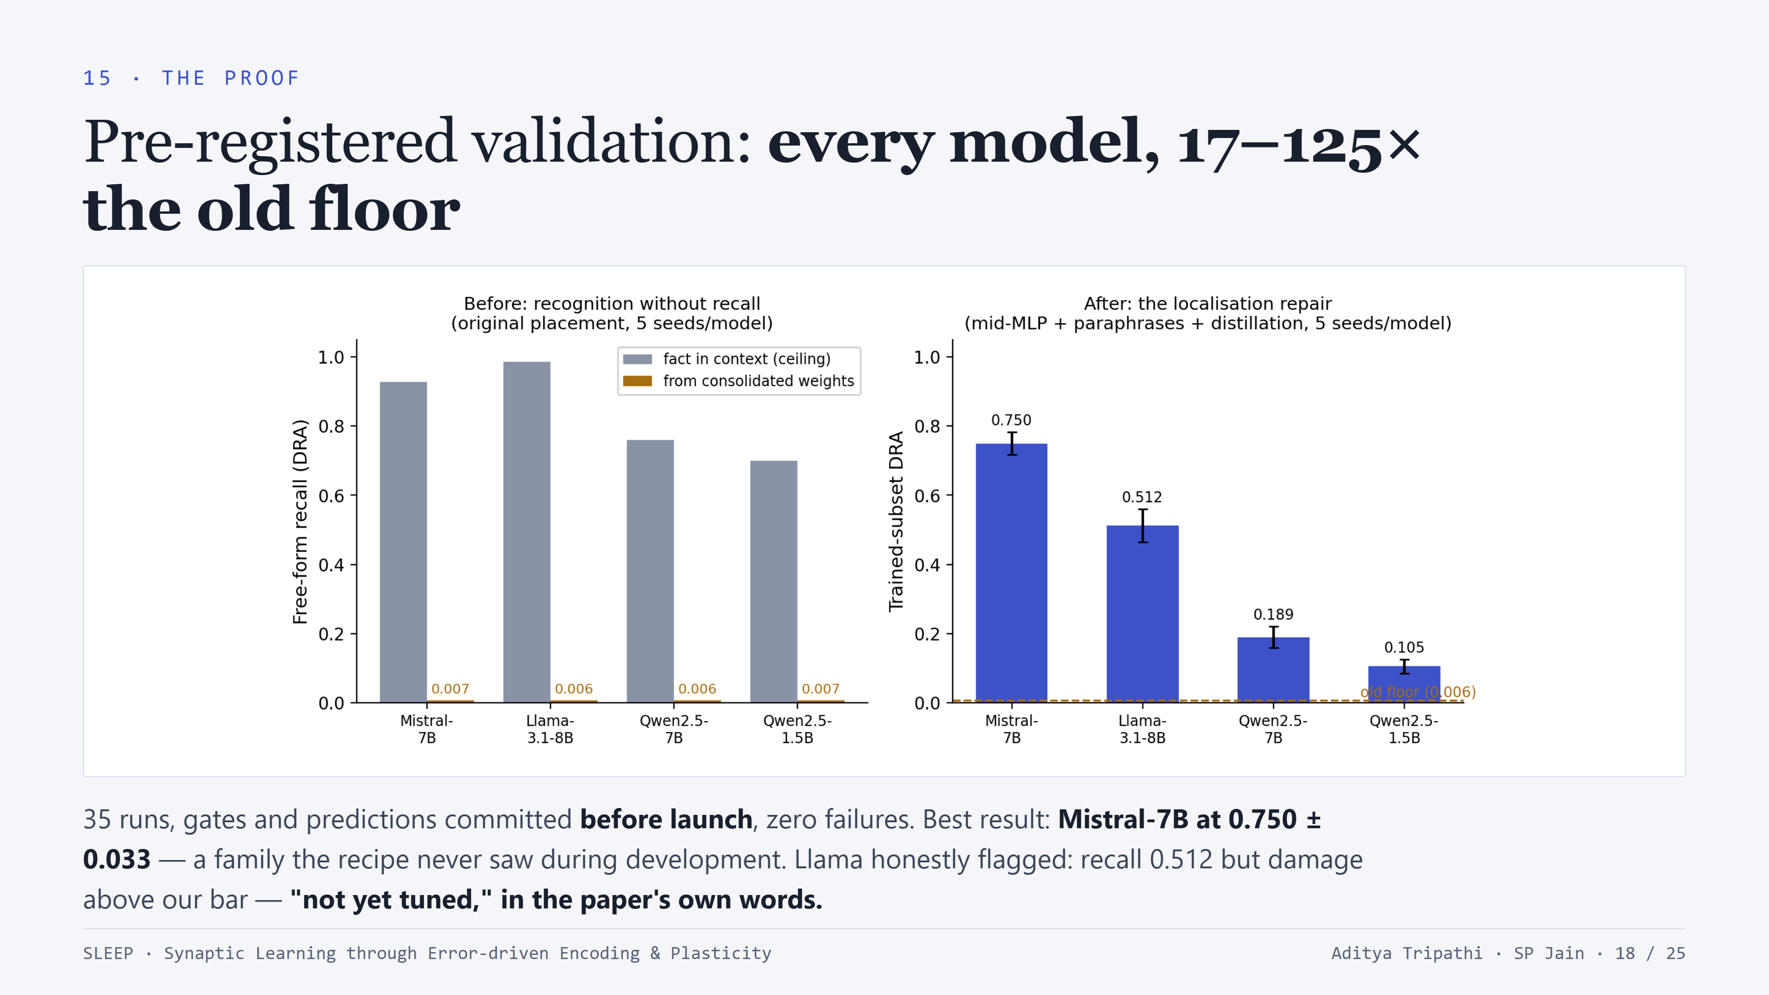
Notes:
The validation matrix - the whole campaign was pre-registered: gates, predictions, stop-loss committed to the repository before launch; 35 runs, zero failures. Left panel: the old story. Right: the repaired system - 0.750 on Mistral (5 seeds, plus-minus 0.033), 0.512 Llama, 0.189 Qwen-7B, 0.105 at 1.5B. Two honest notes: strongest result is on a family the recipe never touched in development (argues against overfitting the recipe to Qwen); and Llama fails our damage bar at every clip setting we pre-registered - it's flagged 'not yet tuned', not hidden. The 1.5B result suggests extraction capacity grows with scale.

Slide 19
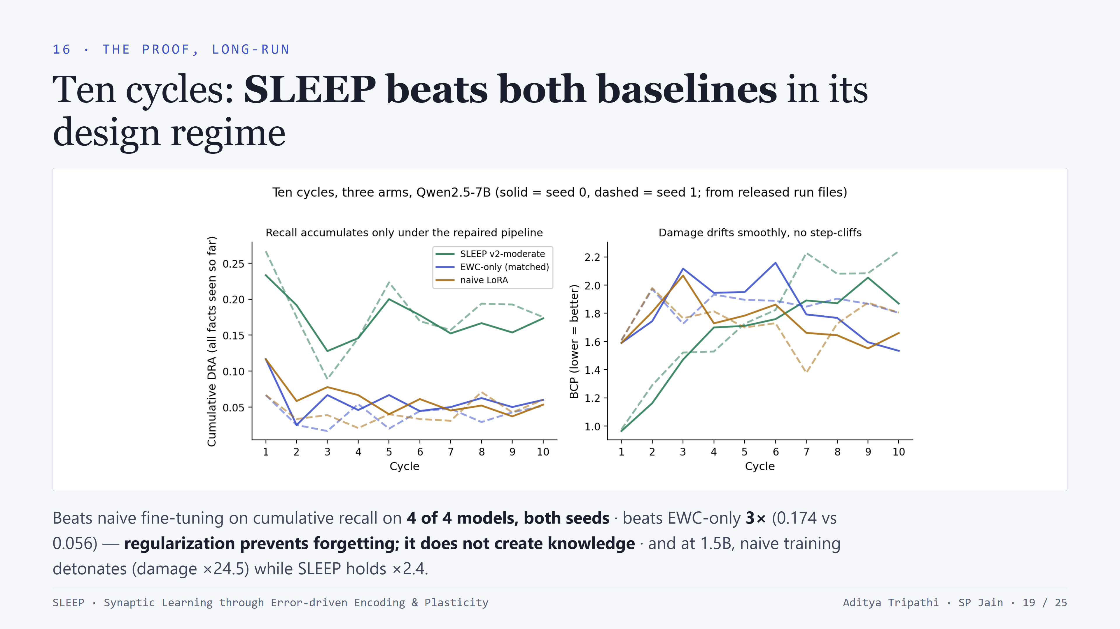
Notes:
The long-run proof, plotted from the released run files. SLEEP v2 holds ~3x cumulative recall above BOTH baselines for all ten cycles, on both seeds. The EWC comparison is the anti-strawman result: matched arms - identical adapter, steps, learning rate, only the penalty differs. EWC gets the best damage numbers but recall stays at naive's level: preservation and acquisition are different capabilities. Bonus findings: at 1.5B naive LoRA blows up (BCP 24.5 / 11.4 - the plateau lottery reproduced) while SLEEP holds ~2.4 - the safety machinery is load-bearing exactly where models are fragile. And SLEEP's across-seed spread is ~0.005 everywhere - the seed lottery turns out to belong to UNCONSTRAINED arms.

Slide 20
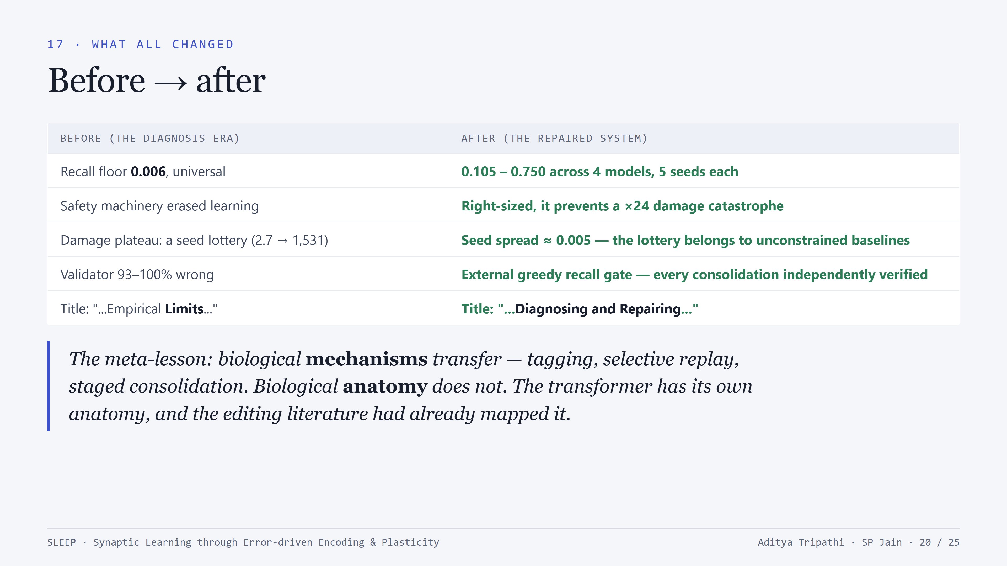
Notes:
The before/after summary - including the paper's own title changing from 'Empirical Limits' to 'Diagnosing and Repairing'. Land the meta-lesson hard, because it generalizes beyond our project: when transferring biology to ML, copy the mechanisms (tagging, replay, staged consolidation, sleep scheduling) but let the substrate's own causal structure decide the wiring. The hippocampus-to-top-layers analogy was the single most expensive assumption in the project.

Slide 21
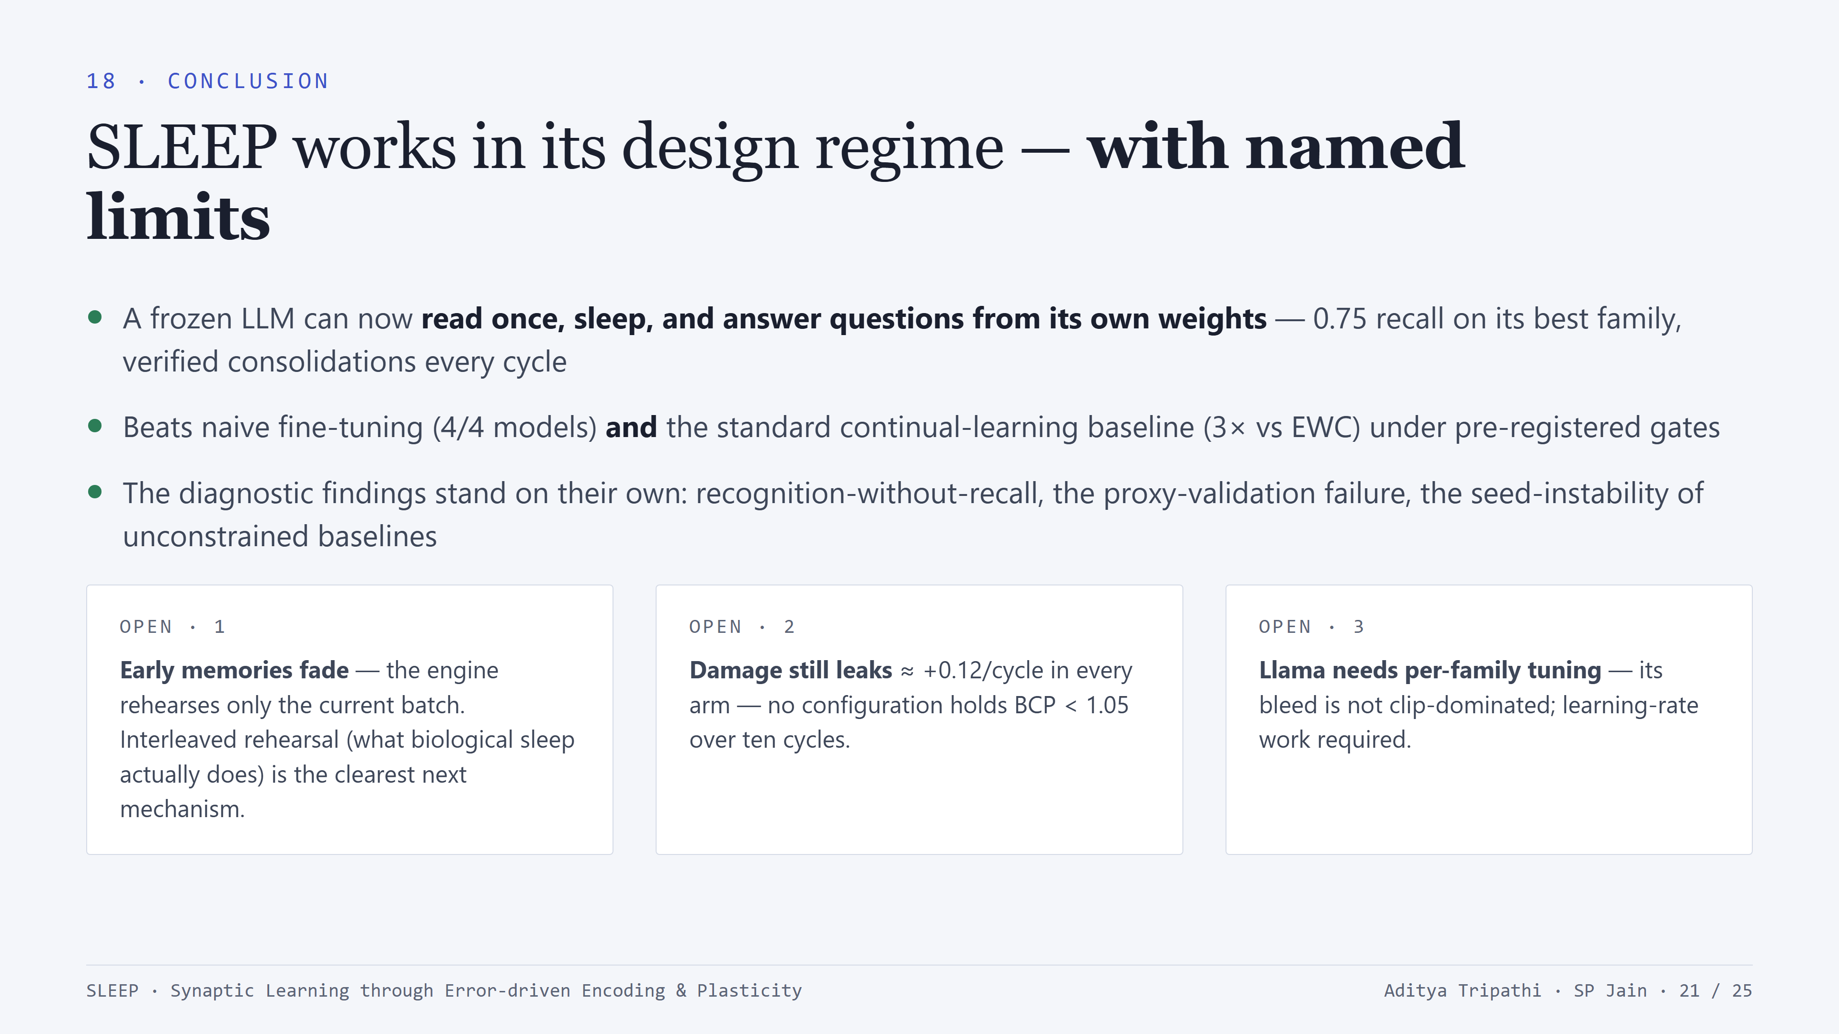
Notes:
The final conclusion, calibrated. What we claim: the system works in its design regime, validated across families and scales, against real baselines, under pre-registered gates. What we don't claim: solved. Three named gaps, each with a specific next experiment: interleaved rehearsal for the early-batch fade (this is also the most biologically faithful next step - real sleep interleaves old memories with new), the damage leak, and Llama's per-family tuning. Naming your own gaps is what makes the positive claims believable.

Slide 22
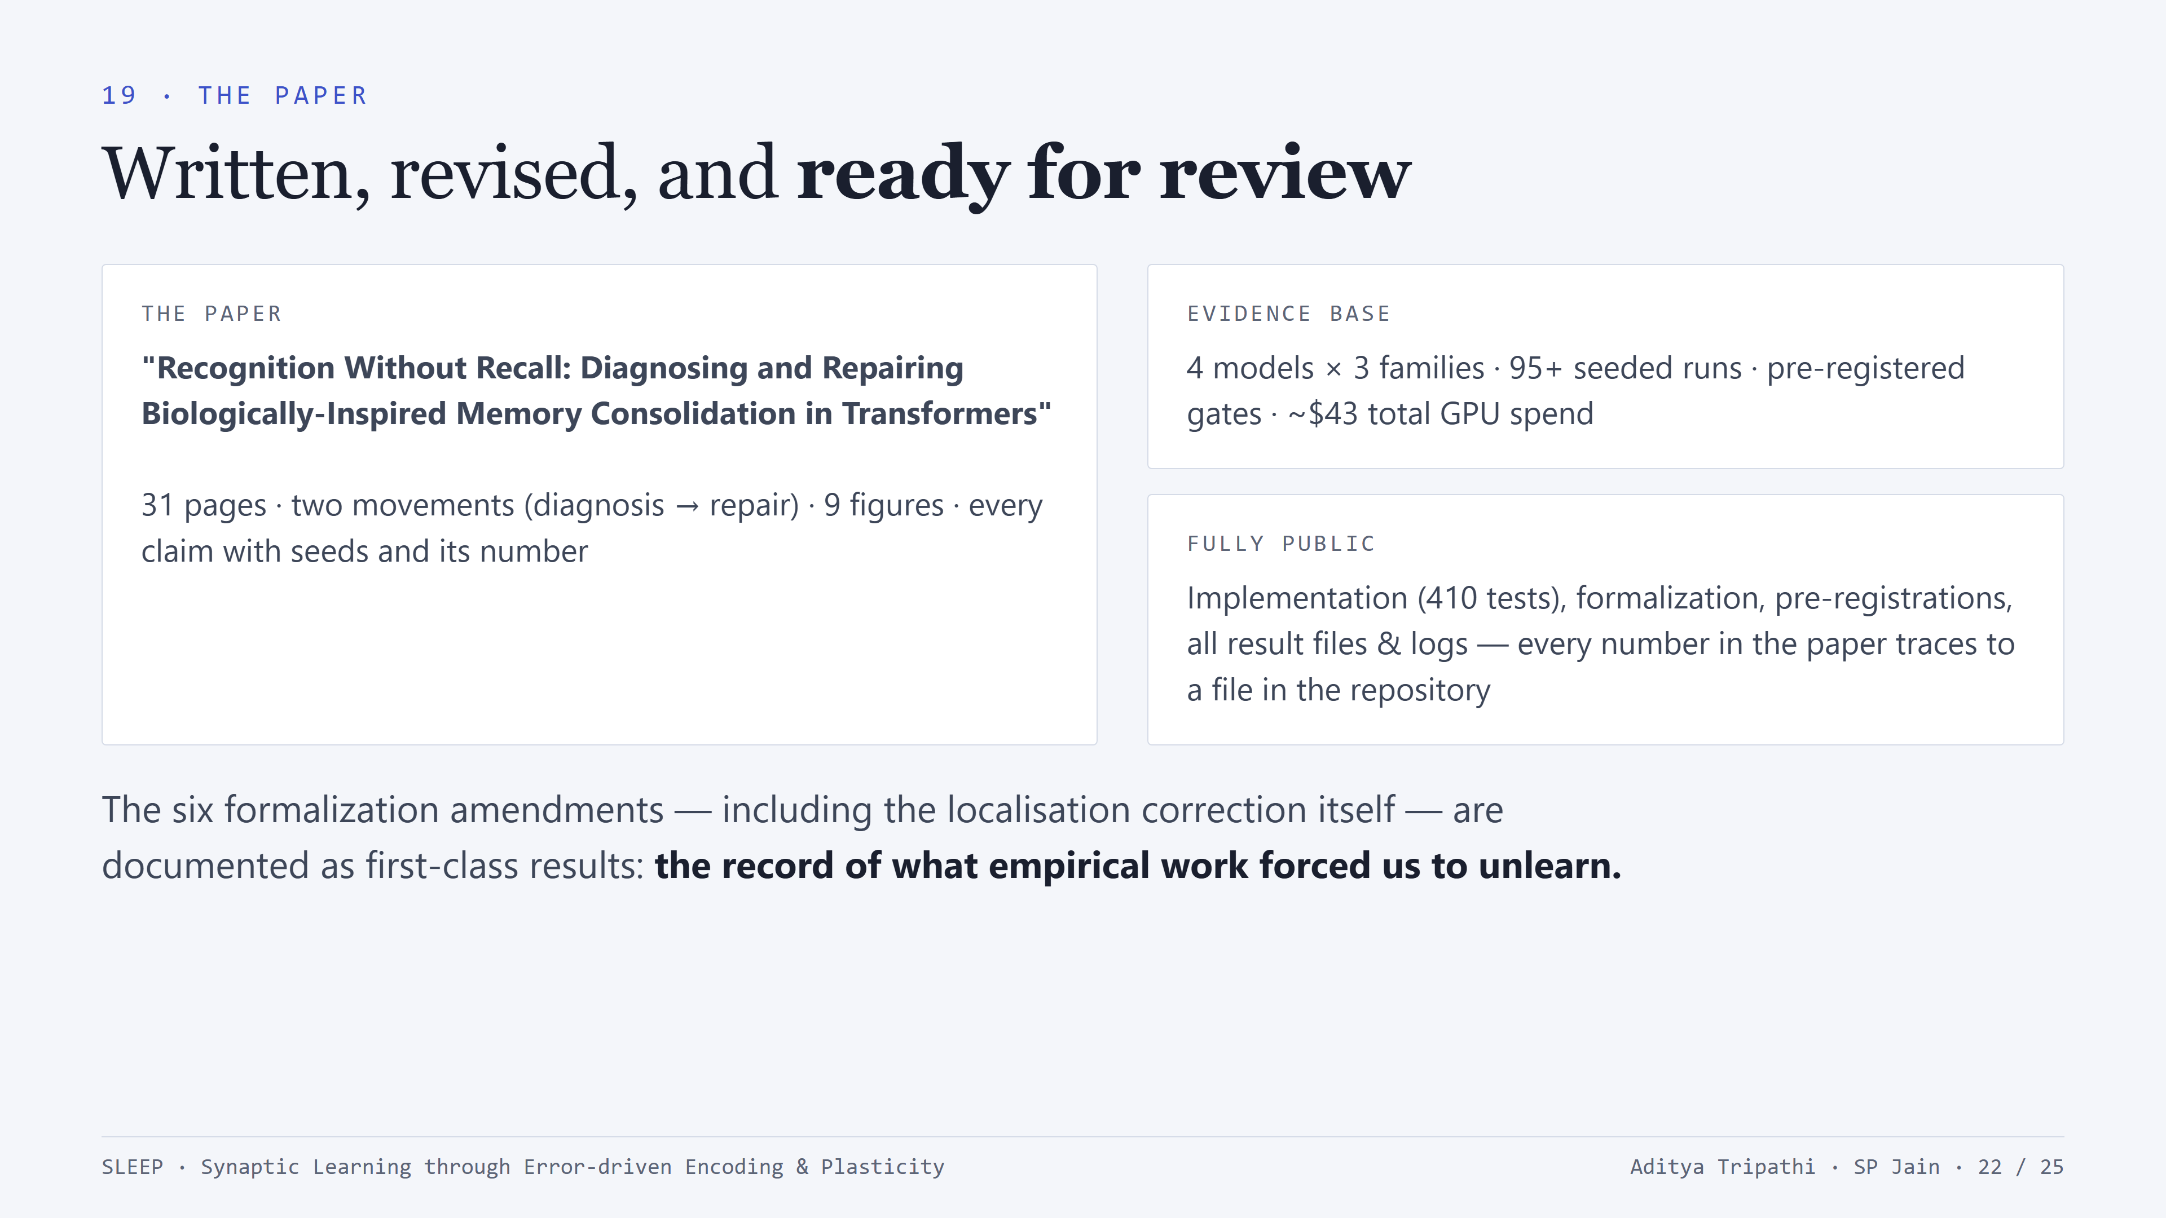
Notes:
The paper status: 31 pages, restructured as two movements so the reader experiences the arc in order - diagnosis with full rigor, then repair with pre-registered validation. Reproducibility is total: the repo has the implementation with 410 tests, the 36-question formalization, the pre-registration documents, and every result JSON and log - any number in the paper can be traced to a file. Entire empirical programme cost about $43 of cloud GPU - rigor at this scale is accessible.

Slide 23
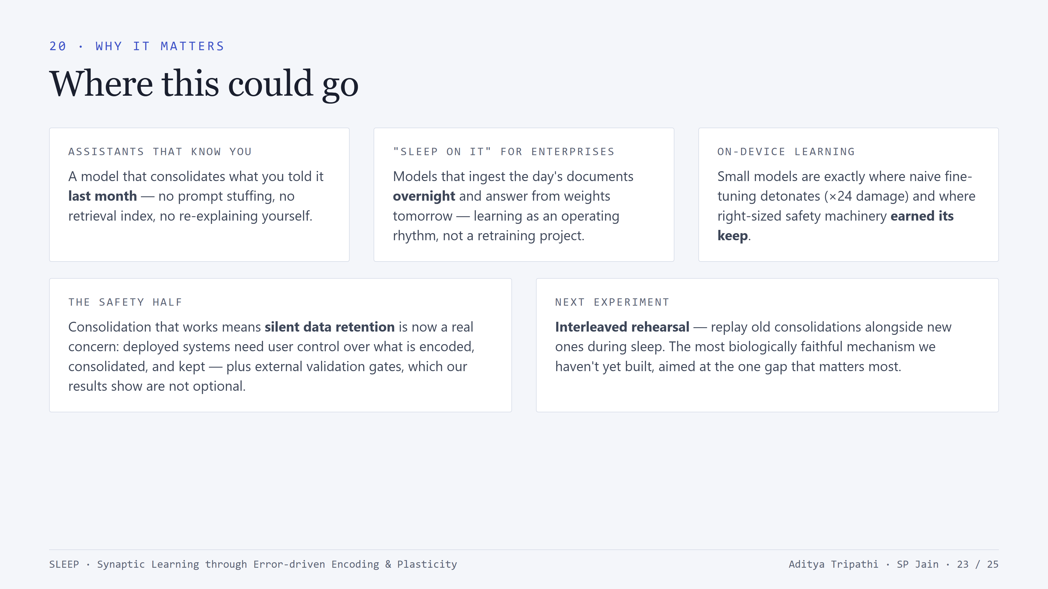
Notes:
Real-world implications, kept honest. Personal assistants with genuine long-term memory; enterprise 'sleep on it' ingestion - learning as a nightly rhythm instead of a retraining project; on-device continual learning, where our small-model result is most relevant. Give the safety paragraph its full weight: a working consolidation path makes silent data retention a real concern - user controls and external validation gates should ship with the capability. And close the research loop: interleaved rehearsal is next.

Slide 24
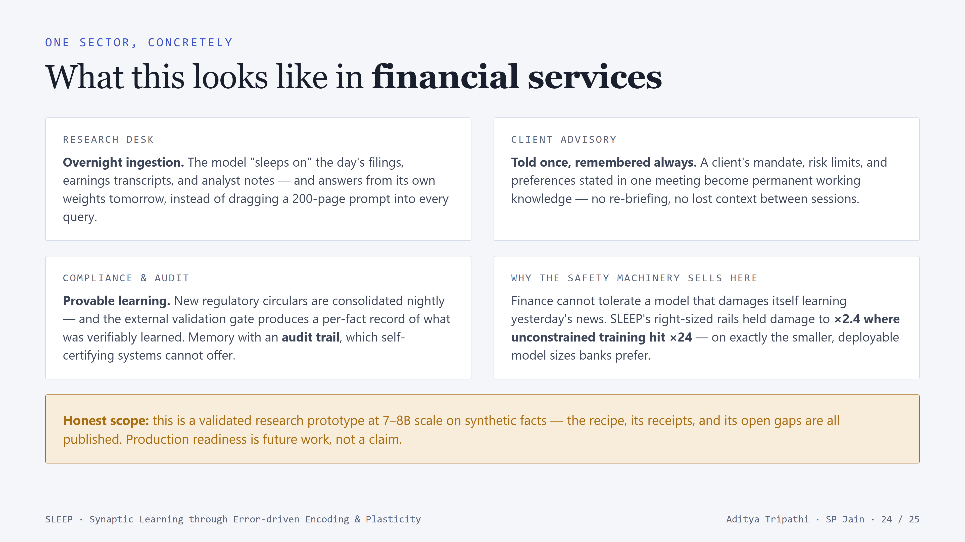
Notes:
Ground the applications in one sector the audience knows. Research desk: the 'sleep on it' rhythm - ingestion as an overnight batch process, answering from weights next day. Client advisory: single-exposure learning is exactly the 'told once' problem. Compliance is the underrated angle: our external validation gate produces a per-fact record of what was verifiably consolidated - that's memory with an audit trail, something self-certifying systems can't offer (recall our 93-100% proxy false-confirmation finding). And the safety machinery is a feature for this sector, not overhead - point at the small-model result. Close on the honest-scope banner before anyone in the audience does it for you.

Slide 25
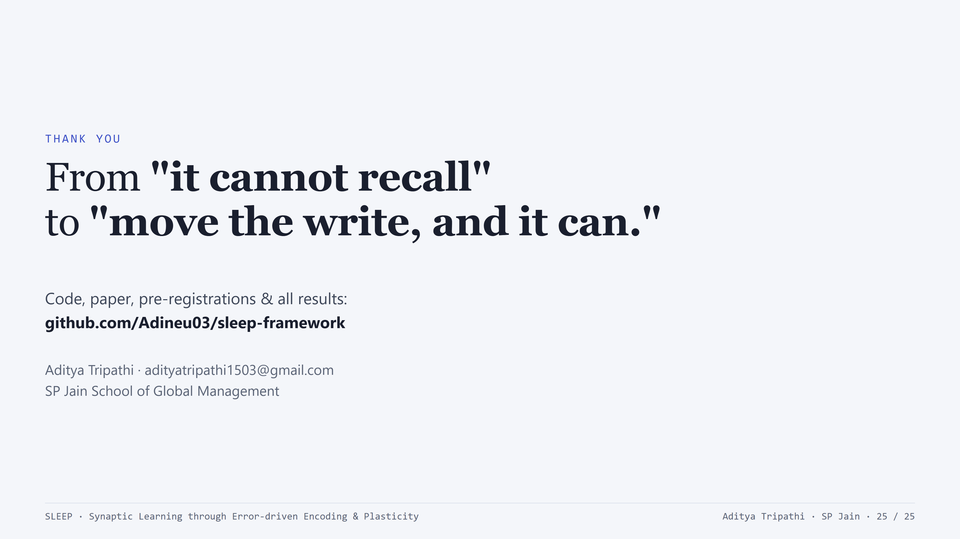
Notes:
Close with the one-line arc: from 'it cannot recall' to 'move the write, and it can.' Point to the repository - everything is public and reproducible. Thank the audience; thank Prof. Guha for research guidance and Dr. Garg for collaboration on the paper. Questions welcome - likely ones: why synthetic facts (pretraining contamination), why Llama fails the damage bar (per-family lr, named gap), how big is the deck's headline number's evidence (5 seeds, pre-registered).

