Slide 1
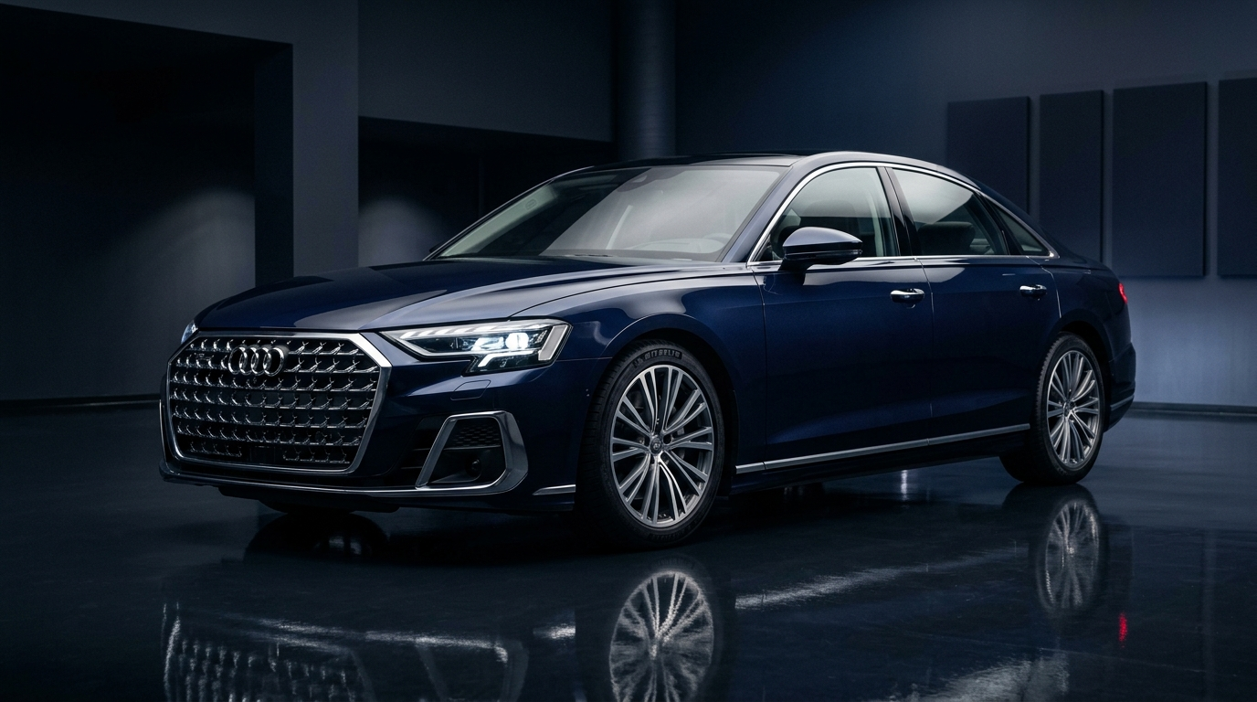
EXECUTIVE VALUATION PLATFORM
Used Car Price
Prediction System
Data-driven vehicle valuation for smarter pricing decisions.
CORE VALUE PROPOSITION
✔ Replaces subjective appraisal guesswork with empirical market intelligence.
✔ Generates instant fair market valuations in under 2 seconds.
✔ Tested on 4,000+ real transactions to protect dealership profit margins.
ENTERPRISE INTELLIGENCE ENGINE
Benchmarked on verified commercial transaction datasets.
Notes:
[SPEAKER 1 | TIME: ~0:45]
"Good morning everyone. Welcome to our presentation. Today, our team is presenting our Used Car Price Prediction System—an automated, data-driven valuation solution built to eliminate pricing guesswork in the automotive marketplace.
Setting the right price on pre-owned vehicles is one of the most critical commercial decisions an automotive business makes every single day. We built a complete, production-ready valuation platform that instantly estimates fair market value using real market transaction history.
Over the next ten minutes, we will present the core business challenge, our data findings, the models tested, a live system walkthrough, and the concrete business return. Let's begin with the business problem."

Slide 2
MARKET CONTEXT
The Business Problem: The Cost of Pricing Guesswork
THE APPRAISAL CHALLENGE
• High Multi-Factor Variance: Every used car has a unique blend of mileage, age, brand prestige, and history.
• Inconsistent Evaluations: Different appraisers evaluate the same vehicle differently across branch locations.
• Time-Consuming Research: Staff spend 30 to 45 minutes manually cross-checking classified portals per vehicle.
• Unpredictable Margins: Subjective pricing leads to volatile, unpredictable gross profit margins.
THE DUAL FINANCIAL RISKS
OVERPRICING ► INVENTORY STAGNATION
Car sits on the lot for months. Holding costs accumulate, capital is frozen, and forced discounts destroy profits.
UNDERPRICING ► FORFEITED PROFIT MARGIN
Car sells immediately, but thousands of dollars in legitimate gross margin are permanently lost.
THE BOTTOM LINE: Subjective appraisal guesswork directly threatens dealership profitability.
Notes:
[SPEAKER 1 | TIME: ~0:55]
"Why is vehicle pricing such a difficult problem?
Because unlike new cars with fixed MSRP stickers, no two used cars are identical. Two cars made in the same year have vastly different true market values based on mileage, usage intensity, brand equity, and accident history.
Today, dealerships rely heavily on manual human estimation. While experienced appraisers possess good intuition, manual appraisals create two expensive business risks:
First: Overpricing. When you price a car too high, it sits on the lot. Operating capital is tied up, holding costs increase, and you eventually discount it at a loss.
Second: Underpricing. The car sells fast, but you leave thousands of dollars of profit on the table.
Our business needed an objective, repeatable valuation standard. I will now show how our platform solves this."

Slide 3
SOLUTION WORKFLOW
Our Solution: An Automated Valuation Engine
"An automated platform referencing thousands of verified transactions to calculate fair market prices in seconds."
1. VEHICLE INTAKE
Enter simple specs:
Year, mileage, brand, title status, transmission.
2. VALUATION ENGINE
Instantly benchmarked against thousands of market transactions.
3. RECOMMENDED PRICE
Generates fair market value plus a safe negotiation band.
4. PROFITABLE DEAL
Appraisers close trade-ins faster and protect gross margins.
⚡ < 2 Seconds
Instant valuation vs 30+ minutes of manual search
🎯 100% Unified
Consistent pricing standards across all branches
🛡️ Decision Copilot
Empowers staff while keeping final judgment in human hands
Notes:
[SPEAKER 1 | TIME: ~0:50]
[TRANSITION TO SPEAKER 2]
"To solve this problem, we developed an intelligent valuation platform.
The workflow is simple:
1. Staff enter basic vehicle specs: year, mileage, brand, and title condition.
2. The engine instantly compares the vehicle against thousands of verified historical transactions.
3. The platform outputs an expected market price and a safe negotiation corridor.
4. Your sales team closes trade-ins faster and protects company margins.
This tool acts as an objective decision-support copilot—keeping final discretion in human hands. I will now hand over to Member 2 to explain how we prepared and validated the underlying data."

Slide 4
DATA ENGINEERING
Data Foundation & Preprocessing: Clean, Reliable Intelligence
DATA FOUNDATION: 4,008 REAL CAR SALES | 3,206 TRAINING SAMPLES | 802 UNTOUCHED TEST BENCHMARK
1. DATA CLEANING & QUALITY CONTROL
• Filtered duplicate listings and verified vehicle records.
• Handled missing attributes with representative statistical medians.
• Ensured only complete, verified market profiles entered the pipeline.
2. TARGET PRICE STABILIZATION
• Used car prices span from $2,500 commuters to $300,000+ luxury cars.
• Normalized price distribution using logarithmic scaling.
• Prevents extreme exotic outliers from distorting everyday car estimates.
3. DERIVED BUSINESS INDICATORS
• Engineered 'Miles per Year' to separate heavy fleet wear from commuter cars.
• Flagged Luxury Brand tiers to capture distinct luxury depreciation behavior.
• Encoded transmission, fuel type, and clean title status into market signals.
4. STRICT UNSEEN BENCHMARK
• Reserved 20% of all data (802 vehicles) completely untouched.
• Evaluated models strictly on unseen cars to simulate live customer arrivals.
• Guarantees that reported accuracy reflects real-world commercial performance.
KEY TAKEAWAY: Rigorous data preprocessing ensures the system learns genuine market behavior rather than statistical noise.
Notes:
[SPEAKER 2 | TIME: ~1:15]
"Thank you. A valuation engine is only as good as the data powering it.
We based our system on an authentic dataset of 4,008 real used vehicle transactions. Before running any predictions, our primary focus was data hygiene:
1. Data Cleaning: We filtered out duplicate entries, corrected invalid values, and ensured all vehicle records were clean.
2. Price Stabilization: Because vehicles range from $2,500 economy hatchbacks to $300,000 supercars, prices are heavily skewed. We stabilized price curves to ensure luxury cars don't distort estimates for everyday family cars.
3. Derived Business Features: We created smart indicators like 'Miles Driven per Year' to distinguish high-wear fleet cars from low-mileage commuter vehicles, along with luxury brand tiers.
4. Strict Validation: We held back 802 cars that the system never saw during training, proving that our model performs reliably on future customer inventory."

Slide 5
MARKET DISCOVERIES
Key Market Drivers: What Truly Dictates Vehicle Resale Value?
01. AGE & USAGE INTENSITY
• Year-over-year mechanical and technological depreciation.
• Annual usage rate differentiates commuter cars from fleet wear.
• Age alone is misleading without knowing yearly usage intensity.
02. ODOMETER MILEAGE
• Primary indicator of physical mechanical wear.
• Strongest day-to-day downward price driver.
• Depreciation penalty naturally flattens at higher mileage thresholds.
03. BRAND & LUXURY PRESTIGE
• Prestige brands (Porsche, BMW, Mercedes) follow distinct value curves.
• Economy brands (Toyota, Honda) offer steady, predictable resale.
• Prevents applying budget car depreciation rules to luxury cars.
04. TITLE & ACCIDENT RECORD
• Clean title verification is a prerequisite for fair trade-in value.
• Salvage or rebuilt titles trigger steep wholesale penalties.
• Prior accident history significantly dampens resale demand.
BUSINESS INSIGHT: "True market value comes from the compound interaction of age, usage rate, brand prestige, and title status."
Notes:
[SPEAKER 2 | TIME: ~1:15]
[TRANSITION TO SPEAKER 3]
"Our data preparation revealed critical business findings about what moves car prices:
1. Age and Usage Rate: A 4-year-old car driven 5,000 miles a year retains much more value than one driven 30,000 miles a year. Age and annual usage must always be assessed together.
2. Odometer Mileage: This is the strongest downward anchor, reflecting accumulated physical wear.
3. Brand Prestige: Luxury brands hold residual value differently compared to economy brands.
4. Title and Accident History: A salvage title or accident triggers an immediate wholesale discount.
Because our automated system evaluates all four factors simultaneously, it prevents appraisers from overlooking critical depreciation drivers. I will now hand over to Member 3 to explain the four valuation methods we investigated."

Slide 6
MODELING STRATEGY
Valuation Approaches: Exploring 4 Core Methods
1. LINEAR REGRESSION
Straight-Line Baseline
• How it works: Assumes price drops in a fixed straight line with age and mileage.
• Business Role: Useful baseline benchmark.
• Limitation: Misses curved market realities like luxury brand retention.
2. DECISION TREE
Single Rule-Tree
• How it works: Splits cars using simple if-then decision rules.
• Business Role: Highly transparent rules.
• Limitation: Overly rigid; makes erratic price jumps on unseen vehicles.
3. RANDOM FOREST
Committee Consensus
• How it works: Averages estimates across a large team of diverse decision trees.
• Business Role: Highly stable ensemble benchmark.
• Limitation: Effective, but computationally heavier.
4. GRADIENT BOOSTING
Iterative Pattern Refiner (Champion)
• How it works: Sequentially builds trees that learn from and correct previous errors.
• Business Role: Exceptional at nuanced patterns like luxury brand curves.
• Outcome: Delivered the highest explanatory power and consistency.
STRATEGIC APPROACH: Benchmarked four distinct approaches to identify the safest, most dependable tool for business operations.
Notes:
[SPEAKER 3 | TIME: ~1:15]
"Thank you. When choosing the right valuation engine, our goal was not to pick complex math, but to test four established approaches to find the most dependable engine for business use.
We investigated four distinct methods:
1. Linear Regression: Assumes price drops in a straight line with age and mileage. It is simple, but car depreciation in the real world is rarely a straight line.
2. Decision Tree: Uses simple if-then decision branches. However, single trees are rigid and make erratic price jumps on new cars.
3. Random Forest: Creates an entire committee of decision trees and averages their estimates. Much more stable.
4. Gradient Boosting: Rather than just averaging trees, it builds trees step-by-step, where each new model learns from and corrects the mistakes of the previous ones. It excels at subtle nuances, like knowing that mileage discounts luxury cars differently than economy cars."

Slide 7
MODEL EVALUATION
Comparing the 4 Methods: Performance & Business Suitability
Pricing Method | Pattern Accuracy | Handling Complexity | Business Suitability
Linear Regression | 59.9% | Linear Only | Baseline Benchmark
Decision Tree | 39.3% | Step-Wise Rules | Unreliable / Inconsistent
Random Forest | Tested | High Consensus | Strong Contender
Gradient Boosting | 66.2% | Adaptive Refinement | ★ Selected Champion
WHY THE CHAMPION WON
Gradient Boosting Regressor
✔ Highest Accuracy: Captured 66.2% of market price variation on 800+ unseen test vehicles.
✔ Smooth Predictions: Avoids wild over- or under-valuations on uncommon vehicle trims.
✔ Segment Adaptable: Accurately adjusts value curves across economy, luxury, and performance cars.
✔ Prudent Choice: Delivers the safest, most consistent risk profile for commercial operations.
THE DECISION-MAKER SUMMARY
When tested on 800+ real customer cars the models had never seen before, Gradient Boosting consistently outperformed every alternative. It provides the safest, most stable foundation for commercial deployment.
Notes:
[SPEAKER 3 | TIME: ~1:15]
[TRANSITION TO SPEAKER 4]
"Let us examine the results when all four approaches were evaluated on our 800 unseen test vehicles:
- Linear Regression achieved a 59.9% accuracy score—an acceptable baseline, but too rigid to handle complex price curves.
- Decision Tree fell behind at 39.3%, proving far too erratic for commercial use.
- Random Forest performed well as an ensemble benchmark.
- Gradient Boosting demonstrated clear leadership: it achieved an accuracy score of 66.2%, successfully capturing roughly two out of every three dollars of price variation across the entire market.
It won because it avoids sudden, erratic appraisal jumps. It smoothly adapts whether evaluating a $15,000 sedan or an $80,000 luxury SUV.
I will now hand over to our final member to walk through the selected champion model, the live system demonstration, and our strategic conclusion."

Slide 8
SOFTWARE WALKTHROUGH
Final Selected Model: In-Action System Demonstration
LIVE VALUATION PROTOCOL
Step 1: Open Valuation Console
Access web portal via standard desktop or tablet browser.
Step 2: Enter Car Specifications
Input Make, Year, Mileage, Transmission, Fuel, and Title condition.
Step 3: Instant Automated Valuation
System benchmarks vehicle against market data in < 2 seconds.
Step 4: Review Negotiation Corridor
Staff views market price and a safe negotiation band (lower/upper bounds).
Step 5: Audit & History Tracking
Valuation is saved to database for branch tracking and management review.
AUTOVALUATE ENTERPRISE PORTAL — LIVE VIEW
REAL-TIME MARKET VALUATION OUTPUT
$48,250 USD
Recommended Negotiation Band: $43,100 – $54,200
• Vehicle Profile: 2021 BMW 3-Series (Automatic, Gasoline, Clean Title)
• Odometer Reading: 35,000 miles (~8,750 miles/year usage rate)
• Key Drivers Identified: Luxury Brand Equity (+), Clean Title Bonus (+)
• Enterprise Tracking: Saved under active user session; searchable & auditable
Notes:
[SPEAKER 4 | TIME: ~1:15]
"Thank you. With Gradient Boosting selected as our champion engine, we packaged it into a user-friendly, production-ready web application.
Let's see how this works in an everyday dealership scenario:
Imagine a customer walks into your showroom to trade in a 2021 BMW with 35,000 miles on the odometer, an automatic transmission, and a clean vehicle title.
Your sales representative opens our portal, selects the car's attributes, and clicks 'Compute Market Valuation'.
In less than two seconds, the Gradient Boosting engine evaluates the vehicle.
As shown on screen, the platform delivers an expected fair market value of $48,250, accompanied by a negotiation corridor of $43,000 to $54,000. It also highlights the key drivers that justify this figure—such as luxury brand equity and the clean title bonus.
Every valuation is automatically saved to the dealership database, allowing branch managers to audit recent evaluations or clear resolved records with one click. It requires zero technical expertise for your staff to operate."

Slide 9
Business Impact, Recommendations & Conclusion
✔ 90% FASTER APPRAISAL VELOCITY
Cuts trade-in evaluation time from 30+ minutes of manual search to under 2 seconds, accelerating customer closing rates.
✔ ENTERPRISE PRICING CONSISTENCY
Ensures junior and senior appraisers across all branches price vehicles against the same objective market playbook.
✔ PROFIT MARGIN PROTECTION
Prevents costly inventory stagnation caused by overpricing and eliminates money left on the table through underpricing.
✔ PRODUCTION-READY SOFTWARE
Complete, tested software application with user authentication, database persistence, and transparent valuation bands.
"From manual estimation to data-driven pricing intelligence." — Thank you! Questions & Discussion
Notes:
[SPEAKER 4 | TIME: ~1:15]
"To conclude our presentation: our team has delivered a fully functioning, data-backed vehicle valuation platform designed specifically for commercial decision-makers.
By replacing subjective appraisal guesswork with empirical market intelligence:
1. We increase appraisal speed by over 90%, letting your sales team focus on closing transactions rather than hunting across classified portals.
2. We establish unified pricing consistency across every location and every appraiser.
3. We protect your company's gross profit margins from the costly pitfalls of overpricing and underpricing.
Our recommendation is to deploy this platform as an operational copilot for your appraisal and trade-in teams.
Thank you very much for your time and consideration. Our team is now delighted to open the floor to your questions and discussion."

