Slide 1
SortedList רשימה ממוינת -
1. SortedList is a collection of unique key/value pairs which are sorted in ascending order according to keys when inserted
2. SortedList has both generic and non-generic type of implementation.
3. Should be considered when the order of stored items is important.
* For example, SortedList of contact numbers, SortedList of exam results with student registration number and name.

Slide 2
Using SortedList- Create/Add/Remove/Find/Update/Contains/Clear/Enumerating
Operations | Code Sample
Instantiate a Sorted List | var sortedlist = new SortedList<string, string>();
Instantiate and assign Sorted List | var sortedlist = new SortedList<string, string>() { { "key","value" } };
Add item to the list | sortedlist.Add(key, value);
Remove item from the list | Sortedlist.Remove(key);
Get an item from the list | var value = sortedlist[key];
Update an item in the list | sortedlist[key] = value;
Contains (Checks) whether an item exists in list or not | sortedlist.ContainsKey(key)
Clears all the items from the list | Sortedlist.Clear();
Iterating the list | foreach (var item in sortedlist) Console.WriteLine($"{item.Key} - {item.Value}");

Slide 3
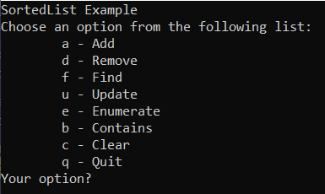
Code practice
1. Create a console application that manages a Sorted List collection.
2. The application allows Add/ Remove /Find / Update /Contains/ Clear / Enumerate operations on the SortedList.

Slide 4
Questions
What is Sorted List?
When to go for Sorted List?
Can Sorted List have duplicate values?
How to insert an item to Sorted List?
How to remove an item in Sorted List?
How to Find an item in Sorted List?
How to Update an item in Sorted List?
What is the default Sort Order of the Sorted List?
How does SortedList differs from Dictionary?

