Slide 1
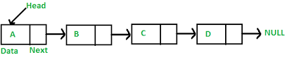
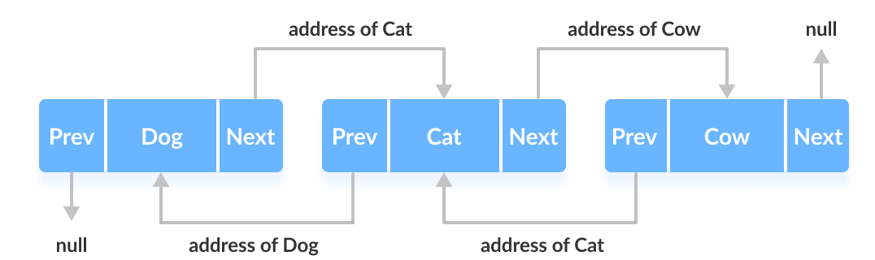
One || Two way linked lists:

Slide 2
LinkedList רשימה מקושרת -
LinkedList is a collection of nodes that each have value and pointers to the next and previous node.
For example : browser history is a linked list, the back and forward button point to each page in history and we can traverse the entire history list, Implementation of stacks and queues

Slide 3
Using LinkedList – Create/Add/Remove/Find/Contains/Clear/Enumerating
Operations | Code Sample
Instantiate a Linked List | var linkedlist = new LinkedList<int>();
Instantiate and assigning Linked List | var linkedlist = new LinkedList<int>(new List<int> { 1, 2 });
Add item to the beginning of list | linkedlist.AddFirst(numberToAddFirst);
Add item to the end of list | linkedlist.AddLast(numberToAddLast);
Remove item from the beginning of list | linkedlist.RemoveFirst();
Remove item from the end of list | linkedlist.RemoveLast();
Find an item from the list | var node = linkedlist.Find(numberToFind);
Contains (Check) whether the item exists in list or not | var itemExists = linkedlist.Contains(numberToCheck);
Clears all items from the list | linkedlist.Clear();
Linked List can be enumerated using foreach | foreach (var item in linkedlist) Console.WriteLine(item);

Slide 4
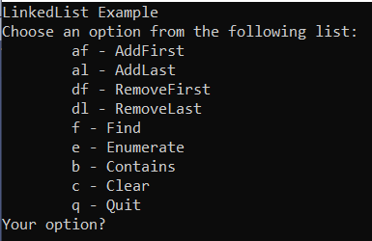
Code practice
1. Create a console application that manages a LinkedList collection.
2. The application allows AddFirst / AddLast / RemoveFirst / RemoveLast / Find / Contains / Clear / Enumerate operations on the LinkedList.

Slide 5
Questions
What is LinkedList?
When to go for LinkedList?
What is a Node?
How to add an item to LinkedList?
How to Remove an item in LinkedList?
How to Find an item in LinkedList?
What is head and tail in LinkedList?

