Slide 1
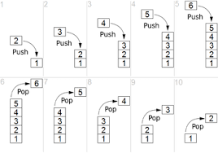

Slide 2
Stack –ערימה
1. Stack is a Last-In, First-Out (LIFO) data structure ,which can be generic Stack<T> and non generic Stack.
2. Stack is useful to store temporary data in LIFO style, and when you wish to remove the current item after retrieving its value.
*For example : undo\redo operation in word processors where you can undo you text removed or redo the text copied , stacking dinner plates ,
pile of books

Slide 3
Using Stack
Operations | Code Example
Instantiate | var stack = new Stack<int>();
Instantiate and assigning | var stack = new Stack<int>(new List<int> { 1, 2 });
Push add an item into stack | stack.Push(3);
Pop remove and retrieve last item from stack | var lastItem = stack.Pop();
Peek read last item from stack | var lastItemWithoutRemoving = stack.Peek();
Contains checks whether an item exists in stack or not | var itemExists = stack.Contains(2);
Clears all items from the stack. | stack.Clear();
Enumerating stack | foreach (var item in stack) Console.WriteLine(item);

Slide 4
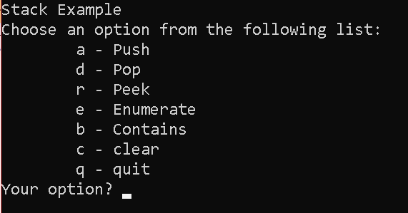
Code Practice
1. Create a console application that manages a Stack collection.
2. The application allows Push / Pop / Peek / Contains / Clear /Enumerate operations on the Stack.

Slide 5
Questions
What is Stack?
When to go for Stack?
What is a LIFO?
How to add an item to Stack?
Can Stack have duplicate items?
What is Peek method in Stack?
How to Remove an item from Stack?

