Slide 1
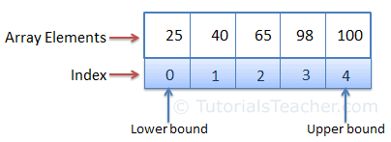
Arrays summery
A variable is used to store a literal value, whereas an array is used to store multiple literal values.
An array is the data structure that stores a fixed number of literal values (elements) of the same data type. Array elements are stored contiguously in the memory.
In C#, an array can be of three types: single-dimensional, multidimensional, and jagged array

Slide 2
Arrays – Usage
//Declaration
string[] a1;
//Declaration and initialization null values v1
string[] a2 =new string[2];
//Declaration and initialization values v2
string[] a3 =new string[]{"aa","bb"};
//Short syntax of array declaration and initialization
string[] a4 ={"aa","bb"};
a2[0]="aa";//assing value to an array cell
string cellValue =a3[1]; //get cell value
//iterate threw the array
for (int i = 0; i < a3.Length; i++)
System.Console.WriteLine(a3[i]);

Slide 3
Some of System.Array class functionality
int[] nums = new int[5]{ 10, 15, 16, 8, 6 };
Array.Sort(nums); // sorts array
//sorts array in descending order
Array.Reverse(nums);
// iterates array
Array.ForEach(nums, n => Console.WriteLine(n));
Array.BinarySearch(nums, 5);// binary search

