Slide 1



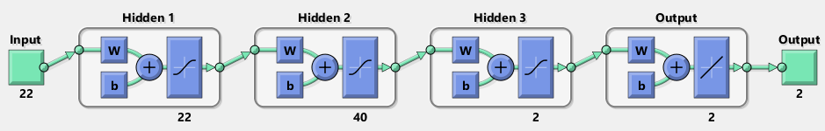
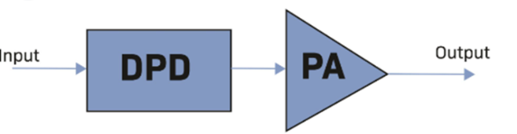
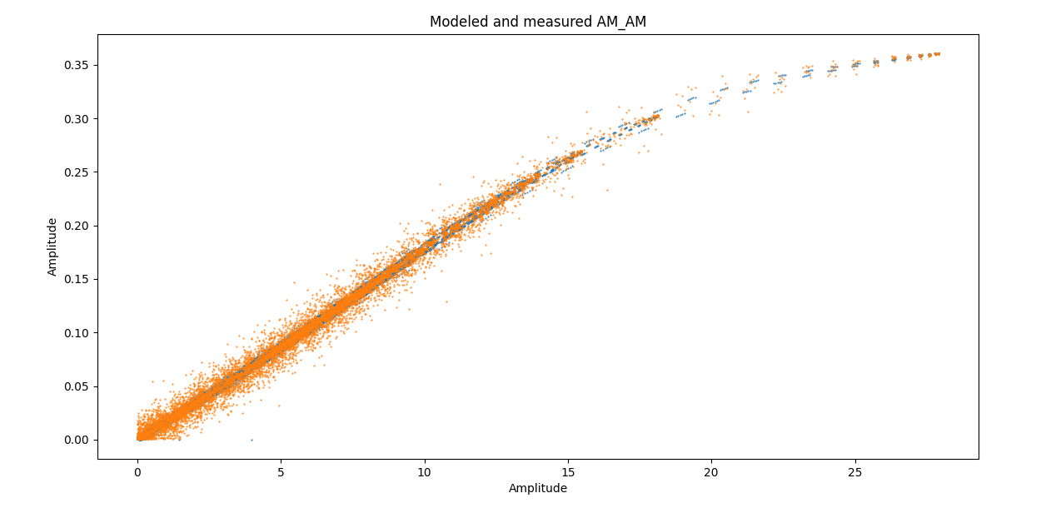
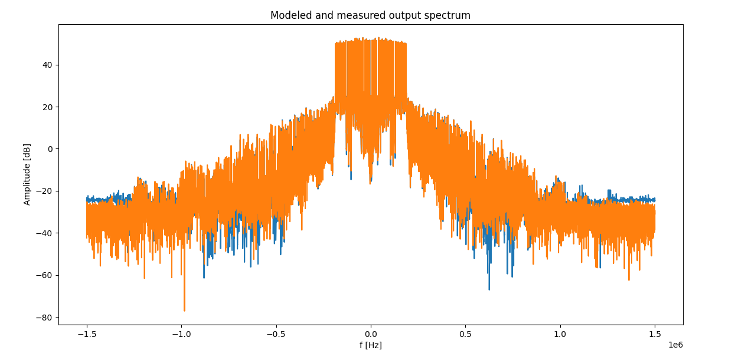
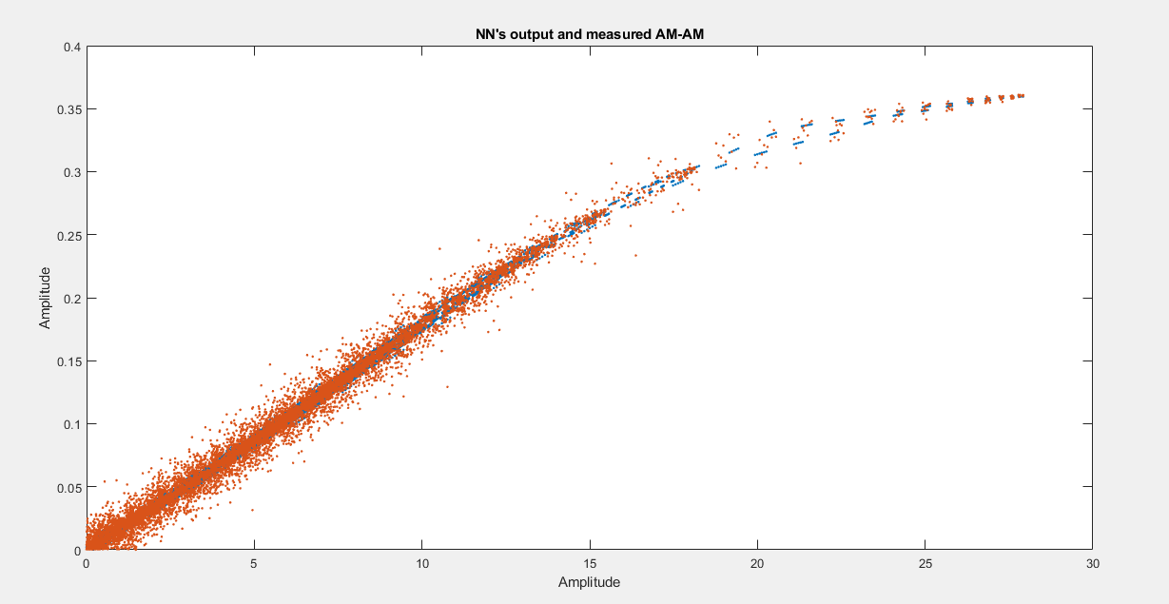
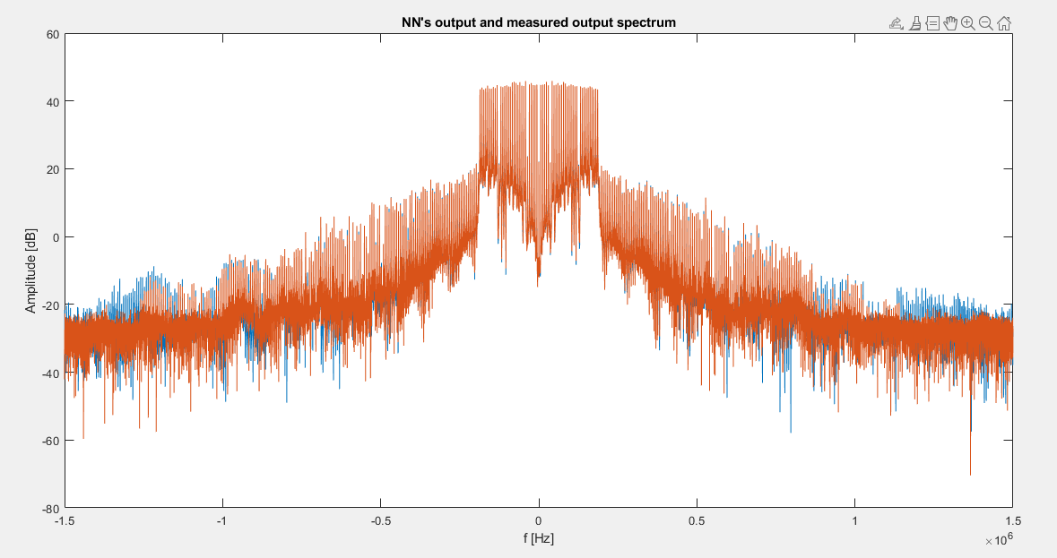
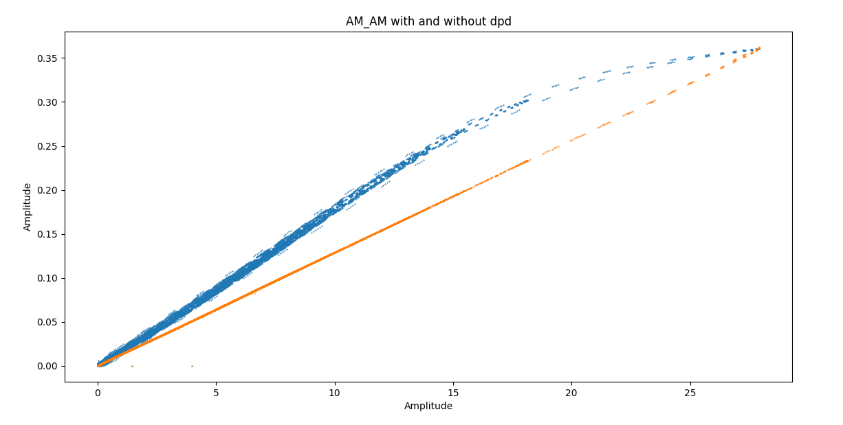
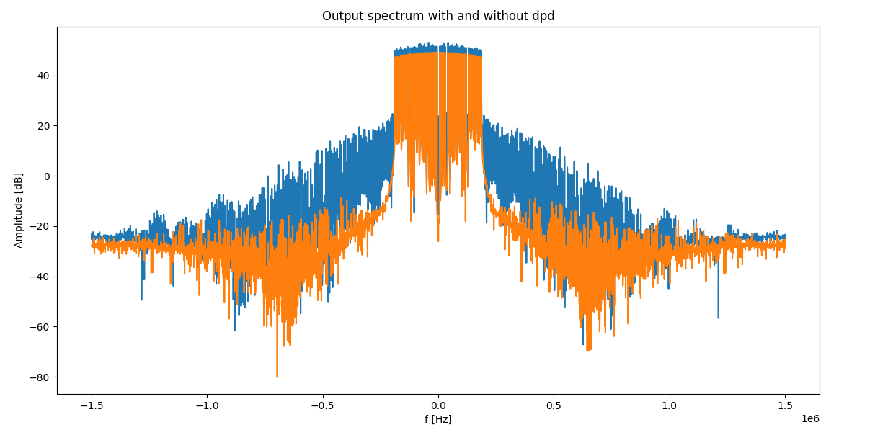
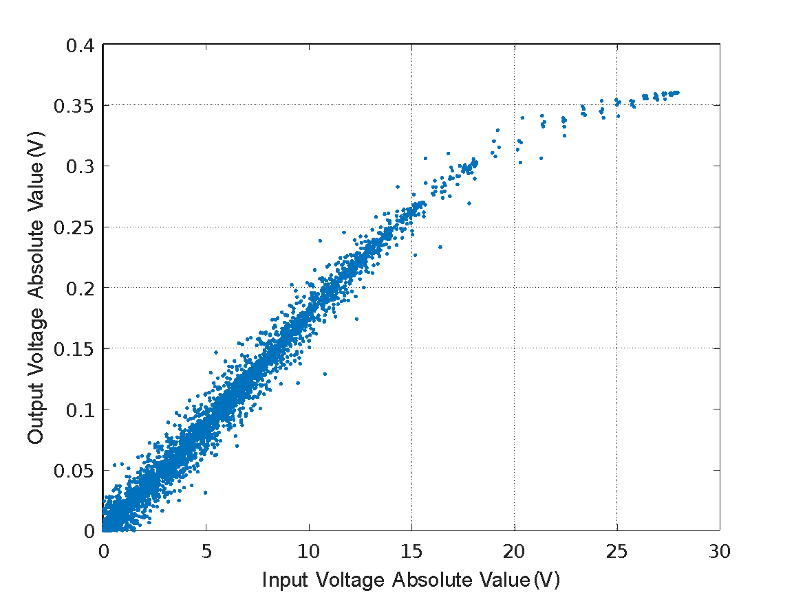
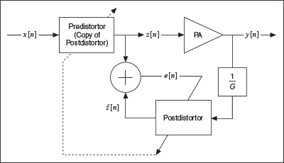
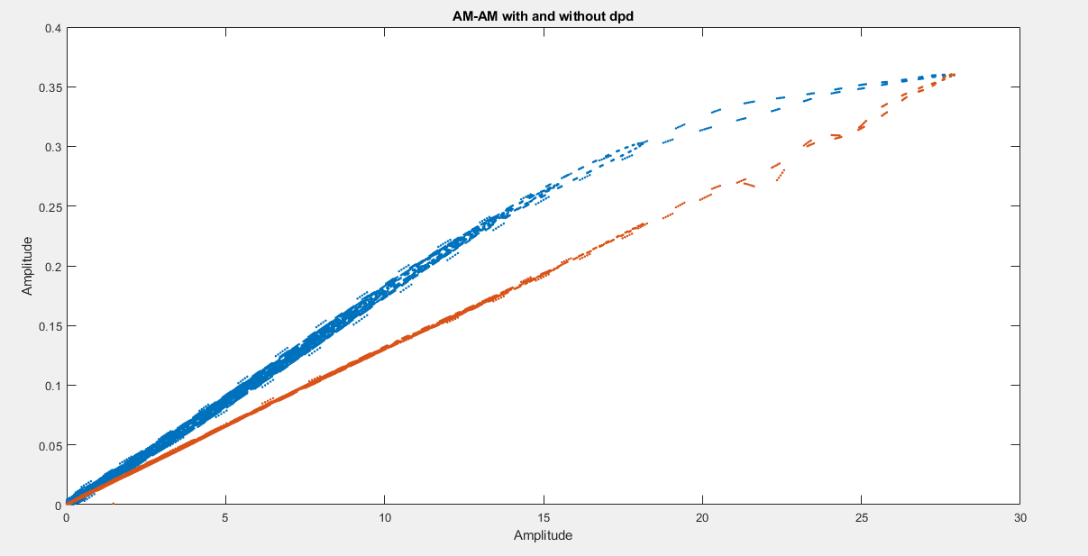
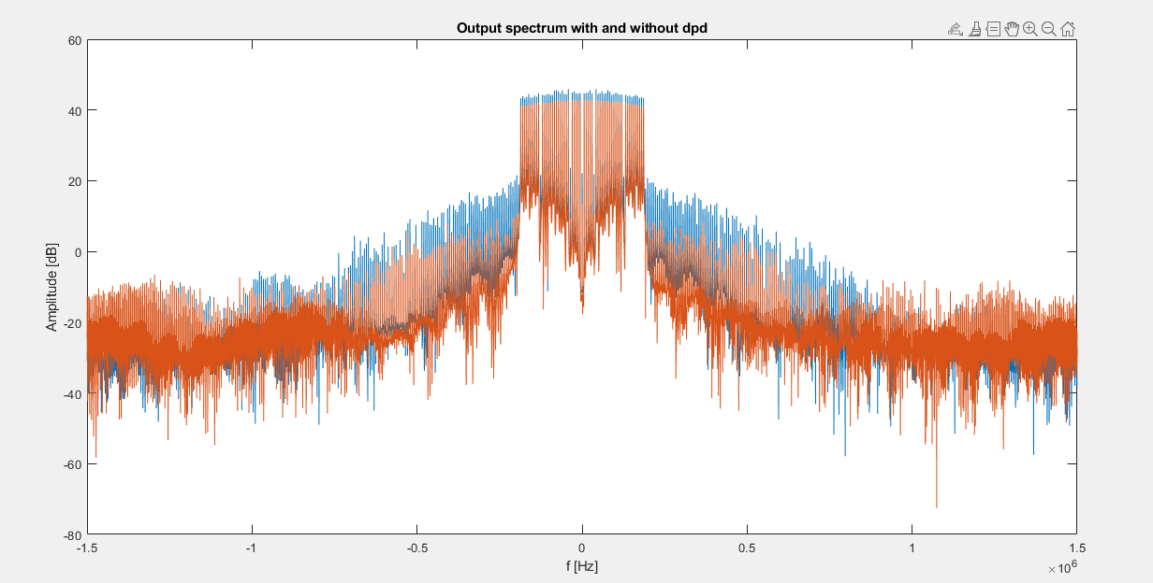
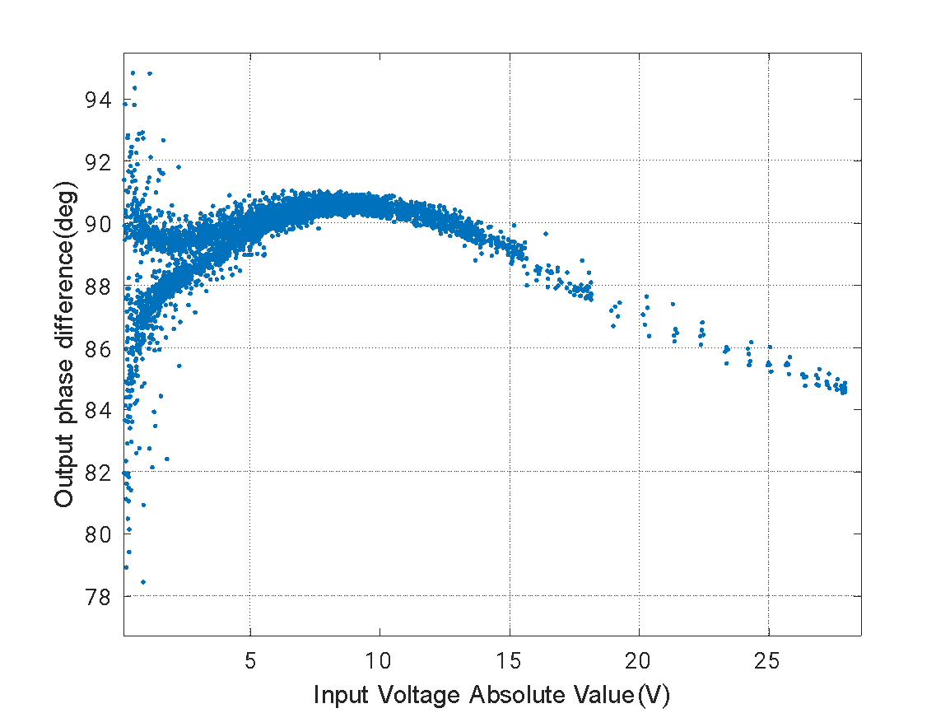
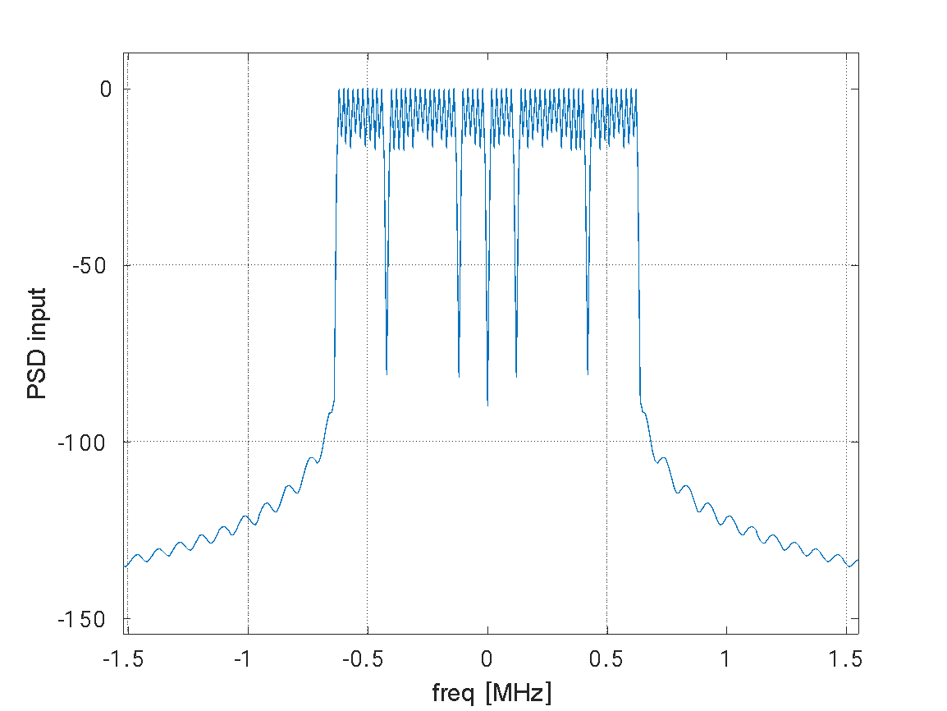
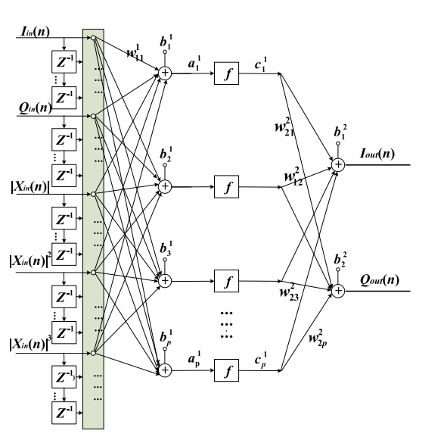
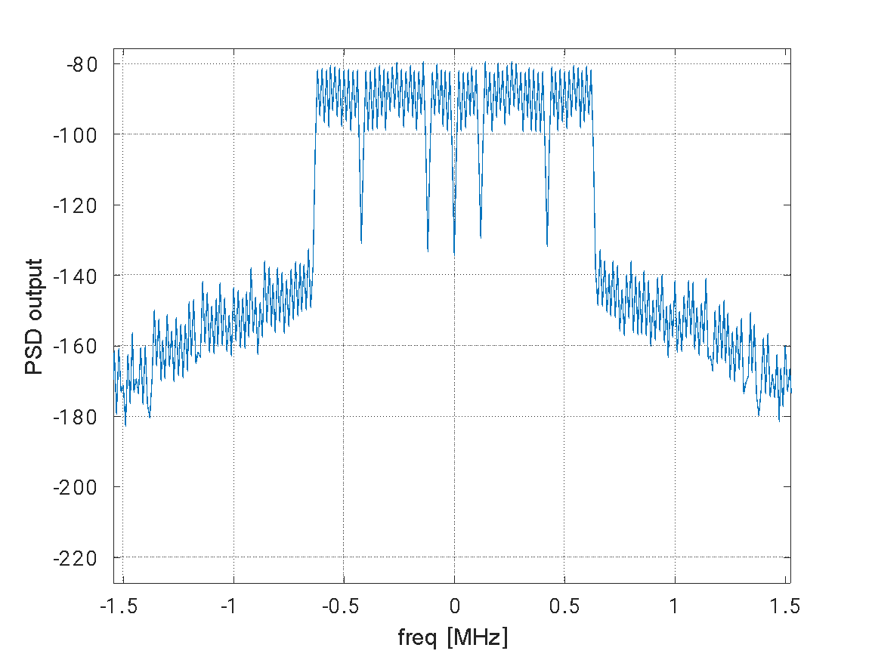


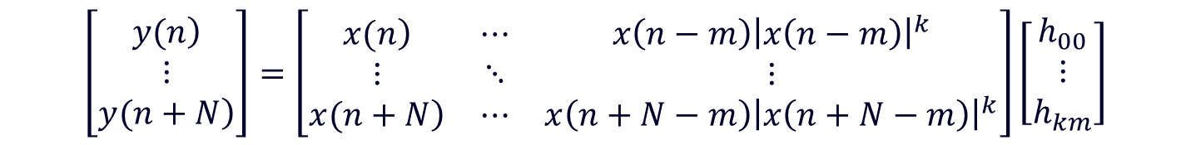
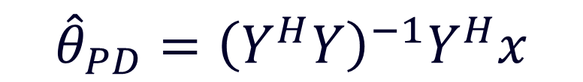

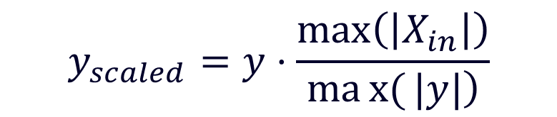
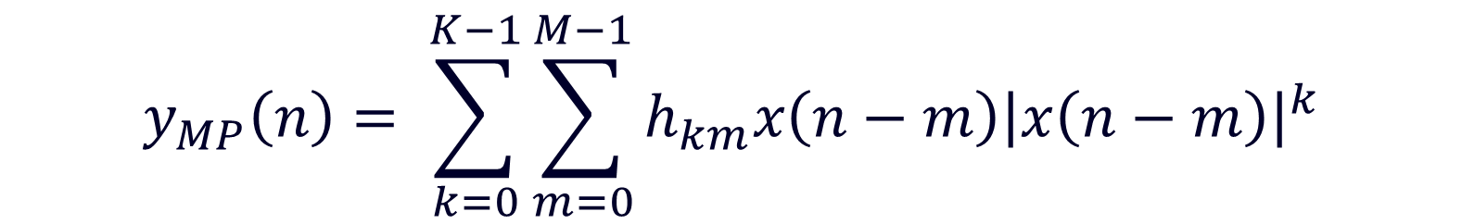

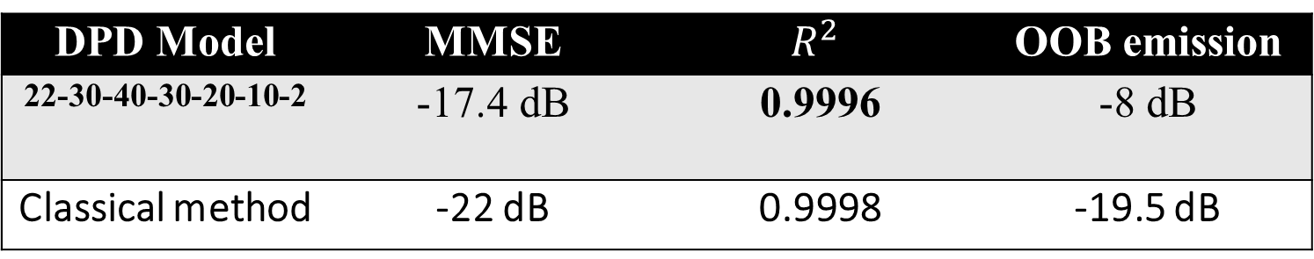

Digital Pre-Distortion
Adir Cohen Nissan, Supervised by Shai Ginzach, Dror Yachil
Introduction
Volterra series as a PA & DPD model
PA NN proposed architecture
Power amplifiers (PAs), are inherently nonlinear systems.
Nonlinearity causes in-band distortion and a spectral regrowth.
The role of the Digital Pre Distortion (DPD) is to distort the signal in a way that will be, in turn, compensated by the PA.
Volterra series are used in order to model systems that are both nonlinear and have memory. Memory Polynomial model is a simplification of the full Volterra model, with less coefficients
This model can be represented efficiently in matrix form as:
The coefficients vector 𝜃_𝑀𝑃 can be found using the well-known method of minimizing the least squares error between the calculated output and measured output.
At the same way, we can model our DPD using Volterra series:
In order to calculate the coefficient array Ѳ_𝑃𝐷, the same set of measurements is used, but it is scaled and used in reverse order:
The coefficients vector 𝜃_𝑀𝑃 can be found using the same algorithm as used at the pa modelling:
DPD NN proposed architecture
feedforward (22-40-2) NN modelled PA
$$y_{MP}\left(n\right)= \sum_{k=0}^{K−1}{\sum_{m=0}^{M−1}{h_{km}x\left(n−m\right){\left|x\left(n−m\right)\right|}^{k}}}$$
$$y=Xθ_{MP}$$
feedforward (22-30-40-30-20-10-2) NN modelled DPD
DPD and PA system
$$\left[\begin{matrix}\left.y(n\right) \\ ⋮ \\ \left.y(n+N\right)\end{matrix}\right]=\left[\begin{matrix}\left.x(n\right) & ⋯ & x\left(n−m\right){\left|x\left(n−m\right)\right|}^{k} \\ ⋮ & ⋱ & ⋮ \\ \left.x(n+N\right) & ⋯ & x\left(n+N−m\right){\left|x\left(n+N−m\right)\right|}^{k}\end{matrix}\right]\left[\begin{matrix}h_{00} \\ ⋮ \\ h_{km}\end{matrix}\right]$$
Results
Goals
The total response of the Pre-distorter and PA will be linear (reduce am/am, am/pm distortions and out of band emission) up to some saturation voltage.
Using both classical and deep learning methods
Classical PA modelling:
$${\hat{θ}}_{MP}={\left(X^{H}X\right)}^{−1} Xy$$
$$x=Yθ_{PD}$$
feedforward (22-40-2) NN modelled PA:
$$y_{scaled}=y⋅\frac{\max\left(\left|X_{in}\right|\right)}{\left.max{(}|y|\right)}$$
AM/AM, AM/PM, OOB emission
Classical DPD modelling:
AM/AM is the relation between the amplitude of the input signal and the amplitude of the output signal. Ideally, this relation should be linear, but due to non-linear components in the PA, is usually nonlinear
AM/PM is the relation between the amplitude of the input signal and the phase difference between the input signal and the output signal. Ideally, the phase difference should not change while changing input amplitude.
Out Of Band (OOB) emission is defined as the difference between the bandwidth of the signal after the PA and the bandwidth of the original signal.
$${\hat{θ}}_{PD}={\left(Y^{H}Y\right)}^{−1}Y^{H}x$$
feedforward (22-30-40-30-20-10-2) NN modelled DPD
$$z=Xθ_{PD}$$
$${\hat{θ}}_{PD}={\left(Y^{H}Y\right)}^{−1}Y^{H}z$$
In order to test AM/AM performance, we calculated the normalized MMSE between desired output (Gain*input) and modeled output with DPD, and 𝑅^2 of linear regression of the AM/AM curvature.
NNs as a PA & DPD model
Due to their strong adaptive nature and approximation capability, NNs are very attractive for the behavioral modeling of PAs.
The proposed model, which takes into account both nonlinear and memory effects:
DPD Model | MMSE | $$R^{2}$$ | OOB emission
22-30-40-30-20-10-2 | -17.4 dB | 0.9996 | -8 dB
Classical method | -22 dB | 0.9998 | -19.5 dB
Conclusions
The methods described in this report can model a real power amplifier and a digital pre distorter that their total response together will be, approximately, linear
classical methods should be considered and tested seriously before using NN solutions.
We used data that contains relatively low content of high power, and was relatively narrowband. In the future this methods should be examined in the communication lab with more suitable measurements.
Dongming Wang et al model
May 2023

