Slide 1
Where should each component live when every gigabyte has a price?
P5
Egress-aware cost-optimal placement across AWS, Azure and Google Cloud · Review 3: Evaluation and documentation
Aditya Raj · 23BCE1052
Divyansh Patil · 23BCE1506
Guide: Dr. Indrapriyadarshini S
School of Computer Science and Engineering
Notes:
Good morning. We're Aditya and Divyansh, and this is our third and final review for P5.
The whole project comes down to the question on the screen. When you split an application across AWS, Azure and Google Cloud, compute might be cheapest in one place, but every gigabyte the components send each other is billed, and the rate depends on who sends to whom. We wanted to know how much it actually costs to ignore that.
Review 1 set up the problem and the testbed, Review 2 showed the implementation. Today is about evaluation: did we evidence every objective, are the statistics sound, does it run live, and is it written up. We'll finish with the demo running on this laptop.

Slide 2
Three reviews, one question
RECAP · 1 MINUTE
R1
Problem, literature, testbed
The question
14 verified papers · 3-provider price snapshot · measured T1 traffic · baselines
If a planner ignores the price of data moving between components, how much more does the application cost, and when does it matter?
R2
Implementation, first results
Unified cost model · exact ILP + heuristics · comparison on shared axes · ablation
R3
Evaluation and documentation
Thresholds for H1–H3 were frozen before the first run and never changed.
Today: evidence for every objective · statistics · live demo · paper
Notes:
A quick reminder of where we started, because the verdicts only make sense against it.
Egress is priced per directed pair of locations: same region is free, same provider is cheap, crossing a provider boundary is expensive. A naive planner puts each component on its cheapest compute and never sees the bill for the traffic between them. That planner is our baseline, B1.
Before running anything we froze three hypotheses with numeric thresholds. They have not moved since September, and today you'll see two of them refuted. We think that's the honest result, and the reasons it happened are the most useful thing we learned.
Likely question: why freeze thresholds? So that we couldn't move the goalposts after seeing data.

Slide 3
What Review 3 asks for, and where we answer it
TODAY'S AGENDA
3
2
2
3
marks
marks
marks
marks
Objectives evidenced
Statistical soundness
Live demonstration
Documentation
O1–O4 each traced to code, results, a figure and a paper section. Four workloads; at least 3 runs per configuration.
Every figure carries n and a 95 % CI. Paired tests decide H1. Single runs are never plotted.
Streamlit app solving placements on stage, plus a live measurement from the Kubernetes testbed.
6–8 page IEEE paper built from generated numbers, and an 11-chapter guided walkthrough.
Slides 4–6
Slides 7–13
Slides 14–15
Slides 16–18
Notes:
This is the rubric, and it's also our agenda. We've organised the talk around it so you can tick things off as we go.
Three marks for evidencing every objective on more than one workload with replicated runs. Two for statistical soundness, which mostly means: no single-run bar charts, and every figure has an interval and a stated n. Two for a live demonstration, and three for the documentation.
One thing to flag up front: the rubric mentions a recorded demo video. Instead we built an eleven-chapter guided walkthrough that runs live, so the same thing a video would show can be clicked through and checked. We'll come back to that on the documentation slide.

Slide 4
Every objective has code, results, a figure and a paper section
RUBRIC · OBJECTIVES EVIDENCED (3 MARKS)
Objective | Code | Results | Figure / table | Paper | Status
O1 Unified cost model (compute, storage, egress; 3 providers) | pricing/ → cost_model/ | cost_model/2026-09-21/: 96 compute, 576 egress cells, 10/10 checks | T cost_model | §III | Met
O2 Placement formulated with explicit per-edge egress | placement/ilp.py | results/exact/: T1–T3 proven optimal, < 0.2 s | formulation.md, T exact | §IV | Met
O3 Exact + heuristic solve, gap quantified | placement/ilp.py, greedy.py, annealing.py | results/scaling/, results/timing/: median gap 0.10 % | F4, F5 | §V, §VII | Met · H2 refuted
O4 Cost penalty of ignoring egress | placement/baselines.py, ablations.py | results/replicates/, ablation/, sensitivity/ | R2-1, F1, F2, F6, F7 | §VII | Met · H1, H3 refuted
Every cell is a committed path; full matrix: docs/review3/objective_evidence.md
Notes:
This is the objective-evidence matrix. Every cell is a path in the repository, and the evidence index checks that each one exists.
O1, the unified cost model, and O2, the formulation, are fully met. O3 is met on the part that matters most, the optimality gap: annealing lands within a tenth of a percent of the proven optimum. What failed is our speed hypothesis, and we'll show why. O4, measuring the penalty of ignoring egress, is the heart of the project and is where the refuted hypotheses live.
We'd like to be clear that 'objective met' and 'hypothesis supported' are different things. The objectives were to build and measure; the hypotheses were bets about what we'd find.
Likely question: where is this table in the repo? docs/review3/objective_evidence.md.

Slide 5
Four workloads, one of them measured on a real cluster
RUBRIC · MULTIPLE WORKLOADS
T1
Three-tier web
T2
Data pipeline
T3
Microservices
Syn
Synthetic grid
1,265.50
3,621.0
2,768.94
1,250
GB / month between components
GB / month between components
GB / month between components
scaling runs
4 components · measured on kind/Kubernetes · run-to-run CV 0.87 %
7 components · heavy internal shuffling, almost no user traffic
11 components, 30 edges · Online Boutique shape
4–40 components · 12 or 24 locations · 5 instances per cell
Sources: topologies/*.json, testbed/measurements/summary.csv, results/scaling/runs.csv
Notes:
The rubric asks for multiple workloads, so we didn't want the conclusion to rest on one app.
T1 is a three-tier web app. We didn't guess its traffic: we ran it on a local kind Kubernetes cluster, put byte counters on every edge, and ran three ten-minute load tests. The variation between runs was under one percent.
T2 is a data pipeline that shuffles a lot of data internally but talks to users very little. T3 has the shape of Google's Online Boutique microservices demo, with eleven services and thirty edges. On top of those, a synthetic generator gave us instances up to forty components for the scaling study.
Keep the T2 description in mind. It turns out to be the only one where ignoring egress really hurts.

Slide 6
Every configuration ran at least 3 times; most ran 30
RUBRIC · AT LEAST 3 RUNS PER CONFIGURATION
Results | Rows | Configs | Min n | Unit of replication
replicates | 8,100 | 162 | 30 | traffic draw
ablation | 4,320 | 72 | 30 | traffic draw
sensitivity | 1,800 | 180 | 10 | traffic draw
scaling | 1,250 | 250 | 5 | synthetic instance
timing | 162 | 54 | 3 | timing repeat
15,632
replicated solver runs checked
0
failed rows
check_replication: PASS · run 2026-11-01
Deterministic re-runs of the same input are not counted as replicates.
Source: python -m experiments.check_replication (results/*/runs.csv)
Notes:
Here's the output of our replication checker, which runs as part of the audit and fails the build if any configuration used in a figure has fewer than three runs.
The unit of replication matters. Our solvers are deterministic, so running the same input twice gives the same answer, and we don't count that as a replicate. A replicate is an independent traffic draw from an uncertainty model, a different synthetic instance, or a separate timing repeat. Thirty draws per configuration for the main results, ten for the sensitivity grid, five synthetic instances per scaling cell, three timing repeats.
Likely question: why thirty? It gives tight bootstrap intervals at a cost the laptop could manage.

Slide 7
Every figure states its n and carries a 95 % interval
RUBRIC · STATISTICAL SOUNDNESS (2 MARKS)
Figure | Shows | n per point | Spread
R2-1 | Cost vs traffic scale, all methods | 30 draws | 95 % CI band
F1 | Cost breakdown, B1 vs ILP | 30 draws | 95 % CI bars
F2 | Egress penalty of B1 | 30 draws | 95 % CI band
F3 | Providers used by the optimum | 30 draws | 95 % CI
F4 | Runtime vs problem size | 3 inst. × 3 repeats | 95 % CI bars
F5 | SA optimality gap | 5 instances | box + 95 % CI
F6 | Gain decomposition (ablation) | 30 draws | 95 % CI bars
F7 | Egress-price sensitivity | 10 draws | 95 % CI bars
CI
95 % percentile bootstrap, B = 10,000
Pair
Methods share each draw, so tests are paired: Wilcoxon signed-rank
0/n
Wilson interval for proportions such as crossover counts
n≥3
analysis.figures --lint refuses to draw from fewer than 3 runs
Source: figures/*.csv (columns mean, sd, ci_lo, ci_hi, n); analysis/stats.py
Notes:
This slide is our answer to 'are the statistics sound'. Every figure in the project has a companion CSV with the mean, the spread and n, and a lint step refuses to draw a figure from fewer than three runs.
The intervals are 95 % percentile bootstrap intervals with ten thousand resamples. Because every method is solved on the same traffic draw, the comparisons are paired, so the hypothesis decisions use a Wilcoxon signed-rank test on the paired differences. For proportions, like 'how many draws show a crossover', we use a Wilson interval, which behaves properly at zero.
And one module computes every mean and interval in the project, so two figures can't disagree.

Slide 8
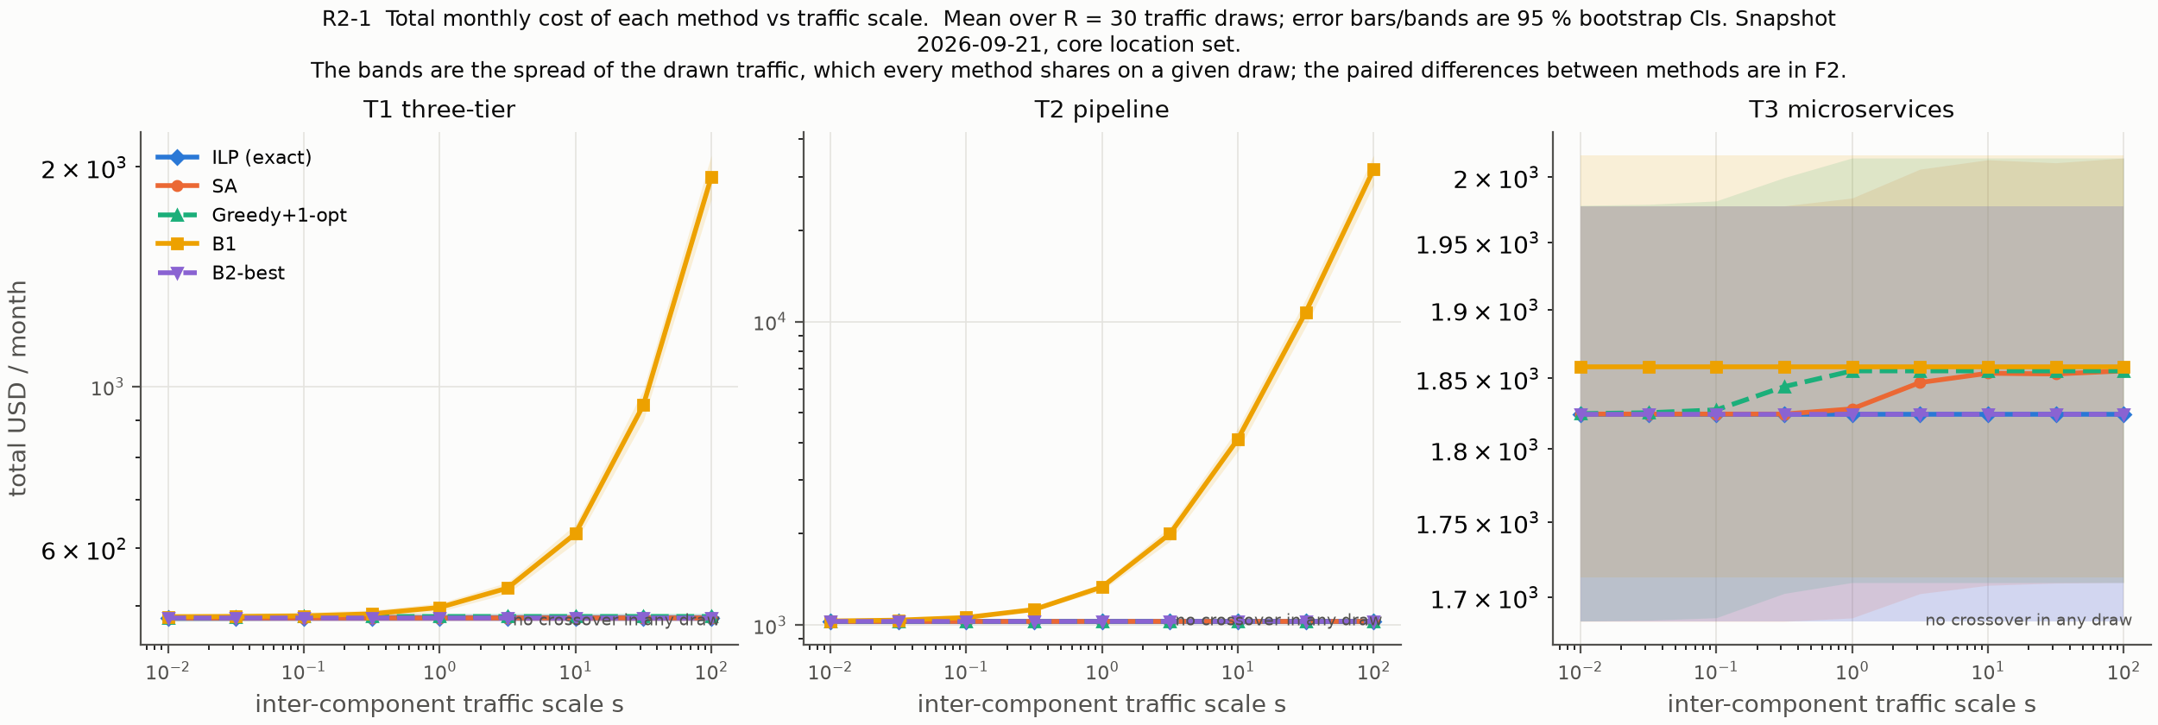
The cost of ignoring egress grows with traffic
HEADLINE RESULT · R2-1
T2 at s = 100: B1 $31,718.46 / month vs the optimum $1,028.88, mean of 30 draws. The gap between the orange line and the blue line is the price of ignoring egress.
Notes:
This is the figure we'd keep if we could only keep one. Total monthly cost against traffic scale, from a hundredth of the stated volume to a hundred times it, for every method on the same axes, with the confidence bands over thirty draws.
Look at the orange line, B1, the egress-blind baseline. On T1 and T2 it climbs steeply, because it split the components across providers and pays for every gigabyte between them. The exact optimum is flat, because it never crossed a provider boundary in the first place. At s = 100 on T2 that is about thirty-one thousand dollars a month against one thousand.
T3 is flat for everyone: B1 already puts T3 in one place, so the remaining gap is internet egress.

Slide 9
H1: only the data pipeline clears the 20 % bar
HYPOTHESIS H1 · ILP AT LEAST 20 % CHEAPER THAN B1
frozen threshold
Verdict
T1
3.29 % [3.04, 3.54]
REFUTED
overall · supported on T2 only
Why it splits this way
T2
22.55 % [20.52, 24.59]
Compute is identical for B1 and the optimum; the whole gap is data movement.
T1 is 84 % compute, so splitting it costs only $14.54 / month.
T2 has $306.90 / month of avoidable egress.
With the opposite tie-break, B1 saves 0 % everywhere.
T3
1.76 % [1.65, 1.87]
0 %
10 %
20 %
30 %
Mean reduction over B1, 30 paired draws, 95 % bootstrap CI
Source: docs/report/verdicts.md, docs/report/tables/h1_replicated.md, figures/F1_cost_breakdown.csv
Notes:
H1 said the exact optimum would be at least 20 % cheaper than the egress-blind baseline on all three topologies. Each dot is the mean reduction over thirty paired draws, and the bar is its 95 % interval.
T2 clears it: 22.55 %, interval 20.52 to 24.59, Wilcoxon p = 0.015. T1 and T3 are nowhere near, at about three and two percent. The rule we registered says all three must pass, so H1 is refuted overall.
The reason is simple once you see the breakdown: compute is identical for B1 and the optimum, so the saving can only come from data movement. T1 is 84 % compute. T2 moves 3,621 GB a month internally and has 307 dollars of avoidable egress.
Likely question: is T2 robust? Barely. The lower bound is half a point above 20.

Slide 10
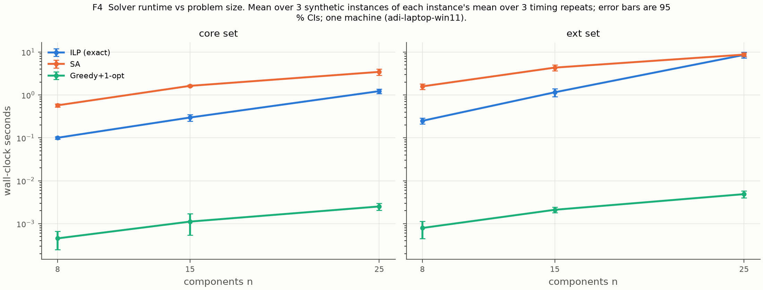
H2: annealing is accurate, but not faster than the exact solver
HYPOTHESIS H2 · SA WITHIN 5 % AND AT LEAST 10× FASTER
Accuracy clause
0.10 %
median gap, CI [0.07, 0.13] %, 25 instances; limit 5 %
Speed clause
0.63×
REFUTED
The tight formulation lets CBC prove optimality fast; the exact frontier was never reached (slowest ILP up to n = 40: 46.3 s). Greedy + 1-opt runs in under 10 ms.
median speed-up, CI [0.21, 1.04]×, 6 instances; needed 10×
Source: docs/report/verdicts.md (H2), results/timing/summary.csv, figures/F4_runtime_vs_n.csv
Notes:
H2 had two clauses, and it needed both. Simulated annealing had to stay within five percent of the optimum and be at least ten times faster than the exact solver at fifteen or more components.
The accuracy clause passes easily: median gap 0.10 %, worst instance 0.24 %. The speed clause fails: median speed-up 0.63, so annealing is actually slower. You can see it on the runtime plot, where the orange line sits above the blue one until about twenty-five components.
We were surprised, but the reason is that our formulation is tight, so CBC proves optimality at the root node. We never reached the size where the exact solver breaks down; the largest took 46 seconds.
Likely question: so why have heuristics? Greedy runs in under ten milliseconds within 2 %.

Slide 11
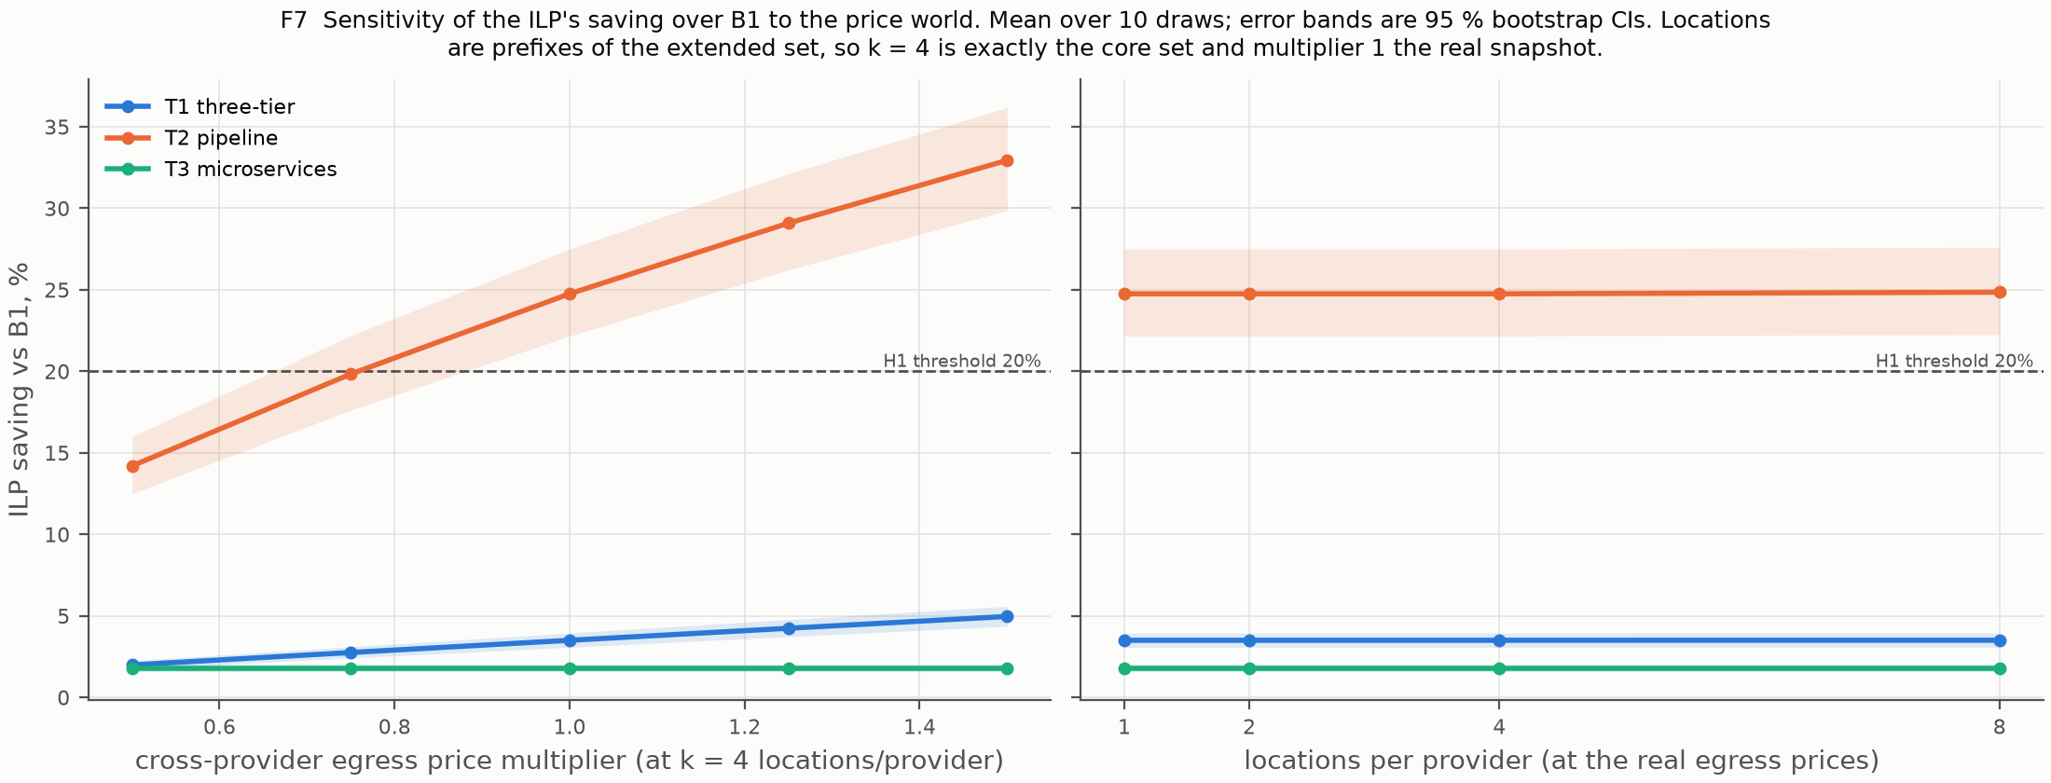
H3: no crossover, one region is cheapest for everything
HYPOTHESIS H3 · A TRAFFIC CROSSOVER EXISTS
And the one supported result is price-fragile
0 / 30
draws with a crossover, on each of T1, T2, T3 (Wilson 95 % CI 0–11.35 %)
REFUTED
azure:eastus minimises every component's own cost, and egress is zero when components share a location. Co-locating is optimal at every scale in this snapshot.
Egress × 0.75: T2 saving falls from 24.75 % to 19.83 %, below the threshold.
Locations per provider 1 → 8: saving moves ≤ 0.10 pp. Price structure drives the result, not the size of the search space.
Source: docs/report/verdicts.md (H3), results/sweep/crossover.csv, figures/F3_providers_used.csv, figures/F7_sensitivity.csv
Notes:
H3 was the one we were most excited about. We expected that at low traffic the optimum would spread across providers to chase cheap compute, and above some threshold it would collapse to one provider.
It never spreads. Across 810 points, three topologies, nine scales and thirty draws, the optimum uses exactly one provider. Zero crossovers in thirty draws on every topology.
This isn't a grid that's too coarse. In this price snapshot, Azure East US is the cheapest location for every component's compute, storage and internet traffic. Egress is never negative, so putting everything there wins at every scale. That's a property of the prices, not of the method.
The right-hand chart is the caveat: cut egress prices 25 % and even the T2 result drops below 20 %.

Slide 12
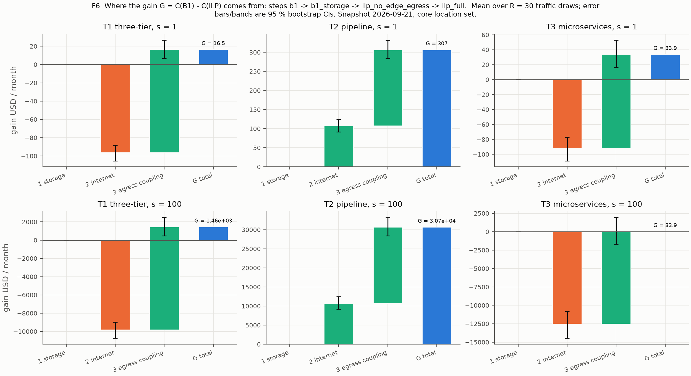
The egress-coupling term does the work, not the heuristic
WHICH COMPONENT CAUSES THE GAIN · ABLATION
6/6
points where egress coupling is the largest step
0.00
USD the storage-aware tie-break explains, everywhere
23.30 %
T1 penalty when the ILP drops per-edge egress, worse than B1 (3.40 %)
≤ 0.2 %
worth of any annealing design choice
Source: results/ablation/, figures/F6_gain_decomposition.csv, docs/report/tables/ablation.md (4,320 runs)
Notes:
The ablation answers 'which ingredient causes the saving'. We start from the baseline and add one ingredient at a time: storage-aware tie-breaking, then internet egress, then the coupling between components. The steps add up exactly to the total gain on every draw.
Storage explains nothing. Adding internet egress on its own actually makes T1 and T3 worse. The coupling term, pricing the traffic between components, is the largest step at all six points.
Our favourite number here: take the per-edge egress term out of the ILP and T1 costs 23.30 % more than the optimum, which is worse than the naive baseline. Annealing design choices are worth at most 0.2 %, so the formulation matters far more than the search.

Slide 13
The scoreboard: one partial win, three refutations
ALL HYPOTHESES, DECIDED ON INTERVALS
H1
Exact optimum ≥ 20 % cheaper than egress-blind B1 on T1–T3
T1
T2
T3
REFUTED
REFUTED
SUPPORTED
REFUTED
H2
Annealing within 5 % of optimum and ≥ 10× faster (n ≥ 15, ≥ 20 locations)
gap
speed
REFUTED
SUPPORTED
REFUTED
H3
A traffic threshold above which the optimum collapses to one provider
T1
T2
T3
REFUTED
REFUTED
REFUTED
REFUTED
Overall verdicts follow the pre-registered conjunctive rule: a hypothesis holds only if every part holds.
Notes:
Here's all of it on one slide. Every verdict was decided on the 95 % interval against a threshold we froze in September, never on a point estimate.
We know a slide full of red looks bad at first glance. We'd argue the opposite. Each refutation came with a reason we can measure: H1 depends on how much traffic flows between components relative to the compute bill, H2 failed because the exact solver is better than expected, and H3 failed because one region dominates the price list.
If we had tuned thresholds after the fact, we could have shown three green pills. We didn't.

Slide 14
Five minutes, live: solve, stress, measure, re-optimise
RUBRIC · LIVE DEMONSTRATION (2 MARKS)
0:00
0:30
1:30
2:30
3:15
4:00
The question
T1, solved live
T2, where it hurts
Traffic × 100
The statistics
Live testbed
Start here: objectives and verdict chips
ILP $481.18 vs B1 $497.58, proven optimal
ILP $1,028.79 vs B1 $1,303.65
B1 reaches $28,511.82; the optimum doesn't move
CI bands over 30 draws; zero crossovers
60 s load test on kind, then re-optimise T1
Before we start
If something breaks
python -m demo.preflight: every line OK
kind cluster up, four pods Running
Streamlit on http://localhost:8501
Cluster down: Use cached measurement (committed 3 × 10 min runs)
Solver slow: capped at 30 s; T3 normally solves in about 0.15 s
Laptop fails: teammate's clone, preflight run the day before
Script and fallbacks: docs/review3/demo_runbook.md · single-run demo values at stated volumes
Notes:
The demo runs on this laptop, not from a recording. Before we switch over, here's the route so you know what to watch for.
We solve T1 live and compare it to the baseline. Then T2, the case where egress really matters. Then we drag the traffic slider to a hundred times and watch the baseline explode while the optimum stays put. Then the replicated charts behind the verdicts, and finally a sixty-second load test against the Kubernetes cluster, re-pricing T1 from bytes measured live.
If the cluster misbehaves, the app falls back to our committed measurement and says so on screen. The preflight check has to pass before we start.

Slide 15
Live demo
Switching to the app · http://localhost:8501 · the runbook takes it from here
Chapters on stage: 0 Start here → 4 Solvers → 5 H1 → 7 H3 → 9 Live testbed → 10 Conclusion
Notes:
Switch to the browser now. Follow docs/review3/demo_runbook.md from 0:00.
Say: 'Everything you're about to see is solved live on this machine, with the same cost function the experiments used. Where a number comes from a file, the page names the file.'
Closing line, at 4:45: 'Egress-aware placement is worth between 2 and 27 % depending on the topology, the exact optimum is cheap enough to compute live, and on this price snapshot the answer is always a single provider, which is a more interesting result than the one we expected.'
Then come back to the deck for documentation and limitations.

Slide 16
Paper and walkthrough share the same generated numbers
RUBRIC · DOCUMENTATION OF FINDINGS (3 MARKS)
IEEE paper · 6–8 pages
197
16
7 + 2
I. Introduction
II. Related work
III. System and cost model
IV. Problem formulation
V. Heuristics and baselines
VI. Experimental setup
VII. Evaluation: H1, ablation, H3, H2, sensitivity
VIII. Threats to validity
IX. Conclusion and references
generated number keys, 0 typed
references, each fetched and verified
figures and tables, all with n and CI
Guided walkthrough, in place of a video
11 chapters, from the question to the verdicts, each with a Next link
Solves live; every page names the file its numbers come from
Headless tests render every chapter and check the shown numbers
Status: LaTeX sources complete; PDF compiled on Overleaf (pdfLaTeX)
paper/main.tex, paper/numbers.tex, paper/refs.bib · docs/review3/walkthrough.md · tests/test_walkthrough.py
Notes:
The documentation has two parts. First, an IEEE conference paper targeted at six to eight pages, with the sections the rubric asks for: abstract, related work, method, evaluation, limitations, references.
We're proud of one thing in particular: none of the numbers in the paper were typed by hand. A script writes 197 named values into the LaTeX, and a checker fails if a bare number appears in the text. All sixteen references were fetched and their titles and years confirmed.
Second, instead of a recorded video, an eleven-chapter guided walkthrough that anyone can open and follow without us, and that still solves live. We felt a video would show the same things but couldn't be checked. That substitution is a deliberate decision, and it's recorded.

Slide 17
What our results do not say
LIMITATIONS · 29 THREATS IN 4 CATEGORIES
C
CONSTRUCT
I
INTERNAL
List price is not an invoice
B1's tie-break decides the gap
Discounts, savings plans and free egress allowances are not modelled.
With the opposite tie-break, B1 already co-locates: 0 % saving.
E
EXTERNAL
S
CONCLUSION
No latency, SLO or residency limits
T2/T3 traffic is assumed
Putting everything in one region may be operationally impossible.
Lognormal σ = 0.3 uncertainty, registered before any run; only T1 is measured.
Full table with bias direction, mitigation and residual risk: docs/review2/threats_to_validity.md
Notes:
Every result has a boundary, and we'd rather draw it ourselves. We catalogued 29 threats in the four standard categories; here is the most important one in each.
The one that matters most for practice is external: we have no latency, SLO or data-residency constraints, so 'put everything in one region' may simply not be allowed for a real system. The most important internal one is the baseline's tie-break. With the opposite tie-break, the baseline already co-locates and the saving is zero.
We also price list rates, not negotiated invoices, and T2 and T3 traffic comes from stated volumes with an uncertainty model we registered before running.

Slide 18
Check one ratio before you optimise placement
WHAT WE WOULD TELL AN ENGINEER TOMORROW
1
Look at traffic ÷ bill first
What surprised us
The saving tracks one ratio: inter-component GB per month against the compute bill. 3 % on T1, 22.55 % on T2.
We set out to show that multi-cloud placement pays. The data kept telling us that, for these prices, the best multi-cloud strategy was to not be multi-cloud.
2
Solve it exactly
A tight ILP proves optimality in under 0.2 s on real topologies and handled every instance up to 40 components.
3
Read the price list
In this snapshot one region was cheapest for everything, so one provider won at every traffic level.
Notes:
If someone asked us on Monday whether they should bother with egress-aware placement, this is what we'd say.
Look at how many gigabytes your components send each other compared with your compute bill. If it's small, like T1 and T3, the saving is a few percent. If it's large, like T2, ignoring it costs you a quarter of the bill, and much more as traffic grows.
Second, the exact solver is fast enough. Don't reach for a metaheuristic by reflex.
Third, check the price list before designing anything multi-cloud. In this snapshot one region won everything. The part that surprised us most was how often the honest answer was 'just use one provider'.

Slide 19
Thank you. Questions welcome
P5
Everything shown today can be re-run from the repository: one price snapshot (2026-09-21), one command per result
Aditya Raj · 23BCE1052
Divyansh Patil · 23BCE1506
Guide: Dr. Indrapriyadarshini S
Notes:
Thank you. We're happy to go back to any slide or any chapter of the app.
Prepared answers:
Why an ILP and not an MIQP? The objective multiplies two placement variables; we linearise with pair variables and a tight constraint set strictly inside McCormick, so CBC proves optimality at the root.
Where do prices come from? A dated snapshot, 2026-09-21: AWS bulk price files, the Azure retail prices API, GCP public pricing pages. One script builds the model, with ten validation checks.
What do the error bars mean? 95 % bootstrap CIs, B = 10,000, over 30 paired traffic draws.
Did the method fail because it always picks one provider? No, the prices say so: azure:eastus is cheapest for every cost term in this snapshot.

