Slide 1
Elastic Stack for Logs Monitoring

Slide 2
Agenda
ElasticSearch
Kibana
Logstash
Filebeat

Slide 3




What is the Elastic Stack?
The Elastic Stack (formerly ELK Stack) is a powerful open-source platform for centralized log management and analysis, comprising four core components:
Elasticsearch
Logstash
Kibana
Filebeat
Distributed search and analytics engine that stores and indexes log data for lightning-fast queries.
Collects logs from multiple sources, parses content, filters noise and transforms data into a standardized format.
Visualisation layer providing interactive dashboards, real-time monitoring, and powerful search capabilities.
Lightweight log shipper that forwards the logs from the servers
Together, these create a centralized log analysis platform capable of handling millions of log events per second.

Slide 4

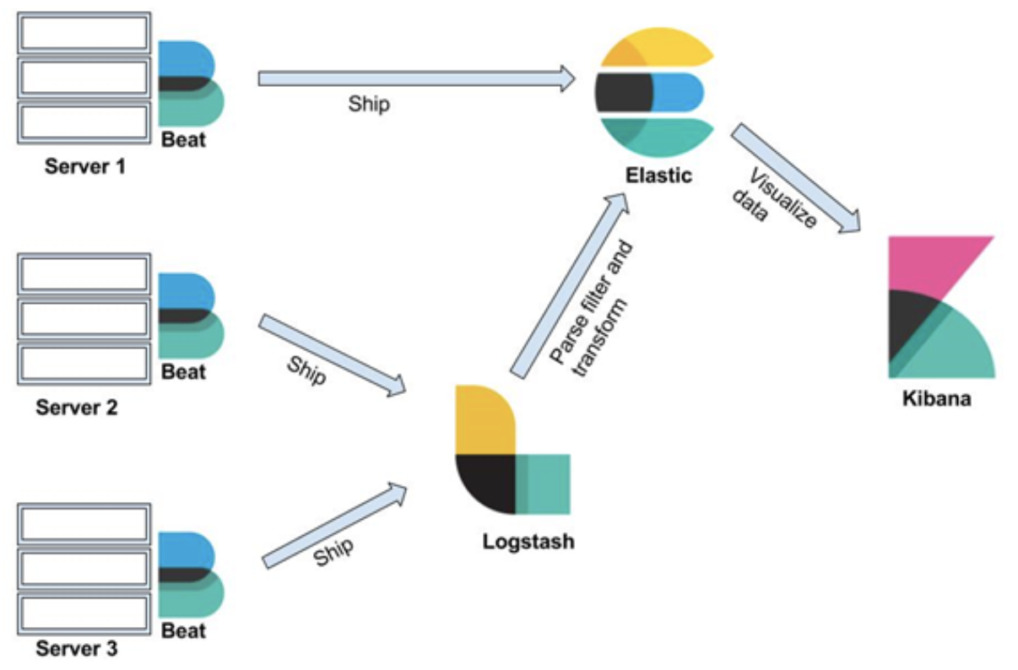



How Elastic Stack Works
Log Generation
Applications and services generate structured or unstructured log data across your infrastructure. Filebeat ships logs reliably.
Collection & Processing
Logstash collects logs from multiple sources, parses content, filters noise and transforms data into a standardized format.
Indexing & Storage
Elasticsearch indexes processed logs and stores them in a distributed, scalable data store optimized for search.
Visualisation & Analysis
Kibana provides real-time dashboards, custom queries, and drill-down capabilities for rapid troubleshooting.

Slide 5

Filebeat: The Lightweight Shipper
Efficient Log Collection
Filebeat monitors log files and directories on your servers, tracking file positions and handling log rotation automatically. Minimal resource footprint (~10-50MB RAM) makes it ideal for deployment on every server.
Reliable Data Delivery
Built-in backpressure handling ensures logs aren't lost when downstream systems are busy. Filebeat remembers its position in files, resuming seamlessly after crashes or restarts without data loss. It can ship the logs to Logstash or directly to ElasticSearch.
Data Enrichment
Filter and transform raw data before indexing – add geolocation data, mask sensitive information, or drop irrelevant events.
Example: Deploy Filebeat on 100 web servers to collect Nginx access logs. Each Filebeat instance ships logs to a central Logstash server, using only 15MB of memory while processing thousands of requests per second.

Slide 6

Logstash: The Data Pipeline
Flexible Data Collection
Logstash ingests logs from diverse sources including log files, databases, message queues, and APIs. Its plugin architecture supports over 200 input sources.
Intelligent Parsing
Extract structured data from unstructured logs using grok patterns, dissecting fields like user IDs, error codes, timestamps, and IP addresses.
Data Enrichment
Filter and transform raw data before indexing – add geolocation data, mask sensitive information, or drop irrelevant events.
Example: Convert an Apache access log line into structured JSON with parsed fields for HTTP method, status code, response time, and user agent.

Slide 7




Elasticsearch: The Search Engine
Real-Time Search
Execute full-text searches across billions of log entries with sub-second response times using inverted indices.
Distributed Architecture
Horizontally scalable across multiple nodes, ensuring high availability and fault tolerance for petabyte-scale data.
Advanced Analytics
Perform complex aggregations, filtering, and statistical analysis to uncover patterns and anomalies in your logs.
Example query: "Find all HTTP 500 errors in the last 24 hours where response time exceeded 2 seconds, grouped by service name."

Slide 8

Kibana: Visualisation & Dashboards
Real-Time Dashboards
Powerful Search Queries
Drill-Down Analysis
Build custom dashboards monitoring error rates, latency trends, user activity, and business metrics with automatic refresh.
Construct complex queries using Kibana Query Language (KQL) to filter logs by any field, timeframe, or pattern.
Click through visualisations to examine specific log events, trace requests across services, and identify root causes.
Security use case: Detect suspicious patterns such as repeated login failures from the same IP address, indicating a potential brute-force attack.

Slide 9
Installation Steps
Navigate to elk-installation-guide.md in the shared git repo

