Slide 1

Photodiode
Process Flow
Version 1
Exported by Adish Gupta
Oct 30, 2026, 8:44 AM
Last saved Oct 29, 2026, 8:12 PM
Open in FabuBlox
https://www.fabublox.com/designer/2cbbc24f-813f-4e72-a331-79439cbee9c8

Slide 2
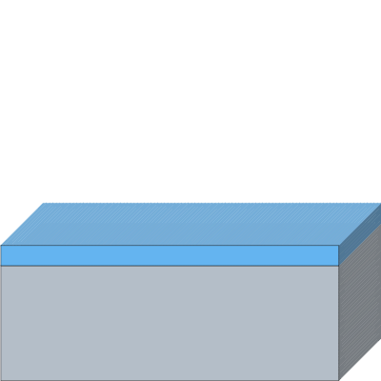
Starting Substrate
p-Si(100) with 300 nm Thermal SiO2
p-Si(100), 4", 1-10 ohm.cm, 300 nm thermal SiO2 (MTI), cleaved to ~2x2 cm dies
WAFER SIZES
100mm - 4"
VENDOR
MTI
LAYER | MATERIAL | THICKNESS | DOPING | CRYSTAL STRUCTURE | CRYSTAL ORIENTATION
1 | Silicon | 525 µm | p-type (B - Boron) | Single Crystal | <100>
2 | SiO₂ | 300 nm | — | — | —
Silicon
Phosphorus Spin-On Dopant
P
P
SiO₂
LOR 3A
S1813
Aluminum

Slide 3
[A] PREP

Slide 4
[A] PREP
Step 1: Solvent clean
Capability Type: Chemical Clean | Tool Name: Wet Bench: Solvents | Recipe Name: -
PROCESS PARAMETERS
Cleaning Bath Composition: Acetone
Ultra-Sonication: No
Dry Method: N₂ blow dry
ADVANCED SETTINGS
Keep Floating Structures: No
NOTES
Process Intent: Cleans organic residues from the wafer surface prior to processing.
Rationale: Sequential solvent clean: acetone > IPA > DI water rinse > N2 dry.
Silicon
Phosphorus Spin-On Dopant
P
P
SiO₂
LOR 3A
S1813
Aluminum

Slide 5
[A] PREP
Step 2: RCA clean
Capability Type: RCA Clean | Tool Name: Wet Bench: RCA | Recipe Name: -
PROCESS PARAMETERS
SC 1 Constituents: SC-1
SC 2 Constituents: SC-2
TOOL PARAMETERS
Dry
  Dry Method: N2 blow dry
ADVANCED SETTINGS
Floating Structures
  Keep Floating Structures: No
NOTES
Process Intent: Standard high-grade clean to remove trace organics, native oxide, and ionic/metallic contamination.
Rationale: Per lab RCA references prior to photolithography and high-temperature processing.
Silicon
Phosphorus Spin-On Dopant
P
P
SiO₂
LOR 3A
S1813
Aluminum

Slide 6
[B] MASK 1: ACTIVE WINDOWS

Slide 7
[B] MASK 1: ACTIVE WINDOWS
Step 3: Dehydration bake
Capability Type: Bake | Tool Name: Hot Plate | Recipe Name: -
PROCESS PARAMETERS
Bake Temperature: 120 °C
Bake Time: 300 secs
ADVANCED SETTINGS
Hard-Bake All Resists: No
Resist Image Reversal: No
NOTES
Process Intent: Dehydrates the wafer surface to promote resist adhesion.
Rationale: ~120 °C for 5 min; HMDS primed if available.
Silicon
Phosphorus Spin-On Dopant
P
P
SiO₂
LOR 3A
S1813
Aluminum

Slide 8
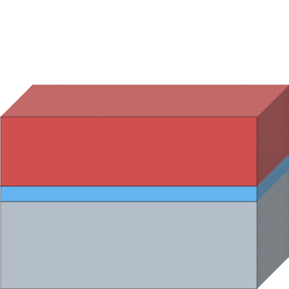
[B] MASK 1: ACTIVE WINDOWS
Step 4: Spin S1813
Capability Type: Spin-Coat | Tool Name: Spin Coater | Recipe Name: -
PROCESS PARAMETERS
Material Type: Positive
Material: S1813
Film Thickness: 1.35 µm
Spin Speed: 4000 rpm
Spin Time: 50 secs
ADVANCED SETTINGS
Fill Gaps: Yes
NOTES
Process Intent: Coats positive photoresist S1813 for patterning active windows.
Rationale: 4000 rpm for 50 s yields ~1.35 µm nominal thickness.
Silicon
Phosphorus Spin-On Dopant
P
P
SiO₂
LOR 3A
S1813
Aluminum

Slide 9
[B] MASK 1: ACTIVE WINDOWS
Step 5: Pre-exposure bake
Capability Type: Bake | Tool Name: Hot Plate | Recipe Name: -
PROCESS PARAMETERS
Bake Temperature: 115 °C
Bake Time: 60 secs
ADVANCED SETTINGS
Hard-Bake All Resists: No
Resist Image Reversal: No
NOTES
Process Intent: Soft-bakes S1813 resist to remove casting solvents.
Rationale: Hotplate pre-exposure bake at ~115 °C for 60 s.
Silicon
Phosphorus Spin-On Dopant
P
P
SiO₂
LOR 3A
S1813
Aluminum

Slide 10
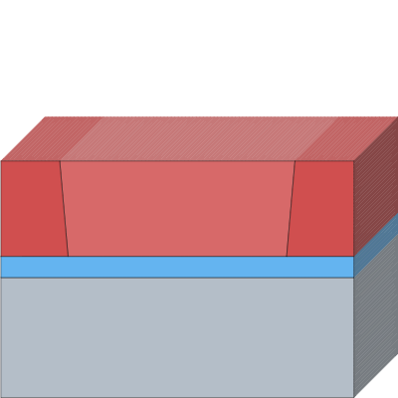
[B] MASK 1: ACTIVE WINDOWS
Step 6: Expose Mask 1
Capability Type: Direct-Write Lithography | Tool Name: litho-v1 | Recipe Name: -
PROCESS PARAMETERS
Laser Wavelength: 405 nm (h-line)
Layer(s) to Expose: S1813
Pattern source: Manual
Define Pattern: 1,4,1
Toggle start exposure region: Yes
ADVANCED SETTINGS
Exposure Sidewall Angle: 5 °
NOTES
Process Intent: Exposes Mask 1 to define 500x500 µm active window, 200x200 µm pad area, marks, van der Pauw cross, and test diodes.
Rationale: Patterned on litho-v1 DLP projector (405 nm LED) at 140 mJ/cm².
Silicon
Phosphorus Spin-On Dopant
P
P
SiO₂
LOR 3A
S1813
Aluminum

Slide 11
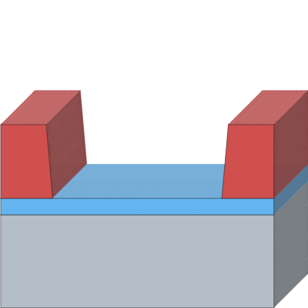
[B] MASK 1: ACTIVE WINDOWS
Step 7: Develop
Capability Type: Develop | Tool Name: Wet Bench: MF-319 | Recipe Name: -
PROCESS PARAMETERS
Layer(s) to Develop: S1813
Developer: MF-319
Develop Time: 30 secs
ADVANCED SETTINGS
Custom Undercut: No
NOTES
Process Intent: Develops exposed S1813 photoresist.
Rationale: MF-319 developer for 15-40 s (~30 s), followed by DI water rinse and N2 dry.
Silicon
Phosphorus Spin-On Dopant
P
P
SiO₂
LOR 3A
S1813
Aluminum

Slide 12
[B] MASK 1: ACTIVE WINDOWS
Step 8: Hard bake
Capability Type: Bake | Tool Name: Hot Plate | Recipe Name: -
PROCESS PARAMETERS
Bake Temperature: 120 °C
Bake Time: 600 secs
ADVANCED SETTINGS
Hard-Bake All Resists: Yes
Resist Image Reversal: No
NOTES
Process Intent: Hardens resist mask prior to wet chemical oxide etching.
Rationale: Hard bake at ~120 °C for 10 min.
Silicon
Phosphorus Spin-On Dopant
P
P
SiO₂
LOR 3A
S1813
Aluminum

Slide 13
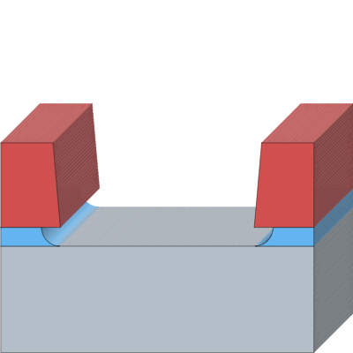
[B] MASK 1: ACTIVE WINDOWS
Step 9: Etch oxide to Si
Capability Type: Chemical Etch | Tool Name: Wet Bench: BOE/DHF | Recipe Name: -
PROCESS PARAMETERS
Layer(s) to Etch: SiO₂
Two-Sided Etch: Yes
Etch Bath Composition: BOE 6:1
Etch Depth: 300 nm
Etch Time: 240 secs
ADVANCED SETTINGS
Etch Mode: Isotropic Etch
Define Etch Selectivity: No
Out-of-plane Etch Buried Layers: No
Keep Floating Structures: No
NOTES
Process Intent: Etches 300 nm SiO2 thermally grown oxide down to bare silicon in opened active windows.
Rationale: BOE wet etch for ~3-5 min (~4 min); visual endpoint indicated when bare silicon dewets. Leave backside uncoated by resist so the backside oxide is stripped simultaneously in this step for subsequent backside metallization.
Silicon
Phosphorus Spin-On Dopant
P
P
SiO₂
LOR 3A
S1813
Aluminum

Slide 14
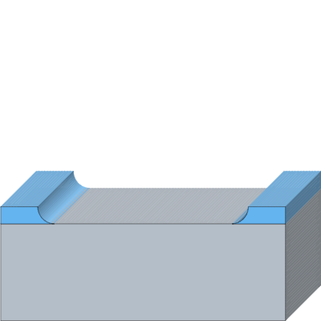
[B] MASK 1: ACTIVE WINDOWS
Step 10: Strip Resist
Capability Type: Chemical Clean | Tool Name: Wet Bench: PG Remover | Recipe Name: -
PROCESS PARAMETERS
Layer(s) to Remove: S1813
Cleaning Bath Composition: NMP
Cleaning Time: 5 mins
Cleaning Temperature: 60 °C
Ultra-Sonication: No
Dry Method: N2 blow dry
ADVANCED SETTINGS
Keep Floating Structures: No
Silicon
Phosphorus Spin-On Dopant
P
P
SiO₂
LOR 3A
S1813
Aluminum

Slide 15
[C] n+ EMITTER

Slide 16
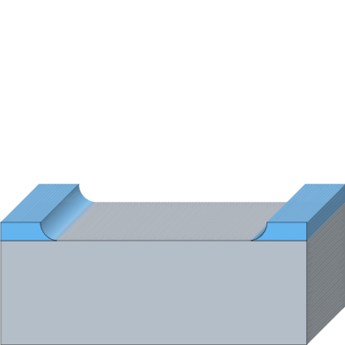
[C] n+ EMITTER
Step 11: Dilute HF dip
Capability Type: Chemical Etch | Tool Name: Wet Bench: BOE/DHF | Recipe Name: -
PROCESS PARAMETERS
Layer(s) to Etch: SiO₂
Two-Sided Etch: No
Etch Bath Composition: DHF 50:1
Etch Depth: 2 nm
Etch Time: 10 secs
ADVANCED SETTINGS
Etch Mode: Isotropic Etch
Define Etch Selectivity: No
Out-of-plane Etch Buried Layers: No
Keep Floating Structures: No
NOTES
Process Intent: Removes native oxide from active silicon windows prior to dopant application.
Rationale: 10 s dilute HF (DHF 50:1) dip.
Silicon
Phosphorus Spin-On Dopant
P
P
SiO₂
LOR 3A
S1813
Aluminum

Slide 17
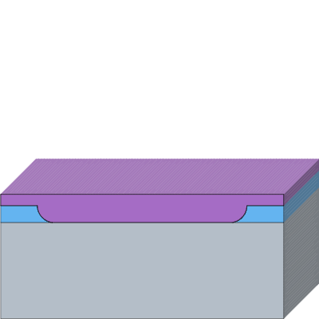
[C] n+ EMITTER
Step 12: Spin P spin-on dopant
Capability Type: Spin-Coat | Tool Name: Spin Coater | Recipe Name: -
PROCESS PARAMETERS
Material Type: Dopant
Dopant Species: P
Material: Phosphorus Spin-On Dopant
Film Thickness: 200 nm
Spin Speed: 3000 rpm
Spin Time: 45 secs
ADVANCED SETTINGS
Fill Gaps: Yes
NOTES
Process Intent: Applies phosphorus spin-on dopant to form shallow n+ emitter layer.
Rationale: Spun per dopant recipe parameters.
Silicon
Phosphorus Spin-On Dopant
P
P
SiO₂
LOR 3A
S1813
Aluminum

Slide 18
[C] n+ EMITTER
Step 13: Bake
Capability Type: Bake | Tool Name: Hot Plate | Recipe Name: -
PROCESS PARAMETERS
Bake Temperature: 165 °C
Bake Time: 300 secs
ADVANCED SETTINGS
Hard-Bake All Resists: No
Resist Image Reversal: No
NOTES
Process Intent: Soft-bakes and dries spin-on dopant layer.
Rationale: Hotplate bake at 150-175 °C (~165 °C).
Silicon
Phosphorus Spin-On Dopant
P
P
SiO₂
LOR 3A
S1813
Aluminum

Slide 19

[C] n+ EMITTER
Step 14: Predeposition
Capability Type: Dopant Diffusion | Tool Name: Tube Furnace | Recipe Name: -
PROCESS PARAMETERS
Diffusion Target Layer(s): Silicon
Gas-Source Diffusion: No
Diffusion Distance: 300 nm
Diffusion Temperature: 1100 °C
Diffusion Time: 8 mins
ADVANCED SETTINGS
Grow Thermal Surface Layer: No
NOTES
Process Intent: Drives phosphorus dopant into exposed silicon active areas to form n+ emitter junction.
Rationale: Tube furnace predeposition at 1100 °C for 5-10 min (~8 min).
Silicon
Phosphorus Spin-On Dopant
P
P
SiO₂
LOR 3A
S1813
Aluminum

Slide 20

[C] n+ EMITTER
Step 15: Strip dopant glass
Capability Type: Chemical Etch | Tool Name: Wet Bench: BOE/DHF | Recipe Name: -
PROCESS PARAMETERS
Layer(s) to Etch: Phosphorus Spin-On Dopant
Two-Sided Etch: No
Etch Bath Composition: BOE 6:1
Etch Depth: 500 nm
Etch Time: 60 secs
ADVANCED SETTINGS
Etch Mode: Isotropic Etch
Define Etch Selectivity: No
Out-of-plane Etch Buried Layers: No
Keep Floating Structures: No
NOTES
Process Intent: Strips residual phosphosilicate dopant glass down to bare Si.
Rationale: Brief BOE etch (60 s) to hydrophobic bare silicon surface. Note: This blanket dip also thins the field oxide from ~300 nm to ~200 nm, which remains sufficiently thick for subsequent Mask 2 and Mask 3 patterning.
Silicon
Phosphorus Spin-On Dopant
P
P
SiO₂
LOR 3A
S1813
Aluminum

Slide 21
[C] n+ EMITTER
Metrology Step 1: Measure R_sheet <GATE G1>
Capability Type: Metrology | Tool Name: Probe Station | Recipe Name: -
NOTES
Process Intent: Measures sheet resistance (R_sheet) on van der Pauw cross structures as quality gate G1.
Rationale: Confirms dopant drive-in and active layer sheet resistance before oxidation split.
Preview unavailable
Silicon
Phosphorus Spin-On Dopant
P
P
SiO₂
LOR 3A
S1813
Aluminum

Slide 22
[D] AR-OXIDE SPLIT

Slide 23
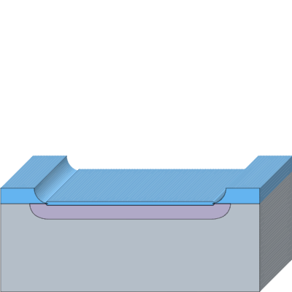
[D] AR-OXIDE SPLIT
Step 16: Dry O2 oxidation
Capability Type: Thermal Oxidation | Tool Name: Tube Furnace | Recipe Name: -
PROCESS PARAMETERS
Layer(s) to Consume: Silicon
Two-Sided Growth: No
Process Gases: O₂
Thermally Grown Material: SiO₂
Layer Thickness: 70 nm
Growth Time: 20 mins
Growth Temperature: 1100 °C
ADVANCED SETTINGS
Consumption Ratio: 46 %
NOTES
Process Intent: Thermally grows passivating anti-reflection (AR) oxide layer.
Rationale: Dry O2 oxidation in furnace at 1100 °C; dies pulled at ~7 min (~40 nm), ~20 min (~70 nm), ~38 min (~100 nm), plus one bare-Si witness.
Silicon
Phosphorus Spin-On Dopant
P
P
SiO₂
LOR 3A
S1813
Aluminum

Slide 24
[D] AR-OXIDE SPLIT
Metrology Step 2: Measure oxide
Capability Type: Metrology | Tool Name: Ellipsometer | Recipe Name: -
NOTES
Process Intent: Ellipsometer metrology of AR oxide thickness across split dies.
Rationale: Confirms targets of ~40 nm / ~70 nm / ~100 nm AR oxide.
Preview unavailable
Silicon
Phosphorus Spin-On Dopant
P
P
SiO₂
LOR 3A
S1813
Aluminum

Slide 25
[E] MASK 2: CONTACT STRIPES

Slide 26
[E] MASK 2: CONTACT STRIPES
Step 17: Dehydration bake
Capability Type: Bake | Tool Name: Hot Plate | Recipe Name: -
PROCESS PARAMETERS
Bake Temperature: 120 °C
Bake Time: 300 secs
ADVANCED SETTINGS
Hard-Bake All Resists: No
Resist Image Reversal: No
NOTES
Process Intent: Dehydration bake before resist application.
Rationale: 120 °C for 5 min.
Silicon
Phosphorus Spin-On Dopant
P
P
SiO₂
LOR 3A
S1813
Aluminum

Slide 27
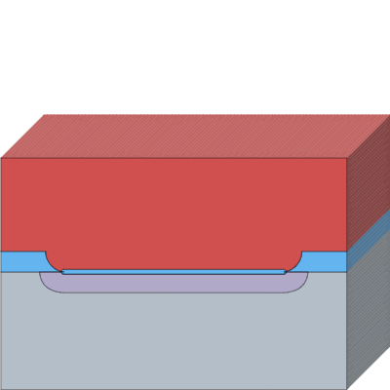
[E] MASK 2: CONTACT STRIPES
Step 18: Spin S1813
Capability Type: Spin-Coat | Tool Name: Spin Coater | Recipe Name: -
PROCESS PARAMETERS
Material Type: Positive
Material: S1813
Film Thickness: 1.35 µm
Spin Speed: 4000 rpm
Spin Time: 50 secs
ADVANCED SETTINGS
Fill Gaps: Yes
NOTES
Process Intent: Coats S1813 positive resist for contact stripe mask.
Rationale: 4000 rpm for 50 s.
Silicon
Phosphorus Spin-On Dopant
P
P
SiO₂
LOR 3A
S1813
Aluminum

Slide 28
[E] MASK 2: CONTACT STRIPES
Step 19: Pre-exposure bake
Capability Type: Bake | Tool Name: Hot Plate | Recipe Name: -
PROCESS PARAMETERS
Bake Temperature: 115 °C
Bake Time: 60 secs
ADVANCED SETTINGS
Hard-Bake All Resists: No
Resist Image Reversal: No
NOTES
Process Intent: Soft-bakes S1813 resist.
Rationale: 115 °C for 60 s.
Silicon
Phosphorus Spin-On Dopant
P
P
SiO₂
LOR 3A
S1813
Aluminum

Slide 29
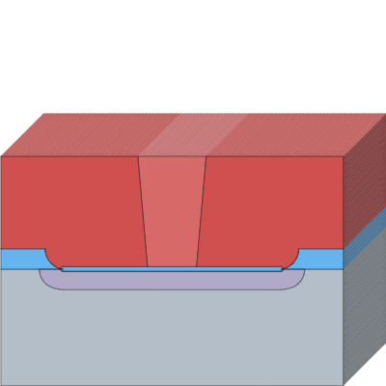
[E] MASK 2: CONTACT STRIPES
Step 20: Expose Mask 2
Capability Type: Direct-Write Lithography | Tool Name: litho-v1 | Recipe Name: -
PROCESS PARAMETERS
Laser Wavelength: 405 nm (h-line)
Layer(s) to Expose: S1813
Pattern source: Manual
Define Pattern: 2,1,2
Toggle start exposure region: Yes
ADVANCED SETTINGS
Exposure Sidewall Angle: 5 °
NOTES
Process Intent: Exposes Mask 2 defining 10 µm contact opening stripes inside 30 µm fingers.
Rationale: Patterned on litho-v1 DLP projector (405 nm LED), aligned to Mask 1 marks using XY + theta stage.
Silicon
Phosphorus Spin-On Dopant
P
P
SiO₂
LOR 3A
S1813
Aluminum

Slide 30
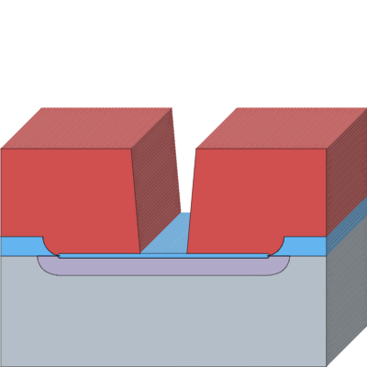
[E] MASK 2: CONTACT STRIPES
Step 21: Develop
Capability Type: Develop | Tool Name: Wet Bench: MF-319 | Recipe Name: -
PROCESS PARAMETERS
Layer(s) to Develop: S1813
Developer: MF-319
Develop Time: 30 secs
ADVANCED SETTINGS
Custom Undercut: No
NOTES
Process Intent: Develops exposed contact opening stripes in S1813 resist.
Rationale: MF-319 developer for 15-40 s (~30 s), DI rinse, and N2 dry.
Silicon
Phosphorus Spin-On Dopant
P
P
SiO₂
LOR 3A
S1813
Aluminum

Slide 31
[E] MASK 2: CONTACT STRIPES
Step 22: Hard bake
Capability Type: Bake | Tool Name: Hot Plate | Recipe Name: -
PROCESS PARAMETERS
Bake Temperature: 120 °C
Bake Time: 600 secs
ADVANCED SETTINGS
Hard-Bake All Resists: Yes
Resist Image Reversal: No
NOTES
Process Intent: Hardens resist mask prior to wet etching of contact stripes.
Rationale: 120 °C for 10 min.
Silicon
Phosphorus Spin-On Dopant
P
P
SiO₂
LOR 3A
S1813
Aluminum

Slide 32
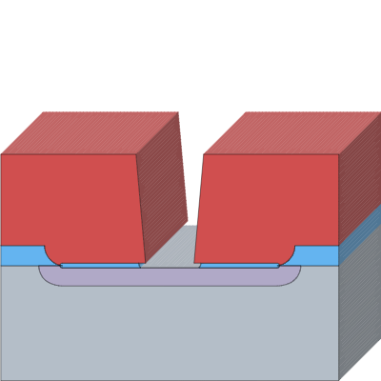
[E] MASK 2: CONTACT STRIPES
Step 23: Etch AR oxide
Capability Type: Chemical Etch | Tool Name: Wet Bench: BOE/DHF | Recipe Name: -
PROCESS PARAMETERS
Layer(s) to Etch: SiO₂
Two-Sided Etch: Yes
Etch Bath Composition: BOE 6:1
Etch Depth: 100 nm
Etch Time: 45 secs
ADVANCED SETTINGS
Etch Mode: Isotropic Etch
Define Etch Selectivity: No
Out-of-plane Etch Buried Layers: No
Keep Floating Structures: No
NOTES
Process Intent: Etches opened contact stripes through AR oxide down to n+ emitter.
Rationale: BOE etch time scaled by AR oxide thickness: ~25 s for 40 nm die, ~45 s for 70 nm die, and ~70 s for 100 nm die. Visual endpoint indicated when bare silicon contact stripes dewet.
Silicon
Phosphorus Spin-On Dopant
P
P
SiO₂
LOR 3A
S1813
Aluminum

Slide 33
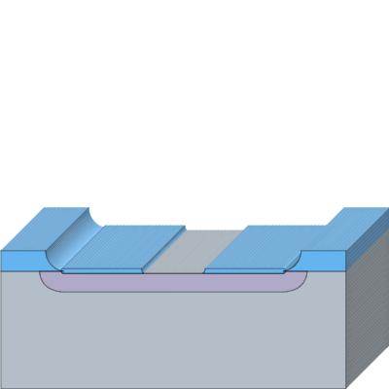
[E] MASK 2: CONTACT STRIPES
Step 24: Strip Resist
Capability Type: Chemical Clean | Tool Name: Wet Bench: PG Remover | Recipe Name: -
PROCESS PARAMETERS
Layer(s) to Remove: S1813
Cleaning Bath Composition: NMP
Cleaning Time: 5 mins
Cleaning Temperature: 60 °C
Ultra-Sonication: No
Dry Method: N2 blow dry
ADVANCED SETTINGS
Keep Floating Structures: No
Silicon
Phosphorus Spin-On Dopant
P
P
SiO₂
LOR 3A
S1813
Aluminum

Slide 34
[F] MASK 3: METAL BY LIFT-OFF

Slide 35
[F] MASK 3: METAL BY LIFT-OFF
Step 25: Dehydration bake
Capability Type: Bake | Tool Name: Hot Plate | Recipe Name: -
PROCESS PARAMETERS
Bake Temperature: 120 °C
Bake Time: 300 secs
ADVANCED SETTINGS
Hard-Bake All Resists: No
Resist Image Reversal: No
NOTES
Process Intent: Dehydration bake before bi-layer resist coating.
Rationale: ~120 °C for 5 min, then cool.
Silicon
Phosphorus Spin-On Dopant
P
P
SiO₂
LOR 3A
S1813
Aluminum

Slide 36
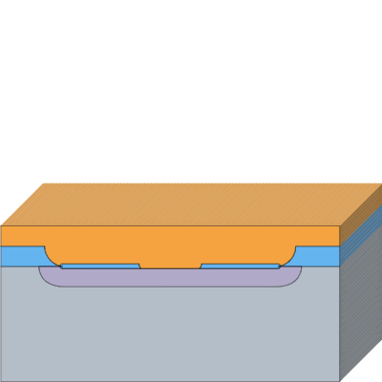
[F] MASK 3: METAL BY LIFT-OFF
Step 26: Spin LOR 3b
Capability Type: Spin-Coat | Tool Name: Spin Coater | Recipe Name: -
PROCESS PARAMETERS
Material Type: Lift-Off Resist (LOR)
Material: LOR 3A
Film Thickness: 300 nm
Spin Speed: 3000 rpm
Spin Time: 50 secs
ADVANCED SETTINGS
Fill Gaps: Yes
NOTES
Process Intent: Coats LOR 3b lift-off resist underlayer to create re-entrant undercut profile.
Rationale: 70 µL dispense, 3000 rpm for 50 s yields ~300 nm film.
Silicon
Phosphorus Spin-On Dopant
P
P
SiO₂
LOR 3A
S1813
Aluminum

Slide 37
[F] MASK 3: METAL BY LIFT-OFF
Step 27: Bake LOR
Capability Type: Bake | Tool Name: Hot Plate | Recipe Name: -
PROCESS PARAMETERS
Bake Temperature: 190 °C
Bake Time: 300 secs
ADVANCED SETTINGS
Hard-Bake All Resists: No
Resist Image Reversal: No
NOTES
Process Intent: Bakes LOR 3b underlayer.
Rationale: 190 °C for 5 min, then cool.
Silicon
Phosphorus Spin-On Dopant
P
P
SiO₂
LOR 3A
S1813
Aluminum

Slide 38
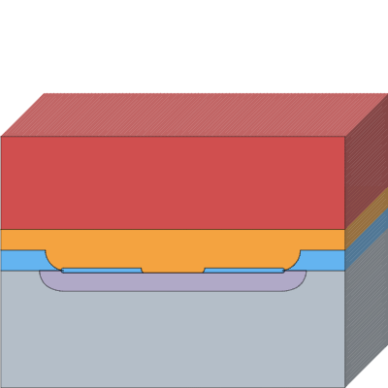
[F] MASK 3: METAL BY LIFT-OFF
Step 28: Spin S1813
Capability Type: Spin-Coat | Tool Name: Spin Coater | Recipe Name: -
PROCESS PARAMETERS
Material Type: Positive
Material: S1813
Film Thickness: 1.35 µm
Spin Speed: 4000 rpm
Spin Time: 50 secs
ADVANCED SETTINGS
Fill Gaps: Yes
NOTES
Process Intent: Coats top photoresist layer S1813 over LOR underlayer.
Rationale: 70 µL dispense, 4000 rpm for 50 s (~1.35 µm).
Silicon
Phosphorus Spin-On Dopant
P
P
SiO₂
LOR 3A
S1813
Aluminum

Slide 39
[F] MASK 3: METAL BY LIFT-OFF
Step 29: Pre-exposure bake
Capability Type: Bake | Tool Name: Hot Plate | Recipe Name: -
PROCESS PARAMETERS
Bake Temperature: 115 °C
Bake Time: 60 secs
ADVANCED SETTINGS
Hard-Bake All Resists: No
Resist Image Reversal: No
NOTES
Process Intent: Soft-bakes top resist layer.
Rationale: ~115 °C for 60 s.
Silicon
Phosphorus Spin-On Dopant
P
P
SiO₂
LOR 3A
S1813
Aluminum

Slide 40
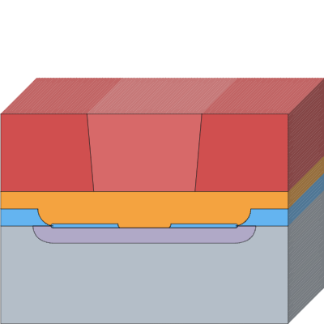
[F] MASK 3: METAL BY LIFT-OFF
Step 30: Expose Mask 3
Capability Type: Direct-Write Lithography | Tool Name: litho-v1 | Recipe Name: -
PROCESS PARAMETERS
Laser Wavelength: 405 nm (h-line)
Layer(s) to Expose: S1813
Pattern source: Manual
Define Pattern: 3,4,3
Toggle start exposure region: Yes
ADVANCED SETTINGS
Exposure Sidewall Angle: 5 °
NOTES
Process Intent: Exposes Mask 3 defining contact fingers, bus bar, and bond pad over the n+ window aligned to Mask 2.
Rationale: Patterned on litho-v1 DLP projector (405 nm LED), aligned to Mask 2 contact openings.
Silicon
Phosphorus Spin-On Dopant
P
P
SiO₂
LOR 3A
S1813
Aluminum

Slide 41
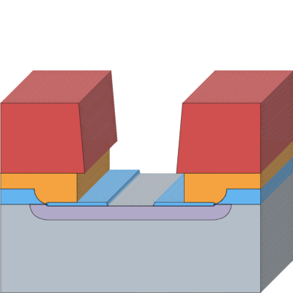
[F] MASK 3: METAL BY LIFT-OFF
Step 31: Develop
Capability Type: Develop | Tool Name: Wet Bench: MF-319 | Recipe Name: -
PROCESS PARAMETERS
Layer(s) to Develop: S1813
Developer: MF-319
Develop Time: 60 secs
ADVANCED SETTINGS
Custom Undercut: No
NOTES
Process Intent: Develops S1813 and isotropically dissolves LOR 3b to create clean lift-off undercut.
Rationale: MF-319 for ~60 s; inspect undercut profile under litho camera.
Silicon
Phosphorus Spin-On Dopant
P
P
SiO₂
LOR 3A
S1813
Aluminum

Slide 42
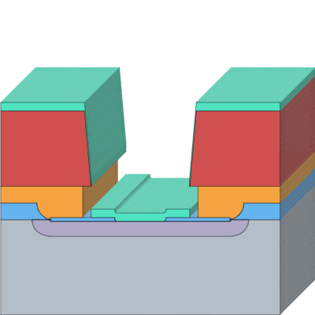
[F] MASK 3: METAL BY LIFT-OFF
Step 32: Evaporate Al
Capability Type: Thermal Evaporation | Tool Name: thermal-evaporator-v1 | Recipe Name: -
PROCESS PARAMETERS
Material: Aluminum
Film Thickness: 1500 Å
Deposition Time: 660 secs
TOOL PARAMETERS
Pumpdown
  Shutter Open: No
Source Ramp-Up
  Shutter Open: No
Deposition
  Shutter Open: No
Source Ramp-Down
  Shutter Open: No
ADVANCED SETTINGS
Deposition Angle: 0 °
Shadow Mask
  Shadow Mask: No
NOTES
Process Intent: Deposits aluminum contact metallization for fingers, bus bar, and pad.
Rationale: Thermal evaporation of ~150 nm (1500 Å) Al to ensure a robust >1.5× thickness ratio under the ~300 nm LOR 3b layer for clean lift-off.
Silicon
Phosphorus Spin-On Dopant
P
P
SiO₂
LOR 3A
S1813
Aluminum

Slide 43
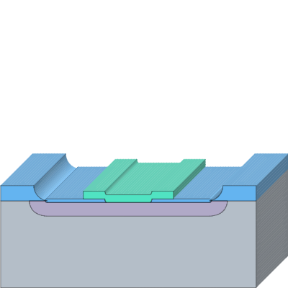
[F] MASK 3: METAL BY LIFT-OFF
Step 33: Lift-off
Capability Type: Lift-Off | Tool Name: Wet Bench: PG Remover | Recipe Name: -
PROCESS PARAMETERS
Chemical Bath Composition: NMP
Time: 5 mins
Temperature: 60 °C
NOTES
Process Intent: Dissolves LOR 3b underlayer and lifts off excess aluminum film.
Rationale: Warm PG Remover bath (~60 °C) for ~5 min with gentle agitation.
Silicon
Phosphorus Spin-On Dopant
P
P
SiO₂
LOR 3A
S1813
Aluminum

Slide 44
[G] BACKSIDE + SINTER

Slide 45
[G] BACKSIDE + SINTER
Step 34: Backside contact
Capability Type: Custom Step | Tool Name: - | Recipe Name: -
PROCESS PARAMETERS
Comment: Apply ~200 nm evaporated Al, silver epoxy, or indium paste (backside oxide stripped earlier during Steps 9 and 23 BOE etches).
NOTES
Scratch the backside lightly with a diamond scribe before applying silver epoxy or indium, because phosphorus vapour during predeposition (step 14) can form a thin n-type skin there.
Process Intent: Applies ohmic backside contact metallization.
Rationale: Backside oxide was stripped earlier during Steps 9 and 23 BOE etches. Apply ~200 nm evaporated Al, silver epoxy, or indium paste to form backside substrate contact without exposing front-side Al to BOE.
Silicon
Phosphorus Spin-On Dopant
P
P
SiO₂
LOR 3A
S1813
Aluminum

Slide 46
[G] BACKSIDE + SINTER
Step 35: Sinter
Capability Type: Bake | Tool Name: Hot Plate | Recipe Name: -
PROCESS PARAMETERS
Bake Temperature: 380 °C
Bake Time: 10 mins
ADVANCED SETTINGS
Hard-Bake All Resists: No
Resist Image Reversal: No
NOTES
Process Intent: Sinters the Al contacts to form low-resistance ohmic contacts.
Rationale: 380 °C, 10 min on a hotplate in air. Kept at or below 400 °C to avoid Al spiking through the shallow junction.
Silicon
Phosphorus Spin-On Dopant
P
P
SiO₂
LOR 3A
S1813
Aluminum

Slide 47
[H] TEST

Slide 48
[H] TEST
Metrology Step 3: Dark I-V <GATE G2>
Capability Type: Metrology | Tool Name: Probe Station | Recipe Name: -
NOTES
Process Intent: Measures dark I-V characteristics as quality gate G2.
Rationale: Confirms diode rectification >= 10^3 between +/-1 V.
Preview unavailable
Silicon
Phosphorus Spin-On Dopant
P
P
SiO₂
LOR 3A
S1813
Aluminum

Slide 49
[H] TEST
Metrology Step 4: Photocurrent <GATE G3/G4>
Capability Type: Metrology | Tool Name: Probe Station | Recipe Name: -
NOTES
Process Intent: Measures photocurrent response on litho-v1 stage under 405 nm LED illumination as quality gate G3/G4.
Rationale: Quantifies on/off response difference vs AR oxide thickness split (40/70/100 nm) and vs finger pitch.
Preview unavailable
Silicon
Phosphorus Spin-On Dopant
P
P
SiO₂
LOR 3A
S1813
Aluminum

Slide 50
[H] TEST
Metrology Step 5: Linearity
Capability Type: Metrology | Tool Name: Probe Station | Recipe Name: -
NOTES
Process Intent: Evaluates photocurrent linearity over optical power.
Rationale: Measures photocurrent (I_ph) versus LED driving current.
Preview unavailable
Silicon
Phosphorus Spin-On Dopant
P
P
SiO₂
LOR 3A
S1813
Aluminum

Slide 51
[H] TEST
Metrology Step 6: Calibration
Capability Type: Metrology | Tool Name: Probe Station | Recipe Name: -
NOTES
Process Intent: Calibrates photodiode responsivity and external quantum efficiency (EQE).
Rationale: Benchmarks against a calibrated commercial silicon photodiode standard.
Preview unavailable
Silicon
Phosphorus Spin-On Dopant
P
P
SiO₂
LOR 3A
S1813
Aluminum

