Slide 1
ClearScript
Fax to Fill prescription intake
Why it is useful
Product snapshot
Stops silent OCR errors
ClearScript converts prescription images into verified orders for pharmacist review. The backend extracts structured fields, verifies them against deterministic checks, and blocks unsafe approvals until the review path resolves the issue.
Every extracted field must pass rule, registry, or pharmacist review before approval.
Closes missing data loops
Unclear or absent fields can trigger a scoped prescriber call instead of manual back-and-forth.
Built for the PillSpark Fax to Fill workflow: image upload, OCR extraction, triage, prescriber clarification, FHIR output, CSV export, and traceable agent behavior.
Keeps evidence visible
The console shows field status, reasons, call outcomes, and export-ready payloads.
Metric | Current benchmark | Why it matters
Field accuracy | 100% | Correct fields across the synthetic evaluation set
Silent error rate | 0% | No wrong fields slipped through unflagged
Fields evaluated | 60 | Benchmark loop already measures workflow changes

Slide 2
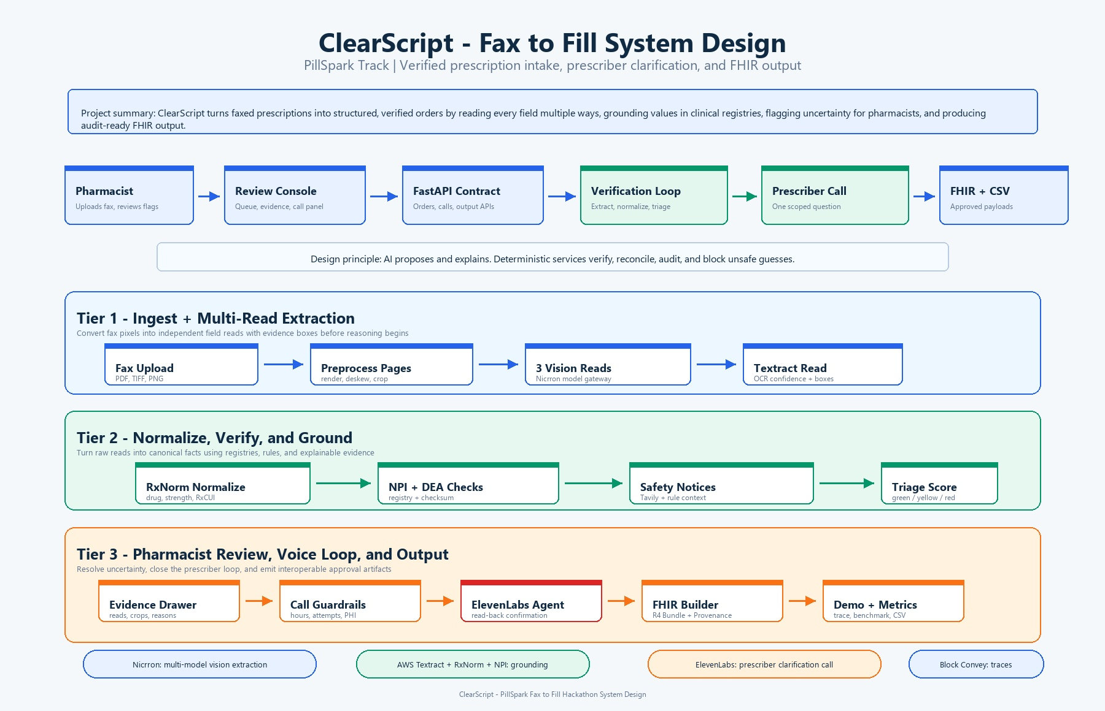
System workflow
How the product moves from fax intake to verified pharmacy output

Slide 3
Explainability and trust
The system treats AI output as a proposal. Rules, web evidence, traces, and pharmacist decisions determine what moves forward.
ElevenLabs
Tavily
Prism
Prescriber clarification
Web search and validation
Agent behavior tracing
When a required field is missing or ambiguous, the call flow asks one scoped question, captures the response, and routes the result back to pharmacist approval.
Agent web search supports public validation for safety context, callback research, and grounding when registry data alone is not enough.
Model calls, search behavior, outputs, and decision paths are traceable so reviewers can explain why the system flagged or accepted a field.
Trust control | What reviewers see | Failure mode reduced
Field triage | Green, yellow, red status with reasons | Unsafe auto-approval
Call result | Transcript, confirmed value, decision | Unverified missing data
Trace record | Agent input, tool use, output | Unexplainable model behavior

