Slide 1


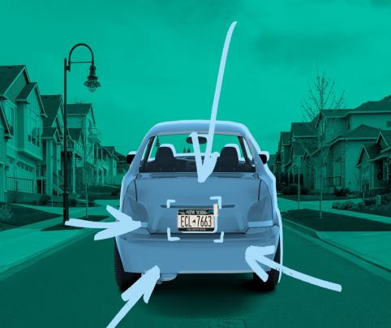
LICENSE PLATE
DETECTION AND
RECOGNITION
Digital Image Processing
Pratik Pujari - 2020300054
Adish Padalia - 2020400031

Slide 2

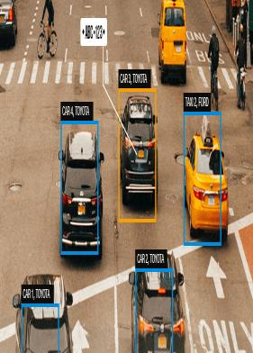
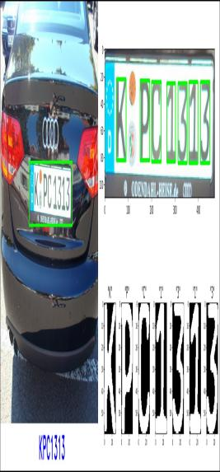
INTRODUCTION
We have made a report for license plate detection and recognition and have 5 to 6 research papers to determine the current trends in this domain.
In order the get the licence plate number, there are two major steps involved
1) Detection
2) Recognition

Slide 3
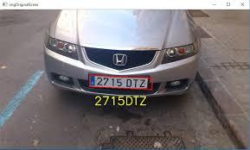
Pratik Side
RESEARCH PAPER
REVIEWED
A robust attentional framework for license plate recognition in the wild
L. Zhang, P. Wang, H. Li, Z. Li, C. Shen, Y. Zhang
2020
EGSANet: edge-guided sparse attention network for improving license plate detection in the wild
J. Liang, G. Chen, Y. Wang, H. Qin
2022
Representation learning in a deep network for license plate recognition
S. Rakhshani, E. Rashedi, H. Nezamabadi-pour
2020

Slide 4
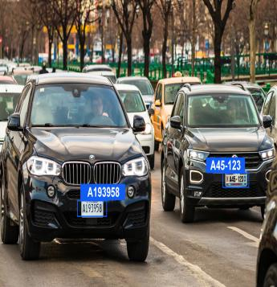
Adish Side
RESEARCH PAPER
REVIEWED
Automatic vehicle license plate recognition using optimal deep learning model
L. ZhT. Vaiyapuri, S. Mohanty, M. Sivaram et.al
2021
Robust license plate recognition using neural networks trained on synthetic images
T. Bjorklund, A. Fiandrotti, M. Annarumma, G. Francini, E. Magli
2019
Representation learning in a deep network for license plate recognition
S. Rakhshani, E. Rashedi, H. Nezamabadi-pour
2020

Slide 5
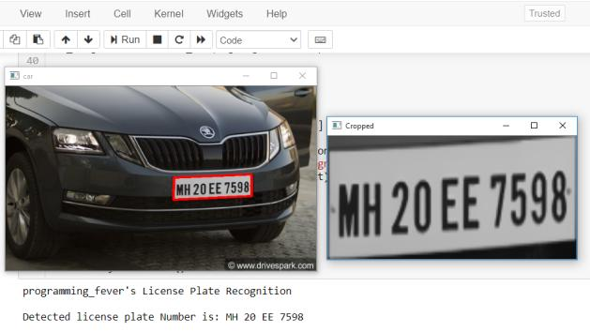
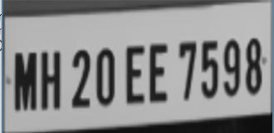
DETECTION
License plate detection utilizes computer vision techniques to identify and extract license plates from images or video streams.
It plays a crucial role in various applications, from surveillance to automated toll collection.
RECOGNITION
License plate recognition follows detection, employing optical character recognition (OCR) technology to convert the alphanumeric characters on the plate into machine-readable text.
This OCR process enables automated data collection and management, enhancing efficiency in tasks like parking management and law enforcement.

Slide 6
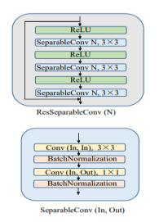
PAPER 1
A ROBUST ATTENTIONAL FRAMEWORK FOR LICENSE PLATE RECOGNITION IN THE WILD
In this research, the authors propose an innovative approach to License Plate Recognition (LPR) using a deep learning model based on a 30-layer Xception network.
A two-layer LSTM network with an attention mechanism processes these features.
Image correction and character segmentation are not required in their approach.
AsymCycleGAN generates synthetic license plates for training, contributing to model robustness.
They build the CLPD dataset with diverse license plates from different vehicles.
High accuracy is achieved: 97.3%, 98.3%, and 91.9% on AOLP, 88.2% and 76.8% for PKU and CLPD.

Slide 7
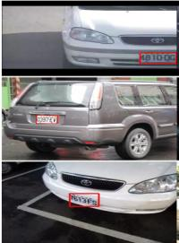
PAPER 2
EGSANET: EDGE-GUIDED SPARSE ATTENTION NETWORK FOR IMPROVING LICENSE PLATE DETECTION IN THE WILD
The authors propose an Edge-Guided Sparse Attention (EGSA) mechanism composed of an Edge-Guided Component (EGC) and a Sparse Attention Component (SAC) to enhance license plate edge contours and improve detection precision by adaptively searching relevant features
EGSANet employs a VGG19 backbone network with an EGSA module and a cascaded multi-task detection head to detect license plates efficiently.
Instead of utilizing all 19 layers, the authors employed 12 layers of the VGG19 network in their approach.
EGSA leverages license plate (LP) edge contours, enabling real-time LP detection, making it advantageous for this task.

Slide 8
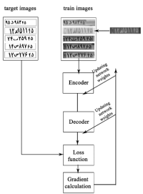
PAPER 3
REPRESENTATION LEARNING IN A DEEP NETWORK FOR LICENSE PLATE RECOGNITION
A deep learning-based approach is introduced for license plate character recognition. Utilizing a multi-task learning algorithm, the method attains a 96% correct character recognition rate
S. Rakhshani et al introduced an encoder-decoder network to extract features from 11,000 license plates.
They employed eight parallel classifiers for character recognition, achieving 96% accuracy on 4,000 test images..
The dataset included high-resolution images captured at different times of day, with the encoder trained for license plate binarization, resulting in a quick recognition time of 123 milliseconds.
Character recognition achieved 95.3% accuracy on the ILPD11 dataset and 96.1% on AOLP.

Slide 9
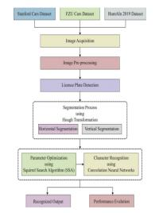
PAPER 4
AUTOMATIC VEHICLE LICENSE PLATE RECOGNITION USING OPTIMAL DEEP LEARNING MODEL
A robust Deep Learning-based model called SSA-CNN, empowered by the Squirrel Search Algorithm, is introduced. The model excels in character recognition, achieving an impressive overall accuracy of 98.3% on benchmark datasets.
The SSA-CNN model integrates Hough Transform as a feature extractor and optimizes CNN parameters using the SSA.
Experimental validation on various datasets, including Stanford Car and HumAIn 2019 Challenge.
This approach signifies a significant stride in the development of efficient Intelligent Transportation Systems by addressing the challenges of non-uniform illumination.

Slide 10
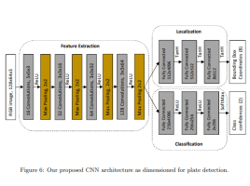
PAPER 5
ROBUST LICENSE PLATE RECOGNITION USING NEURAL NETWORKS TRAINED ON SYNTHETIC IMAGES
A innovative License Plate Recognition (LPR) system utilizes synthetic images to train Convolutional Neural Networks (CNNs), circumventing the need for extensive real image datasets. Here are key takeaways
The method introduces a framework for generating synthetic license plate images that consider crucial variables.
The LPR system incorporates two CNNs for plate and character detection with shared training procedures, exhibiting robust performance.
Through experiments on diverse real image datasets, the synthetically trained system outperforms competitors, emphasizing the effectiveness of synthetic image training.

Slide 11
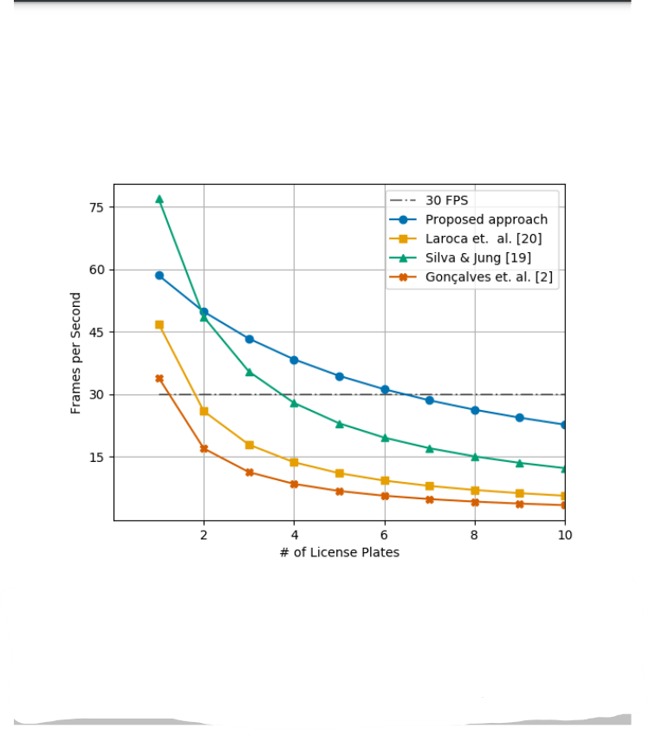
PAPER 6
REAL-TIME AUTOMATIC LICENSE PLATE RECOGNITION THROUGH DEEP MULTI-TASK NETWORKS
Efficient traffic analysis in urban environments, such as Automatic License Plate Recognition (ALPR), is made more accurate and faster by our approach, which utilizes two deep networks for license plate detection and recognition.
The author’s method minimizes error propagation by combining license plate detection and recognition in two deep networks, eliminating the need for explicit character segmentation.
The paper introduces innovative data augmentation methods and a new dataset for effective training and evaluation, enabling deep networks to achieve state-of-the-art results.
Real-time performance: Even in scenarios with multiple license plates in a single frame.

Slide 12

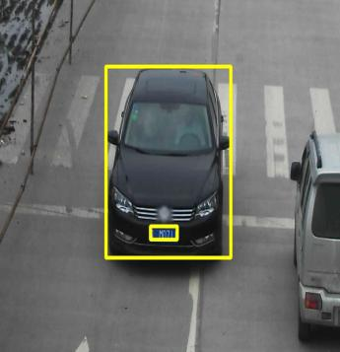
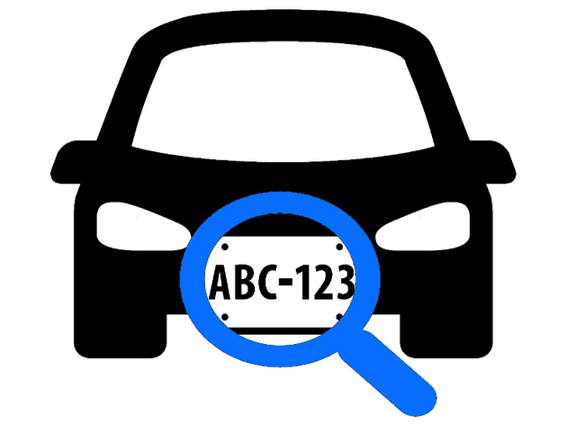
We first perform license plate detection by performing image processing techniques and find the contour
OUR
METHODOLOGY
We then segment the image and recognize each individual character using our trained model

Slide 13

DATA PREPROCESSING
DATASET
The Dataset is taken from Kaggle to train the model on optical character recognition
DATASET 1
DATASET 2
This Dataset is primarily used for training optical character recognition (OCR) models. This dataset provides valuable character images for the development of accurate, robust OCR systems
This Dataset specifically curated for car license plate detection. It includes a collection of images with annotated regions of license plates

Slide 14


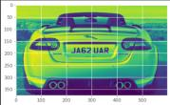
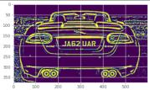
IMAGE PREPROCESSING
First the image is grayscaled using the OpenCV python library.
Image processing is one of the most important part of the lincense plate detection
We have perform accurate image processing techniques to get the license plate
The grayscaled image is then convoluted with morphological operations such as the Black-Hat transformation.
At the end, we get contours boundaries, to recognize the text
The processed image is then put through adaptive thresholding effectively separates objects from the background.

Slide 15
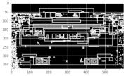
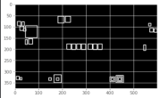
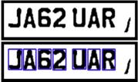
CONTOUR
EXTRACTION
AND
SEGMENTATION
After the morphological operation is applied, contours are generated.
We visualize the contours in this segment.
After careful processing, selected license plate numbers are detected.
Only after selected contour using recursive grouping, we take the license plate 7 digits contours
The image then segmented using the contours generated in the previous step

Slide 16
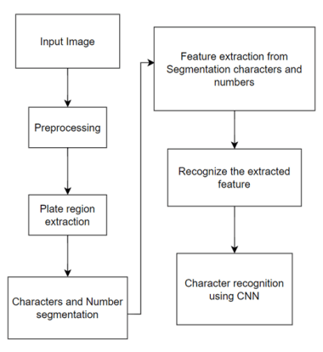
ARCHITECTURE
The proposed methodology involves a systematic process:
Preprocessing enhances image quality for analysis.
License Plate Region Extraction identifies the plate area.
Character Recognition employs Convolutional Neural Networks for accuracy.

Slide 17
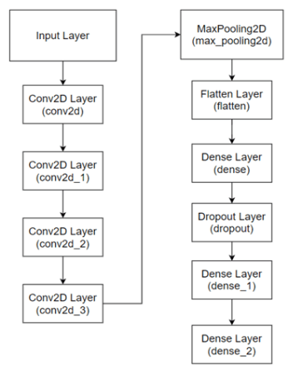
CNN ARCHITECTURE
To train the neural network model for license plate character recognition, the dataset provided by Kaggle
The proposed CNN model consists of multiple layers, starting with Conv2D layers that apply convolution operations with varying filter sizes
The model is trained using data generators, which are suitable for handling large datasets. The key parameter here is the batch size, set to 4

Slide 18

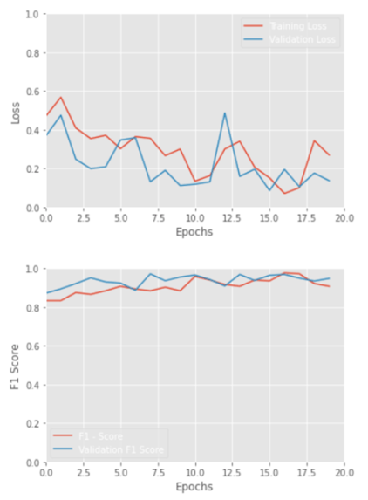
PERFORMANCE METRICS
For the performance metrics, we have choosen the loss and F1-score
RESULTS
The model exhibited significant improvement in classification performance, with the F1 score until 96.18%, indicating a well-balanced precision and recall trade-off for highly accurate classifications over 20 epochs.

Slide 19
CONCLUSION
FUTURE WORK
Our CNN-based system achieved an impressive F1 score increase from 8.68% to 96.18%, showcasing its robust performance.
A validation accuracy of 98.15% demonstrates strong generalization capabilities, making it valuable in real-world scenarios.
From preprocessing to performance evaluation, our system ensures effective license plate detection.
Enhance system versatility by accommodating various license plates, fonts, and real-time processing..
Focus on reducing computational complexity and memory requirements for edge device deployment, ensuring efficiency in a broader range of applications.

Slide 20
[1] | L. Zhang, P. Wang, H. Li, Z. Li, C. Shen, Y. Zhang, “A robust attentional framework for license plate recognition in the wild”, IEEE Transactions on Intelligent Transportation Systems, pp. 1-10, doi: 10.1109/TITS.2020.3000072, June 2020.
[2] | J. Liang, G. Chen, Y. Wang, H. Qin, "EGSANet: edge-guided sparse attention network for improving license plate detection in the wild", Applied Intelligence, vol.52, no.4, pp.4458-4472, 2022.
[3] | S. Rakhshani, E. Rashedi, H. Nezamabadi-pour, “Representation learning in a deep network for license plate recognition”, Multimedia tools and applications, 10.1007/s11042-019-08416-0, May 2020
[4] | T. Vaiyapuri, S. Mohanty, M. Sivaram, I. Pustokhina, D. Pustokhin, K. Shankar, "Automatic vehicle license plate recognition using optimal deep learning model", Computers, Materials & Continua, no.62, nol.7, pp.1881- 1897, 2021
[5] | T. Bjorklund, A. Fiandrotti, M. Annarumma, G. Francini, E. Magli, "Robust license plate recognition using neural networks trained on synthetic images", Pattern Recognition, vol.93, pp. 134-146, 2019
[6] | G. Goncalves, M. Diniz, R. Laroca, D. Menotti, W. Schwartz, "Real-time automatic license plate recognition through deep multi-task networks", 31st IEEE SIBGRAPI Conference on Graphics, Patterns and Images, pp.110-117, 2018
REFERENCES

Slide 21
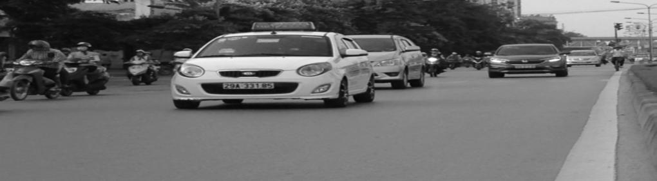
THANK YOU
We have completed our presentation for license plate detection and recognition.
Feel free to ask any questions!!!

