Slide 1
OPERATING SYSTEMS · PROJECT REVIEW 1
ThrashGuard
Thrashing Detection
System Design · Data Pipeline · PatchTST Model · Backend · Dashboard
Presented by
Team Members:
Adish Kumar Gupta (24BCE2092) | Lakshay Sharma (24BCE2410)

Slide 2
INTRODUCTION
Project Summary
The Problem
Key Objectives
When physical memory is over-committed, a Linux system spends more time moving pages between RAM and disk than doing useful work. This is thrashing. Most tools only notice it after performance has already collapsed.
1
Collect five live OS metrics from a Linux system
2
Build 16-step multivariate time-series windows
Our Approach
ThrashGuard samples five OS metrics (page fault rate, swap I/O, free memory, CPU usage, run queue length) and feeds a rolling 16-step window to a PatchTST Transformer that classifies the current system state.
3
Classify four system states with a PatchTST model
Expected Outcome
An early-warning classifier that labels the system Normal, Memory Pressure, Approaching Thrashing or Thrashing, shown live on a dashboard so action can be taken before throughput collapses.
4
Serve predictions through a Flask API and dashboard
2

Slide 3
BACKGROUND
What is Thrashing?
High memory demand
Definition
Thrashing is a state in which a system spends most of its time paging data between RAM and disk, instead of executing actual processes.
↓
More page faults
↓
What is a Page Fault?
More paging / swap activity
A page fault occurs when a process accesses a memory page that is not currently in physical RAM, forcing the OS to fetch it from disk (swap space).
↓
Less useful CPU work
↓
Why Do Page Faults Increase?
System performance degradation
As more processes compete for limited physical memory, each process's working set no longer fits in RAM, so page faults rise sharply and the OS must swap pages in and out continuously.
↓
THRASHING
Detecting the transition toward thrashing early - rather than only after it occurs - allows the OS to intervene before throughput collapses.
3

Slide 4
BACKGROUND
Why It Matters & Limits of Current Approaches
Why detection matters
Limitations of existing approaches
Thrashing leaves the CPU waiting on disk, so a machine can become almost unusable while technically still running.
Memory over-commitment is common in practice: many processes, containers or VMs share limited RAM.
Detecting the build-up early leaves time to act (throttle, pause or terminate processes) before throughput collapses.
Static thresholds
Fixed cut-offs (for example on free memory) ignore trends and differ across workloads and machines.
1
Reactive handling
Tools such as the Linux OOM killer act only once memory is nearly exhausted and performance has already degraded.
2
Single-metric view
A high page-fault rate alone is ambiguous: it also occurs during normal program start-up.
3
Goal: detect the transition toward thrashing, not just thrashing itself.
No temporal context
Point-in-time snapshots miss how the metrics evolve together in the lead-up to thrashing.
4
4

Slide 5
LITERATURE SURVEY
Literature Survey
Ref | Work | Approach / contribution | Limitation for our problem
[1] | Denning (1968) Thrashing: Its Causes and Prevention | Explains thrashing as too many active processes for the available memory; proposes working-set based load control to prevent it. | Analytical model that relies on tracking per-process working sets; no learned or predictive component.
[2] | Weiner (2018) Linux PSI: Pressure Stall Information | Kernel interface (/proc/pressure) reporting how long tasks stall waiting for CPU, memory or I/O, with trigger thresholds. | Measures current stall pressure; does not classify system state or signal that thrashing is approaching.
[3] | Vaswani et al. (2017) Attention Is All You Need | Introduces the Transformer, which uses self-attention over a sequence instead of recurrence. | Designed for language; attention cost grows quickly when every time step is a separate token.
[4] | Nie et al. (2023) A Time Series Is Worth 64 Words (PatchTST) | Splits a time series into patches used as Transformer tokens, shortening the sequence and improving long-term forecasting. | Evaluated on forecasting benchmarks; not applied to OS metrics or system-state classification.
[5] | Chuah et al. (2025) Deep learning-based prediction of major page faults in cluster systems | Applies deep learning to cluster resource-usage data and system logs to predict major page faults. | Targets page-fault prediction on HPC clusters, not graded detection of the path into thrashing.
5

Slide 6
RESEARCH GAP
Research Gap & Our Contribution
GAP 1
→
OUR RESPONSE
Existing OS tools (PSI, OOM killer, fixed thresholds) report current pressure or react late. Few offer an early-warning stage before thrashing sets in.
A dedicated "Approaching Thrashing" class lets ThrashGuard flag the transition, not only the final state.
GAP 2
→
OUR RESPONSE
Classical analysis and recent deep-learning work focus on single quantities such as working sets or page-fault counts, not several OS metrics read together.
Five metrics (page faults, swap I/O, free memory, CPU, run queue) are modelled jointly as a 16 x 5 time window.
GAP 3
→
OUR RESPONSE
Patch-based Transformers such as PatchTST are mainly benchmarked on forecasting; there is limited work applying them to OS thrashing-state classification.
PatchTST is adapted as a 4-class classifier on Linux metrics, with a Flask API and dashboard around it.
Problem statement: detect the build-up to thrashing early from multivariate OS metrics, using a patch-based Transformer.
6

Slide 7
WORKING PRINCIPLE · MODULE 1 · DATA COLLECTION & PREPARATION
Why Real OS Metric Collection?
Linux System
Synthetic data (early stage)
Useful for developing and testing the pipeline quickly, without needing a live system.
↓
metrics.py
↓
Raw OS Metrics
Limitation of synthetic data
↓
Cleaning / Preparation
May not fully capture the real temporal relationships between OS metrics as they occur on an actual machine.
↓
Scaling (StandardScaler)
Moving to real collection
↓
Time-Series Windows (16 steps)
A Linux-based metric collection approach was developed using metrics.py to gather live system readings.
↓
PatchTST Input (16 × 5)
7

Slide 8
WORKING PRINCIPLE · MODULE 1 · DATA COLLECTION & PREPARATION
Metrics & System State Labels
Input Metrics
Classification States
Metric
Represents
Relevance
State
Description
Page Fault Rate
Faults/sec needing disk fetch
Direct signal of memory shortage
0 - Normal
Healthy operation, low memory pressure
Swap I/O
Data swapped in/out per interval
Indicates active paging pressure
1 - Memory Pressure
Memory usage rising, faults increasing
Free Memory
Available physical RAM
Falling trend precedes thrashing
2 - Approaching Thrashing
Sustained high paging activity
CPU Usage
Productive vs. idle/wait time
Drops as system stalls on I/O
3 - Thrashing
Severe paging, CPU mostly stalled on I/O
Run Queue Length
Processes waiting for CPU
Rises when system is overloaded
4 - Recovery (future)
Design placeholder - not yet classified
Note: Recovery exists in the metric-collection design as a future-oriented class. The current trained model classifies only the four states above (0–3).
8

Slide 9
WORKING PRINCIPLE · MODULE 2 · PATCHTST DEEP LEARNING MODEL
Why PatchTST?
The problem isn't simply “is the page fault rate high right now?” - it's how multiple OS metrics evolve together over time.
Multivariate modelling
Temporal patterns
Five metrics must be interpreted together, not as isolated numbers.
Thrashing builds up gradually - a single snapshot misses the trend.
Cross-metric relationships
Sequential behavior
Rising swap I/O alongside falling free memory is more informative than either alone.
The pattern of change leading up to and during thrashing matters, not just the current value.
9

Slide 10
WORKING PRINCIPLE · MODULE 2 · PATCHTST DEEP LEARNING MODEL
What is PatchTST?
Patch-based Time Series Transformer - learns temporal patterns from multivariate sequences
Input time-series
Patch creation
Patch embeddings
Transformer / self-attention
Temporal feature extraction
Classification → System state
→
→
→
→
→
What is a “Patch”?
Why patches help
Instead of processing every individual time step independently, PatchTST groups consecutive time steps into small patches, similar to how a vision transformer groups pixels into image patches.
Reduces sequence length seen by the transformer, making attention more efficient
Preserves local temporal structure within each patch
Time steps: t1 t2 t3 t4 | t5 t6 t7 t8 | ...
Lets the model attend to relationships between patches rather than every raw point
[t1 t2 t3 t4] → Patch 1
[t5 t6 t7 t8] → Patch 2 ...
Well suited for a rolling 16-step sequence of 5 OS metrics
(Actual configuration: patch length = 4, patch stride = 4)
10

Slide 11
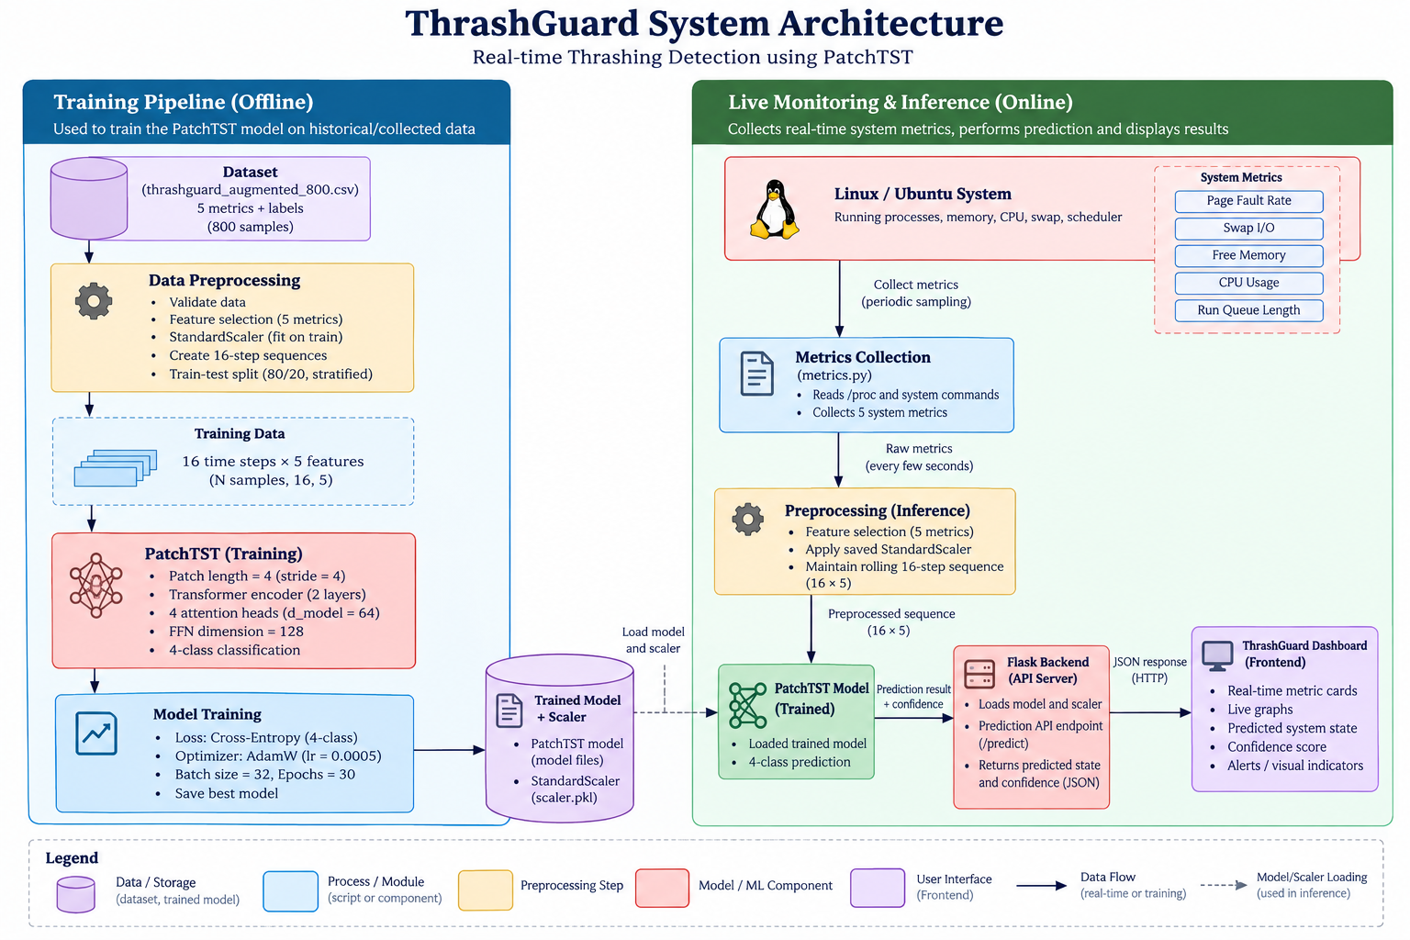
SYSTEM DESIGN
System Architecture
End-to-end data flow from the Linux system to the ThrashGuard dashboard
Linux / Ubuntu
Metric Collection
Data Preparation
Live OS environment
→
metrics.py - 5 system metrics
→
Scaling + 16-step sequences
↓
PatchTST Model
Flask Backend
ThrashGuard Dashboard
4-class deep learning classifier
→
Model + scaler, prediction API
→
Live metrics, state, confidence
Five input metrics: page fault rate, swap I/O, free memory, CPU usage, and run queue length. Each prediction uses 16 time steps × 5 features.
11

Slide 12
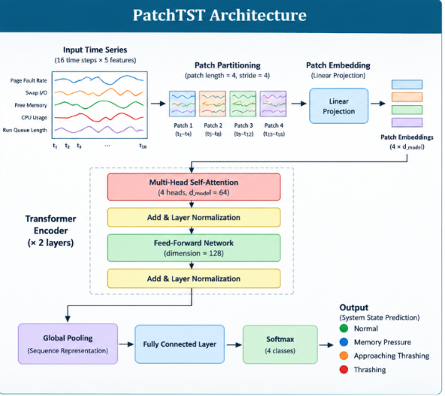
WORKING PRINCIPLE · MODULE 2 · PATCHTST DEEP LEARNING MODEL
Model Configuration
Parameter
Value
Input shape
16 time steps × 5 features
Patch length / stride
4 / 4
Hidden layers
2
Model dimension (d_model)
64
Attention heads
4
How the model works
Feed-forward dimension
128
Each 16 x 5 window is cut into 4 patches (length 4, stride 4).
Patches are linearly embedded to 64 dimensions.
A 2-layer Transformer encoder (4 heads, 128-d feed-forward) learns temporal features.
Global pooling, a fully connected layer and softmax give 4 class probabilities.
Loss function
Cross-Entropy Loss (4-class)
Optimizer
AdamW, learning rate = 0.0005
These are the actual configuration values used in the current trained implementation.
12

Slide 13
MODULE 3 · THRASHGUARD BACKEND
Backend Architecture
Flask service connecting the trained model to the application
3.1 Model Loading
3.2 Input Preprocessing
3.3 Prediction Pipeline
Loads the trained PatchTST model and the fitted StandardScaler at startup.
Applies the saved scaler and maintains a rolling 16-sample buffer per sequence.
Forms the 16 × 5 sequence and passes it through the loaded model.
3.4 Evaluation
3.5 API / Prediction Output
Computes accuracy, classification report, and confusion matrix on test data.
Returns predicted class, confidence, and full class probabilities.
Endpoints:
/metrics (receive samples) /predict (accept sequences) /health /info
13

Slide 14
MODULE 3 · THRASHGUARD BACKEND - EVALUATION
Model Evaluation & Results
73.79%
Class
Accuracy
Analysis
Normal
97.14%
Normal states are identified strongly. Intermediate states (Memory Pressure, Approaching Thrashing) are harder to separate because metric ranges overlap. Thrashing is more distinguishable due to stronger combined stress indicators.
Best observed test accuracy
Memory Pressure
58.33%
Approaching Thrashing
69.44%
Thrashing
71.05%
Dataset
Preparation
Reading the result
800 rows after removing Recovery; 4 balanced classes with 200 samples each.
StandardScaler applied, 16-step windows, stratified 80/20 train-test split.
Intermediate classes overlap, which motivates a larger real-world dataset.
14

Slide 15
RESULTS SUMMARY
Project Completion Status
Component
Status
Thrashing concept / problem definition
Completed
Linux metric collection (metrics.py)
Completed
Data preparation (scaling, sequencing)
Completed
PatchTST model (training)
Completed
Model evaluation
Completed
Flask backend (prediction API)
Completed
Interactive frontend dashboard
Completed
Real Ubuntu → live dashboard integration
Planned next (currently simulated demo values)
Current browser demonstration uses simulated metric values; connecting live Ubuntu system metrics is the next integration step.
15

Slide 16
CONCLUSION
Conclusion
ThrashGuard demonstrates an end-to-end pipeline: real Linux metric collection, data preparation, a PatchTST-based deep learning classifier, a Flask backend, and an interactive dashboard.
The model classifies four system states - Normal, Memory Pressure, Approaching Thrashing, and Thrashing - with a best observed test accuracy of 73.79%.
Recovery remains a designed-for but not yet implemented class, intended for future extension.
The current system establishes the full working pipeline; the next phase focuses on scaling the dataset, improving accuracy, and moving from simulated to live system integration.
16

Slide 17
FUTURE SCOPE
Scope for Next Reviews
1
Bigger Dataset
2
Better Model Accuracy
Collect a larger, more diverse set of real Linux system traces to improve generalization.
Tune PatchTST hyperparameters and training strategy to improve on the current 73.79% baseline.
3
Recovery State Label
4
Live CPU Metric Integration
Extend the model to classify the Recovery state, currently only a design placeholder.
Replace simulated dashboard values with a real-time feed from live Ubuntu system metrics.
5
Intervention Policy
Add an automated response - such as adjusting process priority or admission control - to actively reduce CPU stress and prevent thrashing once detected.
17

Slide 18
REFERENCES
References
[1] P. J. Denning, "Thrashing: Its causes and prevention," in Proc. AFIPS Fall Joint Computer Conf., vol. 33, 1968, pp. 915-922.
[2] J. Weiner, "PSI - Pressure Stall Information," Linux Kernel Documentation, 2018. [Online]. Available: https://docs.kernel.org/6.9/accounting/psi.html
[3] A. Vaswani et al., "Attention is all you need," in Advances in Neural Information Processing Systems (NeurIPS), vol. 30, 2017.
[4] Y. Nie, N. H. Nguyen, P. Sinthong, and J. Kalagnanam, "A time series is worth 64 words: Long-term forecasting with Transformers," in Proc. Int. Conf. Learning Representations (ICLR), 2023.
[5] E. Chuah, A. Jhumka, S. Narasimhamurthy, and A. Ayesh, "Deep learning-based prediction of major page faults in cluster systems," CCF Trans. High Performance Computing, vol. 7, no. 5, pp. 413-430, 2025, doi: 10.1007/s42514-025-00233-2.
[6] A. Silberschatz, P. B. Galvin, and G. Gagne, Operating System Concepts, 10th ed. Hoboken, NJ, USA: Wiley, 2018.
[7] I. Loshchilov and F. Hutter, "Decoupled weight decay regularization," in Proc. Int. Conf. Learning Representations (ICLR), 2019.
18

Slide 19
Thank You
Questions & Feedback
Adish Kumar Gupta (24BCE2092) | Lakshay Sharma (24BCE2410)

