Slide 1


SMART INDIA HACKATHON 2024
Problem Statement ID –SIH1666
Problem Statement Title-develop
Theme-
PS Category- Software
Team ID-
Team Name-Brainiacs

Slide 2
IDEA TITLE
Brainiacs
Proposed Solution:
We aim to develop an Android and web-based application designed to provide students with personalized career guidance based on their interests. The prototype will work as follows:
Sahayak is a android and web-based application for students . This will provide a proper guidance to students by interacting with mentor
The application will identify a user’s interests through an interactive game powered by Artificial Intelligence (AI). Each user will have a unique character, progressing through different levels in the game. A mentor will assign tasks to the user, which they must complete to advance to higher levels.
As users complete these tasks, their progress and interests will be tracked and analyzed using Machine Learning (ML) and AI. This analysis will help tailor future tasks and recommendations to better align with the user’s developing interests and skills.
Additionally, the platform will allow users to interact with mentors, alumni, and current students from various colleges, offering them a deeper understanding of their career goals. Users can also learn about the future scope of their chosen careers by engaging with professionals already working in the field.

Slide 3
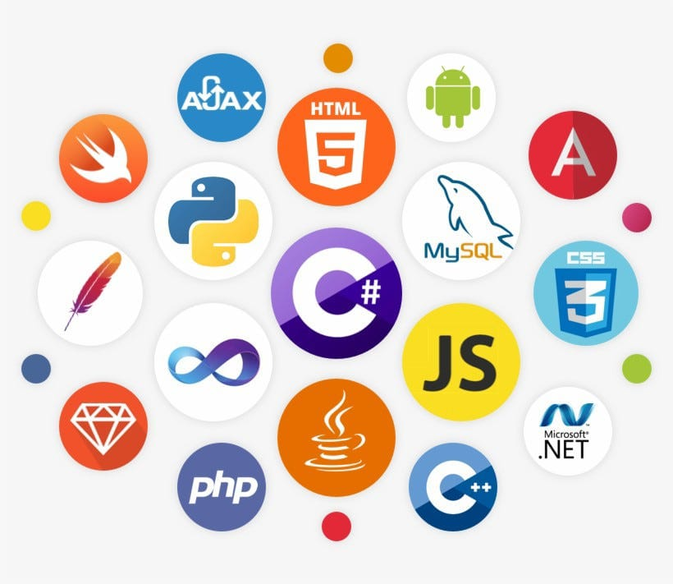
TECHNICAL APPROACH
Brainiacs
TECHNOLOGY STACK:

Slide 4
FEASIBILITY AND VIABILITY
Brainiacs
In this application student have to enter his details about his current grade and some personal details to register,then he/she will be playing a game in which they choose their character
Potential challenges and risks
Strategies for overcoming these challenges

Slide 5
IMPACT AND BENEFITS
Brainiacs
Students will get benefited through this web page.
Students of 10th,12th and graduation will get a proper guidance to succeed in their career , which was opted based on their interest , as most of the students and graduates are struggling in this generation, this roadmap and guidance will help them to easily achieve their career goal.The main benefits will be as follows
Knows particular interest of the student and guides them in that path.
Connecting with alumini and current students of that University/college.
To avoid false reviews,Students will be verified to post genuine reviews,so that others will get awareness about it.

Slide 6
RESEARCH AND REFERENCES
Brainiacs
Details / Links of the reference and research work

