Slide 1
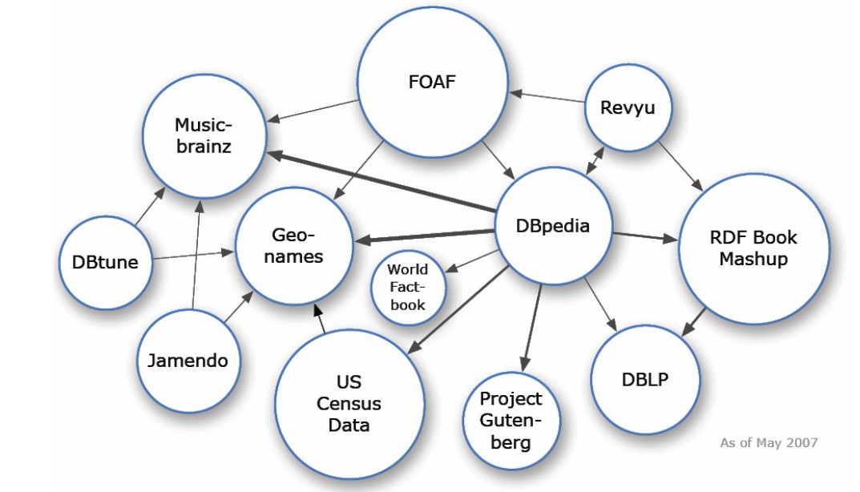
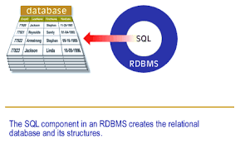
Linked Data vs. Relational Database

Slide 2
THE WORLD TODAY:
Two main data models are currently used for representing
knowledge and information in computer systems.
Database models, especially relational databases, have been the leader in last few decades, enabling information to be efficiently stored and queried.
On the other hand, ontologies have appeared as an alternative to databases in applications that require a more ‘enriched’ meaning.

Slide 3
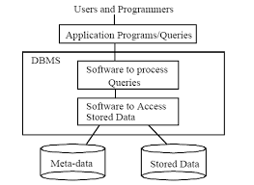
Relational Database
A relational database is a collection of data items organized as a set of formally-described tables from which data can be accessed or reassembled into predefined categories, structured to recognize relations between stored items of information

Slide 4
A relational database is a set of tables containing data fitted into. Each table (which is sometimes called a relation) contains one or more data categories in columns called ATTRIBUTES. Each row contains a unique instance of data called TUPLES for the categories defined by the columns.
Relations can be linked by Foreign Key attribute, which must be present in all the tables to be linked.
The standard user and application program interface for running interactive queries and for gathering data for reports in a relational database is the Structured Query Language (SQL).
Tables can be joined using several join operations (maximum number of joins is limited to 16.)

Slide 5
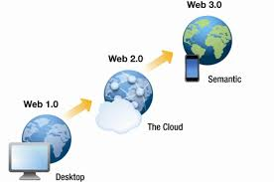
Evolution of Internet
Three stages of Internet Evolution are:
WEB 1.0: “Readable”
Closed, Individual Publishing, One-Way Communication, Passive
Involvement, Read-Only Content & Personal Websites.
WEB 2.0: “Writable”
Collaborative, Group Participation, Two-Way Communication, Active
Involvement, User-Generated Content & Blogging.
WEB 3.0: “Executable” (Semantic Web)

Slide 6

Semantic Web
Semantics means the meaning and interpretation of words, signs, and sentence structure.
It is a project that should provide a common framework that allows data to be shared and reused across application, enterprise, and community boundaries. It is a collaborative effort led by World Wide Web Consortium (W3C).
It lets the web and computers to analyze all its contents, links and transactions that occur over the network.

Slide 7
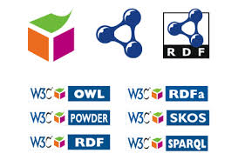
WEB 3.0
According to Conrad Wolfram, the term Web 3.0 (“Semantic Web”)
describes sites where computers will be generating raw data on their
own.
The Internet will be able to perform tasks faster and more efficiently, such as
search engines being able to search for the actual individual users interests,
and not just for the keyword typed into search engines.
This brings us to Semantic Search.
Semantic search seeks to improve search accuracy by understanding
searcher intent and the contextual meaning of terms as they appear in the
searchable data space, whether on the Web or within a closed system, to
generate more relevant results.

Slide 8
LINKED DATA is a method of publishing structured data so that it can be
interlinked and become more useful through semantic queries[1].
Linked data builds upon standard Web technologies such as HTTP, RDF and URIs, but
Rather than using them to serve web pages for human readers, it extends them to
share information in a way that can be read automatically by computers.
ONTOLOGY is a description (like a formal specification of a program) of the
concepts and relationships that can exist for an agent or a community of
agents.
It is a specification used for making ontological commitments.
An ontological commitment is an agreement to use a vocabulary (i.e., ask queries and
make assertions) in a way that is consistent (but not complete) with respect to the
theory specified by an ontology. Agents then commit to ontologies and ontologies are
designed so that the knowledge can be shared among these agents.
[1]Semantic queries allow for queries and analytics of associative and contextual
nature. It enable the retrieval of both explicitly and implicitly derived information
based on syntactic, semantic and structural information contained in data.

Slide 9
THE DIFFERENCE:
RDBMS | LINKED DATA
Focus is on the DATA stored in each relation/table. | Focus is on the MEANING of all the data stored as a structure.
It has closed world assumptions. | It has open world assumption.
Each entity has a unique name. | Entities can have more than one names.
We can derive/infer only implicit information that are stored in the relations of a database. | We can derive/infer both implicit and explicit information linked to an entity.
The database schema have simple and smaller schema. | The schema of an ontology is large and complex
There is minimal focus on semantics because the main purpose of RDBMS to represent entities and their relationships. | There is strong focus on formal semantics because the aim of ontologies is to represent meaning rather than data.

Slide 10
RDBMS | LINKED DATA
ER Diagram is used to represent a relational database. | Descriptive Logic is used to represent an ontology.
Purpose is to structure instances for storage and querying. | Purpose is searching, human communication, interoperability.
Query processing is carried out using Structured Query Languages such as MySQL, Mssql, PostgreSQL, SQLite. | There are several query languages available such as SPARQL, PSPARQL, SPARQL++, RDQL etc.
It cannot carry out very complex queries (which are very common in real world) as it requires more table joins than what is supported. | Linked data is stored as triples (subject-predicate-object triplets). One subject concept can be another triplet’s object. So, even very complex queries can be processed.

Slide 11
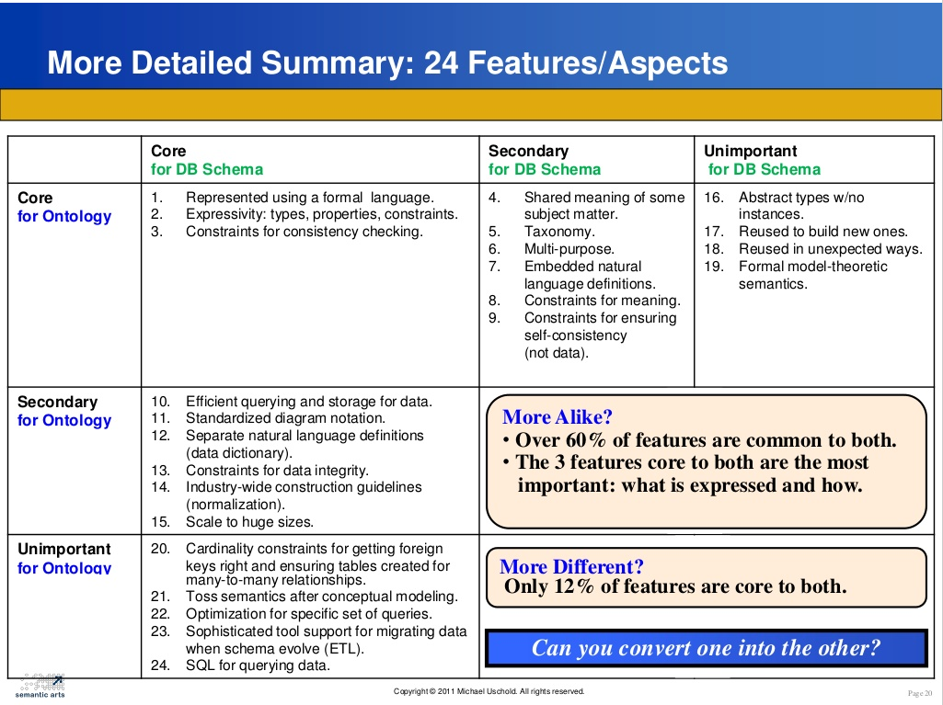

Slide 12
Popularity of Ontology
Much like SQL has views and stored procedures, running queries on SPARQL produces Named Graphs, which is itself a resource.
For organizations like NSA , where electronic intelligence gathering is crucial, ontology is a better option — If one has access to enough RDF data, then you can know quite a lot about everything, and you can draw conclusions and make predictions over complex ideas.
Google has a lot vested in growing their Knowledge Graph
Facebook is desperately trying to import more information into its Social Graph.
And other tech giants are either very interested in developing it, or aren’t and should be.

Slide 13
For our Project...
We have a PERSON ontology, an EMPLOYER and a
WORKER ontology, which are sub-classes of Person
ontology. And our base ontology is the SKILL ontology
(which contains several sub-classes like Field, JobTitle,
PaymentMode etc).
Now, if we used Relational Databases, instead of
Ontologies, there will be the following relations:

Slide 14
Person Table (Name, Age, Gender, Ph.No, Email, Job Address)
Worker Table (All the attributes of Person + Skill possessed, Job Title, Education, Experience, Recommendation, Competency Level, Payment)
Employer Table (All the attributes of Person + Skill required, Job Title offered, Experience required, Competency Level required, Payment offered)
Skill Table (Skill Type)
Job Title (Specific to each Skill Type)
Payment Mode (of each Job Title for each Skill Type)
and many more such relations...

Slide 15
PROBLEM with RDBMS approach:
There will be a need to construct a huge number of tables, each containing large amount of tuples. This could be avoided if the focus was on the meaning of data stored accordingly like in ontologies.
Storing, maintaining and querying over so many tables is a tough job. Also, we won’t be able to process complex queries which require to fetch information from maybe, over 20 relations. Such queries are realistic but not possible through relational database approach. Ontologies produce graphs as output of queries. And these graphs can deal with even very complex relations.
There are many redundant attributes in many tables (for example, Person, Worker and Employer) which is a wastage of space. Though it is evident that Worker and Employer inherits from Person, we cannot make use of this property. But Inheritance is utilized in ontologies.
There will be lots of tuples containing NULL values as certain attributes do not match with certain tuples. Like there may be some illiterate workers for whom Education attribute will be invalid, or for young workers with no Experience.

