Slide 1

Combatting Mis-Information: Fake News Classifier
Using ML
Project by- Aditya Sharma (112115011)
Aryan Shukla (112115028) Akshat Jaiswal (112115017)

Slide 2
Combatting Mis-Information: Fake News Classifier
Using ML
ABOUT
NEED OF THE PROJECT NLP METHODOLOGY RESULT FUTURE SCOPE
In an age where information inundates our lives, the Fake News Classifier emerges as a beacon of truth. This revolutionary tool, driven by the power of machine learning and natural language processing, empowers us to distinguish between authentic news and misleading narratives. Its mission is to champion accuracy and integrity, aiding readers and fact-checkers in the quest for reliable journalism. Join us on a journey to understand the inner workings of the Fake News Classifier, where data-driven insights help combat misinformation and foster a more informed society. Welcome to a world where facts reign supreme, and the Fake News Classifier leads the way.

Slide 3
Combatting Mis-Information: Fake News Classifier
Using ML
INTRODUCTION
NEED OF THE PROJECT NLP METHODOLOGY RESULT FUTURE SCOPE
Pervasive Spread of Misinformation.
Preserving Information Integrity.
Enhancing Media Literacy.
Contributing to a More Informed Society.
Technological Innovation in Information Verification

Slide 4
Combatting Mis-Information: Fake News Classifier
Using ML
INTRODUCTION
NEED OF THE PROJECT NLP METHODOLOGY RESULT FUTURE SCOPE
Natural Language Processing (NLP) is an interdisciplinary field of artificial intelligence that focuses on enabling computers to understand, interpret, and generate human language in a way that is both meaningful and contextually relevant. It encompasses a range of techniques and methods to process and analyze large volumes of text data.

Slide 5
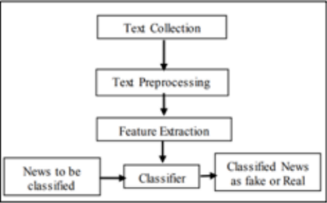
Combatting Mis-Information: Fake News Classifier
Using ML
INTRODUCTION
NEED OF THE PROJECT NLP METHODOLOGY RESULT FUTURE SCOPE
The Fake news model detection is built using steps,
text collection (collected from DataFlair Website),
text preprocessing (Cleaning Null Values, StopWord Removal, Lemmatization, stemming etc.) ,
feature extraction (TermFrequency_Inverse_Document_Frequency(tfidf) for n=1-3).
Then we trained our model using various classification models (LinearSVC, Bernouli Naïve Bayes, Logistic Regression) and then finally created a web portal using
(StreamLit library of python) as a user interface

Slide 6
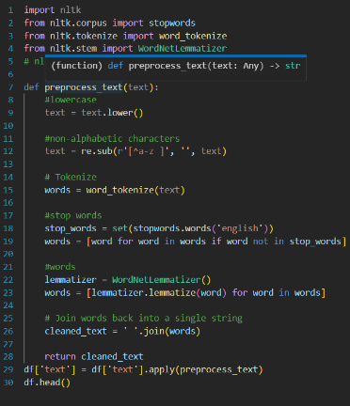
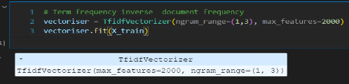
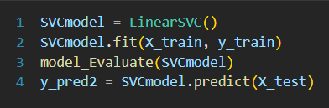

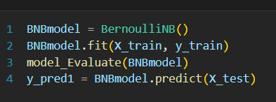

Combatting Mis-Information: Fake News Classifier
Using ML
Feature Extraction
INTRODUCTION
NEED OF THE PROJECT NLP METHODOLOGY RESULT FUTURE SCOPE
Model Training
Data Pre-processing
Converting to a pickle file and using it for prediction

Slide 7
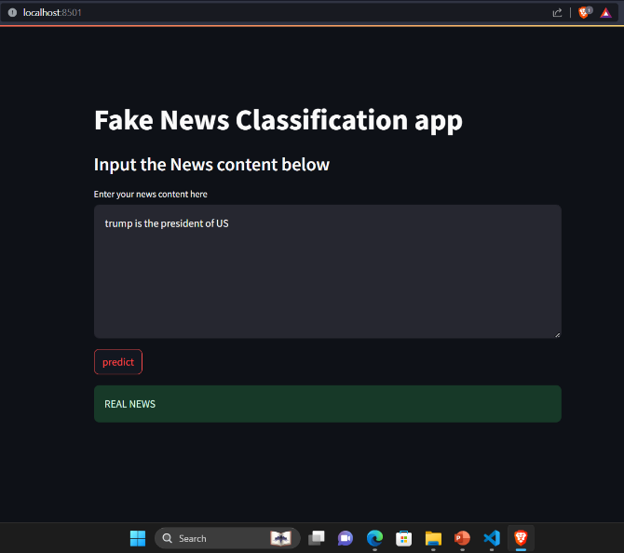
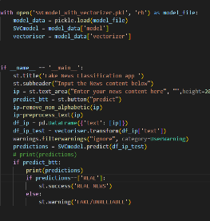
Combatting Mis-Information: Fake News Classifier
Using ML
INTRODUCTION
NEED OF THE PROJECT NLP METHODOLOGY RESULT FUTURE SCOPE
Backend Code
Using streamlit library to create a portal that will classify the news.

Slide 8
Combatting Mis-Information: Fake News Classifier
Using ML
INTRODUCTION
NEED OF THE PROJECT NLP METHODOLOGY RESULT FUTURE SCOPE
After Comparing different models for classification these were our result:
Therefore we used LinearSVC in our model.
MODEL | ACCURACY
Linear SVC (SVM) | 92%
Logistic Regression | 91%
Bernoulli Naive Bayes (BNB) model | 74%
Voting Classifier (Linear SVC + LR) | 91%

Slide 9
Combatting Mis-Information: Fake News Classifier
Using ML
INTRODUCTION
NEED OF THE PROJECT NLP METHODOLOGY RESULT FUTURE SCOPE
Using Deep Learning and Neural network or other Advanced Machine Learning Models/
Also using Images, videos and audio data for detecting fake news
Improving User accessibility by improving the UI and adding functionalities for easier methods of user input like: a url of an article
Improve project's potential to differentiate between different types of misinformation (such as satire, propaganda, misleading information)

