Slide 1
Udvikling af Cloud-baserede Sundheds-apps
13.12.2023
Thomas Hildebrandt, Tilman Zuckmantel
Software, Data, People & Society
Datalogisk Institut Københavns Universitet

Slide 2
Agenda for Today
(1)
Classes
UML Class Diagrams
In Lecture Exercise about classes
(2)
Iterative vs. Recursive Programming
Exercise about Recursive Programming

Slide 3
Understanding Classes
int, string, float
This defines a type named Dog
?
class Dog: def sound(self): return ”vov”
Type Dog has a class method that returns the sound of a dog
Notes:
You have all used classes before, but I noticed that it is not quite clear what a class actually is and what is the difference between an instance, a class, what is self ? This by the way does not only reflect python code but also code in other object oriented programming languages such as C++, Java, etc. Usually in programming languages we talk about types, such as an integer, a string, etc. Now in oop languages you are very much allowed to create your own types by specifying classes

Slide 4
Understanding Classes – Self ?
Runtime environment
Code Instructions
d1
d2
class Dog: def sound(self): return ”vov”
if __name__ == ‘__main__’:
d1 = Dog() d2 = Dog()
d1.sound() → vov
d2.sound() → vov
sound
sound
“vov”
“vov”
There is more happening! Let’s make d1 and d2 sound differently!
Notes:
What do these two brackets here mean ? How can we change the behavior of a dog to sound differently ?

Slide 5
Understanding Classes – Self ?
Runtime environment
class Dog: def __init__(self, sound): self.sound = sound def make_sound(self): return self.sound if __name__ == '__main__': d1 = Dog("vov") d2 = Dog("VOOOOOV") print(d1.make_sound()) → vov print(d2.make_sound()) → VOOOOOV
d1
self
sound = “vov”
make_sound
d2
self
make_sound
sound = “VOOOOOV”

Slide 6
Let’s add a cat
class Cat: def __init__(self, sound): self.sound = sound def make_sound(self): return self.sound
class Dog: def __init__(self, sound): self.sound = sound def make_sound(self): return self.sound
What do you notice ?

Slide 7
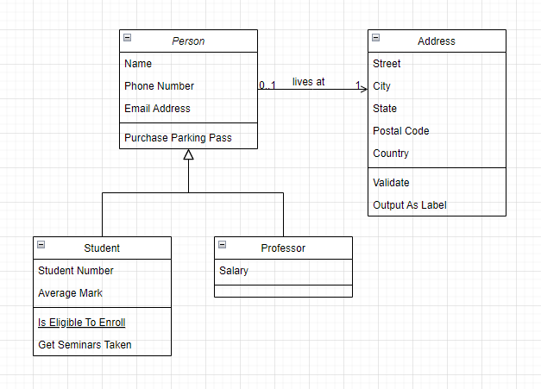
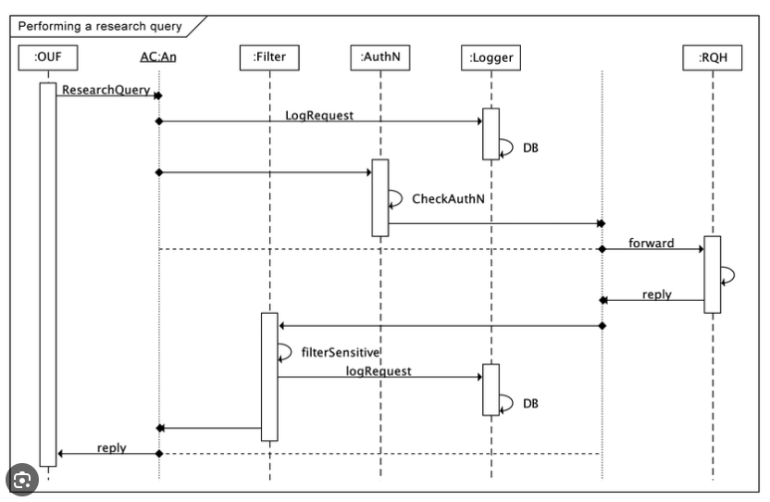
Unified Modelling Language (UML) Diagrams
UML is a Suite of Diagram Types to illustrate the structure of Source Code Projects

Slide 8
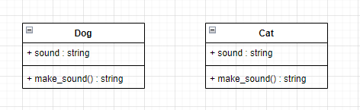
UML Class Diagram
This is what we have at the moment
Let’s improve the redundancies

Slide 9
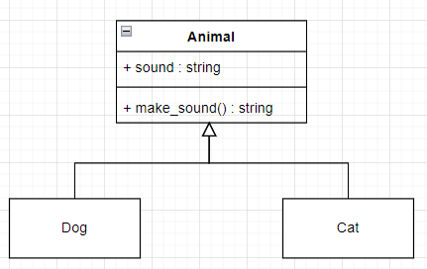
Cats and Dogs are Animals - Inheritance
class Animal: def __init__(self, sound): self.sound = sound def make_sound(self): return self.sound class Dog(Animal): pass class Cat(Animal): pass
“is” relationship

Slide 10
We can agree on a contract now
if __name__ == '__main__': animals: list[Animal] = [Dog("vov"), Cat("miau"), Dog("VOOOOOV")]
Every member of this List is guaranteed to be an Animal,
=> And, thus, contains the properties
for a in animals: print(a.make_sound())
We can iterate through the list and we know that every member has the make_sound() method

Slide 11
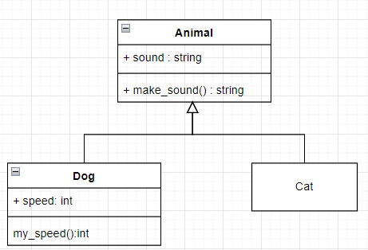
Adding behavior to classes
Runtime environment
class Dog(Animal): def __init__(self, sound, speed): Animal.__init__(self, sound) self.speed = speed def my_speed(self): return self.speed
class Cat(Animal): pass if __name__ == '__main__': d = Dog("vov", 4) print(d.sound) → vov print(d.speed) → 4
d:Animal
d:Dog
sound = “vov”
speed = 4

Slide 12
Now it’s your turn!
Expand the source code for a dog having a list of tricks. Tricks can be string values describing the trick (e.g. “sit”,”flip”). Add a method add_trick(self, trick) that adds a trick to the dogs’ tricks. You will also need to add an initial empty list to the constructor. (list.append(element)) can be used to append an element to a list
Create a class Home that contains a list of Animals to later add a few animals to the list. (You can do that by implementing an add_animal(self,a:Animal) method)
In the main method, create a home and print all animals living there by adding a method print_me(self) to the class Animal. Implement this method in the Dog and Cat class (just like make_sound()) . Then create a method printAll(self) in the Home class to print all animals in a loop.
For now, only dogs have tricks. ☺
30-45 Minutes

Slide 13
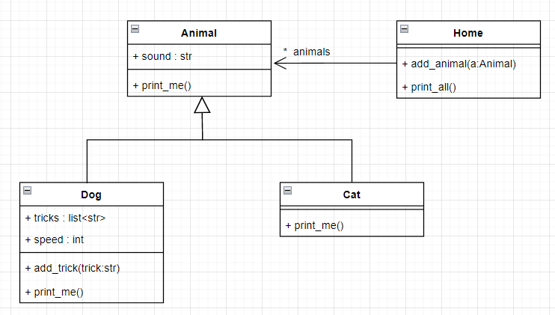
UML Diagram of the Result

Slide 14
Applying the concepts in the Hand-In
Inheritance
class SimulationButton(Button): def __init__(self, event_id: int, graph_id: str, simulation_id: str, username: str, password: str, text: str): Button.__init__(self) self.event_id = event_id self.text = text self.graph_id = graph_id self.simulation_id = simulation_id self.username = username self.password = password self.manipulate_box_layout: BoxLayout = BoxLayout() self.bind(on_press=self.execute_event)
passing custom elements
to the constructor
calling the constructor of the Button class
using self to store attributes within
the class instance
Notes:
What are the concepts that you see here ?

Slide 15
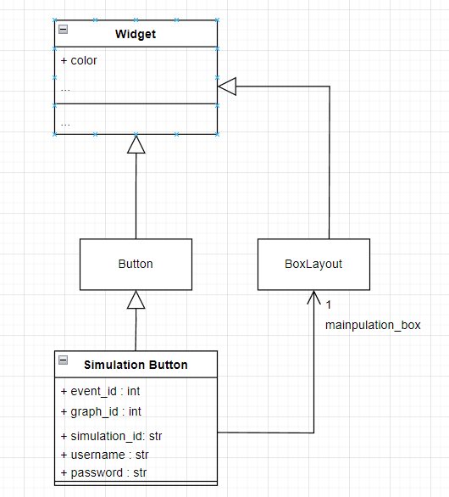
UML Class Diagram Simulation Button
class SimulationButton(Button): def __init__(self, event_id: int, graph_id: str, simulation_id: str, username: str, password: str, text: str): Button.__init__(self) self.event_id = event_id self.text = text self.graph_id = graph_id self.simulation_id = simulation_id self.username = username self.password = password self.manipulate_box_layout: BoxLayout = BoxLayout() self.bind(on_press=self.execute_event)

Slide 16


Slide 17
Iterative vs Recursive Approach
Let‘s look at a function calculating factorial numbers:
Short reminder:
def factorial(n: int): if n > 0: res = 1 while n > 0: res = res * n n = n - 1 return res return -1

Slide 18
Iterative vs Recursive Approach
6! = factorial(6)
def factorial(n: int): if n > 0: res = 1 while n > 0: res = res * n n = n - 1 return res return -1
n > 0 , Check

Slide 19
Iterative vs Recursive Approach
6! = factorial(6)
def factorial(n: int): if n > 0: res = 1 while n > 0: res = res * n n = n - 1 return res return -1
res = 1

Slide 20
Iterative vs Recursive Approach
6! = factorial(6)
def factorial(n: int): if n > 0: res = 1 while n > 0: res = res * n n = n - 1 return res return -1
n > 0, Check
res = 1

Slide 21
Iterative vs Recursive Approach
6! = factorial(6)
def factorial(n: int): if n > 0: res = 1 while n > 0: res = res * n n = n - 1 return res return -1
res = 6
res = 1 * 6

Slide 22
Iterative vs Recursive Approach
6! = factorial(6)
def factorial(n: int): if n > 0: res = 1 while n > 0: res = res * n n = n - 1 return res return -1
res = 6
n = 5
n = n - 1

Slide 23
Iterative vs Recursive Approach
6! = factorial(6)
def factorial(n: int): if n > 0: res = 1 while n > 0: res = res * n n = n - 1 return res return -1
n > 0, Check
res = 6
n = 5

Slide 24
Iterative vs Recursive Approach
6! = factorial(6)
def factorial(n: int): if n > 0: res = 1 while n > 0: res = res * n n = n - 1 return res return -1
res = 30
res = res * n
= 6 * 5 = 30
n = 5

Slide 25
Iterative vs Recursive Approach
6! = factorial(6)
def factorial(n: int): if n > 0: res = 1 while n > 0: res = res * n n = n - 1 return res return -1
res = 30
n = 4
n = n -1
= 5 – 1 = 4

Slide 26
Iterative vs Recursive Approach
6! = factorial(6)
def factorial(n: int): if n > 0: res = 1 while n > 0: res = res * n n = n - 1 return res return -1
n > 0, Check
res = 30
n = 4

Slide 27
Iterative vs Recursive Approach
6! = factorial(6)
def factorial(n: int): if n > 0: res = 1 while n > 0: res = res * n n = n - 1 return res return -1
res = 120
res = res * n
= 30 * 4 = 120
n = 4

Slide 28
Iterative vs Recursive Approach
6! = factorial(6)
def factorial(n: int): if n > 0: res = 1 while n > 0: res = res * n n = n - 1 return res return -1
res = 120
n = 3
n = n -1
= 4 – 1 = 3

Slide 29
Iterative vs Recursive Approach
6! = factorial(6)
def factorial(n: int): if n > 0: res = 1 while n > 0: res = res * n n = n - 1 return res return -1
n > 0, Check
res = 120
n = 3

Slide 30
Iterative vs Recursive Approach
6! = factorial(6)
def factorial(n: int): if n > 0: res = 1 while n > 0: res = res * n n = n - 1 return res return -1
res = 360
res = res * n
= 120 * 3 = 360
n = 3

Slide 31
Iterative vs Recursive Approach
6! = factorial(6)
def factorial(n: int): if n > 0: res = 1 while n > 0: res = res * n n = n - 1 return res return -1
res = 360
n = 2
n = n -1
= 3 – 1 = 2

Slide 32
Iterative vs Recursive Approach
6! = factorial(6)
def factorial(n: int): if n > 0: res = 1 while n > 0: res = res * n n = n - 1 return res return -1
n > 0, Check
res = 360
n = 2

Slide 33
Iterative vs Recursive Approach
6! = factorial(6)
def factorial(n: int): if n > 0: res = 1 while n > 0: res = res * n n = n - 1 return res return -1
res = 720
res = res * n
= 360 * 2 = 720
n = 2

Slide 34
Iterative vs Recursive Approach
6! = factorial(6)
def factorial(n: int): if n > 0: res = 1 while n > 0: res = res * n n = n - 1 return res return -1
res = 720
n = 1
n = n -1
= 2 – 1 = 1

Slide 35
Iterative vs Recursive Approach
6! = factorial(6)
def factorial(n: int): if n > 0: res = 1 while n > 0: res = res * n n = n - 1 return res return -1
n > 0, Check
res = 720
n = 1

Slide 36
Iterative vs Recursive Approach
6! = factorial(6)
def factorial(n: int): if n > 0: res = 1 while n > 0: res = res * n n = n - 1 return res return -1
res = 720
res = res * n
= 720 * 1 = 720
n = 1

Slide 37
Iterative vs Recursive Approach
6! = factorial(6)
def factorial(n: int): if n > 0: res = 1 while n > 0: res = res * n n = n - 1 return res return -1
res = 720
n = 0
n = n -1
= 1 – 1 = 0

Slide 38
Iterative vs Recursive Approach
6! = factorial(6)
def factorial(n: int): if n > 0: res = 1 while n > 0: res = res * n n = n - 1 return res return -1
n > 0, Fail
res = 720
n = 0

Slide 39
Iterative vs Recursive Approach
6! = factorial(6)
def factorial(n: int): if n > 0: res = 1 while n > 0: res = res * n n = n - 1 return res return -1
res = 720
n = 0
return 720
This is the iterative approach

Slide 40


Iterative vs Recursive Approach
There is also another definition!
The definition is refering to itself
6! = 6 * 5!
6! = 6 * (5 * 4!) 6! = 6 * (5 * (4 * 3!)) 6! = 6 * (5 * (4 * (3 * 2!))) 6! = 6 * 5 * 4 * 3 * 2 * 1! 6! = 6 * 5 * 4 * 3 * 2 * 1
We can do this in Python to!

Slide 41
Iterative vs Recursive Approach
factorial(6)
def factorial(n: int): if n > 0: return n * factorial(n - 1) if n == 0: return 1 else: return -1
Check

Slide 42
Iterative vs Recursive Approach
factorial(6)
factorial(5)
def factorial(n: int): if n > 0: return n * factorial(n - 1) if n == 0: return 1 else: return -1
invoke

Slide 43
Iterative vs Recursive Approach
factorial(6)
factorial(5)
def factorial(n: int): if n > 0: return n * factorial(n - 1) if n == 0: return 1 else: return -1
factorial(4)
n == 0
factorial(3)
1
factorial(0)
factorial(1)
factorial(2)

Slide 44
Iterative vs Recursive Approach
factorial(6)
factorial(5)
def factorial(n: int): if n > 0: return n * factorial(n - 1) if n == 0: return 1 else: return -1
n * factorial(0)
factorial(4)
factorial(3)
1
1*1
factorial(0)
factorial(1)
factorial(2)

Slide 45
Iterative vs Recursive Approach
factorial(6)
factorial(5)
def factorial(n: int): if n > 0: return n * factorial(n - 1) if n == 0: return 1 else: return -1
n * factorial(1)
factorial(4)
factorial(3)
1
1*1=1
1*2=2
factorial(0)
factorial(1)
factorial(2)

Slide 46
Iterative vs Recursive Approach
factorial(6)
factorial(5)
def factorial(n: int): if n > 0: return n * factorial(n - 1) if n == 0: return 1 else: return -1
n * factorial(2)
factorial(4)
2*3=6
factorial(3)
1
1*1=1
1*2=2
factorial(0)
factorial(1)
factorial(2)

Slide 47
Iterative vs Recursive Approach
factorial(6)
factorial(5)
def factorial(n: int): if n > 0: return n * factorial(n - 1) if n == 0: return 1 else: return -1
4*6=24
n * factorial(3)
factorial(4)
2*3=6
factorial(3)
1
1*1=1
1*2=2
factorial(0)
factorial(1)
factorial(2)

Slide 48
Iterative vs Recursive Approach
factorial(6)
5*24=120
factorial(5)
def factorial(n: int): if n > 0: return n * factorial(n - 1) if n == 0: return 1 else: return -1
4*6=24
n * factorial(5)
factorial(4)
2*3=6
factorial(3)
1
1*1=1
1*2=2
factorial(0)
factorial(1)
factorial(2)

Slide 49
Iterative vs Recursive Approach
factorial(6)
6*120=720
5*24=120
factorial(5)
def factorial(n: int): if n > 0: return n * factorial(n - 1) if n == 0: return 1 else: return -1
4*6=24
n * factorial(5)
factorial(4)
2*3=6
factorial(3)
1
1*1=1
1*2=2
factorial(0)
factorial(1)
factorial(2)

Slide 50


Now it is your turn!
Implement the Fibonacci numbers sequence recursively defined as follows:

