Slide 1


Code editor: F#
1: let myArray: int[] = [| 1; 2; 3; 4; 5; 6; 7; 8; 9; 10 |]
2: let myReduceArray = [|50; 20; 15; 15|]
3: let myList: int list = [ 10; 11; 12; 13; 14; 15 ]
4: let myA½rraySum = Array.fold (fun acc num -> acc + num) 0 myArray
5: let evenNumbers = Array.filter (fun n -> n % 2 = 0) myArray
6: let subtractArray arr = arr |> Array.reduce (fun acc x -> acc - x)
7: let reduceResult = subtractArray myReduceArray
8: let myListAvg = List.map float myList |> List.average
9: printfn($"Sum of myArray {myArraySum}")
10: printfn "Even Numbers of myArray %A" evenNumbers
11: printfn($"The result of subtracting all numbers is {reduceResult}")
12: printfn($"Average of myList {myListAvg}")
13: printfn($"Max of myList {List.max myList}")
Console output
Tasks
Sum of myArray 55
Even Numbers of myArray [|2; 4; 6; 8; 10|]
The result of subtracting all numbers is 0
Average of myList 12.5
Max of myList 15
Task 1
Task 2
Task 3
Task 4

Slide 2

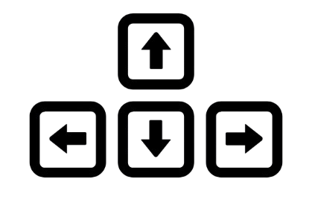
Code editor: F#
1:
Console output
Tasks
-------
-------

Slide 3
Profile >
Practices >
Assignments >
Syllabus >
Settings >
Code editor: F#
1:
Week 1 >
Week 2 >
Week 3 >
Week 4 >
Namespaces og moduler, afprøvning af programmer
Sporring, Kap. 9-10 <download>
4i <download>
Console output
Tasks
-------
-------

Slide 4
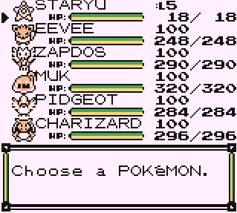
Code editor: F#
1:
Console output
Tasks
-------
-------

Slide 5
